Slide 1
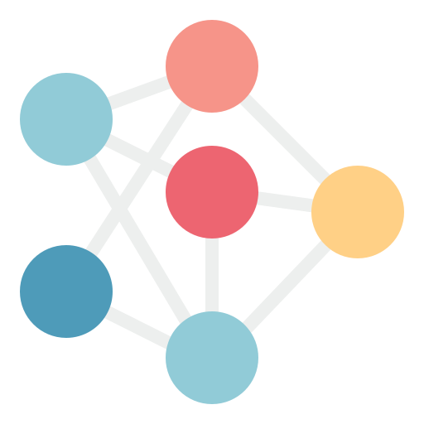






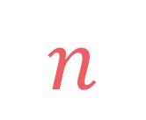
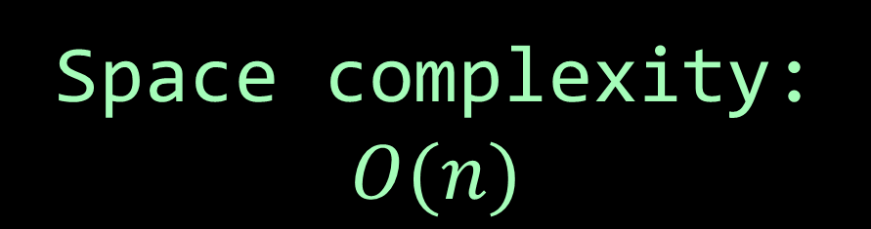
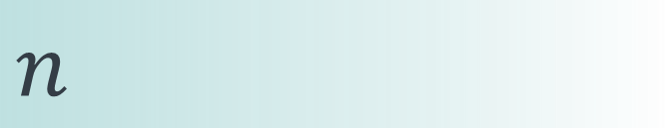

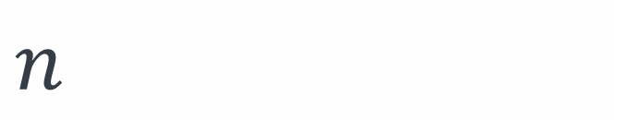
left
[4, 5, 1, 7, 2, 6, 3, 8]
no margin
Space complexity:
$$O(n)$$
list
list
list
list
mid
no margin
"string"
4 | 5 | 1 | 7 | 2 | 6 | 3 | 8
Space complexity:
$$O(n)$$
5
5
$
5
rec(n)
$$n$$
5
$$n$$
$$⇒$$
$$n$$
Time complexity:
$$O(n)$$
text
text
 |  |  | a
$$n$$
text
text
no margin
no margin
no margin
no margin
no margin
no margin
no margin
no margin

Slide 2


How is a graph represented in memory?

Slide 3
1
2
0
5
3
4

Slide 4
"London"
"Berlin"
"Mexico"
"Tokyo"
"Lima"
"Algiers"

Slide 5
class Person: def __init__(self, name, age, salary): self.name = name self.age = age self.salary = salary
name: "Rais"
age: 51
salary: 76000
name: "Ivan"
age: 42
salary: 52000
name: "Iris"
age: 27
salary: 41000
name: "Nada"
age: 29
salary: 45000
name: "Sam"
age: 35
salary: 42000
name: "Ali"
age: 31
salary: 38000

Slide 6
class Edge: def __init__(self, src, dest): self.src = src self.dest = dest

Slide 7
class Edge: def __init__(self, src, dest): self.src = src self.dest = dest
(src, dest)

Slide 8
class Edge: def __init__(self, src, dest, weight): self.src = src self.dest = dest self.weight = weight
(src, dest, weight)

Slide 9


A graph $G=\left(V,E\right)$ is a structure made of a set of vertices $V$ and a set of edges $E$, an edge is a pair of vertices it connects
1
2
0
5
Example:
3
4
$$V=\left\{0, 1, 2, 3, 4, 5\right\} \\ E=\{\left(0,1\right),\left(0,3\right),\left(1,2\right),\left(1,3\right),\left(1,4\right),\left(2,4\right),\left(3,5\right),\left(4,5\right)\}$$

Slide 10
class Graph: def __init__(self, V, E): self.V = V self.E = E
1
2
0
5
Example:
3
4
$$V=\left\{0, 1, 2, 3, 4, 5\right\} \\ E=\{\left(0,1\right),\left(0,3\right),\left(1,2\right),\left(1,3\right),\left(1,4\right),\left(2,4\right),\left(3,5\right),\left(4,5\right)\}$$

Slide 11

class Graph: def __init__(self, V, E): self.V = V self.E = E
1
2
0
5
Example:
3
4
$$V=\left\{0, 1, 2, 3, 4, 5\right\} \\ E=\{\left(0,1\right),\left(0,3\right),\left(1,2\right),\left(1,3\right),\left(1,4\right),\left(2,4\right),\left(3,5\right),\left(4,5\right)\}$$
V = {0, 1, 2, 3, 4, 5} E = {(0, 1), (0, 3), (1, 2), (1, 3), (1, 4), (2, 4), (3, 5), (4, 5)} graph = Graph(V, E)

Slide 12

We need to traverse the whole set of edges to find neighbors of a vertex, not efficient

Slide 13
Adjacency list

Slide 14
0
1
2
3
4
5
6
7
8

Slide 15

$$0→\left[1, 4, 3\right] \\ 1→\left[0, 2, 5, 4\right] \\ 2→\left[1\right] \\ 3→\left[0, 6\right] \\ 4→\left[0, 1, 5\right] \\ 5→\left[1, 4\right] \\ 6→\left[3, 7\right] \\ 7→\left[6\right] \\ 8→[]$$
0
1
2
3
4
5
6
7
8

Slide 16

$$0→\left[1, 4, 3\right] \\ 1→\left[0, 2, 5, 4\right] \\ 2→\left[1\right] \\ 3→\left[0, 6\right] \\ 4→\left[0, 1, 5\right] \\ 5→\left[1, 4\right] \\ 6→\left[3, 7\right] \\ 7→\left[6\right] \\ 8→[]$$
0
1
2
3
4
5
6
7
8

Slide 17

By using an array
0
$$\left[1, 4, 3\right] \\ \left[0, 2, 5, 4\right] \\ \left[1\right] \\ \left[0, 6\right] \\ \left[0, 1, 5\right] \\ \left[1, 4\right] \\ \left[3, 7\right] \\ \left[6\right] \\ []$$
1
2
3
4
5
6
7
8

Slide 18

By using an array
By using a hash table
$$\left[1, 4, 3\right] \\ \left[0, 2, 5, 4\right] \\ \left[1\right] \\ \left[0, 6\right] \\ \left[0, 1, 5\right] \\ \left[1, 4\right] \\ \left[3, 7\right] \\ \left[6\right] \\ []$$
{0: [], 1: [], 2: [], 3: [], 4: [], 5: [], 6: [], 7: [], 8: []
$$\left[1, 4, 3\right], \\ \left[0, 2, 5, 4\right], \\ \left[1\right], \\ \left[0, 6\right], \\ \left[0, 1, 5\right], \\ \left[1, 4\right], \\ \left[3, 7\right], \\ \left[6\right], \\ []$$
0
1
2
3
4
5
6
7
8
}

Slide 19

By using an array:
[0, 2, 5, 4]
$$[0, 2, 5, 4]$$

Slide 20
By using an array:
[0, 2, 5, 4]
By using a linked list:
$$[0, 2, 5, 4]$$
Node(0, Node(2, Node(5, Node(4))))

Slide 21
By using an array:
[0, 2, 5, 4]
By using a linked list:
$$[0, 2, 5, 4]$$
Node(0, Node(2, Node(5, Node(4))))
By using a set:
{0, 2, 5, 4}

Slide 22

3 possibilities
$$0→\left[1, 4, 3\right] \\ 1→\left[0, 2, 5, 4\right] \\ 2→\left[1\right] \\ 3→\left[0, 6\right] \\ 4→\left[0, 1, 5\right] \\ 5→\left[1, 4\right] \\ 6→\left[3, 7\right] \\ 7→\left[6\right] \\ 8→[]$$
 | array | linked list | set
array
hash table
2 possibilities

Slide 23
Implementing an adjacency list as
an array of arrays:
[ [1, 4, 3], [0, 2, 5, 4], [1], [0, 6], [0, 1, 5], [1, 4], [3, 7], [6], [] ]
 | array | linked list | set
array
hash table

Slide 24
Implementing an adjacency list as
an array of linked lists:
[ Node(1, Node(4, Node(3))), Node(0, Node(2, Node(5, Node(4)))), Node(1), Node(0, Node(6)), Node(0, Node(1, Node(5))), Node(1, Node(4)), Node(3, Node(7)), Node(6), None ]
 | array | linked list | set
array
hash table

Slide 25
Implementing an adjacency list as
an array of sets:
[ {1, 4, 3}, {0, 2, 5, 4}, {1}, {0, 6}, {0, 1, 5}, {1, 4}, {3, 7}, {6}, {} ]
 | array | linked list | set
array
hash table

Slide 26
Implementing an adjacency list as
a hash table of vertex to array:
{ 0: [1, 4, 3], 1: [0, 2, 5, 4], 2: [1], 3: [0, 6], 4: [0, 1, 5], 5: [1, 4], 6: [3, 7], 7: [6], 8: [] }
 | array | linked list | set
array
hash table

Slide 27
Implementing an adjacency list as
a hash table of vertex to linked list:
{ 0: Node(1, Node(4, Node(3))), 1: Node(0, Node(2, Node(5, Node(4)))), 2: Node(1), 3: Node(0, Node(6)), 4: Node(0, Node(1, Node(5))), 5: Node(1, Node(4)), 6: Node(3, Node(7)), 7: Node(6), 8: None }
 | array | linked list | set
array
hash table

Slide 28
Implementing an adjacency list as
a hash table of vertex to set:
{ 0: {1, 4, 3}, 1: {0, 2, 5, 4}, 2: {1}, 3: {0, 6}, 4: {0, 1, 5}, 5: {1, 4}, 6: {3, 7}, 7: {6}, 8: {} }
 | array | linked list | set
array
hash table

Slide 29
By using an array
By using a hash table
$$\left[1, 4, 3\right] \\ \left[0, 2, 5, 4\right] \\ \left[1\right] \\ \left[0, 6\right] \\ \left[0, 1, 5\right] \\ \left[1, 4\right] \\ \left[3, 7\right] \\ \left[6\right] \\ []$$
{0: [], 1: [], 2: [], 3: [], 4: [], 5: [], 6: [], 7: [], 8: []
$$\left[1, 4, 3\right], \\ \left[0, 2, 5, 4\right], \\ \left[1\right], \\ \left[0, 6\right], \\ \left[0, 1, 5\right], \\ \left[1, 4\right], \\ \left[3, 7\right], \\ \left[6\right], \\ []$$
0
1
2
3
4
5
6
7
8
}

Slide 30

By using a hash table
{0: [], 1: [], 2: [], 3: [], 4: [], 5: [], 6: [], 7: [], 8: []
$$\left[1, 4, 3\right], \\ \left[0, 2, 5, 4\right], \\ \left[1\right], \\ \left[0, 6\right], \\ \left[0, 1, 5\right], \\ \left[1, 4\right], \\ \left[3, 7\right], \\ \left[6\right], \\ []$$
}

Slide 31
By using an array:
[0, 2, 5, 4]
By using a linked list:
$$[0, 2, 5, 4]$$
Node(0, Node(2, Node(5, Node(4))))
By using a set:
{0, 2, 5, 4}

Slide 32
Implementing an adjacency list as
a hash table of vertex to array:
{ 0: [1, 4, 3], 1: [0, 2, 5, 4], 2: [1], 3: [0, 6], 4: [0, 1, 5], 5: [1, 4], 6: [3, 7], 7: [6], 8: [] }
 | array | linked list | set
array
hash table

Slide 33
Creating a graph:
class Graph: def __init__(self): self.adj_list = {} # Hash table of vertex to array of vertices

Slide 34
Adding a vertex:
def add_vertex(self, u): if u not in self.adj_list: self.adj_list[u] = []

Slide 35
Removing a vertex:
def remove_vertex(self, u): if u in self.adj_list: del self.adj_list[u] for v in self.adj_list: if u in self.adj_list[v]: v.remove(u)

Slide 36
Adding an edge: in a directed graph:
def add_edge(self, u, v): if u in self.adj_list and v in self.adj_list: self.adj_list[u].append(v)

Slide 37
Adding an edge in an undirected graph:
def add_edge(self, u, v): if u in self.adj_list and v in self.adj_list: self.adj_list[u].append(v) self.adj_list[v].append(u)
Adding an edge: in a directed graph:
def add_edge(self, u, v): if u in self.adj_list and v in self.adj_list: self.adj_list[u].append(v)

Slide 38
Adding an edge in an undirected weighted graph:
def add_edge(self, u, v, w): if u in self.adj_list and v in self.adj_list: self.adj_list[u].append((v, w)) self.adj_list[v].append((u, w))
Adding an edge:in a directed weighted graph:
def add_edge(self, u, v, w): if u in self.adj_list and v in self.adj_list: self.adj_list[u].append((v, w))

Slide 39
Removing an edge: in a directed graph:
def remove_edge(self, u, v): if u in self.adj_list and v in self.adj_list[u]: self.adj_list[u].remove(v)

Slide 40
Removing an edge in an undirected graph:
def remove_edge(self, u, v): if u in self.adj_list and v in self.adj_list[u]: self.adj_list[u].remove(v) self.adj_list[v].remove(u)
Removing an edge: in a directed graph:
def remove_edge(self, u, v): if u in self.adj_list and v in self.adj_list[u]: self.adj_list[u].remove(v)

Slide 41
Checking edge existence: in a directed graph:
def check_edge(self, u, v): if u in self.adj_list: return v in self.adj_list[u]

Slide 42
Traversing neighbors: in a directed graph:
if u in graph.adj_list: for neighbor in graph.adj_list[u]: print(neighbor)

Slide 43
1
2
0
5
3
4

Slide 44
neighbor
1
2
neighbor
neighbor
0
5
3
4

Slide 45
1
2
0
5
3
4

Slide 46
out-neighbor
1
2
in-neighbor
out-neighbor
0
5
3
4
$$out_neighbours\left(u\right)=\left\{v \right| (u,v)∈E\}$$
$$in_neighbours\left(u\right)=\left\{v \right| (v,u)∈E\}$$

Slide 47

$$0→\left[3\right] \\ 1→\left[0, 2, 4\right] \\ 2→\left[4\right] \\ 3→\left[1, 5\right] \\ 4→\left[5\right] \\ 5→[ ]$$
1
2
0
5
3
4

Slide 48
Building the graph from two sets $V$ and $E$:
def build(self, V, E): for u in V: self.add_vertex(u) for u, v in E: self.add_edge(u, v)

Slide 49
$$0→\left[1, 4, 3\right] \\ 1→\left[0, 2, 5, 4\right] \\ 2→\left[1\right] \\ 3→\left[0, 6\right] \\ 4→\left[0, 1, 5\right] \\ 5→\left[1, 4\right] \\ 6→\left[3, 7\right] \\ 7→\left[6\right] \\ 8→[]$$
0
1
2
3
4
5
6
7
8

