Slide 1







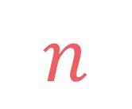

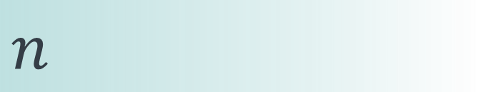

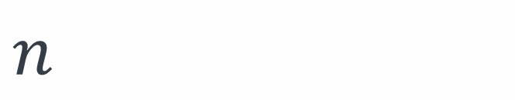
left
[4, 5, 1, 7, 2, 6, 3, 8]
no margin
Space complexity:
$$O(n)$$
list
list
list
list
mid
no margin
"string"
4 | 5 | 1 | 7 | 2 | 6 | 3 | 8
Space complexity:
$$O(n)$$
5
5
$
5
rec(n)
$$n$$
5
$$n$$
$$⇒$$
$$n$$
Time complexity:
$$O(n)$$
text
text
 |  |  | a
$$n$$
text
text
no margin
no margin
no margin
no margin
no margin
no margin
no margin
no margin

Slide 2

$$0→\left[1, 4, 3\right] \\ 1→\left[0, 2, 5, 4\right] \\ 2→\left[1\right] \\ 3→\left[0, 6\right] \\ 4→\left[0, 1, 5\right] \\ 5→\left[1, 4\right] \\ 6→\left[3, 7\right] \\ 7→\left[6\right] \\ 8→[]$$
0
1
2
3
4
5
6
7
8

Slide 3

Adjacency matrix:
A $|V|×|V|$ matrix where $M_{ij}$ is $1$ if there's an edge from the vertex $i$ to the vertex $j$, and $0$ otherwise
0
1
2
3
4
5
6
7
8

Slide 4
 | 0 | 1 | 2 | 3 | 4 | 5 | 6 | 7 | 8
0 | 0 | 1 | 0 | 1 | 1 | 0 | 0 | 0 | 0
1 | 1 | 0 | 1 | 0 | 1 | 1 | 0 | 0 | 0
2 | 0 | 1 | 0 | 0 | 0 | 0 | 0 | 0 | 0
3 | 1 | 0 | 0 | 0 | 0 | 0 | 1 | 0 | 0
4 | 1 | 1 | 0 | 0 | 0 | 1 | 0 | 0 | 0
5 | 0 | 1 | 0 | 0 | 1 | 0 | 0 | 0 | 0
6 | 0 | 0 | 0 | 1 | 0 | 0 | 0 | 1 | 0
7 | 0 | 0 | 0 | 0 | 0 | 0 | 1 | 0 | 0
8 | 0 | 0 | 0 | 0 | 0 | 0 | 0 | 0 | 0
0
1
2
3
4
5
6
7
8

Slide 5
 | 0 | 1 | 2 | 3 | 4 | 5 | 6 | 7 | 8
0 | 0 | 1 | 0 | 1 | 1 | 0 | 0 | 0 | 0
1 | 1 | 0 | 1 | 0 | 1 | 1 | 0 | 0 | 0
2 | 0 | 1 | 0 | 0 | 0 | 0 | 0 | 0 | 0
3 | 1 | 0 | 0 | 0 | 0 | 0 | 1 | 0 | 0
4 | 1 | 1 | 0 | 0 | 0 | 1 | 0 | 0 | 0
5 | 0 | 1 | 0 | 0 | 1 | 0 | 0 | 0 | 0
6 | 0 | 0 | 0 | 1 | 0 | 0 | 0 | 1 | 0
7 | 0 | 0 | 0 | 0 | 0 | 0 | 1 | 0 | 0
8 | 0 | 0 | 0 | 0 | 0 | 0 | 0 | 0 | 0
0
1
2
1
3
4
5
6
7
8

Slide 6
 | 0 | 1 | 2 | 3 | 4 | 5 | 6 | 7 | 8
0 | 0 | 1 | 0 | 1 | 1 | 0 | 0 | 0 | 0
1 | 1 | 0 | 1 | 0 | 1 | 1 | 0 | 0 | 0
2 | 0 | 1 | 0 | 0 | 0 | 0 | 0 | 0 | 0
3 | 1 | 0 | 0 | 0 | 0 | 0 | 1 | 0 | 0
4 | 1 | 1 | 0 | 0 | 0 | 1 | 0 | 0 | 0
5 | 0 | 1 | 0 | 0 | 1 | 0 | 0 | 0 | 0
6 | 0 | 0 | 0 | 1 | 0 | 0 | 0 | 1 | 0
7 | 0 | 0 | 0 | 0 | 0 | 0 | 1 | 0 | 0
8 | 0 | 0 | 0 | 0 | 0 | 0 | 0 | 0 | 0
0
1
2
3
4
5
0
6
7
8

Slide 7
 | 0 | 1 | 2 | 3 | 4 | 5 | 6 | 7 | 8
0 | 0 | 1 | 0 | 1 | 1 | 0 | 0 | 0 | 0
1 | 1 | 0 | 1 | 0 | 1 | 1 | 0 | 0 | 0
2 | 0 | 1 | 0 | 0 | 0 | 0 | 0 | 0 | 0
3 | 1 | 0 | 0 | 0 | 0 | 0 | 1 | 0 | 0
4 | 1 | 1 | 0 | 0 | 0 | 1 | 0 | 0 | 0
5 | 0 | 1 | 0 | 0 | 1 | 0 | 0 | 0 | 0
6 | 0 | 0 | 0 | 1 | 0 | 0 | 0 | 1 | 0
7 | 0 | 0 | 0 | 0 | 0 | 0 | 1 | 0 | 0
8 | 0 | 0 | 0 | 0 | 0 | 0 | 0 | 0 | 0
0
1
2
3
4
5
6
7
8

Slide 8
 | 0 | 1 | 2 | 3 | 4 | 5 | 6 | 7 | 8
0 | 0 | 1 | 0 | 1 | 1 | 0 | 0 | 0 | 0
1 | 1 | 0 | 1 | 0 | 1 | 1 | 0 | 0 | 0
2 | 0 | 1 | 0 | 0 | 0 | 0 | 0 | 0 | 0
3 | 1 | 0 | 0 | 0 | 0 | 0 | 1 | 0 | 0
4 | 1 | 1 | 0 | 0 | 0 | 1 | 0 | 0 | 0
5 | 0 | 1 | 0 | 0 | 1 | 0 | 0 | 0 | 0
6 | 0 | 0 | 0 | 1 | 0 | 0 | 0 | 1 | 0
7 | 0 | 0 | 0 | 0 | 0 | 0 | 1 | 0 | 0
8 | 0 | 0 | 0 | 0 | 0 | 0 | 0 | 0 | 0
0
1
2
3
4
5
6
7
8

Slide 9
 | 0 | 1 | 2 | 3 | 4 | 5 | 6 | 7 | 8
0 | 0 | 1 | 0 | 1 | 1 | 0 | 0 | 0 | 0
1 | 1 | 0 | 1 | 0 | 1 | 1 | 0 | 0 | 0
2 | 0 | 1 | 0 | 0 | 0 | 0 | 0 | 0 | 0
3 | 1 | 0 | 0 | 0 | 0 | 0 | 1 | 0 | 0
4 | 1 | 1 | 0 | 0 | 0 | 1 | 0 | 0 | 0
5 | 0 | 1 | 0 | 0 | 1 | 0 | 0 | 0 | 0
6 | 0 | 0 | 0 | 1 | 0 | 0 | 0 | 1 | 0
7 | 0 | 0 | 0 | 0 | 0 | 0 | 1 | 0 | 0
8 | 0 | 0 | 0 | 0 | 0 | 0 | 0 | 0 | 0
0
1
2
3
4
5
6
7
8

Slide 10
 | 0 | 1 | 2 | 3 | 4 | 5 | 6 | 7 | 8
0 | ∞ | 15 | ∞ | 7 | 12 | ∞ | ∞ | ∞ | ∞
1 | 15 | 0 | 22 | 0 | 8 | 31 | ∞ | ∞ | ∞
2 | 0 | 22 | ∞ | ∞ | ∞ | ∞ | ∞ | ∞ | ∞
3 | 7 | 0 | ∞ | ∞ | ∞ | ∞ | 11 | ∞ | ∞
4 | 12 | 8 | ∞ | ∞ | ∞ | 10 | ∞ | ∞ | ∞
5 | 0 | 31 | 0 | 0 | 10 | ∞ | ∞ | ∞ | ∞
6 | ∞ | ∞ | ∞ | 11 | ∞ | ∞ | ∞ | 16 | ∞
7 | ∞ | ∞ | ∞ | ∞ | ∞ | ∞ | 16 | ∞ | ∞
8 | ∞ | ∞ | ∞ | ∞ | ∞ | ∞ | ∞ | ∞ | ∞
0
1
2
15
22
7
12
8
31
3
4
5
10
11
6
7
8
16

Slide 11
class Graph: def __init__(self): self.adj_mat = []

Slide 12
1
2
1
2
6
insert
0
5
6
0
5
3
4
3
4
 | 0 | 1 | 2 | 3 | 4 | 5
0 | 0 | 0 | 0 | 1 | 0 | 0
1 | 1 | 0 | 1 | 0 | 0 | 0
2 | 0 | 0 | 0 | 0 | 1 | 0
3 | 0 | 1 | 0 | 0 | 0 | 1
4 | 0 | 1 | 0 | 0 | 0 | 0
5 | 0 | 0 | 0 | 0 | 1 | 0
0 | 0 | 0 | 1 | 0 | 0
1 | 0 | 1 | 0 | 0 | 0
0 | 0 | 0 | 0 | 1 | 0
0 | 1 | 0 | 0 | 0 | 1
0 | 1 | 0 | 0 | 0 | 0
0 | 0 | 0 | 0 | 1 | 0

Slide 13
1
2
1
2
6
insert
0
5
6
0
5
3
4
3
4
 | 0 | 1 | 2 | 3 | 4 | 5
0 | 0 | 0 | 0 | 1 | 0 | 0
1 | 1 | 0 | 1 | 0 | 0 | 0
2 | 0 | 0 | 0 | 0 | 1 | 0
3 | 0 | 1 | 0 | 0 | 0 | 1
4 | 0 | 1 | 0 | 0 | 0 | 0
5 | 0 | 0 | 0 | 0 | 1 | 0
 | 0 | 1 | 2 | 3 | 4 | 5 | 6
0 | 0 | 0 | 0 | 0 | 0 | 0 | 0
1 | 0 | 0 | 0 | 0 | 0 | 0 | 0
2 | 0 | 0 | 0 | 0 | 0 | 0 | 0
3 | 0 | 0 | 0 | 0 | 0 | 0 | 0
4 | 0 | 0 | 0 | 0 | 0 | 0 | 0
5 | 0 | 0 | 0 | 0 | 0 | 0 | 0
6 | 0 | 0 | 0 | 0 | 0 | 0 | 0
0 | 0 | 0 | 1 | 0 | 0
1 | 0 | 1 | 0 | 0 | 0
0 | 0 | 0 | 0 | 1 | 0
0 | 1 | 0 | 0 | 0 | 1
0 | 1 | 0 | 0 | 0 | 0
0 | 0 | 0 | 0 | 1 | 0

Slide 14
1
2
1
2
6
insert
0
5
6
0
5
3
4
3
4
 | 0 | 1 | 2 | 3 | 4 | 5
0 | 0 | 0 | 0 | 1 | 0 | 0
1 | 1 | 0 | 1 | 0 | 0 | 0
2 | 0 | 0 | 0 | 0 | 1 | 0
3 | 0 | 1 | 0 | 0 | 0 | 1
4 | 0 | 1 | 0 | 0 | 0 | 0
5 | 0 | 0 | 0 | 0 | 1 | 0
 | 0 | 1 | 2 | 3 | 4 | 5 | 6
0 | 0 | 0 | 0 | 0 | 0 | 0 | 0
1 | 0 | 0 | 0 | 0 | 0 | 0 | 0
2 | 0 | 0 | 0 | 0 | 0 | 0 | 0
3 | 0 | 0 | 0 | 0 | 0 | 0 | 0
4 | 0 | 0 | 0 | 0 | 0 | 0 | 0
5 | 0 | 0 | 0 | 0 | 0 | 0 | 0
6 | 0 | 0 | 0 | 0 | 0 | 0 | 0
0 | 0 | 0 | 1 | 0 | 0
1 | 0 | 1 | 0 | 0 | 0
0 | 0 | 0 | 0 | 1 | 0
0 | 1 | 0 | 0 | 0 | 1
0 | 1 | 0 | 0 | 0 | 0
0 | 0 | 0 | 0 | 1 | 0

Slide 15
1
2
1
2
6
insert
0
5
6
0
5
3
4
3
4
 | 0 | 1 | 2 | 3 | 4 | 5
0 | 0 | 0 | 0 | 1 | 0 | 0
1 | 1 | 0 | 1 | 0 | 0 | 0
2 | 0 | 0 | 0 | 0 | 1 | 0
3 | 0 | 1 | 0 | 0 | 0 | 1
4 | 0 | 1 | 0 | 0 | 0 | 0
5 | 0 | 0 | 0 | 0 | 1 | 0

Slide 16
1
2
1
2
6
insert
0
5
6
0
5
3
4
3
4
 | 0 | 1 | 2 | 3 | 4 | 5
0 | 0 | 0 | 0 | 1 | 0 | 0
1 | 1 | 0 | 1 | 0 | 0 | 0
2 | 0 | 0 | 0 | 0 | 1 | 0
3 | 0 | 1 | 0 | 0 | 0 | 1
4 | 0 | 1 | 0 | 0 | 0 | 0
5 | 0 | 0 | 0 | 0 | 1 | 0
 | 0 | 1 | 2 | 3 | 4 | 5 | 6
0 |  |  |  |  |  |  | 0
1 |  |  |  |  |  |  | 0
2 |  |  |  |  |  |  | 0
3 |  |  |  |  |  |  | 0
4 |  |  |  |  |  |  | 0
5 |  |  |  |  |  |  | 0
6 | 0 | 0 | 0 | 0 | 0 | 0 | 0

Slide 17
def add_vertex(self): for row in self.adj_mat: row.append(0) self.adj_mat.append([0]*len(self.adj_mat[0]))

Slide 18
1
2
1
remove
0
5
2
0
5
3
4
3
4
0
1
2
3
4
5
0
0
0
0
1
0
0
1
1
0
1
0
0
0
2
0
0
0
0
1
0
3
0
1
0
0
0
1
4
0
1
0
0
0
0
5
0
0
0
0
1
0

Slide 19
1
2
1
remove
0
5
2
0
5
3
4
3
4
0
1
2
3
4
5
0
0
0
0
1
0
0
1
1
0
1
0
0
0
5
0
0
0
0
1
0
3
0
1
0
0
0
1
4
0
1
0
0
0
0
2
0
0
0
0
1
0

Slide 20
1
2
1
remove
0
5
2
0
5
3
4
3
4
0
1
2
3
4
5
0
0
0
0
1
0
0
1
1
0
1
0
0
0
5
0
0
0
0
1
0
3
0
1
0
0
0
1
4
0
1
0
0
0
0

Slide 21
1
2
1
remove
0
5
2
0
5
3
4
3
4
0
1
5
3
4
2
0
0
0
0
1
0
0
1
1
0
0
0
0
1
5
0
0
0
0
1
0
3
0
1
1
0
0
0
4
0
1
0
0
0
0

Slide 22
1
2
1
remove
0
5
2
0
5
3
4
3
4
0
1
5
3
4
0
0
0
0
1
0
1
1
0
0
0
0
5
0
0
0
0
1
3
0
1
1
0
0
4
0
1
0
0
0

Slide 23
def delete_vertex(self, u): self.adj_mat[u], self.adj_mat[-1] = self.adj_mat[-1], self.adj_mat[u] self.adj_mat.pop() for row in self.adj_mat: row[u], row[-1] = row[-1], row[u] row.pop()

Slide 24
1
2
1
2
add edge from
to
0
5
2
3
0
5
3
4
3
4
 | 0 | 1 | 2 | 3 | 4 | 5
0 | 0 | 0 | 0 | 1 | 0 | 0
1 | 1 | 0 | 1 | 0 | 0 | 0
2 | 0 | 0 | 0 | 0 | 1 | 0
3 | 0 | 1 | 0 | 0 | 0 | 1
4 | 0 | 1 | 0 | 0 | 0 | 0
5 | 0 | 0 | 0 | 0 | 1 | 0
 | 0 | 1 | 2 | 3 | 4 | 5
0 | 0 | 0 | 0 | 1 | 0 | 0
1 | 1 | 0 | 1 | 0 | 0 | 0
2 | 0 | 0 | 0 | 1 | 1 | 0
3 | 0 | 1 | 0 | 0 | 0 | 1
4 | 0 | 1 | 0 | 0 | 0 | 0
5 | 0 | 0 | 0 | 0 | 1 | 0

Slide 25
def add_edge(self, u, v): self.adj_mat[u][v] = 1

Slide 26
1
2
1
2
add edge bw
and
0
5
2
3
0
5
3
4
3
4
 | 0 | 1 | 2 | 3 | 4 | 5
0 | 0 | 1 | 0 | 1 | 0 | 0
1 | 1 | 0 | 1 | 1 | 1 | 0
2 | 0 | 1 | 0 | 0 | 1 | 0
3 | 1 | 1 | 0 | 0 | 0 | 1
4 | 0 | 1 | 1 | 0 | 0 | 1
5 | 0 | 0 | 0 | 1 | 1 | 0
 | 0 | 1 | 2 | 3 | 4 | 5
0 | 0 | 1 | 0 | 1 | 0 | 0
1 | 1 | 0 | 1 | 1 | 1 | 0
2 | 0 | 1 | 0 | 1 | 1 | 0
3 | 1 | 1 | 1 | 0 | 0 | 1
4 | 0 | 1 | 1 | 0 | 0 | 1
5 | 0 | 0 | 0 | 1 | 1 | 0

Slide 27
def add_edge(self, u, v): self.adj_mat[u][v] = 1
self.adj_mat[v][u] = 1

Slide 28
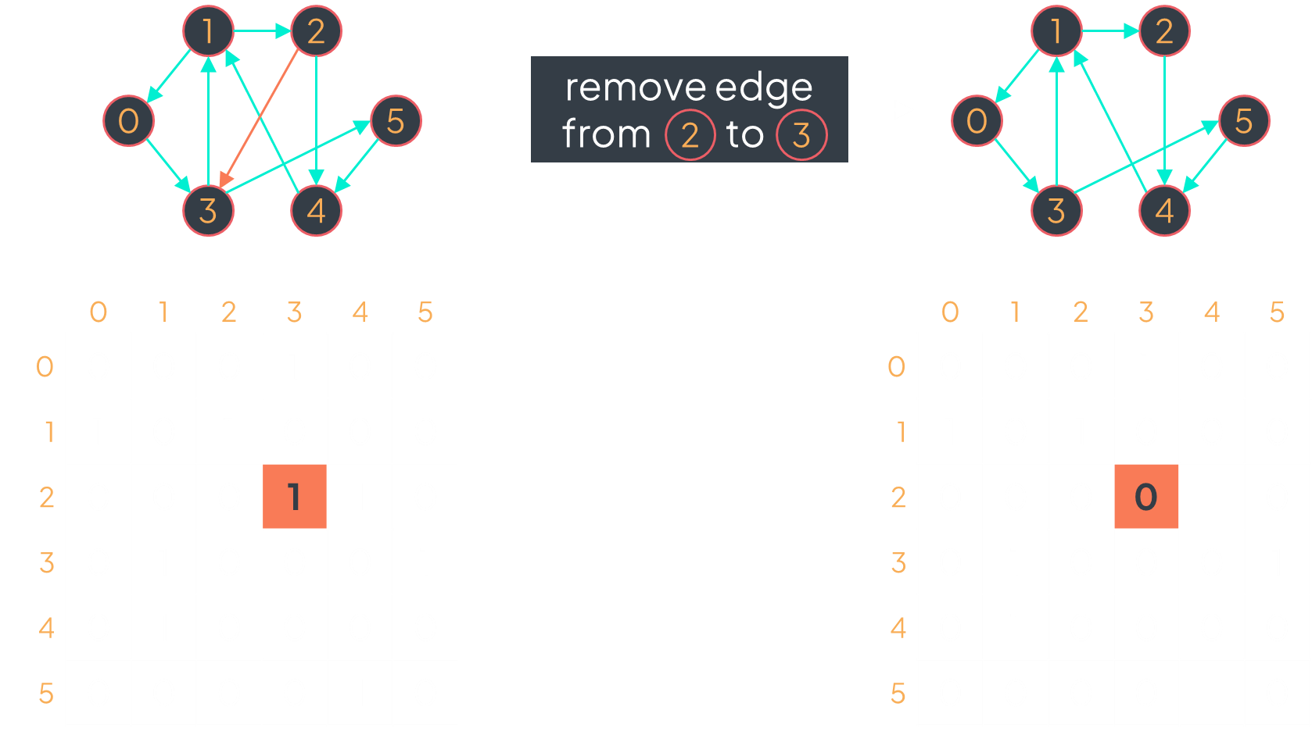
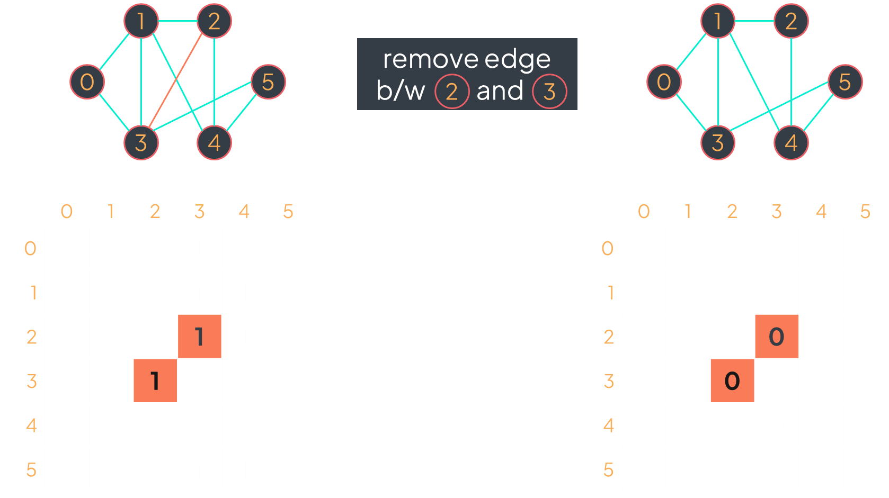
directed graph
undirected graph
def remove_edge(self, u, v): self.adj_mat[u][v] = 0 self.adj_mat[v][u] = 0
def remove_edge(self, u, v): self.adj_mat[u][v] = 0

Slide 29

1
2
check if there is an edge from $u$ to $v$:
we just check if mat[u][v] is equal to 1
0
5
3
4
 | 0 | 1 | 2 | 3 | 4 | 5
0 | 0 | 0 | 0 | 1 | 0 | 0
1 | 1 | 0 | 1 | 0 | 0 | 0
2 | 0 | 0 | 0 | 1 | 1 | 0
3 | 0 | 1 | 0 | 0 | 0 | 1
4 | 0 | 1 | 0 | 0 | 0 | 0
5 | 0 | 0 | 0 | 0 | 1 | 0
Examples:
mat[2][3] == 1?
True, so there is an edge from 2 to 3
mat[4][2] == 1?
False, so there no edge from 4 to 2
def edge_exists(self, u, v): return self.adj_mat[u][v] == 1

Slide 30
neighbors of 1
4
0
1
2
3
4
5
6
7
8

Slide 31
neighbors of 1
 | 0 | 1 | 2 | 3 | 4 | 5 | 6 | 7 | 8
0 | 0 | 1 | 0 | 1 | 1 | 0 | 0 | 0 | 0
1 | 1 | 0 | 1 | 0 | 1 | 1 | 0 | 0 | 0
2 | 0 | 1 | 0 | 0 | 0 | 0 | 0 | 0 | 0
3 | 1 | 0 | 0 | 0 | 0 | 0 | 1 | 0 | 0
4 | 1 | 1 | 0 | 0 | 0 | 1 | 0 | 0 | 0
5 | 0 | 1 | 0 | 0 | 1 | 0 | 0 | 0 | 0
6 | 0 | 0 | 0 | 1 | 0 | 0 | 0 | 1 | 0
7 | 0 | 0 | 0 | 0 | 0 | 0 | 1 | 0 | 0
8 | 0 | 0 | 0 | 0 | 0 | 0 | 0 | 0 | 0
4
0
1
2
3
4
5
6
7
8

Slide 32
neighbors of 1
 | 0 | 1 | 2 | 3 | 4 | 5 | 6 | 7 | 8
0 | 0 | 1 | 0 | 1 | 1 | 0 | 0 | 0 | 0
1 | 1 | 0 | 1 | 0 | 1 | 1 | 0 | 0 | 0
2 | 0 | 1 | 0 | 0 | 0 | 0 | 0 | 0 | 0
3 | 1 | 0 | 0 | 0 | 0 | 0 | 1 | 0 | 0
4 | 1 | 1 | 0 | 0 | 0 | 1 | 0 | 0 | 0
5 | 0 | 1 | 0 | 0 | 1 | 0 | 0 | 0 | 0
6 | 0 | 0 | 0 | 1 | 0 | 0 | 0 | 1 | 0
7 | 0 | 0 | 0 | 0 | 0 | 0 | 1 | 0 | 0
8 | 0 | 0 | 0 | 0 | 0 | 0 | 0 | 0 | 0
4
0
1
2
3
4
5
6
7
8

Slide 33
neighbors of 1
 | 0 | 1 | 2 | 3 | 4 | 5 | 6 | 7 | 8
0 | 0 | 1 | 0 | 1 | 1 | 0 | 0 | 0 | 0
1 | 1 | 0 | 1 | 0 | 1 | 1 | 0 | 0 | 0
2 | 0 | 1 | 0 | 0 | 0 | 0 | 0 | 0 | 0
3 | 1 | 0 | 0 | 0 | 0 | 0 | 1 | 0 | 0
4 | 1 | 1 | 0 | 0 | 0 | 1 | 0 | 0 | 0
5 | 0 | 1 | 0 | 0 | 1 | 0 | 0 | 0 | 0
6 | 0 | 0 | 0 | 1 | 0 | 0 | 0 | 1 | 0
7 | 0 | 0 | 0 | 0 | 0 | 0 | 1 | 0 | 0
8 | 0 | 0 | 0 | 0 | 0 | 0 | 0 | 0 | 0
4
0
1
2
3
4
5
6
7
8

Slide 34
for v in range(len(graph.adj_mat[u])): if graph.adj_mat[u][v] == 1: print(f'{v} is a neighbor of {u}')

Slide 35


$$V=\left\{0,1,2,3,4,5\right\} \\ E=\{\left(0,1\right),\left(0,3\right),\left(1,2\right),\left(1,3\right),\left(1,4\right),\left(2,4\right),\left(3,5\right),\left(4,5\right)\}$$
$$⇒$$
 | 0 | 1 | 2 | 3 | 4 | 5
0 | 0 | 1 | 0 | 1 | 0 | 0
1 | 1 | 0 | 1 | 1 | 1 | 0
2 | 0 | 1 | 0 | 0 | 1 | 0
3 | 1 | 1 | 0 | 0 | 0 | 1
4 | 0 | 1 | 1 | 0 | 0 | 1
5 | 0 | 0 | 0 | 1 | 1 | 0

Slide 36



$$V=\left\{0,1,2,3,4,5\right\} \\ E=\{\left(0,1\right),\left(0,3\right),\left(1,2\right),\left(1,3\right),\left(1,4\right),\left(2,4\right),\left(3,5\right),\left(4,5\right)\}$$
$$|V|$$
 | 0 | 1 | 2 | 3 | 4 | 5
0 | 0 | 0 | 0 | 0 | 0 | 0
1 | 0 | 0 | 0 | 0 | 0 | 0
2 | 0 | 0 | 0 | 0 | 0 | 0
3 | 0 | 0 | 0 | 0 | 0 | 0
4 | 0 | 0 | 0 | 0 | 0 | 0
5 | 0 | 0 | 0 | 0 | 0 | 0
$$|V|$$
def initialize(self, vertices, edges): self.adj_mat = [[0]*len(vertices) for _ in range(len(vertices))] for edge in edges: src, dest = edge self.adj_mat[src][dest] = 1

Slide 37
$$V=\left\{0,1,2,3,4,5\right\} \\ E=\{\left(0,1\right),\left(0,3\right),\left(1,2\right),\left(1,3\right),\left(1,4\right),\left(2,4\right),\left(3,5\right),\left(4,5\right)\}$$
$$|V|$$
 | 0 | 1 | 2 | 3 | 4 | 5
0 | 0 | 1 | 0 | 1 | 0 | 0
1 | 0 | 0 | 1 | 1 | 1 | 0
2 | 0 | 0 | 0 | 0 | 1 | 0
3 | 0 | 0 | 0 | 0 | 0 | 1
4 | 0 | 0 | 0 | 0 | 0 | 1
5 | 0 | 0 | 0 | 0 | 0 | 0
$$|V|$$
def initialize(self, vertices, edges): self.adj_mat = [[0]*len(vertices) for _ in range(len(vertices))] for edge in edges: src, dest = edge self.adj_mat[src][dest] = 1
self.adj_mat[dest][src] = 1

Slide 38
$$V=\left\{0,1,2,3,4,5\right\} \\ E=\{\left(0,1\right),\left(0,3\right),\left(1,2\right),\left(1,3\right),\left(1,4\right),\left(2,4\right),\left(3,5\right),\left(4,5\right)\}$$
$$|V|$$
 | 0 | 1 | 2 | 3 | 4 | 5
0 | 0 | 1 | 0 | 1 | 0 | 0
1 | 1 | 0 | 1 | 1 | 1 | 0
2 | 0 | 1 | 0 | 0 | 1 | 0
3 | 1 | 1 | 0 | 0 | 0 | 1
4 | 0 | 1 | 1 | 0 | 0 | 1
5 | 0 | 0 | 0 | 1 | 1 | 0
$$|V|$$
def initialize(self, vertices, edges): self.adj_mat = [[0]*len(vertices) for _ in range(len(vertices))] for edge in edges: src, dest = edge self.adj_mat[src][dest] = 1
self.adj_mat[dest][src] = 1

Slide 39
 | 0 | 1 | 2 | 3 | 4 | 5
0 | 0 | 1 | 0 | 1 | 0 | 0
1 | 1 | 0 | 1 | 1 | 1 | 0
2 | 0 | 1 | 0 | 0 | 1 | 0
3 | 1 | 1 | 0 | 0 | 0 | 1
4 | 0 | 1 | 1 | 0 | 0 | 1
5 | 0 | 0 | 0 | 1 | 1 | 0

Slide 40
 | 0 | 1 | 2 | 3 | 4 | 5
0 | 0 | 1 | 0 | 1 | 0 | 0
1 | 1 | 0 | 1 | 1 | 1 | 0
2 | 0 | 1 | 0 | 0 | 1 | 0
3 | 1 | 1 | 0 | 0 | 0 | 1
4 | 0 | 1 | 1 | 0 | 0 | 1
5 | 0 | 0 | 0 | 1 | 1 | 0

Slide 41

 | 0 | 1 | 2 | 3 | 4 | 5
0 | 0 | 1 | 0 | 1 | 0 | 0
1 | 1 | 0 | 1 | 1 | 1 | 0
2 | 0 | 1 | 0 | 0 | 1 | 0
3 | 1 | 1 | 0 | 0 | 0 | 1
4 | 0 | 1 | 1 | 0 | 0 | 1
5 | 0 | 0 | 0 | 1 | 1 | 0
$$?$$

Slide 42
B
C
A
F
D
E
 | 0 | 1 | 2 | 3 | 4 | 5
0 | 0 | 1 | 0 | 1 | 0 | 0
1 | 1 | 0 | 1 | 1 | 1 | 0
2 | 0 | 1 | 0 | 0 | 1 | 0
3 | 1 | 1 | 0 | 0 | 0 | 1
4 | 0 | 1 | 1 | 0 | 0 | 1
5 | 0 | 0 | 0 | 1 | 1 | 0

Slide 43
B
C
A
F
D
E
 | 0 | 1 | 2 | 3 | 4 | 5
0 | 0 | 1 | 0 | 1 | 0 | 0
1 | 1 | 0 | 1 | 1 | 1 | 0
2 | 0 | 1 | 0 | 0 | 1 | 0
3 | 1 | 1 | 0 | 0 | 0 | 1
4 | 0 | 1 | 1 | 0 | 0 | 1
5 | 0 | 0 | 0 | 1 | 1 | 0
{ 'A': 0, 'B': 1, 'C': 2, 'D': 3, 'E': 4, 'F': 5 }

Slide 44
B
C
A
F
D
E
 | 0 | 1 | 2 | 3 | 4 | 5
0 | 0 | 1 | 0 | 1 | 0 | 0
1 | 1 | 0 | 1 | 1 | 1 | 0
2 | 0 | 1 | 0 | 0 | 1 | 0
3 | 1 | 1 | 0 | 0 | 0 | 1
4 | 0 | 1 | 1 | 0 | 0 | 1
5 | 0 | 0 | 0 | 1 | 1 | 0
{ 'A': 0, 'B': 1, 'C': 2, 'D': 3, 'E': 4, 'F': 5 }
C

Slide 45
B
C
A
F
D
E
 | 0 | 1 | 2 | 3 | 4 | 5
0 | 0 | 1 | 0 | 1 | 0 | 0
1 | 1 | 0 | 1 | 1 | 1 | 0
2 | 0 | 1 | 0 | 0 | 1 | 0
3 | 1 | 1 | 0 | 0 | 0 | 1
4 | 0 | 1 | 1 | 0 | 0 | 1
5 | 0 | 0 | 0 | 1 | 1 | 0
{ 'A': 0, 'B': 1, 'C': 2, 'D': 3, 'E': 4, 'F': 5 }
C

Slide 46
B
C
A
F
D
E
 | 0 | 1 | 2 | 3 | 4 | 5
0 | 0 | 1 | 0 | 1 | 0 | 0
1 | 1 | 0 | 1 | 1 | 1 | 0
2 | 0 | 1 | 0 | 0 | 1 | 0
3 | 1 | 1 | 0 | 0 | 0 | 1
4 | 0 | 1 | 1 | 0 | 0 | 1
5 | 0 | 0 | 0 | 1 | 1 | 0
{ 'A': 0, 'B': 1, 'C': 2, 'D': 3, 'E': 4, 'F': 5 }
C

Slide 47
B
C
A
F
D
E
 | 0 | 1 | 2 | 3 | 4 | 5
0 | 0 | 1 | 0 | 1 | 0 | 0
1 | 1 | 0 | 1 | 1 | 1 | 0
2 | 0 | 1 | 0 | 0 | 1 | 0
3 | 1 | 1 | 0 | 0 | 0 | 1
4 | 0 | 1 | 1 | 0 | 0 | 1
5 | 0 | 0 | 0 | 1 | 1 | 0
{ 'A': 0, 'B': 1, 'C': 2, 'D': 3, 'E': 4, 'F': 5 }
C

Slide 48
B
C
A
F
D
E
 | 0 | 1 | 2 | 3 | 4 | 5
0 | 0 | 1 | 0 | 1 | 0 | 0
1 | 1 | 0 | 1 | 1 | 1 | 0
2 | 0 | 1 | 0 | 0 | 1 | 0
3 | 1 | 1 | 0 | 0 | 0 | 1
4 | 0 | 1 | 1 | 0 | 0 | 1
5 | 0 | 0 | 0 | 1 | 1 | 0
{ 'A': 0, 'B': 1, 'C': 2, 'D': 3, 'E': 4, 'F': 5 }

Slide 49
B
C
A
F
D
E
 | 0 | 1 | 2 | 3 | 4 | 5
0 | 0 | 1 | 0 | 1 | 0 | 0
1 | 1 | 0 | 1 | 1 | 1 | 0
2 | 0 | 1 | 0 | 0 | 1 | 0
3 | 1 | 1 | 0 | 0 | 0 | 1
4 | 0 | 1 | 1 | 0 | 0 | 1
5 | 0 | 0 | 0 | 1 | 1 | 0
{ 'A': 0, 'B': 1, 'C': 2, 'D': 3, 'E': 4, 'F': 5 }
A

Slide 50
B
C
A
F
D
E
 | 0 | 1 | 2 | 3 | 4 | 5
0 | 0 | 1 | 0 | 1 | 0 | 0
1 | 1 | 0 | 1 | 1 | 1 | 0
2 | 0 | 1 | 0 | 0 | 1 | 0
3 | 1 | 1 | 0 | 0 | 0 | 1
4 | 0 | 1 | 1 | 0 | 0 | 1
5 | 0 | 0 | 0 | 1 | 1 | 0
{ 'A': 0, 'B': 1, 'C': 2, 'D': 3, 'E': 4, 'F': 5 }
A
E

Slide 51
B
C
A
F
D
E
 | 0 | 1 | 2 | 3 | 4 | 5
0 | 0 | 1 | 0 | 1 | 1 | 0
1 | 1 | 0 | 1 | 1 | 1 | 0
2 | 0 | 1 | 0 | 0 | 1 | 0
3 | 1 | 1 | 0 | 0 | 0 | 1
4 | 0 | 1 | 1 | 0 | 0 | 1
5 | 0 | 0 | 0 | 1 | 1 | 0
{ 'A': 0, 'B': 1, 'C': 2, 'D': 3, 'E': 4, 'F': 5 }
A
E

Slide 52
{ 0: [1, 4, 3], 1: [0, 2, 5, 4], 2: [1], 3: [0, 6], 4: [0, 1, 5], 5: [1, 4], 6: [3, 7], 7: [6], 8: [] }
 | 0 | 1 | 2 | 3 | 4 | 5 | 6 | 7 | 8
0 | 0 | 1 | 0 | 1 | 1 | 0 | 0 | 0 | 0
1 | 1 | 0 | 1 | 0 | 1 | 1 | 0 | 0 | 0
2 | 0 | 1 | 0 | 0 | 0 | 0 | 0 | 0 | 0
3 | 1 | 0 | 0 | 0 | 0 | 0 | 1 | 0 | 0
4 | 1 | 1 | 0 | 0 | 0 | 1 | 0 | 0 | 0
5 | 0 | 1 | 0 | 0 | 1 | 0 | 0 | 0 | 0
6 | 0 | 0 | 0 | 1 | 0 | 0 | 0 | 1 | 0
7 | 0 | 0 | 0 | 0 | 0 | 0 | 1 | 0 | 0
8 | 0 | 0 | 0 | 0 | 0 | 0 | 0 | 0 | 0
VS

