Slide 1
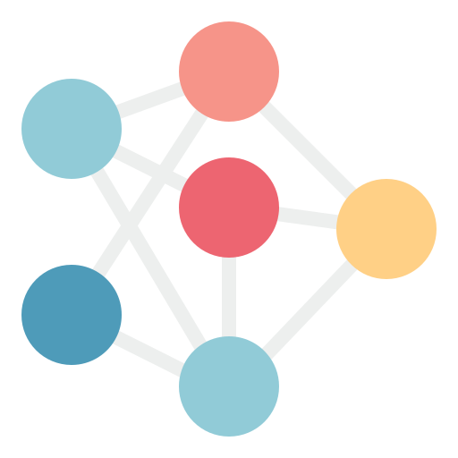






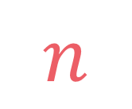

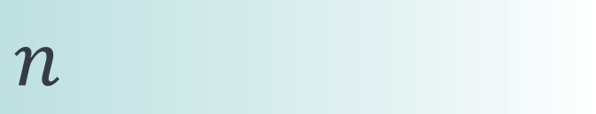

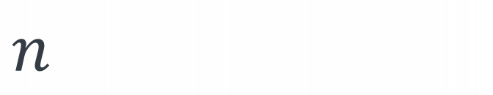
left
[4, 5, 1, 7, 2, 6, 3, 8]
no margin
Space complexity:
$$O(n)$$
list
list
list
list
mid
no margin
"string"
4 | 5 | 1 | 7 | 2 | 6 | 3 | 8
Space complexity:
$$O(n)$$
5
5
$
5
rec(n)
$$n$$
5
$$n$$
$$⇒$$
$$n$$
Time complexity:
$$O(n)$$
text
text
 |  |  | a
$$n$$
text
text
no margin
no margin
no margin
no margin
no margin
no margin
no margin
no margin

Slide 2
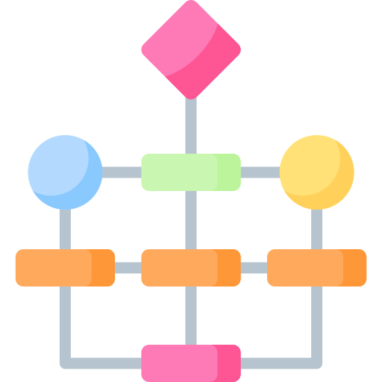

Graph algorithms

Slide 3
Depth-first search
Breadth-first search

Slide 4
Depth-first search and Breadth-first search give us the ability to traverse a graph
1
2
0
5
Depth-first search
Breadth-first search
3
4

Slide 5
Depth-first search

Slide 6
Q
P
L
R
O
K
F
H
I
E
B
C
D
J
A
A

Slide 7
Q
P
L
R
O
K
F
H
I
E
B
C
D
J
A
A

Slide 8
Q
P
L
R
O
K
F
H
I
E
B
B
C
C
D
D
J
A
A

Slide 9
Q
P
L
R
O
K
F
H
I
E
B
B
C
C
D
D
J
A
A

Slide 10
Q
P
L
R
O
K
F
H
I
E
B
B
C
C
D
D
J
A
A

Slide 11
Q
P
L
R
O
K
F
H
I
E
B
B
C
C
D
D
J
A
A

Slide 12
Q
P
L
R
O
K
F
F
H
I
E
E
B
B
C
C
D
D
J
A
A

Slide 13
Q
P
L
R
O
K
K
F
F
H
I
E
E
B
B
C
C
D
D
J
A
A

Slide 14
Q
P
P
L
L
R
O
K
K
F
F
H
I
E
E
B
B
C
C
D
D
J
A
A

Slide 15
Q
P
P
L
L
R
O
K
K
F
F
H
I
E
E
B
B
C
C
D
D
J
A
A

Slide 16
Q
P
P
L
L
R
O
K
K
F
F
H
I
E
E
B
B
C
C
D
D
J
A
A

Slide 17
Q
Q
P
P
L
L
R
R
O
K
K
F
F
H
I
E
E
B
B
C
C
D
D
J
A
A

Slide 18
Q
Q
P
P
L
L
R
R
O
K
K
F
F
H
I
E
E
B
B
C
C
D
D
J
A
A

Slide 19
Q
Q
P
P
L
L
R
R
O
K
K
F
F
H
I
E
E
B
B
C
C
D
D
J
A
A

Slide 20
Q
Q
P
P
L
L
R
R
O
K
K
F
F
H
I
E
E
B
B
C
C
D
D
J
A
A

Slide 21
Q
Q
P
P
L
L
R
R
O
K
K
F
F
H
I
E
E
B
B
C
C
D
D
J
A
A

Slide 22

Q
Q
A B
E K
P L
Q R
P
P
L
L
R
R
O
K
K
F
F
H
I
Done missions
E
E
B
B
C
C
D
D
J
A
A

Slide 23
Q
Q
P
P
L
L
R
R
O
K
K
F
F
H
I
E
E
B
B
C
C
D
D
J
A
A

Slide 24
Q
Q
P
P
L
L
R
R
O
K
K
F
F
H
I
E
E
B
B
C
C
D
D
J
A
A

Slide 25
Q
Q
P
P
L
L
R
R
O
K
K
F
F
H
I
E
E
B
B
C
C
D
D
J
A
A

Slide 26
Q
Q
P
P
L
L
R
R
O
K
K
F
F
H
I
E
E
B
B
C
C
D
D
J
A
A

Slide 27
Q
Q
P
P
L
L
R
R
O
K
K
F
F
H
I
E
E
B
B
C
C
D
D
J
A
A

Slide 28
Q
Q
P
P
L
L
R
R
O
K
K
F
F
H
I
E
E
B
B
C
C
D
D
J
A
A

Slide 29
Q
Q
P
P
L
L
R
R
O
K
K
F
F
H
I
E
E
B
B
C
C
D
D
J
A
A

Slide 30
Q
Q
P
P
L
L
R
R
O
K
K
F
F
H
I
E
E
B
B
C
C
D
D
J
A
A

Slide 31
Q
Q
P
P
L
L
R
R
O
K
K
F
F
H
H
I
I
E
E
B
B
C
C
D
D
J
J
A
A

Slide 32
Q
Q
P
P
L
L
R
R
O
K
K
F
F
H
H
I
I
E
E
B
B
C
C
D
D
J
J
A
A

Slide 33
Q
Q
P
P
L
L
R
R
O
K
K
F
F
H
H
I
I
E
E
B
B
C
C
D
D
J
J
A
A

Slide 34
Q
P
L
R
O
K
F
H
I
E
B
C
D
J
A

Slide 35
Q
P
L
R
O
K
F
H
I
E
B
C
D
J
A

Slide 36
Q
P
L
R
O
K
F
H
I
E
B
C
D
J
A

Slide 37
Q
P
L
R
O
K
F
H
I
E
B
C
D
J
A

Slide 38
Q
P
L
R
O
K
F
H
I
E
B
C
D
J
A

Slide 39
Q
P
L
R
O
K
F
H
I
E
B
C
D
J
A

Slide 40
Q
P
L
R
O
K
F
H
I
E
B
C
D
J
A

Slide 41
Depth-first search

Slide 42
Q
P
L
R
O
K
F
H
I
E
B
C
D
J
A
A

Slide 43
Q
P
L
R
O
K
F
H
I
E
B
B
C
C
D
D
J
A
A

Slide 44
Q
P
L
R
O
K
F
F
H
I
E
E
B
B
C
C
D
D
J
A
A

Slide 45
Q
P
L
R
O
K
K
F
F
H
I
E
E
B
B
C
C
D
D
J
A
A

Slide 46
Q
P
P
L
L
R
O
K
K
F
F
H
I
E
E
B
B
C
C
D
D
J
A
A

Slide 47
Q
P
P
L
L
R
O
K
K
F
F
H
I
E
E
B
B
C
C
D
D
J
A
A

Slide 48
Q
P
P
L
L
R
O
K
K
F
F
H
I
E
E
B
B
C
C
D
D
J
A
A

Slide 49
Q
Q
P
P
L
L
R
R
O
K
K
F
F
H
I
E
E
B
B
C
C
D
D
J
A
A

Slide 50
Done missions

Slide 51
Q
P
L
R
O
K
F
H
I
E
B
B
C
C
D
D
J
A
A

Slide 52
Q
P
L
R
O
K
F
F
H
I
E
E
B
B
C
C
D
D
J
A
A

Slide 53
Q
P
L
R
O
K
K
F
F
H
I
E
E
B
B
C
C
D
D
J
A
A

Slide 54
Q
P
P
L
L
R
O
K
K
F
F
H
I
E
E
B
B
C
C
D
D
J
A
A

Slide 55
Q
P
P
L
L
R
O
K
K
F
F
H
I
E
E
B
B
C
C
D
D
J
A
A

Slide 56
Q
P
P
L
L
R
O
K
K
F
F
H
I
E
E
B
B
C
C
D
D
J
A
A

Slide 57
Q
Q
P
P
L
L
R
R
O
K
K
F
F
H
I
E
E
B
B
C
C
D
D
J
A
A

Slide 58
Q
Q
P
P
L
L
R
R
O
K
K
F
F
H
I
E
E
B
B
C
C
D
D
J
A
A

Slide 59
Q
Q
P
P
L
L
R
R
O
K
K
F
F
H
I
E
E
B
B
C
C
D
D
J
A
A

Slide 60
Q
Q
P
P
L
L
R
R
O
K
K
F
F
H
I
E
E
B
B
C
C
D
D
J
A
A

Slide 61
Q
Q
P
P
L
L
R
R
O
K
K
F
F
H
I
E
E
B
B
C
C
D
D
J
A
A

Slide 62
Q
Q
P
P
L
L
R
R
O
K
K
F
F
H
I
E
E
B
B
C
C
D
D
J
A
A

Slide 63
Q
Q
P
P
L
L
R
R
O
K
K
F
F
H
I
E
E
B
B
C
C
D
D
J
A
A

Slide 64
Q
Q
P
P
L
L
R
R
O
K
K
F
F
H
I
E
E
B
B
C
C
D
D
J
A
A

Slide 65
Q
Q
P
P
L
L
R
R
O
K
K
F
F
H
I
E
E
B
B
C
C
D
D
J
A
A

Slide 66
Q
Q
P
P
L
L
R
R
O
K
K
F
F
H
I
E
E
B
B
C
C
D
D
J
A
A

Slide 67
Q
Q
P
P
L
L
R
R
O
K
K
F
F
H
I
E
E
B
B
C
C
D
D
J
A
A

Slide 68
Q
Q
P
P
L
L
R
R
O
K
K
F
F
H
I
E
E
B
B
C
C
D
D
J
A
A

Slide 69
Q
Q
P
P
L
L
R
R
O
K
K
F
F
H
I
E
E
B
B
C
C
D
D
J
A
A

Slide 70



Slide 71

$$function complete_missions\left(mission, notebook\right) \\ finish_mission\left(mission\right) \\ notebook.write\left(mission\right) \\ for each unlocked mission: \\ if unlocked not in notebook: \\ complete_missions(unlocked)$$

Slide 72
$$function complete_missions\left(mission, notebook\right) \\ finish_mission\left(mission\right) \\ notebook.write\left(mission\right) \\ for each unlocked mission: \\ if unlocked not in notebook: \\ complete_missions(unlocked)$$

Slide 73
$$function complete_missions\left(mission, notebook\right) \\ finish_mission\left(mission\right) \\ notebook.write\left(mission\right) \\ for each unlocked mission: \\ if unlocked not in notebook: \\ complete_missions(unlocked)$$

Slide 74
$$function complete_missions\left(mission, notebook\right) \\ finish_mission\left(mission\right) \\ notebook.write\left(mission\right) \\ for each unlocked mission: \\ if unlocked not in notebook: \\ complete_missions(unlocked)$$

Slide 75
$$function complete_missions\left(mission, notebook\right) \\ finish_mission\left(mission\right) \\ notebook.write\left(mission\right) \\ for each unlocked mission: \\ if unlocked not in notebook: \\ complete_missions(unlocked)$$

Slide 76
$$function complete_missions\left(mission, notebook\right) \\ finish_mission\left(mission\right) \\ notebook.write\left(mission\right) \\ for each unlocked mission: \\ if unlocked not in notebook: \\ complete_missions(unlocked)$$

Slide 77
def f():
#...
#...
g()
#...
#...
def g():
#...
#...
#...

Slide 78
def f():
#...
#...
g()
#...
#...
def g():
#...
#...
#...

Slide 79
def f():
#...
#...
g()
#...
#...
def g():
#...
#...
#...

Slide 80
def f():
#...
#...
g()
#...
#...
def g():
#...
#...
#...

Slide 81
def f():
#...
#...
g()
#...
#...
def g():
#...
#...
#...

Slide 82
def f():
#...
#...
g()
#...
#...
def g():
#...
#...
#...

Slide 83
def f():
#...
#...
g()
#...
#...
def g():
#...
#...
#...

Slide 84
def f():
#...
#...
g()
#...
#...
def g():
#...
#...
#...

Slide 85
def f():
#...
#...
g()
#...
#...
def g():
#...
#...
#...

Slide 86
$$function complete_missions\left(mission, notebook\right) \\ finish_mission\left(mission\right) \\ notebook.write\left(mission\right) \\ for each unlocked mission: \\ if unlocked not in notebook: \\ complete_missions(unlocked)$$

Slide 87

$$function _dfs\left(graph,vertex, visited\right): \\ print\left(vertex\right) \\ visited.add\left(vertex\right) \\ for each neighbor in graph[vertex]: \\ if neighbor not in visited: \\ _dfs(neighbor)$$

Slide 88
{
0: [1, 4, 3],
1: [0, 2, 5, 4],
2: [1],
3: [0, 6],
4: [0, 1, 5],
5: [1, 4],
6: [3, 7],
7: [6],
8: []
}
 | 0 | 1 | 2 | 3 | 4 | 5 | 6 | 7 | 8
0 | 0 | 1 | 0 | 1 | 1 | 0 | 0 | 0 | 0
1 | 1 | 0 | 1 | 0 | 1 | 1 | 0 | 0 | 0
2 | 0 | 1 | 0 | 0 | 0 | 0 | 0 | 0 | 0
3 | 1 | 0 | 0 | 0 | 0 | 0 | 1 | 0 | 0
4 | 1 | 1 | 0 | 0 | 0 | 1 | 0 | 0 | 0
5 | 0 | 1 | 0 | 0 | 1 | 0 | 0 | 0 | 0
6 | 0 | 0 | 0 | 1 | 0 | 0 | 0 | 1 | 0
7 | 0 | 0 | 0 | 0 | 0 | 0 | 1 | 0 | 0
8 | 0 | 0 | 0 | 0 | 0 | 0 | 0 | 0 | 0
VS

Slide 89
def _dfs(graph, vertex, visited):
print(vertex)
visited.add(vertex)
for neighbor in graph.adj_list[vertex]:
if neighbor not in visited:
_dfs(graph, neighbor, visited)

Slide 90
def _dfs(graph, vertex, visited):
print(vertex)
visited.add(vertex)
for neighbor in graph.adj_list[vertex]:
if neighbor not in visited:
_dfs(graph, neighbor, visited)

Slide 91
def _dfs(graph, vertex, visited):
print(vertex)
visited.add(vertex)
for neighbor in graph.adj_list[vertex]:
if neighbor not in visited:
_dfs(graph, neighbor, visited)

Slide 92
def _dfs(graph, vertex, visited):
print(vertex)
visited.add(vertex)
for neighbor in graph.adj_list[vertex]:
if neighbor not in visited:
_dfs(graph, neighbor, visited)

Slide 93
def _dfs(graph, vertex, visited):
print(vertex)
visited.add(vertex)
for neighbor in graph.adj_list[vertex]:
if neighbor not in visited:
_dfs(graph, neighbor, visited)

Slide 94
def _dfs(graph, vertex, visited):
print(vertex)
visited.add(vertex)
for neighbor in graph.adj_list[vertex]:
if neighbor not in visited:
_dfs(graph, neighbor, visited)

Slide 95
def _dfs(graph, vertex, visited):
print(vertex)
visited.add(vertex)
for neighbor in graph.adj_list[vertex]:
if neighbor not in visited:
_dfs(graph, neighbor, visited)
def dfs(graph, vertex):
visited = set()
_dfs(graph, vertex, visited)

Slide 96
def _dfs(graph, vertex, visited):
print(vertex)
visited.add(vertex)
for neighbor in graph.neighbors(vertex):
if neighbor not in visited:
_dfs(graph, neighbor, visited)
def dfs(graph, vertex):
visited = set()
_dfs(graph, vertex, visited)

Slide 97
Q
P
L
R
O
K
F
H
I
E
B
C
D
J
A
A

Slide 98
Q
P
L
R
O
K
F
H
I
E
B
C
D
J
A

Slide 99
Q
P
L
R
O
K
F
H
I
E
B
C
D
J
A
A

Slide 100
Q
P
L
R
O
K
F
H
I
E
B
C
D
J
A
A

Slide 101
Q
P
L
R
O
K
F
H
I
E
B
C
D
J
A
A

Slide 102
Q
P
L
R
O
K
F
H
I
E
B
C
D
J
A
A

Slide 103
Q
P
L
R
O
K
F
H
I
E
B
C
D
J
A
A

Slide 104
Q
P
L
R
O
K
F
H
I
E
B
C
D
J
A
A

Slide 105
Q
P
L
R
O
K
F
H
I
E
B
C
D
J
A
A

Slide 106
Q
P
L
R
O
K
F
H
I
E
B
C
D
J
A
A

Slide 107
Q
P
L
R
O
K
F
H
I
E
B
C
D
J
A
A

Slide 108
Q
P
L
R
O
K
F
H
I
E
B
C
D
J
A
A

Slide 109
Q
P
L
R
O
K
F
H
I
E
B
C
D
J
A
A

Slide 110
Q
P
L
R
O
K
F
H
I
E
B
C
D
J
A
A

Slide 111
Q
P
L
R
O
K
F
H
I
E
B
C
D
J
A
A

Slide 112
Q
P
L
R
O
K
F
H
I
E
B
C
D
J
A
A

Slide 113
Q
P
L
R
O
K
F
H
I
E
B
C
D
J
A
A

Slide 114
Q
P
L
R
O
K
F
H
I
E
B
C
D
J
A
A

Slide 115
Q
P
L
R
O
K
F
H
I
E
B
C
D
J
A
A

Slide 116
Q
P
L
R
O
K
F
H
I
E
B
C
D
J
A
A

Slide 117
def _dfs(graph, vertex, visited):
print(vertex)
visited.add(vertex)
for neighbor in graph.adj_list[vertex]:
if neighbor not in visited:
_dfs(graph, neighbor, visited)
def dfs(graph):
visited = set()
for vertex in graph:
if vertex not in visited:
_dfs(graph, vertex, visited)

Slide 118


Slide 119
_dfs()
Q
_dfs()
_dfs()
_dfs()
P
L
R
O
_dfs()
_dfs()
_dfs()
K
F
_dfs()
H
I
_dfs()
_dfs()
E
B
C
D
J
_dfs()
_dfs()
_dfs()
_dfs()
A
A
_dfs()

Slide 120
def _dfs(graph, vertex, visited):
print(vertex)
visited.add(vertex)
for neighbor in graph.adj_list[vertex]:
if neighbor not in visited:
_dfs(graph, neighbor, visited)
def dfs(graph):
visited = set()
for vertex in graph:
if vertex not in visited:
_dfs(graph, vertex, visited)
traversing neighbors
traversing vertices

Slide 121

def _dfs(graph, vertex, visited):
print(vertex)
visited.add(vertex)
for neighbor in graph.adj_list[vertex]:
if neighbor not in visited:
_dfs(graph, neighbor, visited)
def dfs(graph):
visited = set()
for vertex in graph:
if vertex not in visited:
_dfs(graph, vertex, visited)
traversing neighbors
traversing vertices
$$|V|$$

Slide 122

def _dfs(graph, vertex, visited):
print(vertex)
visited.add(vertex)
for neighbor in graph.adj_list[vertex]:
if neighbor not in visited:
_dfs(graph, neighbor, visited)
def dfs(graph):
visited = set()
for vertex in graph:
if vertex not in visited:
_dfs(graph, vertex, visited)
$$O(1)$$
traversing neighbors
traversing vertices
$$|V|$$

Slide 123
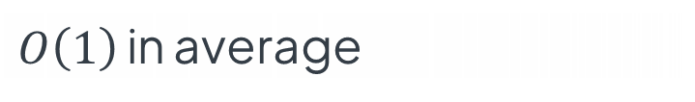
def _dfs(graph, vertex, visited):
print(vertex)
visited.add(vertex)
for neighbor in graph.adj_list[vertex]:
if neighbor not in visited:
_dfs(graph, neighbor, visited)
def dfs(graph):
visited = set()
for vertex in graph:
if vertex not in visited:
_dfs(graph, vertex, visited)
$$O(1)$$
$O\left(1\right)$ in average
traversing neighbors
traversing vertices
$$|V|$$

Slide 124
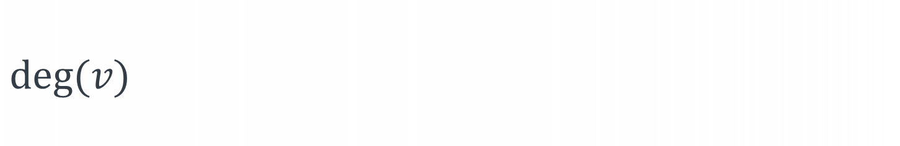
def _dfs(graph, vertex, visited):
print(vertex)
visited.add(vertex)
for neighbor in graph.adj_list[vertex]:
if neighbor not in visited:
_dfs(graph, neighbor, visited)
def dfs(graph):
visited = set()
for vertex in graph:
if vertex not in visited:
_dfs(graph, vertex, visited)
$$O(1)$$
$O\left(1\right)$ in average
traversing neighbors
$$deg⁡(v)$$
traversing vertices
$$|V|$$

Slide 125
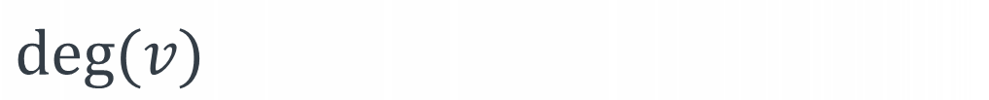
def _dfs(graph, vertex, visited):
print(vertex)
visited.add(vertex)
for neighbor in graph.adj_list[vertex]:
if neighbor not in visited:
_dfs(graph, neighbor, visited)
def dfs(graph):
visited = set()
for vertex in graph:
if vertex not in visited:
_dfs(graph, vertex, visited)
$$O(1)$$
$O\left(1\right)$ in average
traversing neighbors
$$deg⁡(v)$$
traversing vertices
$$|V|$$
$$deg⁡(v)$$

Slide 126

cost of traversing vertices
cost of calling _dfs() on each vertex
$$T\left(V,E\right)=\left|V\right|+\sum_{v∈V}{deg⁡(v)}$$

Slide 127

directed graph:
$$\sum_{v∈V}{deg⁡(v)}=|E|$$

Slide 128

directed graph:
$$\sum_{v∈V}{deg⁡(v)}=|E|$$
undirected graph:
$$\sum_{v∈V}{deg⁡(v)}=2|E|$$

Slide 129
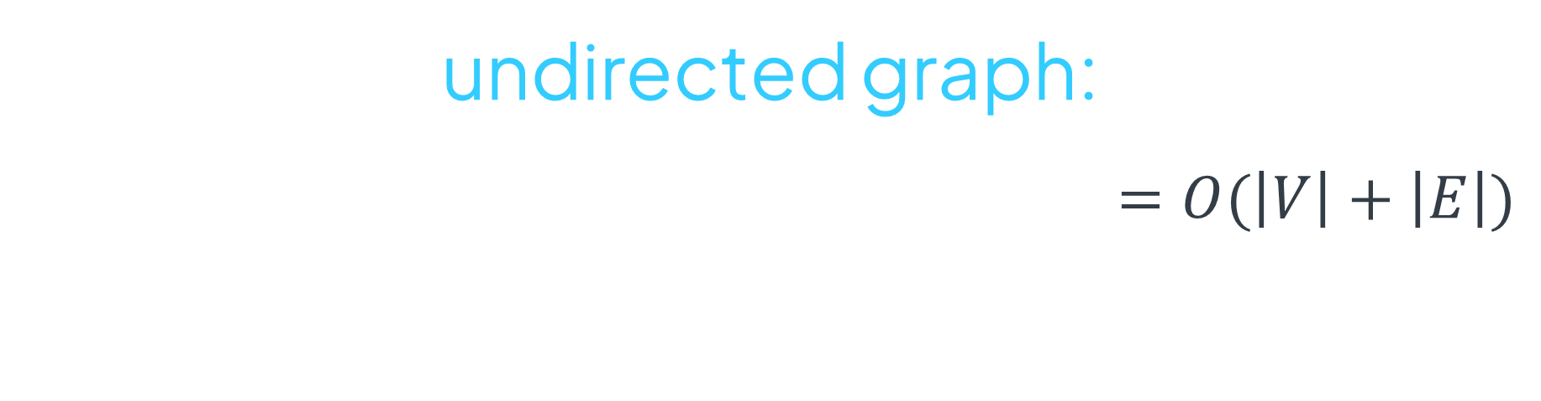
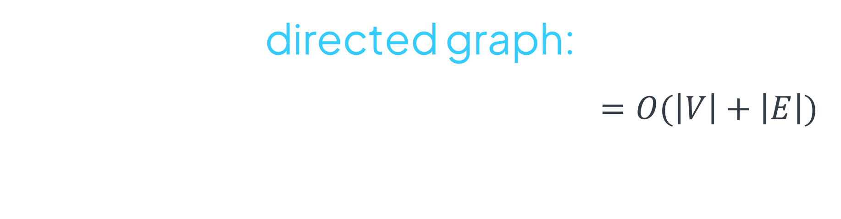
directed graph:
$$T\left(V,E\right)=\left|V\right|+\sum_{v∈V}{deg⁡(v)}=\left|V\right|+\left|E\right|=O(\left|V\right|+\left|E\right|)$$
undirected graph:
$$T\left(V,E\right)=\left|V\right|+\sum_{v∈V}{deg⁡(v)}=\left|V\right|+2\left|E\right|=O(\left|V\right|+\left|E\right|)$$

Slide 130
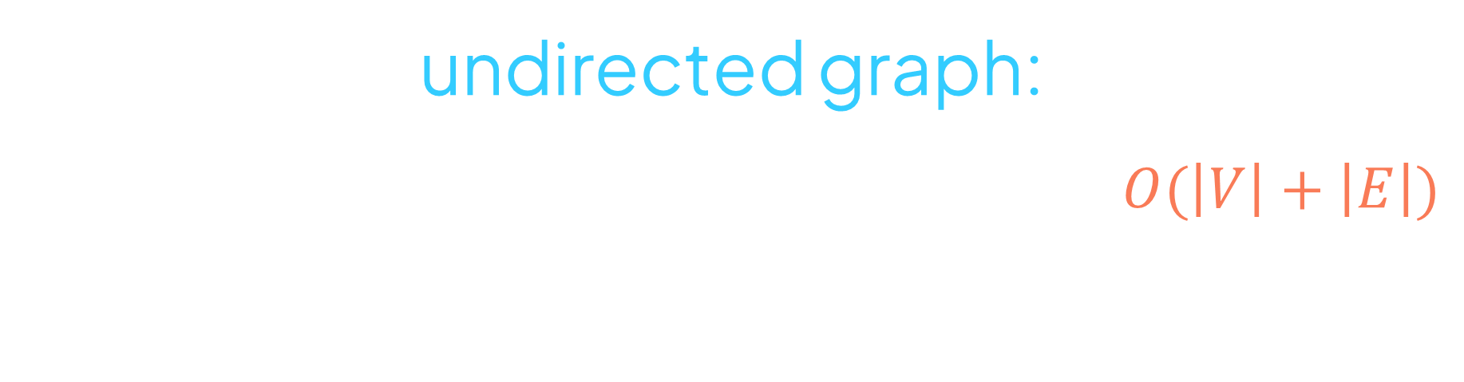
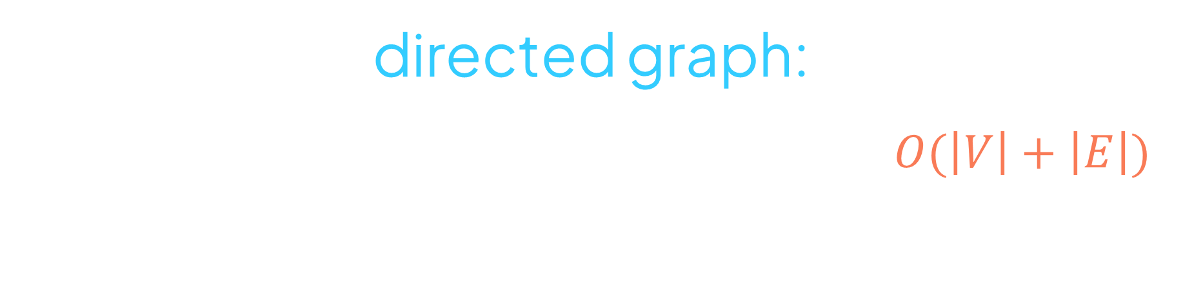
directed graph:
$$T\left(V,E\right)=\left|V\right|+\sum_{v∈V}{deg⁡(v)}=\left|V\right|+\left|E\right|=O(\left|V\right|+\left|E\right|)$$
undirected graph:
$$T\left(V,E\right)=\left|V\right|+\sum_{v∈V}{deg⁡(v)}=\left|V\right|+2\left|E\right|=O(\left|V\right|+\left|E\right|)$$

Slide 131
def _dfs(graph, vertex, visited):
print(vertex)
visited.add(vertex)
for neighbor in graph.neighbors(vertex):
if neighbor not in visited:
_dfs(graph, neighbor, visited)
def dfs(graph):
visited = set()
for vertex in graph:
if vertex not in visited:
_dfs(graph, vertex, visited)

Slide 132
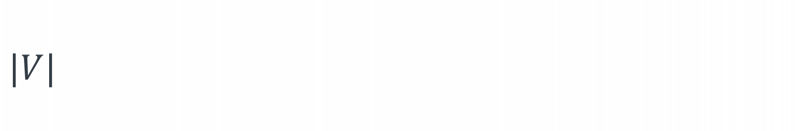
def _dfs(graph, vertex, visited):
print(vertex)
visited.add(vertex)
for neighbor in graph.neighbors(vertex):
if neighbor not in visited:
_dfs(graph, neighbor, visited)
def dfs(graph):
visited = set()
for vertex in graph:
if vertex not in visited:
_dfs(graph, vertex, visited)
$$O(1)$$
$O\left(1\right)$ in average
$$|V|$$
$$|V|$$

Slide 133

def _dfs(graph, vertex, visited):
print(vertex)
visited.add(vertex)
for neighbor in graph.neighbors(vertex):
if neighbor not in visited:
_dfs(graph, neighbor, visited)
def dfs(graph):
visited = set()
for vertex in graph:
if vertex not in visited:
_dfs(graph, vertex, visited)
$$O(1)$$
$O\left(1\right)$ in average
$$|V|$$
$$|V|$$
$$|V|$$

Slide 134
$$T\left(V,E\right)=\left|V\right|+\left|V\right|∗\left|V\right|=\left|V\right|+{\left|V\right|}^{2}=O({\left|V\right|}^{2})$$

Slide 135
$$T\left(V,E\right)=\left|V\right|+\left|V\right|∗\left|V\right|=\left|V\right|+{\left|V\right|}^{2}=O({\left|V\right|}^{2})$$

Slide 136

def dfs(graph):
visited = set()
for vertex in graph:
if vertex not in visited:
_dfs(graph, vertex, visited)
$$|V|$$

Slide 137

def dfs(graph):
visited = set()
for vertex in graph:
if vertex not in visited:
_dfs(graph, vertex, visited)
$$|V|$$
call stack
_dfs(D)
A
B
C
D
_dfs(C)
$$|V|$$
_dfs(B)
_dfs(A)

Slide 138
def dfs(graph):
visited = set()
for vertex in graph:
if vertex not in visited:
_dfs(graph, vertex, visited)
$$|V|$$
call stack
_dfs(D)
A
B
C
D
_dfs(C)
$$|V|$$
_dfs(B)
$$S\left(V,E\right)=\left|V\right|+\left|V\right|=2\left|V\right|=O(\left|V\right|)$$
_dfs(A)
visited
call
stack

Slide 139
Use the visualization program
Do the quiz
Ask questions
Focus during practice problems
Focus during next lectures

Slide 140
Use the visualization program
Do the quiz
Ask questions
Focus during practice problems
Focus during next lectures

Slide 141
Use the visualization program
Do the quiz
Ask questions
Focus during practice problems
Focus during next lectures

Slide 142
Use the visualization program
Do the quiz
Ask questions
Focus during practice problems
Focus during next lectures

Slide 143
Use the visualization program
Do the quiz
Ask questions
Focus during practice problems
Focus during next lectures

Slide 144
Depth-first search

