Slide 1


Slide 2
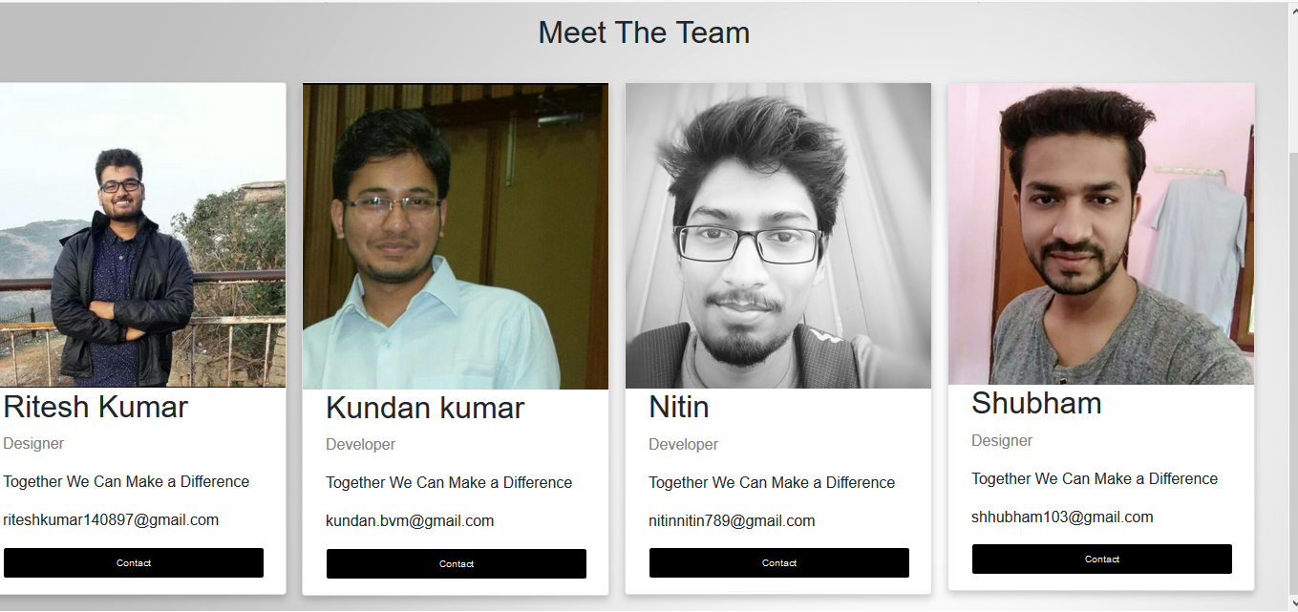

Slide 3
INTRODUCTION:
Kissan bazar provides a platform for the Farmers to sell the product directly to the Customer, there by eliminating the involvement of the middle man, in the doing so the farmer are directedly benefited and customer gets the fresh product at a cheaper rate.
How it’s done?
The farmer can log in with the a unique user ID and password in order to use the platform . After they are logged in, they can sell the product by uploading the image of the product and filling all the necessary details of the product. Once the product is uploaded on the website the product are displayed on the website. In order to buy the product ,the customer has to log in the website and the customer can browse the product directly as well as category wise or else directly from the search bar. The respective details of the product is displayed and on clicking the Buy now button ,the user is directed to the payment page and on paying the respective amount ,invoice is generated and sent to the user’s e-mail Id. The delivery address of the user is sent the farmer through e-mail, and thus the transection is complete.

Slide 4
DB DIAGRAM :
User:
id
Username
password
name
utype
phone
Email
active
city
state
Pin
userimage
address
Product
id
PcategoryID
Pname
Pdedcription
Pimg
Pquantity
Pprice
Uploaded_date
User_detailID
Active
Purchase:
id
Pid
Purches_date
PurchesPrice
Tax
Total_cost
Purches_U_Id
Pquantity
Category:
id
Category Name
Active

Slide 5
Modules details
def home(request): Passes the signed in userdetail,Product Catogery detail to html page
def navcategory(request):Passes the respective product detail corresponding catogery.
def changepassword(request,pk):Allows logged in user to change the password.
def logout1(request):Allows the logged in user to log out and return to the home page.
def checking(request):Check weather the user is logged in before buying a product.
def login(request):Open up a log in page if the user is not blocked by the Admin.
def signup(request):Open up sign up page and takes the user details as input for database.
def myaccount(request,pk):Pass the data from database to users profile page to display the uploaded product ,purchased product and user details.
def contact(request):Displays the meet the team page.
def info(request):Display the information related to crops(Crop calender).
def admin1(request):Open up the Admin page.
def product(request):Allows the Admin to view the all the uploaded product.

Slide 6
def category(request):Displays the all the uploaded category to the admin.
def purchase(request):Displays the all the purchased product detail to the admin.
def useractivate(request,pk):Allows the Admin to activate the user (valid user).
def userdeactivate(request,pk):Allows the Admin to deactivate the user(Block user).
def prodactivate(request,pk):Allows the Admin to activate a uploaded product.
def proddeactivate(request,pk):Allows the Admin to deactivate a uploaded product.
def cateactivate(request,pk): Allows the Admin to activate a category of a product.
def catedeactivate(request,pk): Allows the Admin to deactivate a category of a product.
def buynow(request):Allow the logged in user to buy a displayed product .
def invoice(request):Allow the user to pay in order to buy a product. On clicking the Pay now button invoice of the product is displayed and invoice of the product is sent to user with the Farmer’s contact no. and the Delivering address of the product is sent to the Farmer.
def search(request):Allows the user to search the product available on the website.

Slide 7
Coding sample
models.py
settings.py
urls.py
templates

Slide 8
Code Sample Views.py
def useractivate(request,pk):
categories=Category.objects.filter(active='1')
userdetails=User_Detail.objects.all()
if request.method=='GET':
uname=request.GET.get('uname','')
user=User_Detail.objects.filter(username=uname)
i=''
for j in user:
i=j.id
user=User_Detail.objects.get(id=pk)
user.active='1'
user.save()
#return redirect('user')
return render(request,'user.html',{'userdetails':userdetails,'categories':categories,'uname':uname,'i':i})

Slide 9
Output
Home
Trending Product
Search result
Admin
Admin product
Admin Category
Admin purchase
Admin user
Meet the team
Sign Up
Product detail
Crop Calendar
Invoice

Slide 10
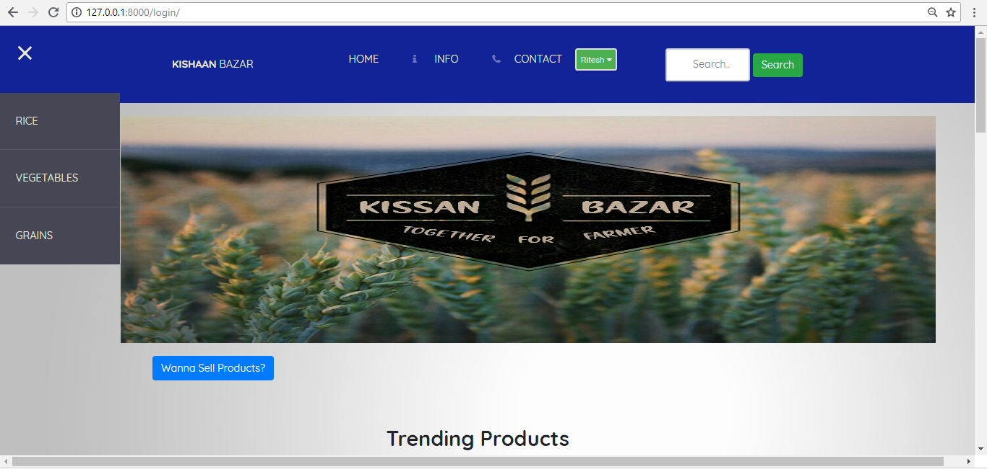
HOME SCREEN

Slide 11
Conclusion
The web project “Kissan Bazar” will directly help the Farmer as well as Customer .The use of website will boost up the economy of the farmer ,as the farmer directly sells the product directly to the customer.
The customer will have to pay the lesser price ,since the role of the middle man is eliminated .More over the customer will get the fresh products at its best price.

Slide 12
Thank You !

