Slide 1
Lending Club Case Study
Ritesh Lath
20-Nov-24

Slide 2
Problem Statement & Expected Result
Problem Statement
The largest online loan marketplace company facilitating in loans need to reduce its financial losses due to defaulting borrowers.
Approach
Perform Exploratory Data Analysis (EDA) on the loans information and identify the features that can help to identify risky customers and thus potentially reduce loan defaults.
EDA Process
Perform Univariate Analysis by Percentage Of Charge Off Loans
Perform Bi-variate Analysis By Loan Amount (Concentration Of Risk)
Expected Result
A list of features that can be used to identify high risk customers
Understanding Data
Data Cleansing & Manipulation
Univariate Analysis
Segmented Analysis
Bivariate Analysis
Derived Metrics Analysis
Step 1: Data Preparation
Step 2 : Identify High Affinity Attributes
Step 3: Identify Related Attributes
Step 4: Derived Metrics

Slide 3
Step 1: Data Preparation
Data Set Statistics
No. Of Rows: 39717 No. Of Attributes: 111 No. Of Attributes (All Nulls) : 54
Data Set Cleaning & Standardization
Remove all unwanted attributes (drop all the attributes for which there is no data)
For Surviving Attributes
Drop if not of significance
Fill Missing Values Or Standardize it
Sr. No | Attribute Name | Action Taken
1 | Publicly Recorded Bankruptcies | No Action taken
2 | Months Since Last Record | No Action since sourced publicly
3 | Last Payment Date | No Action taken
4 | Next Payment Date | No Action taken
5 | Publicly Recorded Bankruptcies | No Action taken
6 | Months Since Last Record | No Action since sourced publicly
7 | Loan Description | Dropped as it a very verbose
8 | Collections In Past 12 Months Excluding Medical | Dropped since zeros or missing
9 | Number of charge offs in last 12 months | Dropped since zeros or missing
10 | Tax Liens | Dropped since all are zeros
11 | Number of accounts narrower is delinquent | Dropped since all are zeros
12 | Application Type | Dropped since all are ‘Individual’
13 | Delinquency Amount | Dropped since all are zeros
Sr. No | Attribute Name | Action Taken
14 | Employment Title | Missing Values Filled With “Unknown”
15 | Employment Length | Missing Values Filled With “Unknown”
16 | Months Since Last Delinquency | Missing Values Filled with ‘0’
17 | Interest Rate | Standardized to float removing %sign
18 | Revolving Credit Utilization Rate | Missing Values filled with ‘0’ Removed row with revolving balance of 49238 (Fully Paid) Standardized to float removing ‘%’ sign
19 | Last Credit Pull Date | Removed row where loan status is Fully Paid for missing value record Standardized to Date
20 | Loan Amount Bucket | Derived Column in Steps of 5K
21 | Monthly Income Bucket | Derived Column in Steps of 10K
22 | Monthly Income | Derived Column from Annual Income

Slide 4
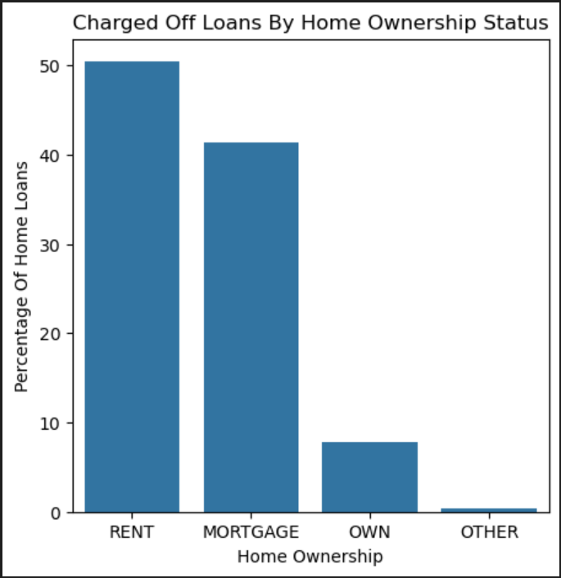
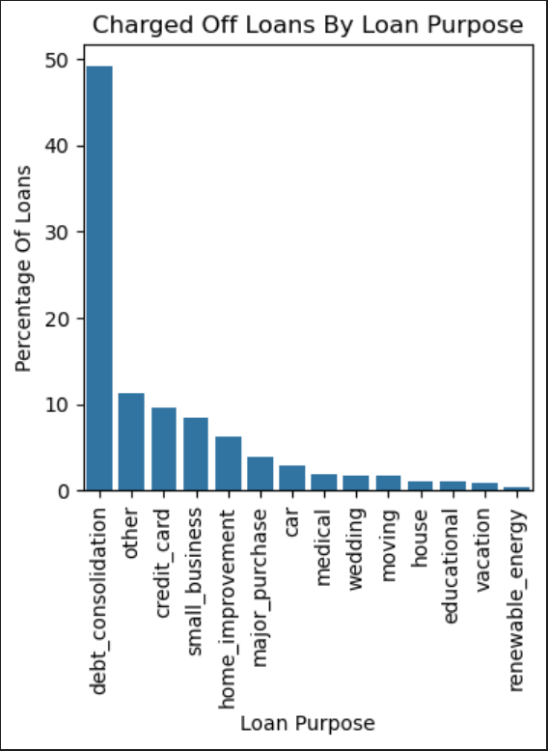
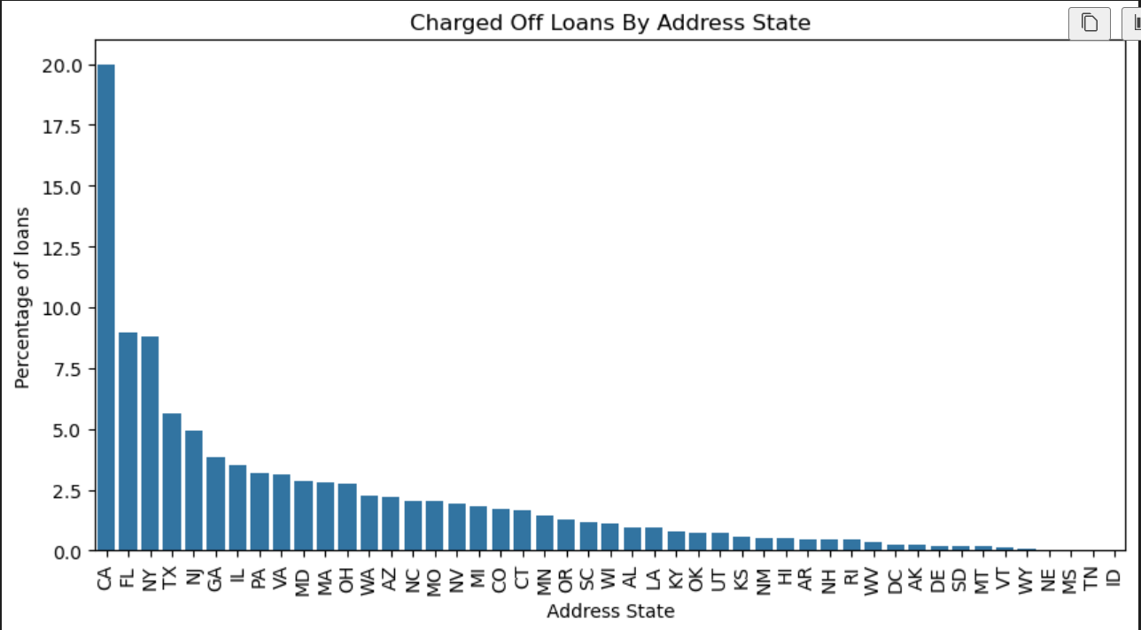
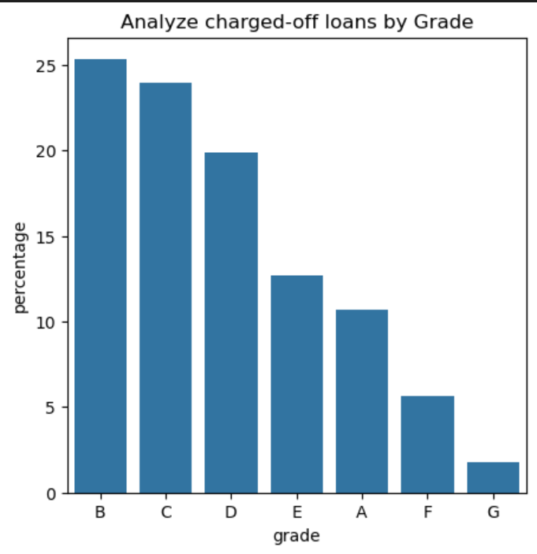
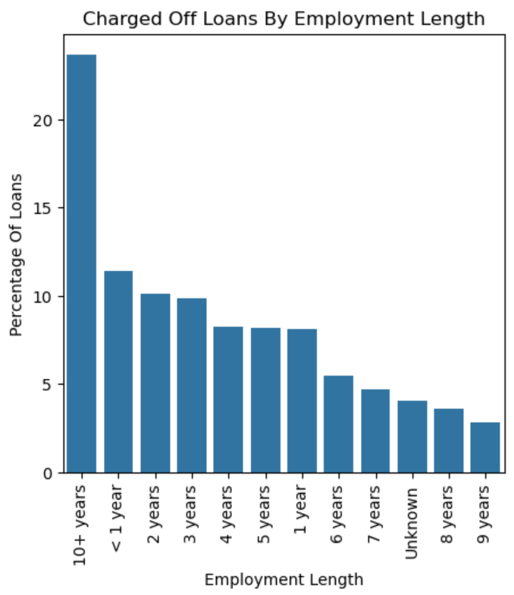
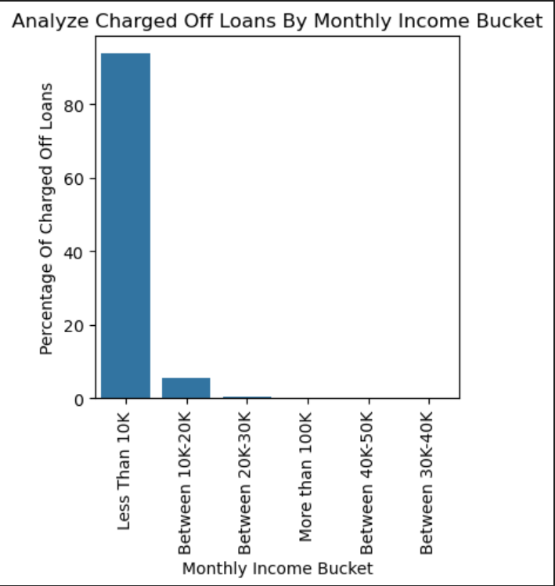
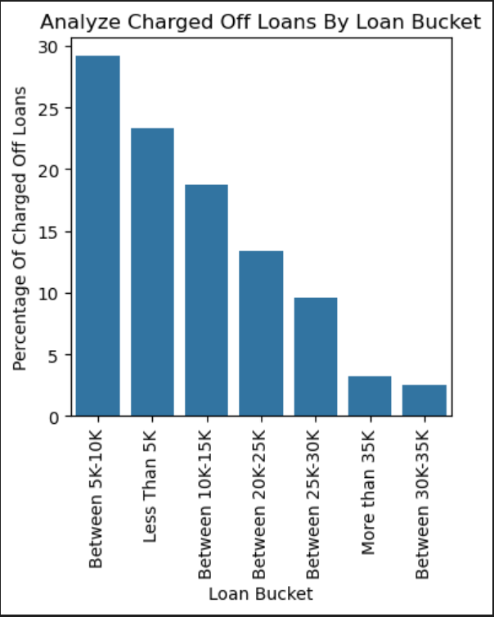
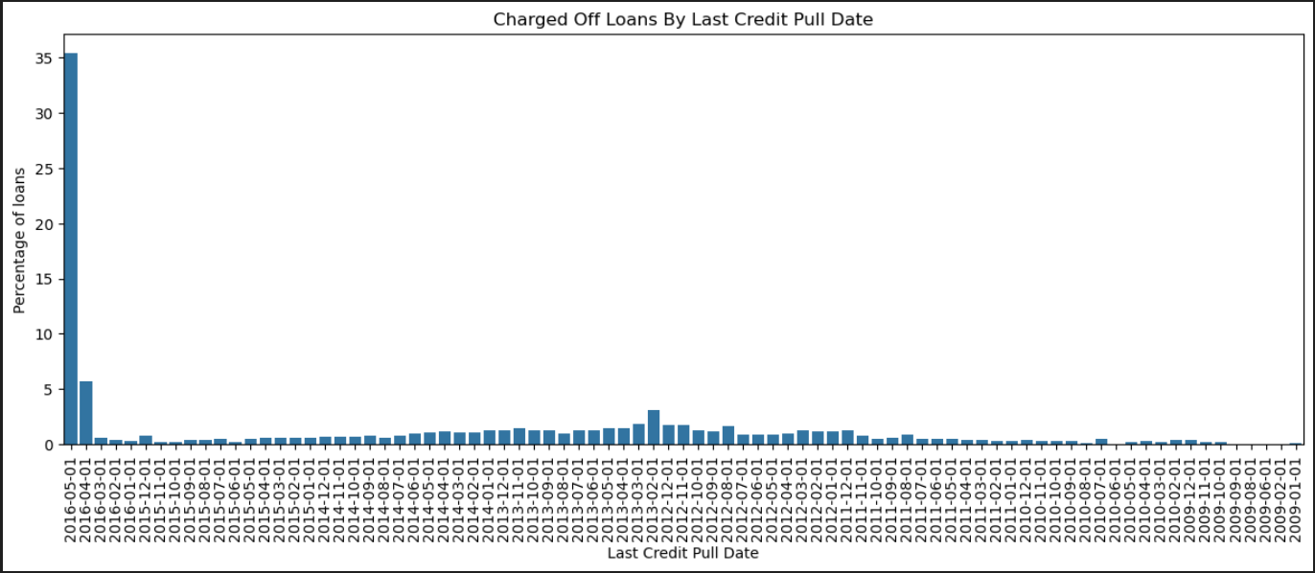
Step 2: Univariate & Segmented Analysis
Univariate and Segmented Analysis Results
Below Attributes Are High Affinity Attributes:
Home Ownership (Rent & Mortgage)
Purpose Of Loan *Debt / Credit Card)
State Of Customer (CA / FL / NY / TX / NJ)
Employment Length
Monthly Income
Loan Grade
Loan Amount
Last Credit Pull Date (Recent Credit Pull Date)
Home Ownership
Purpose
Address State
Loan Grade
Employment Length
Monthly Income
Loan Amount
Last Credit Pull Date

Slide 5
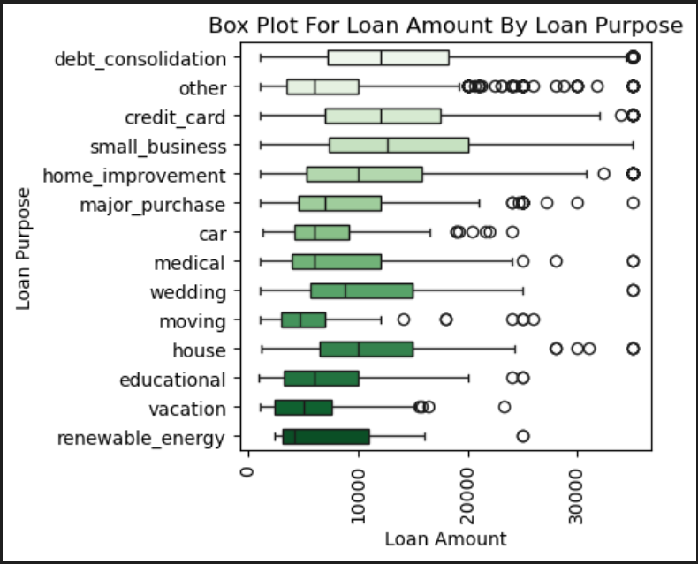
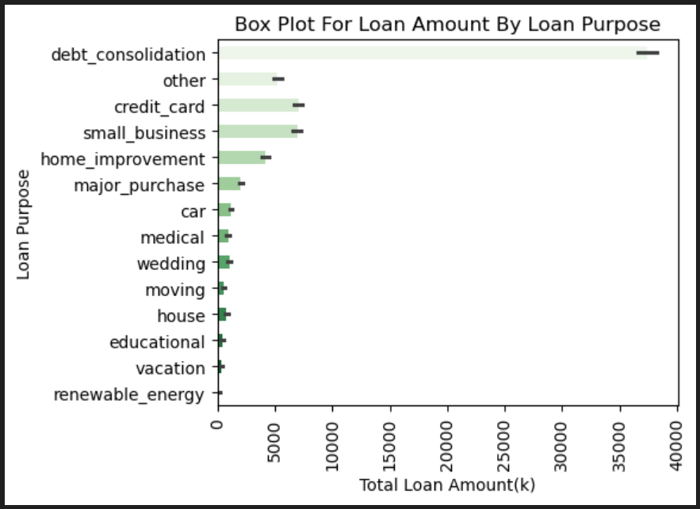
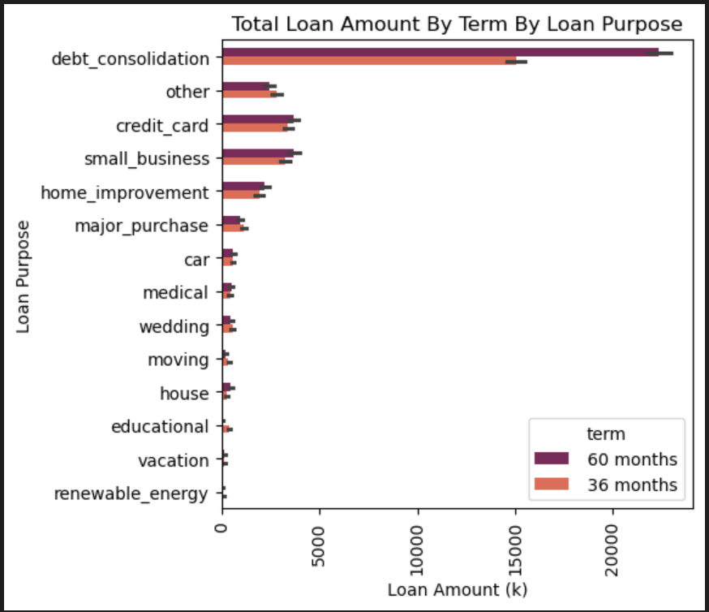
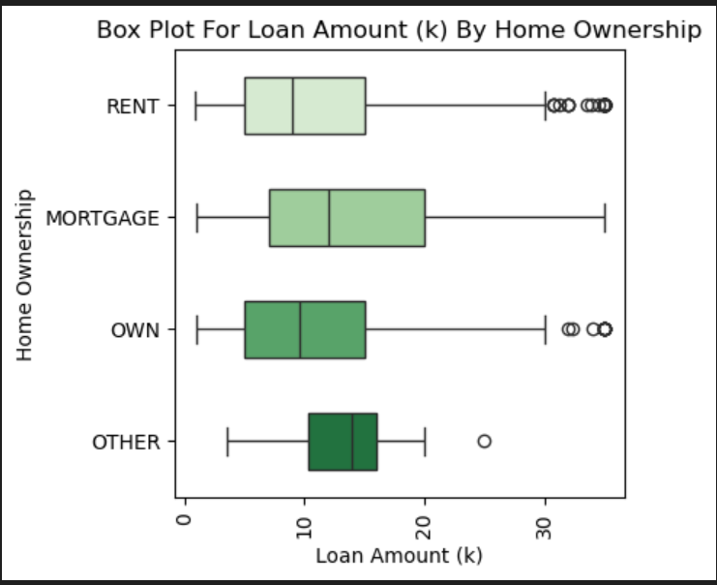
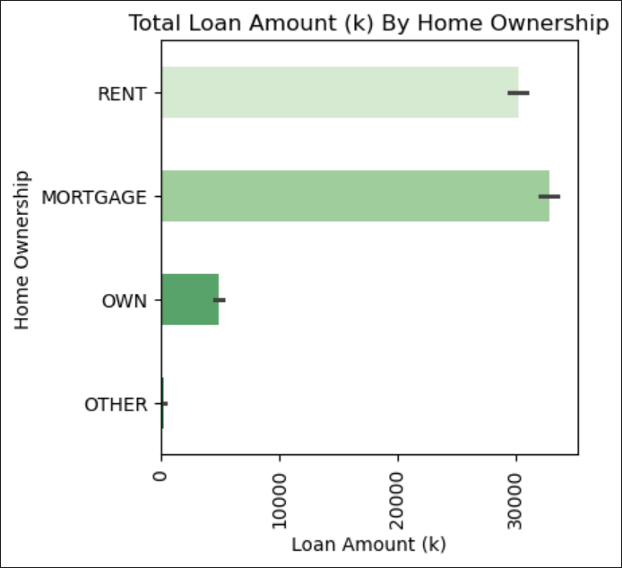
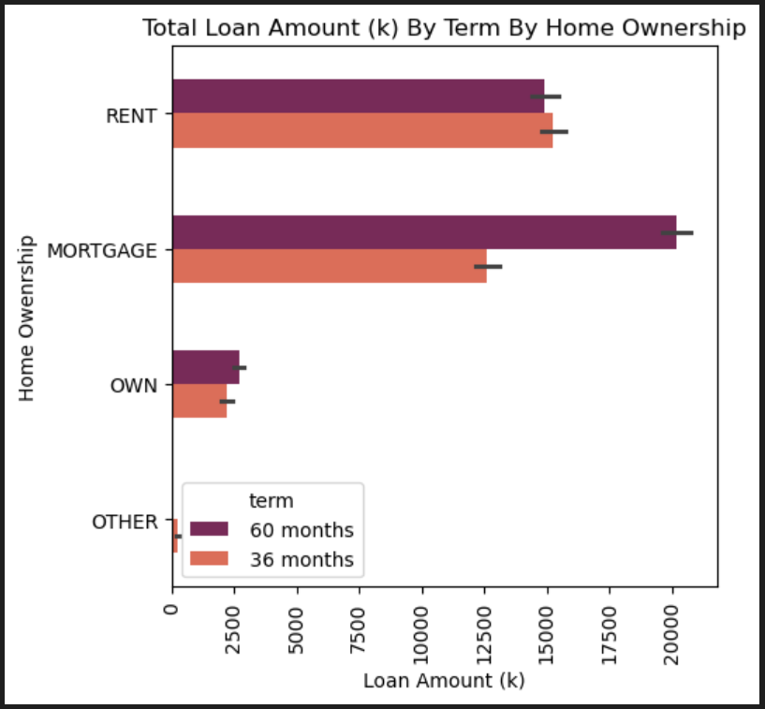
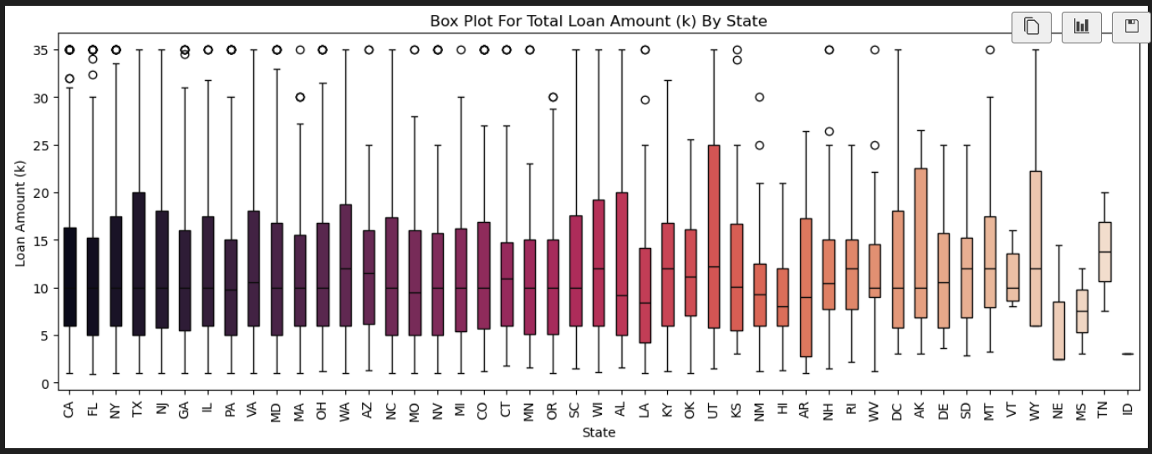
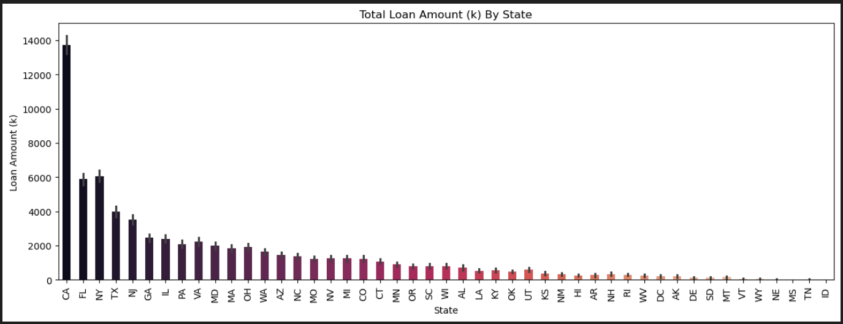
Step 3: Bivariate Analysis (Purpose, Home Ownership, Address State)
Loan Purpose
Debt Consolidation
Credit Card
Small Business
Home Ownership
Rent
Mortgage
Address State
CA
NY
TX
FL
NJ

Slide 6
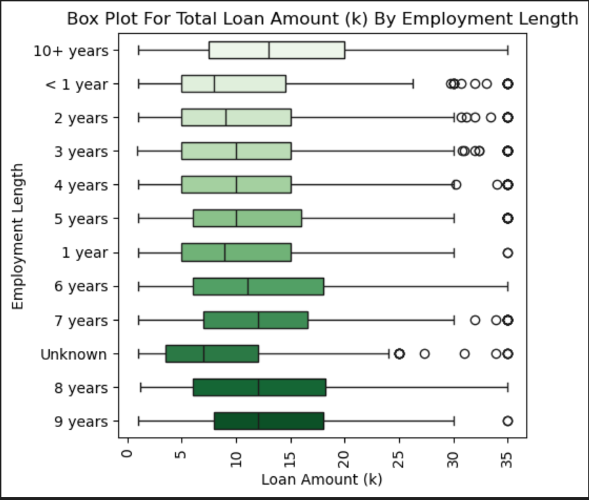
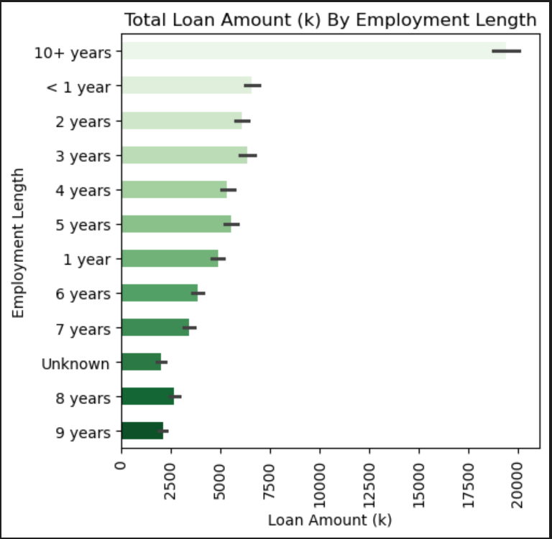
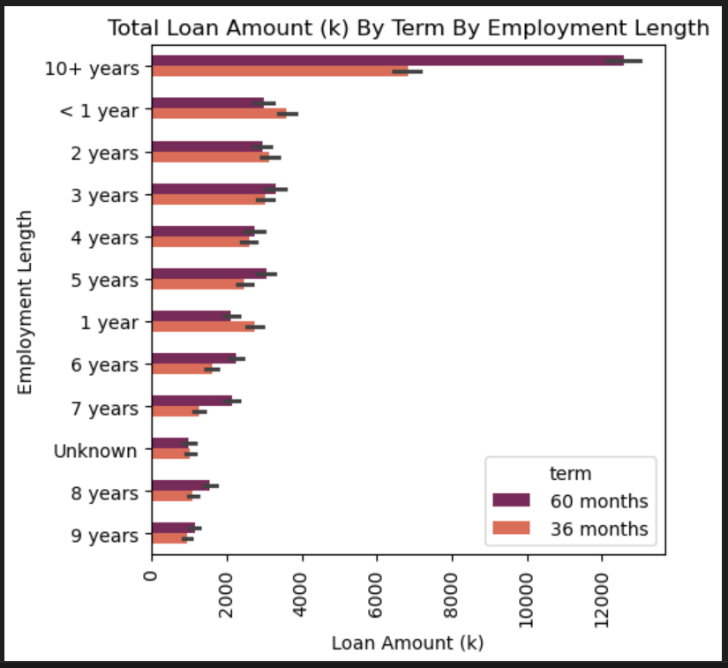
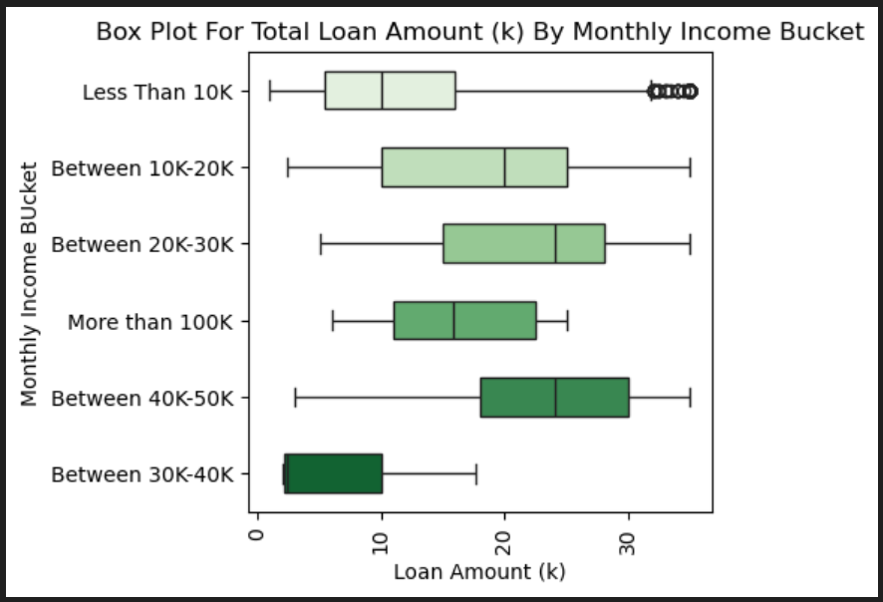
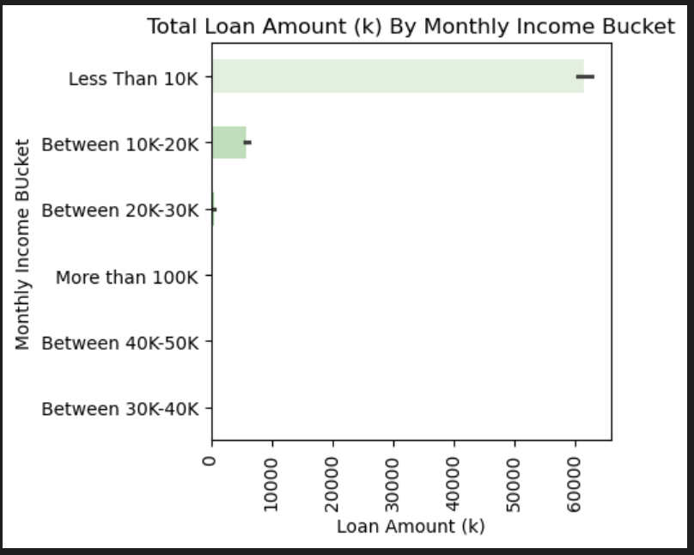
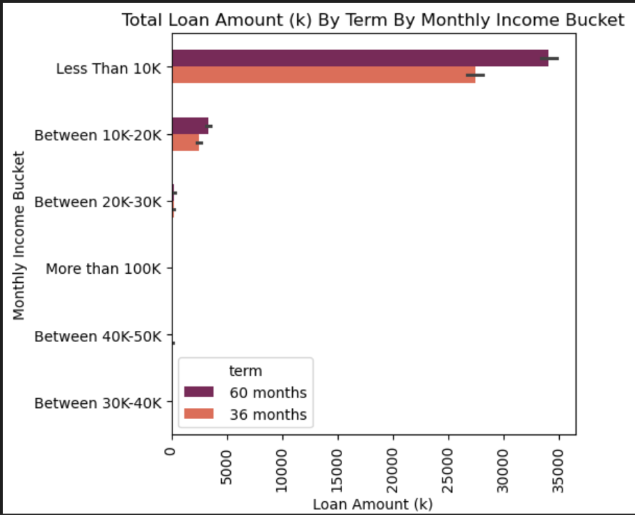
Step 3: Bivariate Analysis (Employment Length, Monthly Income Bucket)
Employment Length
10 + years
<1 year
2 year
3 year
4 year
Monthly Income
Less Then 10K

Slide 7
Conclusion
As per EDA findings the below attributes and its values point to a potential risky customer:
Address State: CA, NY, TX, NJ, FL
Monthly Income: Less Than 10K (Granular affinity is between Less Than 5K)
Home Ownership: Rent or Mortgage
Purpose Of Loan: Debt Consolidation, Credit Card
Employment Length: More Than 10 years

