Slide 1
GPU PROGRAMMING · PARALLEL COMPUTING
GPU-Based Connected-Component Labeling of a Binary Image
8-connectivity · iterative label propagation in CUDA · convergence decided on the device · area, centroid and bounding box with atomics
Ritesh Maury
Shrikrishna Tripathi
Alok Sahni
G25AIT2087
G25AIT2103
G25AIT2138
PGD AI, IIT Jodhpur · GPU Programming · Problem 3 · September 2026
PGD AI, IIT Jodhpur · GPU Programming · Problem 3 — GPU Connected-Component Labeling
1 / 18

Slide 2
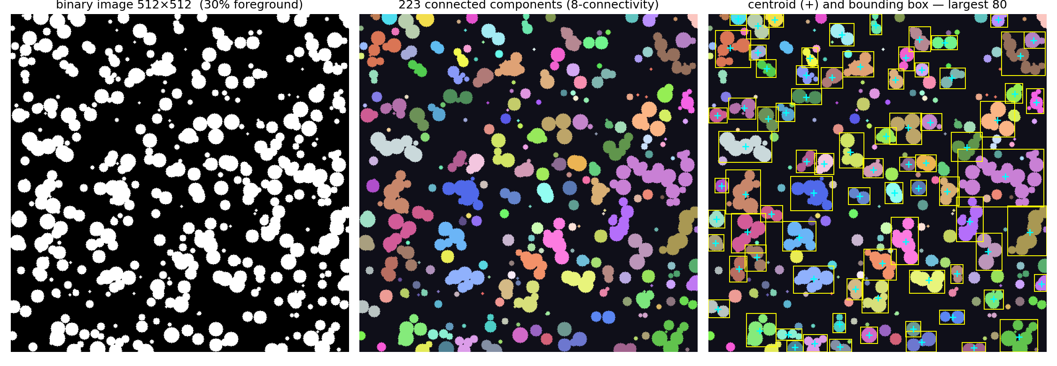
First, a story…
A satellite photo has been thresholded: every pixel is land (1) or water (0). We must find every island — and for each island, how big it is, where its centre is, and the box that contains it.
A person walking the map (CPU) visits every pixel once, but one after another.
Sixteen million pixels, each asking its 8 neighbours "who has the smallest name?" all at once — that is the GPU.
After a few rounds every island agrees on one name. That moment is convergence — and we want the GPU itself to notice it.
The design question
How do millions of threads agree on a label without a central coordinator — and how does the host know they are done without pulling the whole image back every round?
PGD AI, IIT Jodhpur · GPU Programming · Problem 3 — GPU Connected-Component Labeling
2 / 18

Slide 3
Problem 3 — what we were asked to build
Input: binary image of arbitrary size · Output: labelled image, K, area / centroid / bounding box per component
✓
8-connectivity
✓
Iterative propagation
✓
Convergence on the GPU
all 8 neighbours incl. diagonals
initial labels, then propagate until converged
no full-image copy per iteration
✓
Boundaries & background
✓
Component properties
✓
Arbitrary size
no out-of-bounds reads; bg never labelled
area, centroid, bbox — in parallel
tested 256² … 4096²
PGD AI, IIT Jodhpur · GPU Programming · Problem 3 — GPU Connected-Component Labeling
3 / 18

Slide 4
8-connectivity and initial labels
NW
N
NE
Initial label = flat index
L(x, y) = y · W + x (foreground)
L(x, y) = 0 (background, reserved)
W
P
E
Unique by construction — no sequential counter, no atomics at init
Order-preserving: the smallest index in a component becomes its root
Background is 0 forever: it exits every kernel and is skipped as a neighbour, so blobs separated by background never merge
SW
S
SE
Two foreground pixels are in the same component iff a chain of 8-adjacent foreground pixels joins them. A diagonal line is one component (it would be N components under 4-connectivity).
PGD AI, IIT Jodhpur · GPU Programming · Problem 3 — GPU Connected-Component Labeling
4 / 18

Slide 5
The iteration: pull the minimum, flag the change
0
init_labels
do {
cudaMemset(d_changed, 0, 4);
propagate_labels<<<grid,block>>>(img, lab, W, H, d_changed);
if ((iter+1) % 4 == 0)
compress_labels<<<grid,block>>>(img, lab, W, H);
cudaMemcpy(&changed, d_changed, 4, D2H); // 4 bytes
++iter;
} while (changed);
label[i] = i (fg) · 0 (bg)
1
propagate_labels
best = min(own, 8 fg neighbours); if best < own → write, atomicExch(d_changed,1)
2
compress_labels
every 4th pass: pointer-jump to root
3
host: memcpy 4 B
changed == 0 ? done : repeat
Why it is correct
Labels only decrease and are bounded by the component minimum; the minimum reaches every pixel along some path. When nothing changes, every pixel holds its component minimum.
4
compact + stats
ids 1..K on device; area/centroid/bbox
PGD AI, IIT Jodhpur · GPU Programming · Problem 3 — GPU Connected-Component Labeling
5 / 18

Slide 6
Kernel: propagate_labels
one thread per pixel · 16×16 blocks · every neighbour read is bounds-checked
__global__ void propagate_labels(const uchar* img, int* labels,
int W, int H, int* d_changed) {
int x = blockIdx.x*blockDim.x + threadIdx.x;
int y = blockIdx.y*blockDim.y + threadIdx.y;
if (x >= W || y >= H) return; // grid rounded up to blocks
int idx = y*W + x;
if (!img[idx]) return; // background: never labelled
int best = labels[idx];
for (dy = -1..1) { ny = y+dy; if (ny<0 || ny>=H) continue;
for (dx = -1..1) { if (!dx && !dy) continue;
nx = x+dx; if (nx<0 || nx>=W) continue;
int n = ny*W+nx; if (!img[n]) continue; // bg neighbour
if (labels[n] < best) best = labels[n]; } }
if (best < labels[idx]) {
labels[idx] = best; atomicExch(d_changed, 1);
}
}
Boundary
Two guards: the thread guard (x<W, y<H) and per-neighbour nx/ny checks. No halo, no padding.
The benign race
A thread may read a neighbour before or after it updates this pass. Both values are valid labels; the algorithm is monotone, so a stale read only costs one extra iteration.
PGD AI, IIT Jodhpur · GPU Programming · Problem 3 — GPU Connected-Component Labeling
6 / 18

Slide 7
Convergence decided on the device
4 B
64 MB
copied host ← device per iteration (d_changed)
what copying the 4096² int32 label image would cost — every iteration
cudaMemset(d_changed, 0) · any thread that lowers a label does atomicExch(d_changed, 1) · host reads one int
Contention is negligible: only changing threads write, and they vanish as the image converges
K (number of components) is also counted on the device: each root does 1 + atomicAdd(d_count, 1)
PGD AI, IIT Jodhpur · GPU Programming · Problem 3 — GPU Connected-Component Labeling
7 / 18

Slide 8
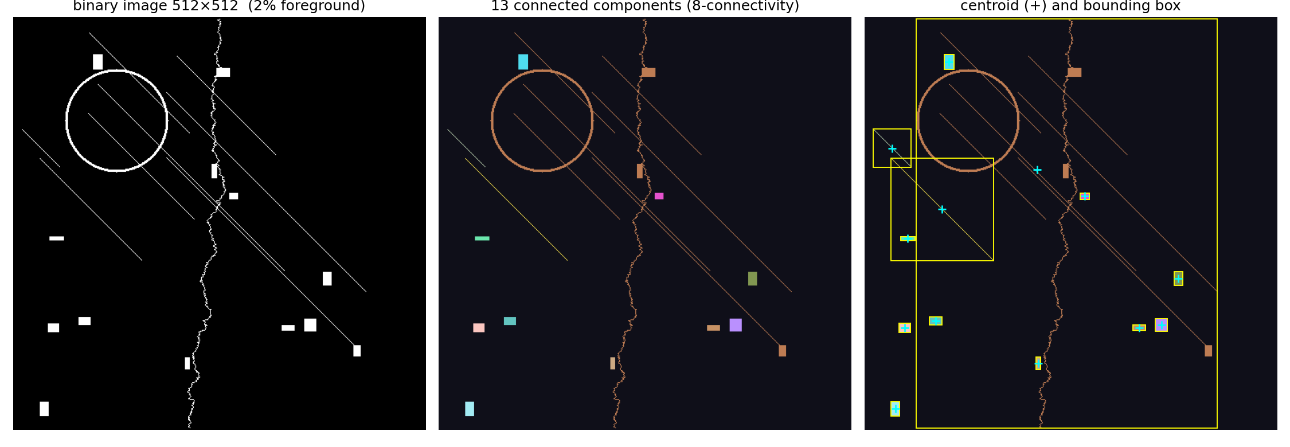
Path compression: why a snake is the worst case
Propagation moves the minimum one pixel per pass → O(diameter) iterations
A thin winding component of length L needs ≈ L passes
compress_labels: while (labels[l] != l) l = labels[l]; every pixel jumps straight to its root
Measured (serial reference, same algorithm): blobs 32–65 passes; the shapes image with one snake 98 / 215 / 513 passes at 256² / 512² / 1024² with compression every 4 — and far more without
PGD AI, IIT Jodhpur · GPU Programming · Problem 3 — GPU Connected-Component Labeling
8 / 18

Slide 9
Area, centroid, bounding box: one kernel
__global__ void component_stats(const int* lab, int W, int H,
int* area, unsigned long long* sumx, unsigned long long* sumy,
int* xmin, int* ymin, int* xmax, int* ymax) {
int x = ..., y = ...; if (x>=W || y>=H) return;
int k = lab[y*W + x]; if (k == 0) return; // background
atomicAdd(&area[k], 1);
atomicAdd(&sumx[k], (ull)x); atomicAdd(&sumy[k], (ull)y);
atomicMin(&xmin[k], x); atomicMin(&ymin[k], y);
atomicMax(&xmax[k], x); atomicMax(&ymax[k], y);
}
// host: cx = sumx[k] / area[k], cy = sumy[k] / area[k]
Why 64-bit sums
A 4096² component can hold 16.7 M pixels with x ≤ 4095 → Σx ≈ 6.9 × 10¹⁰, past int32.
Contention
All pixels of a component hit the same K-indexed slots. Fine for many small blobs; for one giant blob, block privatisation (as in our K-Means reduction) is the fix.
CSV: id,area,cx,cy,xmin,ymin,xmax,ymax e.g. 1,107,24.25,3.61,16,0,31,9
PGD AI, IIT Jodhpur · GPU Programming · Problem 3 — GPU Connected-Component Labeling
9 / 18

Slide 10
Output: components, centroids and bounding boxes
512² random blobs · 223 components · visualize.py from labels.bin + stats.csv
Left: binary input (30 % foreground). Middle: each component in its own colour. Right: centroid (+) and bounding box of the 80 largest components.
PGD AI, IIT Jodhpur · GPU Programming · Problem 3 — GPU Connected-Component Labeling
10 / 18

Slide 11
CPU baseline (measured)
single core, gcc -O3 · ccl_cpu.c · flood-fill vs the serial version of our algorithm
Linear in pixels
0.8 ms → 164 ms for blobs, 3 ms → 888 ms for noise (55 k components) from 256² to 4096². One visit per pixel.
Serial propagation
The GPU algorithm run serially: 197 ms (blobs) and 1.35 s (noise) at 1024², vs 10 / 59 ms BFS — each of its tens of passes is O(N). The GPU wins by doing each pass in parallel.
PGD AI, IIT Jodhpur · GPU Programming · Problem 3 — GPU Connected-Component Labeling
11 / 18

Slide 12
Benchmark table
blobs, 30 % foreground · CPU measured · GPU column from the Colab T4 run (07_Colab_Notebook)
Image | Pixels | Components | Iterations | CPU BFS (ms) | GPU T4 (ms) | Speed-up
256² | 65 K | 143 | 32 | 0.80 | — | —
512² | 262 K | 223 | 65 | 2.83 | — | —
1024² | 1.05 M | 250 | 40 | 10.08 | — | —
2048² | 4.19 M | 264 | — | 38.54 | — | —
4096² | 16.8 M | 276 | — | 163.54 | — | —
Expected on a T4: time per pass ≈ 0.1–1 ms for 1024²–4096² (one O(N) launch), so total GPU time ≈ iterations × pass time + one stats pass; speed-up grows with image size and is highest for blob-like images with few iterations.
PGD AI, IIT Jodhpur · GPU Programming · Problem 3 — GPU Connected-Component Labeling
12 / 18

Slide 13
Validation: same partition, exact statistics
GPU ids come from atomic-counter order, CPU ids from raster order → ids differ, so verify.py tests the partition: a one-to-one map between labelings on foreground pixels, identical background
For every component: area, centroid (±10⁻³) and bounding box must equal the reference
Two references: ccl_cpu.c (BFS) and scipy.ndimage.label with an all-ones 3×3 structure
Edge cases: all-foreground → 1 · all-background → 0 · 1-pixel column · 200×200 diagonal → 1 (8-connectivity)
$ python verify.py blobs.bin l_gpu.bin s_gpu.csv --ref-labels l_cpu.bin
components: test=250 ref=250 partition identical: True
statistics: 250 components checked, 0 mismatches
PASS
Measured on this package
CPU path, blobs 256² … 4096²: 143 / 223 / 250 / 264 / 276 components, every run PASS against SciPy; serial propagation and BFS agree exactly.
PGD AI, IIT Jodhpur · GPU Programming · Problem 3 — GPU Connected-Component Labeling
13 / 18

Slide 14
Live demonstrations
06_Live_Demo (browser, no GPU) · 07_Colab_Notebook (Tesla T4)
Browser model of the pipeline
Colab CUDA lab (≈ 8 min)
• pipeline strip lights the active kernel
• every pixel is a thread; colours merge as minimum labels spread
• the changed counter is the 4-byte flag
• shapes + compress-every 0 vs 4 vs 1 shows the snake problem
• at changed = 0: ids 1..K, then area / centroid / bbox with boxes and + marks
• log prints the same lines as ./ccl_cuda --verbose
1. nvidia-smi, compile with auto-detected arch
2. 1024² blobs, --verbose: one line per iteration
3. verify.py → PASS vs C and vs SciPy
4. figure: components, centroids, boxes
5. shapes image: iterations with / without compression
6. edge cases
7. benchmark sweep → fig5 + summary CSV
8. download artefacts for the report
PGD AI, IIT Jodhpur · GPU Programming · Problem 3 — GPU Connected-Component Labeling
14 / 18

Slide 15
Limitations and future work
Limitations
Future work
• O(diameter) passes for thin structures even with compression (513 at 1024² shapes)
• Statistics atomics serialise on one giant component
• Launch overhead dominates below ~256²
• Simple min-propagation converges slower than GPU union-find on pathological inputs
• Block-local labelling in shared memory, then border merging (fewer global passes)
• GPU union-find with atomicCAS (Playne & Hawick 2018)
• Shared-memory privatisation for component_stats (as in our K-Means reduction)
• 3-D volumes (26-connectivity) for CT / MRI
• Multi-GPU tiling with border merge
PGD AI, IIT Jodhpur · GPU Programming · Problem 3 — GPU Connected-Component Labeling
15 / 18

Slide 16
Three-member team contribution
Member | Contribution
Ritesh Maury (G25AIT2087) | CUDA propagate_labels kernel, 8-neighbour boundary handling, device-side convergence flag, host loop, race-condition analysis, compress_labels
Shrikrishna Tripathi (G25AIT2103) | component_stats kernel (area / centroid / bbox with atomics), assign_ids + compact_labels, benchmarking, figures, visualiser, CPU–GPU comparison
Alok Sahni (G25AIT2138) | Algorithm design, CPU reference (BFS + serial propagation), image generator, init_labels, verify.py, edge cases, report preparation
All | Integration, testing, debugging, report, presentation, viva preparation
LLM tools were used for conceptual clarification, CUDA debugging suggestions, code review and documentation assistance. Final code integration, execution, testing, validation, benchmarking and result interpretation were performed by the team.
PGD AI, IIT Jodhpur · GPU Programming · Problem 3 — GPU Connected-Component Labeling
16 / 18

Slide 17
Conclusion
One thread per pixel
4 bytes per iteration
Iterative 8-neighbour min-label propagation labels images of any size; every neighbour read is bounds-checked and background is never labelled.
A device flag set with atomicExch decides convergence; K is counted with an atomic counter; the label image leaves the GPU once.
Properties in one pass
Validated
area, centroid (64-bit sums) and bounding box via atomicAdd / atomicMin / atomicMax.
Identical partition and exact statistics vs a C reference and SciPy, including edge cases; measured CPU baseline 0.8 ms → 888 ms.
PGD AI, IIT Jodhpur · GPU Programming · Problem 3 — GPU Connected-Component Labeling
17 / 18

Slide 18
Thank you
Questions?
Ritesh Maury (G25AIT2087) · Shrikrishna Tripathi (G25AIT2103) · Alok Sahni (G25AIT2138)
Code, notebook, demo and guides: GPU_CCL_FINAL_SUBMISSION/ (see 00_START_HERE.md)
PGD AI, IIT Jodhpur · GPU Programming · Problem 3 — GPU Connected-Component Labeling
18 / 18

