Slide 1
Ensure Reliable environments through Operational Validation test on Production
RootConf 2017
Ritesh Modi
Senior Technology Evangelist
Microsoft

Slide 2
IN THIS Session
What is Infrastructure as Code?
Understanding Infrastructure as Code lifecycle
What is Operational validation Tests
Provision environment and deploy application
Operational validation as part of Release pipeline
Introduce sample highly available environment and application
Operational validation of provisioned environment

Slide 3
What is Infrastructure as Code?

Slide 4
Infrastructure as Code
Reusable Automation
Source Control
Unit Testing
Continuous Deployment
Integration and Operations Validation

Slide 5
What is Operational validation Tests

Slide 6
Perform end-to-end validation of system operations for applications consisting of multiple tiers.
Ensure application and environments are working according to what they are supposed to do.
It includes every component including directory services and network connectivity.
Means to ensure high reliability for environments and applications
Executed continuously and before every release and change to system and environments
Performed on production environment

Slide 7
Why Operational validation Tests

Slide 8
Gain insights into production environment on continuous basis
Configuration meets industry, organization and engagement standards
Environments are in desired configuration
Stack and Pop up an drifts and deviation
Environments and applications operating properly after upgrades and maintenance.
Brings high fidelity, cadence and confidence to overall deployment on production
Fixing issues before going live on production
Improves Reliability and helps in conducting advance tests like A/B testing

Slide 9
Tools for conducting Operation Validation

Slide 10
Any Continuous Deployment Orchestration and release pipeline tool
Jenkins
Visual Studio Team Services
PowerShell - PowerShell is a task automation and configuration management framework
Pester – BDD (behavior driven development) based test runner for PowerShell. Pester provides a framework for running Unit, Integration and Operations Validation Tests
Git - version control system (VCS) for tracking changes to test cases
Operations Validation framework – framework to conduct Ops Validation

Slide 11
Sample Operation validation script

Slide 12
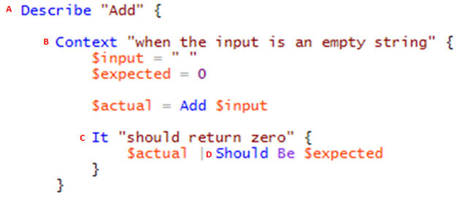
A – ‘Describe’ creates a logical grouping of test cases.
B – ‘Context’ provides logical grouping of test cases based on resource state and behavior
C- ‘It’ validates the result of a test inside describe and context block

Slide 13
Conduct Operations Validation

Slide 14
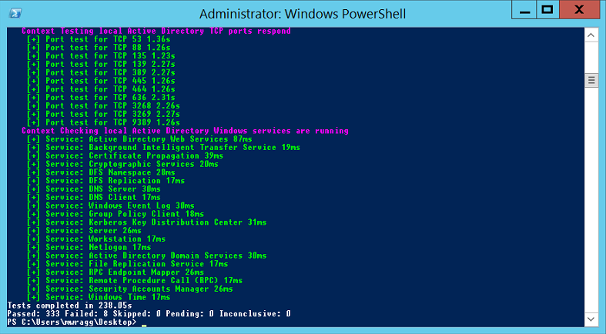

Slide 15
Operational validation as part of Release pipeline

Slide 16
Questions and Thank you

