Slide 1



BLOCKCHAIN
SIMULATION
PPT

Slide 2
Project Overview
Goals
This project is a simple blockchain visualizer built using Python Flask for the backend and HTML, CSS, and JavaScript for the frontend.
It demonstrates the core blockchain ideas of:
Block creation
SHA-256 hashing
proof-of-work mining
linking blocks using previous hash
chain validation
tamper detection
chain reconstruction after tampering
The project helps explain how blockchain achieves immutability and integrity in a practical way.
To create a blockchain-like structure where each block depends on the previous block.
To implement a Proof-of-Work (PoW) mechanism using SHA-256 hashing and nonce searching.
To show how a tampered block breaks the integrity of the chain.
To validate the blockchain by recomputing hashes and checking previous-hash links.
To provide a visual and interactive interface for mining, validation, tampering, and rehashing.

Slide 3
Tech Stack
Programming language: Python for backend logic.
Backend framework: Flask.
Cryptographic library used: Python’s hashlib for SHA-256 hashing.
Frontend technologies: HTML, CSS, JavaScript.
Communication method: Fetch API + SSE streaming for live mining progress.

Slide 4
Libraries and their Uses
hashlib:
1
Used to perform the SHA-256 cryptographic hashing required for the Proof-of-Work algorithm.
Used to generate exact timestamps (in UTC) for when each block is created.
2
datetime:

Slide 5
Other Libraries
Flask: The core application object.
request: To handle incoming data from the frontend.
jsonify: To easily format Python dictionaries into JSON responses.
Response: Used to manage the streaming data for the live mining updates.
render_template: To serve the index.html frontend file.

Slide 6
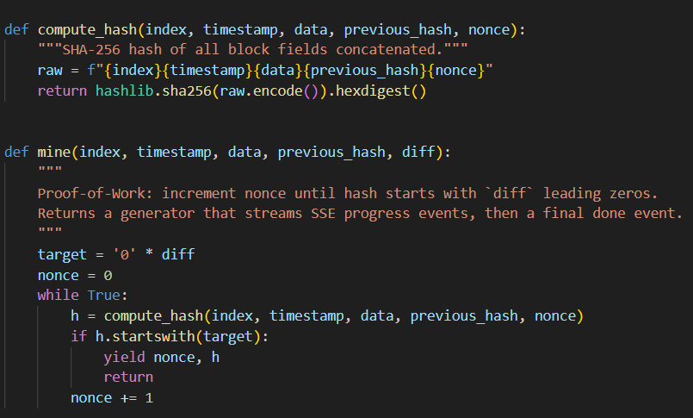
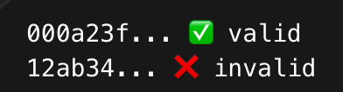
Helper Functions

Slide 7
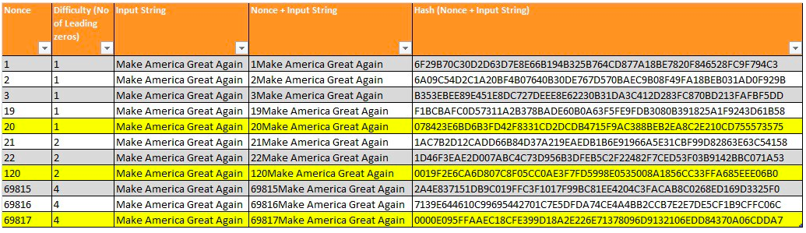

Slide 8
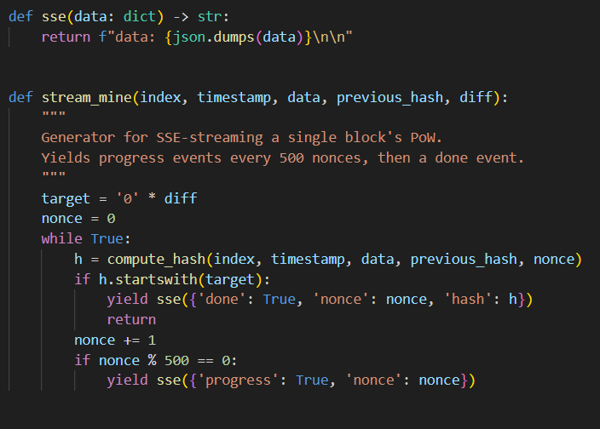
More Helper Functions

Slide 9
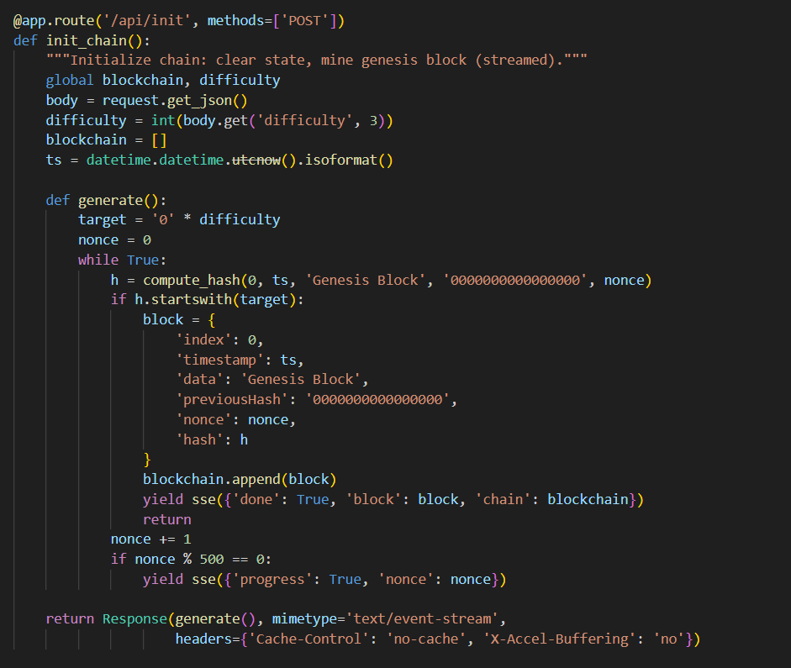
Initialize function
Genesis Block Initialization
The /api/init route resets the blockchain and mines the genesis block.
The genesis block has:
index - 0
data - "Genesis Block"
previous hash as a fixed zero value.
Once mined successfully, the genesis block is appended to the chain and sent to the frontend.
This block acts as the starting point of the chain and has no previous block before it.

Slide 10
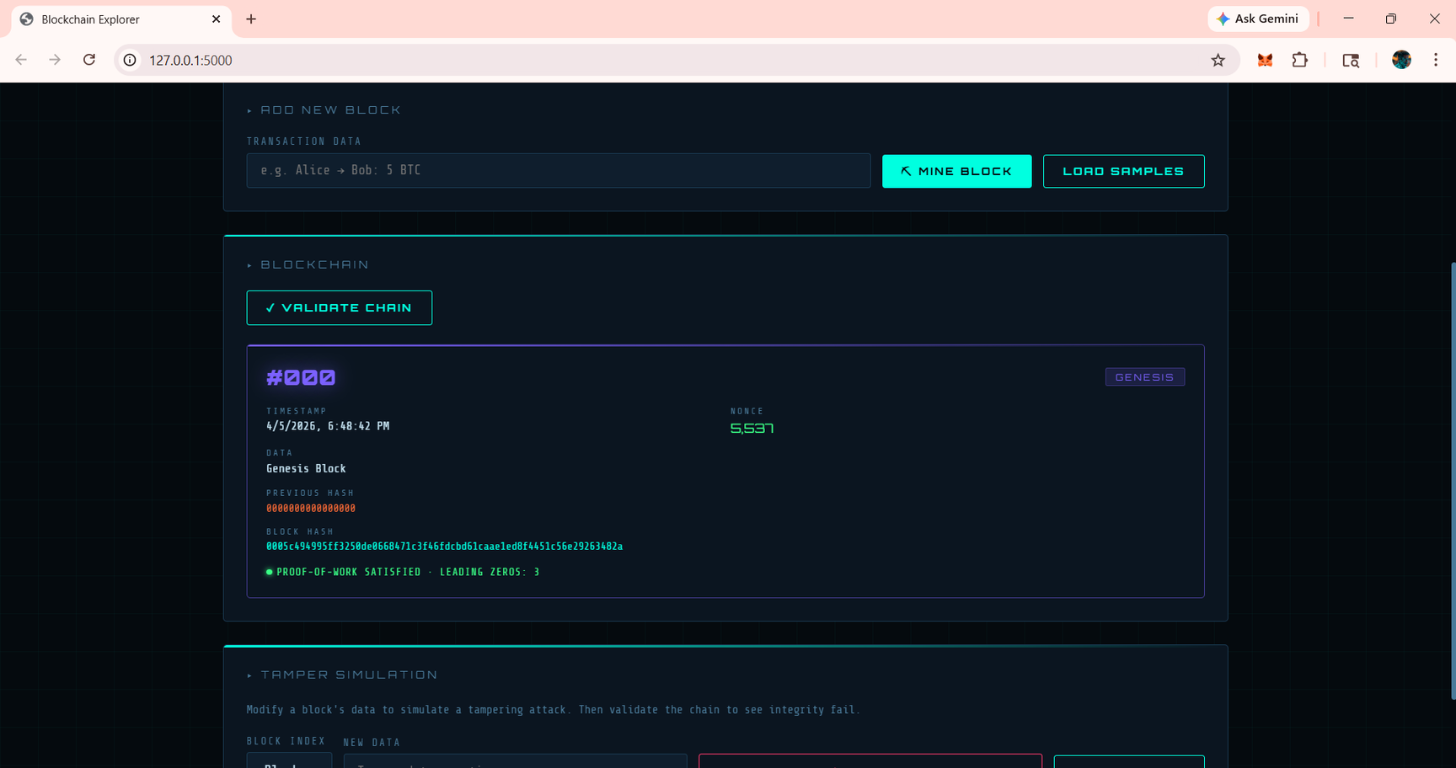
Initialize function

Slide 11
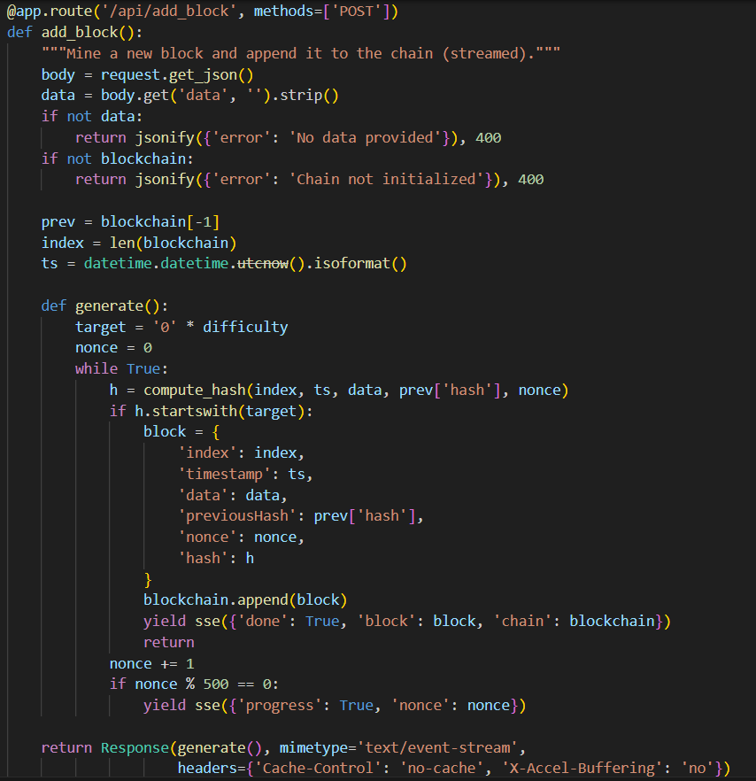
Add Block function
Adding New Blocks
The /api/add_block route adds a new block containing transaction data entered by the user.
The new block stores the hash of the last block as its previousHash.
The backend mines the new block using the same PoW process until the hash condition is satisfied.
After mining, the block is appended to the blockchain and the updated chain is returned to the UI.

Slide 12
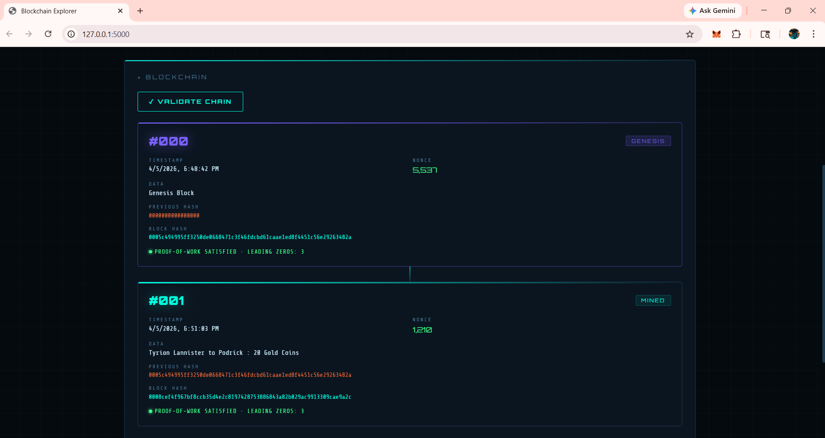
Add Block function

Slide 13
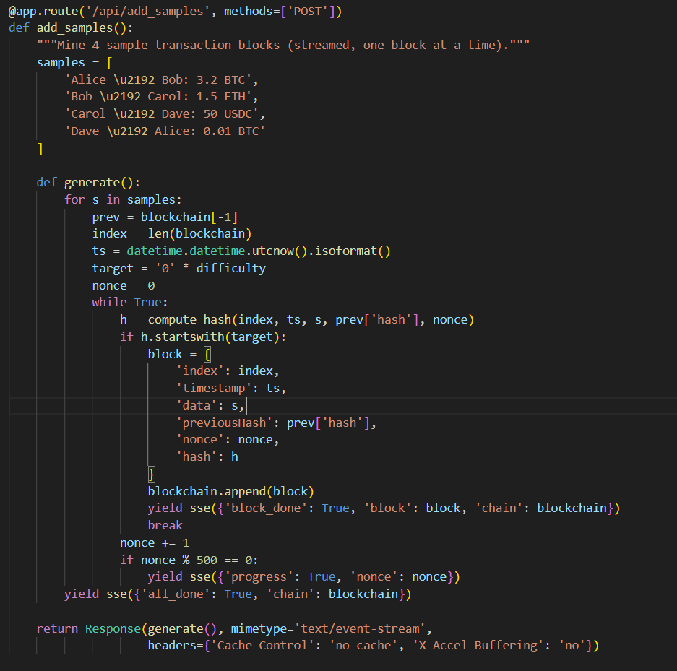
Add Sample Block function

Slide 14
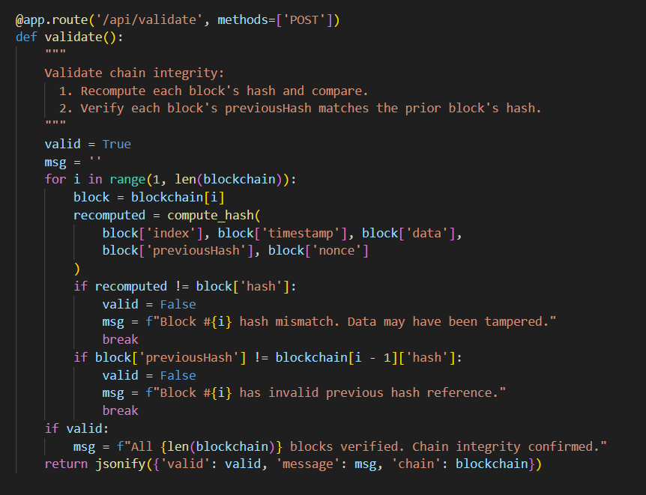
Validate

Slide 15
TAMPER
REHASH
RESET

Slide 16
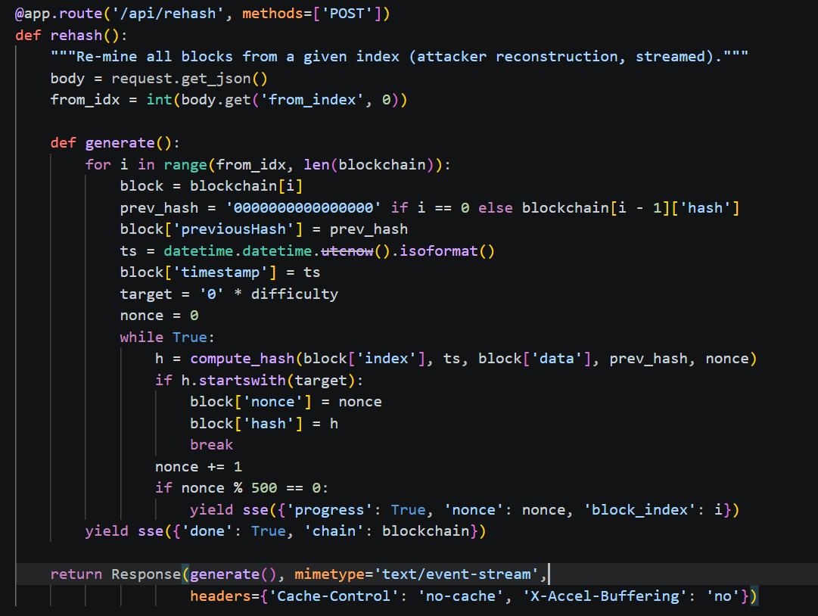
ReHash Function

Slide 17
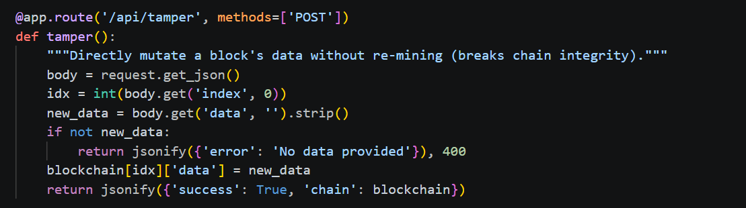
Tamper Function

Slide 18
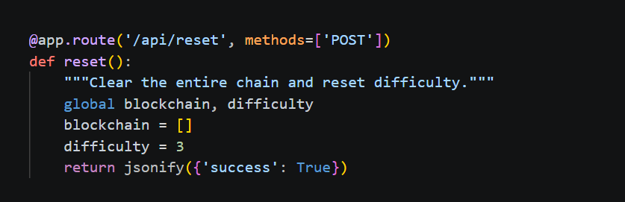
Reset Function

Slide 19
Thank You

