Slide 1
MIS- 637 A
ML Algorithms to Predict Loan Default
Presented by : Ritesh Patil, Shenglin Wang, Rachel Rouse, Ruimin Zeng

Slide 2
Contents
Overview of CRISP-DM
Business understanding
Data understanding
Data preparation and analysis
Modeling and evaluation (KNN and K-means)
Deployment and conclusion
Reference

Slide 3
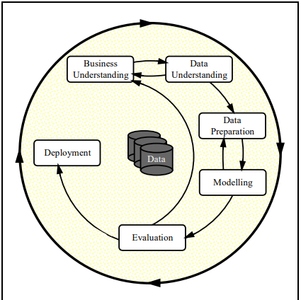
Overview of CRISP-DM
We will use CRISP-DM method to deal with this project. There are 6 phases in CRISP-DM process:
Business understanding phase
Data understanding phase
Data preparation phase
Modeling phase
Evaluation phase
Deployment phase

Slide 4

Business understanding
Banks run into losses when customers don't pay their loans on time. Because of this, every year, banks have losses in crores, and this also impacts the country's economic growth to a large extent.
The most important task is to predict whether a person will be a loan defaulter.

Slide 5
Data understanding
Dataset information:
a training dataset of 67,463 rows and 35 columns
However, it is very unbalanced data set.
61222 rows are non-defaulters. Only 6241 rows are defaulters.

Slide 6
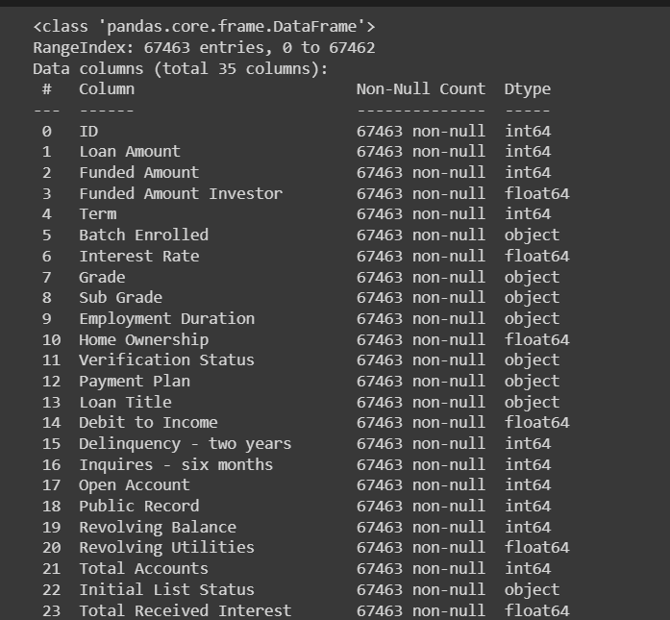
Data preparation
Check the missing value:

Slide 7
Data preparation
Check the missing value:
Here we need to check if any of the attributes has null values(missed values).
If we found the missing value, we need to handle them with these methods:
Delete the records.
Replace the missing values with the mean and mode of attribute's values
Replace the missing values with random value
No missed values have been detected.

Slide 8
Data Preparation
Feature Selection
We separate numerical features and categorical features.
Remove 'ID' because it is the primary key and has no prediction power. Remove 'Accounts Delinquent' and 'Payment Plan' because they have zero variance and thus have no prediction power.
Because high dimensions are easy to cause overfitting, thus we need to drop some features for dimension reduction.
For numerical features, we drop features with low variance. Because features with high variance might contain more information and thus provide more prediction power. We also perform z-normalization because these numerical features have different scales.
For categorical features, we encode features with large number of unique values. Because when creating dummy variables, features with large number of unique values will generate large number of dimensions and we want to reduce dimensions. We encode these features by each category's frequency.

Slide 9
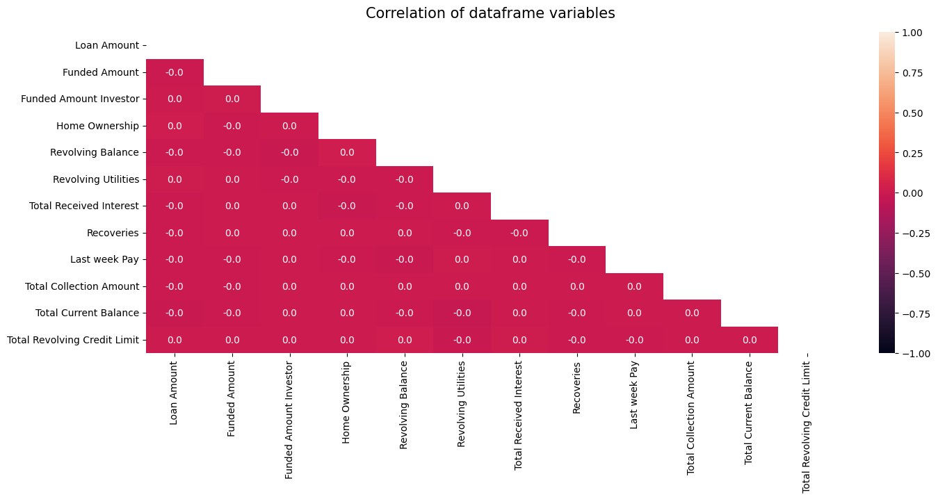
Data preparation
Check the independence of numerical features:

Slide 10
Data Preparation
Creating More Balanced Data Set and Data Set Split
Since our data set is very unbalanced, it might cause bias in training. Thus, it is important to create a smaller sample but more balanced from the data set.
We select 6241 defaulter rows and 6241 non-defaulter rows and combine them together. The non-defaulter rows are chosen by random selection.
We split the data set into 70% of training data and 30% of testing data. Training set will fit the model and testing set will test the model performance.

Slide 11
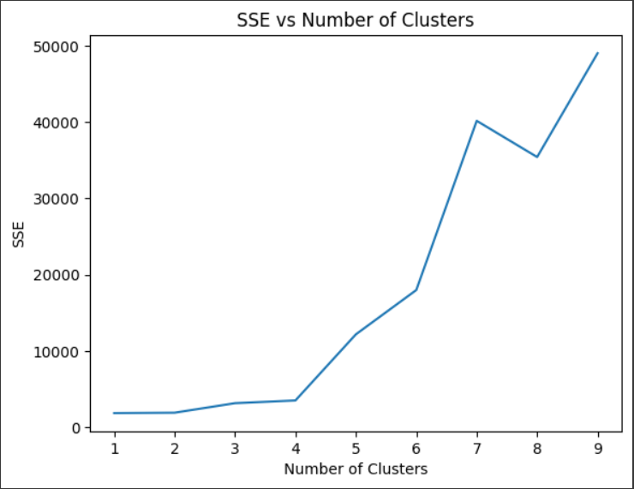
K-means
SSE vs Number of Clusters
Choosing the appropriate number of clusters is important for the K-means algorithm. In this case, we used SSE (sum of squared errors) vs. the number of clusters to determine the optimal number of clusters.
The optimal number of clusters for this dataset was determined to be two, which aligns with the nature of the problem - predicting loan defaults, which has two outcomes: default or non-default.
We decide to use K = 2 for our K-means model because it has a low SSE.

Slide 12
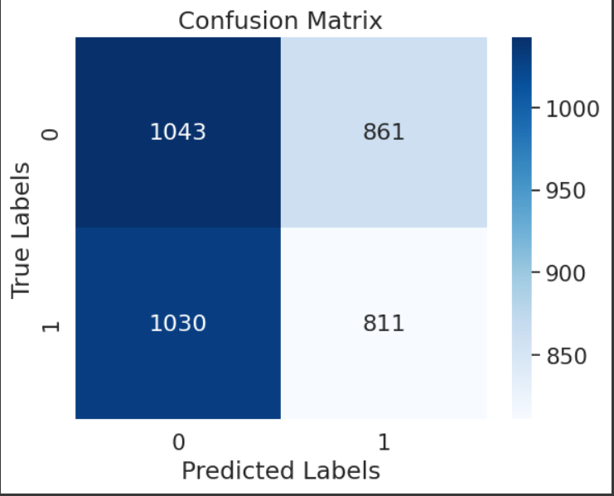

K-means
Model Performance
Precision measures the accuracy of positive predictions. This precision score of just over 48.5% is much lower than would be ideal.​
Recall measures the sensitivity of the model. This indicates that only 44.1% of defaulters were detected.​
The F1-score computes a value for the relationship between precision and recall. The F1-score is 0.46，also lower than would be ideal.​

Slide 13
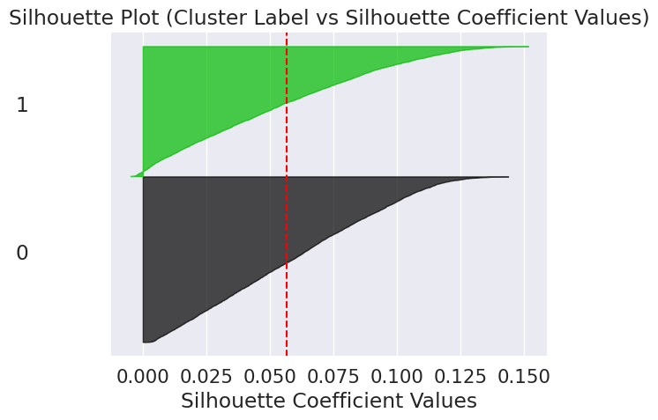
K-means
Silhouette Analysis
A silhouette plot is a graphical tool used to evaluate the quality of the clusters. The silhouette values show the degree of cohesion and separation of the clusters. The mean of the silhouette values allows identifying number of clusters appear in the dataset.
Silhouette plot have k=2. The x-axis shows the silhouette values, and the height of each silhouette indicates the number of points in the corresponding cluster.
The red line shows the average silhouette value for all the clusters. In this case, the average value is 0.055

Slide 14
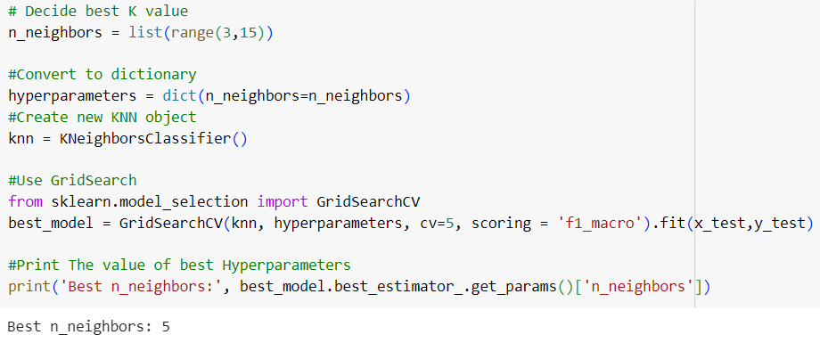
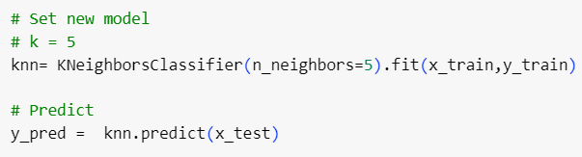
K-Nearest Neighbor (KNN)
Utilize KNN algorithm for classification
Step 1: Identify best k value using GridSearch
Step 2: Set model k=5

Slide 15

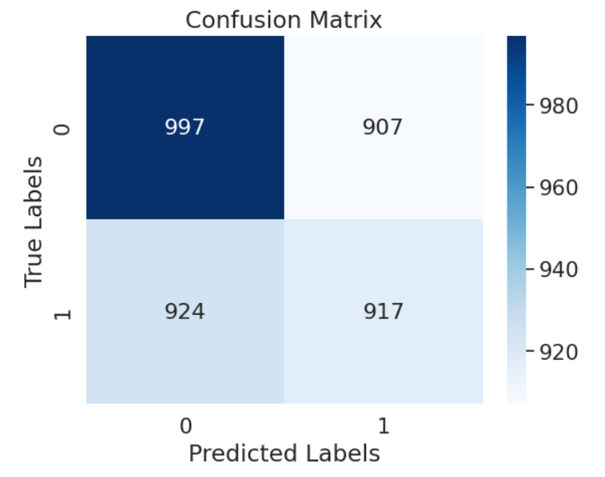
K-Nearest Neighbor (KNN)
Model Evaluation
Step 3: Confusion Matrix
Step 4: Precision, recall, and F1-score
Precision measures the accuracy of positive predictions. This precision score of just over 0.5 is much lower than would be ideal.
Recall measures the sensitivity of the model. This indicates that only 49.8% of defaulters were detected.
The F1-score computes a value for the relationship between precision and recall. The F1-score is also lower than would be ideal.

Slide 16
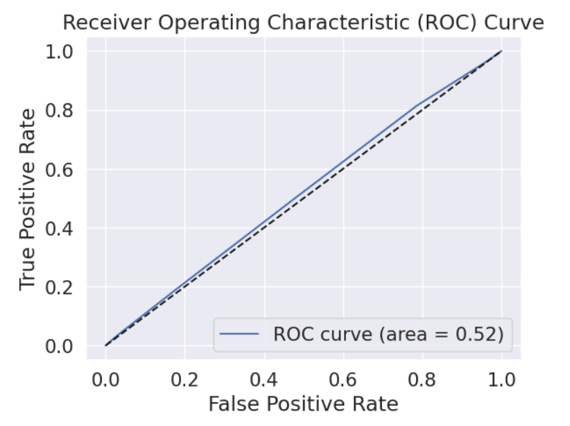
K-Nearest Neighbor (KNN)
ROC Curve
The ROC Curve creates a visualization of model performance. The area under the curve of 0.52 indicates that the model performs slightly better than a random classifier.

Slide 17
Conclusion
Compare Two Algorithms
By using the same training set, KNN has higher precision, recall and f1 score than K-means.
KNN perhaps has better accuracy than K-means. However, K-means can train the model without the target label. Thus, K-means is more flexible when using.
Both of algorithms do not perform good enough on this data set. There can be several potential reasons.

Slide 18
Conclusion
Potential Reasons Why Model Performance Is NOT Good Enough and Improvement
Our data set has large dimensions. It is hard to balance between underfitting and overfitting. Large dimension increases the risk of overfitting.
Probably KNN and K-means are not the best choices to handle large dimension data set when doing clustering or classification.
The data set is very unbalanced. Perhaps there are other problems of data set that we did not realize.
Potential approaches to improve the result:
Use another high-quality data set
If we have more knowledge of finance and loan, we can manually choose high-quality features by financial knowledge.
Try other clustering or classification algorithms to see if they perform better (Random Forest, etc.).
Try other dimension reduction technics to handle large dimension problem
We may need another attribute (or combination of attributes) not considered in this dataset to better predict whether a customer will default

Slide 19
References
"K-Nearest Neighbors in Python + Hyperparameters Tuning" (https://medium.datadriveninvestor.com/k-nearest-neighbors-in-python-hyperparameters-tuning-716734bc557f)
Data source (https://www.kaggle.com/datasets/hemanthsai7/loandefault?select=train.csv)

