Slide 1
SAP ENTERPRISE ARCHITECTURE BRIEFING
SAP Fiori Launchpad Cross-App Navigation
Comprehensive Intent-Based Routing: Cloud-to-Cloud, Hybrid, & On-Premise to On-Premise
Pattern 1: Cloud to Cloud
SAP BTP / S/4HANA Cloud
In-place modern Fiori Elements OData V4 apps decoupled via Semantic Object contracts.
Pattern 2: Cloud to On-Premise
Hybrid Integration via SCC
Cloud Fiori Launchpad invoking on-premise ABAP BSP via SAP Cloud Connector & destinations.
Pattern 3: On-Premise to On-Premise
S/4HANA FES to Classic GUI
Embedded Fiori Launchpad routing into classic SAP GUI transactions (VA03) via WebGUI.

Slide 2
EXECUTIVE PROBLEM STATEMENT
The Failure of Hardcoded URL Routing in Enterprise Landscapes
01
Landscape Drift & Multi-Tier Desync
DEV -> QAS -> PRD Fragility
Hardcoded URLs embed physical hostnames, ports, and protocols directly into application code. When transporting through the landscape (DEV to QAS to PRD), every link breaks, requiring code modifications, manual transports, or fragile environment-variable switches that impede zero-downtime cutovers.
02
Security & SSO Context Breakdown
Boundary Violations & Session Loss
Navigating via raw URLs completely bypasses the SAP Fiori Launchpad Shell Container. This strips the user's SAML2/OAuth2 security assertions, invalidates the SAP Single Sign-On (SSO) session, forces redundant login prompts, and leaves applications vulnerable to Cross-Site Scripting (XSS).
03
Lifecycle & Technology Coupling
Monolithic Tight Coupling
Direct URL linkages bind independent business capabilities to specific technology stacks and deployment endpoints. Migrating a legacy backend or splitting a monolith breaks external consumers, preventing modernization and continuous deployment.

Slide 3
ARCHITECTURE FOUNDATION
Intent-Based Navigation (IBN): Semantic Decoupling Contract
THE ENTERPRISE RESOLUTION CONTRACT
#<SemanticObject>-<Action>?<ParameterKey>=<Value> -> Resolved to Target Application Runtime
Layer 1: Source Application
Pure Business Intent
The caller app specifies WHAT business entity it wants to interact with (e.g. SemanticObject: 'Customer', Action: 'display'). It possesses zero knowledge of the target's physical server, path, UI technology, or repository.
Layer 2: FLP Shell Resolver
Dynamic Target Mapping Engine
The SAP Fiori Launchpad Shell intercepts intent changes. It inspects the logged-in user's PFCG role catalogs and target mappings. It dynamically matches the intent to the authorized physical endpoint.
Layer 3: Target Application
Context Ingestion
The resolved target (SAPUI5 Component, Web Dynpro, BSP, or SAP GUI WebGUI) is instantiated in-place or in a dedicated container, seamlessly receiving startup parameters via standard component hooks.

Slide 4
INTEGRATION PATTERN 1
Cloud-to-Cloud Navigation: SAP BTP & Modern Fiori Elements
Runtime Architecture & Topology
In a pure cloud landscape (SAP BTP Cloud Foundry / ABAP Environment or S/4HANA Cloud), both applications run as SAPUI5 Components hosted in the HTML5 Application Repository.
• In-Place Execution: The Launchpad navigates 'inplace' without full browser page reload, maintaining the shell header, theme, and user session.
• Component Isolation: Each application runs in its own UI5 Component sandbox (`crossn.orders` -> `crossn.customers`), preventing CSS or global JS pollution.
• Zero-Config SSO: BTP Identity Authentication Service (IAS) propagates OIDC/SAML2 tokens across applications automatically.
How Our Implementation Executes
1. App A (Orders List Report): Renders customer column as a hyperlink using declarative CDS annotation `UI.DataFieldWithIntentBasedNavigation`.
2. Intent Emission: Clicking '1' emits intent `#Customer-display?ID=1`.
3. FLP Resolver: Maps `Customer-display` to component `crossn.customers` via Launchpad Target Mapping.
4. Context Binding: App B reads startup parameter `ID=1` and applies it as an OData V4 filter, displaying Acme Corp details seamlessly.

Slide 5
DECLARATIVE IMPLEMENTATION
Source CDS Annotations vs Target Manifest Inbound Contract
1. App A (Source): Declarative CDS Annotation
File: app/orders/annotations.cds | Pure metadata, zero JavaScript
// DataFieldWithIntentBasedNavigation creates link
{
$Type : 'UI.DataFieldWithIntentBasedNavigation',
Value : customer_ID,
Label : 'Customer ID',
SemanticObject : 'Customer',
Action : 'display',
Mapping : [
{
$Type : 'Common.SemanticObjectMappingType',
LocalProperty : customer_ID,
SemanticObjectProperty : 'ID'
}
]
}
Architectural Note: Common.SemanticObjectMappingType dynamically maps the local row property (customer_ID) to the target parameter (ID). Fiori Elements generates the intent link automatically.
2. App B (Target): Inbound Manifest Target Mapping
File: app/customers/webapp/manifest.json | Inbound Contract
"sap.app": {
"id": "crossn.customers",
"crossNavigation": {
"inbounds": {
"customer-display": {
"semanticObject": "Customer",
"action": "display",
"signature": {
"parameters": {
"ID": { "required": false }
},
"additionalParameters": "allowed"
}
}
}
}
}
Architectural Note: App B explicitly registers Customer-display as an inbound capability. Parameter 'ID' is ingested at bootstrap, automatically binding the entity key and routing to Customers(1).

Slide 6
INTEGRATION PATTERN 2
Hybrid Navigation: Cloud Fiori to Standard / Legacy ABAP BSP
01. ICF Node Active
Transaction SICF
The BSP service under /sap/bc/bsp/sap/<app> must be active in the ABAP Internet Communication Framework tree.
02. System Alias & RFC
SM59 / /UI2/V_ALIASMAP
A logical system alias (e.g. S4FIN) maps to the physical RFC / HTTPS destination of the ABAP NetWeaver backend.
03. Cloud Connector
Secure Reverse TLS Tunnel
In BTP Cloud deployments, the Cloud Connector bridges cloud Launchpad requests to the private on-premise network.
04. URL Target Mapping
FLP Catalog Configuration
A Target Mapping of Application Type 'URL' wraps the classic BSP endpoint into intent #LegacyOrder-display.
05. Shell Navigation API
Unified Runtime Dispatch
Client code calls sap.ushell.Container.getServiceAsync('Navigation') to execute the intent with parameters.
Client-Side Implementation: Calling the Navigation Service (< 15 lines of JS)
sap.ushell.Container.getServiceAsync("Navigation").then(function (oNav) {
oNav.navigate({
target: { semanticObject: "LegacyOrder", action: "display" },
params: { customerId: String(sId) } // FLP resolves to /sap/bc/bsp/sap/<app>?customerId=1
});
});

Slide 7
INTEGRATION PATTERN 3
On-Premise to On-Premise: S/4HANA Fiori to Classic SAP GUI (WebGUI)
On-Premise Architecture & ITS WebGUI
In an on-premise S/4HANA or Business Suite system, the Fiori Launchpad runs directly on the ABAP Frontend Server (FES) or embedded S/4HANA (/sap/bc/ui2/flp).
• Native SAP GUI Rendering: Many deep ERP transactions (VA03, ME23N, FB03) are rendered via the ABAP Internet Transaction Server (ITS WebGUI) inside browser tabs.
• No Cloud Connector Needed: All communication stays inside the corporate intranet routed via SAP Web Dispatcher.
• System Alias 'LOCAL': Target Mappings use the 'LOCAL' alias to route directly to the local ABAP client with zero network hops.
Target Mapping Configuration in /UI2/FLPD_CUST
// Target Mapping in S/4HANA Launchpad Designer
Semantic Object : Order
Action : displayGUI
Application Type : Transaction
Transaction Code : VA03
System Alias : LOCAL
// Launchpad Runtime URL Resolution:
/sap/bc/gui/sap/its/webgui?~transaction=VA03%20VBAK-VBELN=4500001
Our Demo Implementation: We created the '#Order-displayGUI' intent mapping to 'legacy-webgui/index.html'. Selecting an order and clicking 'Open in SAP GUI (VA03)' simulates the exact S/4HANA WebGUI transition.

Slide 8
ARCHITECTURAL COMPARISON
Master Enterprise Matrix: Comparing All 3 Topologies
Dimension | 1. Cloud to Cloud | 2. Cloud to On-Premise | 3. On-Prem to On-Prem
Source Tech | SAP BTP Fiori Elements | SAP BTP Fiori Elements | On-Prem S/4HANA Fiori
Target Tech | SAPUI5 / OData V4 App | Classic ABAP BSP / WDA | Classic SAP GUI (WebGUI)
Network Path | Public Cloud (BTP HTTPS) | BTP -> Cloud Connector -> On-Prem | Corporate Intranet (Web Disp)
Authentication | IAS (OIDC / SAML2) | Principal Propagation via SCC | Kerberos / SAP Logon Ticket
Mapping Type | SAPUI5 Component (inplace) | URL Target Mapping (newWindow) | Transaction (VA03) via LOCAL
Parameters | Component args & OData filter | HTTP GET query (?customerId=1) | ITS OK-Code (VBAK-VBELN=4500001)

Slide 9
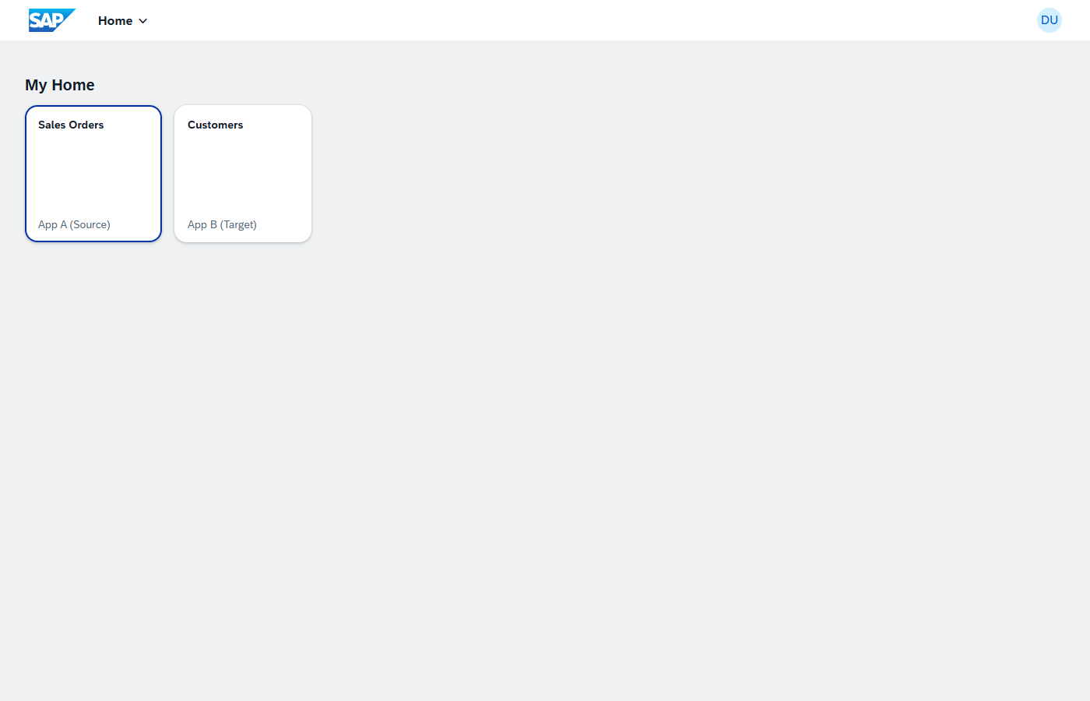

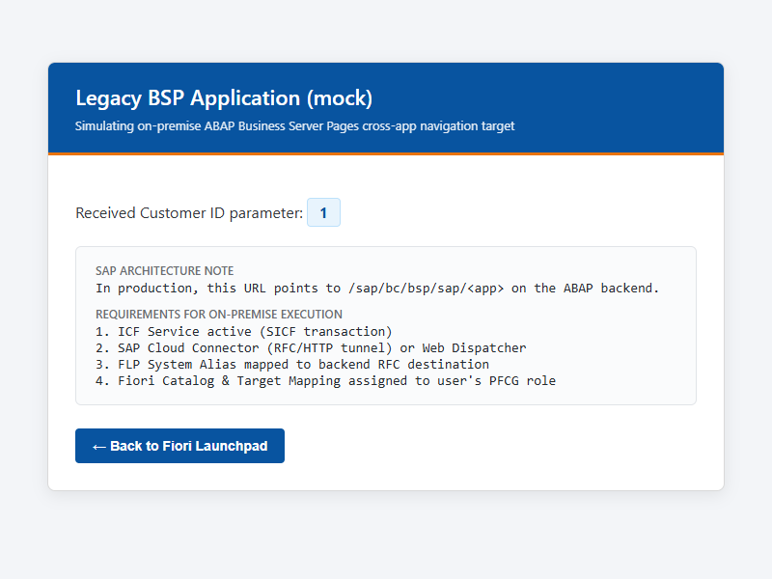

END-TO-END VERIFICATION
Live Working Demo: 4-Step Verification Across All 3 Topologies
Step 1: FLP Dashboard
flp.html
Step 2: Cloud to Cloud
#Customer-display?ID=1
Step 3: Cloud to On-Prem
legacy-bsp?customerId=1
Step 4: On-Prem to On-Prem
legacy-webgui?orderId=4500001
Launchpad Sandbox with 'Demo' group featuring tiles for Sales Orders, Customers, and SAP GUI VA03.
Orders List Report loads. Clicking Customer ID '1' navigates in-place to App B filtered on Acme Corp.
In Customers app, clicking 'Open in legacy BSP' opens mock ABAP BSP with customerId=1 parameter.
In Orders app, clicking 'Open in SAP GUI (VA03)' opens classic WebGUI with order 4500001 bound.

Slide 10
OPERATIONS & GOVERNANCE
Production Troubleshooting Checklist: 4 Real-World Failure Modes
Failure Mode 1: Target Mapping Not Found
Resolution: Check FLP Catalogs & Target Mappings in /UI2/FLPD_CUST or BTP Work Zone. Confirm casing of Semantic Object ('Customer') and Action ('display').
Failure Mode 2: Parameter Dropped During Navigation
Resolution: Ensure parameter ('ID') is declared in target inbound 'signature.parameters'. In Fiori Elements, configure SemanticObjectMappingType.
Failure Mode 3: Navigation Link Renders as Plain Text
Resolution: Confirm user's PFCG role has the target catalog assigned. The FLP shell automatically disables links for unassigned intents to prevent 403 errors.
Failure Mode 4: Legacy BSP 403 / 404 Not Found
Resolution: Ensure SICF service tree node is activated under /sap/bc/bsp/sap/<app>. Verify SAP Cloud Connector subaccount mapping and system alias RFC destination.

Slide 11
EXECUTIVE SUMMARY
Four Golden Rules of Enterprise SAP Navigation Architecture
01
Never Hardcode URLs
Always route via Intent-Based Navigation (#Object-action). Abstract all physical hostnames and protocols into FLP target mappings.
02
Annotate Over Code
Prefer declarative CDS annotations (UI.DataFieldWithIntentBasedNavigation) over hand-written JavaScript event handlers.
03
Enforce Inbound Contracts
Treat manifest inbounds as strict API contracts. Define explicit parameter signatures and semantic types for incoming context.
04
Bridge Hybrid Securely
Route on-premise ABAP workloads through SAP Cloud Connector and SM59 System Aliases, preserving single sign-on.

