Slide 1

DEPARTMENT OF COMPUTER SCIENCE & ENGINEERING
SCHOOL OF COMPUTING
1156CS601- MINOR PROJECT
WINTER SEMESTER 20-21
SEMESTER END PROJECT VIVA VOCE EXAMINATIONS
“AMBIENT TEMPERATURE PREDICTION OF ELECTRIC MOTOR USING MACHINE LEARNING”
SUPERVISED BY
Dr. M. SHYAMALA DEVI
Professor
PRESENTED BY
RITESH RANJAN (VTU14607) (18UECS0736)
KUMKUM KUMARI (VTU14606) (18UECS0443)
UTPAL KUMAR SHARMA (VTU14558) (18UECS0886)

Slide 2
AGENDA
ABSTRACT
OBJECTIVE
INTRODUCTION
LITERATURE REVIEW
DESIGN AND METHODOLOGIES
STANDARDS & POLICIES USED
IMPLEMENTATION
TESTING
INPUT AND OUTPUT
INCLUDE DEMO VIDEO
CONCLUSION
FUTURE ENHANCEMENTS
REFERENCES
PLAGIARISM REPORT OF PPT
POSTER PRESENTATION

Slide 3
ABSTRACT
Nowadays electric vehicles driven by permanent magnet synchronous motors (PMSM) are becoming more and more popular. Many studies have shown a drop in vehicle performance as well as thermal robustness at high motor temperatures due to high speed. In this project, the machine learning methods is being used to predict the ambient temperature of electric motor. We analyzed and selected major features for models we used later to train the data. Subsequently, regression tools including simple linear regression with selected features, and with added kernels were used. The raw data set is pre-processed to perform feature scaling and missing values. The performance analysis is done for the raw data set and feature reduced electric motor data set by reviewing the performance metrics mean squared error (MSE), Mean Absolute Error (MAE) and R2 Score. In order to study the influencing factors of stator winding temperature and prevent motor insulation ageing, insulation burning, permanent magnet demagnetization and other faults caused by high stator winding temperature, we propose a computer model for PMSM temperature prediction. The result can be applied to real-life situation in optimizing motor performance and giving out warnings when the motor temperature is abnormally high (above ambient temperature).
Keywords: Machine learning, feature scaling, under sampling, precision, accuracy, classification

Slide 4
OBJECTIVES
Aim of the project:
To develop a software to know the ambient temperature of the electric motor and processed by machine learning algorithms to know the different aspects of electric motor like prevent motor insulation ageing, insulation burning, permanent magnet demagnetization and other faults caused by high stator winding temperature.
To optimize the motor performance and will give warnings when the motor temperature is abnormally high (above ambient temperature).
Data visualization is also used to represent the output in the form of images, graphs and charts.
Scope of the project:
The scope of the project is to increase the motor life in any industries and automobiles.

Slide 5
INTRODUCTION
The heat loss and cooling modes of a permanent magnet synchronous motor (PMSM) directly affect the its temperature rise. The accurate evaluation and prediction of stator winding temperature is of great significance to the safety and reliability of PMSMs.
In order to study the Ambient temperature of stator winding and prevent motor insulation ageing, insulation burning, permanent magnet demagnetization and other faults caused by high stator winding temperature, we propose a computer model for PMSM temperature prediction from that we optimize the motor performance and will give warnings when the motor temperature is abnormally high.

Slide 6
LITERATURE REVIEW
High-Reliable Temperature Prediction Considering Stray Load Loss for Large Induction Machine. Sunghyun Moon 1,2 and Sungho Lee, IEEE TRANSACTIONS ON MAGNETICS, VOL. 55, NO. 6, JUNE 2019
In this paper, a versatile method to allocate the SLL was proposed for high-reliable temperature prediction. Electromagnetic losses were calculated with 2-D transient FEA and verified with experimental measurements of a 1.8 MW 6 kV .The core was segmented into four parts—stator teeth, stator yoke, rotor teeth, and rotor yoke and amplifying fractions from no-load to rated-load condition were calculated for each segment. Stator winding temperature calculated with the proposed synthetic loss was increased by 20% than the temperature with only FEA loss, and then, it completely matched with the result of the actual load test.
Analysis on Multiple Factors Influencing the Lifetime of IGBTs of Electric Vehicles Converters, Yalei Sang1 , Xuemei Wang1 , Xun Yuan1 , Bo Zhang1 , Haiping Wu2 , Jiajian Li1 International Journal of Engineering Research & Technology (IJERT)
This paper has presented a method to predict the lifetime of IGBTs during a long-term driving cycle by considering multiple influence factors, such as the ambient temperature, the driving cycle, and the degradation of thermal resistance. Then the influence factors on lifetime prediction are discussed in detail to improve the accuracy of lifetime prediction. The percentage growth to lifetime prediction for these three influence factors is 108.4%, 124.9%, and 69.9%, respectively.

Slide 7
LITERATURE REVIEW
Operating Points as Communication Bridge between Energy Evaluation with Air Temperature and Velocity based on Extreme Learning Machine (ELM) Models, Deqing Zhai, Yeng Chai Soh, Wenjian Cai, MDPI, Basel, Switzerland Received: 20 October 2019; Accepted: 21 November 2019; Published: 25 November 2019
According to the experimental data on evaluating the energy consumptions and indoor environmental parameters via the operating points as bridges, the relationships between them are modeled and trained by the experimental data through ELM neural networks ideology. The model predicting results have been shown that the ELM predicting model is accurate within the tolerances. The further study could base on this model to evaluate the thermal comfort level with the respect to energy.
Temperature prediction based on double feedback of three-dimensional forming machine control system, Yuanbin Hou; MeiE Gao* ; Chen Li; Hongyan Li, 2016 International Symposium on Computer, Consumer and Control
Based on the analysis of the actual working conditions of the thermal bed and the hot nozzle of the three dimensional forming machine, a feedback control algorithm is presented based on least squares support vector machine, which is a kind of dual temperature prediction.
Both temperature prediction model based on LS-SVM algorithm is established.

Slide 8
DESIGN AND METHODOLOGIES
DATA COLLECTION
The data collection is the process of selecting the data for the Ambient Temperature of motor. The data set is collected and given to the system to study and predict the new data values using the machine learning algorithms.
DATA ANALYSIS
The electric motor temperature dataset extricated from the UCI machine learning store is utilized for usage. The dataset comprises of 9,98,8071 information with following 12 autonomous highlights .
Ambient- Encompassing temperature as measured by a warm sensor found closely to the stator.
Coolant - Coolant temperature. The engine is water cooled. Estimation is taken at outflow.
Ud- Voltage d-component
Uq - Voltage q-component
Motor speed
Torque - Torque induced by electricity.
Id – electricity d component
Iq – electricity d component
statoryoke - Stator yoke burden temperature measured with a warm sensor.
statortooth - Stator tooth burden temperature measured with a warm sensor.
statorwinding - Stator wind burden temperature measured with a warm sensor.
Profile id – identifier of the electric motor machine

Slide 9
STANDARDS AND POLICIES
Standards of the project ensure that quality is maintained throughout the project and to effectively manage all the documentation created throughout the project. The project is maintained and done according to the standards of the system.
Policies of the project are managed effectively within the scope, quality and resources (time and risk limitations). Appropriate governance and supervision are established During the life of a project, communication, quality, and risk management plans are developed and executed. Appropriate authorization and acceptance shall be established during a project’s lifetime.

Slide 10
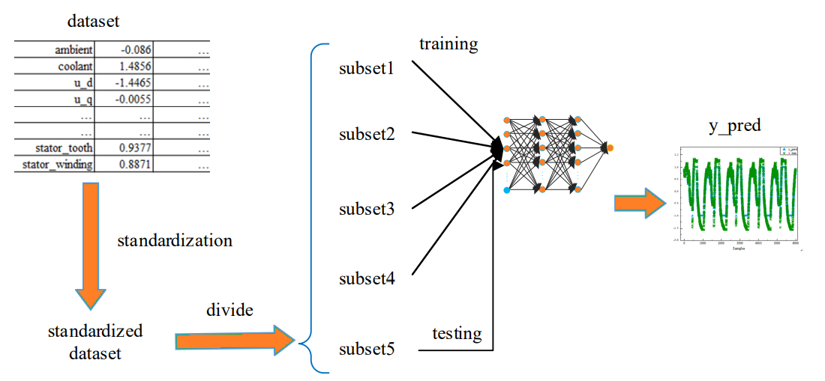
IMPLEMENTATION
ARCHITECTURE DIAGRAM
Fig: The process of predicting the PMSM stator winding temperature

Slide 11
IMPLEMENTATION
DATA FLOW DIAGRAM
Collection of Data
Storage of the Dataset
Analysis of Details
Applying Linear Regression
Training of the Data
Testing of the Data
Get the Output

Slide 12
IMPLEMENTATION
Automobiles
ER DIAGRAM
Motor
Database
Industries
Ic
Tq
Process the Data
Collection of Data
Refines
V
sp
Get the Output
Test the Output

Slide 13
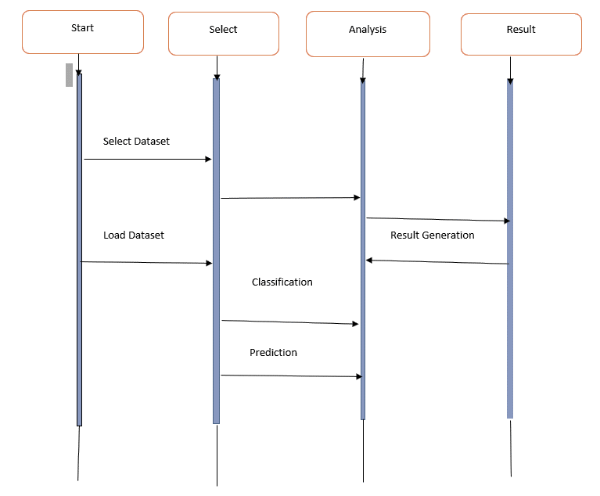
IMPLEMENTATION
SEQUENCE DIAGRAM

Slide 14
TESTING
WHITE BOX TESTING:
White Box Testing is a testing in which in which the software tester has knowledge of the inner workings, structure and language of the software, or at least its purpose. It is purpose. It is used to test areas that cannot be reached from a black box level.
BLACK BOX TESTING:
Black Box Testing is testing the software without any knowledge of the inner workings, structure or language of the module being tested. Black box tests, as most other kinds of tests, must be written from a definitive source document, such as specification or requirements document, such as specification or requirements document. It is a testing in which the software under test is treated, as a black box .you cannot “see” into it. The test provides inputs and responds to outputs without considering how the software works.

Slide 15
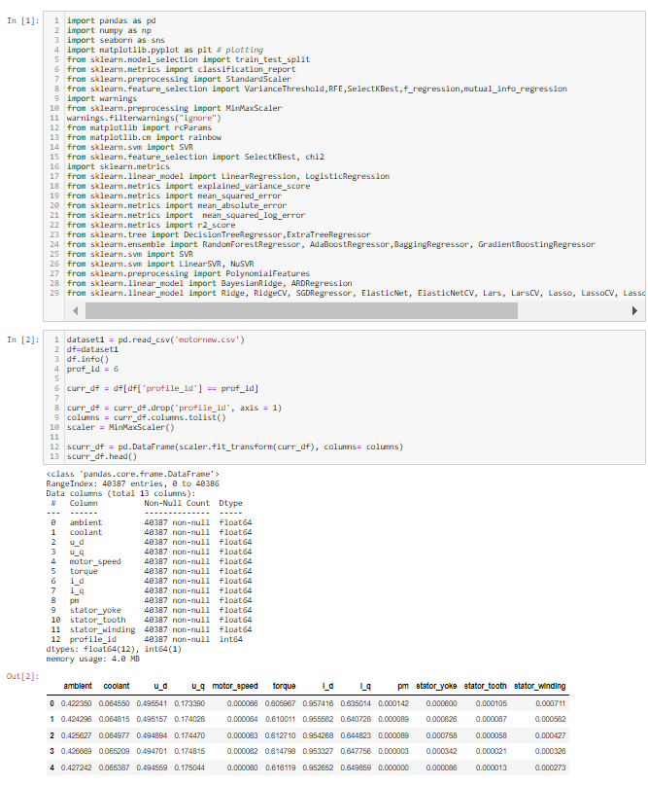
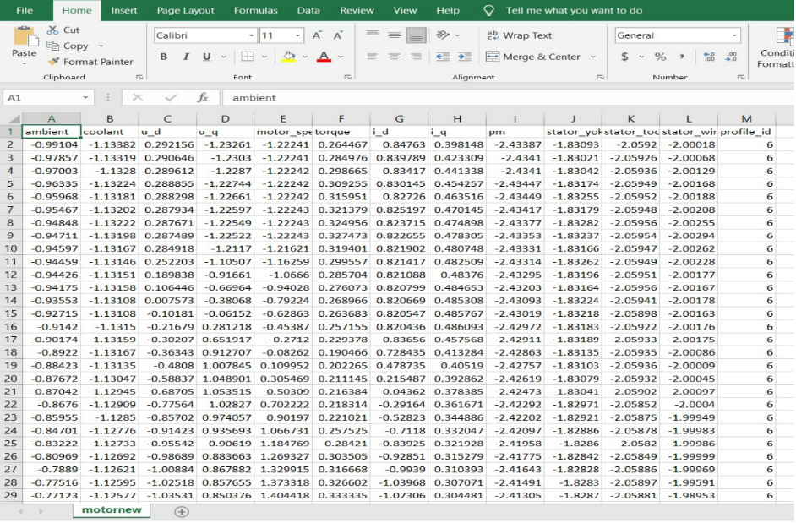
INPUT
Fig: Input Dataset
Fig: Python code

Slide 16
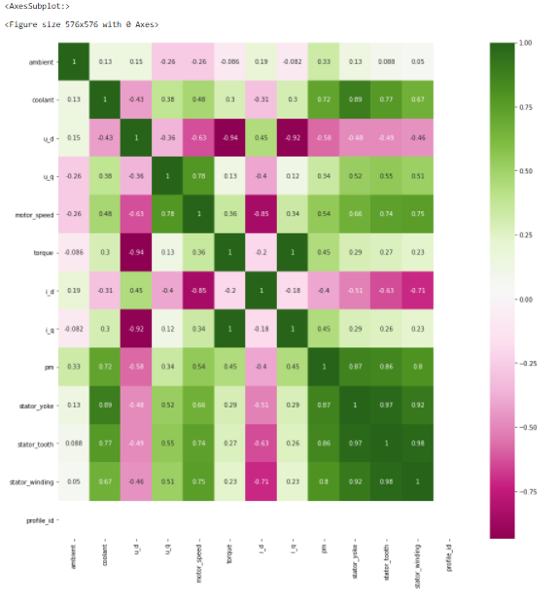
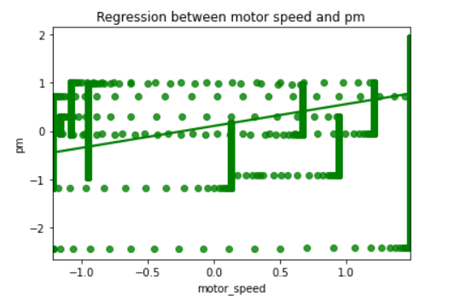
OUTPUT
Fig: Regression graph b/w speed vs permanent magnet temperature
Fig: Correlation Matrix for the dataset

Slide 17
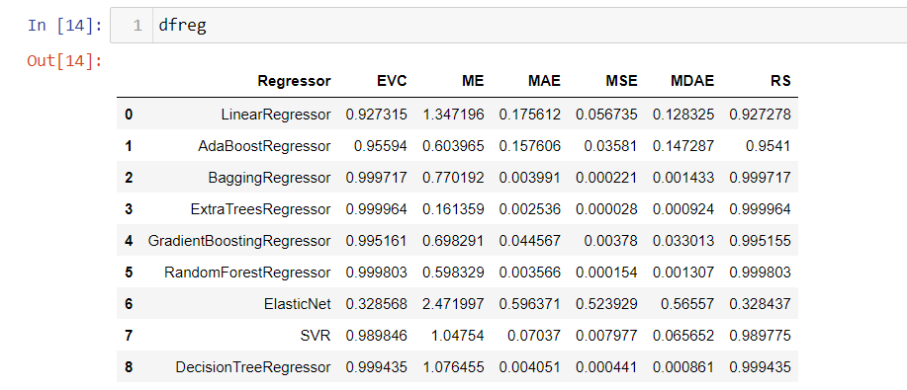
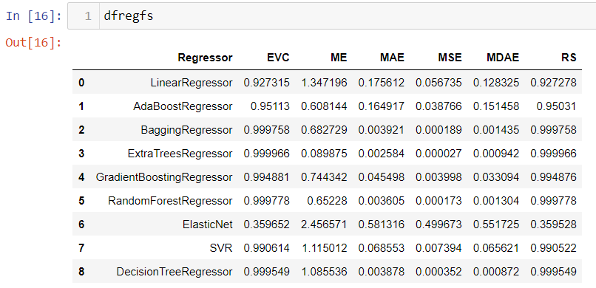
OUTPUT
Fig: Table for Regressor before Scaling
Fig: Table for Regressor after Scaling

Slide 18

DEMO VIDEO
https://youtu.be/sgyWQxIIDUM

Slide 19
CONCLUSION
An attempt is made to find the performance analysis of the electric motor temperature dataset in forecasting the ambient temperature of the electric motor by applying various activation layers with convolutional neural network sequential model.
The empirical feature examination is done and the relation of motor speed and ambient temperature of the motor is visualized. The correlation of each features in the dataset is extricated and the distribution of target variable with respect to other features are analyzed.
Experimental results shows that the ExtraTreesRegressor tends to reach the RScore of 99.9966 with the mean error of 0.0025

Slide 20
FUTURE ENHANCEMENTS
The raw data set is subjected to feature selection to find the important features with different types of test analysis.
The resampled dataset after raw data changeset is fitted to all the regressors with and without the presence of feature scaling and performance to get more accurate result.

Slide 21
REFERENCES
Electromagnetic and Thermal Analysis/Design of an Induction Motor for Electric Vehicles, International Journal of Mechanical Engineering and Robotics Research Vol. 7, No. 6, November 2018.
Neil J. Hewitt (2016) Energy storage as a regional economy enabler, International Journal of Ambient Energy, 37:4, 329-330
An electric motor thermal management system for hybrid vehicles: Modelling and control, January 2016, International Journal of Vehicle Performance 2(3):207-227

Slide 22
REFERENCES
Suh, H.K. Analysis of thermal performance of an outer-rotor Surface-mounted permanent magnet (SPM) motor for electric vehicles. J Mech Sci Technol 30, 5699–5706 (2016).
Effect of Ambient Temperature on Electric Vehicles’ Energy Consumption and Range: Model Definition and Sensitivity Analysis Based on Nissan Leaf Data, World Electric Vehicle Journal 2019, 10, 2
Predicting Temperature of Permanent Magnet Synchronous Motor Based on Deep Neural Network Hai Guo 1,2 , Qun Ding 1,*, Yifan Song 2 , Haoran Tang 2 , Likun Wang 3 and Jingying Zhao 2

Slide 23
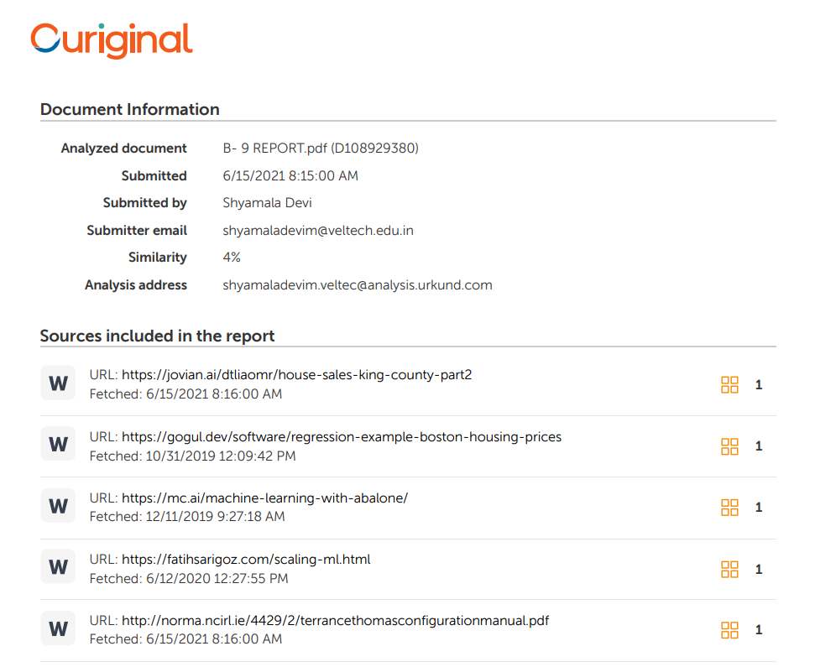
PLAGIARISM REPORT

Slide 24
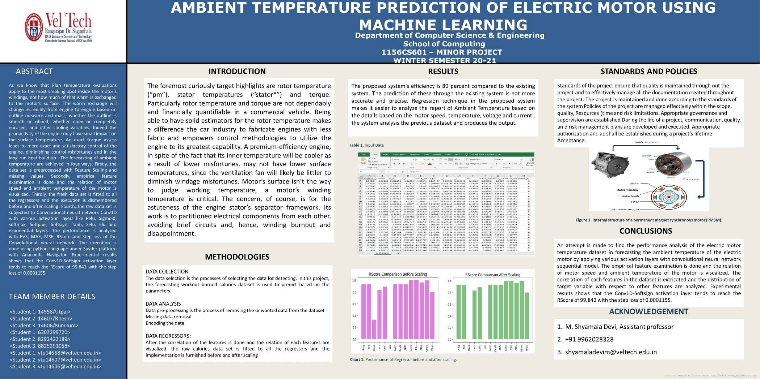
POSTER PRESENTATION

Slide 25
THANK YOU

