Slide 1

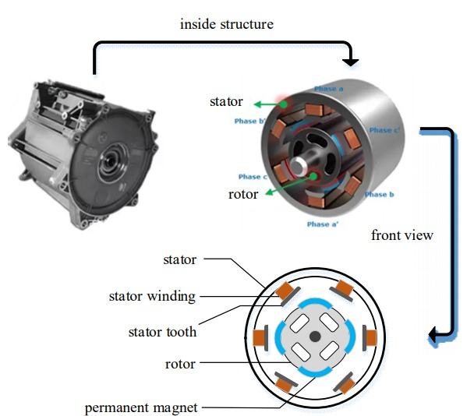
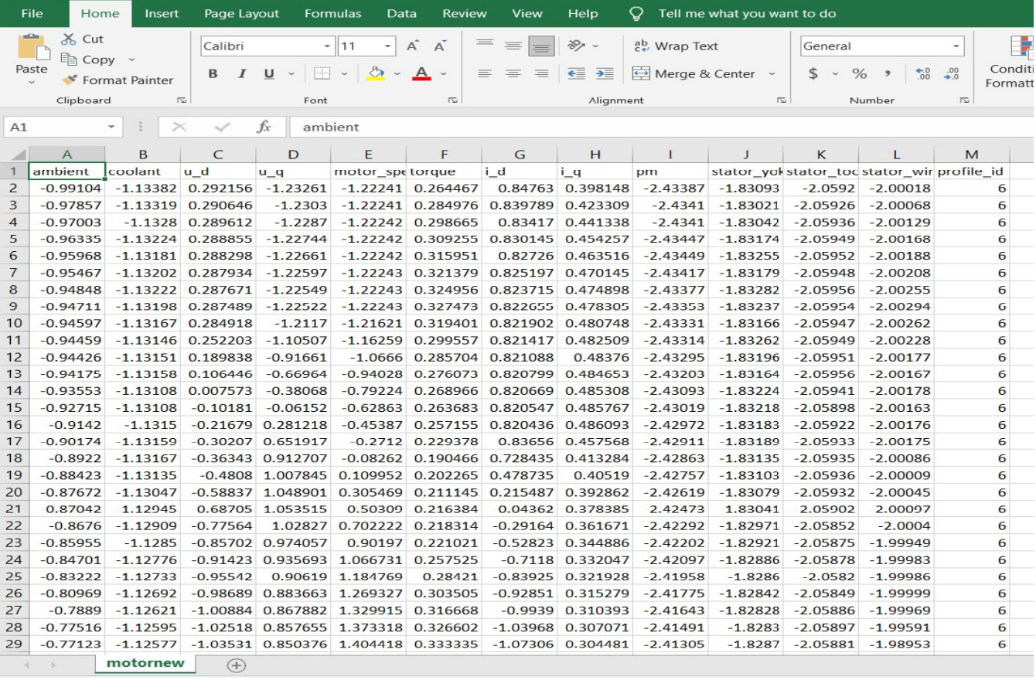
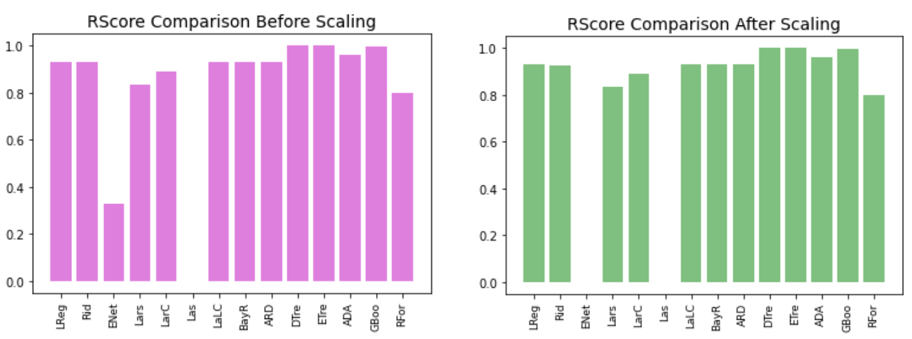
AMBIENT TEMPERATURE PREDICTION OF ELECTRIC MOTOR USING MACHINE LEARNING
Department of Computer Science & Engineering
School of Computing
1156CS601 – MINOR PROJECT
WINTER SEMESTER 20-21
ABSTRACT
INTRODUCTION
RESULTS
STANDARDS AND POLICIES
As we know that Plan temperature evaluations apply to the most smoking spot inside the motor’s windings, not how much of that warm is exchanged to the motor’s surface. The warm exchange will change incredibly from engine to engine based on outline measure and mass, whether the outline is smooth or ribbed, whether open or completely encased, and other cooling variables. Indeed the productivity of the engine may have small impact on the surface temperature. An exact torque assess leads to more exact and satisfactory control of the engine, diminishing control misfortunes and in the long run heat build-up.. The forecasting of ambient temperature are achieved in four ways. Firstly, the data set is preprocessed with Feature Scaling and missing values. Secondly, empirical feature examination is done and the relation of motor speed and ambient temperature of the motor is visualized. Thirdly, the fresh data set is fitted to all the regressors and the execution is dismembered before and after scaling. Fourth, the raw data set is subjected to Convolutional neural network Conv1D with various activation layers like Relu, Sigmoid, softmax, Softplus, Softsign, Tanh, Selu, Elu and exponential layers. The performance is analyzed with EVS, MAE, MSE, RScore and Step loss of the Convolutional neural network. The execution is done using python language under Spyder platform with Anaconda Navigator. Experimental results shows that the Conv1D-Softsign activation layer tends to reach the RScore of 99.842 with the step loss of 0.0001155.
The foremost curiously target highlights are rotor temperature (“pm”), stator temperatures (“stator*”) and torque. Particularly rotor temperature and torque are not dependably and financially quantifiable in a commercial vehicle. Being able to have solid estimators for the rotor temperature makes a difference the car industry to fabricate engines with less fabric and empowers control methodologies to utilize the engine to its greatest capability. A premium-efficiency engine, in spite of the fact that its inner temperature will be cooler as a result of lower misfortunes, may not have lower surface temperatures, since the ventilation fan will likely be littler to diminish windage misfortunes. Motor’s surface isn’t the way to judge working temperature, a motor’s winding temperature is critical. The concern, of course, is for the astuteness of the engine stator’s separator framework. Its work is to partitioned electrical components from each other, avoiding brief circuits and, hence, winding burnout and disappointment.
The proposed system’s efficiency is 80 percent compared to the existing system. The prediction of these through the existing system is not more accurate and precise. Regression technique in the proposed system makes it easier to analyze the report of Ambient Temperature based on the details based on the motor speed, temperature, voltage and current , the system analysis the previous dataset and produces the output.
Standards of the project ensure that quality is maintained through out the project and to effectively manage all the documentation created throughout the project. The project is maintained and done according to the standards of the system Policies of the project are managed effectively within the scope. quality, Resources (time and risk limitations. Appropriate governance and supervision are established During the life of a project, communication, quality, an d risk management plans are developed and executed. Appropriate authorization and ac shall be established during a project’s lifetime Acceptance.
Table 1. Input Data
Figure 1. Internal structure of a permanent magnet synchronous motor (PMSM).
CONCLUSIONS
An attempt is made to find the performance analysis of the electric motor temperature dataset in forecasting the ambient temperature of the electric motor by applying various activation layers with convolutional neural network sequential model. The empirical feature examination is done and the relation of motor speed and ambient temperature of the motor is visualized. The correlation of each features in the dataset is extricated and the distribution of target variable with respect to other features are analyzed. Experimental results shows that the Conv1D-Softsign activation layer tends to reach the RScore of 99.842 with the step loss of 0.0001155.
METHODOLOGIES
DATA COLLECTION
The data selection is the processes of selecting the data for detecting. In this project, the forecasting workout burned calories dataset is used to predict based on the parameters.
DATA ANALYSIS
Data pre-processing is the process of removing the unwanted data from the dataset
Missing data removal
Encoding the data
DATA REGRESSORS:
After the correlation of the features is done and the relation of each features are visualized. the raw calories data set is fitted to all the regressors and the implementation is furnished before and after scaling
TEAM MEMBER DETAILS
<Student 1. 14558/Utpal>
<Student 2 .14607/Ritesh>
<Student 3 .14606/Kumkum>
<Student 1. 6303299720>
<Student 2. 8292423189>
<Student 3. 8825391958>
<Student 1. vtu14558@veltech.edu.in>
<Student 2. vtu14607@veltech.edu.in>
<Student 3. vtu14606@veltech.edu.in>
ACKNOWLEDGEMENT
M. Shyamala Devi, Assistant professor
+91 9962028328
shyamaladevim@veltech.edu.in
Chart 1. Performance of Regressor before and after scalling.

