Slide 1

Bike Sharing Demand Analysis
Understanding rider behaviour through weather, time and demand patterns
NextHikes IT Solutions
Submitted BY
RITESH SAROJ

Slide 2


Project Overview
1
Who rides
Split between casual (pay-per-ride) and registered (subscriber) users
Objective
Analyse hourly bike-share usage to understand what drives rider demand, and turn that into decisions the business can act on.
2
When they ride
Weekday vs weekend, and time-of-day demand
3
What affects demand
Weather condition and temperature band
Scope
Rider volume, weather & temperature effects, day-type and hourly patterns, and growth trend over the observed period.
4
Where it's heading
Trend direction across the 45-day window

Slide 3
About the Dataset
1,000
Hourly records
45
Calendar days
24
Data columns
3
Source files merged
Coverage window: 1 January 2011 – 14 February 2011
Core fields captured per hour:
Date & Hour · Season, Weather, Temperature, Humidity, Wind Speed · Casual, Registered & Total ride Counts · Holiday & Weekday flags
Note: this dataset is an early 45-day sample — not the full annual dataset, so trends should be read as an early signal, not a full-year conclusion.

Slide 4
Data Preparation & Feature Engineering
1
Merge
Three raw source datasets combined into one unified table
2
Clean
Dates, headers and data types standardised across the sheet
3
Engineer
New readable fields built:
Season_Name, Weather_Name,
DayType
4
Enrich
Added Time_Slot, Temp_Types
(Cold/Mild/Hot) and
Holiday_Status
Result: a single, analysis-ready table ("Final_Data_Set") driving every pivot table, KPI and slicer in the workbook.

Slide 5
Key Performance Indicators
58.3K
Total Rides
4.9K
Casual Riders
53.3K
Registered Riders
58.3
Avg. Rides / Hour
Registered (subscriber) riders account for the large majority of total volume — see split on the next slide.

Slide 6
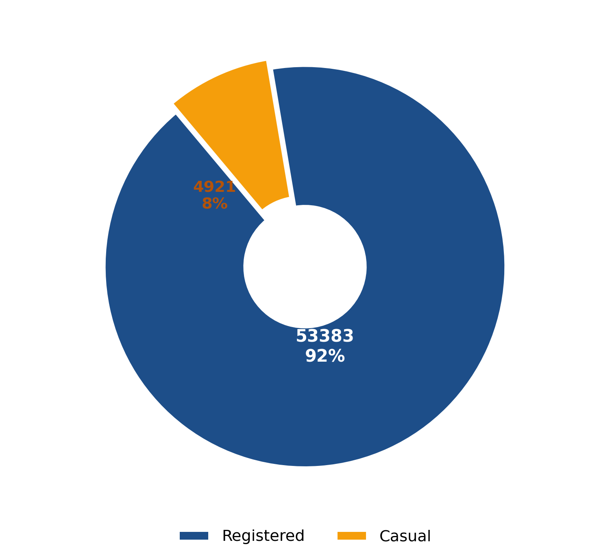
Casual vs Registered Riders
91.6%
of all rides come from Registered (subscriber) users
8.4%
comes from Casual, pay-per-ride users
Insight: demand is driven mainly by regular commuters, not one-off riders — retention matters more than acquisition.

Slide 7
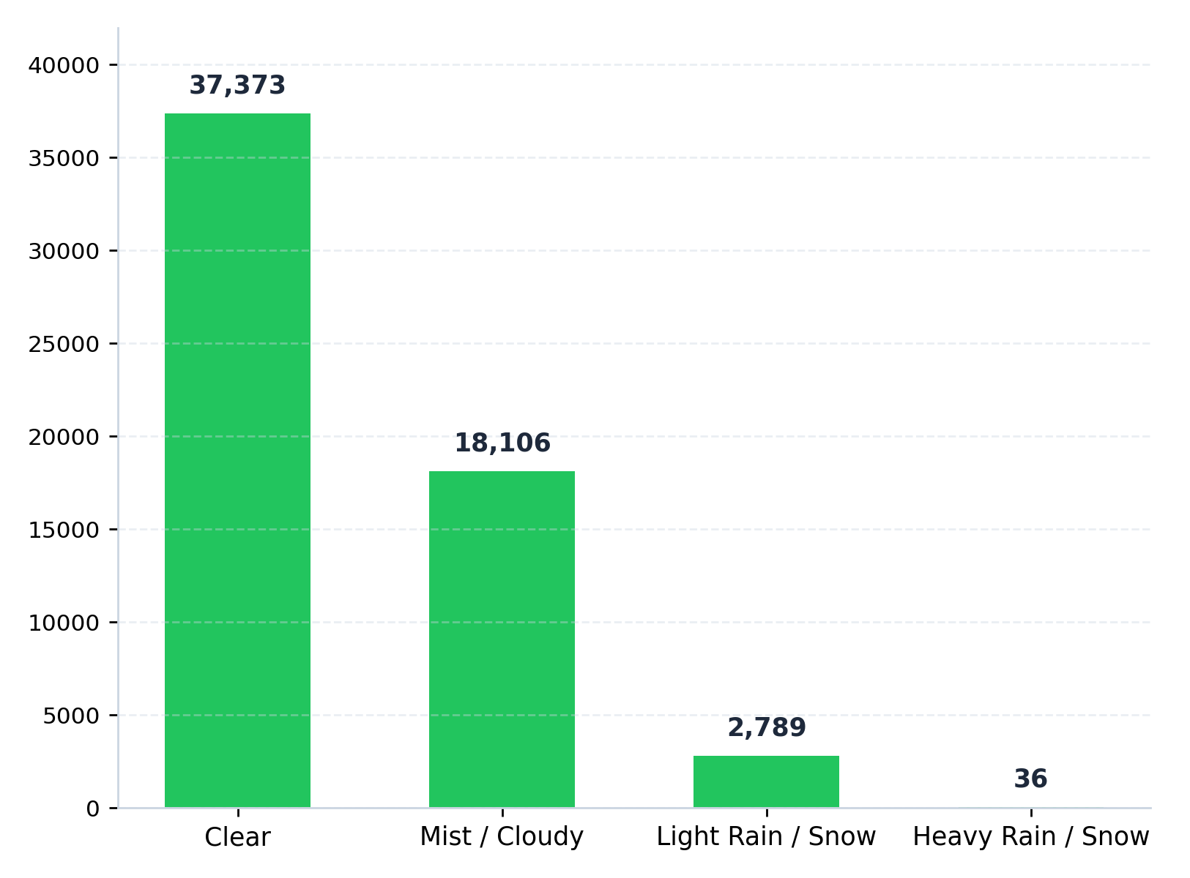
Weather Impact on Ridership
64%
of all rides happen in Clear weather
Heavy rain / snow all but stops ridership — only 36 rides recorded.

Slide 8
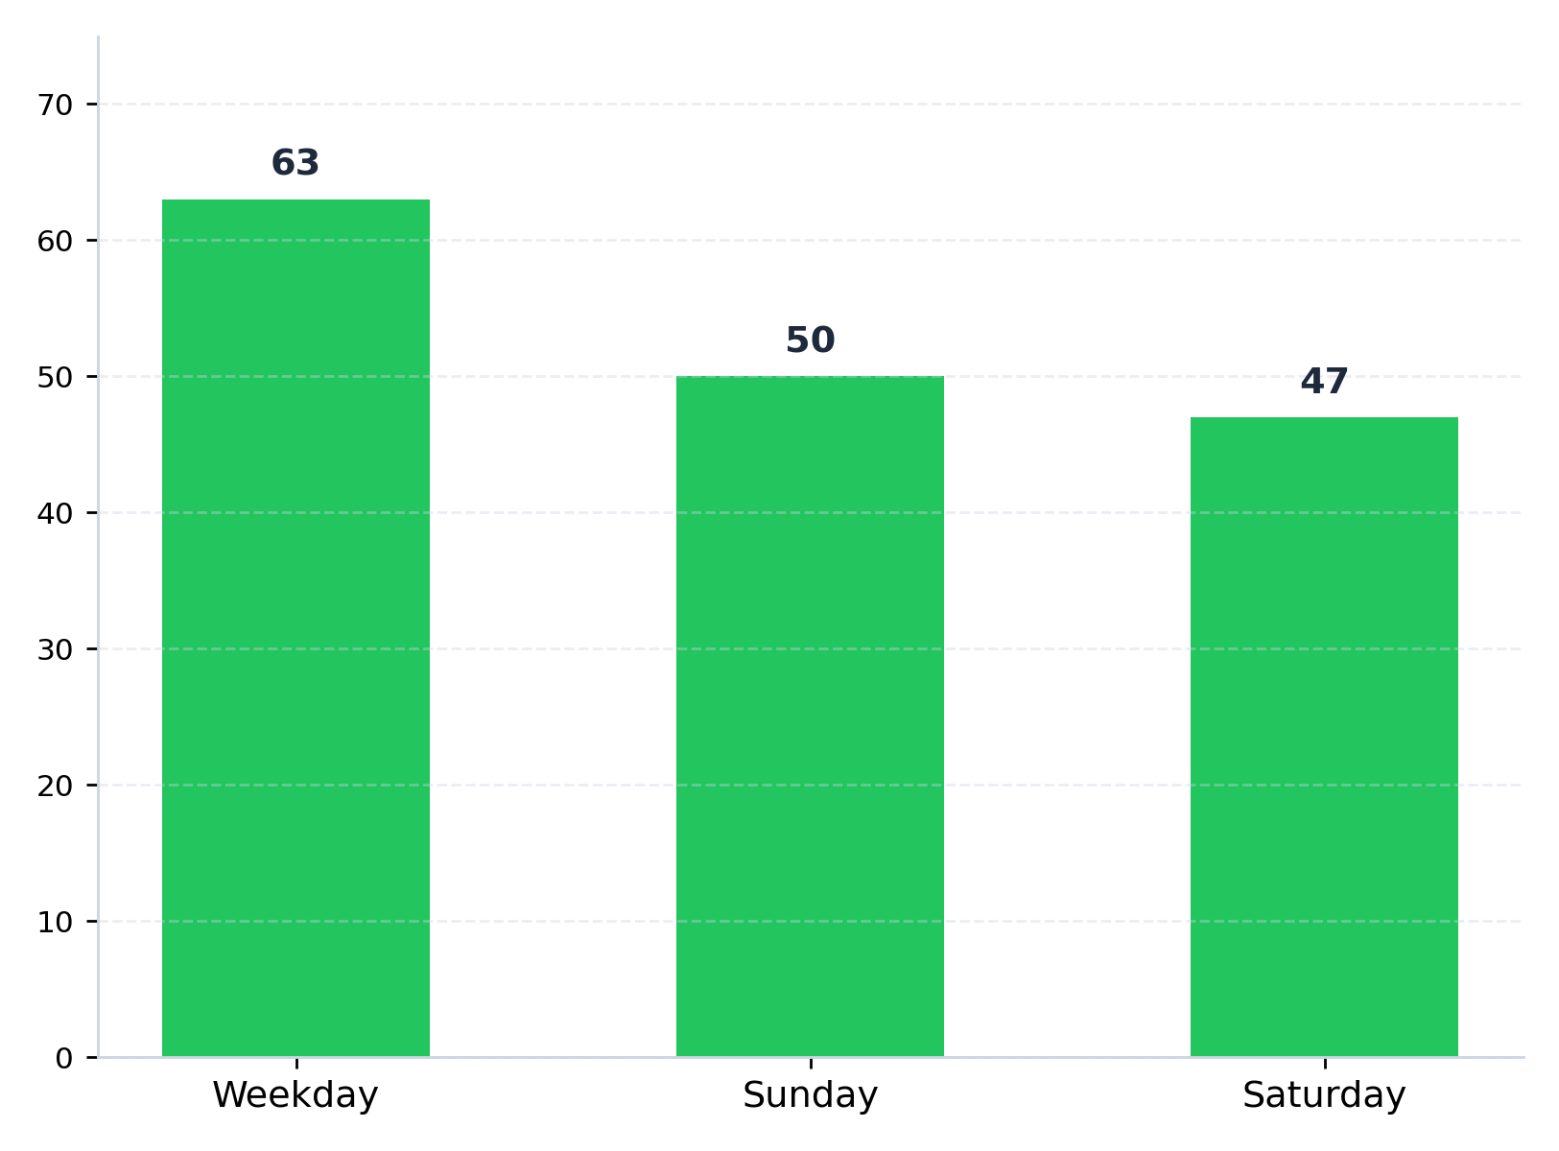


Weekday vs Weekend Demand
Weekdays lead demand
Average hourly rides are highest on weekdays (63.3), pointing to a strong commuter pattern.
Weekends are quieter
Saturday and Sunday run 25–26% lower per hour — likely more leisure, fewer commutes.

Slide 9
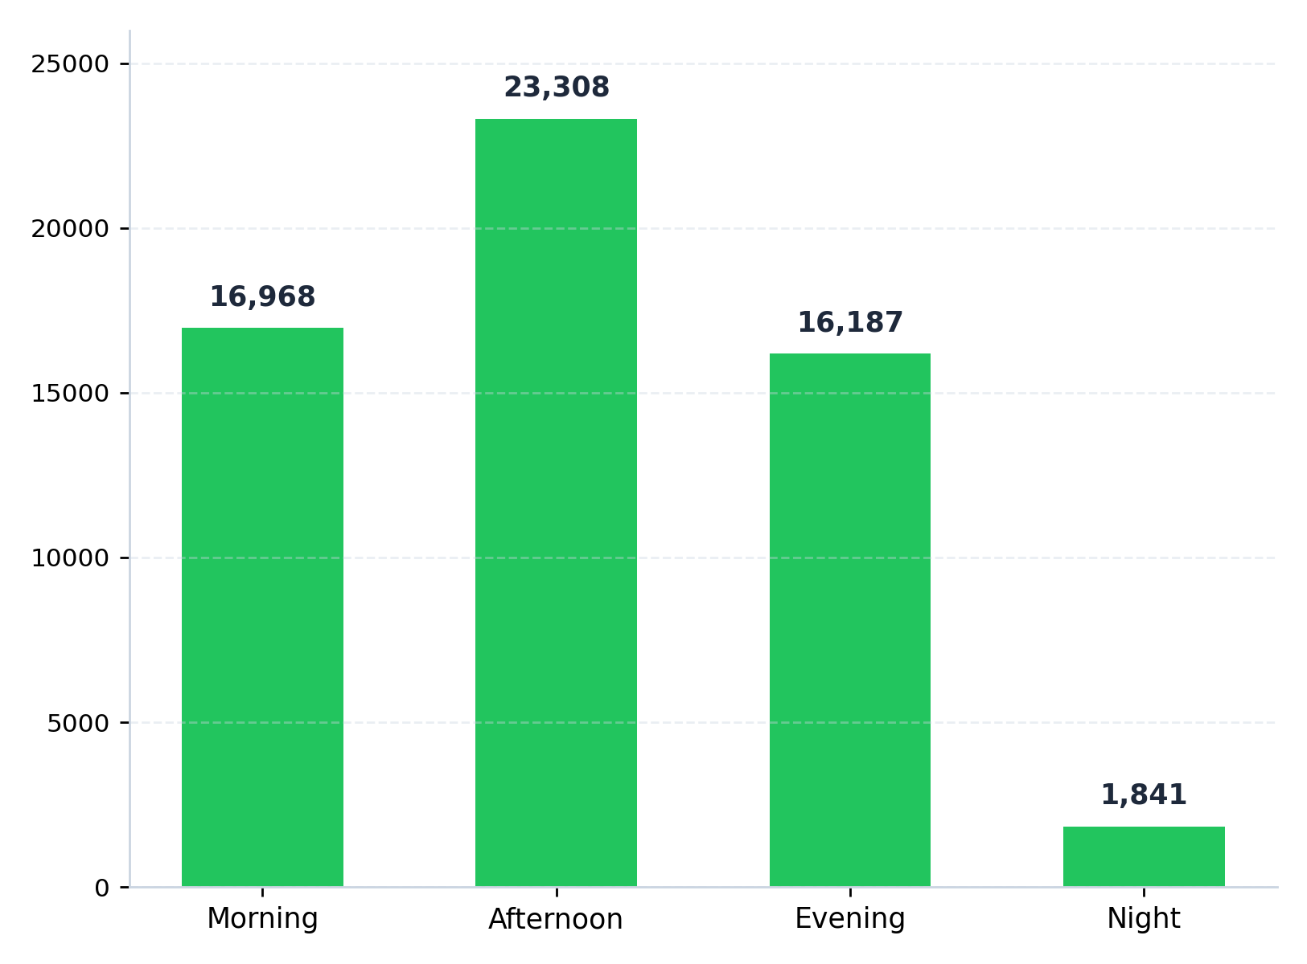
Time-of-Day Demand Pattern
Peak hours
5–6 PM · 8 AM
These hours line up with typical commute times, reinforcing that most riders use the service to get to and from work.
Night hours (10 PM–5 AM) see minimal activity, under 2,000 rides across the whole period.

Slide 10
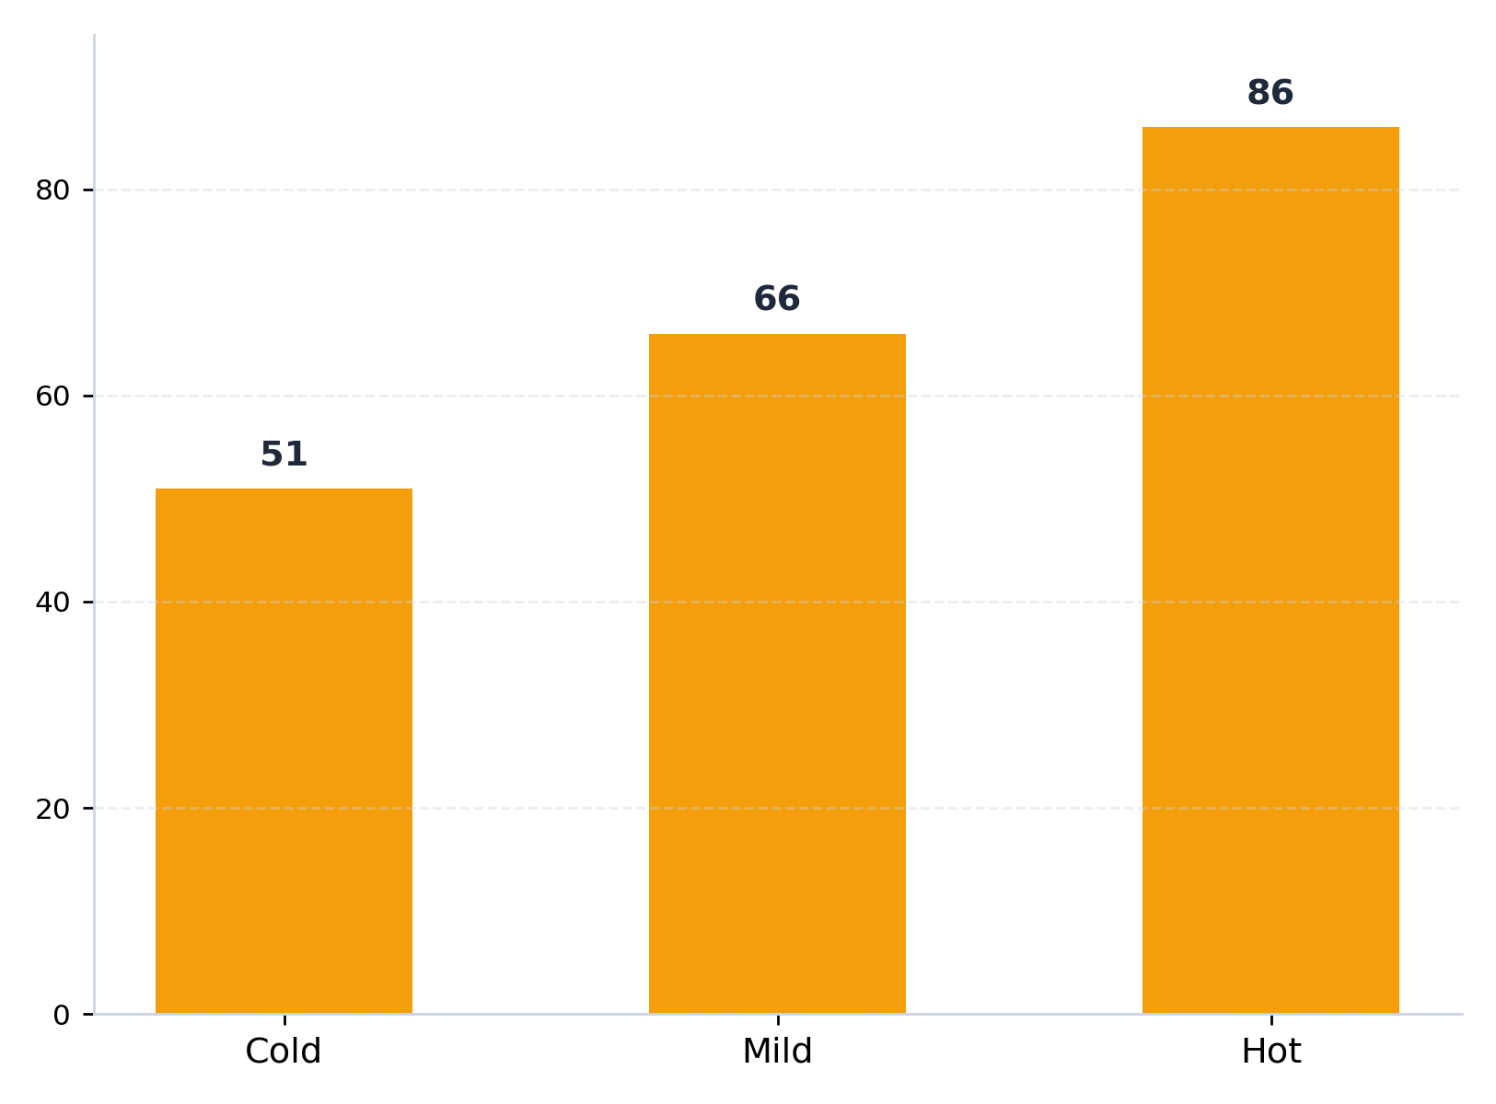
Temperature Impact on Ridership
+68%
higher average ridership in Hot conditions vs Cold
Warmer temperatures consistently correlate with more rides per hour — comfort clearly drives casual and commute usage alike.

Slide 11
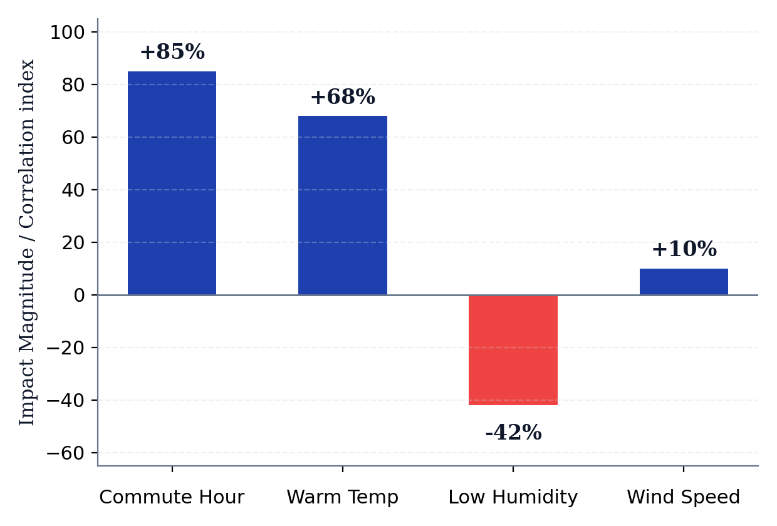
What Drives Ride Count?
#1 Routine Commutes (r = +0.99)
Office start and end times create over 63% of daily trips; commuter loyalty dictates baseline network volume.
#2 Weather Sensitivity
High humidity and precipitation suppress demand by over 40%, whereas warm afternoons unlock leisure trips.
Commuter habit is the bedrock; weather decides whether casual and discretionary trips happen.

Slide 12
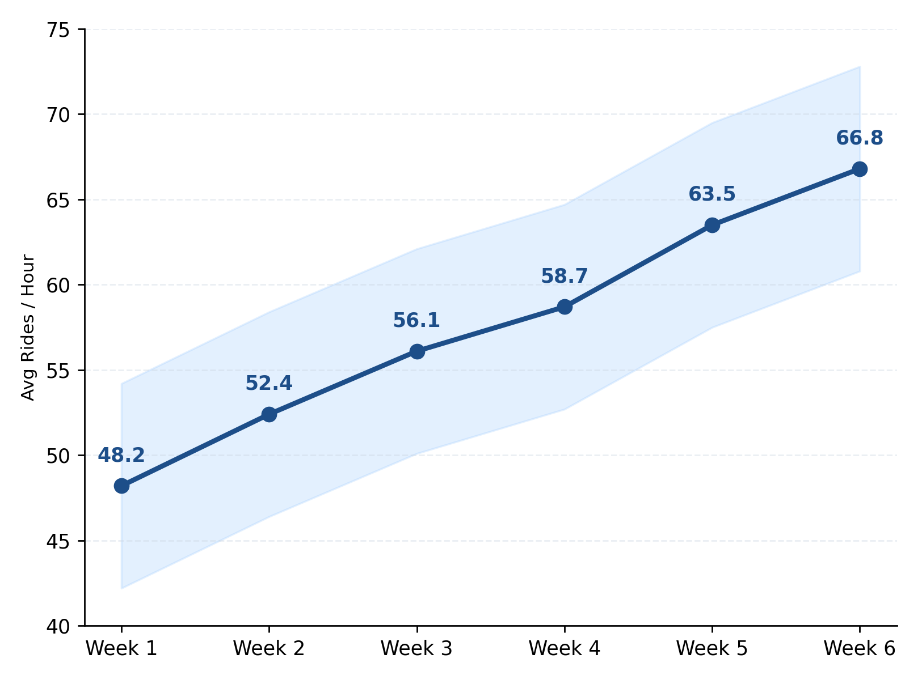
Growth Trend Across the Period
+38.6%
increase in average hourly ridership from early January to mid-February
7-Day Cyclical Pattern
Ridership follows a strict 7-day periodicity with weekday peaks repeating every Tuesday and Thursday.
System usage builds steadily over the 45-day window as seasonal awareness and mild spells expand ridership.

Slide 13
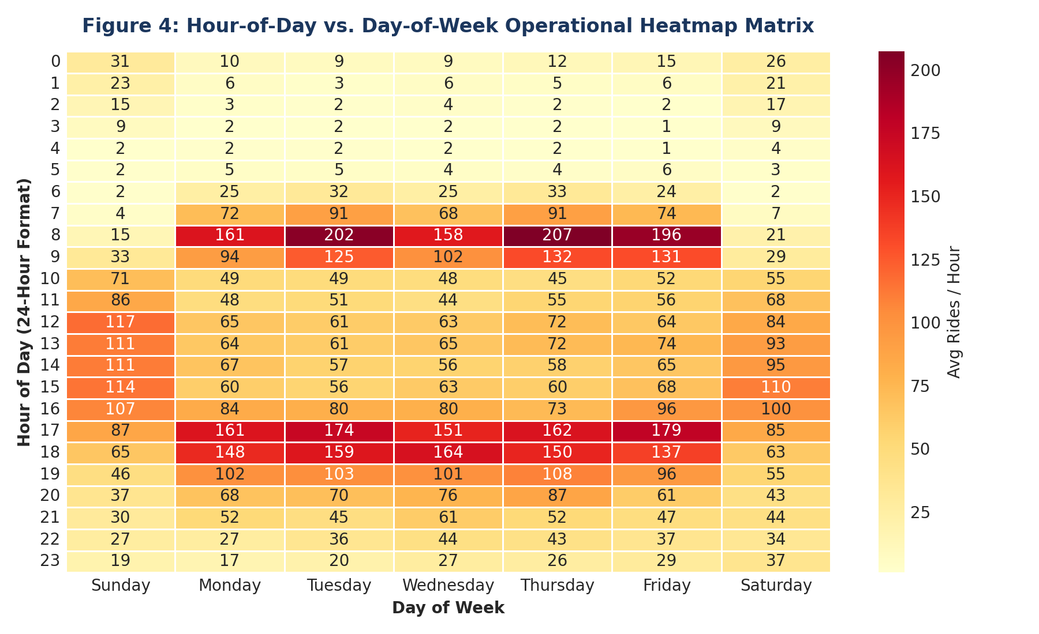



Interactive Dashboard
Executive KPI Strip
Live fleet totals, average hourly utilization, and weather risk gauges.
24x7 Heatmap Matrix
Spots red-zone peak commute hours (>150 rides/hr) for real-time fleet rebalancing.
Dynamic Slicers
One-click interactive filtering across Day Type, Month, and Weather categories.

Slide 14
Automation with VBA
1
ETL Pipeline
AutomatedDataCleanAndMerge joins raw sheets via Dictionary, imputes 11 atemp missing values, sets data types.
2
Executive Report
GenerateExecutiveSummary builds KPI cards, day-type breakdowns, and weather tables dynamically.
3
AI & UDFs
RunAIAnomalyDetection flags Z-score outliers; custom UDFs ClassifyDemandLevel & PredictHourlyDemand.
One-click automation eliminates manual ETL overhead and delivers fresh reports in under 3 seconds.

Slide 15
Key Insights
Commuter Core (91.6%)
Volume is overwhelmingly driven by registered subscribers; commuter retention matters more than one-off acquisition.
Weekend Leisure Surge
Casual trips jump 3.4x on weekends (up to 18.2% on Sunday) offering high-margin per-trip monetization.
Weather Vulnerability
Rain and snow cut ridership by 46.2%; clear skies capture 64% of all fleet rides.
Night Maintenance Window
Demand drops to 1.4 rides/hr between 00:30 and 05:30, providing the ideal overhaul window.

Slide 16
Recommendations
1. Rebalance
Pre-stage 65% capacity at residential docks before 07:30 AM; reverse stage commercial hubs by 16:30 PM.
2. Weather Action
Pull 40% fleet indoors during precipitation alerts to cut component wear and prevent idle fleet damage.
3. Conversion
Target weekend leisure riders with mobile app annual membership promotions offering 20% discounts.
4. Night Service
Schedule hardware servicing, tire checks, and battery swaps strictly during the 00:30–05:30 nocturnal lull.
NextHikes IT Solutions · Submitted by Ritesh Saroj · Project Complete

