Slide 1
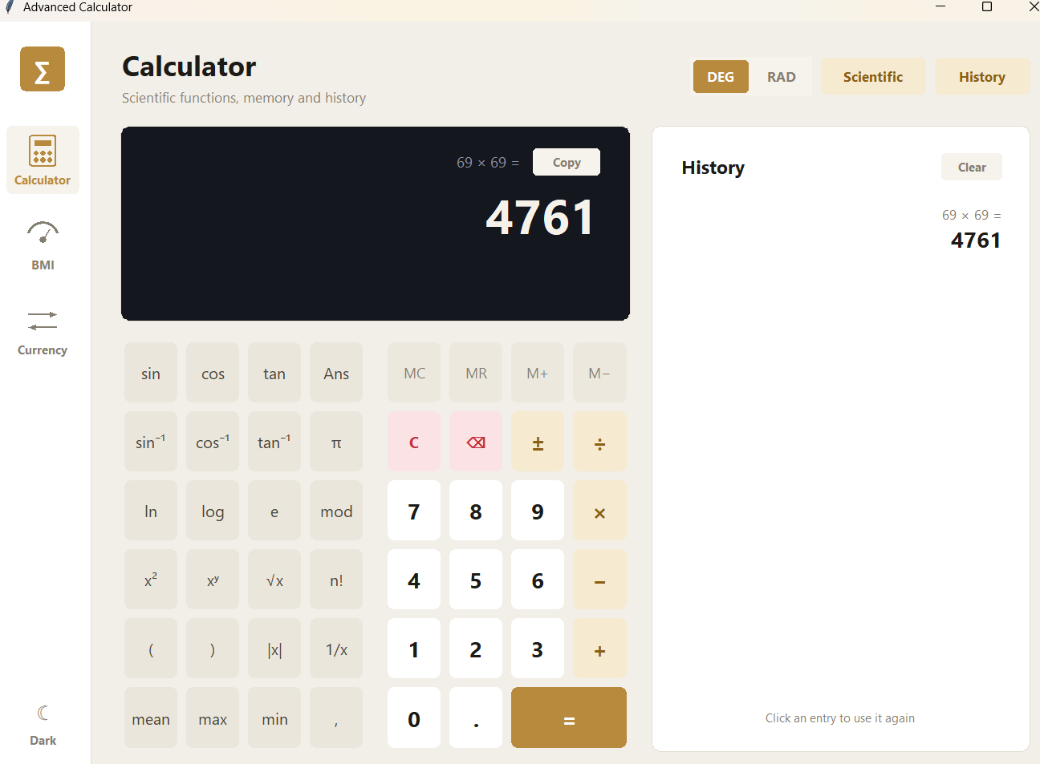
∑
PROJECT PRESENTATION
Advanced Calculator
A multi-purpose desktop tool built with Python and Tkinter
NEXTHIKES IT SOLUTIONS
Presented by: Ritesh Saroj

Slide 2
Project objectives
∑
01 / OBJECTIVES
01
One app, three tools
02
Safe and accurate maths
Bring a scientific calculator, a BMI calculator and a currency converter into a single window with sidebar navigation.
Evaluate expressions with a custom tokenizer and parser instead of eval(), with clear messages for invalid input.
03
Stay responsive and reliable
04
Comfortable to use
Fetch live rates in a background thread and fall back to built-in rates when there is no internet.
Light and dark themes, keyboard input and sharp text on high-DPI Windows screens.

Slide 3
Feature set
∑
02 / FEATURE SET
Calculator
BMI
Currency
Scientific functions and inverse trig
DEG and RAD angle modes
Memory keys and last answer (Ans)
History of up to 100 entries
Copy result and keyboard input
Metric and imperial units
Result updates while you type
Category: underweight to obese
Healthy weight range
Visual gauge with marker
40 currencies
One or many amounts at once
Swap button for From and To
Live rates with offline fallback
Status note for rate source
Across the whole app: light and dark theme · sidebar navigation · no third-party packages

Slide 4
Scientific calculator
∑
03 / CALCULATOR
Scientific keypad
sin, cos, tan and inverses, ln, log, √, x², xʸ, n!
DEG / RAD modes
Switch the angle unit for trigonometry
Memory and Ans
MC, MR, M+, M− and reuse of the last answer
History panel
Up to 100 entries; click one to use it again
Copy and keyboard
Copy the result, or type expressions directly

Slide 5
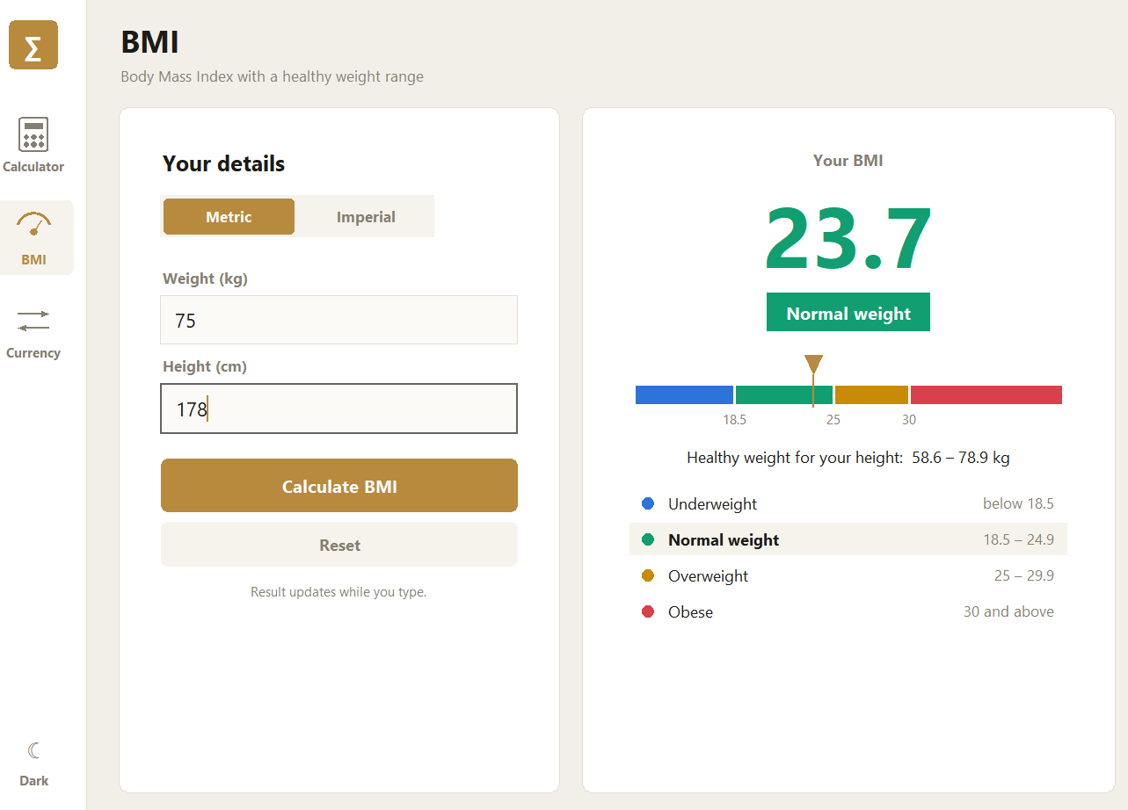
BMI calculator
∑
04 / BMI CALCULATOR
Metric or imperial
kg and cm, or lb with feet and inches
Live result
Updates while you type, plus Calculate and Reset
Colour-coded category
Underweight, Normal weight, Overweight, Obese
Healthy weight range
Shown for the height you enter
75 kg, 178 cm → BMI 23.7, Normal weight

Slide 6
Currency converter
∑
05 / CURRENCY CONVERTER
40 currencies
Pick From and To, or press ⇄ to swap them
10, 50, 250 USD → INR
10.00 USD
885.00 INR
Many amounts at once
Up to 12 values separated by commas
50.00 USD
4,425.00 INR
250.00 USD
22,125.00 INR
Clear status note
Shows live rates with time, or offline rates in use
Example using the built-in offline rates
Where the rates come from
open.er-api.com
api.frankfurter.dev
Built-in table
Live rates, tried first
Backup source
Offline fallback

Slide 7
How the application works
∑
06 / HOW IT WORKS
Calculator
Keys or keyboard
Tokenizer
Parser
Result + history
Live rates
Update button
Background thread
Queue
Convert again
Built with Python 3.8+ · Tkinter / ttk · Standard library only
Custom canvas widgets (rounded buttons, cards, sidebar items) give the modern look.

Slide 8
Challenges and solutions
∑
07 / CHALLENGES
CHALLENGE
SOLUTION
Evaluating expressions safely
Own tokenizer and parser, no eval(); 2π and 3(4+1) also work
Invalid maths
Clear errors such as “Cannot divide by 0”; tan 90° and huge powers guarded
Freezing while fetching rates
Download runs in a background thread and returns through a queue
No internet connection
Built-in offline rates and a note saying they are approximate
A modern look in plain Tkinter
Custom canvas buttons, cards and sidebar, with light and dark themes

Slide 9
Project outcomes
∑
08 / OUTCOMES
3
40
2
0
tools in one window
currencies supported
themes: light and dark
third-party packages
Key takeaways
A complete desktop application in a single Python file
Accurate results from a custom parser, with clear error messages
Works with or without internet and runs on plain Python

Slide 10
∑
Thank You

