Slide 1
Changes from Assignment 2 to assignment 3
Here are few screenshot from assignment 2 of the storyboard on story “ The Clever Fox and Foolish Crow”

Slide 2
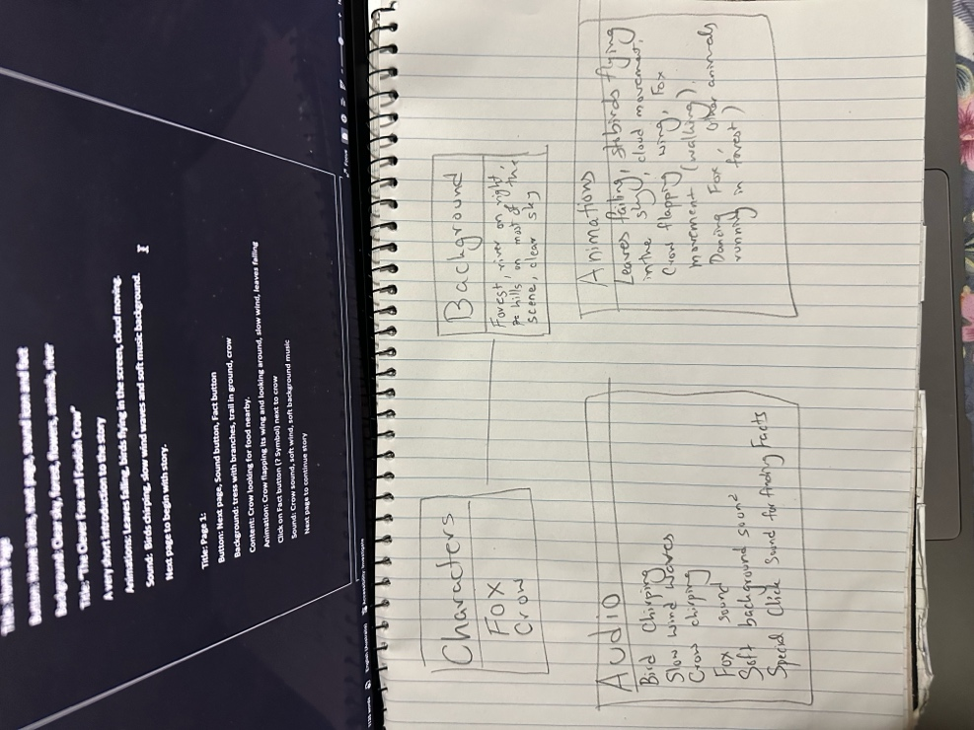
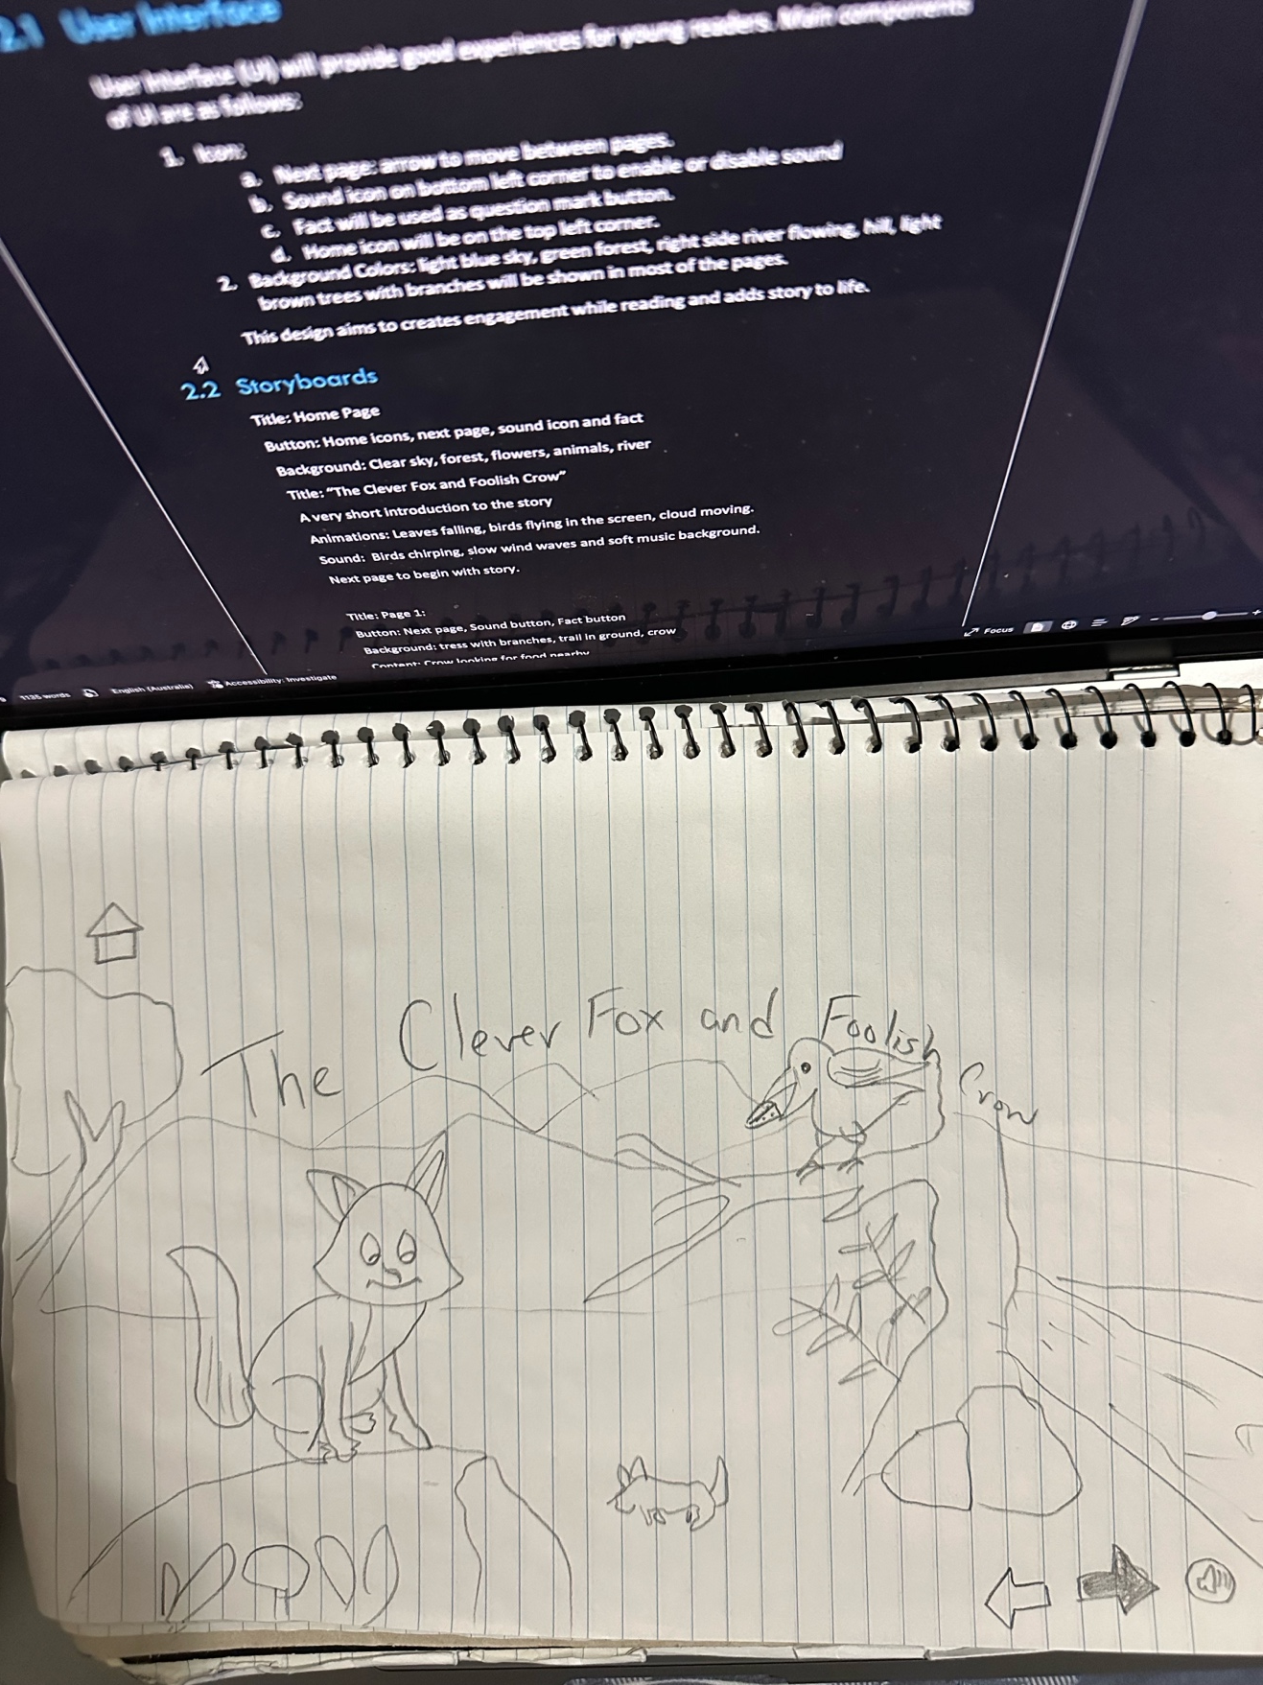
Mind Map A2
Beginning of story
A2

Slide 3
Feedback from Assignment 2
Good attempt but needs much improvement in Ass3 such as:
The report does not sufficiently justify its design choices from a UX perspective with references. The explanations for why particular UX principles were applied are lacking in depth.
The report provides media elements and storyboarding but lacks depth. By expanding on these sections with clearer details and justifications tied to user needs and the overall theme, the report will better communicate how these elements are integral to the project’s success.
The report should provide more in-depth details on the selection and use of media elements. It should clarify why specific media choices were made based on the theme and target audience preferences.
Little more focus should be placed on engaging users through interactive elements
There is no clear reference to established research or best practices in UX/UI design when formulating evaluation questions. The report does not include any form of rating scale, such as Likert scales, that can allow users to provide quantifiable feedback.

Slide 4
Changes in Assignment 3
Several key changes have been made in this iteration. The focus has shifted towards enhancing interactive features, which are now a primary concern for the improvement section. Additionally, the total number of scenes has been reduced for better user navigation.The color scheme has been updated to create a more visually appealing background, making the interface more attractive for the users. This improvement aims to enhance the overall user experience and engagement. Here are some screenshot of assignment 3 from unity.

Slide 5
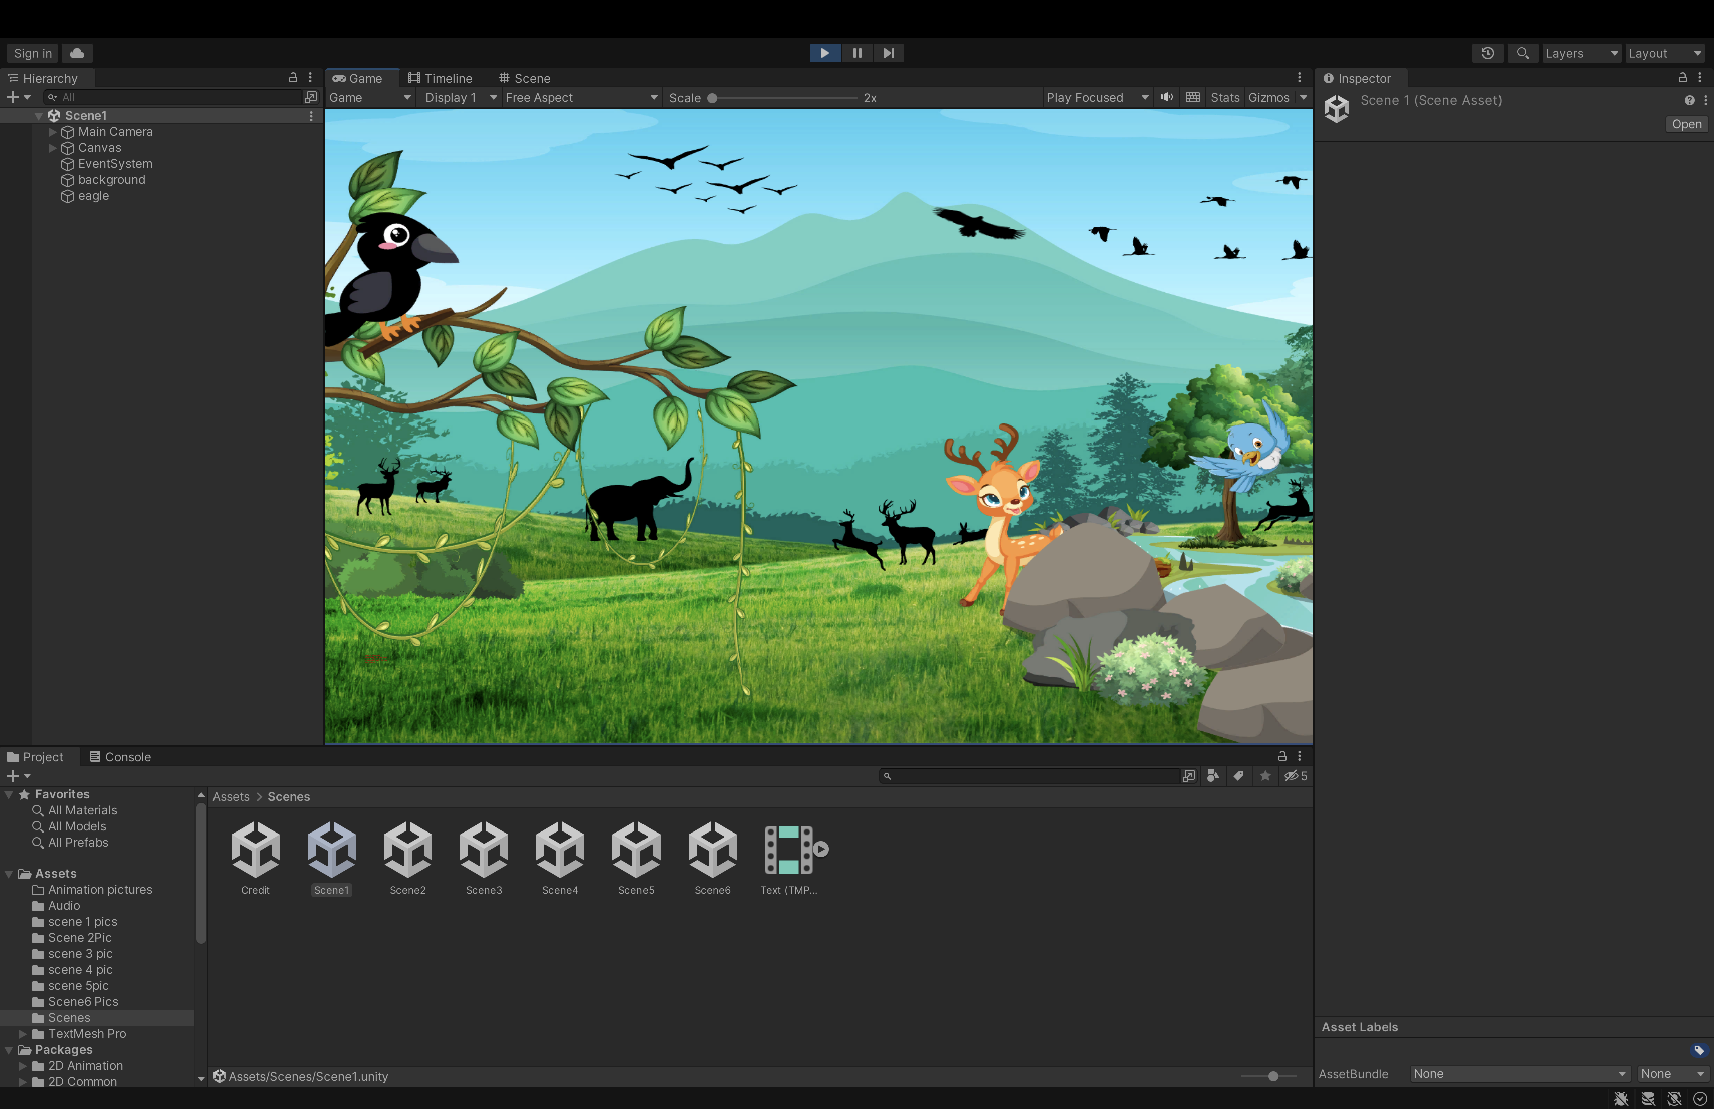
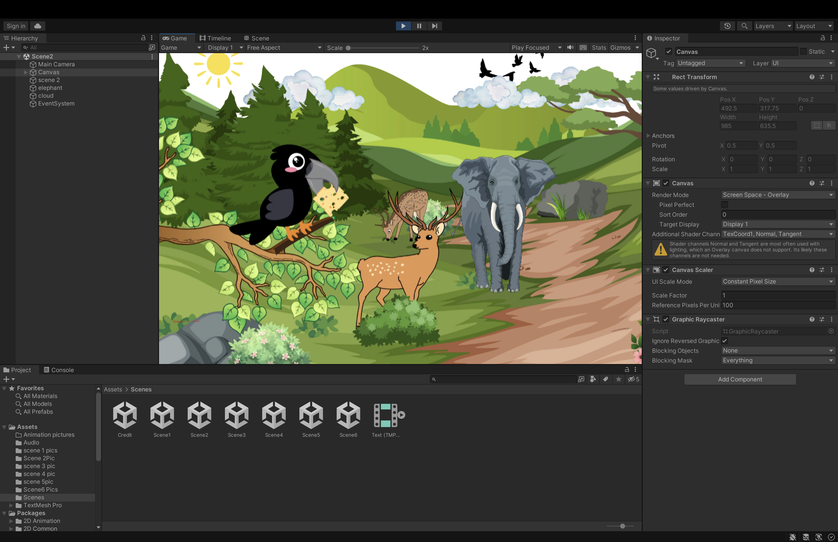
Beginning of A3
2nd scene of A3

Slide 6
Application of UX Principles
In my design, I prioritized several key principles to improve user experience. One of the main focuses was on ensuring consistency across the interface. This included maintaining uniformity in buttons, navigation, and feedback mechanisms, which helps users intuitively understand how to interact with the application. Additionally, I enhanced accessibility by optimizing text size and ensuring sufficient contrast to promote readability. These changes are intended to create a more user-friendly environment that caters to a diverse audience.

Slide 7
Challenges
Technical Challenges
During the project, I encountered several technical challenges that impacted my workflow. Initially, I faced difficulties in determining the appropriate version of Unity needed for development. Additionally, scaling elements and setting up animations took more time than anticipated. Implementing navigation required coding specific button functionalities, which added complexity to the project.
I am currently addressing these issues, and I will share further details about the challenges I faced and the solutions I implemented during my presentation.

Slide 8
Conclusion
In conclusion, this project has been a valuable learning experience, highlighting the importance of user experience (UX) principles in design. By focusing on consistency, accessibility, and interactive elements, I have aimed to create an engaging interface that meets user needs. Despite facing technical challenges, I have developed problem-solving skills and gained insights into effective project management. As I finalize the prototype, I look forward to gathering feedback and making further enhancements to ensure a seamless user experience. This process has reinforced my understanding of the critical role UX plays in creating successful applications.

Slide 9
Refrences:
Gibson, J. J. (1977). The Theory of Affordances. In R. Shaw & J. Bransford (Eds.), Perception (pp. 67-82). Lawrence Erlbaum.
Nielsen, J. (1994). Usability Engineering. Academic Press.Shneiderman, B., Plaisant, C., Cohen, M., & Jacobs, S. (2016).
Designing the User Interface: Strategies for Effective Human-Computer Interaction. Pearson.

