Slide 1
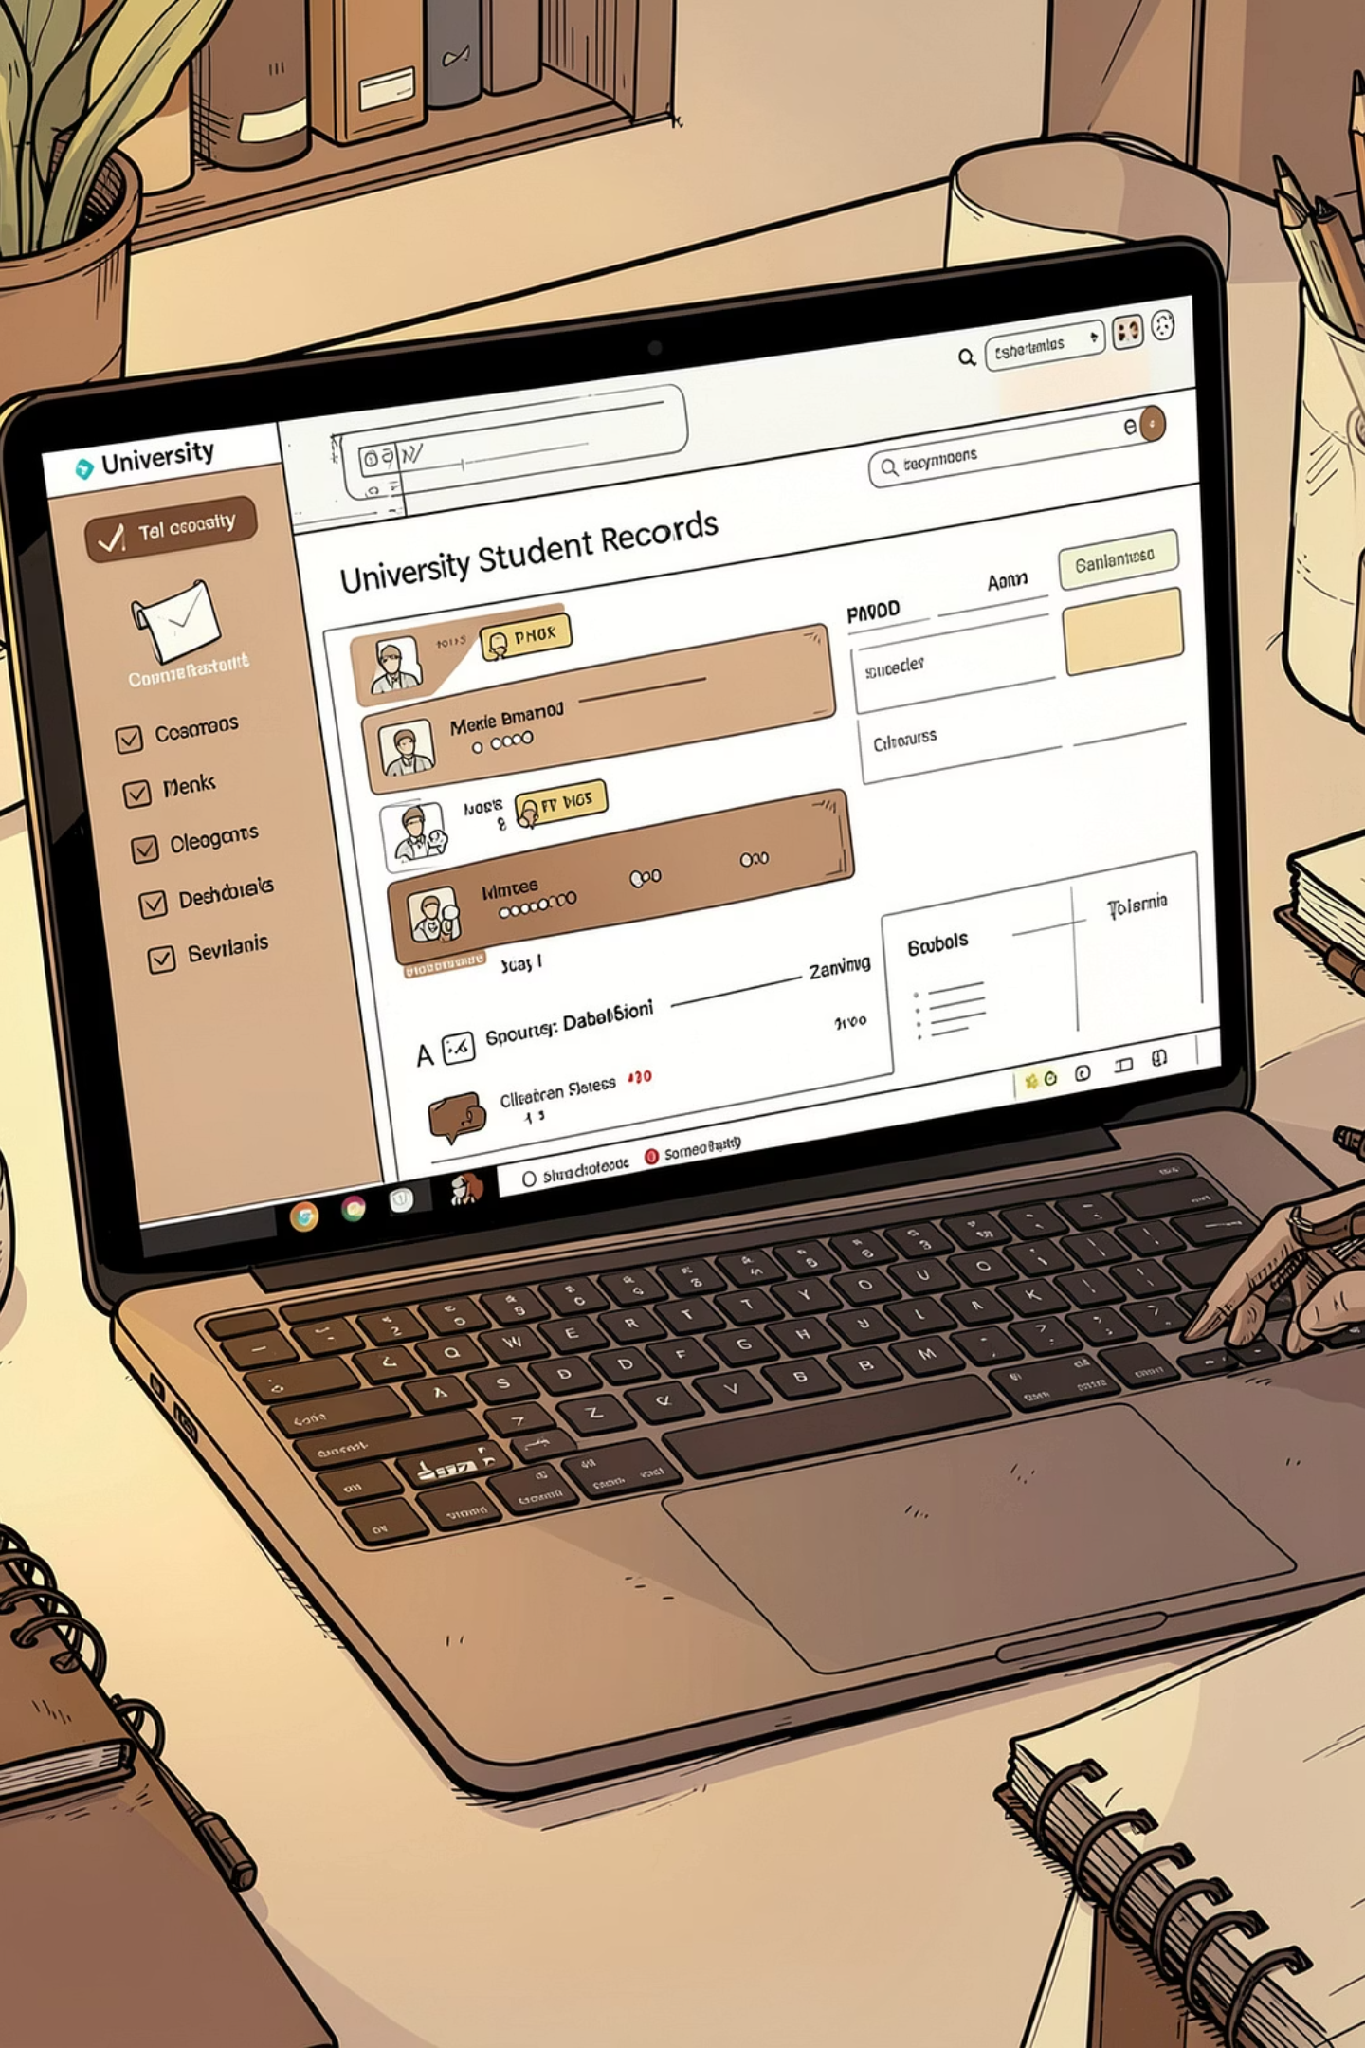
Student Grading System
Vineet Vidyarthi — ERP: RU-25-11679
A concise Java-based application that automates grade calculation, CGPA assignment and student record management. Designed for faculty and administrative use — fast, auditable and easy to operate.

Slide 2


Introduction: Why this project matters
Efficiency
Accuracy
Automates repetitive tasks: grade calculation, report generation and record retrieval.
Consistent CGPA computation and deterministic grading logic reduce errors from manual calculation.
Usability
Menu-driven interface that faculty can use without technical knowledge.
Theme accents: primary emphasis color #3E2513 with soft background #F3E3D8 to match institutional branding.

Slide 3
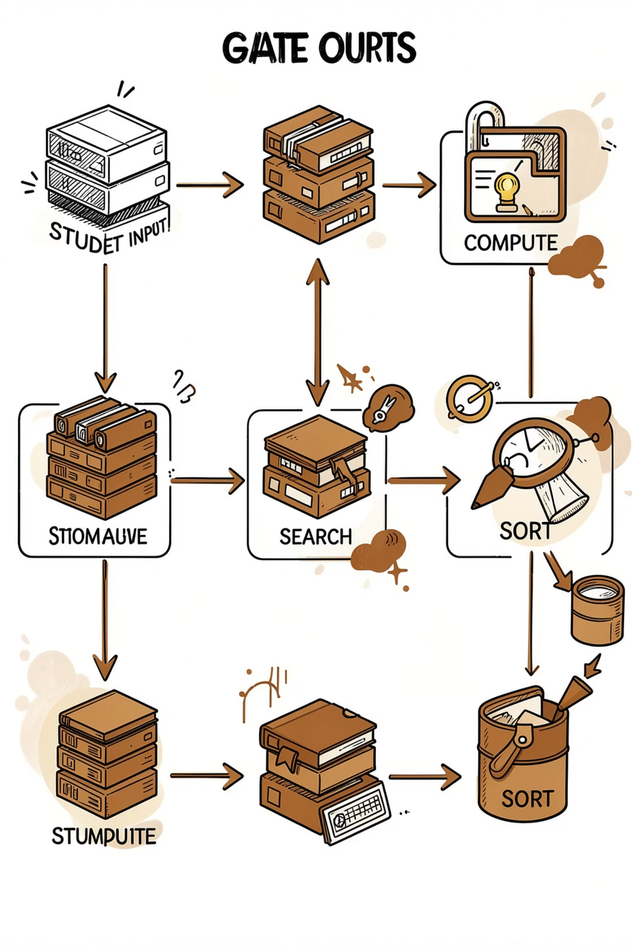
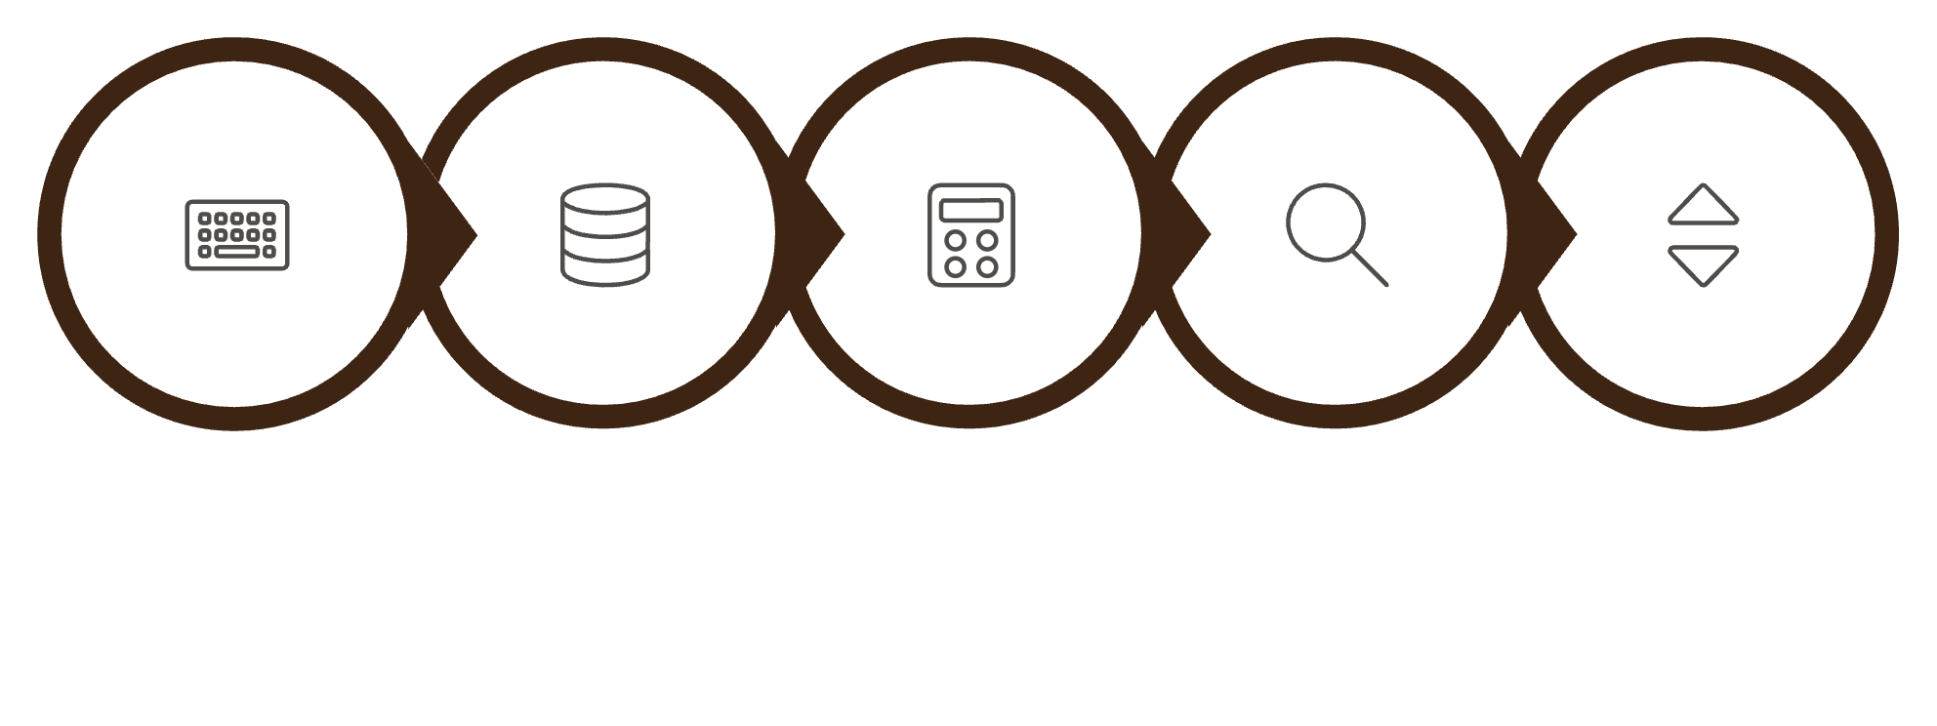
Working of the Project
Input Marks
Store Records
Compute CGPA
Binary Search
Sorted Results
Key components: - Data storage: structured records hold student details and subject marks. - Calculation: CGPA computed from subject scores using weighted averages; grading rules applied to assign letter/grade points. - Algorithms: Binary Search for quick lookup on sorted IDs; Bubble Sort to order small-to-moderate record sets for display. - Interface: Menu-driven console allowing add/update/search/sort and results display.

Slide 4
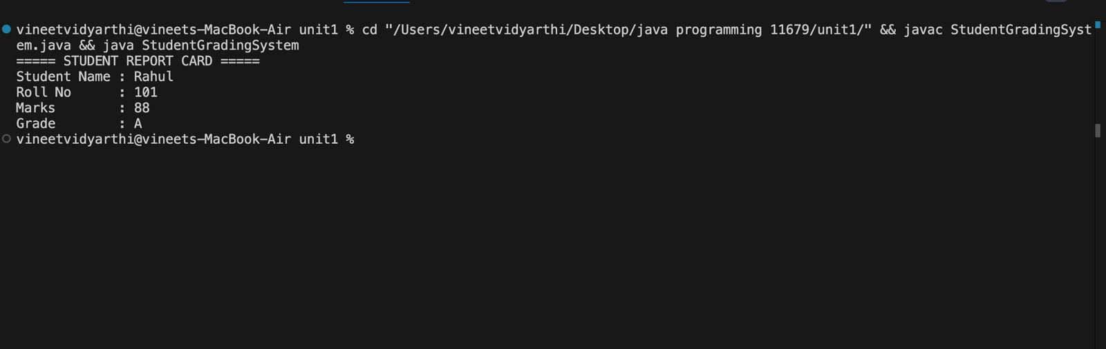
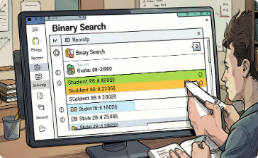
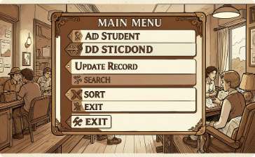
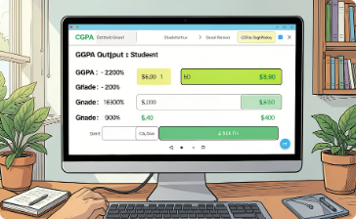
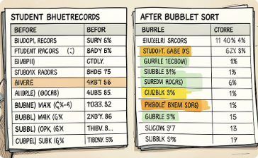
Screenshots & Visual Walkthrough
Student Lookup
Main Menu
Grade / CGPA Output
Sorting View
Fast binary search returns the exact student record when IDs are kept sorted.
Clear, numbered options let users perform core tasks quickly.
Displays computed CGPA, grade point and corresponding letter grade for verification and printing.
Bubble Sort v

Slide 5
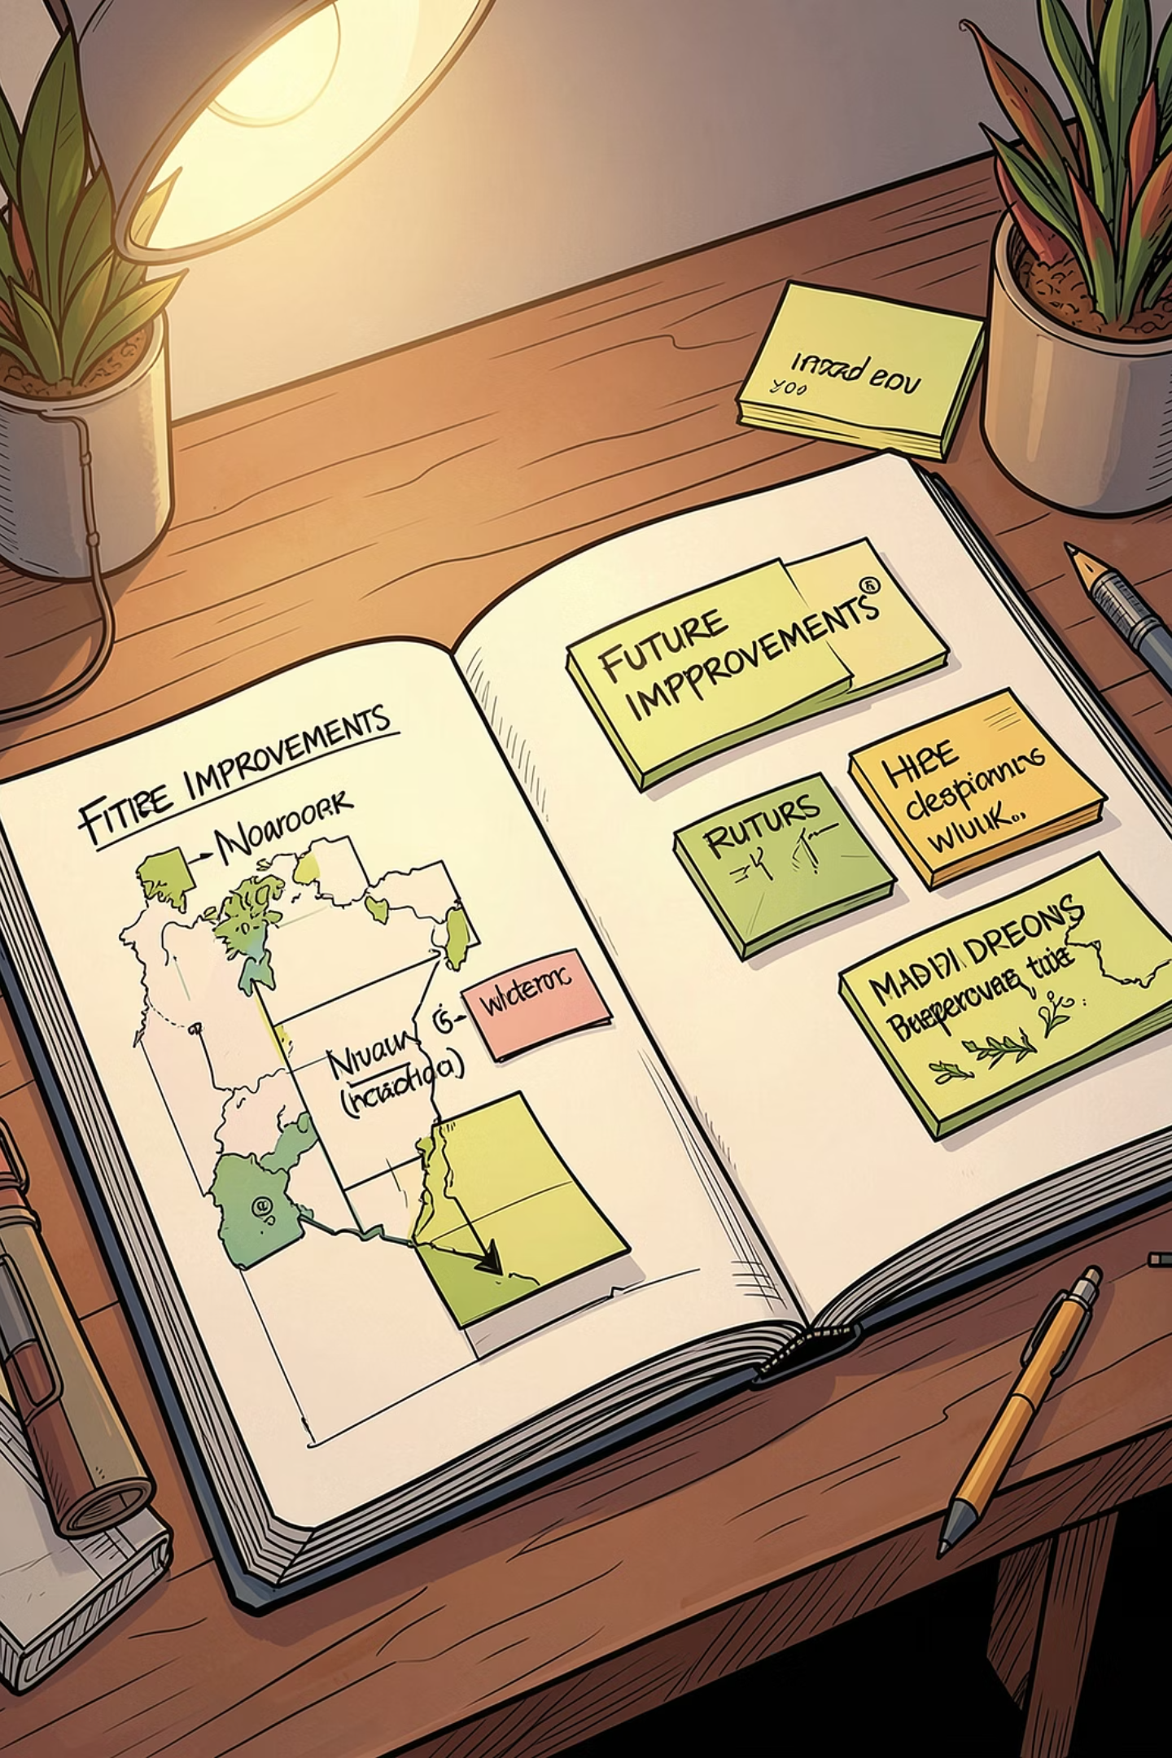
Conclusion & Future Scope
Conclusion
Future scope
The system replaces manual grade calculations by providing reliable CGPA computation, consistent grading and fast record retrieval—improving administrative efficiency and accuracy.
Persistent storage: integrate a relational database for scalability and backups.
Improved UI: migrate from console to a GUI or web front-end for ease of use.
Robustness: add input validation, exception handling and audit logs.
Advanced features: import/export CSV, role-based access, analytics dashboards.

Slide 6
Thank You
We appreciate your time and attention to this presentation.

