Slide 1

codeSanta
A place to help the stuck programmers, because of unavailability of solution

Slide 2
What Is The Innovation ?
While coding, if someone stucks at some point it is very time wasting approach to read each and every line of the code.
codeSanta provides users to both share their code as well they can access the already shared codes.

Slide 3
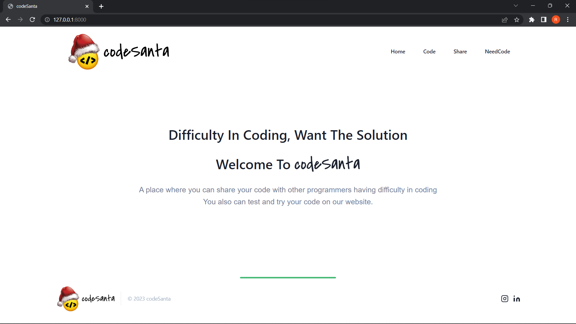

Slide 4
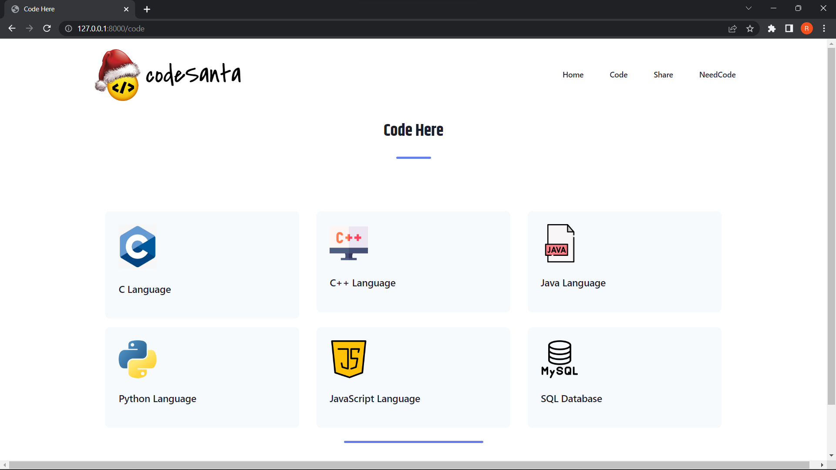
Here You Can Code On Multiple Languages Before Submitting The Code

Slide 5
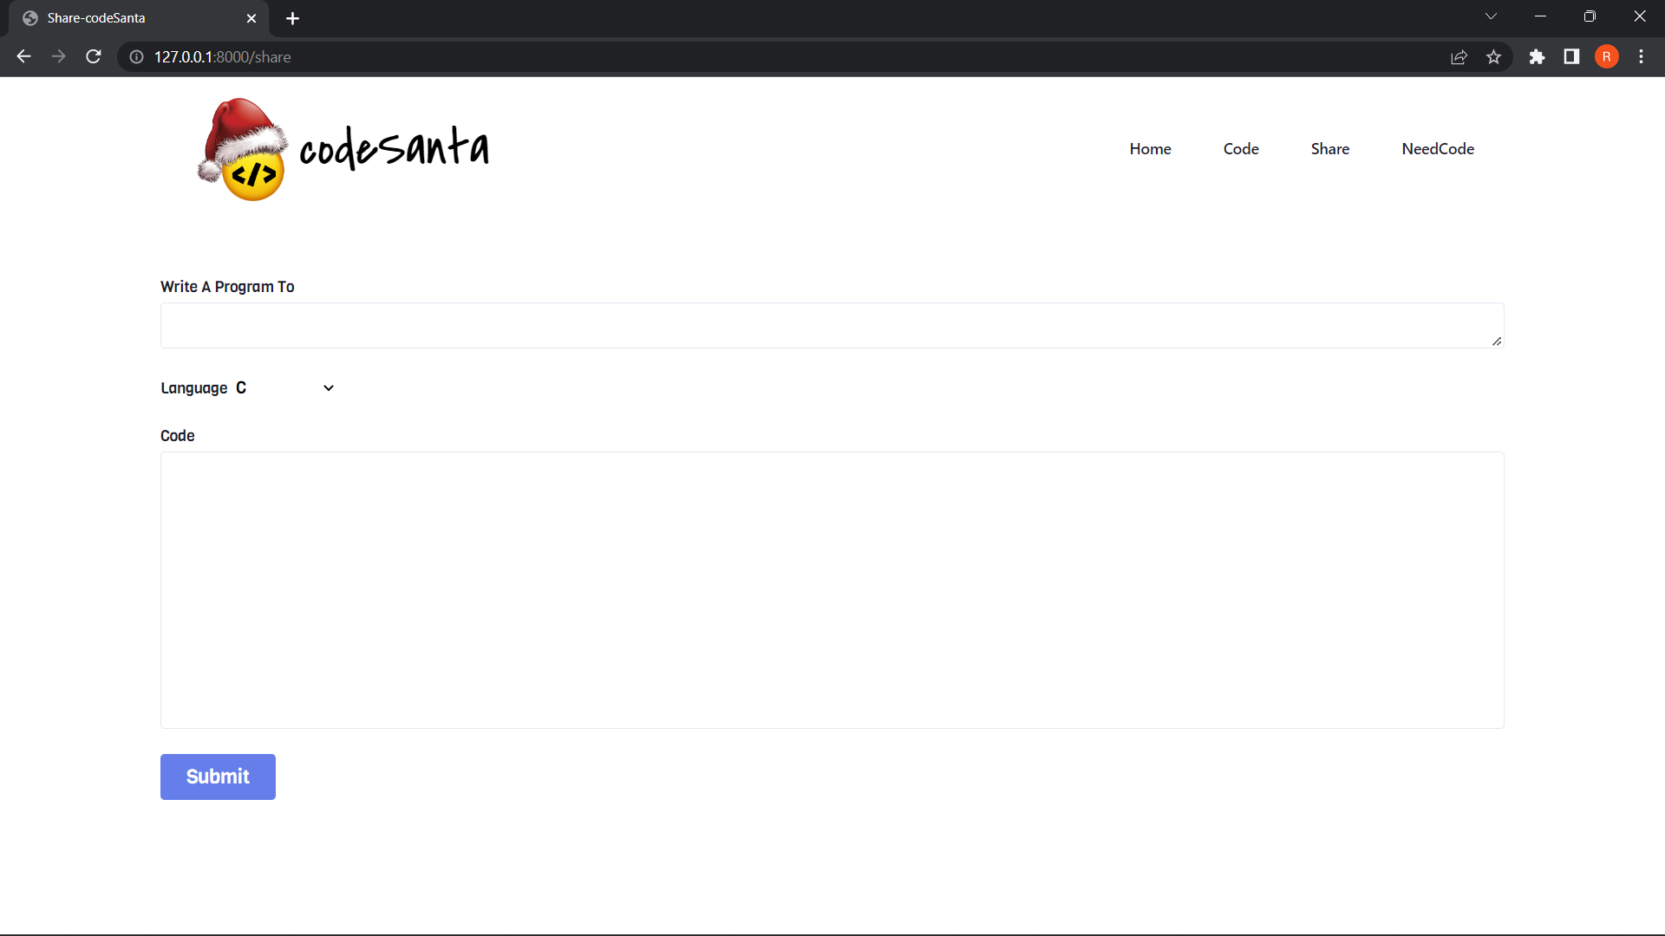
Write Program Title,
Select Language,
Paste The Code,
And Help The Hackers Out There

Slide 6
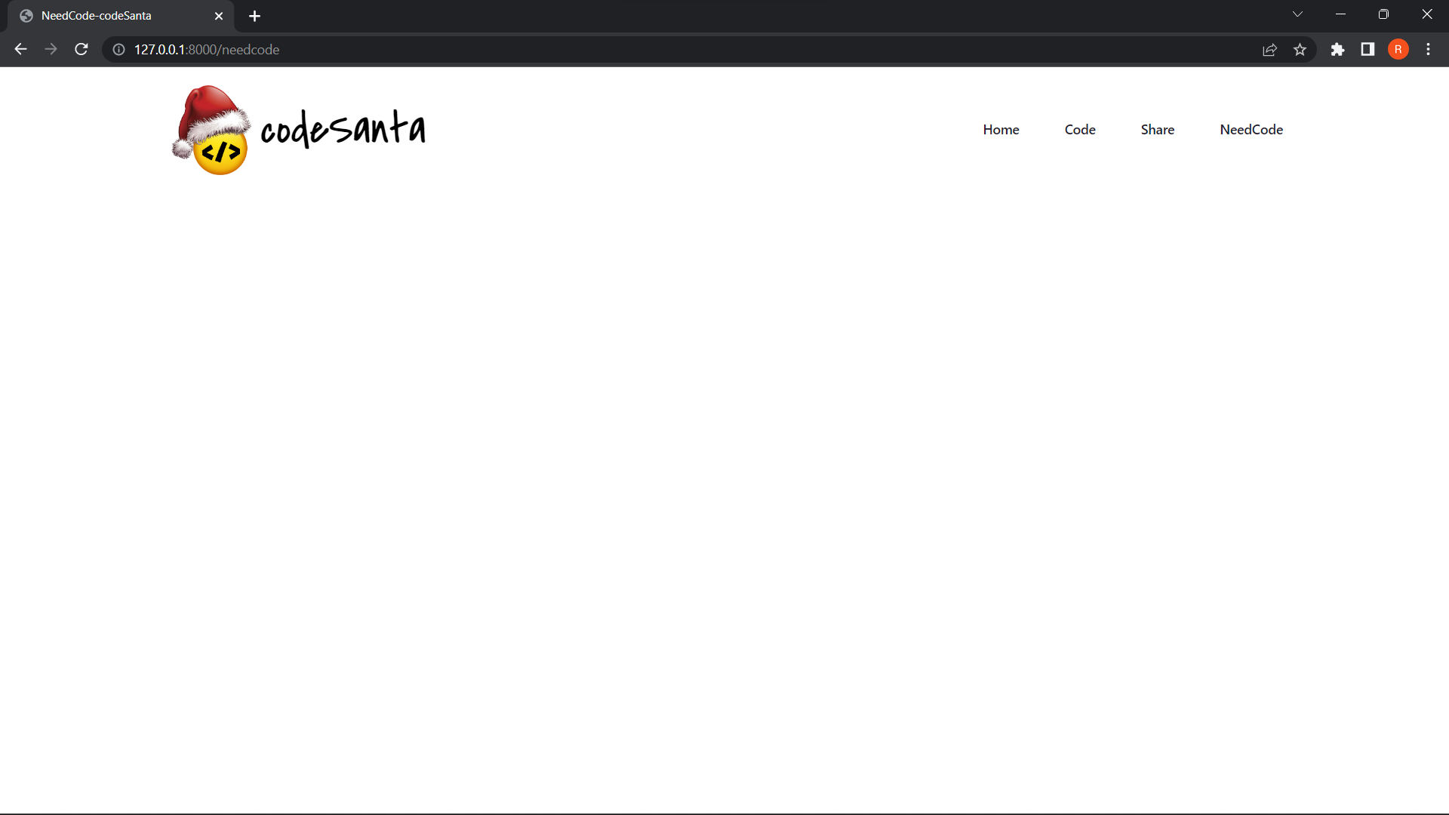
WAP: Add Numbers
Language: python
Code:
a=10
b=20
sum=a+b
print(sum)
Here The Person Can View Already Written Codes For Help

Slide 7
#include <stdio.h>
int main() {
printf("Thank You");
return 0;
}

