Slide 1
Fund Research Agent
Ask about a fund in plain language and get factual, comparable answers in seconds — cutting research time, keeping answers consistent.
Agenda Development approach · Technical flow · Current Architecture · Demo · Target architecture · Delivery Plan

Slide 2
Development Approach - Leveraging AI
Step 1
Set up the project structure
Layered packages — models, services, tools, agent, app, added dependencies
Step 2
Write the context file for AI Assistance
AGENT / Copilot.md in-repo: scope, data model, tool signatures, guardrails.
Step 3
Build the data and service layer
Fund model (ticker, name, AUM, expense ratio, avg return), then a thin API client onto it.
Step 4
Build the agent and tools
Three typed tools — search, details, compare — on a LangChain agent, no-advice prompt.
Step 5
Build the UI and validate
Streamlit chat over the same interfaces; validate each layer before the next.
6

Slide 3
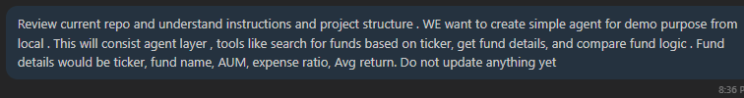
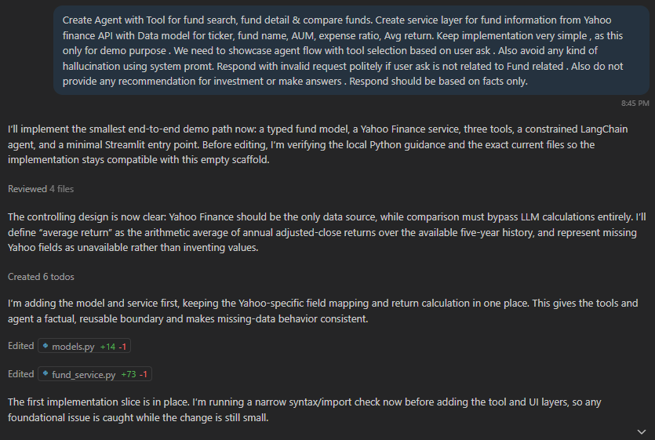
Prompt Capture

Slide 4
Technical flow
Ask
Route
Fetch
Map
Answer
01
02
03
04
05
Streamlit chat captures the question and session context.
LangChain agent selects tools and decomposes the request.
The tool calls the third-party fund API through the service layer.
Response mapped to the fund model: ticker, name, AUM, expense ratio, average return.
Facts returned as text or a comparison table — nothing beyond the data.
3

Slide 5
Current architecture
Chat UI
STREAMLIT
LANGCHAIN
Fund research agent
FUND RESEARCH AGENT TOOLS
Fund search (API)
3rd Party API
Fund details (API)
DATA SOURCES
Compare funds (local)
Fund search and fund details call the third-party API; compare funds is local logic over what they return.
5

Slide 6
Demo

Slide 7
Scalable target architecture
Chat UI
Agent orchestrator
proposed
Fund research agent
live in MVP
Balances agent
proposed
Transaction agent
proposed
FUND RESEARCH AGENT TOOLS
Fund search
Fund details
Compare funds
3rd Party API
DATA SOURCES
5

Slide 8
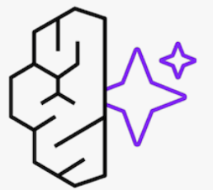














AWS - Cloud
Amazon Bedrock AgentCore
External Resources
Fund Research Agent
CloudWatch
Agent Core Runtime
Observability
WAF +
API Gateway
Orchestrator Agent
API
Balances Agent
A2A
Chat UI
Agent Core Runtime
Agent Core Runtime
Tools
Transaction Agent
3rd Party
Service
AWS Bedrock
conditional
Agent Core Runtime
Human in loop
Foundation Model
bench
Agent Registry
Agent Core
Gateway
Evaluate Agent
(LLM as a Judge)
Agent Core
Memory
Knowledge Base
5

Slide 9
Delivery plan
MVP 1
MVP 2
MVP 3
Fund research agent with UI
Orchestrator and balances agent
Transaction agent
RELEASED AS
RELEASED AS
RELEASED AS
Chat UI that answers fund questions
Same UI, now answering balance questions too
Users can act on accounts, not just ask
BUILD
BUILD
BUILD
Streamlit UI, service API, agent and its tools, guardrail prompt.
Orchestrator, agent registry, A2A routing, balances agent, shared memory
Transaction agent, human in loop on conditional basis, audit logging, judge evaluation
DEPENDS ON
DEPENDS ON
DEPENDS ON
3rd party data, AWS and model access via Bedrock
MVP 1 live, balances API, auth
MVP 2 delivery, transaction APIs
RISK
RISK
RISK
Security risk, Cost
Wrong-agent routing, account data reaching the wrong user
Write actions on real accounts
VALIDATION
VALIDATION
VALIDATION
Input validation, Agent reasoning
Routing accuracy.
Judge scores plus human approval flow
Each MVP ships end to end — UI, auth, observability and evaluation included. Deferred: multi-channel front end, fine-tunining
9

Slide 10
Appendix

Slide 11
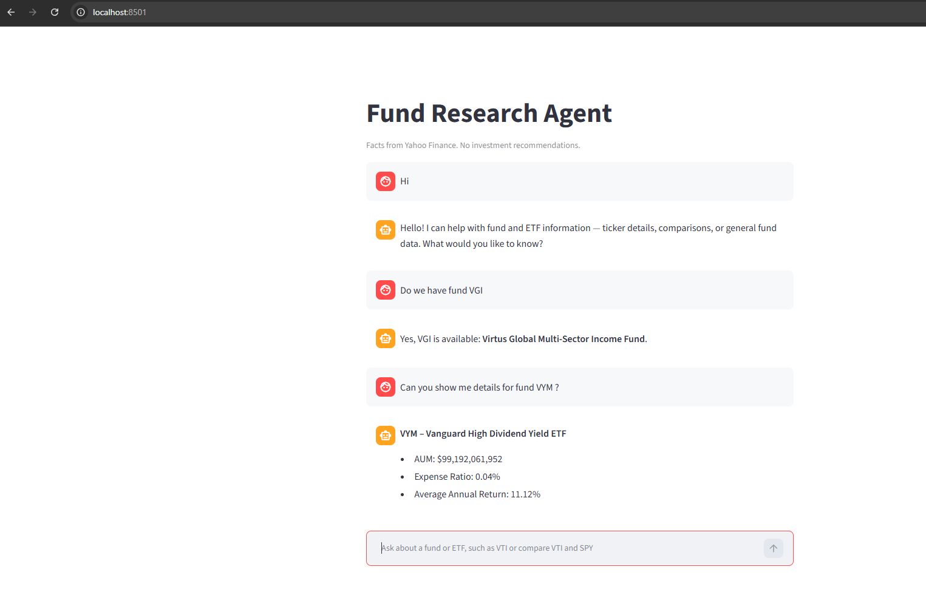

Slide 12
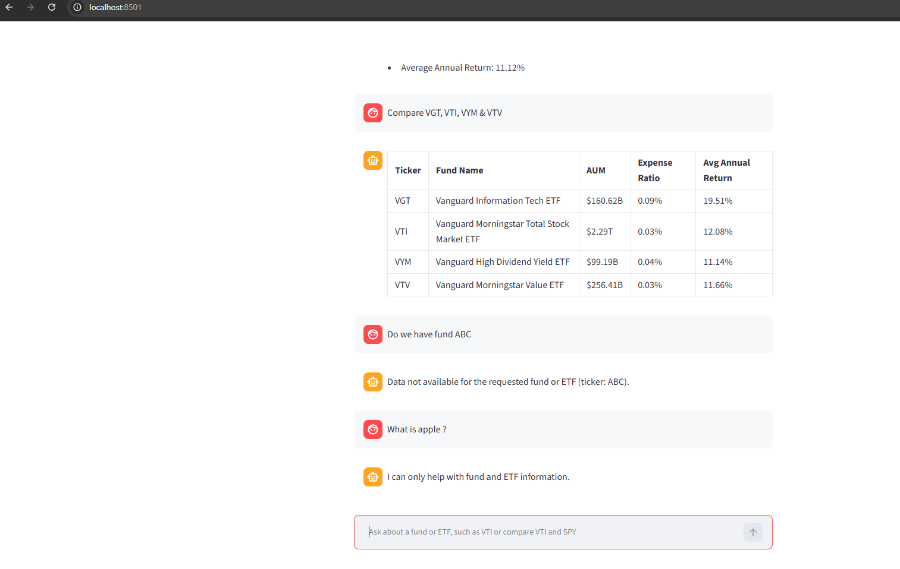

Slide 13
Thank you

