Slide 1
1. What is Data?
Data is a collection of raw facts, figures, numbers, text, images, audio, or videos that have not yet been processed into meaningful information.
Examples
Rahul
25
Pune
₹45,000
9876543210
These are all pieces of data.

Slide 2
2. What is Information?
Information is processed, organized, and meaningful data that helps in making decisions.
Information
Average Salary = ₹57,500
Highest Salary = ₹65,000
Total Employees = 2
Name | Age | Salary
Rahul | 25 | 50000
Priya | 28 | 65000

Slide 3
Database
A Database is an organized collection of data stored electronically so it can be easily accessed, managed, and updated.
Example:
Student records in a college.
Bank account details.
E-commerce product data .

Slide 4
Advantages of Database
Centralized storage
Fast data retrieval
Easy updates
Data security
Data consistency
Reduced duplication
Backup and recovery
Multi-user access
Data sharing
Better decision making

Slide 5
Applications of Database
Banking
Education
Hospitals
E-commerce
Airlines
Hotels
Social Media
Government
Insurance
Finance
Telecommunications
Manufacturing
Logistics
Human Resources

Slide 6
Types of Databases
Relational Database (RDBMS)
NoSQL Databases (NRDBMS)
Other Types
Cloud Databases

Slide 7
1. Relational Database (RDBMS)
Data stored in tables (rows & columns)
Uses SQL
Examples: MySQL, Oracle, PostgreSQL, SQL Server
2. NoSQL Databases
Used for unstructured data
Flexible schema
Examples: MongoDB ,Cassandra ,Firebase,Redis
Used for
Social media
Chat applications
Big Data

Slide 8
3.Other Types
Hierarchical DB
Network DB
Cloud DB
4. Cloud Database
Database stored on cloud servers.
Examples
Amazon RDS
Google Cloud SQL
Azure SQL

Slide 9
Database Languages
Database languages are programming/query languages used to:
Store data
Retrieve data
Manage databases

Slide 10
SQL (Structured Query Language)
Used for Relational Databases (RDBMS)
Most popular database language
Used in:
MySQL
Oracle Database
PostgreSQL
Microsoft SQL Server
Best for: Structured data (tables)

Slide 11
2. PL/SQL (Procedural Language SQL)
Extension of SQL developed by Oracle Corporation
Supports programming concepts (loops, conditions)
Used in:
Oracle Database

Slide 12
3. NoSQL Query Languages
Used for non-relational databases
Examples:
MongoDB Query Language (MQL)
Used in MongoDB
Cassandra Query Language (CQL)
Used in Apache Cassandra
Looks similar to SQL but works differently

Slide 13
Why Use Databases?
Data storage
Easy retrieval
Security
Data consistency

Slide 14
SQL
SQL (Structured Query Language) is a standard database language used to interact with relational databases by performing operations such as data storage, retrieval, updating, and deletion.

Slide 15
Why Use SQL?
Reasons:
Standard language for databases
Easy to learn
High performance
Handles large data efficiently
Works with almost all industries

Slide 16
Advantages of SQL
1) Easy to understand 2) Fast queries 3) Reliable & secure 4) ACID properties (data consistency) 5) Widely used

Slide 17
Features of MySQL
Free & open-source
Fast performance
Supports large databases
Works with languages like Python, Java, PHP

Slide 18
Job Opportunities
SQL Developer
Data Analyst
Database Administrator (DBA)
Backend Developer
Data Scientist
Database Engineer

Slide 19
SQL Roadmap
SQL ROADMAP 1. Basic - What Is SQL - Databases & Tables - Data Types - CRUD (Create, Read, Update, Delete) 2. Queries - SELECT Statements - WHERE Clauses - ORDER BY, GROUP BY - LIMIT, DISTINCT

Slide 20
3. Functions - Aggregate: COUNT(), SUM(), AVG() - String: UPPER(), LOWER(), CONCAT() - Date: NOW(), DATE(), DATEDIFF() 4. Joins - INNER JOIN - LEFT JOIN - RIGHT JOIN - FULL JOIN - SELF JOIN 5. Subqueries - In SELECT, FROM, WHERE - Correlated Subqueries

Slide 21
6. Constraints - PRIMARY KEY - FOREIGN KEY - UNIQUE - NOT NULL - CHECK 7. Indexes & Views - Indexing For Speed - Creating & Using Views 8. Normalization - 1NF, 2NF, 3NF - Avoiding Redundancy

Slide 22
9. Transactions - BEGIN, COMMIT, ROLLBACK - ACID Properties 10. Advanced - Stored Procedures - Triggers - Window Functions - CTEs (WITH Clause) 11. Practice - Projects - Resources - SQL Exercises

Slide 23
Data
Data is raw facts or figures, or any information that is stored in or used by a computer.
Data by itself has no meaning until it is processed or given context.
It can be numbers, text, dates, images, etc.
These are just raw pieces of information.

Slide 24
Database
A database is an organized collection of data (or information) that is stored in such a way that it can be easily accessed, managed, and updated.
A database is like a well-organized digital filing cabinet.
It keeps data in a structured format so that we can find, add, change, or delete information quickly and efficiently.

Slide 25
Ex :- Database Example | What kind of data it stores
School Management System | Student names, roll numbers, marks, attendance
Bank Database | Customer accounts, balances, transactions
E-commerce Website (Amazon) | Products, prices, customer details, orders
Hospital System | Patient records, medical history, appointments
Social Media (Instagram) | User profiles, posts, likes, comments

Slide 26
What are SQL Data Types?
Data Types in SQL define what kind of data can be stored in a column of a table. They tell the database how to store, handle, and validate the data.
Choosing the correct data type is very important for:
Saving storage space
Better performance
Data accuracy and validation

Slide 27
Main Categories of SQL Data Types
Category | Purpose | Common Data Types
Numeric | Numbers (integers & decimals) | INT, BIGINT, DECIMAL, FLOAT
String/Text | Text and characters | VARCHAR, CHAR, TEXT
Date and Time | Dates, times, timestamps | DATE, TIME, DATETIME, TIMESTAMP
Boolean | True/False values | BOOLEAN / BOOL
Binary | Binary data (images, files, etc.) | BLOB, VARBINARY

Slide 28
1. Numeric Data Types
Data Type | Description | Example Values | When to Use
INT | Integer (whole numbers) | 25, -10, 100000 | Age, Quantity, Student ID
BIGINT | Very large integers | 9876543210 | Phone numbers, Large IDs
DECIMAL(p,d) | Exact decimal numbers | 99.99, 1234.567 | Price, Salary, Marks (with decimals)
FLOAT | Approximate decimal numbers | 3.14159 | Scientific calculations
SMALLINT | Small range integers | 1 to 32767 | Status codes, Small counts

Slide 29
2. String / Text Data Types
Data Type | Description | Max Length | Example
CHAR(n) | Fixed length text | Up to 255 chars | 'M', 'Male'
VARCHAR(n) | Variable length text (most commonly used) | Up to 65,535 chars | 'Amit Sharma', 'Delhi'
TEXT | Large text (long descriptions) | Very large | Product description, comments

Slide 30
3. Date and Time Data Types
Data Type | Description | Example Value
DATE | Only Date (Year-Month-Day) | '2026-04-04'
TIME | Only Time (Hours:Minutes:Seconds) | '14:30:25'
DATETIME | Date + Time | '2026-04-04 15:45:30'
TIMESTAMP | Date + Time (auto-updates) | '2026-04-04 15:45:30'

Slide 31
4. Boolean Data Type
Data Type | Description | Possible Values
BOOLEAN | True or False | TRUE, FALSE, 1, 0

Slide 32
SQL Constraints : SQL constraints are rules applied to table columns to ensure data accuracy, consistency, and integrity. They restrict invalid data entry and enforce relationships between tables. Constraints can be added during table creation (CREATE TABLE) or later using ALTER TABLE.

Slide 33
SQL constraints
SQL constraints are rules enforced by the database management system (DBMS) on table columns or entire tables. They ensure data integrity, accuracy, consistency, and reliability by limiting the types of data that can be inserted, updated, or deleted.
NOT NULL
UNIQUE
PRIMARY KEY
FOREIGN KEY
CHECK
DEFAULT
INDEX

Slide 34
1)NOT NULL Ensures a column cannot contain NULL values. Every row must have a value in that column. Syntax (column-level):
Syntax:
CREATE TABLE employees (
employee_id INT NOT NULL,
name VARCHAR(100) NOT NULL
);

Slide 35
2) UNIQUE Ensures all values in a column (or combination of columns) are distinct. Multiple UNIQUE constraints are allowed per table. It allows one NULL value in most DBMS (like MySQL, PostgreSQL, SQL Server), but not duplicates.
Syntax:
CREATE TABLE employees (
employee_id INT UNIQUE,
email VARCHAR(255) UNIQUE
);

Slide 36
3) PRIMARY KEY Uniquely identifies each row in a table. It is a combination of NOT NULL + UNIQUE. Only one primary key per table is allowed (it can be composite, spanning multiple columns).
Syntax:
CREATE TABLE employees (
employee_id INT PRIMARY KEY,
name VARCHAR(100)
);

Slide 37
4) FOREIGN KEY Enforces referential integrity by linking a column (or columns) in one table to the PRIMARY KEY (or UNIQUE key) in another table. It prevents actions that would break the link between tables (e.g., deleting a parent record if child records exist, depending on ON DELETE rules).
Syntax:
CREATE TABLE orders (
order_id INT PRIMARY KEY,
customer_id INT,
FOREIGN KEY (customer_id) REFERENCES customers(customer_id)
);

Slide 38
5) CHECK Ensures values in a column satisfy a specific condition (boolean expression).
Syntax:
CREATE TABLE employees (
employee_id INT PRIMARY KEY,
salary DECIMAL(10,2) CHECK (salary > 0),
age INT CHECK (age >= 18 AND age <= 65)
);

Slide 39
6) DEFAULT Provides a default value for a column when no value is specified during INSERT.
Syntax:
CREATE TABLE employees (
employee_id INT PRIMARY KEY,
status VARCHAR(20) DEFAULT 'Active',
hire_date DATE DEFAULT CURRENT_DATE
);

Slide 40
6) INDEX: UNIQUE and PRIMARY KEY constraints automatically create indexes for fast lookups.
Benefits: Constraints enforce rules automatically, reduce application-level validation needs, and improve data quality.

Slide 41
SQL Comments
SQL comments are explanatory notes added to your SQL code that are ignored by the database engine during execution. They help document your queries, making them easier to understand and maintain.
1. Single-Line Comments
Starts with -- (two hyphens)
Everything after -- on the same line is treated as a comment
Most widely supported across all databases

Slide 42
2. Multi-Line Comments (Block Comments)
Starts with /* and ends with */
Can span multiple lines
Useful for longer explanations or temporarily disabling blocks of code
Common Use Cases
Header Information (at the top of scripts)
Explaining Complex Logic
Temporarily Disabling Code (commenting out sections)
TODO notes for future improvements
Business Rule Documentation

Slide 43
Section | Purpose
Left Panel | Databases
Center | Write SQL
Top | Run Query
Bottom | Output/Error
Right | Help

Slide 44
Icon | Function
⚡ | Execute query
⛔ | Stop query
💾 | Save
📂 | Open file
📝 | New tab
🔄 | Refresh schema
🔍 | Search
✔ | Commit
↩ | Rollback

Slide 45
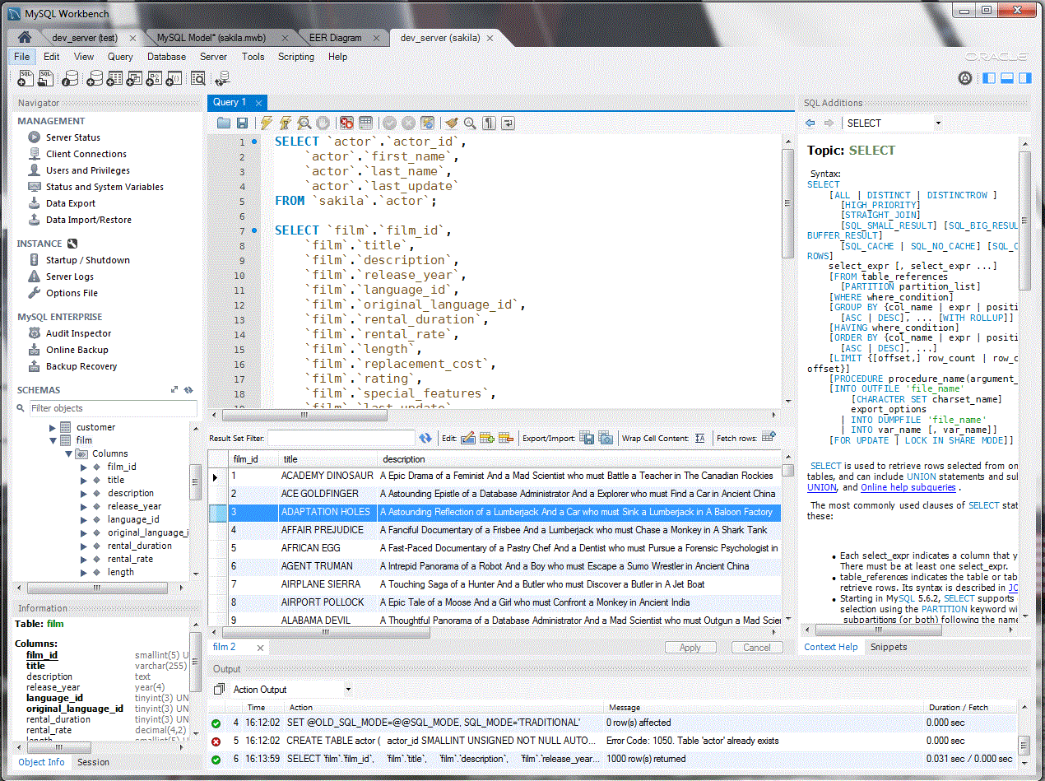

Slide 46
What is a Key in SQL?
A key is a special column (or group of columns) in a table that helps identify rows uniquely or connect tables together.
Your Aadhaar number or Phone number is a key that uniquely identifies you.
Same way, keys help the database find or connect data easily.

Slide 47
1. Super Key :
A Super Key is any combination of columns that can uniquely identify each row in a table.
Ex:
Customer ID | Name | Email | Phone | City
101 | Pratap | pratap@gmail.com | 9876543210 | Pune
Super Keys can be:
Customer ID (alone)
Email address (alone)
Phone Number (alone)
Customer ID + Name
Customer ID + City
Customer ID + Email
→ Any set that can uniquely identify a customer is a Super Key.

Slide 48
2. Candidate Key
Simple Definition: A Candidate Key is a minimal super key — the smallest possible combination that can still uniquely identify a row.
example:
Customer ID → Candidate Key
Email Address → Candidate Key
Phone Number → Candidate Key
But (Customer ID + Name) is not a candidate key because it has extra columns. You can remove "Name" and Customer ID alone is still enough.
Rule: Candidate keys are the "smallest" possible super keys.

Slide 49
3. Primary Key
Simple Definition: The Primary Key is the main candidate key chosen by the database designer.
Rules for Primary Key:
It must be unique
It cannot be NULL (empty)
A table can have only one Primary Key
Example: Most companies choose Customer ID as the Primary Key.

Slide 50
4. Alternate Key
Simple Definition: All Candidate Keys except the Primary Key are called Alternate Keys.
Example:
Primary Key = Customer ID
Alternate Keys = Email Address, Phone Number
They are good alternatives, but not chosen as the main key.

Slide 51
5. Foreign Key
A Foreign Key is a column in one table that refers to the Primary Key of another table.
It is used to link two tables together.
1) Department Table: | a) Employee Table:
DeptID (Primary Key) | EmpID (Primary Key)
DeptName | Name

Slide 52
DeptID ← This is a Foreign Key
Here DeptID in Employee table links to DeptID in Department table.
Main Purpose of Foreign Key:
Maintain Referential Integrity (It prevents you from adding wrong or invalid data)

Slide 53
What is a Composite Key?
A Composite Key is a key made up of two or more columns together that uniquely identify each row in a table.
Single column is not enough to make every row unique.
But when you combine 2 or more columns, their combination becomes unique.
It is also called a Compound Key sometimes.
Important: A composite key is usually used as a Primary Key (or it can be a Candidate Key).
Easy Real-Life Example

Slide 54
Key Type | Meaning in Simple Words | How Many Allowed?
Super Key | Any combination that uniquely identifies a row | Many
Candidate Key | Smallest possible super key | Many
Primary Key | Main unique identifier (chosen one) | Only 1 per table
Alternate Key | Other candidate keys (not chosen as primary) | Many
Foreign Key | Link to another table's primary key | Many

Slide 55
SQL Commands :-
Used to:
Store data
Retrieve data
Update data
Delete data
Manage databases

Slide 56
