Slide 1
Adaptive Evidence Acquisition for
Grounded Video Question Answering
A cost-aware evidence selection view of grounded VideoQA
Opening question
How much visual evidence is enough to answer a video question while staying temporally grounded?
Main claim
Answer accuracy, evidence cost, and temporal grounding must be evaluated together.
Aniket Salunke, Ketan More, Nazish Baliyan, Ritesh Thawkar | MBZUAI

Slide 2
Three Questions We Answer
2 / 16
Research Question 1
Q1. Do all video questions need the same amount of visual evidence?
Research Question 2
Q2. Can compact question-conditioned evidence improve grounding without using the full fixed budget?
Research Question 3
Q3. Is the remaining gap caused by evidence routing, answerer strength, or candidate-pool quality?
We answer these through controlled evidence-budget experiments and an answerer swap from a frozen scorer to Qwen2.5-VL.

Slide 3
Motivation: Correct Answers Can Be Ungrounded
3 / 16
VideoQA evidence is distributed over time.
A correct option may be guessed from priors or broad scene context.
Fixed frame/clip budgets can waste evidence or miss the support moment.
Grounded VideoQA asks
1. Is the answer correct?
2. Does selected evidence overlap the support moment?
Why it matters
Grounding turns answer classification into evidence-supported reasoning.
Failure mode
correct but weakly grounded
Desired behavior
correct and grounded

Slide 4
Related Work and Gap
4 / 16
Area | Examples | What they provide
VideoQA benchmarks | MovieQA, TGIF-QA, TVQA, NExT-QA | Temporal and causal reasoning tasks
Grounded VideoQA / localization | TVQA+, NExT-GQA, Moment-DETR, QVHighlights, SeViLA | Support spans and temporal evidence annotations
Pretrained answerers | CLIP, FrozenBiLM, BLIP-2, Video-LLaVA, Qwen2.5-VL | Strong visual-language reasoning backbones
Retrieval/adaptive context | R2A, VideoRAG/VRAG, UniversalRAG, ModaRoute | Selective context construction for long videos
Gap
Prior work often reports answer quality without jointly charging evidence cost and verifying temporal support. We evaluate Acc@QA, cost, IoP/IoU, and Acc@GQA under one evidence-selection protocol.

Slide 5
Task Formulation
5 / 16
Grounded VideoQA example
x = (v, q, A, y, T)
video, question, answer options, label, support span
Evidence pool
E(x) = {e1, ..., eN}
frames and short temporal segments with cost and interval metadata
Policy
Selects S subset E(x)
C(S) = sum_i c_i
Answerer
Predicts the answer from the question, answer options, and selected evidence only.
Optimization intuition: maximize answer accuracy and grounding while minimizing acquired evidence cost.

Slide 6
Method: Adaptive Evidence Acquisition Pipeline
6 / 16
Input
video + question
answer options
Candidate pool
keyframes + short
temporal segments
Evidence router
MLP+NMS selects compact,
diverse evidence
Qwen answerer
predicts answer using
selected evidence only
Evaluation
Acc@QA + cost
+ IoP/IoU + Acc@GQA
>
>
>
>
Controlled answerer swap
Keep selected evidence fixed, then swap only the answerer. This separates routing quality from visual reasoning quality.
What is trained?
The proposed router is a lightweight MLP candidate scorer with temporal NMS. Qwen is not trained.
This keeps the research question focused on evidence acquisition rather than full VLM fine-tuning.

Slide 7
Evidence Policies and Cost Ladder
7 / 16
Policy | Selection rule | Count | Cost | Role
One segment | top segment | 1 | 1.500 | low-cost control
Linear policy | oracle-trace imitation | 2 | 2.795 | compact baseline
MLP top-2 | candidate MLP scores | 2 | 3.000 | router ablation
MLP+NMS (Our) | MLP + temporal diversity | 2 | 2.935 | proposed selector
Temporal-supervised | overlap-label MLP | 2 | 2.273 | diagnostic router
Oracle top-2 | ground-truth IoP from pool | 2 | 2.493 | headroom reference
Fixed 3+3 | 3 frames + 3 segments | 6 | 7.500 | coverage reference
Temporal-supervised, oracle, and fixed 3+3 rows are diagnostic/reference rows, not the proposed method.

Slide 8
Experimental Setup and Metrics
8 / 16
Dataset
NExT-GQA
Validation: 3,358 examples
Test: 5,553 examples
Answerers
Frozen CLIP-style scorer
Qwen2.5-VL-3B-Instruct
Protocol
Same selected evidence
Swap only final answerer
Deterministic Qwen decoding
Metric | Meaning
Acc@QA | Whether the answer letter is correct
Cost / Count | Amount and number of acquired evidence items
mIoP, IoP@0.5 | Selected evidence is inside the support span
mIoU, IoU@0.5 | Stricter temporal overlap with support span
Acc@GQA | Correct answer and IoP@0.5 grounding success
Grounded answer accuracy is stricter than answer accuracy because it gates correctness by temporal support.

Slide 9
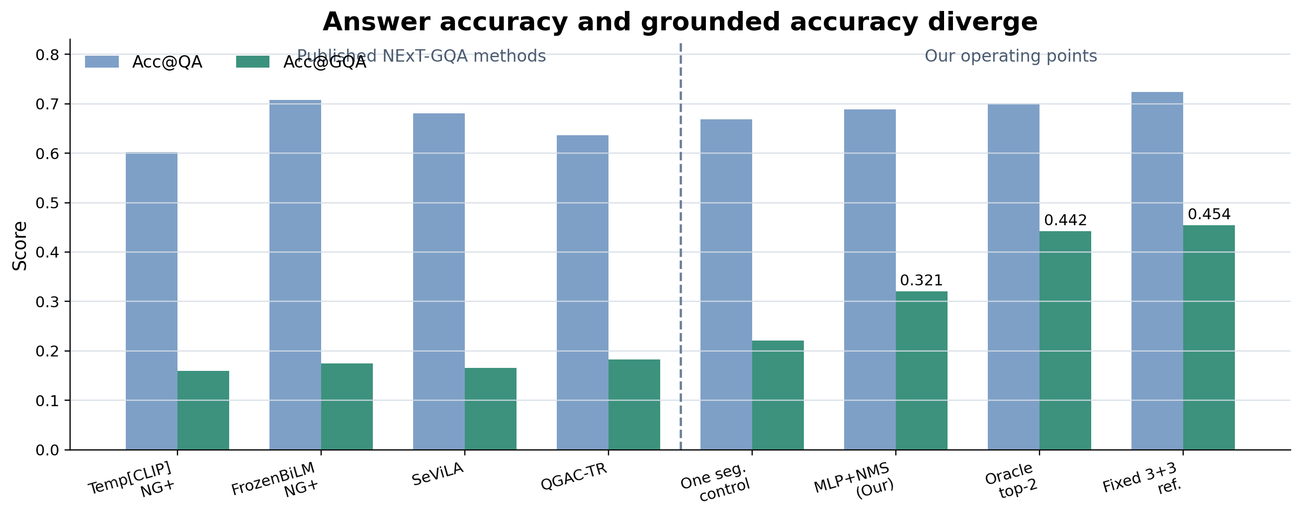
Main Comparison: Answer Accuracy Is Not Grounding
9 / 16
Protocol context
Proposed point
References
Prior rows use official NExT-GQA metrics. Our grounding uses selected-evidence best overlap.
Qwen MLP+NMS: 0.689 Acc@QA, 0.321 Acc@GQA, cost 2.935.
Oracle top-2: 0.442 Acc@GQA. Fixed 3+3: 0.454 Acc@GQA.

Slide 10
Result 1: Frozen Answerer Is the Bottleneck
10 / 16
Method | Acc@QA | Cost | IoP@0.5 | Acc@GQA
One segment | 0.378 | 1.500 | 0.311 | 0.124
Linear policy, two items | 0.381 | 2.795 | 0.410 | 0.164
Fixed 3 frames + 3 segments | 0.388 | 7.500 | 0.615 | 0.245
Fixed 6 frames + 6 segments | 0.394 | 14.908 | 0.787 | 0.316
Observation
Temporal coverage improves as evidence budget increases, but answer accuracy remains near 0.38-0.39.
Conclusion
A weak answerer can hide evidence-selection improvements in the answer metric.

Slide 11
Result 2: Qwen Reveals the Selector Tradeoff
11 / 16
Method | Acc@QA | Cost | IoP@0.5 | mIoU | Acc@GQA
One segment | 0.668 | 1.500 | 0.311 | 0.165 | 0.221
Linear policy | 0.696 | 2.795 | 0.410 | 0.206 | 0.297
MLP top-2 | 0.687 | 3.000 | 0.423 | 0.238 | 0.301
MLP+NMS (Our) | 0.689 | 2.935 | 0.453 | 0.246 | 0.321
Temporal-supervised | 0.696 | 2.273 | 0.432 | 0.088 | 0.312
Oracle top-2 ref. | 0.701 | 2.493 | 0.615 | 0.224 | 0.442
Fixed 3+3 ref. | 0.724 | 7.500 | 0.615 | 0.296 | 0.454
MLP+NMS is the strongest learned grounded selector; temporal supervision is cheaper but under-covers by IoU.

Slide 12
Result 2 Takeaway: Compact Evidence Works
12 / 16
Answer retained
95%
Cost used
39%
Acc@GQA retained
71%
Why this matters
MLP+NMS gives a much cheaper learned operating point than fixed 3+3 while preserving most answer accuracy.
Remaining headroom
Oracle top-2 reaches 0.442 Acc@GQA at cost 2.493, showing compact support exists in the candidate pool.
Reviewer-facing message: compact evidence is not just cheaper; it changes what is measured, because grounded correctness penalizes correct answers supported by the wrong moment.

Slide 13
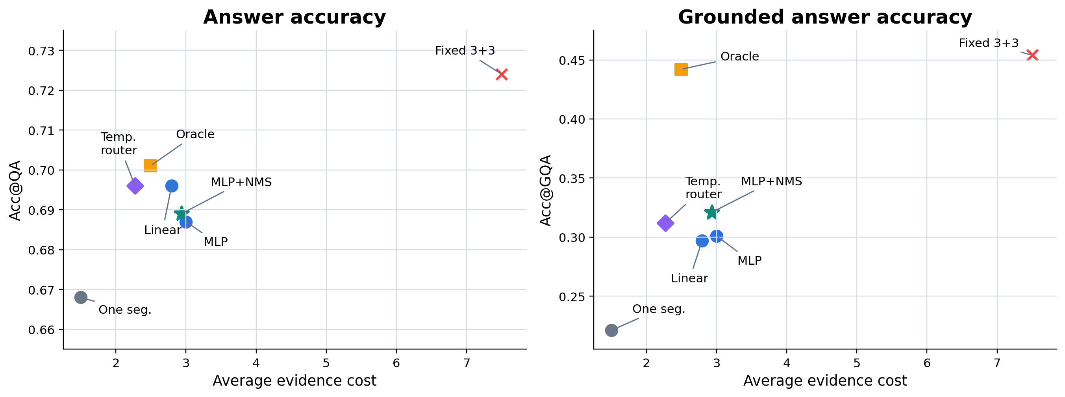
Accuracy-Cost-Grounding Tradeoff
13 / 16
Interpretation
Answer accuracy is relatively flat among compact selectors, but Acc@GQA separates evidence quality. MLP+NMS is the strongest learned grounded point; oracle top-2 shows compact support exists in the pool.

Slide 14
Qualitative Lessons
14 / 16
Case from report | What happens | Lesson
Temporal NMS helps | MLP top-2 selects redundant late evidence; MLP+NMS recovers support overlap while preserving the answer. | Diversity filtering improves compact grounding
Router misses support | MLP+NMS can miss the annotated moment; oracle top-2 and fixed 3+3 recover it from the same pool. | Candidate pool has headroom
Grounding and answering separate | High temporal overlap can still produce a wrong answer, and correct answers can be weakly grounded. | Report Acc@QA, cost, IoP/IoU, and Acc@GQA together
Takeaway
The qualitative examples support the same conclusion as the tables: the remaining bottleneck is ranking and diversifying support evidence.

Slide 15
Answers to the Opening Questions
15 / 16
Q1. Same evidence budget for every question?
No. Some questions need one short segment; others need broader temporal coverage. Fixed context can be wasteful or weakly grounded.
Q2. Can compact learned evidence preserve accuracy?
Yes. MLP+NMS improves Acc@GQA by 10.0 points over one segment, keeps about 95% of fixed 3+3 answer accuracy, and uses 39% of its evidence cost.
Q3. Evidence problem or answerer problem?
Both, but the final gap is mainly routing. The frozen answerer hides evidence gains; Qwen exposes them; oracle top-2 shows compact support exists in the pool.
Final claim for the paper: report answer accuracy, temporal grounding, and evidence cost together; otherwise the evaluation cannot distinguish efficient grounded reasoning from answer-only recognition.

Slide 16
Final Takeaway
16 / 16
Central message
Grounded VideoQA should be evaluated as adaptive evidence acquisition followed by answer generation, not answer classification alone.
1. Main method
MLP+NMS is the proposed learned selector: 0.321 Acc@GQA at cost 2.935.
2. Best reference
Fixed 3+3 reaches 0.454 Acc@GQA, but uses cost 7.500; it is a high-cost reference, not our method.
3. Key evidence
Oracle top-2 reaches 0.442 Acc@GQA at cost 2.493, showing that compact support exists in the candidate pool.
4. Submission takeaway
The remaining challenge is better temporal routing: ranking compact support while avoiding redundant or irrelevant evidence.
Report recommendation
Always present Acc@QA, Acc@GQA, IoP/IoU, and evidence cost together.

