Slide 1
Adaptive Evidence Acquisition for Grounded Video Question Answering
A cost-aware evidence selection view of grounded VideoQA
Opening question
Main claim
How much visual evidence is enough to answer a video question while staying temporally grounded?
Answer accuracy, evidence cost, and temporal grounding must be evaluated together.
Aniket Salunke, Ketan More, Nazish Baliyan, Ritesh Thawkar | MBZUAI

Slide 2
Three Questions We Answer
2 / 15
Research Question 1
Q1. Do all video questions need the same amount of visual evidence?
Research Question 2
Q2. Can a compact learned policy preserve answer accuracy at lower cost?
Research Question 3
Q3. Is poor performance caused by weak evidence selection or by a weak answerer?
We answer these after defining the task, method, and evidence-budget experiments.
Adaptive Evidence Acquisition for Grounded VideoQA
Final Presentation

Slide 3
Motivation: Correct Answers Can Be Ungrounded
3 / 15
VideoQA evidence is distributed over time.
A correct option may be guessed from priors or broad scene context.
Fixed frame/clip budgets can waste evidence or miss the support moment.
Grounded VideoQA asks two things
1. Is the answer correct? 2. Does the selected evidence overlap the annotated support moment?
Why it matters
Grounding turns VideoQA from answer classification into evidence-supported reasoning.
Failure mode
Desired behavior
correct but weakly grounded
correct and grounded
Adaptive Evidence Acquisition for Grounded VideoQA
Final Presentation

Slide 4
Related Work and Gap
4 / 15
Area | Examples | What they provide
VideoQA benchmarks | MovieQA, TGIF-QA, TVQA, NExT-QA | Temporal and causal reasoning
Grounded VideoQA | TVQA+, NExT-GQA | Answer must be supported by temporal evidence
Pretrained VLMs | CLIP, FrozenBiLM, SeViLA, Qwen2.5-VL | Strong visual-language reasoning
Retrieval-augmented video | VideoRAG-style selective context | Long-video evidence construction
Gap
Prior work often fixes the amount of context or reports answer quality without jointly charging evidence cost and measuring temporal support.
Adaptive Evidence Acquisition for Grounded VideoQA
Final Presentation

Slide 5
Task Formulation
5 / 15
Grounded VideoQA example
Evidence pool
x = (v, q, A, y, T) video, question, answer options, label, support span
E(x) = {e1, ..., eN} frames and short temporal segments with cost and interval metadata
Policy
Answerer
Selects S subset E(x) C(S) = sum_i c_i
Predicts answer from question, options, and selected evidence only.
Optimization intuition: maximize answer accuracy and grounding while minimizing acquired evidence cost.
Adaptive Evidence Acquisition for Grounded VideoQA
Final Presentation

Slide 6
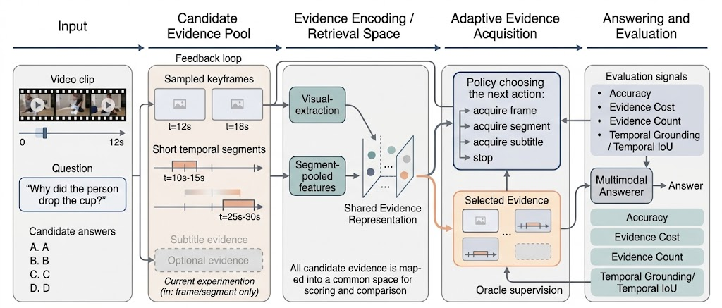
Method: Adaptive Evidence Acquisition Pipeline
6 / 15
Candidate pool
Controlled answerer swap
Sample frames and 4s sliding segments; rank top candidates with CLIP question-option similarity.
Keep selected evidence fixed, then swap only the answerer to separate evidence quality from reasoning quality.
Adaptive Evidence Acquisition for Grounded VideoQA
Final Presentation

Slide 7
Evidence Policies and Cost Ladder
7 / 15
Policy | Selection | Count | Cost | Role
One segment | highest-scoring segment | 1 | 1.500 | Low-cost baseline
Linear two-item | linear router: frame/segment/stop | 2 | 2.795 | Efficient middle point
Fixed 3+3 | 3 frames + 3 segments | 6 | 7.500 | High-coverage control
Fixed 6+6 | 6 frames + 6 segments | about 12 | 14.908 | Large frozen-answerer control
Policy training
Why fixed controls matter
The MLP router is trained from oracle traces; Qwen is not trained or used for routing.
They show what grounding improves when we spend much more visual context.
Adaptive Evidence Acquisition for Grounded VideoQA
Final Presentation

Slide 8
Experimental Setup and Metrics
8 / 15
Dataset
Answerers
Protocol
NExT-GQA Validation: 3,358 examples Test: 5,553 examples
Frozen CLIP-style scorer Qwen2.5-VL-3B-Instruct
Same selected evidence Swap only final answerer
Metric | Meaning
Acc@QA | Whether the answer letter is correct
Cost / Count | Amount of visual evidence consumed
mIoP, IoP@0.5 | How much selected evidence lies inside support span
mIoU, IoU@0.5 | Stricter temporal overlap with support span
Acc@GQA | Correct answer plus IoP@0.5 grounding
Adaptive Evidence Acquisition for Grounded VideoQA
Final Presentation

Slide 9
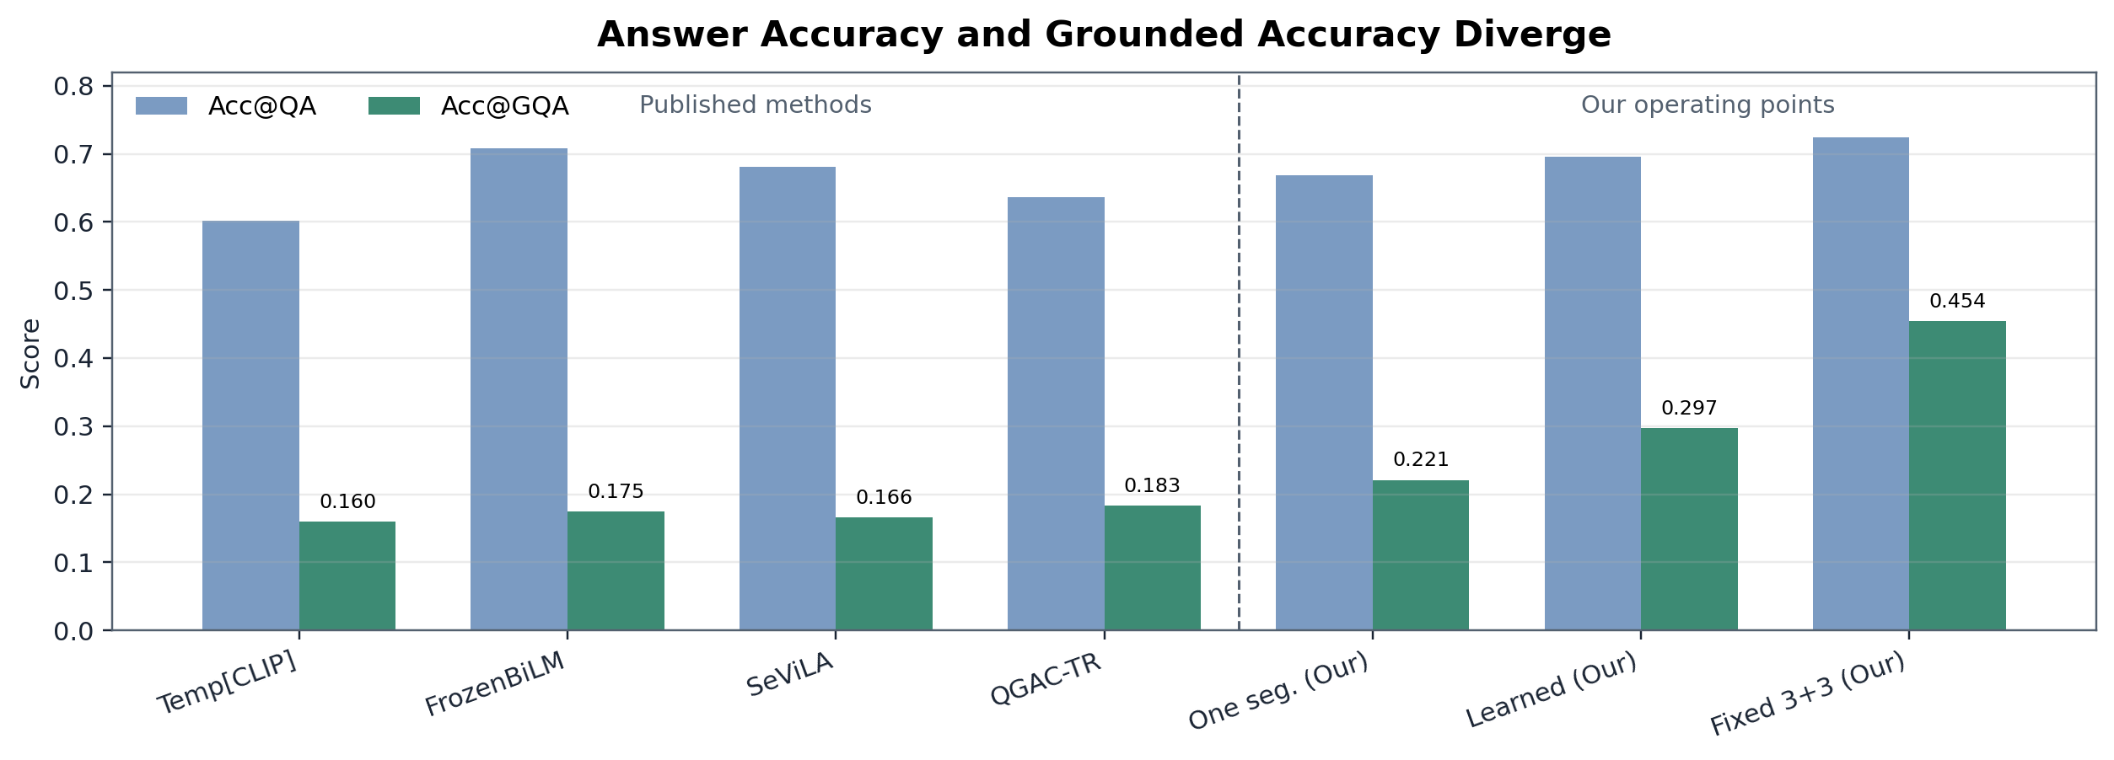
Main Comparison: Answer Accuracy Is Not Grounding
9 / 15
Context
Our proposed point
Our upper point
Prior rows provide scale; our grounding uses selected-evidence best overlap.
MLP+NMS gives the best learned cost-aware tradeoff.
Fixed 3+3 gives the strongest grounding.
Adaptive Evidence Acquisition for Grounded VideoQA
Final Presentation

Slide 10
Result 1: Frozen Answerer Is the Bottleneck
10 / 15
Method | Acc@QA | Cost | IoP@0.5 | Acc@GQA
One segment | 0.378 | 1.500 | 0.311 | 0.124
Linear two-item | 0.381 | 2.795 | 0.410 | 0.164
Fixed 3+3 | 0.388 | 7.500 | 0.615 | 0.245
Fixed 6+6 | 0.394 | 14.908 | 0.787 | 0.316
Observation
Conclusion
Grounding improves as evidence budget increases, but answer accuracy remains near 0.38.
A weak answerer hides evidence-policy improvements in the answer metric.
Adaptive Evidence Acquisition for Grounded VideoQA
Final Presentation

Slide 11
Result 2: Stronger VLM Reveals the Tradeoff
11 / 15
Method | Acc@QA | Cost | IoP@0.5 | Acc@GQA
Qwen one segment | 0.668 | 1.500 | 0.311 | 0.221
Qwen learned two-item | 0.696 | 2.795 | 0.410 | 0.297
Qwen fixed 3+3 reference | 0.724 | 7.500 | 0.615 | 0.454
Answer retained
Cost used
Grounding retained
95%
39%
71%
MLP+NMS evidence is the best learned budgeted method: near-fixed accuracy at much lower evidence cost.
Adaptive Evidence Acquisition for Grounded VideoQA
Final Presentation

Slide 12
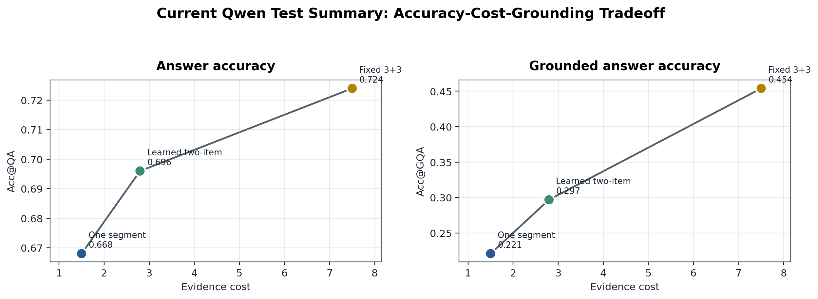
Accuracy-Cost-Grounding Tradeoff
12 / 15
Interpretation
MLP+NMS gives the best learned budgeted tradeoff: most of the high-cost answer accuracy, much lower evidence cost, and better grounding than one segment.
Adaptive Evidence Acquisition for Grounded VideoQA
Final Presentation

Slide 13
Qualitative Lessons
13 / 15
Case | What happens | Lesson
Correct and grounded | Evidence overlaps the support moment and Qwen predicts the gold answer. | Desired behavior
Correct, weakly grounded | Qwen predicts correctly but selected evidence has low temporal overlap. | Answer accuracy alone misleads
Grounded but wrong | Selected evidence overlaps support span, but answer reasoning fails. | Evidence and reasoning are separate
Takeaway
Grounded VideoQA needs both components: evidence policy must find the right moment, and the answerer must reason from it.
Adaptive Evidence Acquisition for Grounded VideoQA
Final Presentation

Slide 14
Answers to the Opening Questions
14 / 15
Q1. Same evidence budget for every question?
No. Evidence need varies; fixed context can be wasteful or weakly grounded.
Q2. Can compact learned evidence preserve accuracy?
Yes. MLP+NMS evidence keeps about 95% of fixed 3+3 answer accuracy at 39% of the cost.
Q3. Evidence problem or answerer problem?
Both. The frozen answerer hides evidence gains; Qwen exposes the accuracy-cost-grounding frontier.
This answers the initial questions after the method and evidence-budget experiments.
Adaptive Evidence Acquisition for Grounded VideoQA
Final Presentation

Slide 15
Final Takeaway
15 / 15
Grounded VideoQA should be evaluated as evidence selection plus answer generation.
A weak answerer can hide better evidence selection.
A strong VLM makes compact evidence useful for answering.
Faithful temporal grounding still benefits from broader evidence coverage.
The result is a Pareto tradeoff, not a single winner.
One-line closing
Select enough evidence, not too much evidence, and verify that the answer is supported by the right moment.
Adaptive Evidence Acquisition for Grounded VideoQA
Final Presentation

