Slide 1
Executive summary

Slide 2
Executive Summary cont...

Slide 3
City Distribution Analysis
City | Bookings | % Total | Hotels | Avg Price | Market Position
City A | 22,366 | 45.6% | 213 | $100.51 | High-Volume Budget
City D | 10,152 | 20.7% | 70 | $218.85 | Premium Concentrated
City C | 6,797 | 13.9% | 146 | $224.84 | Premium Diverse
City B | 4,932 | 10.1% | 344 | $118.32 | Mid-Market Fragmented
City E | 4,817 | 9.8% | 107 | $142.07 | Mid-Market Growing
City A dominates with nearly half of all bookings despite lower prices — suggests high tourist traffic or business hub
Cities C & D command 2x premium pricing but with lower volume — likely luxury/resort destinations
City B has highest hotel count (344) but lowest booking share — fragmented market with high competition

Slide 4
Accommodation Type Distribution
Property Type | Bookings | % Total | Avg Price | Segment Positioning
Hotel | 35,441 | 72.2% | $158.13 | Core segment
Resort | 3,525 | 7.2% | $190.98 | Premium leisure
Serviced Apartment | 2,797 | 5.7% | $90.07 | Extended stay
Hostel | 2,774 | 5.7% | $88.78 | Budget travelers
Guest House / B&B | 2,758 | 5.6% | $85.76 | Local experiences
Capsule Hotel | 822 | 1.7% | $61.31 | Ultra-budget niche
Resort Villa | 397 | 0.8% | $259.49 | Ultra-premium
Apartment | 239 | 0.5% | $196.31 | Family/group
Others (8 types) | 311 | 0.6% | Varies | Niche segments
Hotels drive 72% of bookings, making them the highest-priority segment for urgency messaging.
Premium stays (Resorts/Villas) should leverage exclusivity and limited availability rather than price-based urgency.
Budget accommodations are best suited for scarcity and price-FOMO messages to drive faster decisions.
Segment-specific urgency messaging can maximize conversion by aligning with traveler intent and price sensitivity.

Slide 5
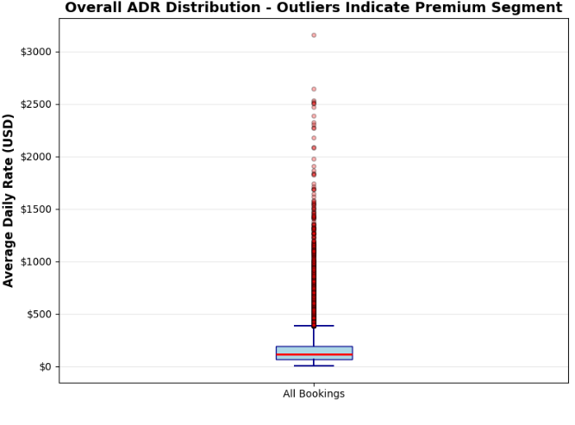
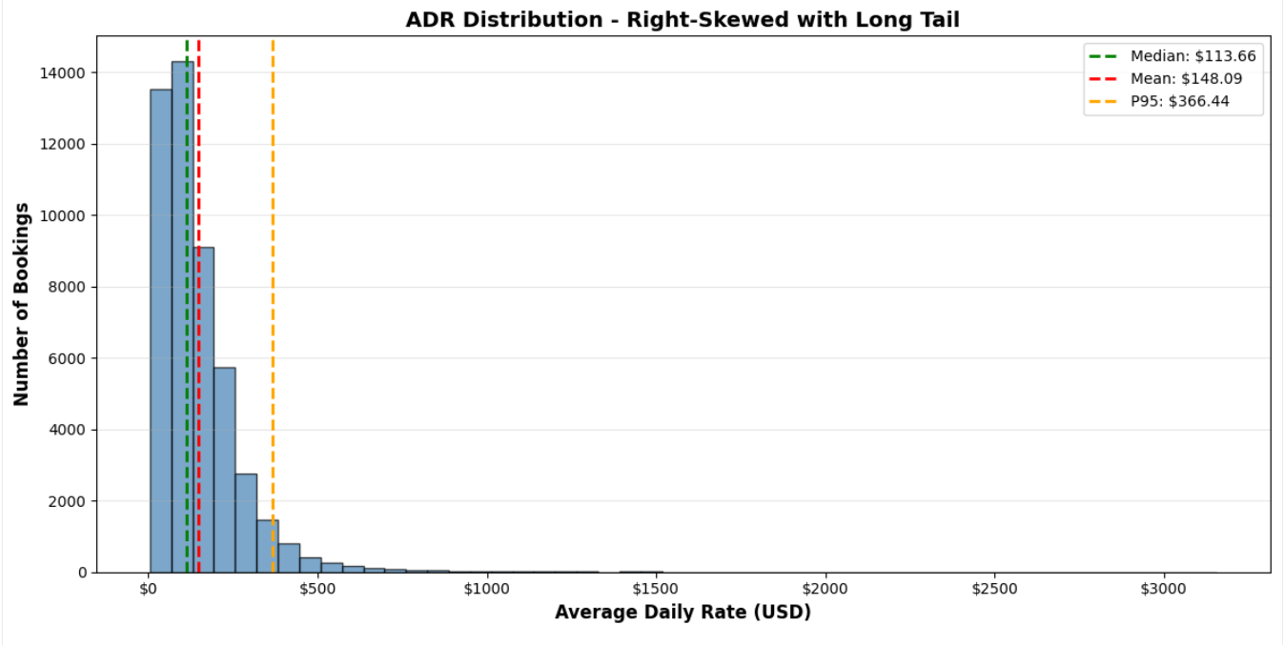
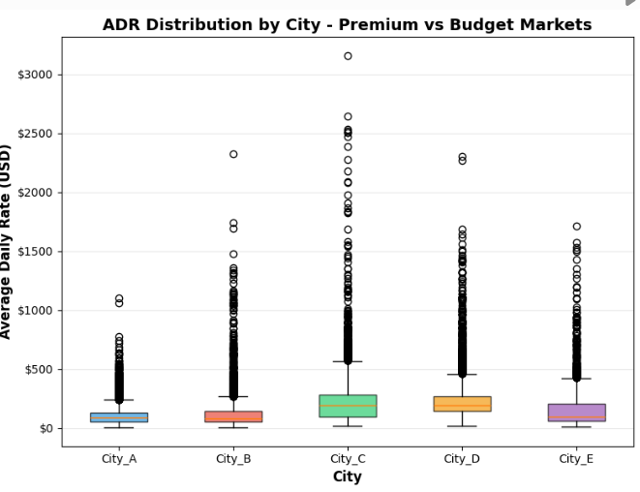
ADR Distribution Analysis
How expensive is the market?
Analyzing Average Daily Rate (ADR) distribution to understand pricing patterns, market segments, and the impact of price skewness on urgency messaging strategies.
VISUAL INSIGHT: Box plots reveal extreme outliers and distinct price tiers across cities
Statistical Metrics
Minimum: $4.26
Median (P50): $113.66
P95: $366.44
P99: $638.15
Maximum: $3,156.86
Distribution Shape
Mean: $148.09
Mean-Median Gap: $34.43 (30.3% above median)
⚠️ HIGHLY RIGHT-SKEWED - Mean significantly exceeds median
VISUAL INSIGHT: ADR distribution shows clear right skew with long tail of premium properties

Slide 6
1️⃣ Use MEDIAN ($113.66) instead of MEAN ($148.09) for central tendency → Mean is inflated by luxury outliers and misrepresents typical booking '
2️⃣ Segment urgency messaging by PRICE TIER, not just accommodation type → Budget (<$100): Scarcity - 'Only 2 left at this price' → Mid-Market ($100-200): Social proof - '15 people viewing' → Premium/Luxury (>$200): Exclusivity - 'Rarely available'
3️⃣ High-ADR outliers (P95+) represent LUXURY SEGMENT - different psychology → 2453 bookings (5.0%) above $366.44 → These buyers need desire-based urgency, not scarcity pressure
4️⃣ 50% of bookings fall in narrow $62.55 - $192.22 range (P25-P75) → Core market is predictable; urgency A/B tests should focus here first

Slide 7
Lead Time Distribution (Urgency Behavior)
Lead Time Bucket | Bookings | % of Total | Cumulative %
Same Day | 5,603 | 11.4% | 11.4%
1-3 days | 11,058 | 22.5% | 34.0%
4-7 days | 6,818 | 13.9% | 47.9%
1-2 weeks | 7,281 | 14.8% | 62.7%
2-4 weeks | 9,810 | 20.0% | 82.7%
30+ days | 8,491 | 17.3% | 100.0%
Key Insights:
🔥 47.9% of bookings happen within 7 days = HUGE urgency market!
🔥 34% are extreme last-minute (0-3 days) = customers in "urgency mode"
🔥 Only 17.3% are true planners (30+ days)
✅ Business Case: Nearly HALF of customers exhibit last-minute behavior = large addressable market for urgency interventions

Slide 8
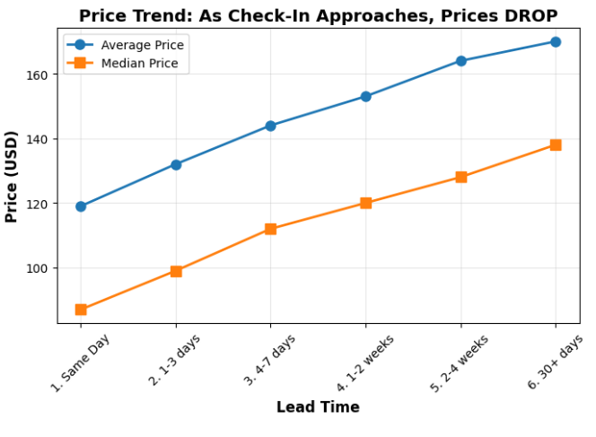
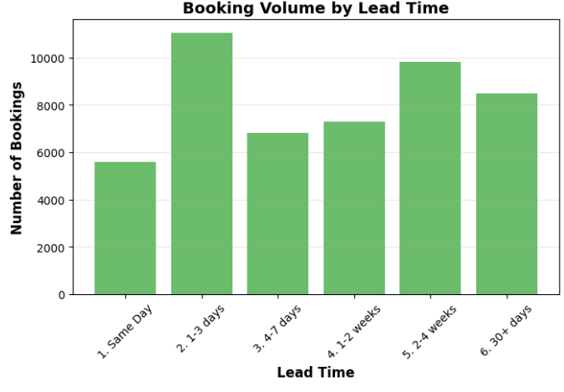
Price by Booking Window
Lead Time | Bookings | Avg Price | Median Price | Min | Max | Std Dev
Same Day | 5,603 | $119 | $87 | $4 | $2,081 | $112
1-3 days | 11,058 | $132 | $99 | $5 | $2,388 | $117
4-7 days | 6,818 | $144 | $112 | $9 | $1,977 | $125
1-2 weeks | 7,281 | $153 | $120 | $5 | $1,909 | $134
2-4 weeks | 9,810 | $164 | $128 | $6 | $3,157 | $154
30+ days | 8,491 | $170 | $138 | $6 | $2,534 | $151
CRITICAL FINDING: PRICES DROP AS CHECK-IN APPROACHES!
❌ The common urgency message "Price may increase" is FALSE!
Same-day bookings are 30% CHEAPER than 30+ day bookings ($119 vs $170)
⚠️ Why This Happens:
Hotels discount unsold inventory as check-in approaches (better to sell at $87 than leave room empty)
Last-minute bookers know this and hunt for deals
💼 Business Implication:
❌ We CANNOT use "Price will increase" messaging — it's factually wrong and will damage trust
✅ Instead, we should use:
Scarcity messaging: "Only 2 rooms left!" (if true)
Social proof: "15 people viewing this hotel right now"
Flip the script: For hotels where prices ARE rising, highlight that: "Price increased 8% in last 24 hrs"

Slide 9
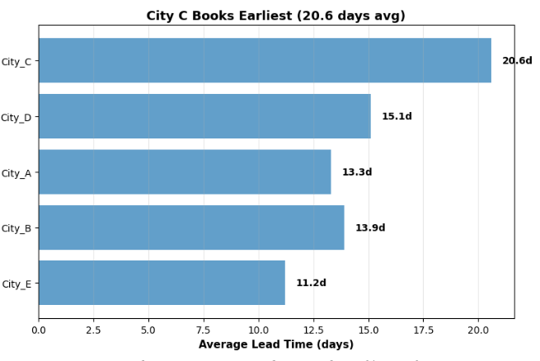
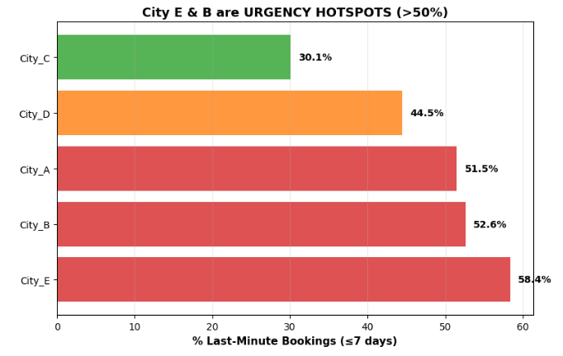
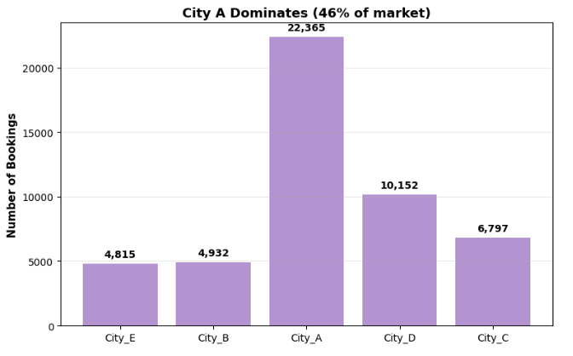
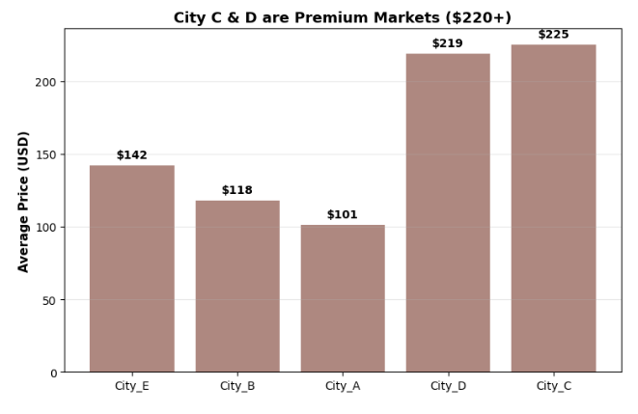
City-Level Urgency Behavior
City | Bookings | % Last-Minute | Avg Lead Time | Avg Price | Hotels
City E | 4,815 | 58.4% 🔥 | 11.2 days | $142 | 107
City B | 4,932 | 52.6% 🔥 | 13.9 days | $118 | 344
City A | 22,365 | 51.50% | 13.3 days | $101 | 213
City D | 10,152 | 44.50% | 15.1 days | $219 | 70
City C | 6,797 | 30.1% ❄️ | 20.6 days | $225 | 146
CITIES VARY 2X IN URGENCY BEHAVIOR!
Tier 1: High-Urgency Cities (>50%)
City E: 58.4% last-minute — extreme urgency market
City B: 52.6% last-minute — high urgency
City A: 51.5% last-minute — high urgency (46% of total market!)
Tier 2: Medium-Urgency City
City D: 44.5% last-minute — moderate urgency, premium pricing ($219 avg)
Tier 3: Low-Urgency City
City C: 30.1% last-minute — PLANNERS dominate, premium market ($225 avg)
🎯 Business Implications:
✅ One-size-fits-all urgency messaging will FAIL
City E customers need urgency triggers (58% are last-minute)
City C customers need value propositions (70% are planners)
✅ Market Size Matters:
City A = 46% of bookings = biggest opportunity
Cities E & B = smaller markets but highest urgency intensity
✅ Price Segments:
Cities C & D = Premium ($220+ avg) = avoid aggressive discounting
Cities A, B, E = Value ($100-$140 avg) = price-sensitive shoppers
📋 Deployment Strategy:
Phase 1 (Test First): Cities E & B — highest urgency, lower risk Phase 2 (Scale): City A — largest market, high urgency Phase 3 (Monitor): City D — moderate urgency, premium segment Avoid: City C — urgency messaging will alienate planner-dominant market

Slide 10
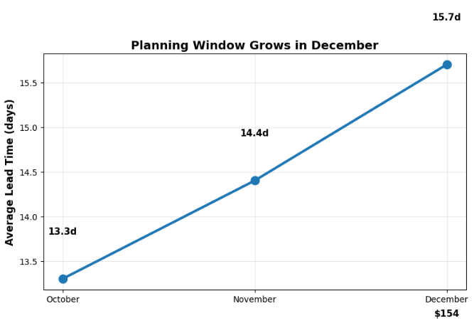
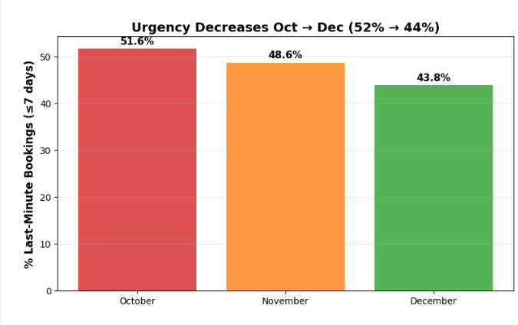
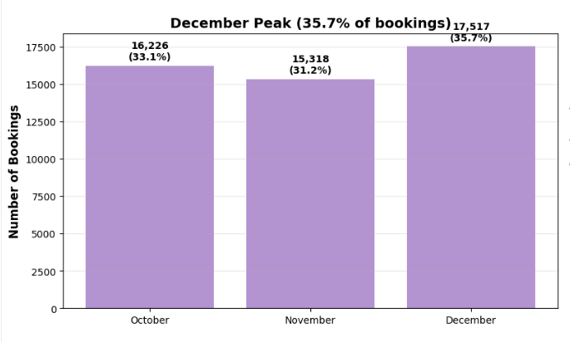
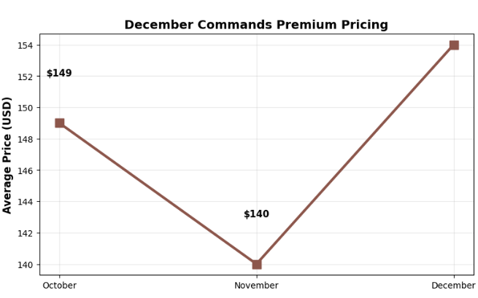
Monthly Seasonality
Month | Bookings | % of Total | Avg Lead Time | % Last-Minute (<=7d) | % Extreme (<=3d) | Avg Price
October | 16,226 | 33.10% | 13.3 days | 51.60% | 36.70% | $149
November | 15,318 | 31.20% | 14.4 days | 48.60% | 34.50% | $140
December | 17,517 | 35.70% | 15.7 days | 43.80% | 30.90% | $154
Business Implications:
October Strategy:
HIGHEST urgency behavior (51.6%) = perfect for urgency messaging
Use aggressive scarcity messaging
Target last-minute business travelers
November Strategy:
Moderate urgency (48.6%)
Price dip = promotional opportunity
Balance urgency with value messaging
December Strategy:
LOWER urgency (43.8%) BUT premium pricing
De-emphasize urgency, emphasize quality and availability
Holiday travelers book early = use social proof instead of scarcity
Avoid discounting (demand is high, prices are premium)

Slide 11
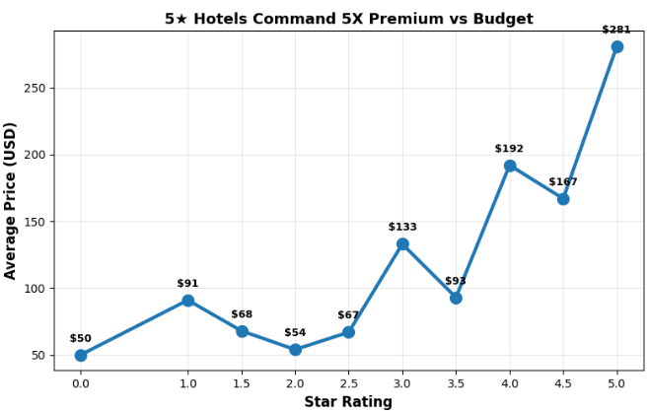
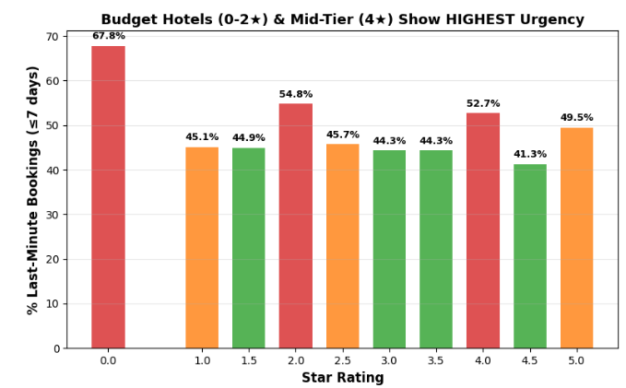
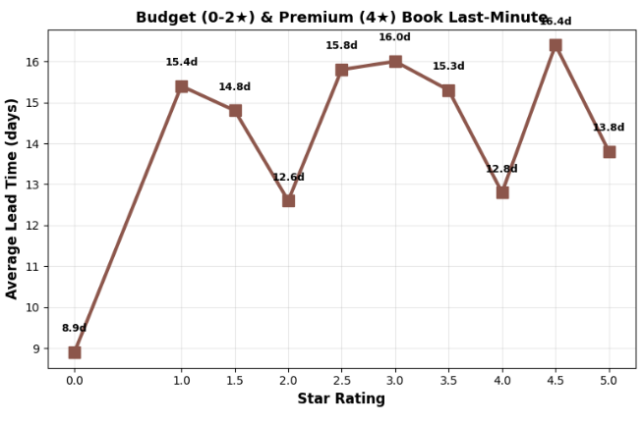
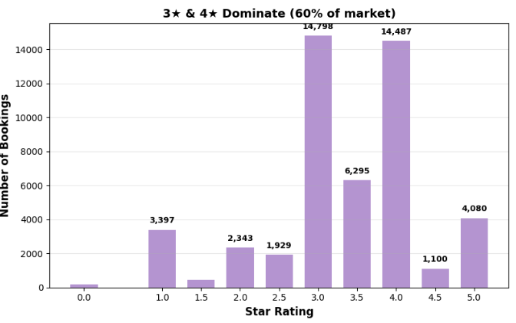
Hotel Characteristics (Star Rating)
Star Rating | Bookings | % of Total | % Last-Minute (<=7d) | Avg Lead Time | Avg Price | Hotels
0-star | 171 | 0.3% | 67.8% | 8.9 days | $50 | 31
1-star | 3,397 | 6.9% | 45.1% | 15.4 days | $91 | 168
1.5-star | 461 | 0.9% | 44.9% | 14.8 days | $68 | 15
2-star | 2,343 | 4.8% | 54.8% | 12.6 days | $54 | 131
2.5-star | 1,929 | 3.9% | 45.7% | 15.8 days | $67 | 43
3-star | 14,798 | 30.2% | 44.3% | 16.0 days | $133 | 278
3.5-star | 6,295 | 12.8% | 44.3% | 15.3 days | $93 | 30
4-star | 14,487 | 29.5% | 52.7% | 12.8 days | $192 | 139
4.5-star | 1,100 | 2.2% | 41.3% | 16.4 days | $167 | 5
5-star | 4,080 | 8.3% | 49.5% | 13.8 days | $281 | 40
🔥 NON-LINEAR URGENCY PATTERN! (U-Shaped Curve)
Urgency does NOT increase linearly with star rating. Instead:
HIGH Urgency Tiers:
0-2 star (Budget): 54-68% last-minute — ultra price-sensitive deal hunters
4-star (Mid-Tier Premium): 52.7% last-minute — largest premium segment with urgency!
5-star (Luxury): 49.5% last-minute — impulse luxury purchases
LOWER Urgency Tiers:
3-star (Mass Market): 44.3% last-minute — family/group travel, planners
4.5-star (Near-Luxury): 41.3% last-minute — small market, planner-heavy
📊 WHY THIS U-SHAPE HAPPENS:
Budget (0-2★): Last-minute deal hunters, flexible solo/couple travelers
3-star: Family/group bookings require coordination = longer planning windows
4-star: Business travelers (company-expensed) + spontaneous premium leisure
5-star: Split between impulse luxury ("treat yourself") and planned special occasions
💰 PRICE SCALING:
Budget: $50-91 avg (ultra price-sensitive)
Mid-Market: $93-133 avg (value seekers)
Premium: $192 avg (4-star) — sweet spot pricing
Luxury: $281 avg (5-star) — less price-sensitive
🎯 BUSINESS IMPLICATIONS:
✅ 4-STAR HOTELS = PERFECT URGENCY TARGET!
29.5% of all bookings = second-largest segment (only 3-star is bigger)
52.7% last-minute = HIGH urgency behavior (8pp higher than 3-star)
$192 avg price = premium revenue per booking
Perfect trifecta: Large volume + High urgency + Premium pricing
✅ Market Segmentation Strategy:
Tier 1 (High Priority):
4-star hotels — launch urgency test HERE FIRST
Business travelers + spontaneous premium leisure
Use aggressive urgency: "Only 2 rooms left at this rate!"
Tier 2 (Moderate Priority):
0-2 star budget — ultra-aggressive urgency + price messaging
5-star luxury — softer urgency framing ("Exclusive availability")
Tier 3 (Lower Priority):
3-star mass market — lowest urgency, family/group bookings
Avoid aggressive urgency (will alienate planners)
✅ Combined Market Opportunity:
3-star + 4-star = 60% of ALL bookings
But 4-star has 8 percentage points higher urgency (52.7% vs 44.3%)
Focus urgency interventions on 4-star first, then expand to 3-star with softer messaging

Slide 12
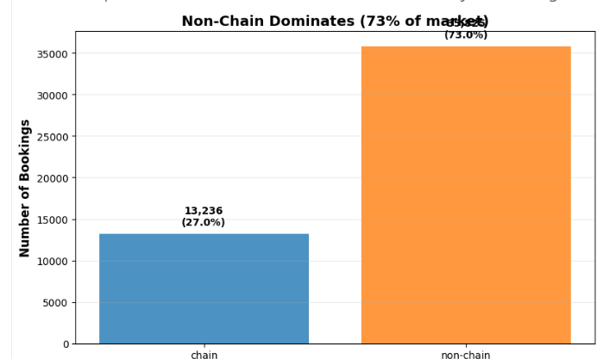
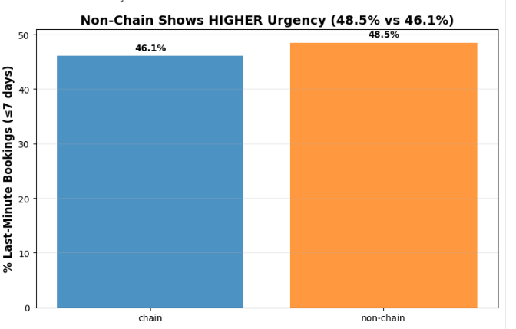
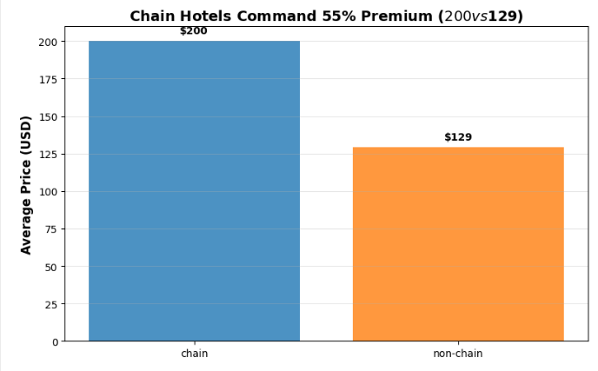
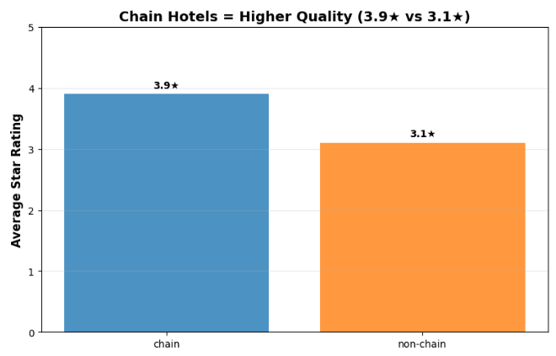
EDA #8 - Chain vs Independent Hotels
Type | Bookings | % of Total | % Last-Minute (<=7d) | Avg Lead Time | Avg Price | Median Price | Avg Star Rating | Hotels
Chain | 13,236 | 27.0% | 46.1% | 14.9 days | $200 | $161 | 3.9★ | 155
Non-Chain | 35,825 | 73.0% | 48.5% | 14.4 days | $129 | $92 | 3.1★ | 725
SO WHAT?
NON-CHAIN HOTELS DOMINATE THE MARKET!
Non-chain = 73% of ALL bookings (35,825 bookings)
Non-chain = 725 hotels (vs 155 chain hotels)
Non-chain = HIGHER urgency behavior (48.5% vs 46.1%)
BUT CHAIN HOTELS COMMAND PREMIUM:
Chain avg price: $200 (+55% vs non-chain)
Chain median price: $161 (+75% vs non-chain)
Chain star rating: 3.9 vs 3.1 (+0.8 stars)
WHY THIS PATTERN:
Chain hotels = Premium positioning, business travelers, brand loyalty
Non-chain = Budget/mid-tier, deal hunters, price-sensitive shoppers
Non-chain urgency is HIGHER because customers are shopping for deals
Business Implications:
PRIORITIZE NON-CHAIN HOTELS FOR URGENCY TESTING!
73% of market = HUGE addressable audience
48.5% last-minute = strong urgency behavior
Price-sensitive shoppers = responsive to urgency triggers
More hotels (725) = broader test surface
Chain Hotel Strategy:
Lower urgency (46.1%) but premium pricing
Business travelers = less price-sensitive
Use softer urgency messaging (quality + scarcity, not price pressure)
"Only 2 suites available" > "Last chance at this price!"
Market Segmentation:
Tier 1 (High Priority): Non-chain hotels
Largest market (73%)
Highest urgency (48.5%)
Price-sensitive shoppers
Test aggressive urgency messaging
Tier 2 (Moderate Priority): Chain hotels
Smaller market (27%)
Lower urgency (46.1%)
Premium segment
Use quality-focused urgency
Combined Insights (Star Rating + Chain Status):
Recall from EDA #7:
4-star hotels = 52.7% last-minute (highest premium urgency)
3-star hotels = 44.3% last-minute (lowest urgency)
Sweet Spot: Non-chain 4-star hotels
High urgency behavior
Premium pricing potential
Large market volume

Slide 13
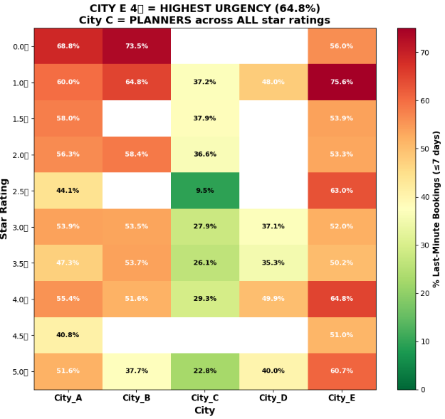
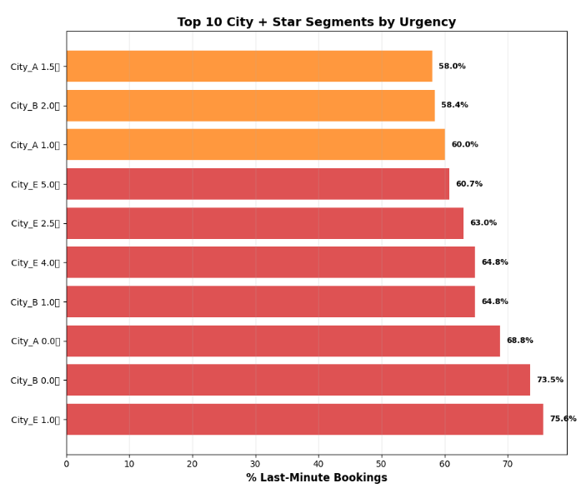
Star Rating × City (City-Level Analysis)
Top 5 City + Star Combinations by Urgency:
Rank | Segment | % Last-Minute | Bookings | Avg Price
1 | City E 1⭐ | 75.6% | 86 | $30
2 | City B 0⭐ | 73.5% | 34 | $24
3 | City A 0⭐ | 68.8% | 112 | $53
4 | City E 4⭐ | 64.8% 🎯 | 1,480 | $161
5 | City B 1⭐ | 64.8% | 216 | $50
Why City E 4⭐ is the SWEET SPOT:
64.8% urgency (2nd highest for substantial volume)
1,480 bookings (LARGE market, 31% of City E)
$161 avg price (premium but not luxury)
13 hotels (actionable inventory)
City-by-City Urgency Patterns:
CITY E: High Urgency Across Board
ALL star ratings >50% urgency (except 4.5⭐)
4⭐ hotels: 64.8% urgency, 30.7% of market
1⭐ budget: 75.6% urgency (but only 86 bookings)
5⭐ luxury: 60.7% urgency (708 bookings = responsive to urgency!)
Market composition: 4⭐ (31%) + 3⭐ (29%) = 60% of City E
CITY A: 4-Star Sweet Spot
4⭐ hotels: 55.4% urgency, 26.1% of market (5,841 bookings!)
2⭐ budget: 56.3% urgency (1,247 bookings)
3⭐ mid-tier: 53.9% urgency (4,844 bookings)
5⭐ luxury: 51.6% urgency (2,584 bookings)
Urgency consistent across most tiers (47-56%)
CITY B: Mixed Patterns
0-2⭐ budget: 58-74% urgency (702 bookings)
3-4⭐ mid/upper: 51-54% urgency (3,691 bookings)
5⭐ luxury: ONLY 37.7% urgency (403 bookings = planners!)
Drop-off at luxury tier
CITY D: 4-Star Urgency
4⭐ hotels: 49.9% urgency, 44.3% of market (4,499 bookings!)
1⭐ budget: 48.0% urgency (1,557 bookings)
3⭐ mid-tier: 37.1% urgency (lower than expected)
Premium pricing ($198-1,073 avg)
CITY C: PLANNERS ACROSS ALL STAR RATINGS! ⚠️
5⭐ luxury: ONLY 22.8% urgency ($667 avg)
4⭐ upper-mid: 29.3% urgency ($445 avg)
3⭐ mid-tier: 27.9% urgency (40% of market)
1⭐ budget: 37.2% urgency (still lowest among all cities)
Even budget travelers plan ahead in City C!
Premium pricing + planning culture = avoid urgency here
🎯 Business Implications:
✅ TIER 1 TARGET (Launch Here):
City E 4⭐: 64.8% urgency, 1,480 bookings, $161 avg
City A 4⭐: 55.4% urgency, 5,841 bookings (MASSIVE!), $130 avg
City E 3⭐: 52.0% urgency, 1,404 bookings, $89 avg
✅ TIER 2 TARGET (Scale):
City A 3⭐: 53.9% urgency, 4,844 bookings
City B 3-4⭐: 51-54% urgency, 3,691 bookings
City D 4⭐: 49.9% urgency, 4,499 bookings (premium)
⚠️ AVOID (Planners):
City C ALL star ratings: 9-38% urgency (planners dominate)
City B 5⭐: 37.7% urgency (luxury planners)
Use availability/quality messaging instead
📊 Key Insights:
City matters MORE than star rating!
City E 5⭐ (60.7%) > City C 1⭐ (37.2%)
A luxury hotel in City E is more urgent than budget in City C
4-star is consistently high urgency (except City C)
City E: 64.8%, City A: 55.4%, City D: 49.9%
City C is UNIQUE: ALL segments are planners
Premium market + planning culture
Need different messaging strategy entirely
Budget (0-2⭐) shows extreme urgency in Cities A/B/E
But low volume except City A 2⭐ (1,247 bookings)

Slide 14
EDA #12 - Chain Status × City

Slide 15
Testing whether the relationship between booking lead time and ADR is statistically significant, and whether this effect varies across markets.
Overall Market:
Spearman ρ: 0.1613 (weak positive correlation)
P-value: 2.15e-283 ✅ Highly significant
Interpretation: Positive relationship exists but is weak
City | Spearman ρ | P-value | Significance | Interpretation
City A | 0.0843 | 1.522 | Significant | No relationship
City B | 0.2271 | 1.047 | Significant | Weak positive
City C | 0.2094 | 3.30 | Significant | Weak positive
City D | 0.0095 | 3.40 | Not significant | No relationship
City E | 0.0726 | 4.58 | Significant | No relationship

