Slide 1
2026 Men's FIFA World Cup
Welcome
June 11 – July 19, 2026
USA · Canada · Mexico

Slide 2
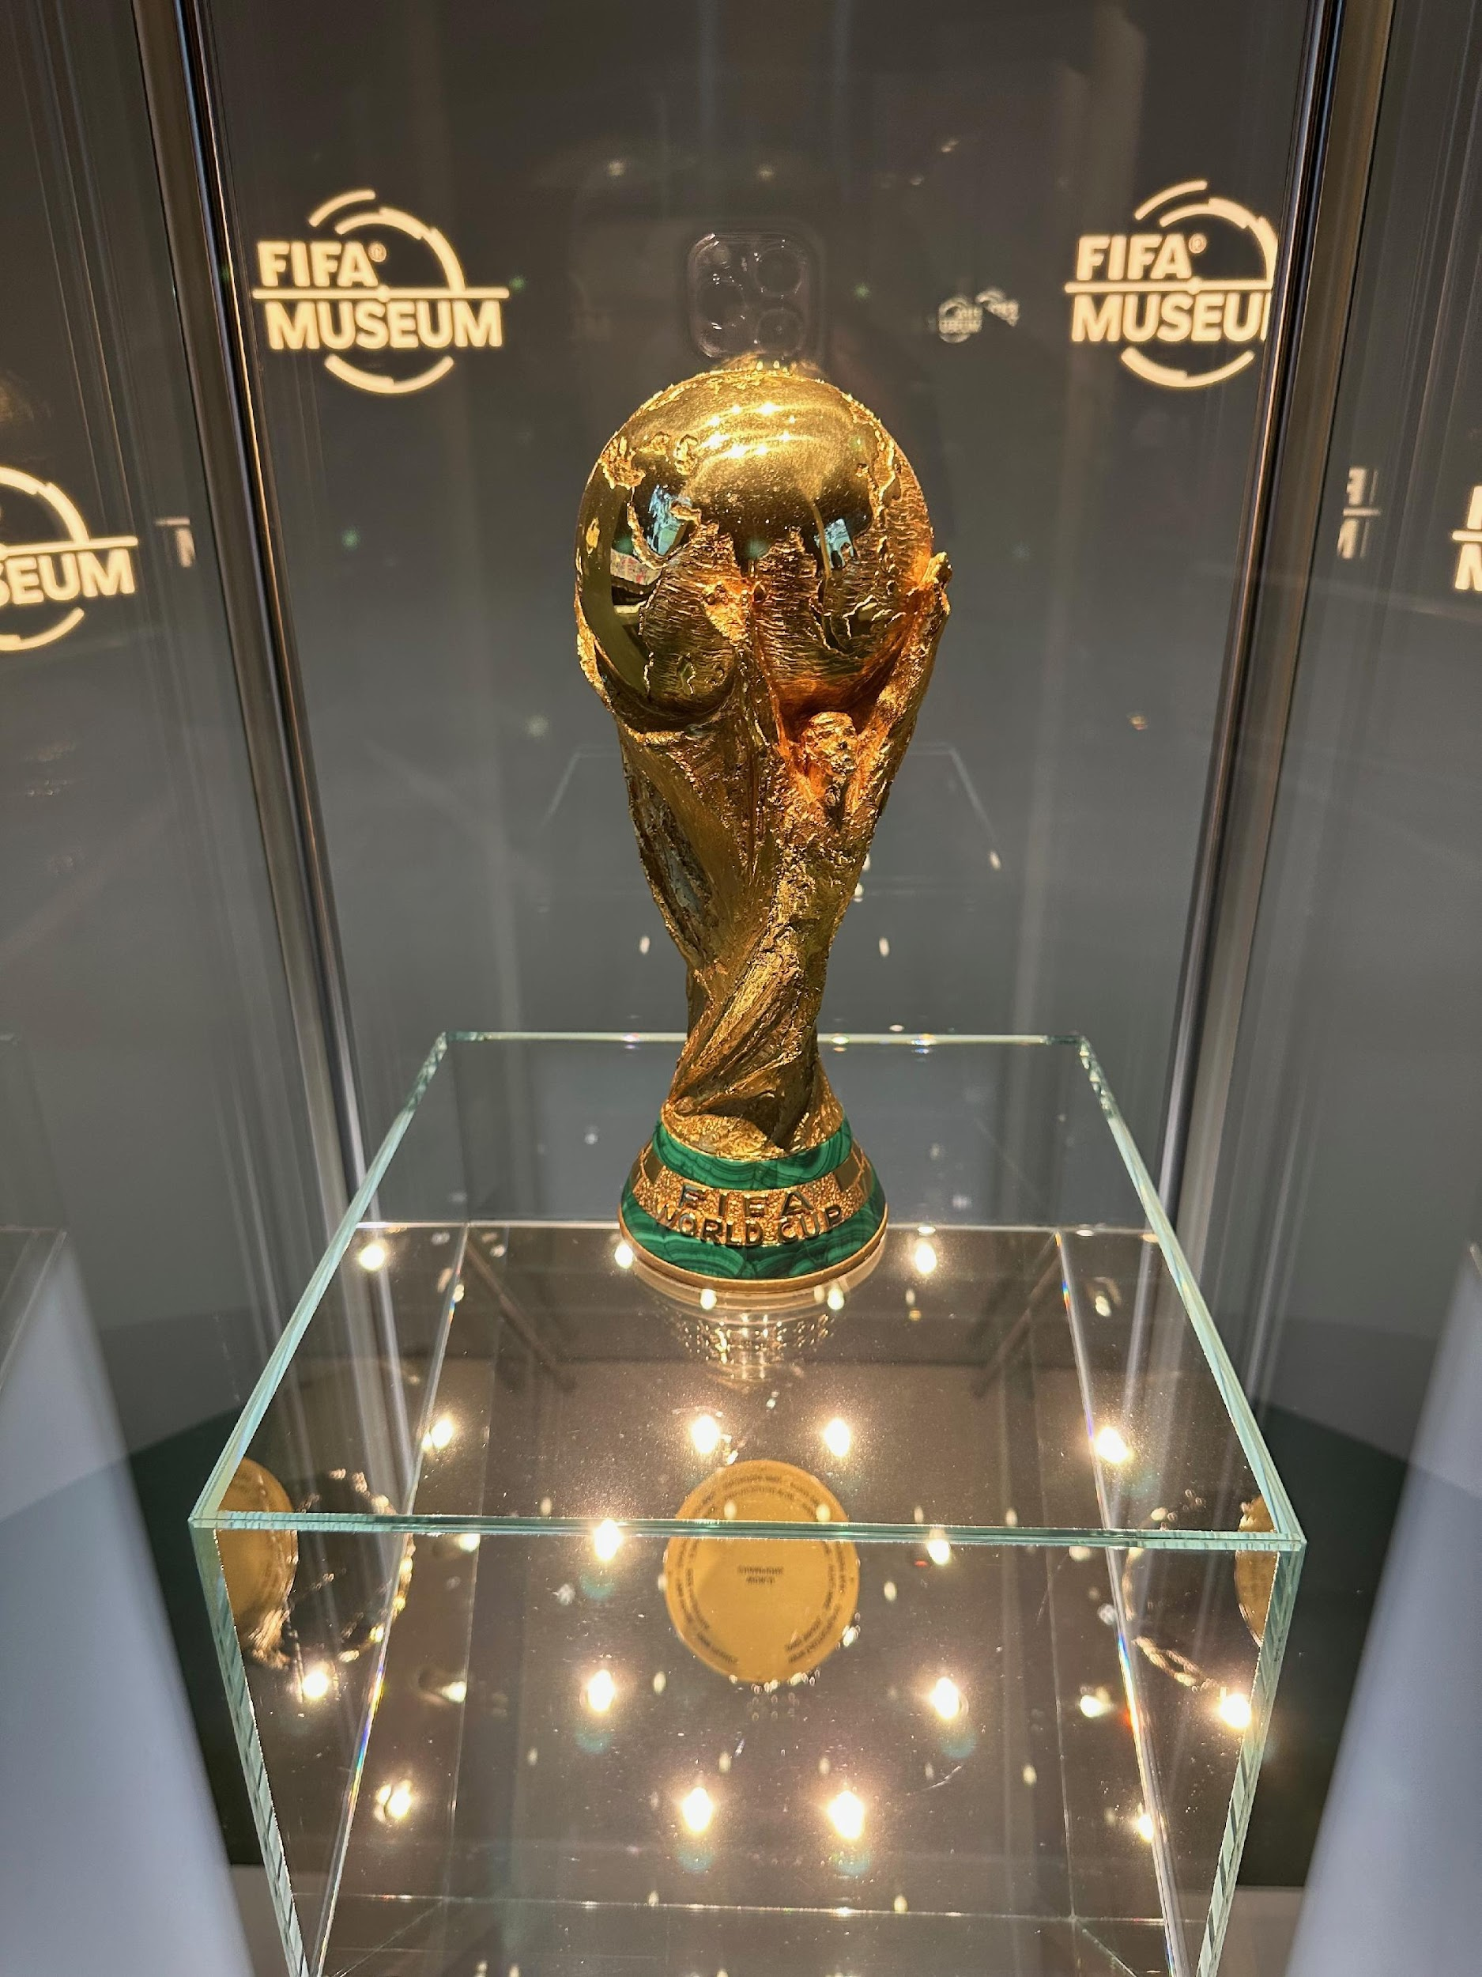
History of the World Cup
Key Facts
1930
First tournament held in Uruguay
4 yrs
Played every four years
8
Nations have ever won it
★
Winners lift the FIFA World Cup trophy
FIFA World Cup Trophy · FIFA Museum, Zürich

Slide 3
A Personal Note
1986
Jun 25
Spain
Fan since
Seeing it live — first time
My pick to win
Watching every game of every tournament since Maradona helped Argentina win. Hand of God goal anyone?
Ivory Coast v Curaçao at the tournament.
Also supporting the USA, any African team, and England. Maybe. Sorry, Brazil.

Slide 4
Famous World Cup Moments
1966
The Stolen Trophy
1994
The Open Goal
2010
The Oracle
Pickles the Dog
Diana Ross
Paul the Octopus
Four months before England hosted the World Cup, the Jules Rimet trophy was stolen from a public exhibition. A dog named Pickles found it wrapped in newspaper under a hedge on a routine walk.
England won the tournament. Pickles received a medal, a year's supply of dog food, and a film role.
The USA '94 opening ceremony featured Diana Ross taking a ceremonial penalty, with the goal rigged to split apart dramatically when she scored. She skied it wide from six yards.
The goal split apart anyway — on cue — to a ball nowhere near it. BBC: "I'm not sure that was supposed to happen."
A German aquarium octopus predicted World Cup results by choosing between two mussel-filled boxes marked with team flags. He went 8-for-8, correctly calling the final.
He received death threats, a state protection offer, and honorary citizenship from a Spanish town. He died peacefully four months later.
▶ YouTube
▶ YouTube
▶ YouTube

Slide 5
The World's Greatest Sporting Event
206
48
104
38
teams began
qualifying
teams in the
final tournament
matches
to be played
days of
football
Up from 32 teams — more underdogs, more upsets, more surprises.

Slide 6
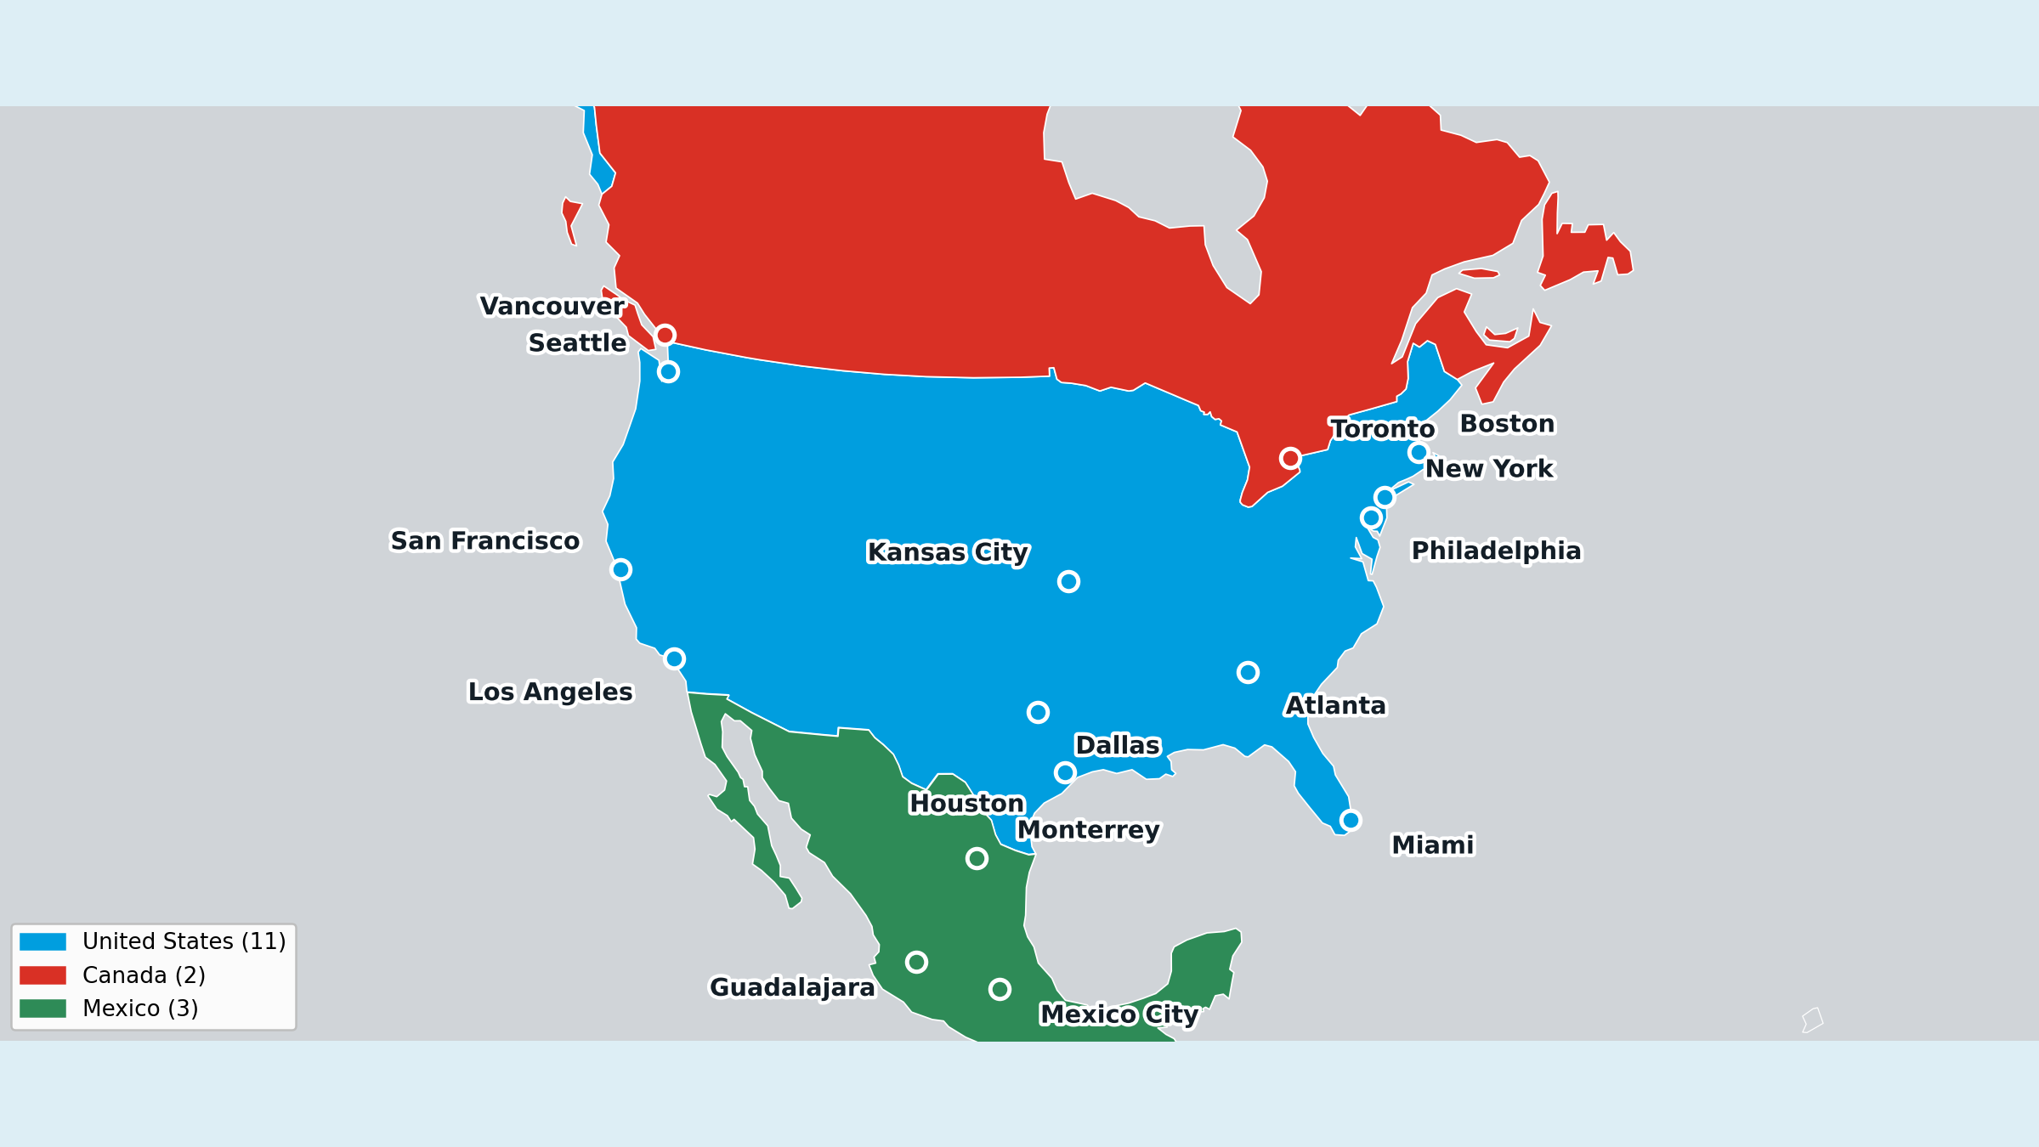
Host cities

Slide 7
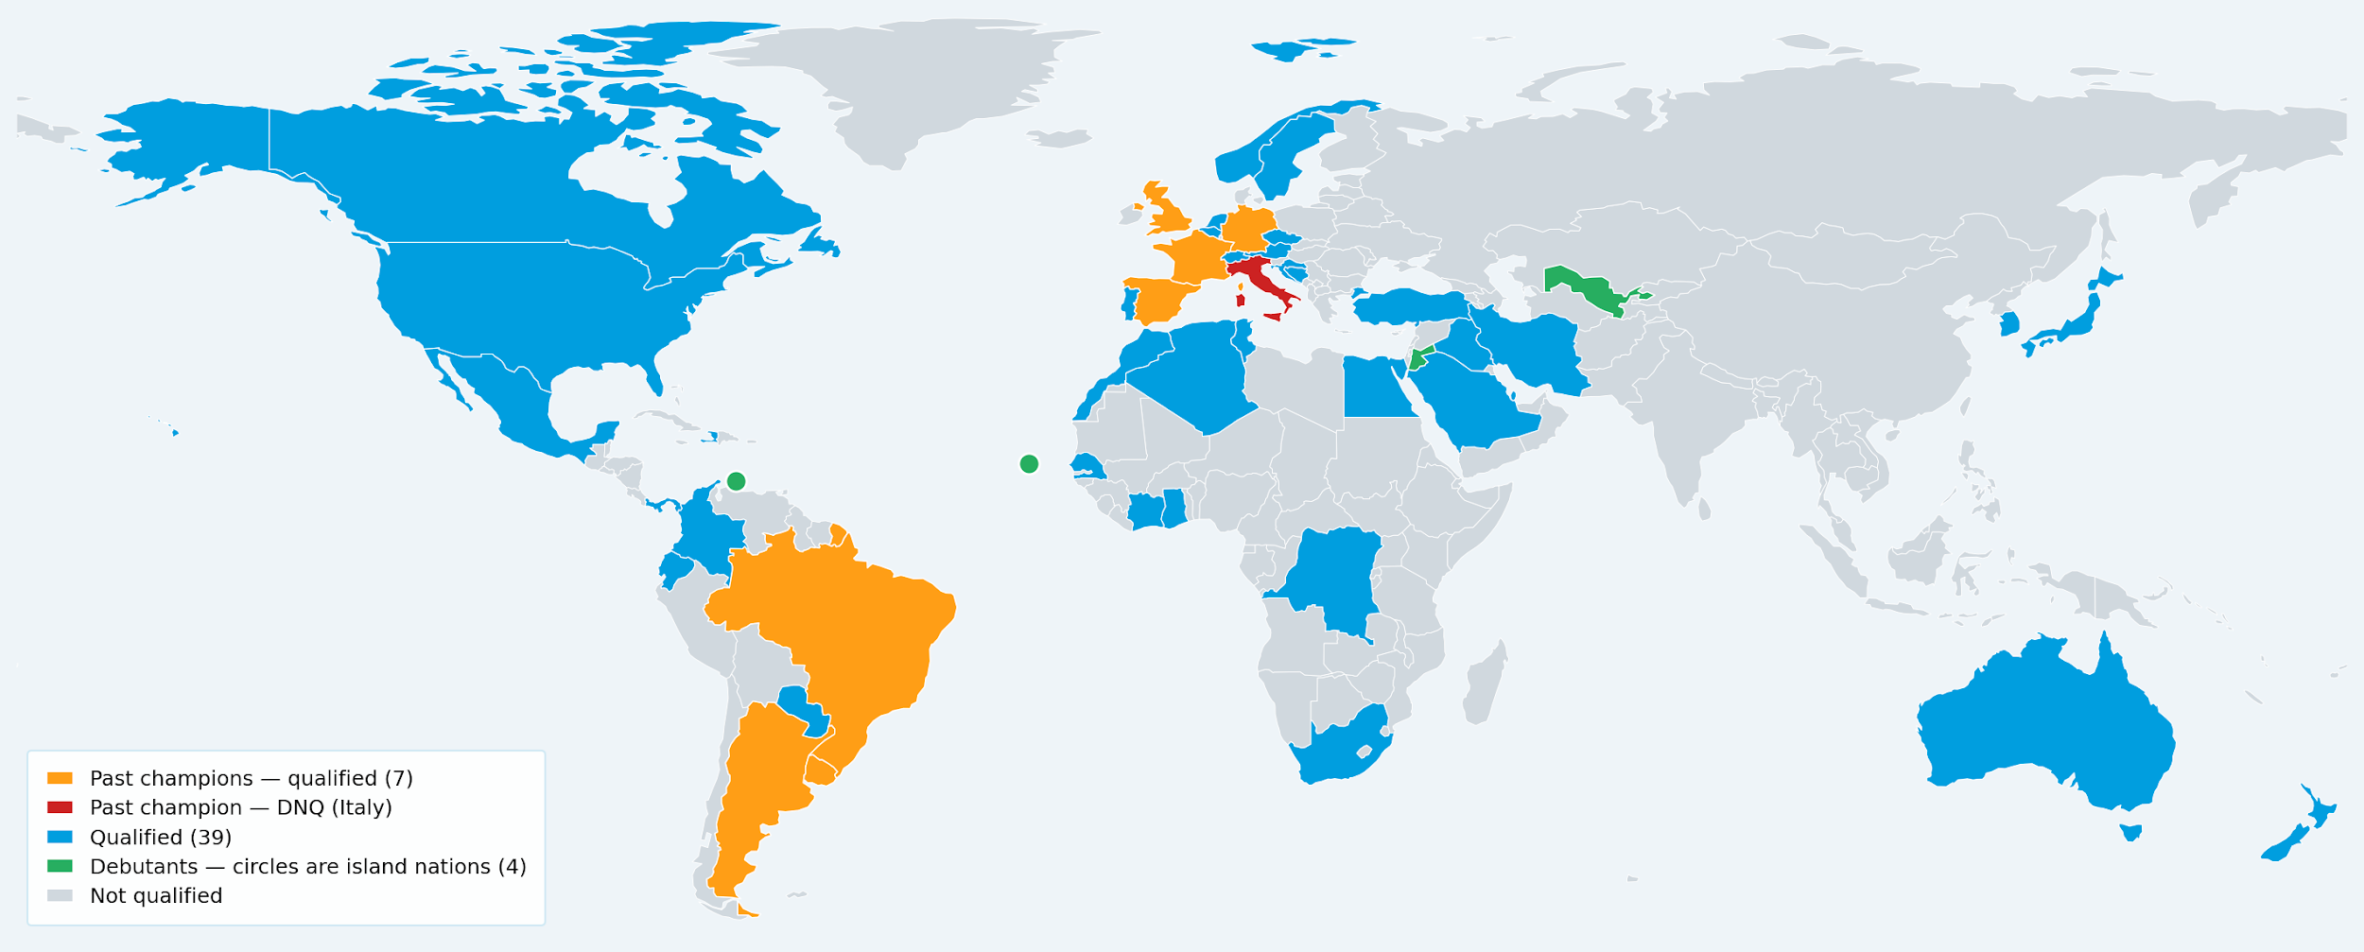
48 Qualified Nations

Slide 8
The Group Stage
Jun 11 – Jun 27, 2026
How Points Are Earned
Example Group Table
Each team plays 3 matches in their group
3rd place can also advance — see left card
Win
3 pts
Team
W
D
L
Pts
Spain
2
1
0
7
Draw
1 pt
Germany
1
1
1
4
Loss
0 pts
USA
1
0
2
3
Morocco
0
1
2
1
Who advances?
Top 2 from each group qualify directly
= direct qualifier (top 2)
= 3rd place, may qualify as one of 8 best
8 best 3rd-place teams (across all 12 groups) also advance

Slide 9
The Knockout Stage
Jun 28 – Jul 19, 2026
The Bracket
How a Match is Decided
32 teams · single-elimination · 5 rounds
No draws allowed — there must be a winner
16 matches
Round of 32
Regular Time
1
90 minutes (2 × 45 min halves)
8 matches
Round of 16
if tied →
4 matches
Quarterfinal
Extra Time
2
2 × 15 min extra periods if still tied
2 matches
Semifinal
if tied →
1 match
3rd Place (SF losers)
Penalty Shootout
3
5 kicks each — sudden death if still tied
1 match
Final

Slide 10
Example Bracket
8-team bracket — showing from the Quarterfinals
Quarter-final
Semi-final
Final
Spain
France
Spain
Germany
Germany
England
Spain
Argentina
Argentina
Brazil
Champion
Argentina
USA
USA
Morocco

Slide 11
Our Pool: Group Stage Picks
Due: Jun 11, 2026
72
2
144
matches to pick
pts per correct pick
points available
What you pick
For each match, pick one:
Team 1 Win
Draw
Team 2 Win
e.g. Brazil wins
match ends level
e.g. Germany wins
2 pts
for each correct pick
0 pts
for a wrong pick

Slide 12
Our Pool: Knockout Picks
Due: Jun 28, 2026
Points by Round
The Cascade Rule
Points increase each round — pick further, earn more
Your knockout picks must survive to score
Round of 32
4 pts
QF
Pick: Brazil
Brazil wins QF ✓ scores 12 pts
Round of 16
8 pts
↓
Quarter-final
SF
Pick: Brazil
12 pts
Brazil LOSES SF ✗ scores 0 pts
Semi-final
16 pts
↓
Final
Pick: Brazil
3rd Place (SF losers)
12 pts
Brazil already out — pick is void
Final
24 pts
Brazil loses SF → their Final pick scores 0. Picks only score if the team is still in.
Max total
244 pts

Slide 13
Have fun.
Best of luck!
FIFA Men's 2026 World Cup · June 11 – July 19

