Slide 1


Interrupts

Slide 2
Let us think of a very common real world situation
You are reading a book , suddenly a courier guy comes and rings the door bell. The bell raises an alert for you , you put a bookmark , go receive the parcel and come back to start reading.
---- Situation 1.
Now , let’s take another situation. You are expecting an important letter delivery but unfortunately your doorbell is not working. So you have to go and check the letter box after say every half n hour.
--- Situation 2.

Slide 3

So we saw two different situations in the last slide. If you think from an MCU’s point of view the first case is what we called Interrupting , i.e. raising an alarm while the second stage is called Polling – waiting for a particular event to happen in order to move to next event.
Now that you know two terms – interrupt & polling and their difference , let us see why do we need interrupts ?

Slide 4
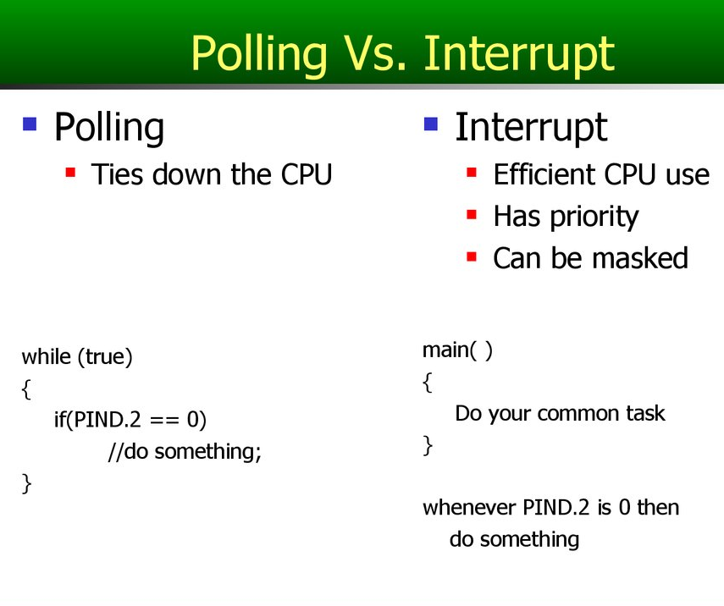
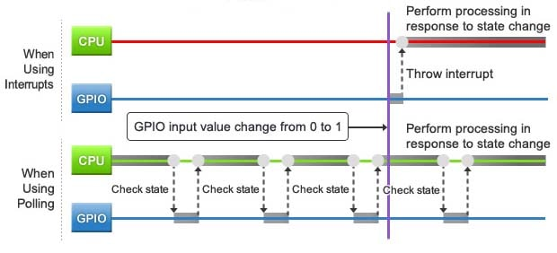

ANS:

Slide 5

Interrupts in Arduino:
In Arduino , there are many types of interrupts :
External Interrupt
Pin change interrupt
Interrupts in Timer
Interrupts in ADC
Interrupts in USART
With so many interrupts , if all fires at the same time , per say , how does the microcontroller prioritize ?

Slide 6
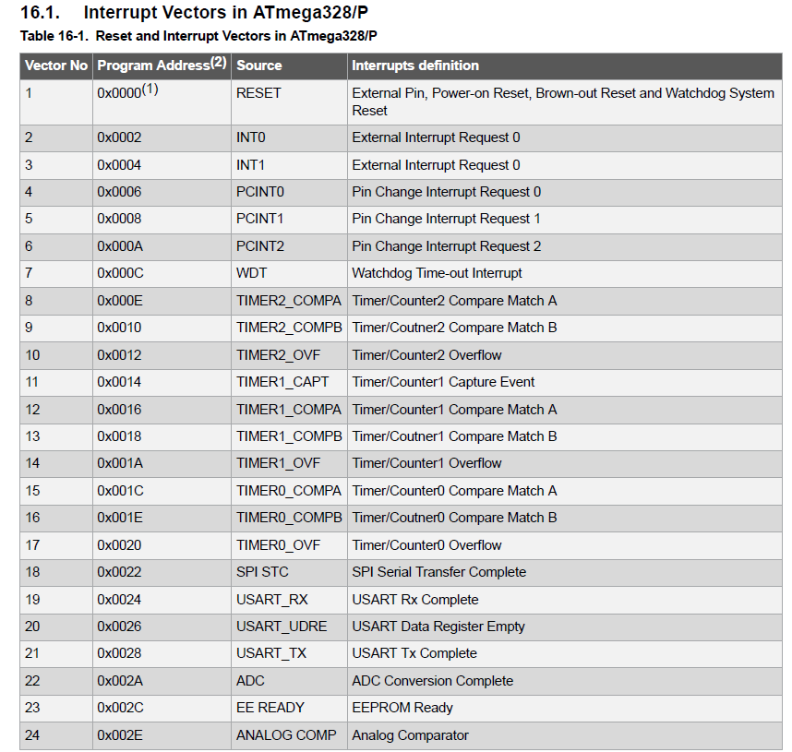
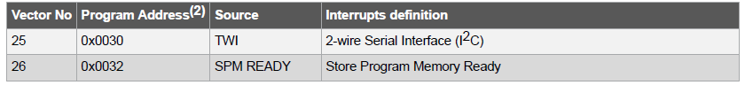
Priority order for interrupts

Slide 7
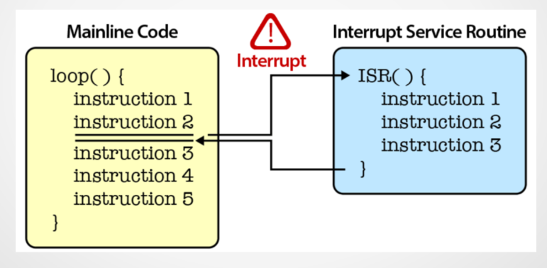
Interrupt Service Routine
The part of the code which contains the interrupt command to be executed.

Slide 8
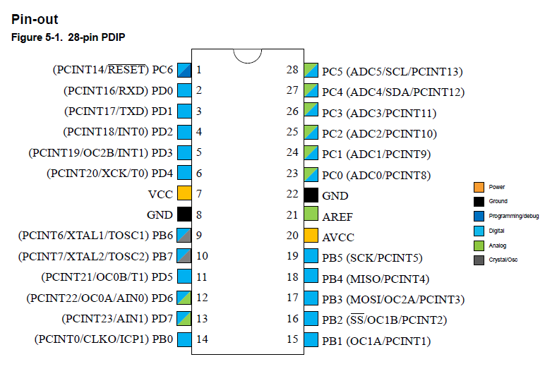
Interrupt Pins in Arduino:

Slide 9
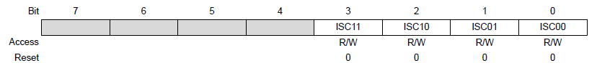
External Interrupts :
In Arduino , External Interrupts can be used via any of the following set of pins
INT0 , INT1
PCINT pins( 23 pins )
To control INT1 , INT 0 pins , we have three registers : EICRA , EIMSK & EIFR.
EICRA :

Slide 10
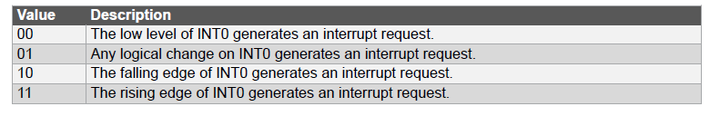
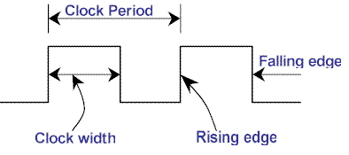
External Interrupts (Contd..):
Function of Interrupt Sense Control(ISC) bits

Slide 11

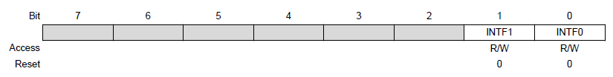
External Interrupts (Contd..):
EIMSK:
EIFR:
We need to write 1 to the INT1 and INT0 bits in EIMSK to enable the corresponding interrupts.
In EIFR , there are two bits INTF1 and INTF0 which get set to 1 whenever corresponding interrupt is fired, and get automatically set to 0 once that particular ISR is over.

Slide 12
How to code the interrupts ?
#include<avr/io.h>
int main()
{
SREG |=1<<I; //enables the global interrupt
EIMSK|=1<<INT0|1<<INT1; //enabling the interrupts
EICRA |=1<<ISC00|1<<ISC10; //setting the input //sense to any logical change
while(1)
{
/* body of the code*/
}
}
ISR(INT0_vect)
{
/*code*/
}

Slide 13
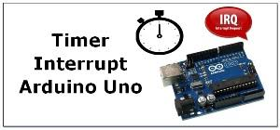
Internal Interrupts :
Here we will see only Timer Interrupts.
Timer has 2 interrupt associated with it
Timer overflow Interrupt
Compare Match Interrupt

Slide 14
Timer Overflow Interrupt :
Whenever Timer Counter overflows Timer overflow flag bit goes high.
If the Interrupt is enabled then the corresponding interrupt will be fired
Once the routine is completed the flag bit automatically goes to low.
The I bit in SREG register should be high to call global interrupts.
To do that, include #include<avr/interrupt.h> and in the main() just call once sei() function. ( Set Interrupt Enable) .
Or else you can do this way also SREG |=1<<I;

Slide 15
Toggle Led using Interrupt :
#include<avr/io.h>
#include<avr/interrupt.h>
volatile int count=0;
ISR(TIMER0_OVF_vect) {
++k;
}
int main()
{
DDRB = 0x00;
TCCR0A = 0x00;
TCCR0B= (1<<CS02)|(1<<CS00);
while(1)
{
if(k>=200) {
PORTB^=0xFF;
k=0;
}
}
return 0;
}

