Slide 1

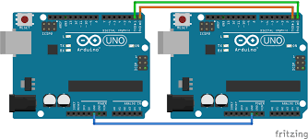
USART

Slide 2
USART:
Stands for :
Universal Synchronous/Asynchronous Receiver Transmitter.
Supports both synchronous and asynchronous transmission.
The data is sent serially with respect to the clock pulse.
The receiver peripheral receives the data when it has the same baud rate as transmitter

Slide 3
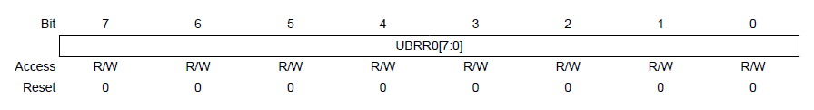
BAUD RATE:
Baud rate decides the rate of transfer of bits from input peripheral to the output peripheral.

Slide 4

The baud rate is set to UBRR register using the formula
UBRR = $\frac{fosc}{16.BAUD}−1$
Where:
f_{osc} = System clock frequency(16MHz for ATMEGA328P)
BAUD = Baud Rate in bits per second.
Q. Calculate the UBBR value for 9600bps and 16MHz system clock frequency.
ANS: 103

Slide 5
MODES OF OPERATION:
Asynchronous – The XCK pin(clock) is not used. The baud rate is set and the data is sent asynchronously.
Asynchronous 2x Mode – Results when U2X pin is set. The divisor for baud rate becomes from 16 to 8 resulting in increase in speed.
Synchronous – UMSEL is set high. The XCK(clock) pin is used. No need of baud rate. The data is sent synchronously with clock pulse.

Slide 6
FRAME FORMAT:
A frame refers to the entire data packet which is being sent/received during a communication.
A typical frame is 10 bit long ( 1 Start bit, 8-bit data, 1 Stop bit).
Order of Bits
Start bit (Always low)
Data bits (LSB to MSB) [5-9 bits]
Parity bit (optional) [Can be odd or even]
Stop bit (1 or 2) (Always high)

Slide 7
FRAME FORMAT(Contd.):
A frame starts with the start bit followed by the least significant data bit.
Then the next data bits, up to a total of nine, are succeeding, ending with the most significant bit.
If enabled, the parity bit is inserted after the data bits, before the stop bits.
When a complete frame is transmitted, a new frame can directly follow it, or the communication line can be set to an idle (high) state.

Slide 8
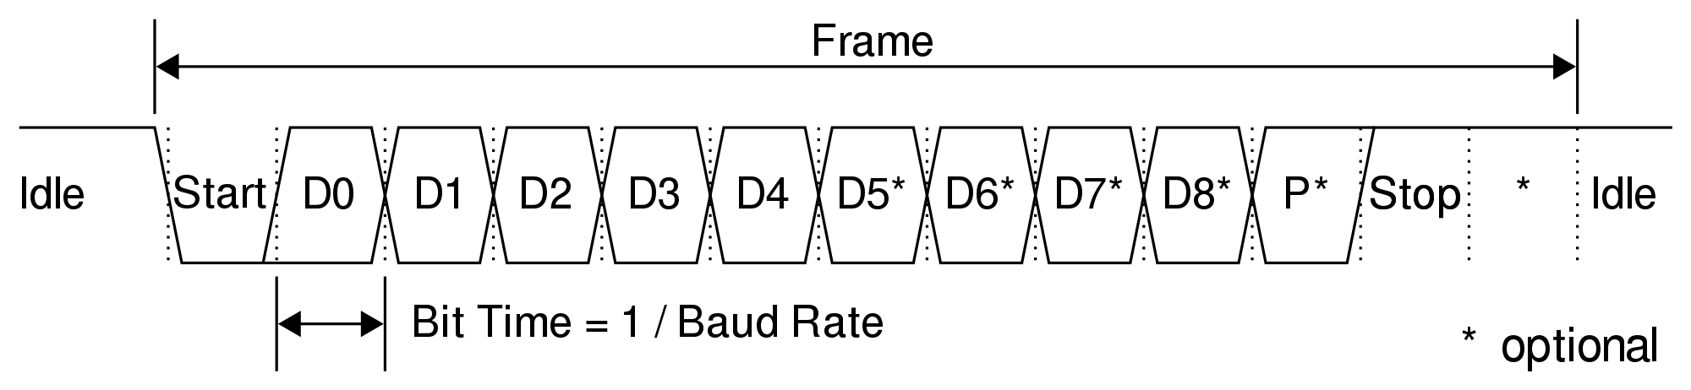
FRAME FORMAT(Contd.):

Slide 9
PARITY:
Even parity:
Even parity result in even number of ones.
When there are odd number of ones in data bits,parity bit is set high to get even number of ones.
When there are even number of ones in data bit, parity bit is set low.
Odd parity:
Odd parity results in odd number of ones.
If data bits has even ones, parity bit is set high.
If data bits has odd ones, parity bit is set low.

Slide 10
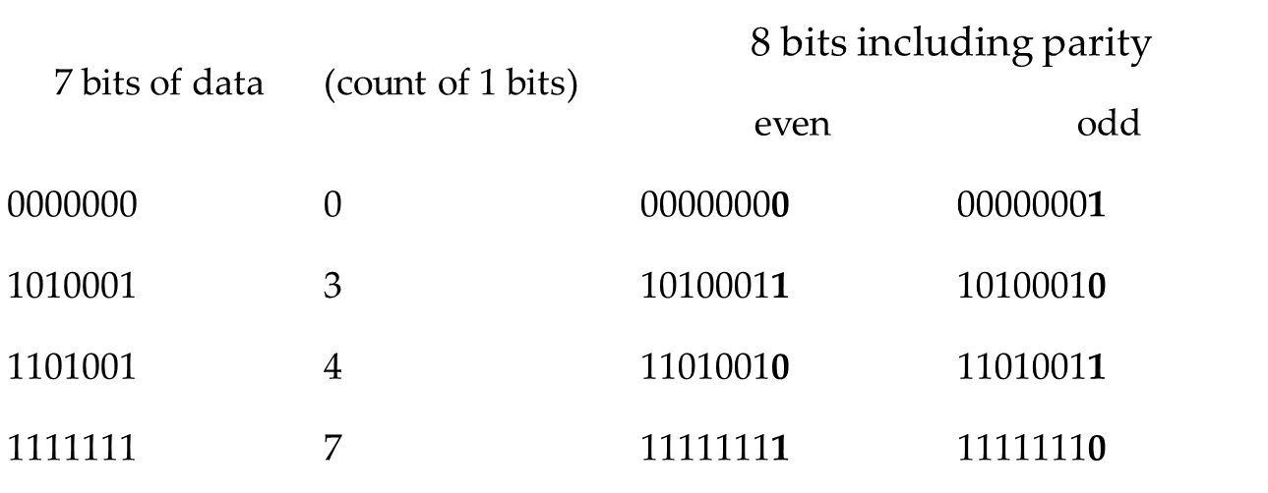
Example : 7 Bit Parity

Slide 11
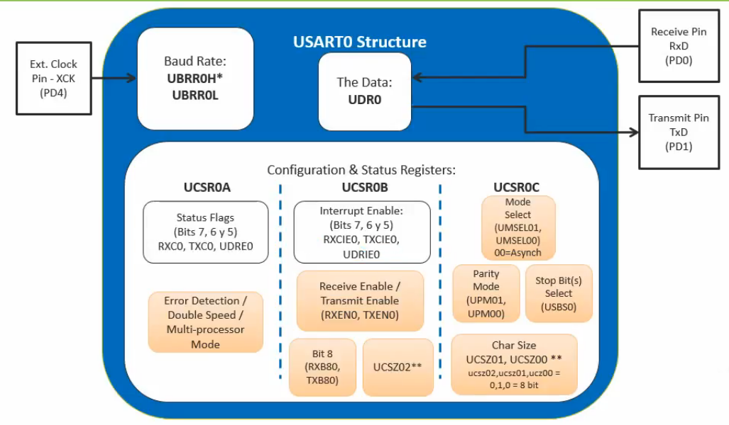
Structure of USART:

Slide 12
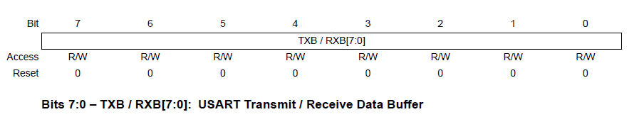
UDR: USART Data Register 0:
The USART Transmit Data Buffer Register and USART Receive Data Buffer Registers share the same I/O address referred to as USART Data Register or UDR.
The Transmit Data Buffer Register (TXB) will be the destination for data written to the UDR Register location.
Reading the UDR Register location will return the contents of the Receive Data Buffer Register (RXB).

Slide 13
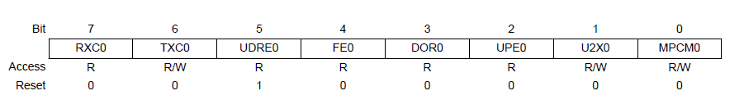
UCSR0A: USART Control and Status Register 0A
Bit 7: RXC0 – USART Receive Complete Flag:
This flag bit is set by the CPU when there are unread data in the Receive buffer and is cleared by the CPU when the receive buffer is empty.
Bit 6: TXC0 – USART Transmit Complete Flag:
This flag bit is set by the CPU when the entire frame in the Transmit Shift Register has been shifted out and there is no new data currently present in the transmit buffer (UDR).

Slide 14
UCSR0A(Contd.).
Bit 5: UDRE0– USART Data Register Empty:
The UDRE Flag indicates if the transmit buffer (UDR) is ready to receive new data. If UDRE is one, the buffer is empty, and therefore ready to be written.
Bit 4: FE0 – Frame Error:
This bit is set if the next character in the receive buffer had a Frame Error when received (i.e. when the first stop bit of the next character in the receive buffer is zero).
Bit 3: DOR0 – Data Overrun Error:
This bit is set if a Data OverRun condition is detected. A Data OverRun occurs when the receive buffer is full (two characters), and a new start bit is detected.

Slide 15
UCSR0A(Contd.).
Bit 2: PE0 – Parity Error:
This bit is set if the next character in the receive buffer had a Parity Error when received and the parity checking was enabled at that point (UPM1 = 1).
Bit 1: U2X0 – Double Transmission Speed:
Writing this bit to one will make Asynchronous mode run at double speed.
Bit 0: MPCM0 – Multi-Processor Communication Mode:
This bit enables the Multi-processor Communication mode. When the MPCM bit is written to one, all the incoming frames received by the USART Receiver that do not contain address information will be ignored.

Slide 16
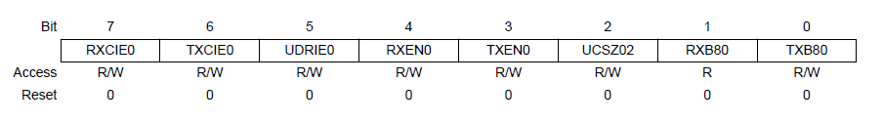
UCSR0B: USART Control and Status Register 0B:
Bit 7: RXCIE0 – RX Complete Interrupt Enable:
Writing this bit to one enables interrupt on the RXC Flag.
Bit 6: TXCIE0 – TX Complete Interrupt Enable:
Writing this bit to one enables interrupt on the TXC Flag. Bit 5: UDRIE – USART Bit 5: UDRIE0 - Data Register Empty Interrupt Enable:
Writing this bit to one enables interrupt on the UDRE Flag.
Bit 4: RXEN0 – Receiver Enable:
Writing this bit to one enables the USART Receiver. The Receiver will override normal port operation for the RxD pin when enabled.

Slide 17
UCSR0B(Contd.)
Bit 3: TXEN0 – Transmitter Enable:
Writing this bit to one enables the USART Transmitter. The Transmitter will override normal port operation for the TxD pin when enabled.
Bit 2: UCSZ02 – Character Size:
The UCSZ2 bits combined with the UCSZ1:0 bits in UCSRC register sets the number of data bits (Character Size).
Bit 1: RXB08 – Receive Data Bit 8:
RXB8 is the ninth data bit of the received character when operating with serial frames with nine data bits. It must be read before reading the low bits from UDR.
Bit 0: TXB08 – Transmit Data Bit 8:
TXB8 is the ninth data bit in the character to be transmitted when operating with serial frames with nine data bits. It must be written before writing the low bits UDR.

Slide 18
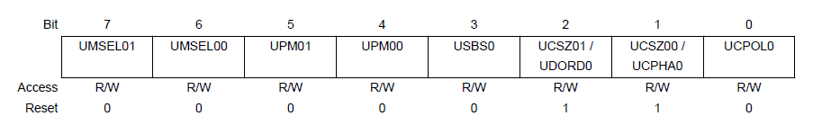
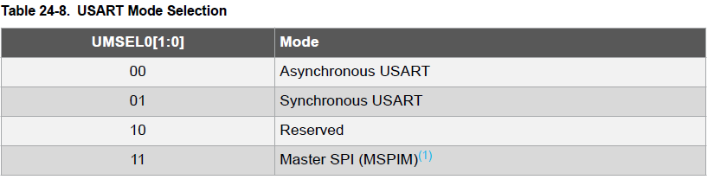
UCSR0C: USART Control and Status Register 0C
Bit 7-6 : UMSEL0[1:0] – Mode Selector
These bits are used to select the operating mode of USART. Between Synchronous and Asynchronous

Slide 19
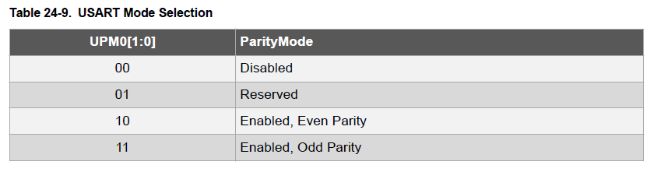
UCSR0C(Contd.):
Bit 5-4: UPM01:0 – Parity Mode:
This bit helps you enable/disable/choose the type of parity.

Slide 20
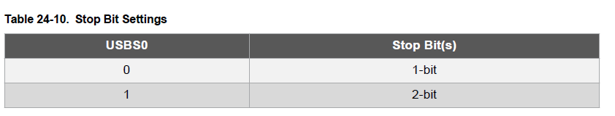
UCSR0C(Contd.):
Bit 3: USBS0 – Stop Bit Select:
This bit selects the number of stop bits to be inserted by the Transmitter.

Slide 21
UCSR0C(Contd.):
Bit 2-1: UCSZ0[1:0] – Character Size:
These two bits in combination with the UCSZ02 bit in UCSR0B register helps choosing the number of data bits in your frame
Bit 0: UCPOL0 – Clock Polarity:
This bit is used for Synchronous mode only. Write this bit to zero when Asynchronous mode is used. The UCPOL bit sets the relationship between data output change and data input sample, and the synchronous clock (XCK).

Slide 22
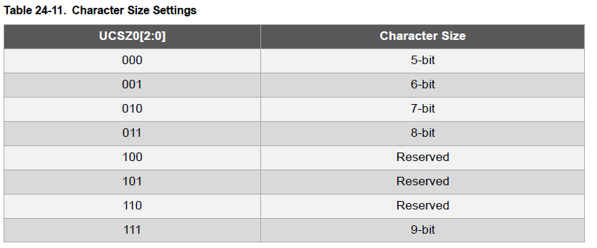
UCSR0C(Contd.):

Slide 23
Coding:
Q. Write a code to configure USART at 9600bps, Asynchronous Mode, Normal Speed, No parity, 1 Stop bit and 8 bit of data.
ANS:
UCSR0A = 0X00;
UCSR0B = (1<<RXEN0) | (1<<TXEN0);
UCSR0C = (1<<UCSZ01) | (1<<UCSZ00);
UBRR0 = 103;
Q. Write a code to configure USART at 9600bps, Asynchronous Mode, Normal Speed, Even parity, 2 Stop bit and 9 bit of data.
ANS:
UCSR0A = 0X00;
UCSR0B = (1<<RXEN0) | (1<<TXEN0) (1<<UCSZ02);
UCSR0C = (1<<UPM01) | (1<<UCSZ01) | (1<<UCSZ00) | (1<<USBS0);
UBRR0 = 103;

Slide 24
Task:
Turning ON/OFF a LED by using USART in UNO

Slide 25
Coding:
We will use our Laptop as the other device for sending the commands over serial communication.
To use serial communication we will use Serial Monitor.
When we will send 1 the LED should turn ON.
When we will send 0 is should turn OFF

Slide 26
Coding(Contd.):
#include<avr/io.h>
void usart_init() {
UCSR0A = 0X00;
UCSR0B = (1<<RXEN0) | (1<<TXEN0);
UCSR0C = (1<<UCSZ01) | (1<<UCSZ00);
UBRR0 = 103;
}
char usart_read() {
while( UCSR0A & (1<<RXC0)) { }
return UDRO;
}
void usart_write(char data) {
while( UCSR0A & (1<<UDRE0)) { }
UDRO=data;
}
int main(void) {
char ch;
usart_init();
DDRB=0x00;
PORTB=0x00;
while(1) {
ch=usart_read();
if(ch==‘0’) {
PORTB=0x00;
usart_write(‘O’);
usart_write(‘K’);
}
else if(ch==‘1’) {
PORTB=0xFF;
usart_write(‘O’);
usart_write(‘K’);
}
}
return 0;
}

Slide 27
Thank You

