Slide 1
Loan Approval Analysis
&
Prediction

Slide 2
Contents / Agenda
Executive Summary – Insights & Recommendations
Business Problem Overview
Solution Approach
Data Dictionary
Solution Design and Methodology
Data Preprocessing
Exploratory Data Analysis (EDA)
Model Development
Model Evaluation & Performance Evaluation
Model Comparison & Selection
Dashboard Development & Visualization
Conclusions and Recommendations

Slide 3
Executive Summary
This project is based on a synthetic loan approval dataset designed to simulate real-world banking decision-making. The dataset contains 50,000 records with customer details. It includes features such as credit score, income, current debt, savings etc, along with a target variable indicating whether a loan is approved or rejected.
The dataset is built using realistic banking rules and correlations followed by financial institutions in the United States and Canada. It reflects actual lending criteria such as the impact of credit score, debt-to-income ratio, and past defaults on loan approval decisions. This makes the dataset suitable for understanding credit risk modelling and real-world loan evaluation processes.
In this project, data preprocessing and exploratory data analysis (EDA) techniques were applied to understand the dataset and identify key patterns. A Power BI dashboard was developed for visualization, and machine learning models were used to predict loan approval outcomes. The project demonstrates how data-driven techniques can be used to support and improve loan approval decision-making.

Slide 4
Key Insights
Customers with higher credit scores and higher income have a higher probability of loan approval.
Current debt plays a major role, and customers with higher debt are more likely to be rejected.
Customers with past default history are usually rejected for loan approval.
Customers with better financial stability (low debt + good credit score) are more likely to be approved.
Loan approval decisions are based on a combination of factors, not a single attribute.
Recommendations
Approve customers with a strong credit score and stable income.
Avoid approving customers with high debt-to-income (DTI) ratio.
Customers with past default history should not be approved for loans.
Consider savings asset while evaluating loan applications.
Evaluate the overall financial profile (credit score, income, debt, savings) rather than a single factor
Use data-driven models to automate and improve loan approval decisions

Slide 5
Business Problem Overview
Banks receive a large number of loan applications, but it is difficult to identify which customers are reliable. Approving loans to high-risk customers can lead to financial loss, while rejecting eligible customers can reduce business opportunities.
Currently, many loan approval decisions are based on manual evaluation or simple rules, which may not always be accurate or consistent. This creates a need for a more efficient and data-driven approach.
Therefore, the main problem is to develop a system that can analyze customer financial and credit data to predict whether a loan should be approved or rejected, helping banks make better and faster decisions.

Slide 6
Solution Approach
The following questions were considered during the analysis
What is the overall distribution of loan approvals vs rejections?
How does credit score affect loan approval?
Does income influence loan approval decisions?
How does current debt impact loan approval?
How do past defaults affect loan approval decisions?
Is there any relationship between savings assets and loan approval?
How does the debt-to-income ratio affect loan approval decisions?
Which factors have the strongest impact on loan approval decisions?
Which loan purpose have highest approval application?

Slide 7
Data Dictionary
Customer Information
Customer ID → Unique identifier for each customer or loan application
Age → Age of the applicant
Occupation Status → Employment type of the customer (Employed, Self-employed, Student)
Years Employed → Work experience in years
Financial Information
Annual Income → Total yearly income of the customer
Credit Score → Creditworthiness of the customer
Credit History Years → Number of years the customer has been using credit
Savings Assets → Savings or assets owned by the customer
Current Debt → Existing debt of the customer

Slide 8
Credit Behaviour
Defaults on File → Whether the customer has past defaults (Yes, No)
Delinquencies (Last 2 Years) → Number of late payments
Derogatory Marks → Negative credit records
Loan Details
Loan Amount → Amount requested by the customer
Interest Rate → Interest applied on loan
Loan Intent → Purpose of the loan (Personal, Medical, Education, Business, etc)
Loan Status → Final decision of the loan application (Approved or Rejected)
Product Type → Type of loan (Credit Card, Personal Loan, Line of Credit)
Financial Ratios
Debt-to-Income Ratio (DTI) → Debt compared to income
Loan-to-Income Ratio → Loan amount vs income
Payment-to-Income Ratio → Monthly payment vs income

Slide 9
Solution Design And Methodology
Data Collection
Import dataset
Check Structure
Data cleaning
Handle missing data
Fix data formats
Exploratory Analysis
Perform EDA using Power BI
Univariate analysis
Bivariate analysis
Feature Assessment
Identify important features
Analyze correlations using heatmap
Model Development
Train models on processed dataset
Evaluated using performance metrics
Selected best performing model
Recommendations
Improve loan approval decisions
Reduce risk by identifying high-risk customers
Apply data-driven decision-making
Reporting & Dashboard
Create Power BI dashboard
Visualize key insights
Support business decision-making

Slide 10
Data Preprocessing
Before building the model, the dataset was prepared carefully.
Checked for duplicate records to ensure data quality
Verified dataset structure and corrected column names
Handled missing values by checking columns and treating them appropriately
Converted all attributes into appropriate data types
Converted binary categorical feature default_on_file into 0 and 1
Applied one-hot encoding to categorical features such as occupation_status, product_type, and loan_intent
Separated independent variables (features) and dependent variable (loan_status)
Split the dataset into training and testing sets using an 80:20 ratio
Applied different classification machine learning algorithms to identify the best model
Exported the cleaned dataset to CSV format for Power BI visualization

Slide 11
Exploratory Data Analysis (EDA)
Data At Hand
Rows: 50,000 loan applications
Columns: Multiple attributes related to customer demographics, financial details, credit behaviour, and loan information
Target Variable: loan_status (Approved vs Rejected)
Dataset Type: Slightly imbalanced — ~55% approved and ~45% rejected
Dataset Nature: Synthetic dataset based on real-world banking rules
Notable Observations
Credit score and Income plays an important role in loan approval
Higher debt and DTI ratio are associated with rejection
Customers with past defaults are mostly rejected
Loan approval depends on multiple financial factors

Slide 12
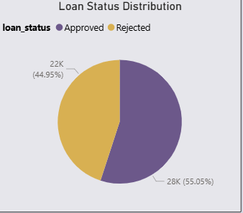
Exploring the overall distribution of loan approvals vs rejections
The pie chart shows the distribution of approved and rejected loan applications. Approximately 55.05% (28K) were approved, while 44.95% (22K) were rejected.
This indicates that slightly more applications are approved than rejected, suggesting a moderately lenient approval trend.

Slide 13
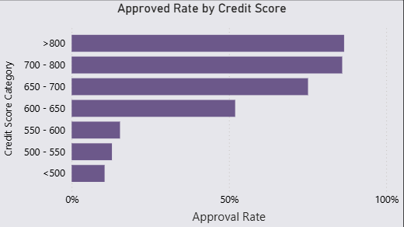
Analyzing the impact of credit score on loan approval rates
The chart shows that loan approval rates increase as the credit score improves.
Applicants with a credit score above 700 have the highest approval rates, while those below 600 have significantly lower chances of approval.
This indicates a strong positive relationship between credit score and loan approval, meaning higher creditworthiness leads to higher approval probability.

Slide 14
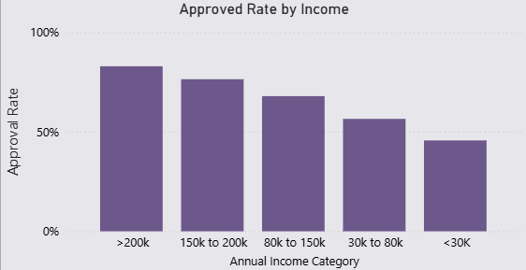
Analyzing the impact of income on loan approval rates
Loan approval rates increase as income levels rise.
Applicants earning above 200k have the highest approval rates, while those below 30k have the lowest.
This indicates that income positively influences loan approval decisions, with higher-income applicants having a greater likelihood of approval.

Slide 15
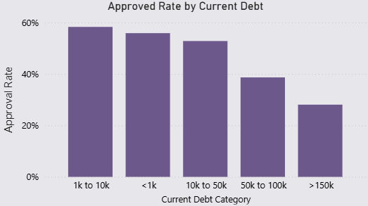
Analyzing the impact of current debt on loan approval rates
Loan approval rates decrease as current debt increases.
Applicants with lower debt levels (less than 10k) tend to have higher approval rates, whereas those with very high debt (above 150k) experience the lowest approval rates.
Overall, this suggests a clear negative relationship between current debt and the likelihood of loan approval.

Slide 16
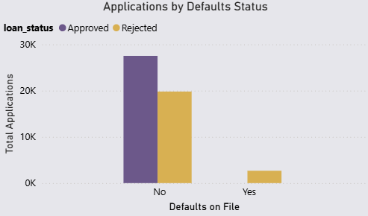
Analyzing the impact of past defaults on loan approval decisions
Applicants with no past defaults have a significantly higher number of approved loans compared to rejected ones.
Applicants with past defaults have no approvals and a higher number of rejections.
This shows that having past defaults significantly reduces the likelihood of loan approval.

Slide 17
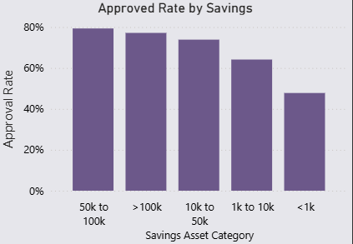
Analyzing the relationship between savings assets and loan approval rates
Loan approval rates tend to increase as savings assets increase.
Applicants with higher savings (above 50k) have higher approval rates, while those with very low savings (<1k) have the lowest.
This indicates a positive relationship between savings assets and loan approval likelihood.

Slide 18
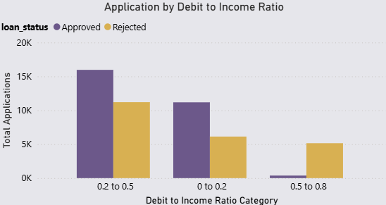
Analyzing the impact of debt-to-income ratio on loan approval
Applicants with a moderate debt-to-income ratio (0.2 to 0.5) have the highest number of approved applications.
Lower ratios (0 to 0.2) also show good approval rates but slightly less than the moderate range.
High ratios (0.5 to 0.8) have very low approvals and higher rejections, indicating reduced approval chances.

Slide 19
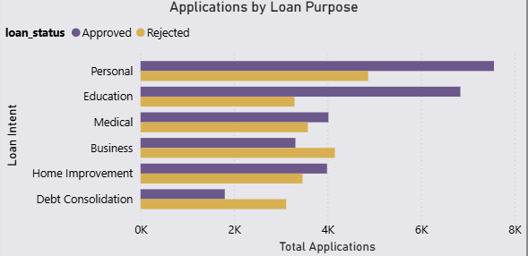
Analyzing loan approvals across different loan purposes
Personal loans have the highest number of approved applications among all loan purposes.
Education and Home Improvement loans also show relatively high approval counts compared to others.
This indicates that personal loan purposes are the most commonly approved in the dataset.

Slide 20
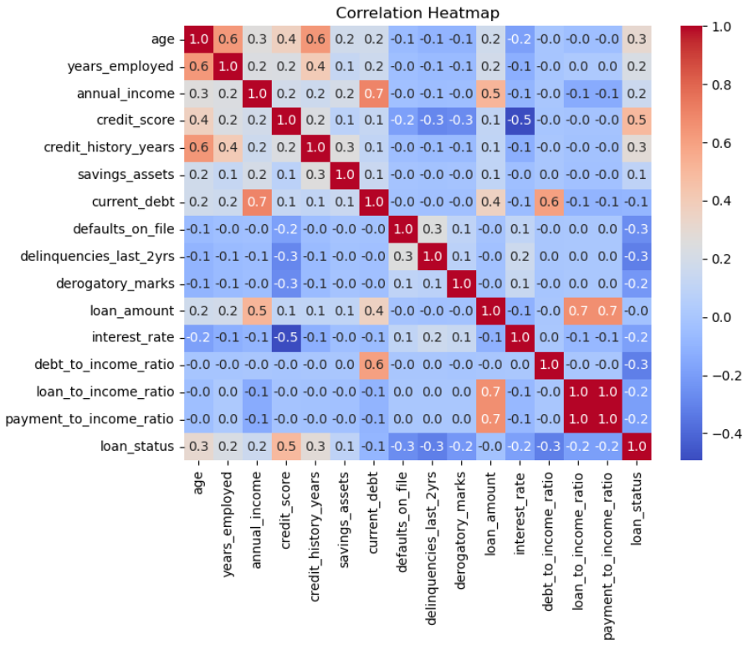
Identifying key factors influencing loan approval decisions using correlation analysis
Credit score shows the strongest positive correlation with loan approval, making it the most influential factor.
Debt-related factors such as debt-to-income ratio and past defaults show negative correlations, indicating they reduce approval chances.
Income and credit history also have a moderate positive impact on loan approval decisions.

Slide 21
Model Development
Model Selection
The objective of this study is to predict whether a customer’s loan application will be approved or rejected based on demographic and financial attributes.
The following machine learning classification algorithms were implemented:
Logistic Regression
K-Nearest Neighbors (KNN)
Decision Tree Classifier
Random Forest Classifier
Support Vector Classifier (SVC)
The target variable used in the model is: Loan Status (Approved, Rejected)
Random Forest was selected as the primary model due to its high accuracy, robustness, and ability to handle non-linear relationships between variables.

Slide 22
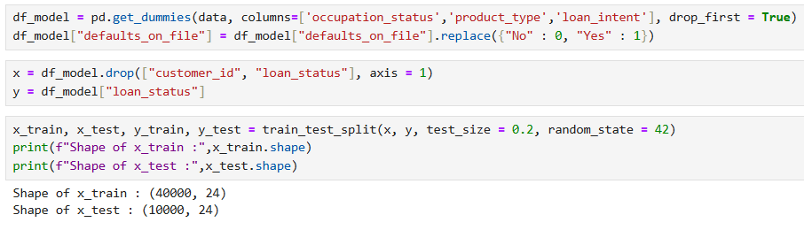
Data Preparation
Categorical variables were converted into numerical format using encoding techniques.
Binary attributes were transformed into 0 and 1 format.
The dataset was divided into independent variables (features) and the dependent variable (loan status).
The dataset was split into 80% training data and 20% testing data.
Model Training
All models were trained using the prepared training dataset.
The models learned patterns between applicant features and loan approval outcomes.
The trained models were then used to predict whether a new loan application would be approved or rejected

Slide 23
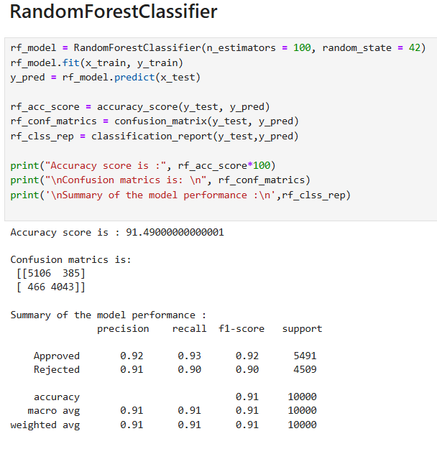
Model Evaluation & Performance Evaluation
Model Accuracy
The performance of the machine learning models was evaluated using standard classification metrics.
Among all the models, Random Forest achieved the highest accuracy of approximately 99%, making it the best-performing model for this dataset.
Performance was evaluated using:
Accuracy Score
Confusion Matrix
Precision
Recall
F1-Score
Performance Interpretation
The model correctly classifies most loan applications.
Some errors are present but overall performance is good.
It helps identify risky applicants before approval.
This supports better decision-making and reduces risk.

Slide 24
Model Comparison & Selection
Model Comparison
Different classification models were compared based on multiple evaluation metrics such as accuracy, confusion matrix, precision, recall, and F1-score.
Logistic Regression – Lower performance with accuracy around 73%, used as a baseline model.
KNN (K-Nearest Neighbors) – Moderate performance with accuracy around 86%, but slightly lower consistency.
Decision Tree – Good performance with accuracy around 87%, and easy to interpret.
Random Forest – Best performance with highest accuracy around 91%, providing reliable and balanced predictions.
SVC (Support Vector Classifier) – Strong performance with accuracy around 90%, close to Random Forest.
Final Model Selection
Random Forest Classifier was selected as the final model.
It provides the highest accuracy among all models.
It handles complex relationships between features effectively.
It gives more reliable predictions compared to other models.

Slide 25
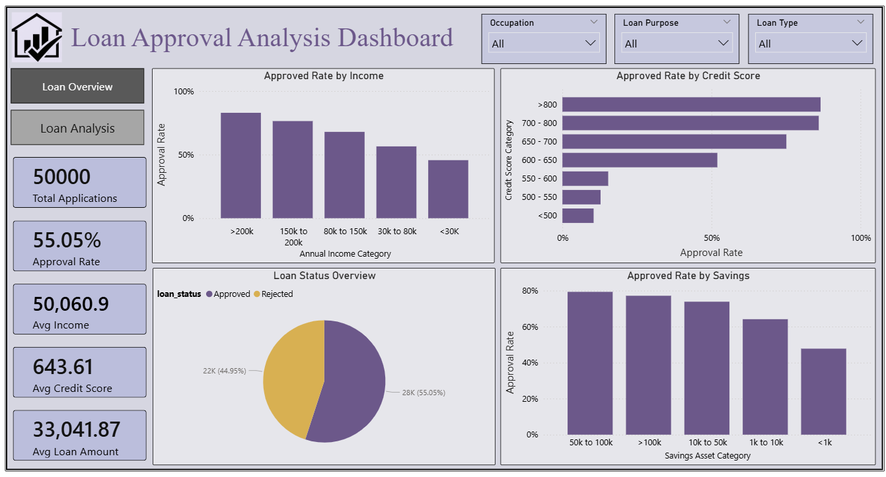
Dashboard Development & Visualization

Slide 26
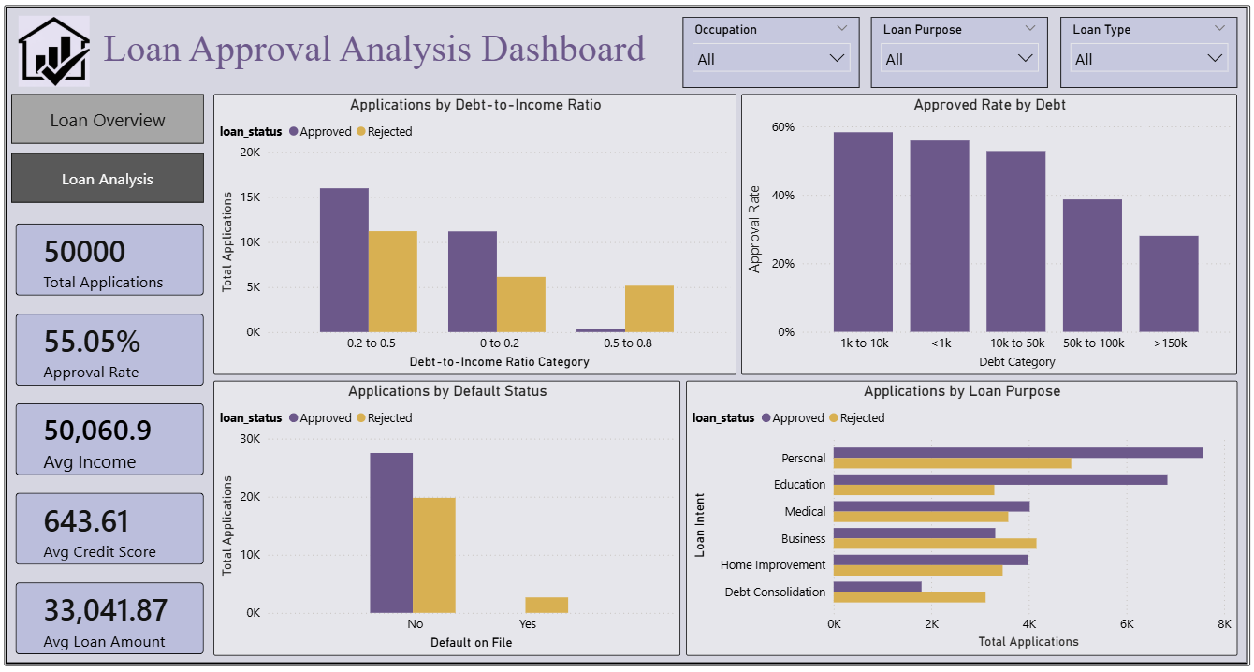

Slide 27
Conclusions and Recommendations
Conclusion
This project focused on predicting loan approval decisions using data analytics and machine learning techniques. The dataset included important customer information such as income level, employment status, credit score, debt, and financial behavior.
After data preprocessing, exploratory data analysis (EDA) was performed to identify patterns. The results showed that factors like income, credit score, debt, savings, and past defaults significantly influence loan approval. Customers with higher income and strong credit history were more likely to be approved, while high-risk applicants were often rejected.
Among various models tested, the Random Forest model achieved the best performance with high accuracy in classifying applicants.
A Power BI dashboard was developed to visualize the insights in an interactive and user-friendly manner. The dashboard highlights key metrics such as approval rate, income distribution, credit score impact, and risk factors. It serves as a valuable decision-support tool for financial institutions.

Slide 28
Among various models tested, the Random Forest model achieved the best performance with high accuracy in classifying applicants.
Recommendations
Banks should adopt predictive models to evaluate customer risk before approving loans.
Customers with low credit scores or past defaults should undergo stricter verification processes.
Among various models tested, the Random Forest model achieved the best performance with high accuracy in classifying applicants.
Medium-risk customers can be approved with controlled loan amounts instead of outright rejection.
Financial institutions should continuously monitor high-risk customers even after loan approval.
Automating the loan approval process can reduce manual effort, minimize human errors, and improve decision speed.
Using data-driven decision systems can enhance overall bank performance and reduce default rates.

