Slide 1
Anomaly Detection on Multi-Relational Data using unsupervised technqiues
Alam Rithika – 2202550F

Slide 2
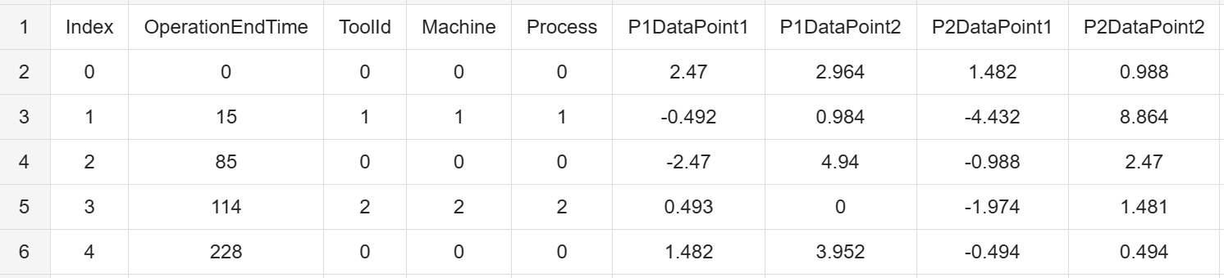
Background
Dataset Origin: Collected from a real-world manufacturing process of a Critical Manufacturing business partner, monitored via an IoT system.
Data Collection: Eight distinct readings are recorded each time a tool is used. Readings include operational parameters and error metrics related to the tool's performance and the machine or process involved.
Use Case: The dataset is relevant for estimating and predicting tool longevity. Tools are retired from the dataset once they begin to underperform.
Importance: Critical for optimizing tool usage and minimizing downtime in advanced manufacturing. Hence, enhancing operational efficiency.
Notes:
The dataset originates from a real-world manufacturing process in which an IoT system monitors the performance of tools used by a Critical Manufacturing business partner. Eight distinct readings are recorded each time a tool is utilized. These readings encompass various operational parameters and error metrics that reflect the tool's performance and the machine or process involved.
As tools wear out and begin to underperform, they are retired from the manufacturing process, creating a unique opportunity to analyze time-dependent covariates related to tool longevity. This dataset is highly relevant for developing predictive maintenance models and multilevel survival analysis, which are critical in advanced manufacturing for optimizing tool usage and minimizing downtime. The dataset’s structure, capturing detailed operational data, makes it particularly suited for high-quality model development. Its well-defined collection methodology ensures that the data is robust and comprehensive, facilitating the creation of models that can predict tool longevity and enhance operational efficiency.
4o

Slide 3
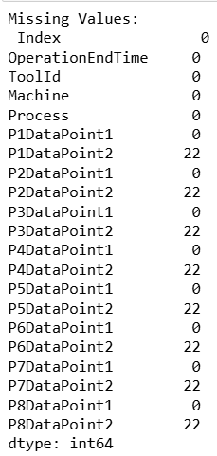



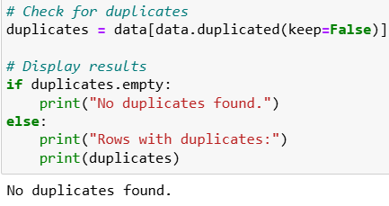



Data Exploring & Cleaning
1. General Information about data
2. Cleaning data
Displayed first and last 5 rows
Get insight on features data type
Calculated basic statistics for each feature which includes mean, STD, min, max, etc.
Conducted a check for missing values and removed rows containing the missing data.
Checked for duplicates but there was none.

Slide 4



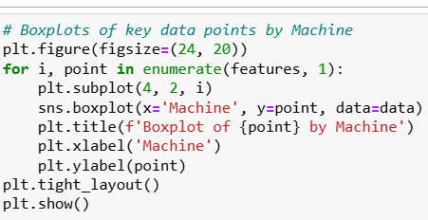
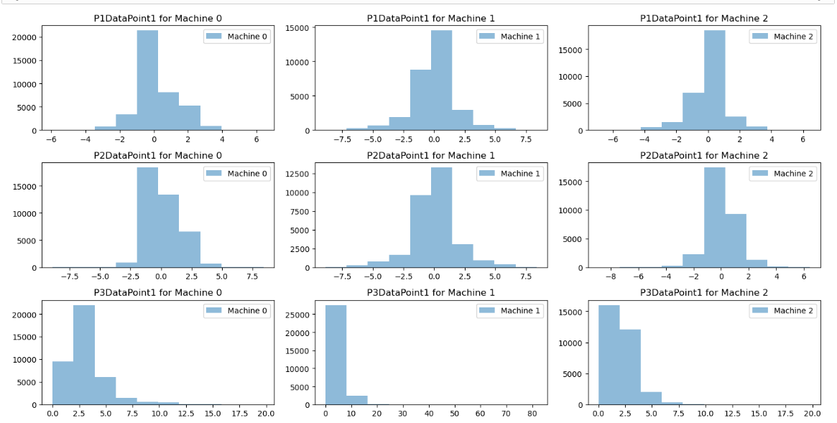
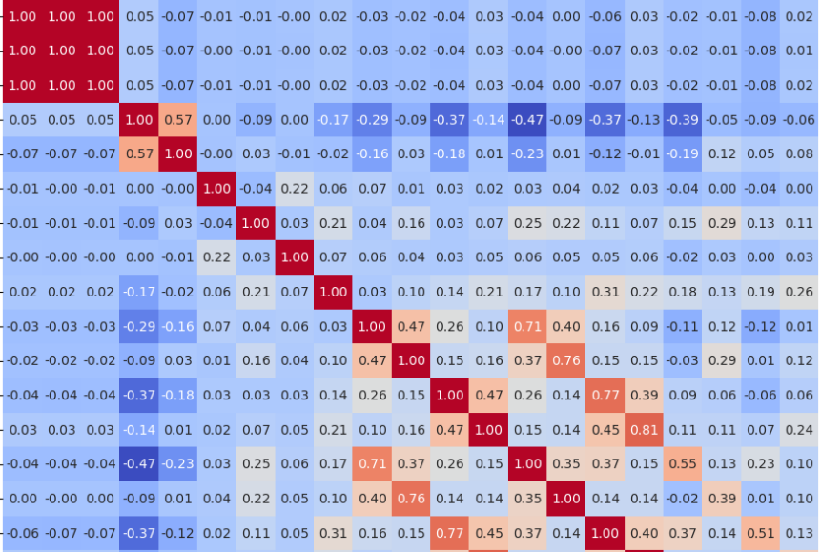
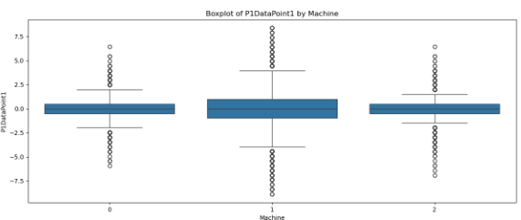
Data Visualisation
1. Histogram
2. Heatmap
3. Boxplot
- Visualize the distribution of primary features for the three machines in the dataset
- Created a heatmap to display the correlation matrix of the dataset, illustrating the strength between the features.
- Displaying the distribution of values across different machines. Also, help identify outliers.

Slide 5
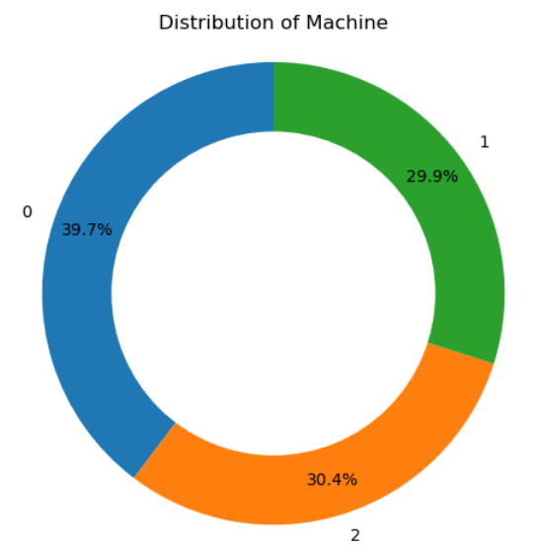
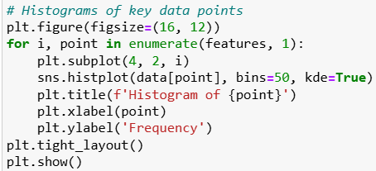
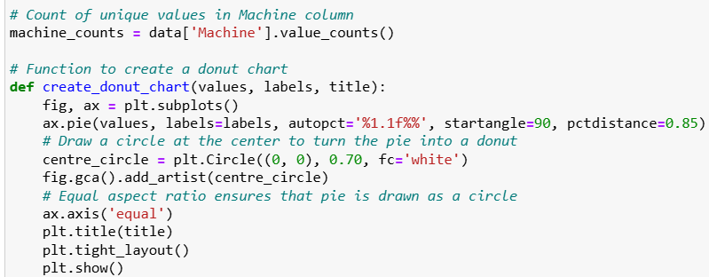
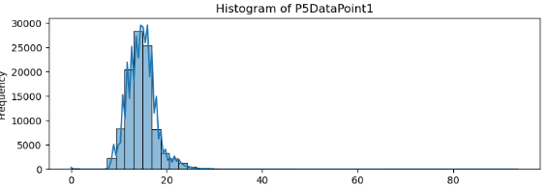
Data Visualisation
4. Histograms
5. Donut Chart
- Generated histograms for each key data point, displaying the distribution of values across the entire dataset with both frequency counts and a kernel density estimate (KDE) for each feature. Each subplot represents a different key data point.
- A donut chart to visualize the distribution of values for the column ‘machine’

Slide 6
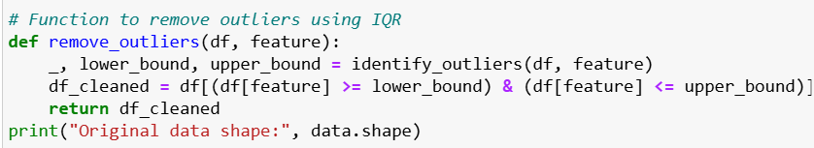

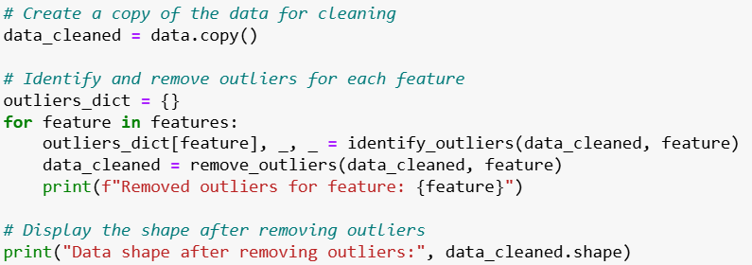
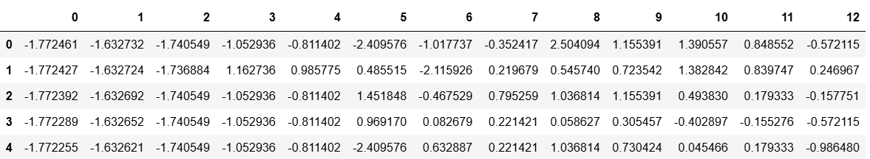
Data Pre-Processing
1. Removing extreme outlier
2. Scaling
Identified and removed extreme outliers from a dataset using the Interquartile Range (IQR) method for each specified feature.
By removing extreme values, you can improve the accuracy and reliability of the anomaly detection process, leading to better insights and model performance.
Centered the data around zero and scaled it to have unit variance, making features comparable when they have different units or scales.
Scaling ensure that each feature contributes equally to the analysis and prevents features with larger ranges from disproportionately influencing the results.

Slide 7

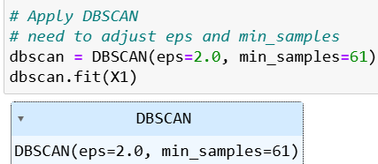
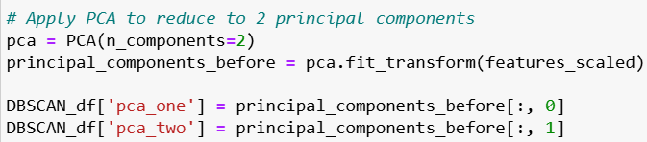
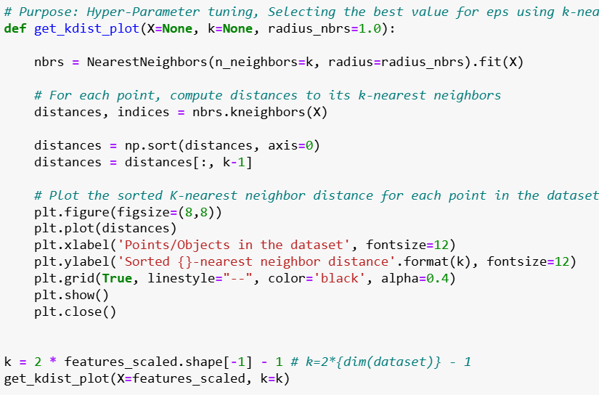
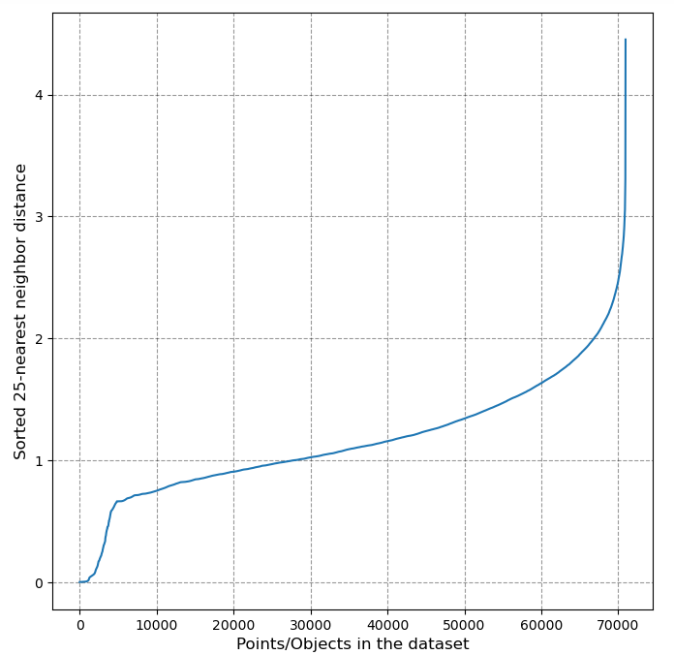
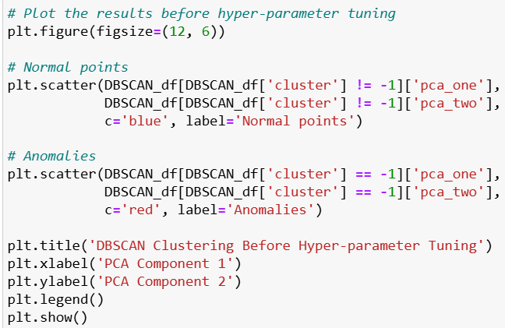
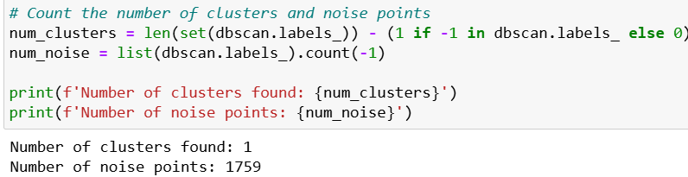
Modelling: DBSCAN
1. Initial Model Set-Up
2. Hyper Parameter tuning
Applied DBSCAN algorithm with params of eps=2, min_samples=61 to detect clusters.
Visualized the results using PCA to reduce the dimensions to 2 components.
Used a k-nearest neighbors approach to determine the optimal value of ‘eps’ for DBSCAN.
Plotted the sorted k-nearest neighbor distances to identify the "elbow" point, suggesting the best eps value.

Slide 8
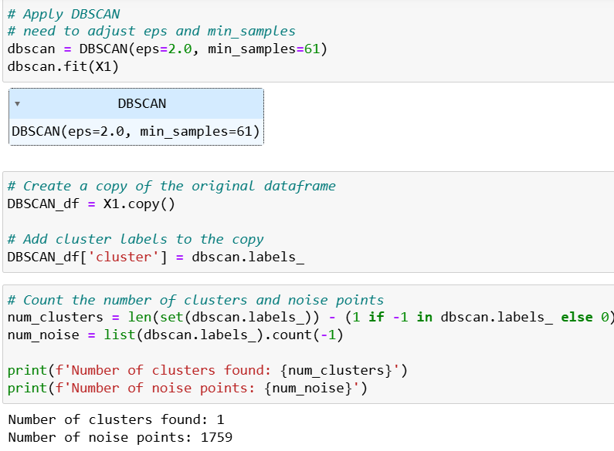
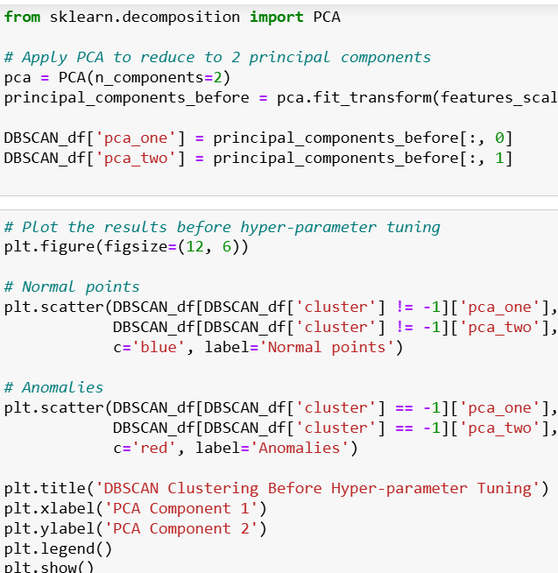
Modelling: DBSCAN
3. Re-Train Model
Adjusted the ‘eps’ parameter based on the optimal value observed from the K-nearest neighbors graph
Manually experimented with different values for min_samples to find the best fit for the data.
Visualized the clustering results using PCA for clearer interpretation.
Noted some improvement in clustering performance after tuning the parameters.

Slide 9
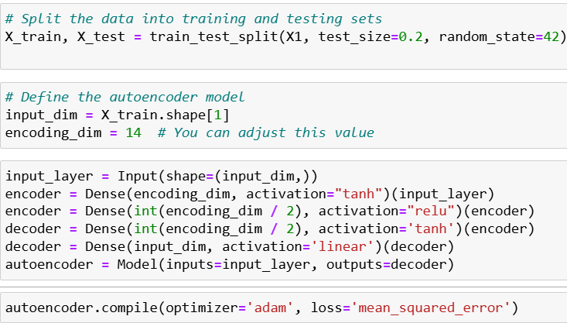
Modelling: Autoencoder
Splitted data into training and testing dataset.
Created an input layer with dimensions matching the number of features in the dataset.
Encoded the input data into a smaller dimension (14 units) using a dense layer with ‘tanh’ activation.
Further reduced the dimension by half using another dense layer with ‘relu’ activation.
Started reconstructing the data by expanding the dimensions using a dense layer with ‘tanh’ activation.
Fully reconstructed the input dimension using a final dense layer with linear activation.
Compiled the model using ‘adam’ optimizer and mse as loss function
Trained model on training data
1. Building Model Architecture

Slide 10
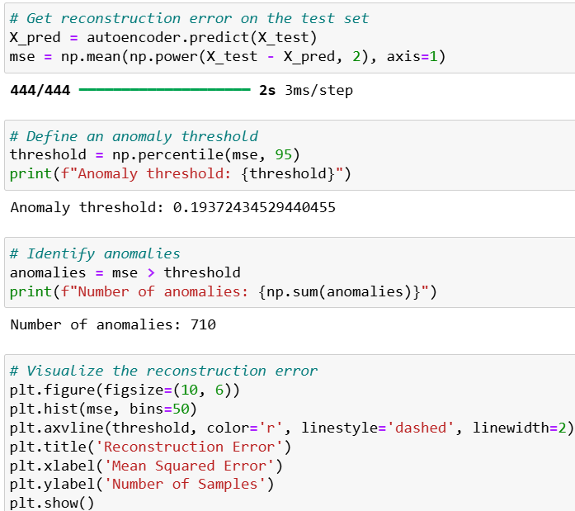
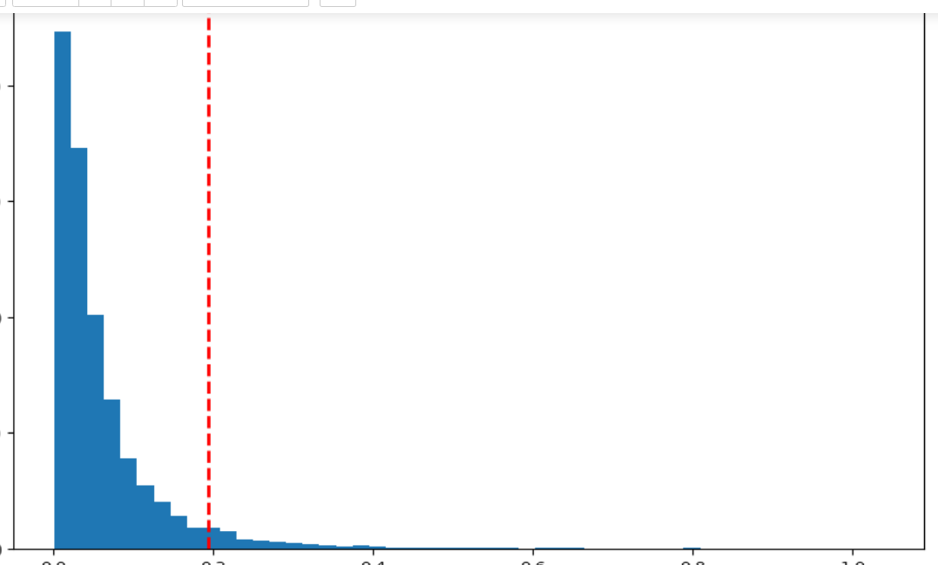
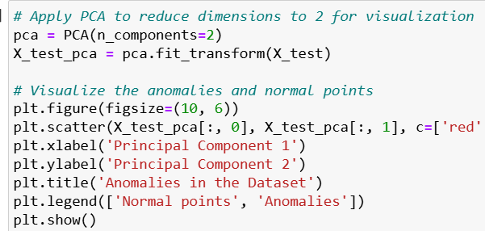
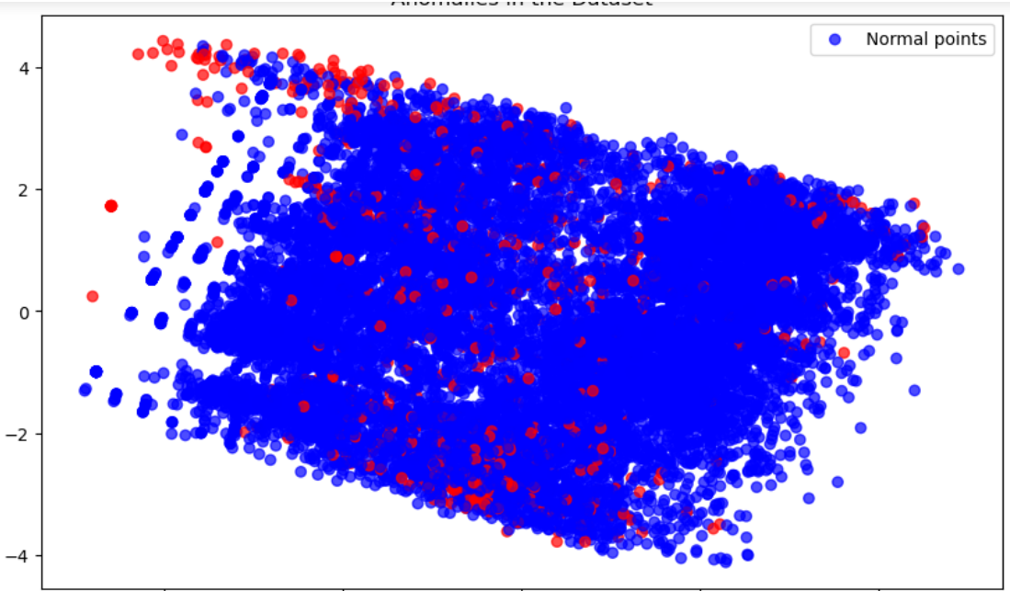
Modelling: Autoencoder
Predicted the output for test set using the trained autoencoder.
Calculated the MSE between the test data and the reconstructed output to measure reconstruction error.
Plotted a histogram of the reconstruction errors
2. Reconstruction Error Calculation & Visualization
3. Anomaly Detection
Defined an anomaly threshold at the 95th percentile of the reconstruction errors.
Identified samples with MSE greater than the threshold as anomalies.
Counted the total number of anomalies detected.
Plotted PCA for visualization.

Slide 11
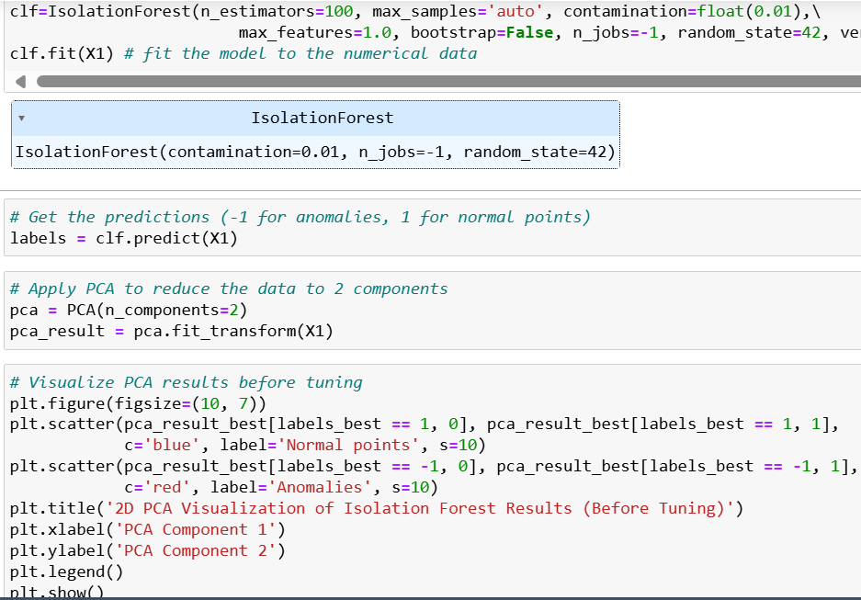
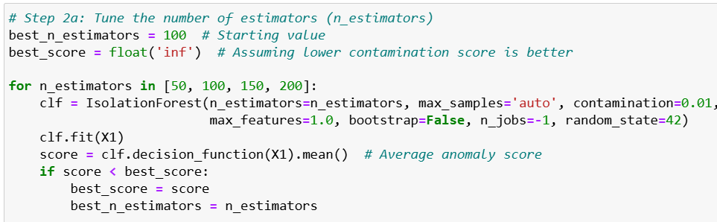
Modelling – Isolation Forest
1. Initial Model
2. Hyper Parameter Tuning and Re-Training the model
Initialized model with some parameters and got predictions.
Used PCA to reduce data to 2 components and visualize the anomalies detected.
Applied t-SNE for another visualization perspective before tuning the model.
First optimized the number of estimators, then fine-tuned the contamination rate, and finally adjusted the max samples for best performance.
Chose the best parameters and used it to re-train the model

Slide 12
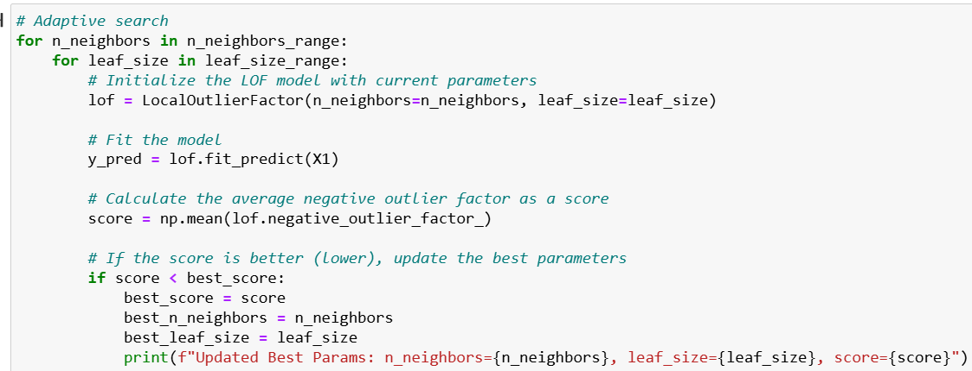
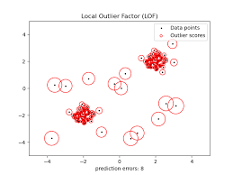
Local Outlier Factor (LOF)
1. Initial Model:
Used LocalOutlierFactor with n_neighbors=20, leaf_size=30.
Detected initial anomalies.
2. Initial PCA Visualization:
Applied PCA to reduce data to 2D.
Plotted normal points vs. anomalies.
3. Hyperparameter Tuning:
Explored n_neighbors in [5, 10, 15, 20, 25, 30] and leaf_size in [10, 20, 30, 40, 50].
Updated best parameters based on the lowest negative outlier factor score.
4. Final Model:
Trained LOF with the best parameters.
Detected final anomalies.
5. Final PCA Visualization:
Reapplied PCA and plotted the final results.

Slide 13
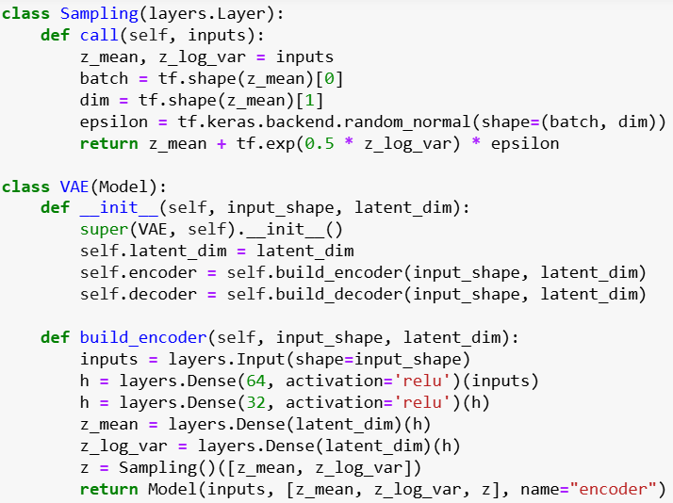
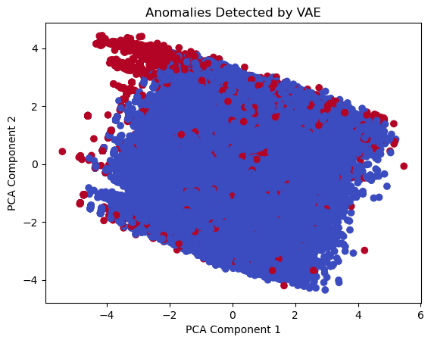
Variational Autoencoder (VAE)
1. VAE Model Architecture:
Encoder:
Two dense layers (64 and 32 units, ReLU activation).
Outputs z_mean, z_log_var, and z (latent space variables).
Decoder:
Two dense layers (32 and 64 units, ReLU activation).
Outputs reconstructed input data.
2. Model Training:
Compiled using Adam optimizer.
Trained for 50 epochs with a batch size of 32 on training data.
3. Anomaly Detection:
Reconstructed training data using the trained VAE.
Calculated reconstruction errors.
Anomalies defined as data points with errors above the 95th percentile.
4. Visualization:
Applied PCA to reduce data to 2D.
Visualized anomalies using a scatter plot with color coding for anomalies.

Slide 14


Evaluation
DBSCAN | Isolation Forest | Autoencoder | Local Outlier Factor
Not suitable for my dataset Seems to have overlap of data points even after tunig | Better than DBSCAN, was able to cluster the points more accurately. Reduction in overlapping of points after tunign | Best model Able to detect anomalies accurately Shows clear distinction between normal and anomalous points | Unable to detect anomalies well Even after parameter tuning, there was still overlapping even though it has improved from the initial model with the baisc params

Slide 15
Conclusion
What went wrong?
In hindsight, choosing this dataset presented significant challenges, primarily due to the lack of labeled data, which made it difficult to evaluate the performance of my models. Additionally, the absence of domain knowledge about the dataset posed obstacles in performing effective feature engineering. The dataset's columns did not clearly indicate whether they represented temperature, humidity, air pressure, or other measurements, further complicating the analysis. I should have been more careful with the selection my dataset and further researched more on it.
What I Would Have Done Differently If Given More Time:
If I had more time, I would have dedicated additional effort to experimenting with different models that align more closely with the specific characteristics of the dataset. Additionally, I would explore alternative techniques beyond PCA to evaluate my model, potentially uncovering methods that could provide more insightful and accurate results given the nature of the data.

