Slide 1
HPE IN-SEMESTER PROJECT 2020
SECURITY-CERTIFICATE
CERTIFICATE AUTHORITY- CHAIN VALIDATION
Team Members :
Nirupama GR - 170905033
Rithika U Shetty - 170905454
Project Guide: Prof Dr.Renuka A

Slide 2
OVERVIEW
Coded in Java.
Separate files for OCSP and CRL validation.
Uses OPENSSL and Java in-built security library.
Calling OPENSSL as a process from Java.
Works on both Ubuntu and Windows.
Works for DER encoded CRL files too.

Slide 3
certValidationCRL.java
PEM encoded chain is usable in Java Application as it is.
CRL file is converted to PEM format using OPENSSL command.
Instance of CRL is created using Java CertificateFactory.
Loop through the chain to get instance of each certificate in the chain from leaf to root.
Extract Certificate Serial number from certificate.
Check if the Certificate Serial Number is present in the CRL.
If revoked, prints CHAIN INVALID.
Otherwise checks for the next certificate till root and prints CHAIN VALID.

Slide 4
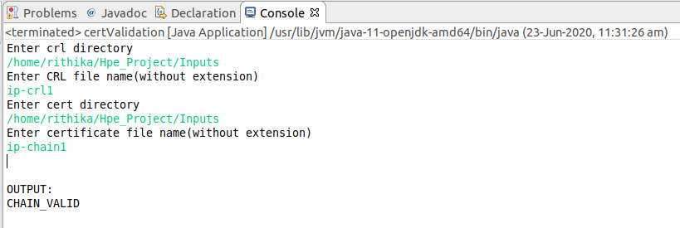
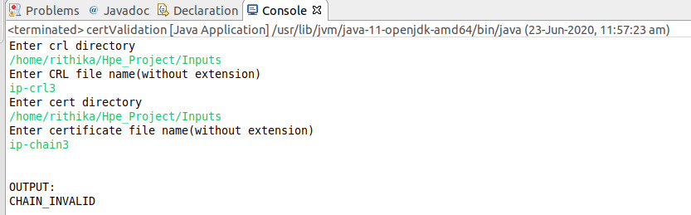
INPUT / OUTPUT
Serial Number of certificates are : Intermediate :1000 Root :e78e167d e54b6dc4
Serial Number of Revoked Certificate: 12
Serial Number of certificates are : Intermediate :6139f621 acead2d5 855a9d4a dded6052 Root :61977f10 fe443385 e460fb99 6dc13db8
Serial Number of Revoked Certificate: 6139f621 acead2d5 855a9d4a dded6052

Slide 5
certValidationOCSP.java (Optional)
Splits the Certificate Chain file to individual files.
Loop through each individual file until the root.
Obtain the ocsp_uri field from the certificate in a file using OPENSSL command.
Send a request to the OCSP server to check for revocation using OPENSSL command.
The response is stored in a file.
If the response is good , the certificate is not revoked and hence continue.
If revoked, prints CHAIN INVALID.
After checking for all the certificates, prints CHAIN VALID.

Slide 6
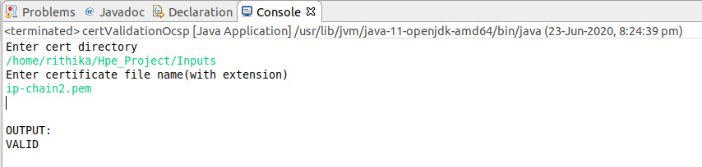
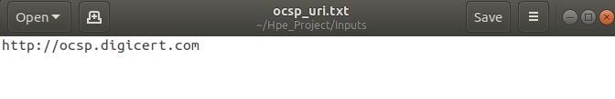
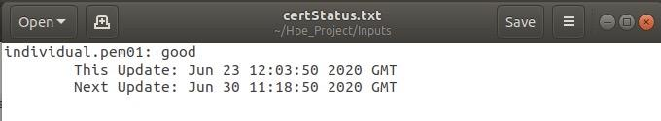
INPUT / OUTPUT

Slide 7
REFERENCES
https://docs.oracle.com/javase/7/docs/technotes/guides/security/overview/jsoverview.html
https://www.openssl.org/docs/man1.1.0/man1/crl.html
https://www.openssl.org/docs/man1.0.2/man1/ocsp.html

