Slide 1

CSA0836 –Python Programming for Numerical Computation MINI PROJECT - JAN 2024

Slide 2
TITLE
GLOBAL INFLATION USING PYTHON PROGRAMMING
SUBMITTED BY:
RITHIGA B M (192210205)
VARSHA S (192210247)
HARINI S (192219015)

Slide 3
INTRODUCTION:
Inflation, a universal economic concept, affects both individuals and nations on a global scale.
Globalization has amplified inflation's reach, with interconnected economies influencing inflationary trends.
Its impacts encompass diverse facts, including consumer purchasing power and income distribution.
Policymakers grapple with the dual challenge of fostering economic growth while mitigating inflationary pressures.
This project explores global inflation dynamics through multifaceted analysis, encompassing macroeconomic indicators, monetary policies, and supply chain disruptions.
Additionally, it evaluates inflation expectations and policy responses to provide a comprehensive understanding.
By integrating theoretical insights, empirical data, and case studies, the project aims to enrich comprehension of inflation's effects and inform strategic decision-making.

Slide 4
ABSTRACT:
Global inflation affects economies worldwide through sustained rises in the overall price level.
Influenced by factors like commodity prices and currency exchange rates, inflationary pressures span borders in an interconnected global economy.
Impacts include reduced purchasing power, strained household budgets, and global income distribution effects.
Policymakers face the challenge of managing inflation to foster economic growth while maintaining price stability.
This project explores drivers, impacts, and mitigation strategies using macroeconomic indicators, monetary policies, and supply chain analyses.

Slide 5
PRIMARY OBJECTIVE:
Develop a comprehensive analysis of global inflation dynamics using Python.
Utilize Python data analysis libraries and techniques to explore macroeconomic indicators, monetary policies, and supply chain disruptions.
Apply core Python programming concepts including variables, functions, conditionals, loops, and object-oriented programming to analyze inflationary trends.
Practice logical planning and implementation of an end-to-end analytical process, including data input, processing, visualization, and interpretation.
Enhance skills in synthesizing theoretical insights, empirical analysis, and real-world case studies to understand the implications of global inflation for economic stability and decision-making.

Slide 6
SECONDARY OBJECTIVE:
Gain insight into the complexities of global economic systems by analyzing the drivers and impacts of inflation on a worldwide scale.
Lay the groundwork for potential expansion of the project to incorporate more advanced economic models or additional factors influencing inflation.
Explore opportunities to integrate real-time data sources or APIs to enhance the accuracy and relevance of the analysis.
Foster collaboration and knowledge-sharing by participating in discussions and forums related to economic analysis and forecasting.
Follow established research methodologies and best practices for data collection, analysis, and interpretation in the field of economics.

Slide 7
ADVANTAGES:
Advantages of Global Inflation Prediction in Creating an Application:
Enhanced
Decision-Making
Market Insights
Financial Planning
Risk Mitigation
Competitive Advantage
Policy Formulation
Resource Allocation
Long-Term Planning
Consumer Empowerment
Innovation Opportunities

Slide 8
DISADVANTAGES:
Disadvantages of Global Inflation Prediction:
Accuracy Limits: Predictions may not always align with actual inflation due to the complex nature of economic systems.
Data Uncertainty: Reliance on historical data and assumptions can lead to unreliable forecasts.
Misinterpretation Risk: Users may make rash decisions based on predictions, impacting financial stability.
Ethical Concerns: Use of prediction technology may raise issues such as data privacy and market manipulation.
Regulatory Hurdles: Developers may face challenges complying with financial regulations and data protection laws.

Slide 9
FUNCTIONAL REQUIREMENTS- MANAGEING GLOBAL INFLATION
1. Encourage monetary policy coordination.
2. Develop robust data analysis and forecasting systems.
3. Implement effective policy communication strategies.
4. Monitor and manage exchange rates.
5. Promote price stability measures.
6. Adopt inflation targeting frameworks.
7. Strengthen financial regulation and supervision.
8. Coordinate fiscal policies with monetary policies.
9. Foster international cooperation.
10. Invest in research and analysis.
11. Maintain policy flexibility.
12. Develop risk management strategies.

Slide 10
TEST CASES AND RESULT
Regional Comparison Test Case:
Test: Compare inflation rates across different regions
Result: Identify any significant divergences in inflation rates between regions and analyze the potential causes
Global Economic Shocks Test Case:
Test: Investigate the impact of major global economic shocks ( on inflation.
Result: Identify how inflation rates have responded to past economic crises and analyze any patterns or differences in inflation dynamics during these periods.
Long-term Inflation Trends Test Case:
Test: Analyze long-term inflation trends over several decades.
Result: Identify underlying structural factors influencing inflation dynamics over time and assess the implications for future inflation expectations and policy formulation.
Monetary Policy Intervention Test Case:
Test: Evaluate the effectiveness of monetary policy interventions in controlling inflation.
Result: Determine whether central banks' policy actions have been successful in achieving their inflation targets and analyze any unintended consequences or limitations of these interventions.

Slide 11
SECURITY AND CONTROL
Monetary Policy Tools: Adjusting interest rates and conducting open market operations.
Fiscal Policy Measures: Using taxation and public spending to manage demand.
Regulatory Framework: Enforcing regulations to prevent market manipulation.
International Cooperation: Collaborating on economic policies and trade agreements.
Price Stability Mandate: Setting clear inflation targets and communicating policies transparently.
Data Monitoring: Continuously tracking economic indicators and analyzing trends.
Financial Market Supervision: Monitoring markets to prevent excessive risk-taking.
Public Education: Informing the public about inflation and policy actions.
Contingency Planning: Developing plans to respond to unexpected inflationary shocks.
Adaptive Policy Framework: Maintaining flexibility in policy approaches.

Slide 12
CODE:
import requests
import pandas as pd
import matplotlib.pyplot as plt
def fetch_nigeria_inflation():
url = 'https://api.worldbank.org/v2/en/country/NGA/indicator/FP.CPI.TOTL.ZG?downloadformat=excel'
response = requests.get(url)
with open('nigeria_inflation.xlsx', 'wb') as file:
file.write(response.content)
fetch_nigeria_inflation()
df = pd.read_excel('nigeria_inflation.xlsx', sheet_name='Data', skiprows=3)
df.dropna(inplace=True)
years = df['Country Name']
inflation_rates = df['1960 [YR 1960]':'2022 [YR2022]'].iloc[0]

Slide 13
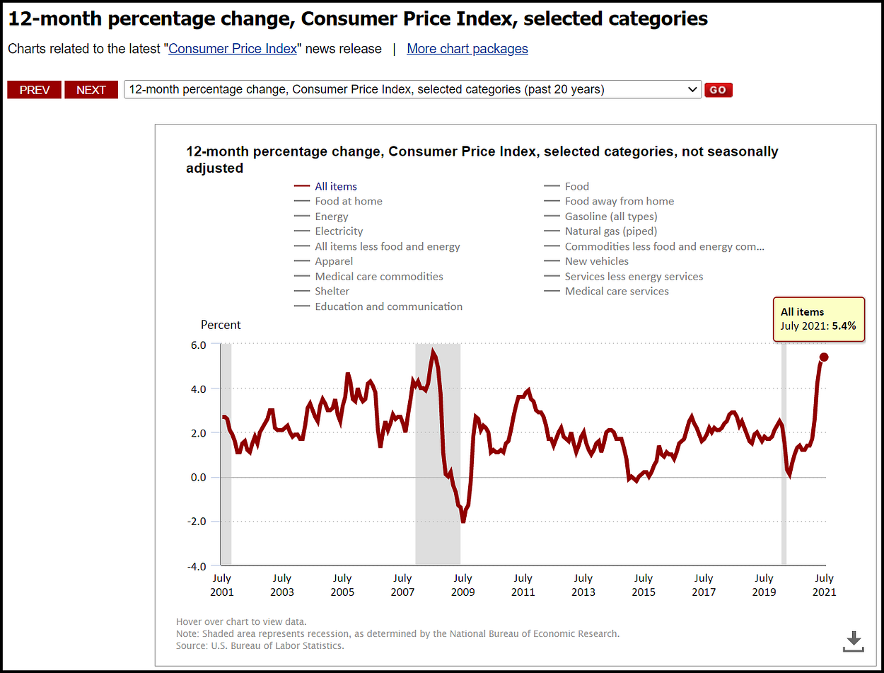
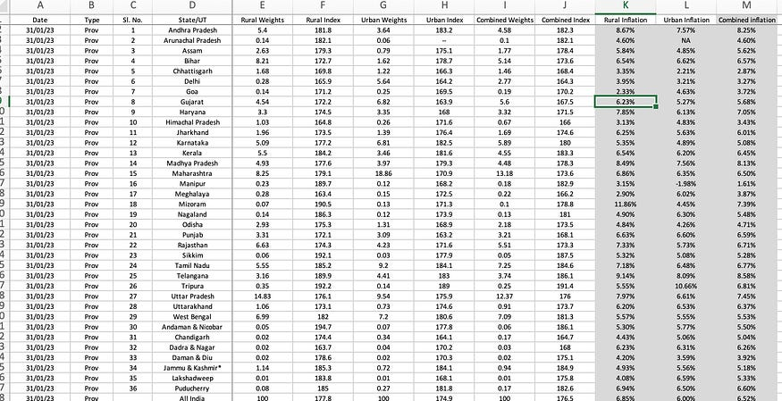
plt.figure(figsize=(10, 6))
plt.plot(years, inflation_rates, marker='o', color='b', linestyle='-')
plt.title('Inflation Rate in Nigeria (1960-2022)')
plt.xlabel('Year')
plt.ylabel('Inflation Rate (%)')
plt.xticks(rotation=45)
plt.grid(True)
plt.tight_layout()
plt.show()
OUTPUT:

Slide 14
CONCLUSION
Global inflation has surged due to fiscal and monetary stimulus responses to the COVID-19 pandemic, flooding financial markets with liquidity. Supply chain disruptions and commodity shortages have further fueled inflation. Geopolitical tensions and trade disputes have added to inflationary pressures by disrupting global supply chains and increasing production costs. Changing consumer behavior post-pandemic, such as increased online shopping and remote work, has also contributed to inflation. Central banks are now challenged with balancing price stability and economic growth, signaling intentions to tighten monetary policy gradually. However, the timing and pace of these adjustments remain uncertain, posing risks to financial markets and economic stability

