Slide 1
Digital Portfolio
STUDENT NAME: Rithik S
REGISTER NO AND NMID: 222407876 and 729E0AE0AC5B85183D94909BFF8D9168
DEPARTMENT: BSC: computer science with Data science
COLLEGE: COLLEGE/ UNIVERSITY Tagore college of arts and science
University of Madras

Slide 2
PROJECT TITLE
Web Developer Portfolio Website

Slide 3


AGENDA
Problem Statement
Project Overview
End Users
Tools and Technologies
Portfolio design and Layout
Features and Functionality
Results and Screenshots
Conclusion
Github Link
3/21/2024 Annual Review

Slide 4

PROBLEM STATEMENT
Modern web developers need an attractive, interactive online presence to showcase skills, projects, and contact information. Generic resumes or static profiles don't provide enough engagement or visual appeal, making it hard to stand out in a competitive market.

Slide 5

PROJECT OVERVIEW
This project is an all-in-one responsive portfolio website developed using HTML, CSS, and JavaScript. It highlights the developer's skills, projects, and contact details, featuring engaging animations and smooth navigation for a professional online impression.

Slide 6

WHO ARE THE END USERS?
Potential employers, clients, and collaborators interested in my web development projects and skills.

Slide 7

TOOLS AND TECHNIQUES
Include web development languages and tools you used such as HTML, CSS, JavaScript, frameworks, and any design tools.

Slide 8
POTFOLIO DESIGN AND LAYOUT
The portfolio features a clean, modern interface with intuitive navigation to highlight key projects and skills.
8

Slide 9
FEATURES AND FUNCTIONALITY
Includes interactive elements and showcases multiple projects with cool features demonstrating technical skills and creativity.

Slide 10
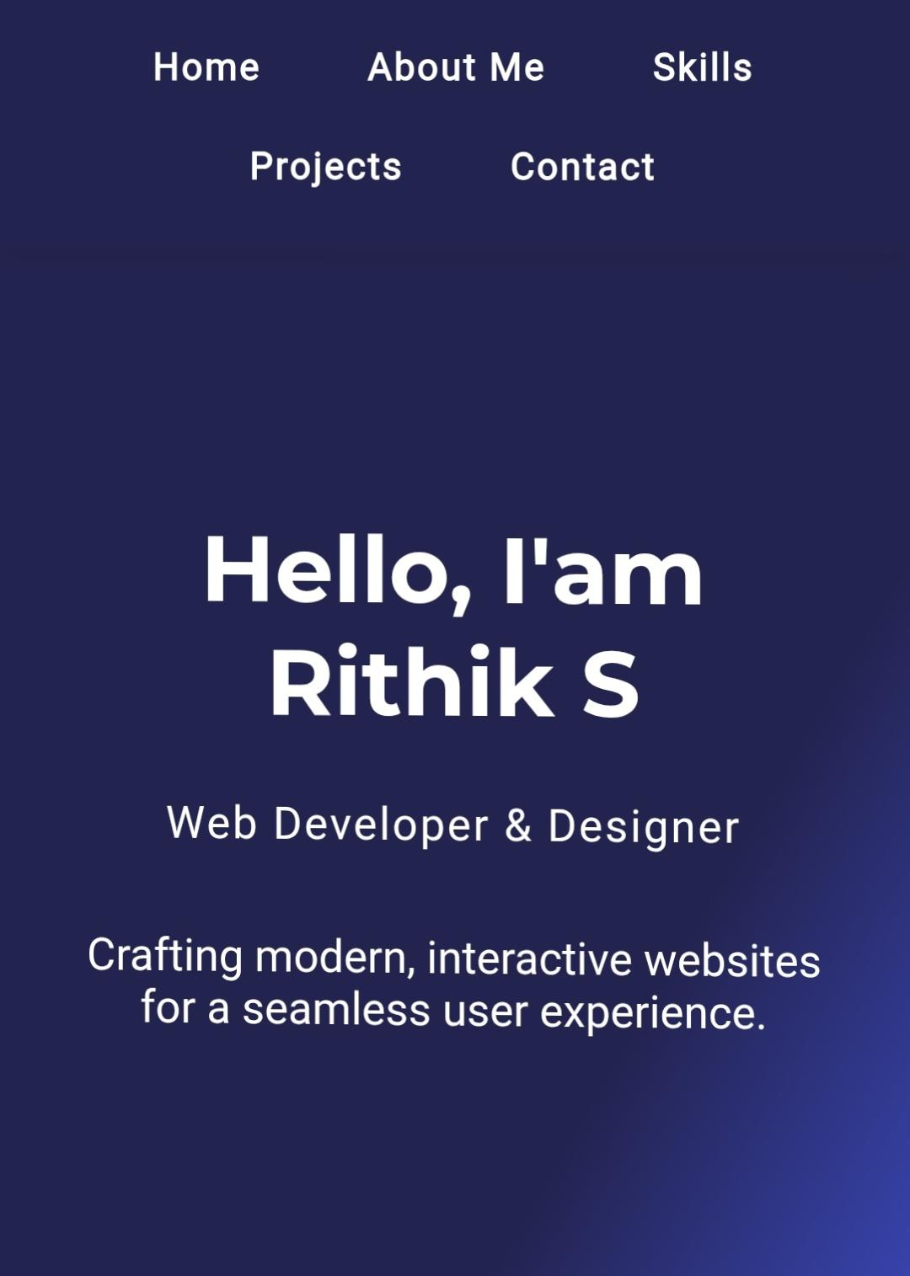
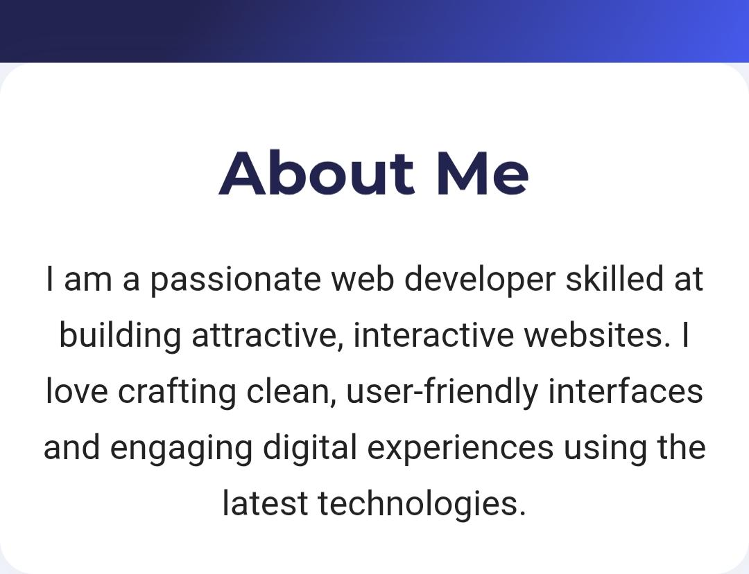

RESULTS AND SCREENSHOTS
3/21/2024 Annual Review
10

Slide 11
CONCLUSION
This portfolio effectively demonstrates my abilities as a web developer through engaging and well-designed projects.
If you provide specific details like your name, tools used, or screenshot files, I can help fill those sections more precisely.
11

