Slide 1
Brain Tumor Detection and Segmentation from MRI ImageS.

Slide 2
Project Submitted by:
Rithik Raj Dhariwal 17MIS1171
Jason Jacinth 17MIS1136
Panner Selvam 17MIS1147

Slide 3
Objectives

Slide 4
1) To detect if there is a tumor in a given MRI Image
&
2) If there is, specify the location of the tumor

Slide 5
Algorithm

Slide 6
Filtering the image using an Anisotropic diffusion Filter
Processing the image in details using morphological
operation .
Taking an MRI Image
Segmentation of the tumor in the image by a particular border
Confirmation of tumor based on density and area .
If no tumor, ending of processing image, but if there, estimating the tumor location

Slide 7
Figures of Simulation Output

Slide 8
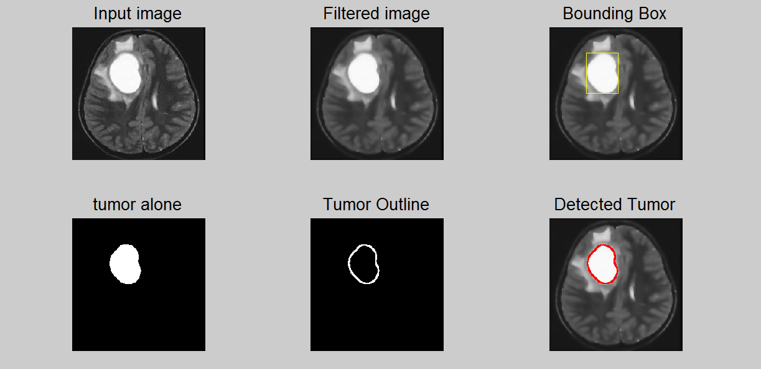
Sample 1

Slide 9
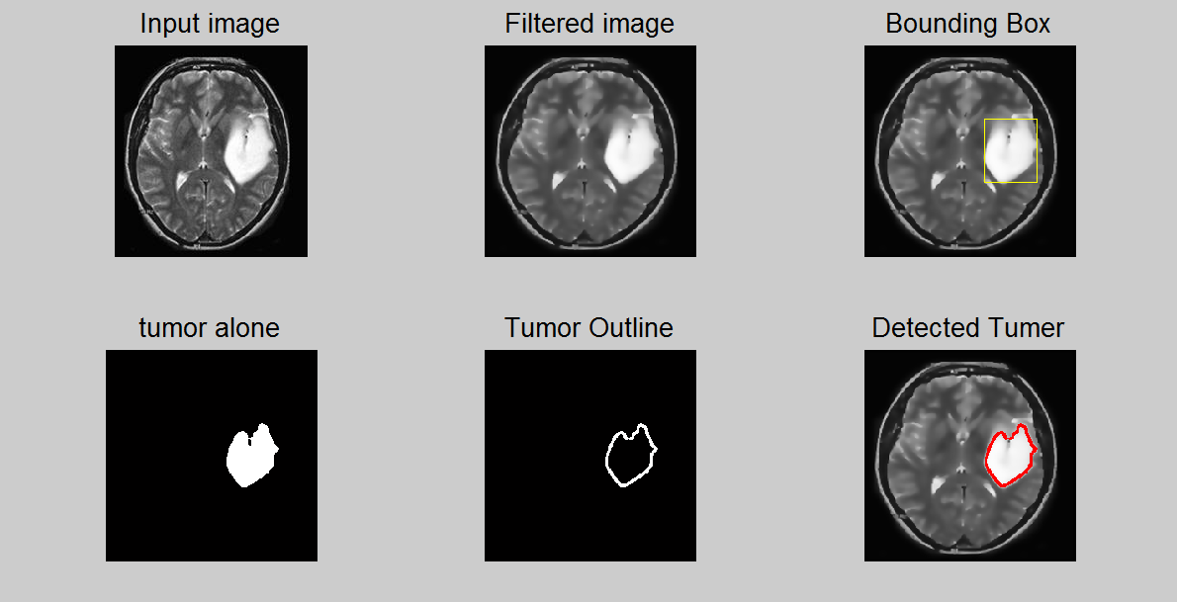
Sample 2

Slide 10
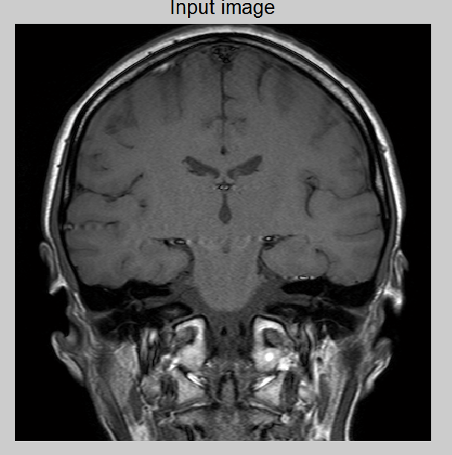
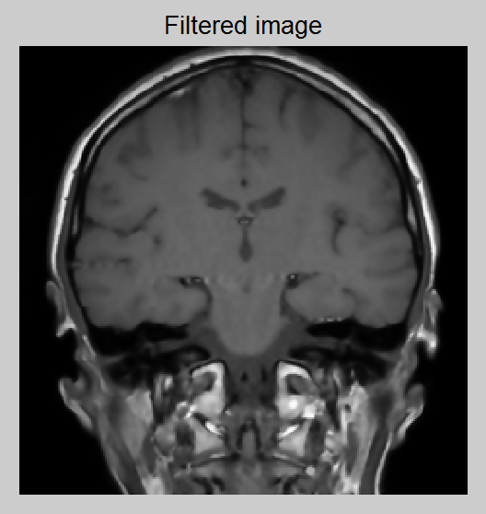
Sample 3 ( No Tumor )

Slide 11
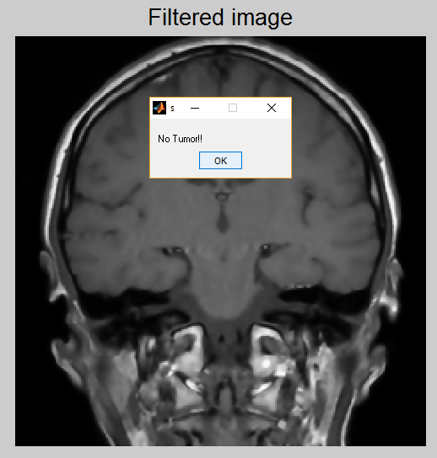

Slide 12
Challenging Detection….
Blurry & Grainy Image
Small Tumor

Slide 13
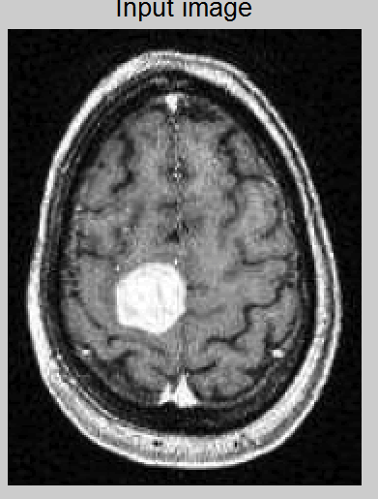
Blurry& Grainy Image…

Slide 14
Solution: Anisotropic Diffusion Filter
Shape-adapted smoothing :
method of enhancing the image quality of textures on surfaces of computer graphics that are at oblique viewing angles with respect to the camera ,it produces a family of parameterized images, but each resulting image is a combination between the original image and a filter that depends on the local content of the original image. As a consequence, anisotropic diffusion is a non-linear and space-variant transformation of the original image.
Anisoptropic Filter blurs the images without removing any edge.
Reference:Wikipedia(https://en.wikipedia.org/wiki/Anisotropic_filtering)

Slide 15
Gaussian Convolution matrix
0 1 0 0 0 0
North = 0 -1 0 East = 0 -1 1 ………
0 0 0 0 0 0
0 0 1 1 0 0
North-East = 0 -1 0 North-west = 0 -1 0 ………
0 0 0 0 0 0

Slide 16
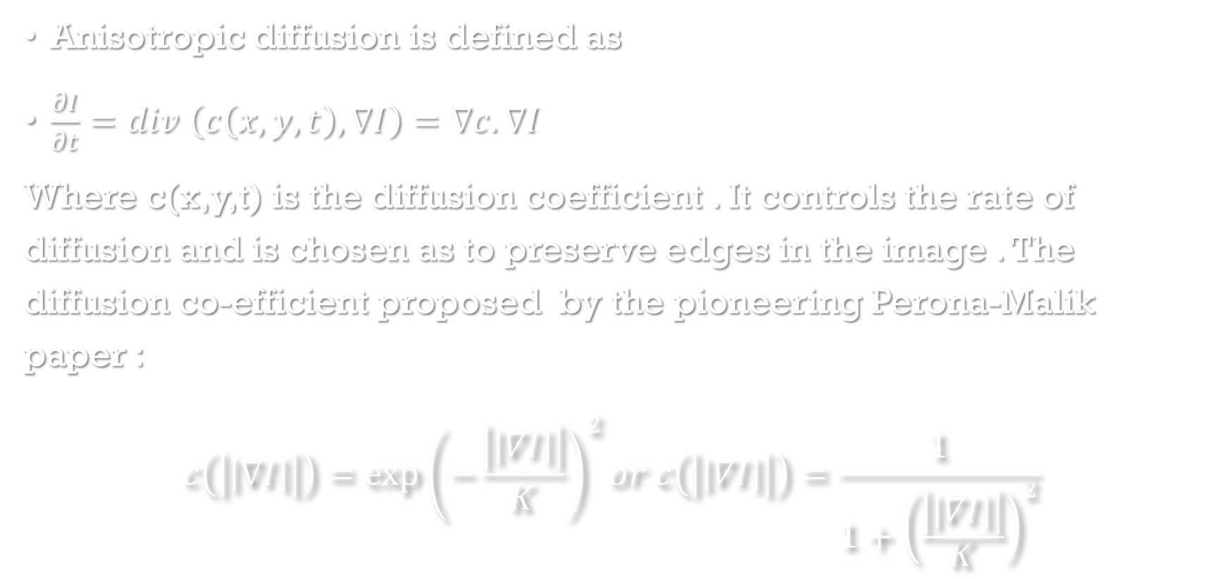
Anisotropic diffusion is defined as
$\frac{∂I}{∂t}=div \left(c\left(x,y,t\right),∇I\right)=∇c.∇I$
Where c(x,y,t) is the diffusion coefficient . It controls the rate of diffusion and is chosen as to preserve edges in the image . The diffusion co-efficient proposed by the pioneering Perona-Malik paper :
$$c\left(\left|\left|∇I\right|\right|\right)={\exp\left(−\frac{\left|\left|∇I\right|\right|}{K}\right)}^{2}or c\left(\left|\left|∇I\right|\right|\right)=\frac{1}{1+{\left(\frac{\left|\left|∇I\right|\right|}{K}\right)}^{2}}$$

Slide 17
Refrence to the project:
Youtube(https://youtu.be/UeFRo7uALhM
https://youtu.be/_PpeMlis4q0 )

Slide 18
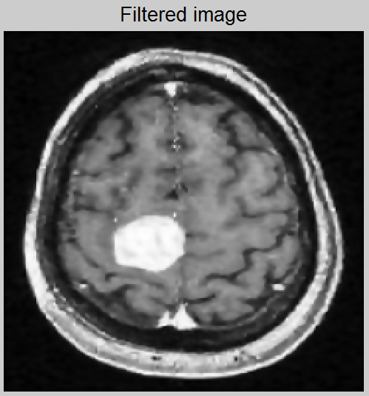

Slide 19
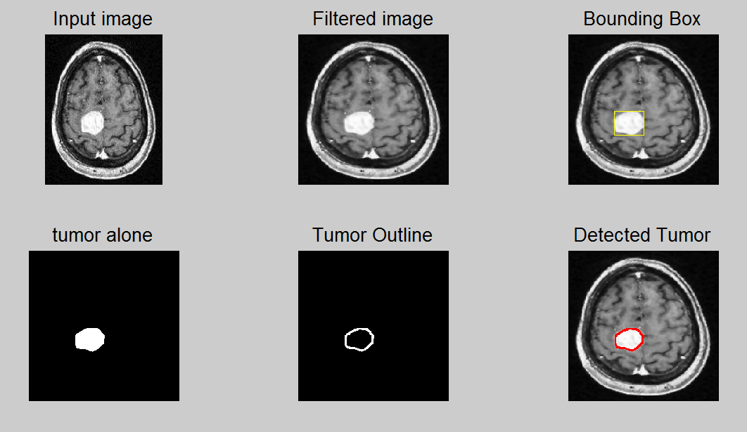

Slide 20
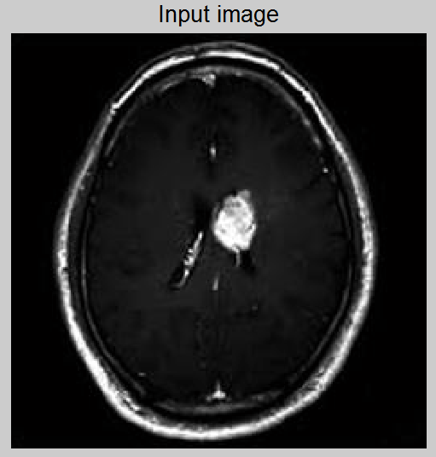
Small Tumor…

Slide 21
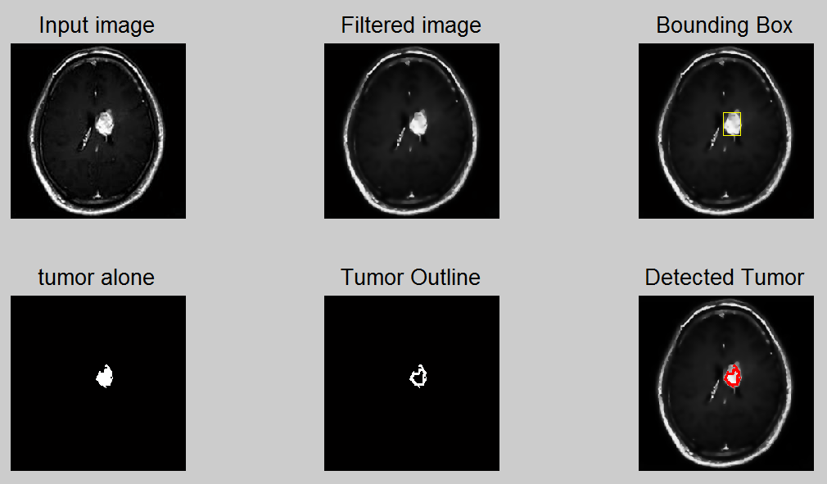

Slide 22
Detecting Tumor Border
Library functions for morphological operation were used to segment the binary image & detect the tumor area.
The Binary image was eroded, i.e, all the points in the neighborhood of a black point was turned black.
Finally we get the border by subtracting the eroded image from original binary image

Slide 23
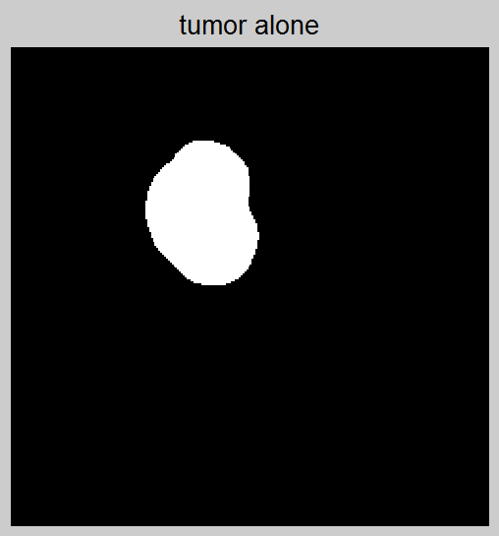
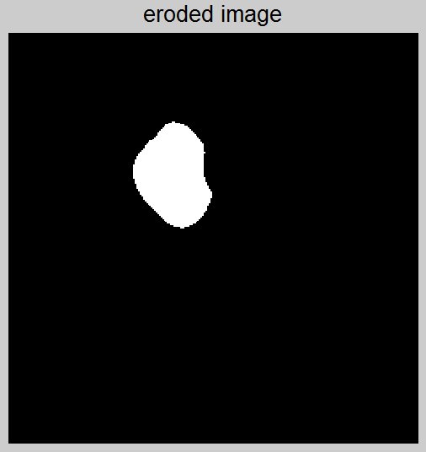
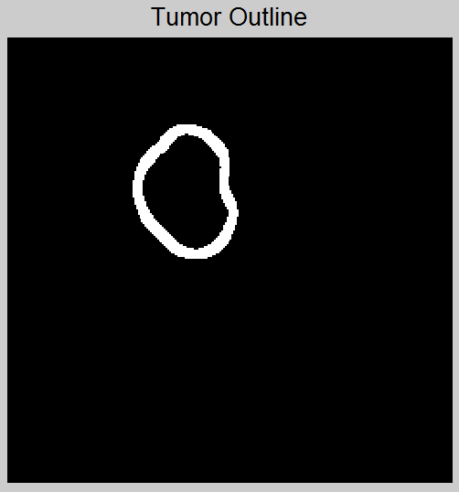

Slide 24
Short Comings…
May give false positive if the section of bones are too thick
May give false negative if the tumor image is hollow, i.e, density of tumor is low.

Slide 25
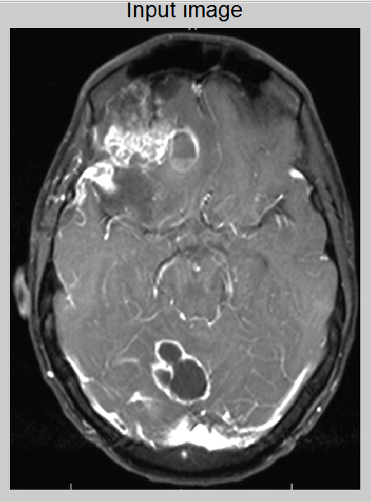
Low density tumor
Thick bone section

Slide 26
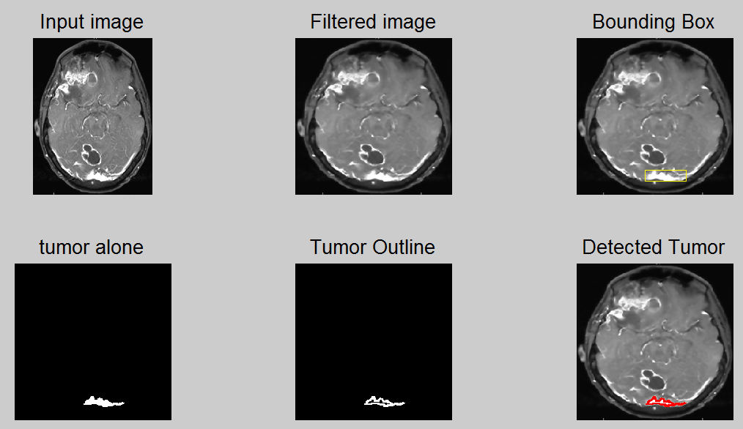

Slide 27
Service to the Society:
Medical image processing is the most challenging and emerging field now a days. Processing of MRI images is one of the part of this field. This code makes MRI image analysis accessible to more people who need not have to be specialist on MRI imaging.
MRI imaging is less harmful than X-ray . It is less attenuated by bones. This project can make MRI image processing and tumor detection process faster and cheaper.

