Slide 1
TEAMS MEMEBERS :
Rithika A.V – 2024115089
Gayathri T – 2024115057
Ramya R - 2023115047
Hostel leave management system

Slide 2
Introduction / Objective
The Hostel Leave Management System is designed to simplify the process of applying for and approving hostel leave. In traditional systems, students have to meet the residential counselor (RC) in person to get a signature, which is time-consuming and inconvenient.
This project provides a digital solution through a web-based system where students can easily submit leave requests online, and the RC or warden can approve or reject them instantly.
Objectives:
To save time by reducing manual work and paper usage.
To make the leave approval process fast, secure, and transparent.
To allow students and wardens to manage leave records efficiently from anywhere.
To improve communication between students and hostel authorities.

Slide 3
Existing System (Problem Statement)
In the current hostel leave process, students have to manually fill out a leave form and get it signed by the residential counselor (RC) and warden. This process takes a lot of time and often causes inconvenience for both students and hostel staff.
There is no proper digital record of leave applications, which makes it difficult to track the leave history of students.
Limitations / Drawbacks:
Time-consuming manual approval process.
Paper-based forms can be lost or damaged.
Students must meet the RC in person for approval.
No automatic record maintenance or data retrieval.
Delays in communication between students and hostel authorities.

Slide 4
Proposed System
The proposed Hostel Leave Management System replaces the manual paper-based process with a web-based platform that allows students to apply for leave online. The residential counselor (RC) and warden can view, approve, or reject leave requests digitally, making the process faster and more efficient.
This system ensures that all leave applications are securely stored in a database and can be accessed anytime for reference. Notifications can also be sent to students after approval or rejection.
Key Features:
Online leave application and approval system.
Secure login for students, RC, and wardens.
Automatic record maintenance of all leave requests.
Instant notification of leave status.
User-friendly and time-saving interface.

Slide 5
Advantages:
Reduces paperwork and manual errors.
Saves time for both students and staff.
Provides easy tracking of leave history.
Improves communication and transparency.

Slide 6
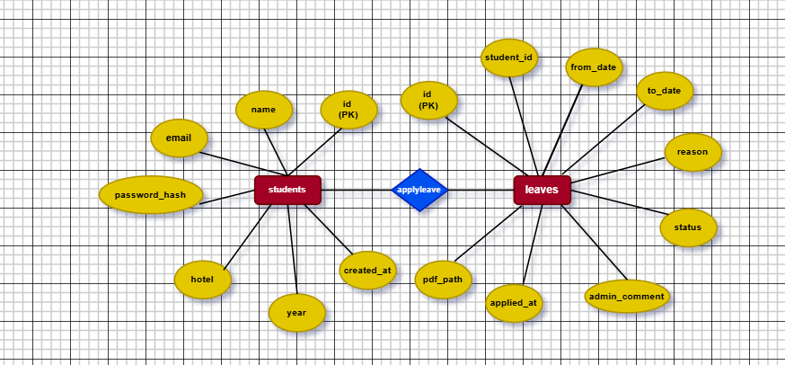
System Architecture / Design Overview

Slide 7
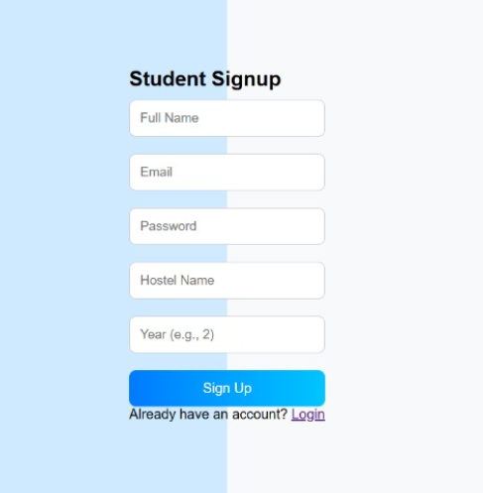
System Architecture / Design Overview
Frontend

Slide 8
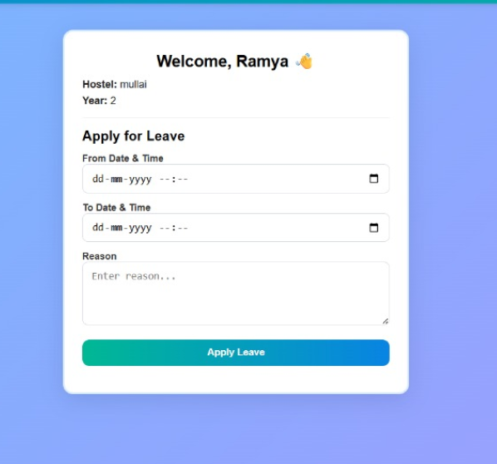

Slide 9
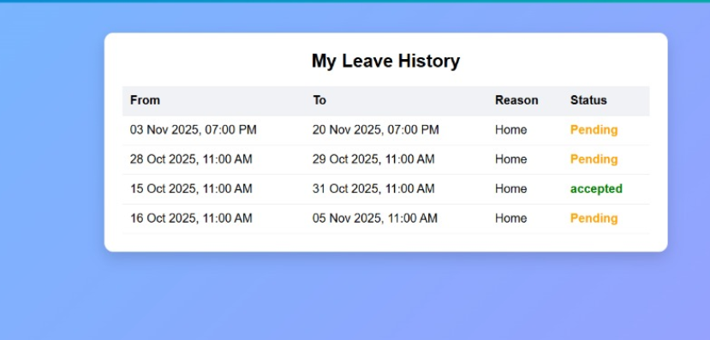

Slide 10
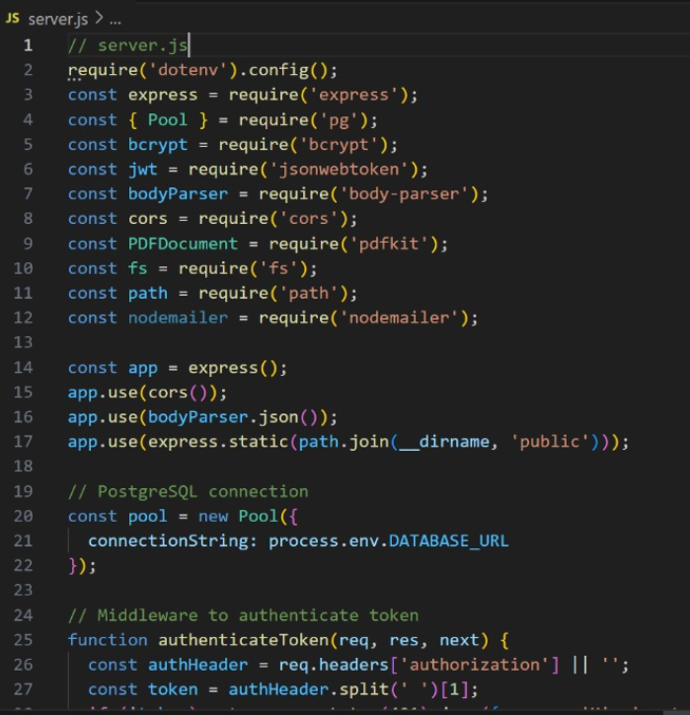
Backend:

Slide 11
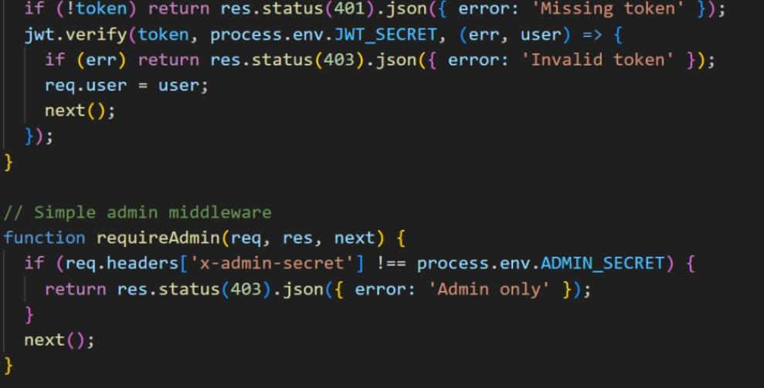

Slide 12
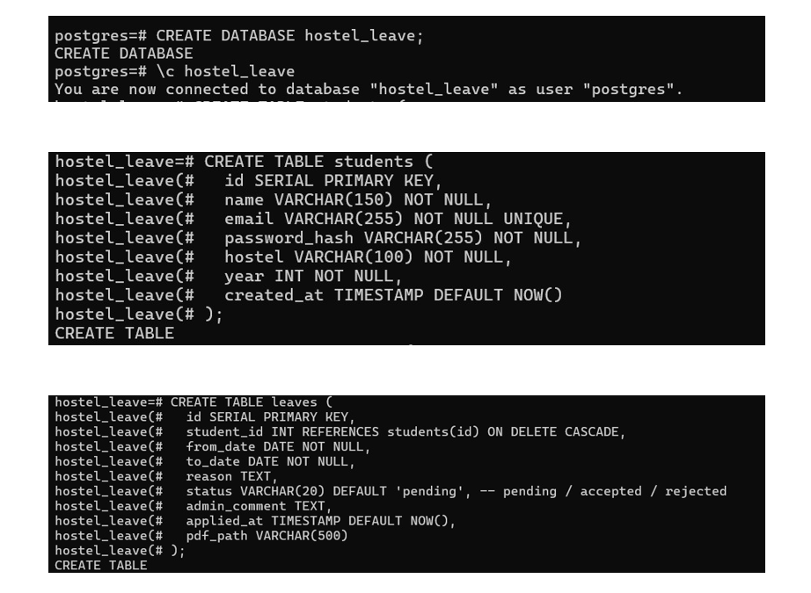
Database:

Slide 13
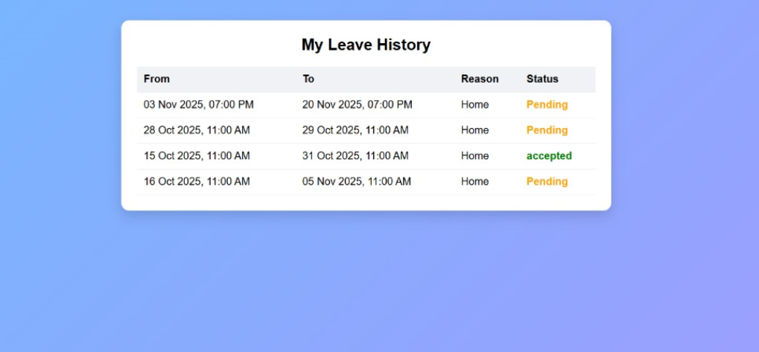
Output:

Slide 14
Conclusion:
The Hostel Leave Management System successfully replaces the traditional manual process of applying for leave with a convenient online platform. It saves time for both students and hostel authorities by automating the entire process — from application to approval.
The system provides a secure way to maintain records, reduces paperwork, and ensures transparency in communication between students, residential counselors (RC), and wardens.
This project demonstrates how database management systems can be effectively used to create efficient and user-friendly applications for hostel administration.

