Slide 1



AIMBIGATHON 2.0
Stay Hungry. Stay Foolish
www.aimbigathon.com

Slide 2
Team Details
Team Name: Technocrates
Problem Code: ET-01
Members | Name
Team Leader | > Vijayalakshmi K
Team Member 1 | > Krupha C M
Team Member 2 | > Vijay Kumaran M
Team Member 3 | > Sharath kumar P
Team Member 4 | > Shanmuga Raja Rajeshwaran M
Team Member 5 | > Rithika M S

Slide 3
Problem Statement
Problem Statement:
Recognize number plate of a vehicle from an image or a video stream and capture vehicle data such as vehicle type, make, model, color and lookup the database for any stolen, invalid or blacklisted registration numbers. Assume you have a database of registration numbers and the associated metadata. Validity of a number could mean that the number matches to an entry in the database and the vehicle type, make, model and color matches as well. Additionally if the number is blacklisted or married as stolen, appropriate messages have to be shown. Bonus for identifying these in near real-time using a webcam.

Slide 4
Abstract
Vehicle theft has become a serious problem in India and the crime is growing at an excellent rate.
According to article ”In 2018, the police said, of the 44,158 stolen vehicles, 32,984 were two-wheelers and 8,036 were cars. However, only 10.46% vehicles were recovered”.
Remaining 90% of the vehicles are hidden or being used by the thieves in a hidden manner.
So to avoid this problem , we approached a solution based on machine learning.
Our basic idea deals with processing of image captured by webcam and give the details about the vehicle ,its owner and whether it is stolen or not.

Slide 5
Abstract
Machine Learning is one of the amazing and important thing used in this world of technology .
Using Machine Learning Image Processing techniques, we grab the image of the vehicle and process it to show the License Plate number.
This processing is Called License Plate Recognition.
After the License Number is retrieved we search it in the Database and Check whether the vehicle is Stolen or Not.
All this are implemented in web application.

Slide 6
Example Scenario
Let us consider the Bike of number TN 02 G 1234 is stolen and the Bike Details and is Stolen is given complaint by the owner.
If the bike ever crosses the webcam which can capture image (At tollgate) the details will be shown and if the complaint is given .
Then we can identify that the bike is stolen and take actions. This is general case .but, apart from this there are several case scenarios which this problem which can be solved by our project.

Slide 7
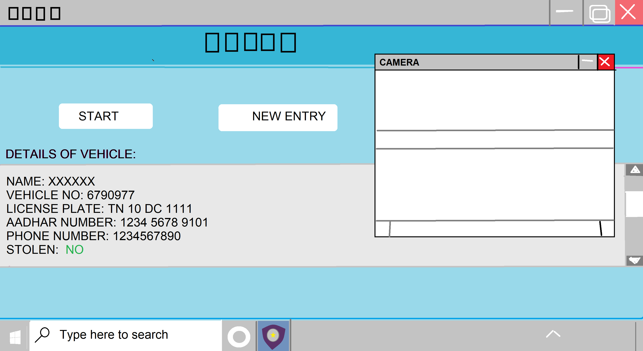
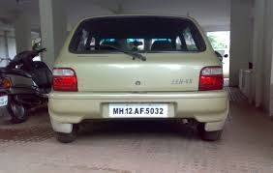
Sample Image
.

Slide 8
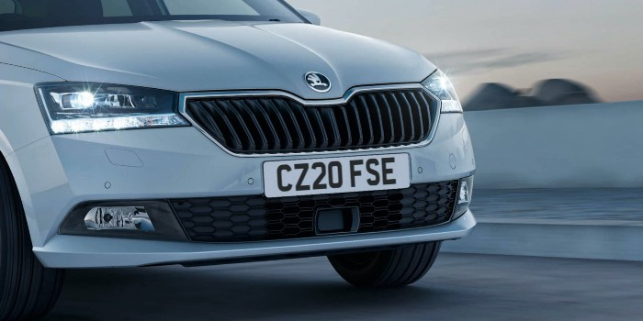
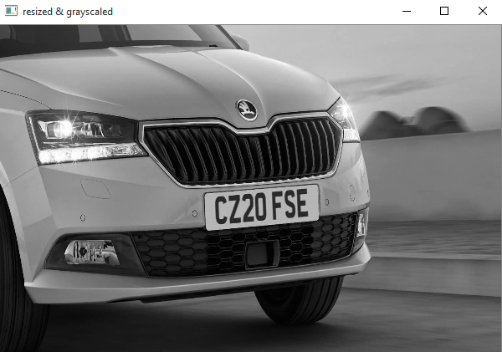
Image Processing
ORIGINAL IMAGE BEFORE PROCESSING
Converted as gray and resized

Slide 9
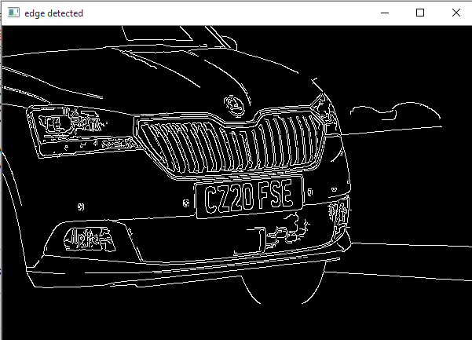
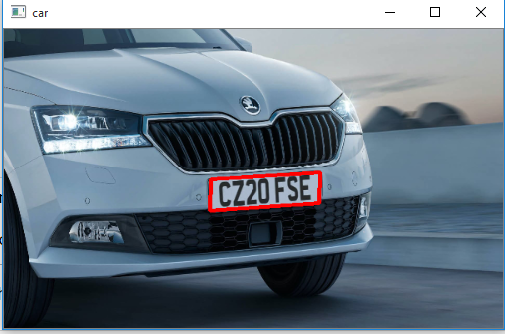
Image Processing
Finding the edges of the image
Contour finding using edges and drawing contour

Slide 10
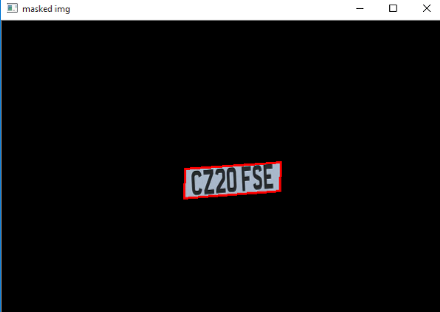
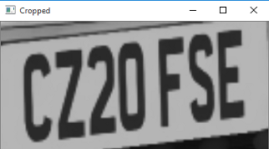
Image Processing
Masking the image except contour part
Cropping the image to contour part

Slide 11
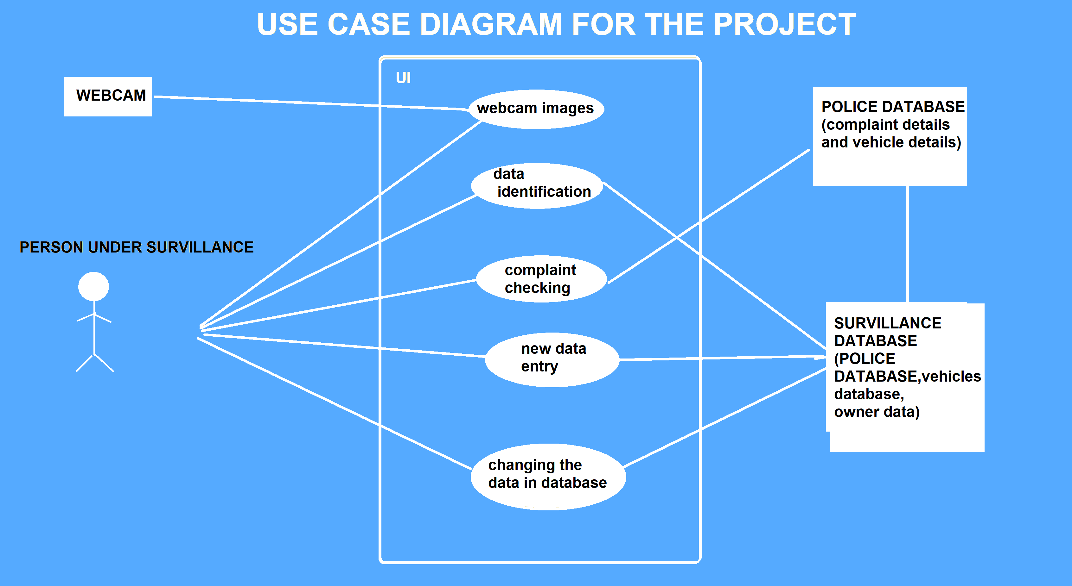
Use Case

Slide 12
Technology Stack
Describe your technology stack here.
Front-end –HTML,CSS,Javascript
Middleware-Firebase/PYTHON/Pycharm(flask)
Back-end-SQL/Python

Slide 13
Dependencies / Show stopper
1.Internet 2.Image processing 3.Database 4.System and Webcam

Slide 14
Thank You

