Slide 1


Forest Fire Detection Using Deep Learning
NAME:Rithika Chowdary Uppalapati
AICTE internship Student Registration ID:STU6575fa97782921702230679

Slide 2

Learning Objectives
Getting to Know Deep Learning
We'll start by getting a feel for what deep learning really is and how it’s like teaching a computer to "think" like the human brain. Specifically, we’ll dive into Convolutional Neural Networks (CNNs).
Finding and Preparing Data
You’ll learn how to get your hands on datasets , like images of forest fires, and get it ready for training. This means resizing, normalizing, and augmenting images so your model has the best chance to learn.
Building Your Model
Next, we’ll get into the fun part—actually building a Convolutional Neural Network (CNN) using tools like TensorFlow and Keras.
Training and Testing Your Model
Once your model is set up, we’ll jump into training it and how to adjust things like epochs (how many times the model looks at the data) to get the best results.
Checking How Well It Works
After training, we’ll talk about how to measure its accuracy and its loss and also touch on other important metrics like precision and recall to make sure the model is working the way we want it.
GOAL
Source :
www.freepik.com/

Slide 3
Learning Objectives
Visualizing Your Progress
We’ll use Matplotlib to create some easy-to-understand charts that show how the model is doing over time.
Making Predictions
Now comes the exciting part: making predictions! For example, you'll be able to tell if an image contains fire or nofire.
Applying It to a Real-World Problem
Finally, we’ll talk about how everything you’ve learned can be applied to a real-world problem like detecting forest fires.
GOAL
Source :
www.freepik.com/

Slide 4
Tools and Technology used
Core Programming Languages and Libraries
Python
Description: Python is a go-to for data science, machine learning, and deep learning. Its extensive library support and effective for writing clean and efficient code.
Key Feature: Widely used for data manipulation and machine learning applications.
TensorFlow
Description: TensorFlow is an open-source deep learning framework used for building and training machine learning models, It's well-suited for complex models like Convolutional Neural Networks.
Key Feature: Powerful tools for building and deploying machine learning models.
Keras
Description: Keras is a high-level neural network API built on top of TensorFlow. It simplifies the process of defining, training, and evaluating deep learning models. Keras is typically used for building models quickly with minimal code.
Key Feature: Simplifies deep learning model design and training.
Data Handling and Visualization Tools
NumPy
Description: A fundamental library for numerical computing in Python.
Key Feature: Efficient array manipulation and mathematical operations.

Slide 5
Tools and Technology used
Matplotlib
Description: A Python plotting library that is widely used for creating static, animated, and interactive visualizations. Matplotlib helps in visualizing metrics such as model accuracy and loss over training epochs.
Key Feature: Used for generating graphs and charts to analyze model performance.
Image Preprocessing and Augmentation
ImageDataGenerator
Description: A utility in Keras that facilitates real-time image preprocessing and augmentation. It helps in dynamically augmenting image data during training, which improves model robustness by increasing the variety of images without actually increasing the dataset size.
Key Feature: Real-time data augmentation for better model generalization.
Cloud-Based and Interactive Platforms
Google Colab
Description: A cloud-based platform that offers a Jupyter notebook environment for writing and running Python code. Google Colab comes with free access to GPUs, making it an ideal choice for training deep learning models efficiently.
Key Feature: Free GPU access for accelerated model training.

Slide 6
Methodology
1. Data Source and Access
The wildfire image dataset utilized in this project was obtained from Kaggle and integration were facilitated through Google Colab, which provided a cloud-based Jupyter notebook interface along with the benefit of GPU acceleration for model training.
2. Preliminary Data Analysis
An initial review of the dataset structure revealed two target classes: 'fire' and 'nofire'. Representative images from each category were visualized to assess the quality, diversity, and complexity of the dataset. This helped establish an understanding of visual patterns and potential.
3. Image Preprocessing Pipeline
All input images were resized to a standardized format of 150×150 pixels.
A batch size of 32 was selected for optimal training efficiency.
Keras ImageDataGenerator was employed to:
Normalize pixel values.
Automatically divide the dataset into training, validation, and test subsets.
Optionally apply real-time data augmentation to increase dataset variability and model robustness.
4. Architecture Design of the Neural Network
The classification model was built using a Convolutional Neural Network (CNN), implemented with the Keras API. The model architecture featured:
Multiple convolutional layers to capture spatial hierarchies.
MaxPooling layers to reduce feature map dimensions and control overfitting.
A flatten layer followed by fully connected dense layers, concluding with a sigmoid-activated output node suitable for binary classification.

Slide 7
Methodology
5. Configuration and Compilation
To prepare the model for training, the following configurations were applied:
Optimizer: Adam — chosen for its effectiveness and adaptability.
Loss Function: Binary Crossentropy — ideal for two-class problems.
Metric: Accuracy — used to evaluate performance throughout training.
6. Supervised Training Procedure
The model was trained over 12 epochs with simultaneous monitoring of training and validation performance. Accuracy and loss curves were plotted for both datasets, allowing visual assessment of learning trends and early detection of overfitting or performance stagnation.
7. Performance Assessment
Upon completion of training, the model was tested using an isolated test dataset. Evaluation metrics and visualization tools were used to analyze the model’s predictive accuracy and generalization capabilities on unseen data.
8. Deployment and Inference
After successful evaluation, the model was saved for reuse. A dedicated prediction function was developed to classify new images as either 'fire' or 'nofire'. This function enables practical application by loading the trained model, preprocessing the input, and returning a classification result.

Slide 8
Problem Statement:
Forest Fire Detection Using Deep Learning
Forest fires are one of the most devastating natural disasters, capable of destroying vast ecosystems, displacing wildlife, threatening human lives, and causing long-term environmental damage. The impact is not only ecological but also emotional and economic, affecting communities, emergency responders, and the very landscapes we depend on.
The key to reducing the scale and severity of these fires lies in early detection. The sooner a fire is identified, the faster emergency teams can respond, potentially saving forests, animals, homes, and lives.
This project aims to develop a deep learning-based image classification model that can accurately detect signs of wildfire from images. Using a dataset containing images of both fire-affected and unaffected areas, the goal is to train a Convolutional Neural Network (CNN) — a powerful model that specializes in recognizing patterns in visual data. The CNN will learn to identify visual cues such as flames, smoke, and color shifts that indicate fire presence.
The success of this model could support real-world applications like:
Automated surveillance systems in forests,
Drone-based monitoring solutions,
Early warning tools for emergency services.
Beyond building a solution to a critical environmental problem, this project is also a personal learning journey. It allows me to apply and deepen my understanding of deep learning, image processing, and model evaluation — skills that are highly relevant in the modern AI landscape.

Slide 9
Solution:
Develop a Convolutional Neural Network (CNN) model that can automatically detect the presence of forest fires in images by recognizing visual patterns.
Data-Driven Method
Utilize a curated image dataset from Kaggle, consisting of:
Fire: Images of areas actively burning.
No Fire: Images of normal, unaffected forest areas.
Preprocess data using techniques such as:
Image resizing and normalization
Data augmentation for model robustness
Model Pipeline
Early fire alerts for urgent Image Preprocessing – Standardize input size and rescale pixel values
Model Architecture – Build a CNN using TensorFlow & Keras
Training & Validation – Train the model to distinguish fire vs. no fire
Testing & Evaluation – Measure accuracy and generalization on unseen data
Prediction Tool – Deploy a function to classify new images in real time
Real-World Impact
Enhanced monitoring through drones or surveillance systems
Reduced damage to ecosystems, property, and lives

Slide 10
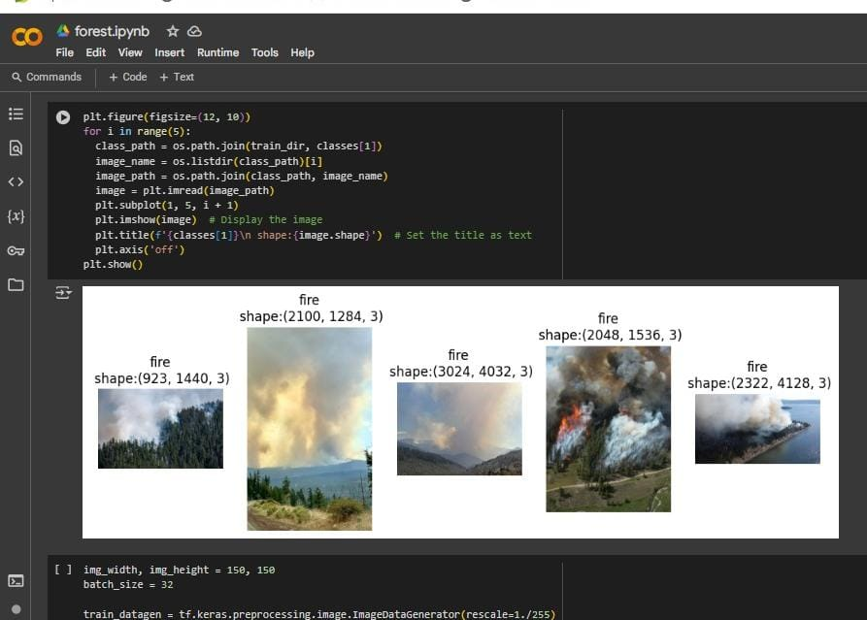
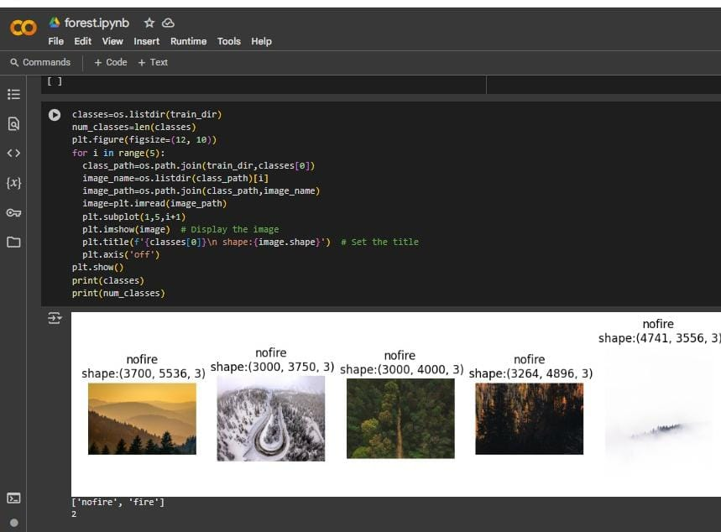
Screenshot of Output:
Data source and access

Slide 11
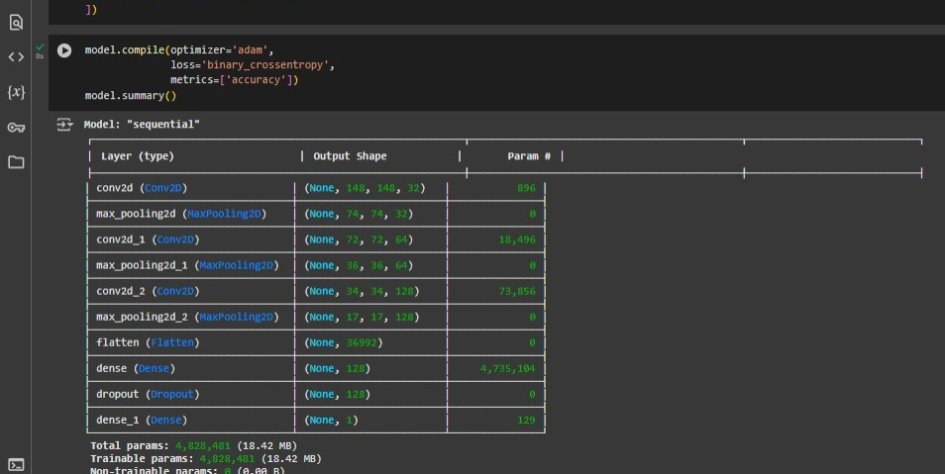
Screenshot of Output:
Model Architecture Summary for CNN Binary Classification

Slide 12
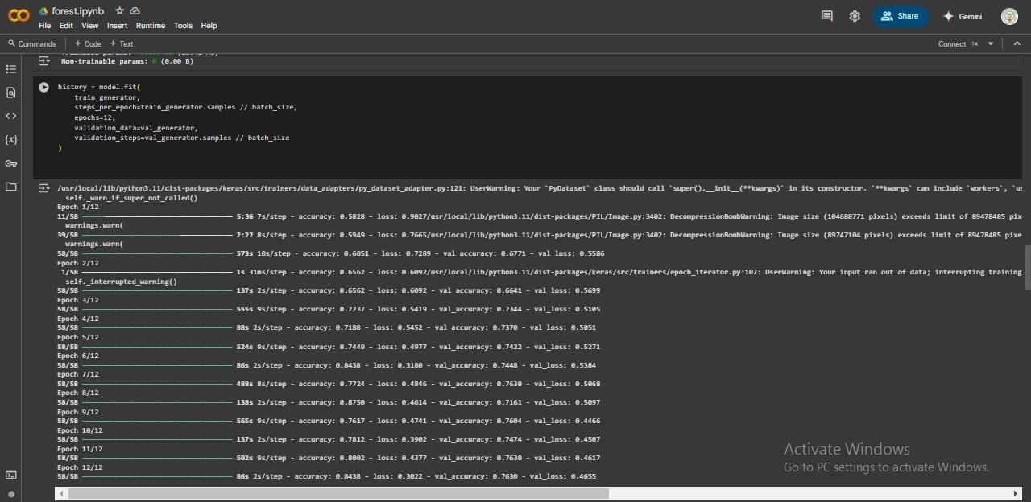
Screenshot of Output:
Epoch training

Slide 13
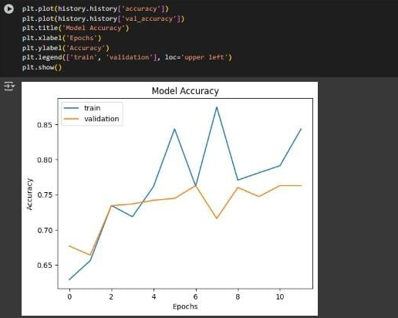
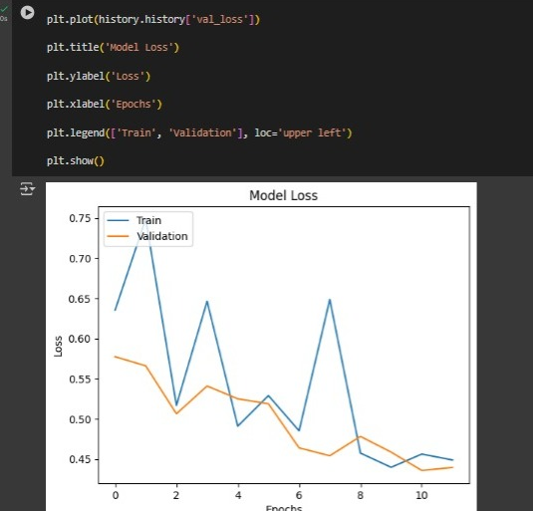
Screenshot of Output:
Accuracy and Loss

Slide 14
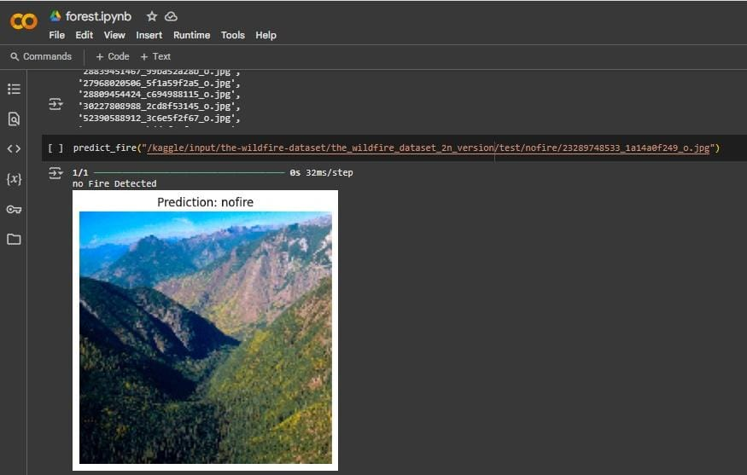
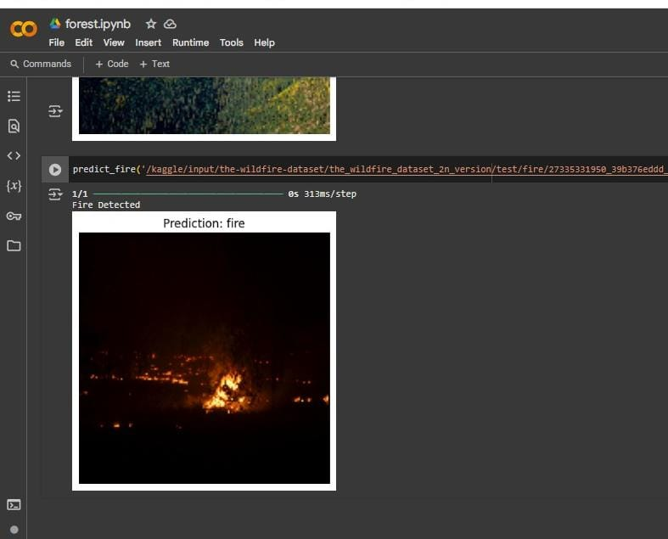
Screenshot of Output:
Predictions from test dataset

Slide 15
Conclusion:
In this project, we successfully developed a deep learning-based model for forest fire detection using a Convolutional Neural Network (CNN). The model architecture was designed to extract hierarchical spatial features from input images, enabling it to effectively distinguish between fire and non-fire scenes
.
Through multiple convolutional and pooling layers, the model learned relevant patterns and textures associated with forest fires. The final classification layer, trained with a binary cross-entropy loss function and optimized using the Adam optimizer, provided accurate predictions for binary classification (fire vs. no fire).
With over 4.8 million trainable parameters, the model achieved a strong balance between depth and computational efficiency. This approach demonstrates that CNN-based models can be powerful tools in real-time forest fire monitoring systems, contributing to early detection and potentially helping in the mitigation of large-scale environmental disasters.
Github link:https://github.com/rithika2155/forest-fire-detection

