Slide 1

Crime in Context, 1975-2015
Are violent crime rates rising or falling in American cities?
Presented By:
M.RITHIKA

Slide 2
About Me
I am Rithika, a recent B.Tech graduate in Artificial Intelligence and Data Science from Vignan College
I am passionate about solving problems using data, logic, and structured thinking
I have worked on academic and personal data analysis projects that reflect real-world problem solving
I am continuously learning and improving my skills in data analytics and visualization

Slide 3
Introduction
Dataset analyzes violent crimes in major U.S. cities
Covers 40+ years of data (1975–2015)
Includes four FBI-defined crimes:
Homicide, Rape, Robbery, Assault
Data collected from 68 large police jurisdictions
Used to study crime trends, population impact, and crime relationships
Focus on actual crime counts, not just per-capita rates

Slide 4
Objective
To understand patterns and trends in violent crime data
To see how crimes changed over the years
To analyze how population affects crime numbers
To study relationships between different crime types
To practice data analysis and visualization skills using real data

Slide 5
Dataset Overview
Analyzed 40+ years of violent crime data (1975–2015) across major U.S. cities
Dataset includes ~3,000 records and 15 features from large police jurisdictions
Covers FBI-defined violent crimes:
Homicide, Rape, Robbery, Assault
Combines crime counts and population data to study real-world impact
Focuses on actual crime numbers, emphasizing that every incident matters
Used to identify crime trends, high-risk regions, and changing patterns over time

Slide 6
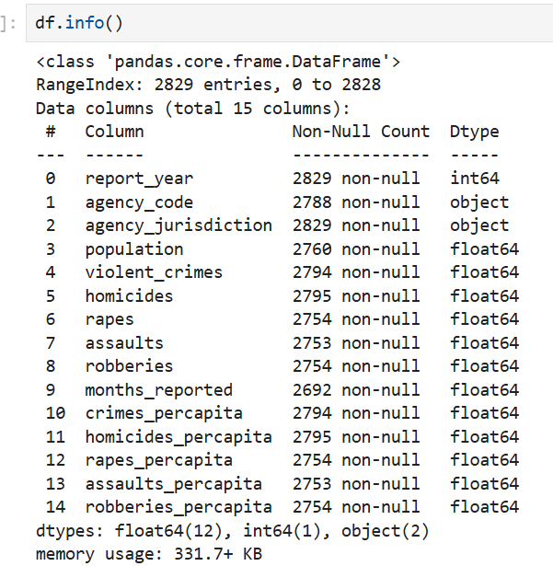
Dataset Info

Slide 7
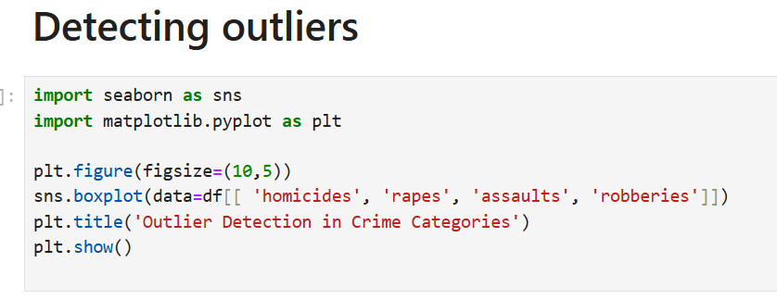
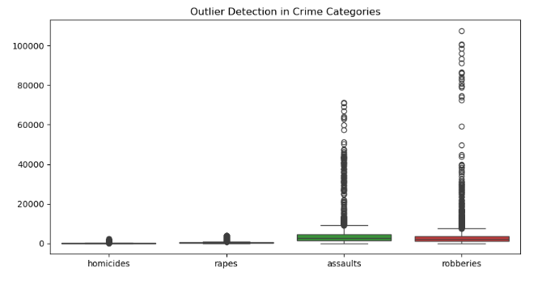
Data Preprocessing
Detecting Outliers

Slide 8
Handling Missing Values
High missing values in assaults, rapes, homicides, and robberies
Missing data could affect crime analysis
Removed records with all key crime values missing
Final dataset is clean and ready for analysis
Handling Duplicates:
Checked for duplicate rows in year, crimes, and percentage, none were found.
Ensures dataset remains clean without redundancy.

Slide 9
Data Cleaning
Fixing Inconsistencies in Categorical Data
Inconsistencies occur when the same category is represented in multiple forms due to formatting differences
Standardized the agency_jurisdiction field by splitting and converting it into separate city and state columns for better clarity and analysis.
  Data Type Conversion
Data type conversion ensures that each column is properly formatted, allowing for more accurate aggregation and comparison in the crime dataset.

Slide 10
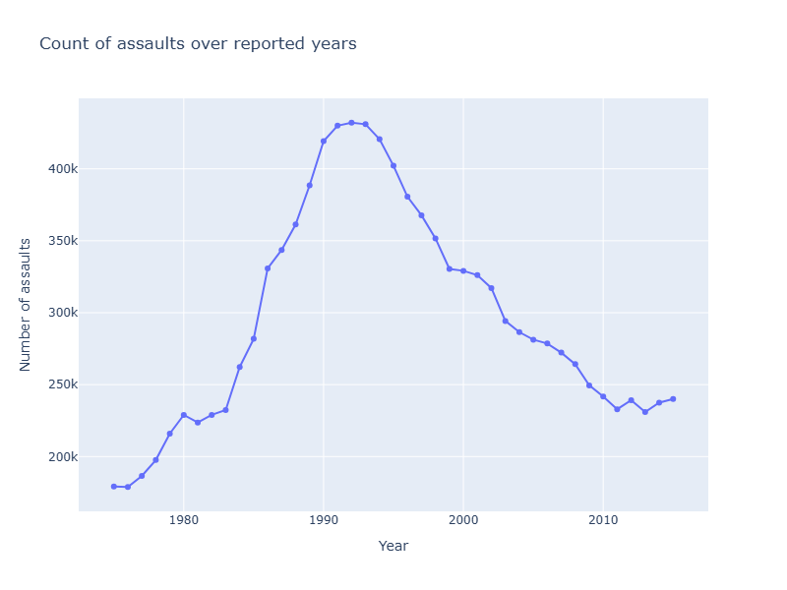
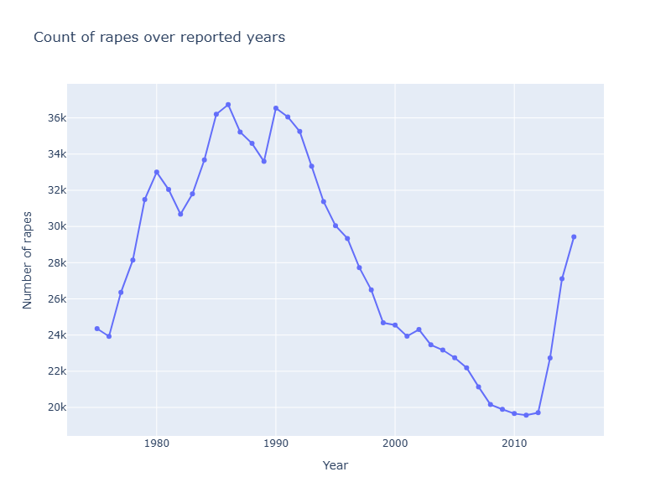
How did each type of violent crime evolve over time?

Slide 11
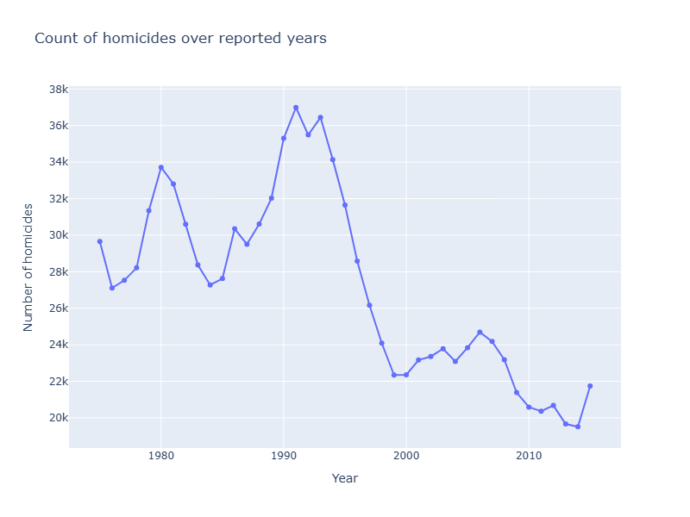
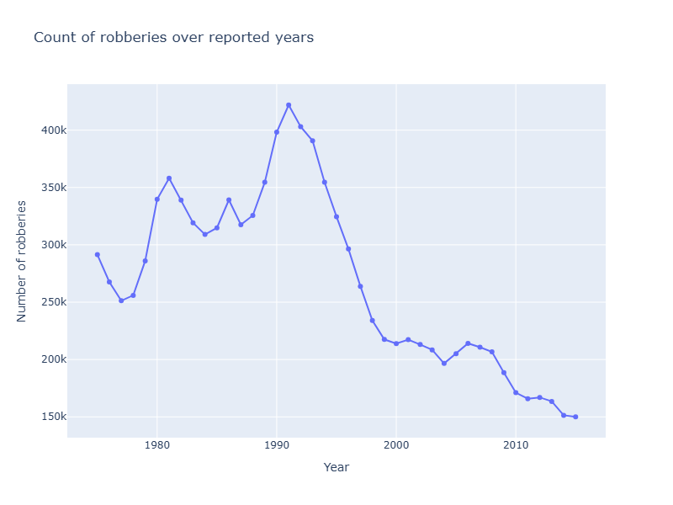

Slide 12
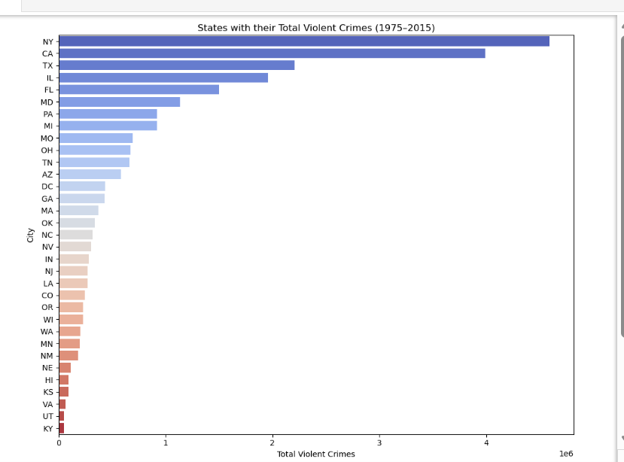
UNIVARIATE ANALYSIS
Are violent crimes concentrated in a few states or spread evenly across all states

Slide 13
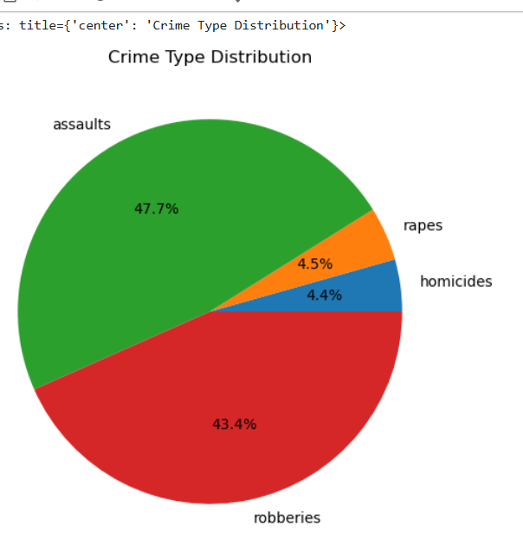
What proportion of total violent crime does each category represent?

Slide 14
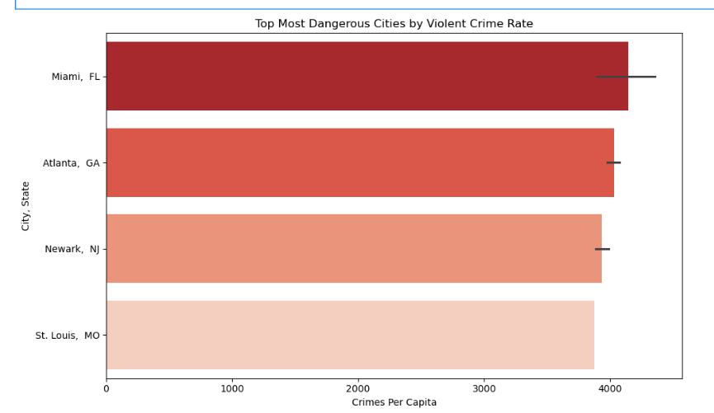
Which cities report the highest number of violent crimes?

Slide 15
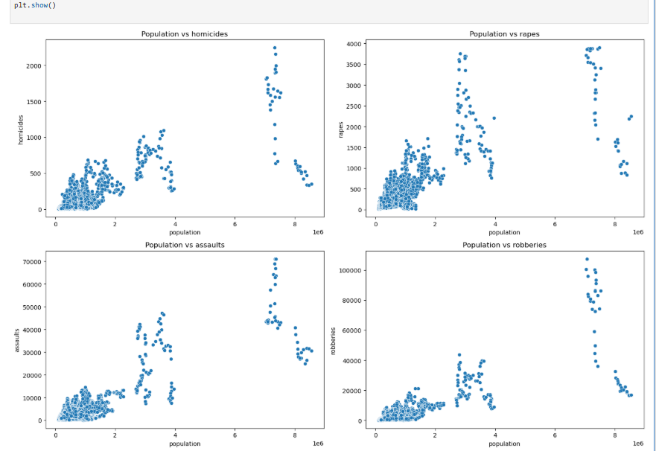
BIVARIATE ANALYSIS
Is there a relationship between population size and crime volume?

Slide 16
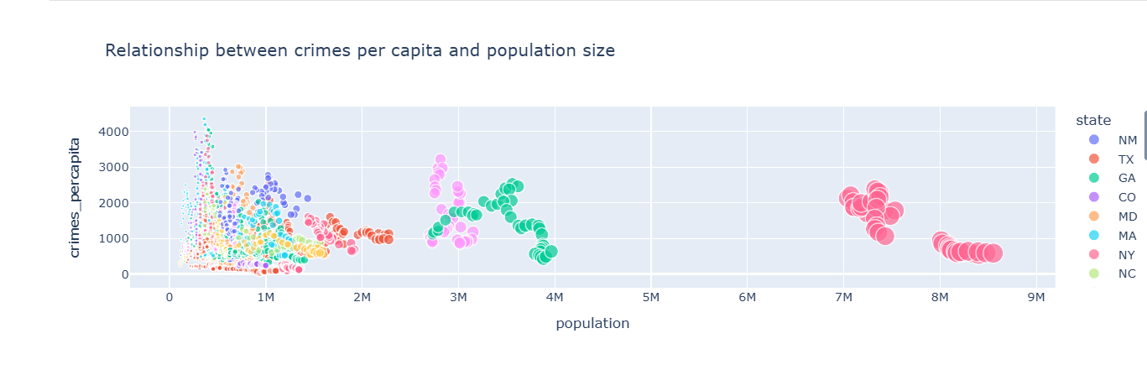
Are there any cities with unusually high crime for their population size?

Slide 17
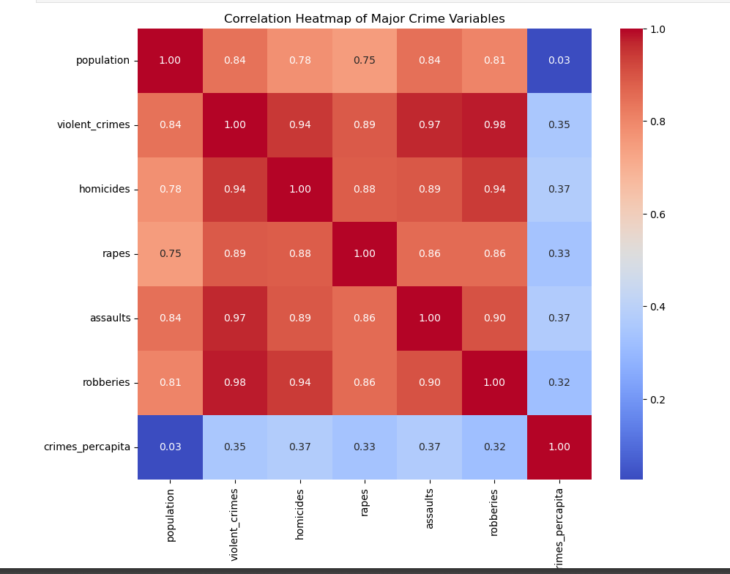
MULTIVARIATE ANALYSIS
Which crime pairs show the strongest relationships?

Slide 18
Insights
Crime levels peaked in the early 1990s but have steadily declined, showing long-term improvements in public safety.
Large metropolitan cities contribute the highest share of violent crimes, with New York, Los Angeles, Chicago, Detroit, and Houston leading by wide margins.
High-risk cities like Miami, Atlanta, Newark, and St. Louis show the highest crimes per capita, making them the most dangerous relative to population size.
Population strongly influences total crime, with bigger, denser cities reporting far more homicides, assaults, robberies, and rapes.
Violent crime categories are closely linked, meaning when one type increases (like assaults), others often rise together.
Crime reporting gaps occur consistently, and missing crime values indicate unreported years rather than incomplete data.
Overall, the analysis shows clear crime concentration in major cities, strong relationships between crime types, and historical patterns that can help guide policing, prevention, and policy decisions.

Slide 19
Conclusion
The analysis shows that violent crime peaked in the early 1990s and then declined steadily across major U.S. cities.
By understanding these trends, we can infer that changes in government policies, law enforcement strategies, and public safety initiatives may have contributed to the reduction in crime.
Through this project, using Exploratory Data Analysis (EDA) and Python, I learned how to clean data, visualize patterns, and extract meaningful insights from real-world datasets.

Slide 20

THANK YOU

