Slide 1

Online Nursery Management System
Rithikasri M
ECE- A

Slide 2

INTRODUCTION:
Purpose:
To provide an easy way for customers to register, login, and buy plants online.
Features:
User Registration & Login
Product Catalog (plants)
Shopping Cart & Orders
Database Integration (MySQL + Java Swing)

Slide 3

OBJECTIVE:
To design and develop an easy‑to‑use platform for buying plants online
To provide secure user registration and login for customers.
To maintain a catalog of plants with prices and details.
To enable customers to place orders and view past purchases.
To integrate with a MySQL database for reliable storage of user and order
information.

Slide 4

Frontend: Java Swing Backend: Java Connector: JDBC (MySQL Connector) IDE: Eclipse Language: Java
Technologies Used:

Slide 5

System Architecture :
1. Presentation Layer (Frontend)
Built using Java Swing.
Provides forms for Login, Registration, and Product Catalog.
Users interact through buttons, text fields, and plant‑themed backgrounds.
2. Application Layer (Business Logic)
Written in Java classes (NurseryLogin, NurseryRegister, NurseryProduct).
Handles user actions: login validation, registration, product selection, and order saving.
Acts as a bridge between GUI and database.

Slide 6
3. Database Layer (Backend)
MySQL Database stores all data.
Tables:
users → stores user details (name, phone, email, password).
orders → stores purchase details (plant, quantity, total, date).
Connected via JDBC (MySQL Connector/J).
4. Data Flow
User interacts with GUI (login/register/product page).
Java application processes input and sends queries via JDBC.
MySQL executes queries and returns results.
Application updates GUI with success/failure messages or product/order details.

Slide 7
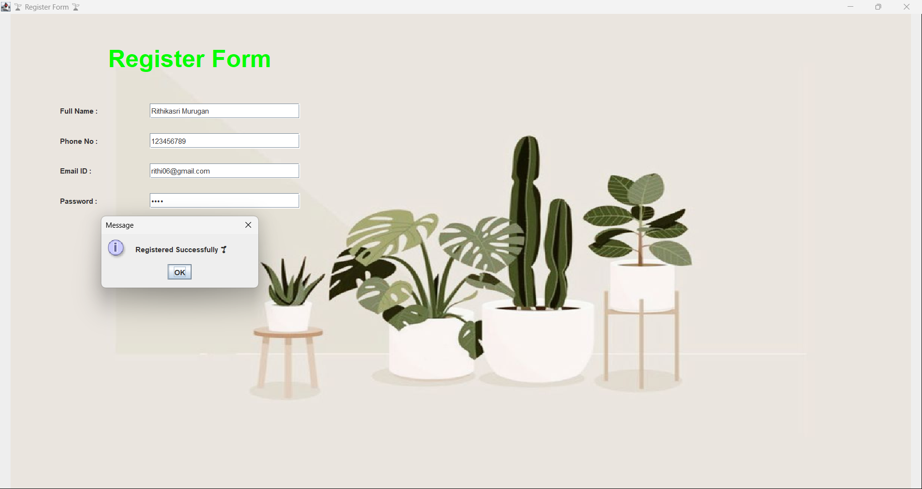
Output:

Slide 8
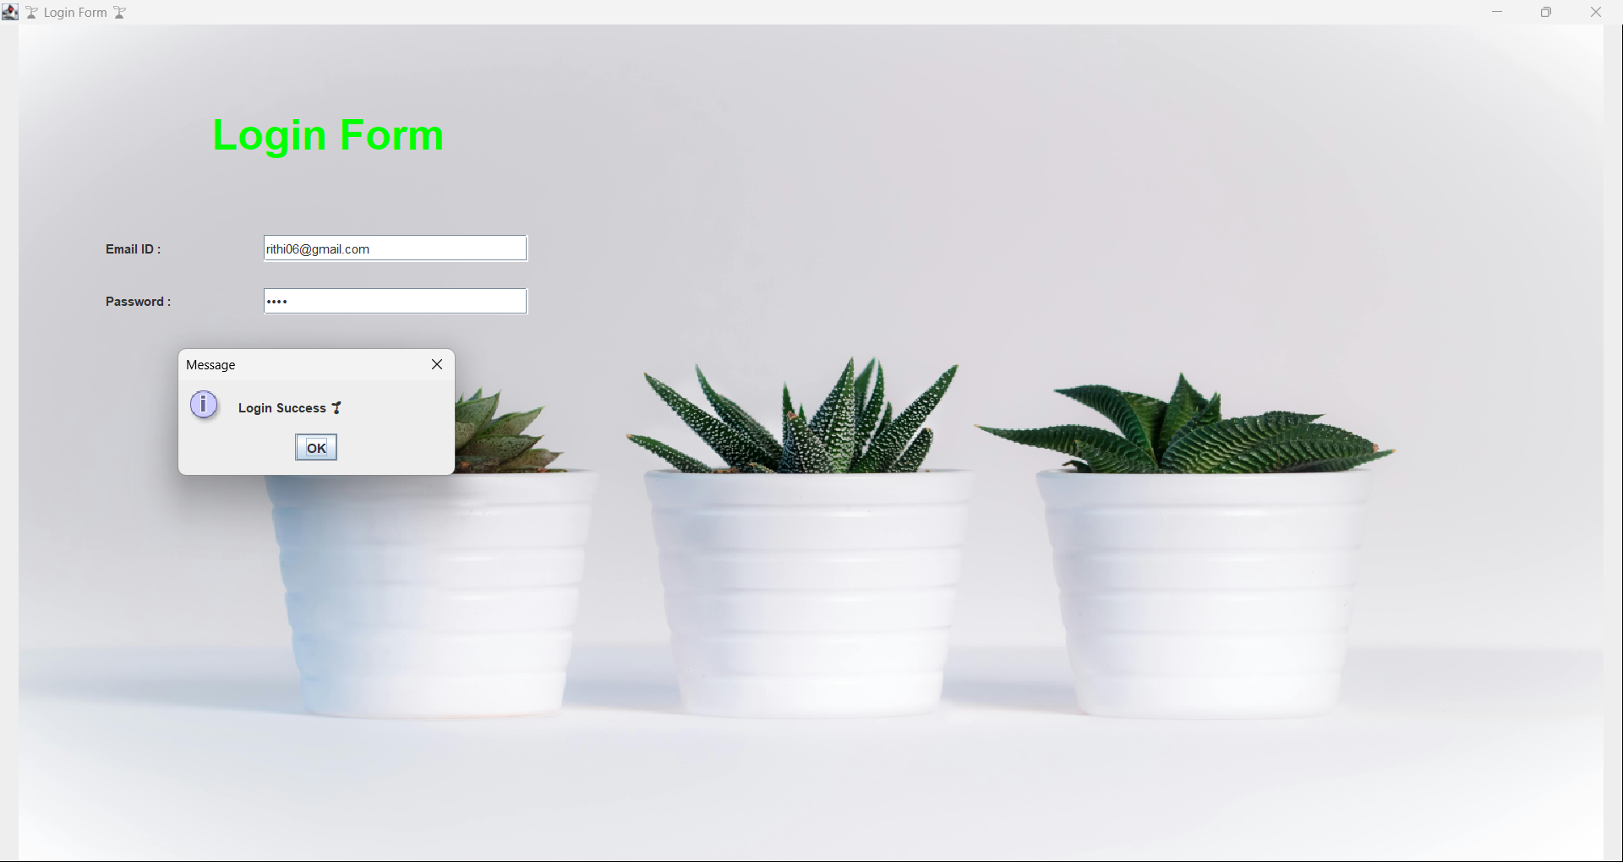
Output:

Slide 9
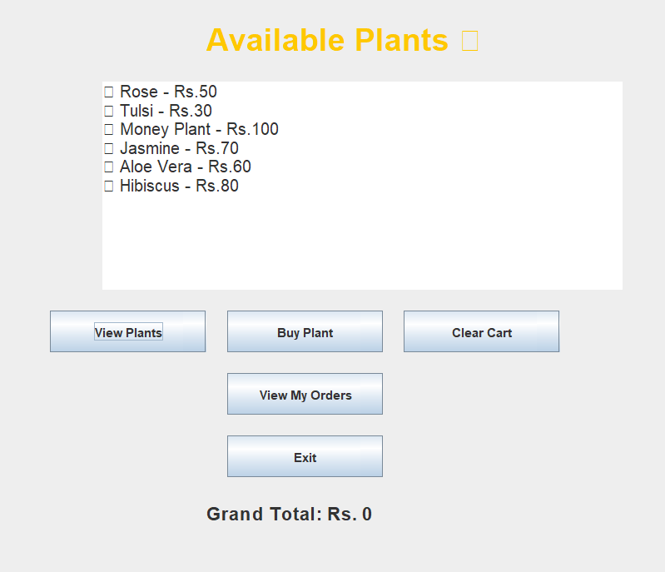
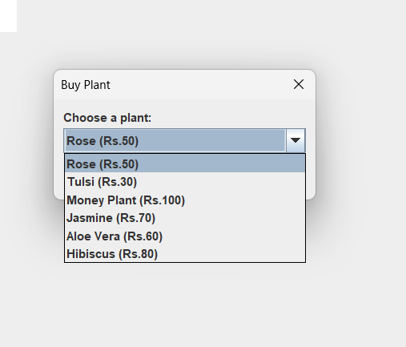
Output:

Slide 10
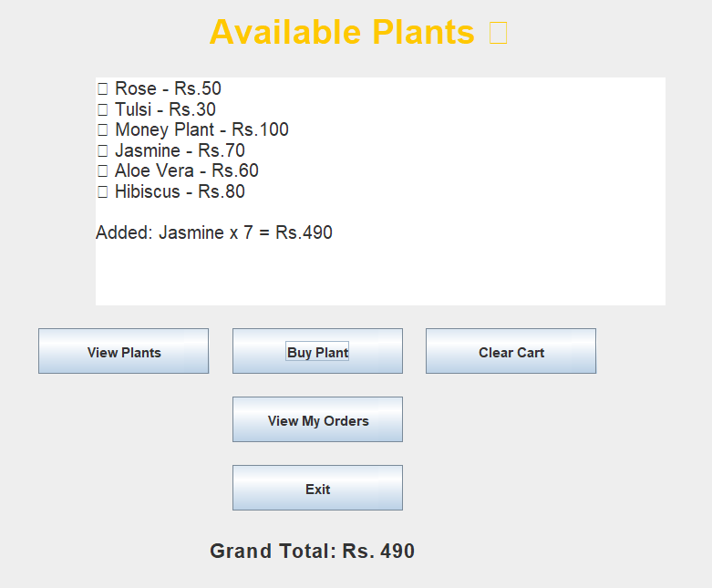
Output:

Slide 11
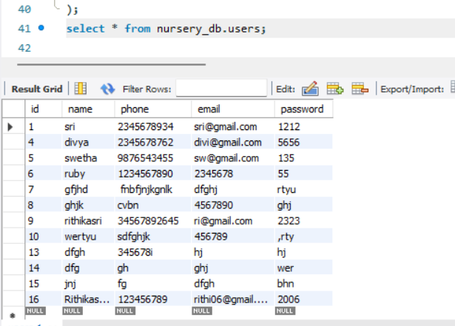
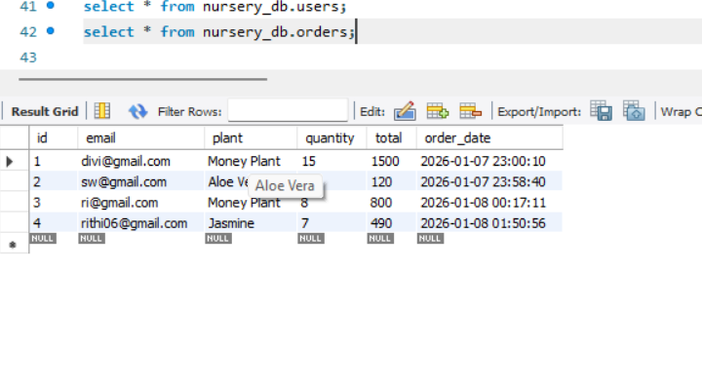
Output:

Slide 12

THANK YOU

