Slide 1



Sprout
Conrad Dudziak, John Smith, Margaret Connor,
Pranav Sakthivel, Rithik Bansal

Slide 2

Low Motivation: A workplace Problem
How does Low Motivation manifest in the workplace?
Low incentive
Boredom
Disfunction
Fleeting desire to participate

Slide 3

Introducing Sprout!
A reward based incentive system.

Slide 4

What is Sprout all About?
In Sprout, a workplace becomes a garden flourishing through an economy of Seeds!

Slide 5
How does it work?
An administrator hosts a Garden for his staff.
Staff receives weekly seeds.
Staff reward each other with seeds for kudos & exceptional work by planting their seeds in their peers flower bed.
Each morning, staff can harvest their flower bed and are rewarded points.
The staff member with the most points at the end of the week wins!

Slide 6


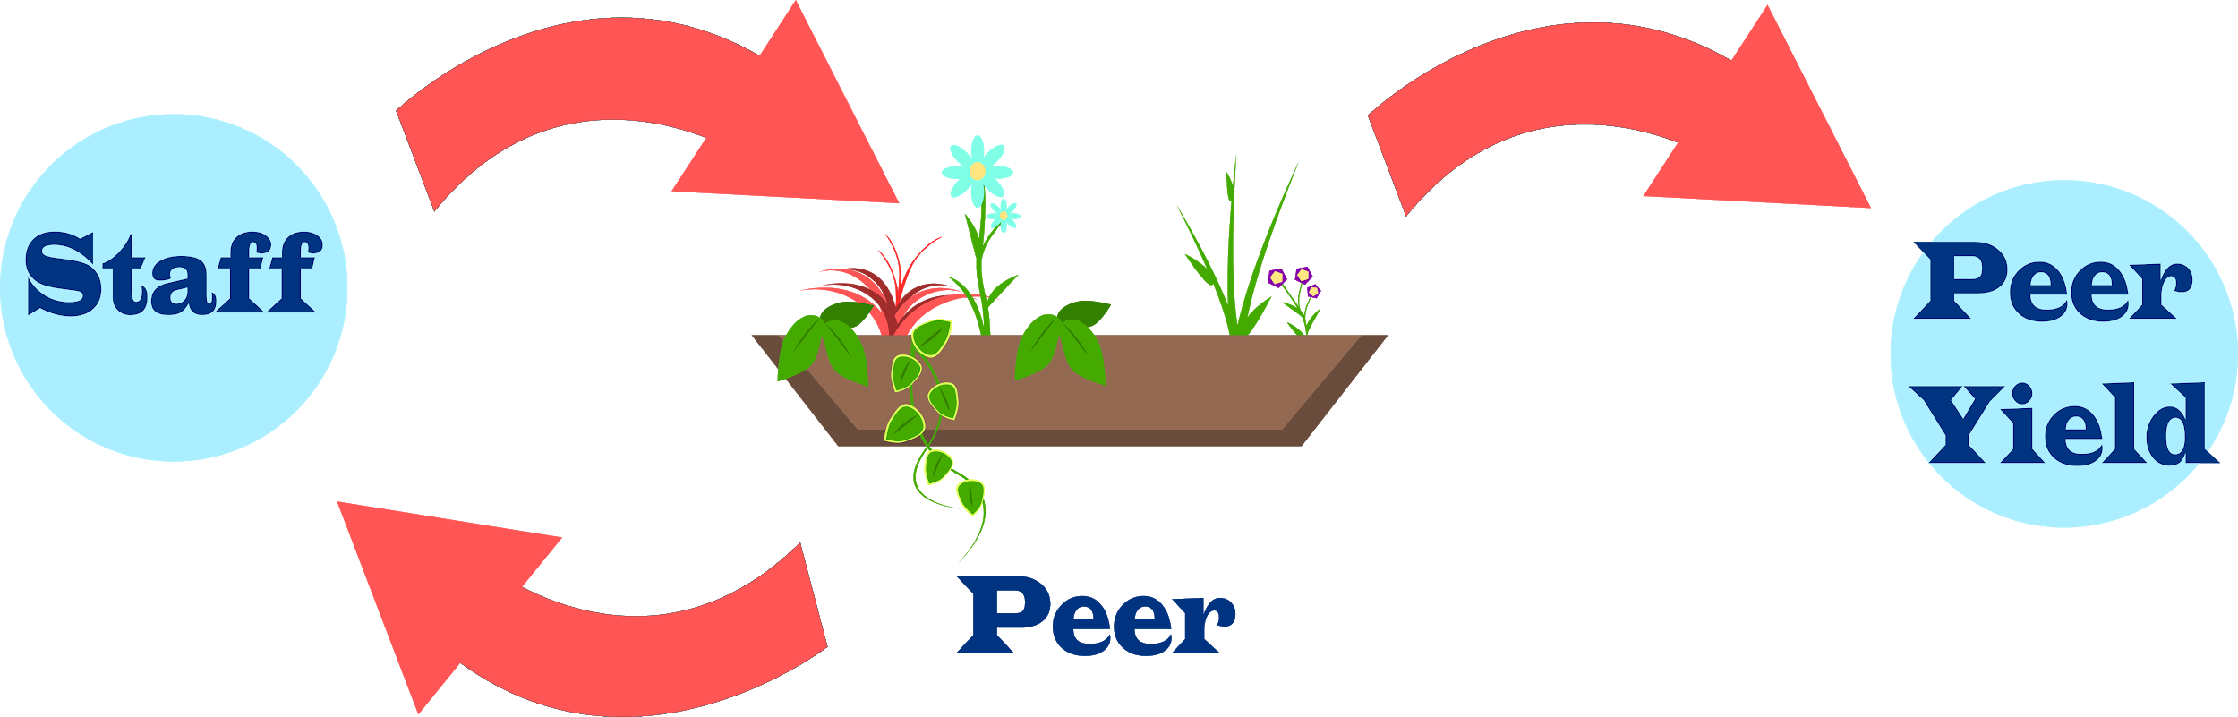

Sprout Economic Flow

Slide 7
In a Nutshell:
Spark new communication
Motivate employees
Fun
Rewards

Slide 8
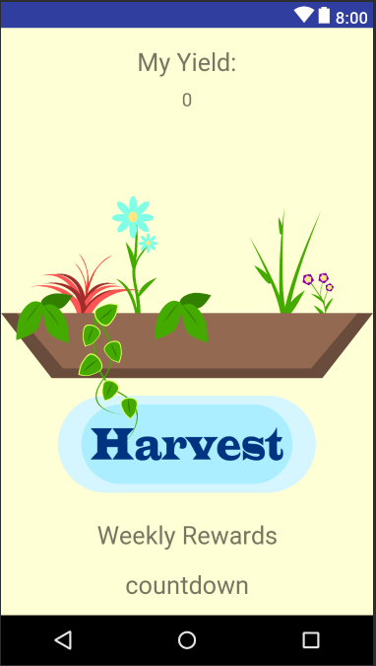

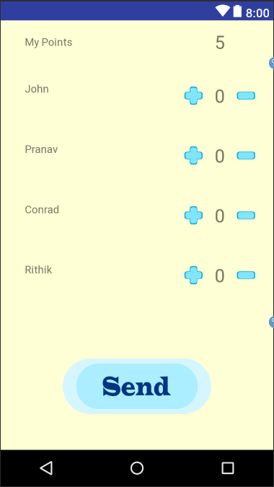

Slide 9
The future of Sprout
Develop manager side of the Garden:
Teams
Reward System: Altruistic & Monetary
Statistics System
Leader Boards
Productivity comparison

