Slide 1
PulseGuard Nexus: AI-Accelerated Industrial Motor & Grid Intelligence Platform
Team Name: ZynXo
Email of Team Leader: sec22am013@sairamtap.edu.in
UN Grand Challenge: SDG 9, Industry Innovation and Infrastructure

Slide 2
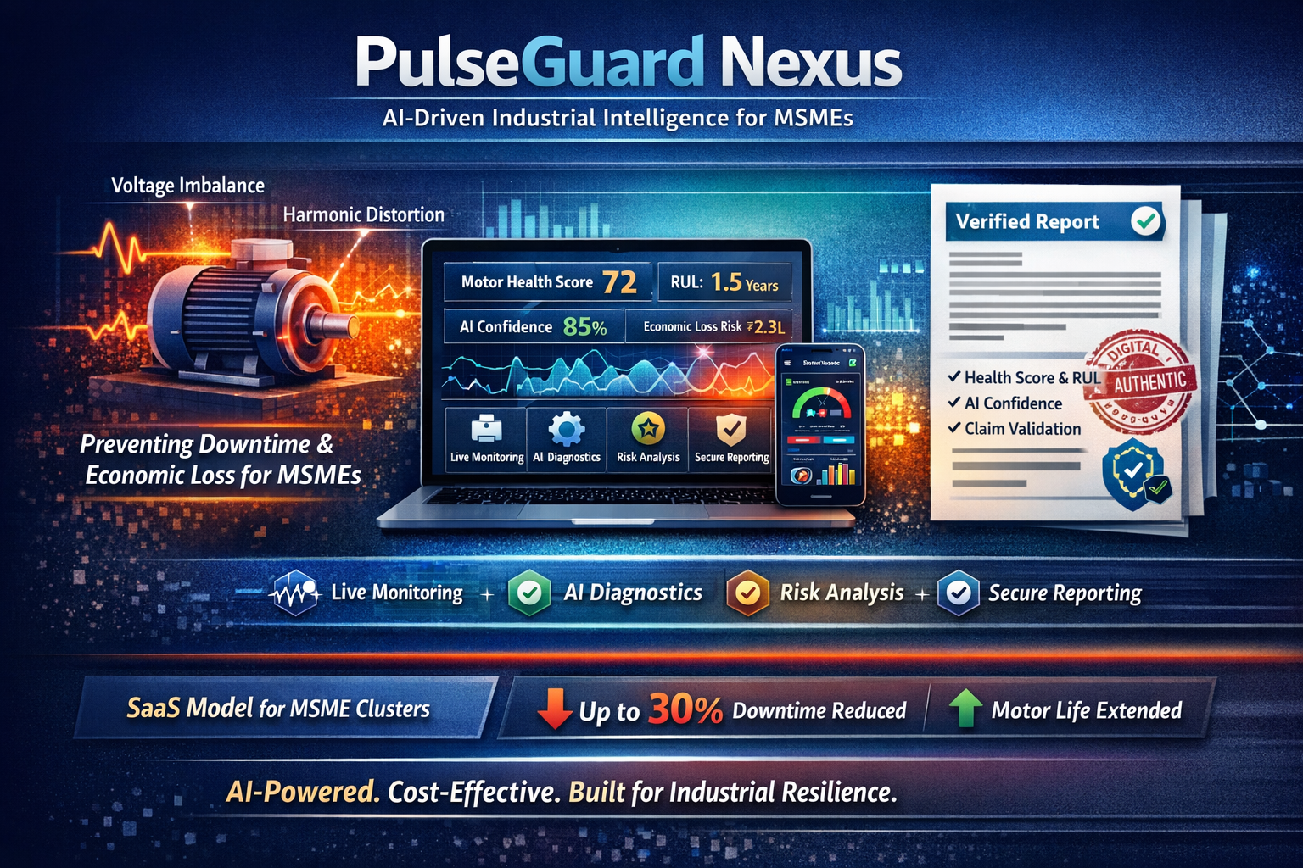
Executive Summary
PulseGuard Nexus is an AI-accelerated industrial intelligence platform designed to protect MSMEs from hidden motor failures caused by poor power quality. Voltage imbalance, harmonic distortion, and vibration stress silently degrade industrial motors, leading to unplanned downtime, production loss, and high maintenance costs. Most MSMEs lack affordable predictive systems and documented proof to validate grid-induced damage.
Our solution transforms live telemetry into actionable insights through monitoring, quantification, automated threshold detection, and AI-driven diagnostics. PulseGuard Nexus calculates Motor Health Score, AI Confidence Score, Remaining Useful Life (RUL), and Economic Loss Risk in real time. It also generates professional, verifiable reports with digital integrity authentication—enabling evidence-based maintenance decisions and potential utility claim validation.
We developed a responsive software prototype that simulates industrial motor stress conditions and dynamically visualizes degradation patterns. The system integrates intelligent recommendations, risk classification, and cluster-level grid insights within an offline-first architecture.
Our business model follows a SaaS subscription approach targeting MSME clusters, offering scalable deployment with sensor integration capability. By enabling early intervention, PulseGuard Nexus has the potential to reduce unplanned downtime by up to 30% and extend motor lifespan through proactive stress mitigation.
The platform is novel in combining AI acceleration, economic risk translation, and secure documentation into a single MSME-focused industrial resilience system aligned with SDG 9.

Slide 3
Goal
The goal of PulseGuard Nexus is to enable MSME industrial units to detect motor degradation early, prevent avoidable downtime, and create verifiable documentation of power-quality–induced damage.
Target Users
MSME factory owners operating motor-driven production lines
Maintenance engineers responsible for uptime
Industrial cluster associations managing shared infrastructure
Insurance, compliance, and audit authorities reviewing failure claims
Problem Context
In many Tier-2 and Tier-3 industrial regions, grid instability—such as voltage imbalance and harmonic distortion—silently increases thermal stress in motors. This accelerates lubricant thinning and bearing wear, ultimately leading to mechanical failure.
Most MSMEs identify issues only after breakdown occurs. By then:
Production halts unexpectedly
Emergency repairs increase costs
Delivery timelines are affected
There is no documented proof linking failure to grid conditions
Constraints
Limited digital infrastructure and connectivity.
Budget-sensitive user base.
Need for offline-first operation.
Requirement for simple, intuitive user interface.
Why Achieving This Goal Matters
Downtime directly reduces production capacity and revenue.
Premature motor replacement increases capital expenditure.
Unstable grid conditions remain undocumented and unchallenged.
MSMEs lack affordable predictive intelligence tools.
Success Criteria
Continuous monitoring of motor stress parameters.
Automated detection of abnormal electrical conditions.
AI-generated diagnostic insights and confidence scoring.
Translation of degradation into economic risk estimates.
Generation of secure, professional documentation.
Scalable integration with real industrial sensors.
PulseGuard Nexus aims to shift MSMEs from reactive maintenance to predictive, data-driven operational control.

Slide 4
Idea
Idea
PulseGuard Nexus is an AI-accelerated industrial intelligence platform that converts early electrical stress signals into operational, financial, and verifiable insights for MSMEs.
Core Concept
Industrial motors fail gradually, not suddenly. Electrical abnormalities such as voltage imbalance and harmonic distortion increase thermal stress long before mechanical damage becomes visible. Traditional systems focus on vibration after degradation begins. PulseGuard Nexus instead detects electrical stress early and translates it into clear, actionable insights—preventing failure rather than reacting to it.
The system achieves this through five integrated layers:
Monitoring – Live telemetry simulation continuously tracks voltage imbalance, harmonics, and vibration indicators.
Quantification – Stress is mathematically modeled into measurable Health Scores and degradation trends.
Detection – Automated threshold monitoring identifies abnormal patterns instantly.
Visualization – Dynamic charting and focus-mode dashboards provide real-time clarity.
Documentation & Verification – Professional reports are generated with digital integrity hashes and claim validation authentication for secure evidence.
Intelligence Layer
AI Confidence Score estimates prediction reliability.
Risk Level Classification categorizes severity.
Remaining Useful Life (RUL) forecasts operational longevity.
Economic Loss Translation converts technical degradation into financial impact.
Interactive alerts enable rapid triage and intervention.
Feasibility
The prototype demonstrates a responsive, offline-first software architecture capable of integrating with real ESA and vibration sensors. Lightweight deployment ensures suitability for cost-sensitive MSMEs.
Unique Value Proposition
Unlike traditional predictive maintenance dashboards, PulseGuard Nexus combines AI acceleration, economic modeling, and secure documentation into a single MSME-focused platform. It not only predicts failure—it creates actionable, verifiable industrial intelligence.

Slide 5
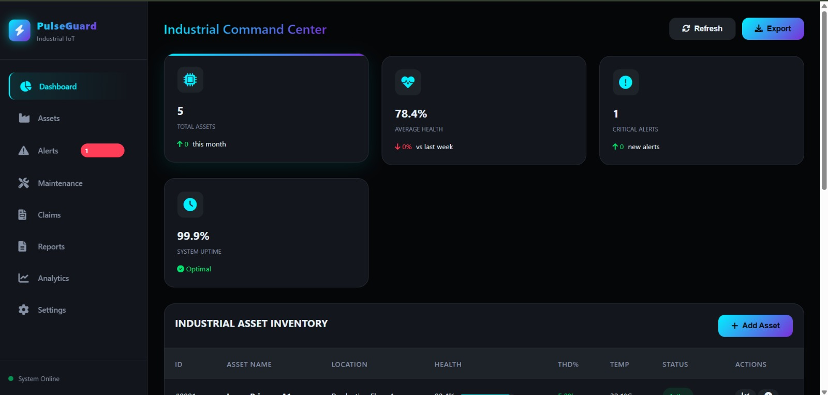
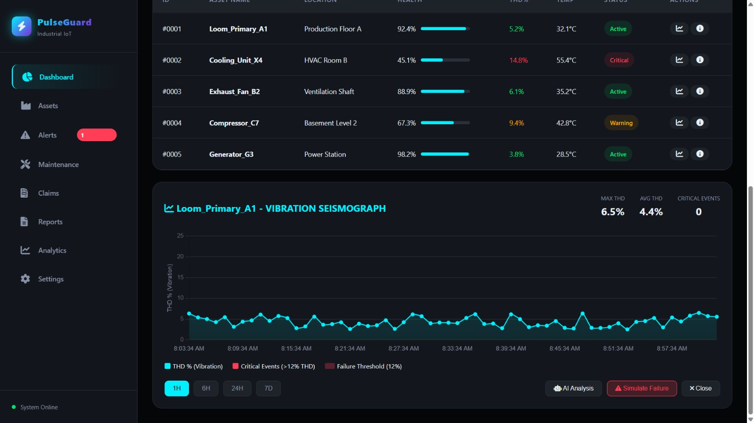
Prototype or Proof-of-Concept (1/2)
The prototype demonstrates a real-time industrial monitoring dashboard that tracks motor health, THD%, temperature, and vibration trends. The system automatically detects anomalies, generates alerts, and provides AI-assisted diagnostic insights. This enables early failure prediction and smarter maintenance decisions.
IMPACT
Early detection → Reduced downtime → Smarter maintenance decisions

Slide 6
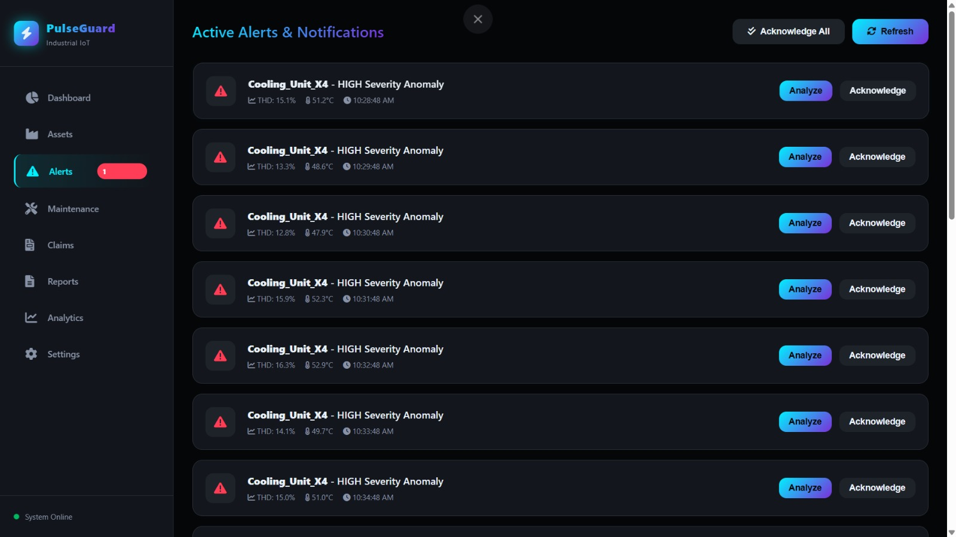
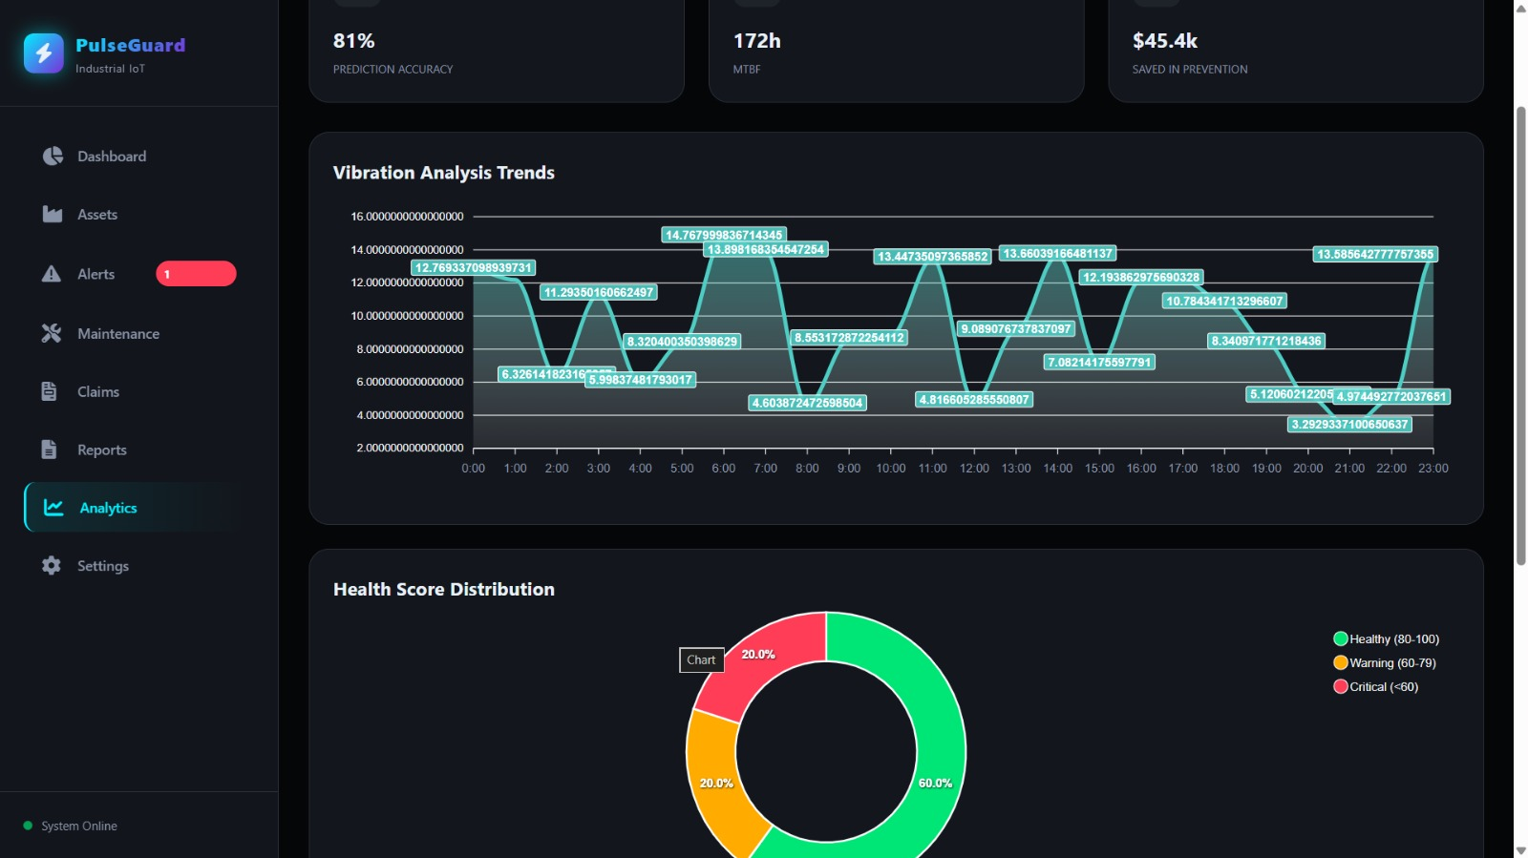
Prototype or Proof-of-Concept (2/2)
Use this slide to write your prototype (font size = 11)
The system provides automated alert management and advanced analytics for proactive maintenance. High-severity anomalies are detected in real time, enabling immediate triage and AI-assisted analysis. The analytics dashboard visualizes vibration trends, prediction accuracy, MTBF, and health score distribution, helping industries understand risk patterns and take preventive action before failures occur.

Slide 7
Market Needs & Business Plan
Market Need
India has 63+ million MSMEs.
Most lack predictive motor monitoring.
Motor failures cause 20–30% unplanned downtime.
Downtime = production loss + high repair cost.
MSMEs need affordable, intelligent, and easy-to-deploy solutions.
Business Model
SaaS subscription per motor (₹499/month)
Pro AI Diagnostics Plan
Cluster Enterprise Dashboard
Insurance & Compliance Reporting Module
Revenue Potential
Even 0.5% adoption (315,000 MSMEs)
→ Strong recurring revenue model
→ Highly scalable nationwide.
Roadmap
Software launch
Sensor integration
MSME pilot deployment
Cluster & utility partnerships
Vision
Make predictive industrial intelligence accessible to every MSME.

Slide 8
Research and Literature Review
What Is Known
Voltage imbalance → increases negative sequence currents → motor overheating.
Harmonic distortion → increases electrical losses → efficiency drop.
Electrical stress → accelerates bearing wear.
Early predictive maintenance → reduces downtime by 20–30%.
What Is Missing
Most systems detect vibration after damage begins.
High-cost, hardware-heavy enterprise solutions.
No economic loss translation for MSMEs.
No secure, claim-ready documentation.
Limited support for low-connectivity industrial clusters.
How PulseGuard Nexus Advances the Field
Electrical-first early detection (before mechanical failure).
AI Confidence + Risk Classification.
Economic loss conversion (technical → financial insight).
Secure reporting with digital integrity verification.
Offline-first, MSME-focused architecture.
Key Insight
Existing systems monitor machines.
PulseGuard Nexus converts stress into actionable, verifiable industrial intelligence.

Slide 9
Competition + Next Steps
Competitors
Traditional Vibration Monitoring Systems
These systems focus primarily on mechanical vibration analysis. While effective for detecting late-stage bearing wear, they often identify problems only after significant degradation has already occurred. They typically lack electrical stress modeling and economic translation features.
Industrial IoT Dashboards
IoT-based platforms collect and visualize machine data but mainly provide monitoring and visualization capabilities. They require strong connectivity infrastructure and often lack predictive confidence scoring or secure documentation features tailored to MSMEs.
Enterprise Predictive Maintenance Platforms
Large-scale industrial analytics solutions offer advanced diagnostics but are expensive, hardware-intensive, and designed for large enterprises. Their complexity and cost make them less accessible for MSME clusters.
Our Key Advantages
AI Confidence Modeling – Provides prediction reliability estimation, improving decision trust.
Economic Loss Translation – Converts technical degradation into clear financial impact.
Secure Claim Validation – Generates professional reports with authentication mechanisms.
Digital Integrity Verification – Ensures data authenticity for audits or insurance review.
MSME Affordability & Offline-First Design – Built for low-infrastructure environments.
PulseGuard Nexus bridges the gap between simple monitoring tools and expensive enterprise systems.
Next Steps
Integrate real Electrical Signature Analysis (ESA) and vibration sensors.
Implement live Groq LPU acceleration for faster AI inference.
Deploy pilot testing in selected MSME clusters.
Add blockchain-backed documentation for immutable verification.
Establish partnerships with utilities and insurance providers for validation use cases.
These steps will strengthen scalability, credibility, and competitive differentiation.

Slide 10
References
V. Sousa, H. Hernández, E. C. Quispe, J. R. Gómez and P. R. Viego, "Analysis of harmonic distortion generated by PWM motor drives," 2017 IEEE Workshop on Power Electronics and Power Quality Applications (PEPQA), Bogota, Colombia, 2017, pp. 1-6, doi: 10.1109/PEPQA.2017.7981644.
keywords: {Harmonic analysis;Pulse width modulation;Motor drives;Power harmonic filters;Harmonic distortion;Induction motors;electrical industrial system;harmonic distortion;PWM motor drives;harmonic statistical analysis},
A. M. Dos Santos Alonso, L. De Oro Arenas, J. P. Bonaldo, J. De A. olímpio Filho, F. P. Marafão and H. K. M. Paredes, "Power Quality Improvement in Commercial and Industrial Sites: An Integrated Approach Mitigating Power Oscillations," in IEEE Access, vol. 12, pp. 50872-50884, 2024, doi: 10.1109/ACCESS.2024.3385991.
keywords: {Reactive power;Inverters;Induction motors;Harmonic analysis;Active filters;Power quality;Power harmonic filters;Oscillators;Reactive power;Power grids;Industrial facilities;Commercialization;Conservative power theory;induction motor;instantaneous power oscillations;multifunctional inverters;power factor;power quality},
M. L. Singgih, F. F. Zakiyyah and Andrew, "Machine Learning for Predictive Maintenance: A Literature Review," 2024 Seventh International Conference on Vocational Education and Electrical Engineering (ICVEE), Malang, Indonesia, 2024, pp. 250-256, doi: 10.1109/ICVEE63912.2024.10823713. keywords: {Support vector machines;Machine learning algorithms;Accuracy;Reviews;Bibliographies;Predictive models;Prediction algorithms;Real-time systems;Classification algorithms;Predictive maintenance;AdaBoost Classifier;Machine Learning;Predictive Maintenance;Random Forest;Supervised Vector Machine;Time-series Classification},

Slide 11
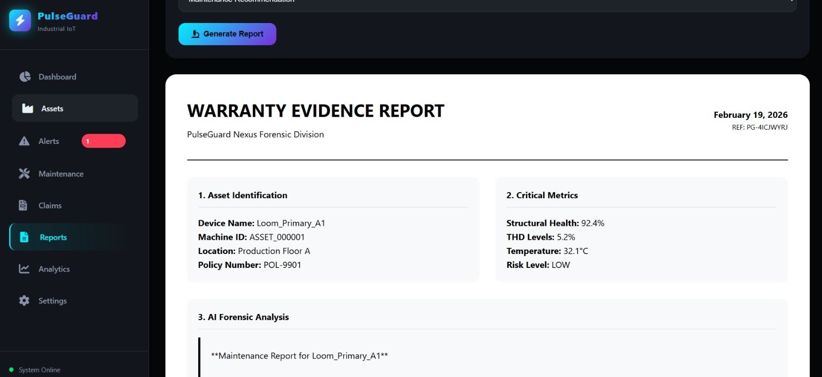
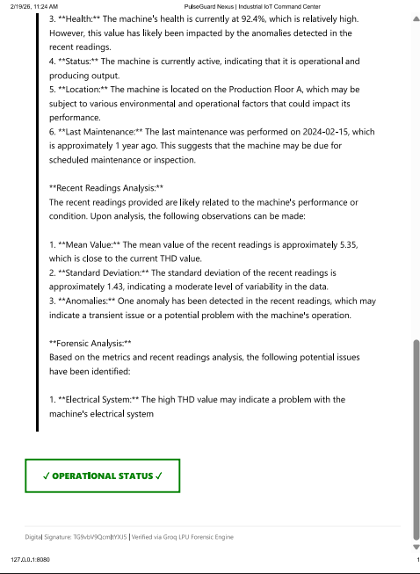
APPENDIX
This demonstrates the digitally generated Warranty Evidence Report, summarizing asset metrics, AI-based diagnostics, and risk classification. It provides structured, verifiable documentation to support maintenance validation and potential warranty or utility claims.

Slide 12
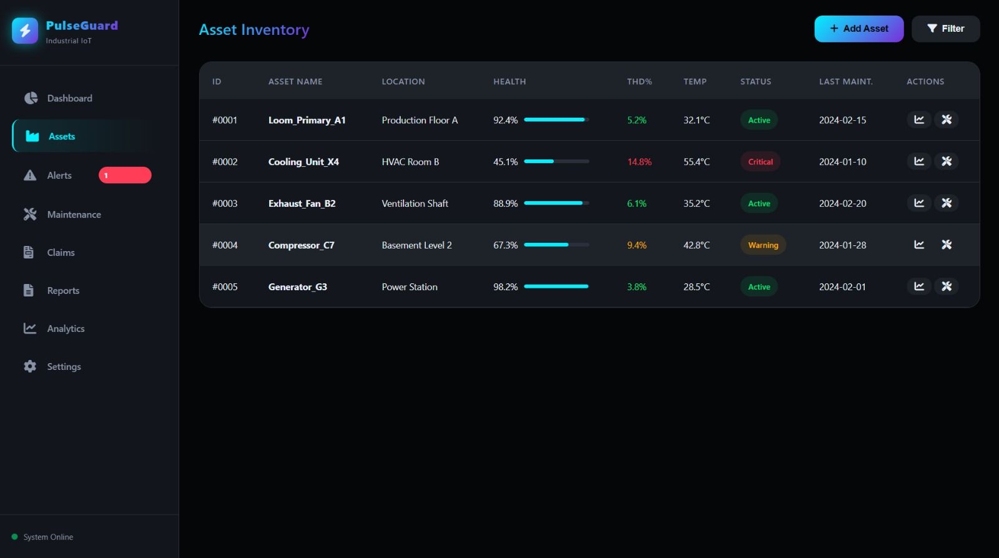
APPENDIX A
The Asset Inventory module provides centralized visibility of all industrial equipment within the facility.
It displays real-time health scores, THD levels, temperature readings, operational status, and last maintenance records.
By consolidating asset performance data into a single dashboard, the system enables early risk identification, prioritization of critical machines, and informed maintenance planning to prevent unexpected failures.

Slide 13
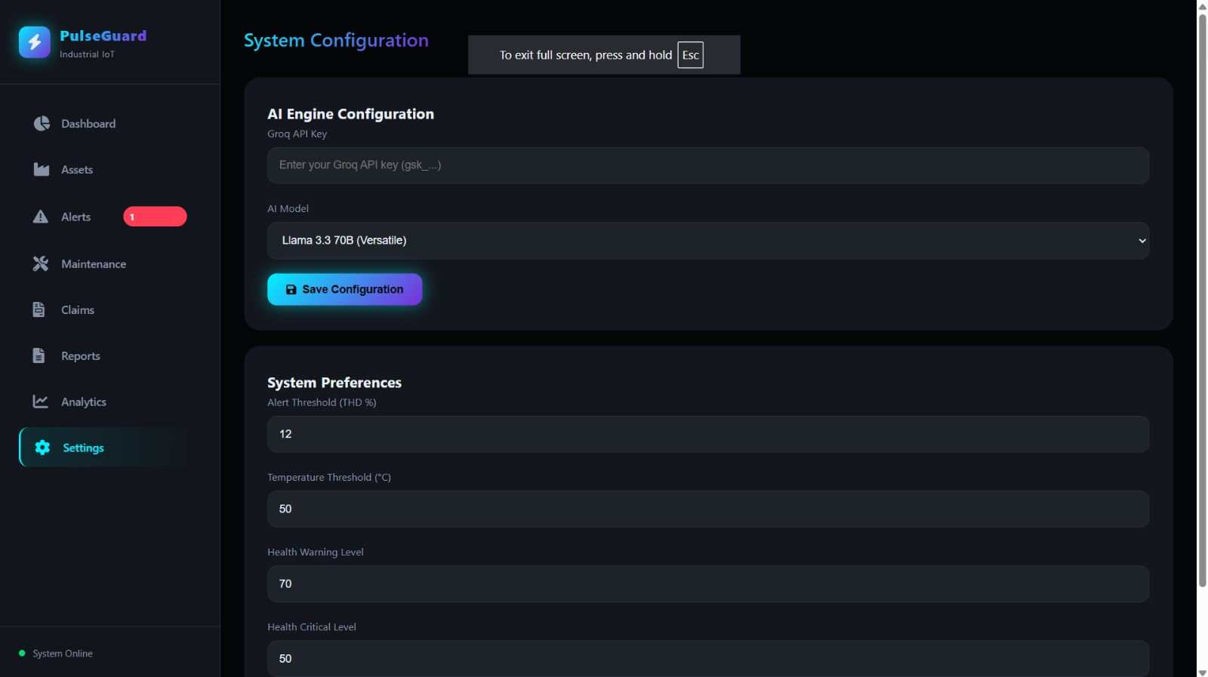
APPENDIX B
The System Configuration module enables secure AI engine setup and customizable operational thresholds. Users can configure the AI model, set alert limits for THD and temperature, and define health warning and critical levels. This flexibility allows industries to adapt monitoring parameters based on machine type, operational environment, and risk tolerance, ensuring accurate anomaly detection and reliable predictive insights.

Slide 14
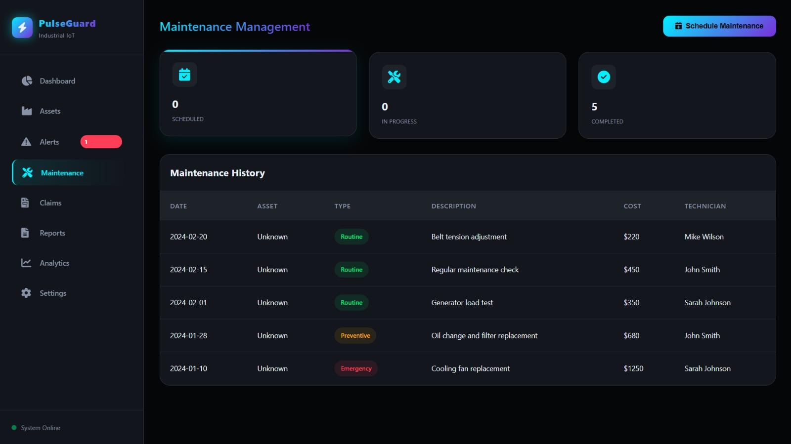
APPENDIX C
Use this slide for any extra content of your choice
The Maintenance Management module tracks scheduled, ongoing, and completed service activities across all industrial assets. It maintains a structured history of routine, preventive, and emergency repairs, including cost and technician details. By linking maintenance records with asset health data, the system enables informed planning, cost analysis, and proactive service scheduling to minimize unexpected breakdowns.

Slide 15
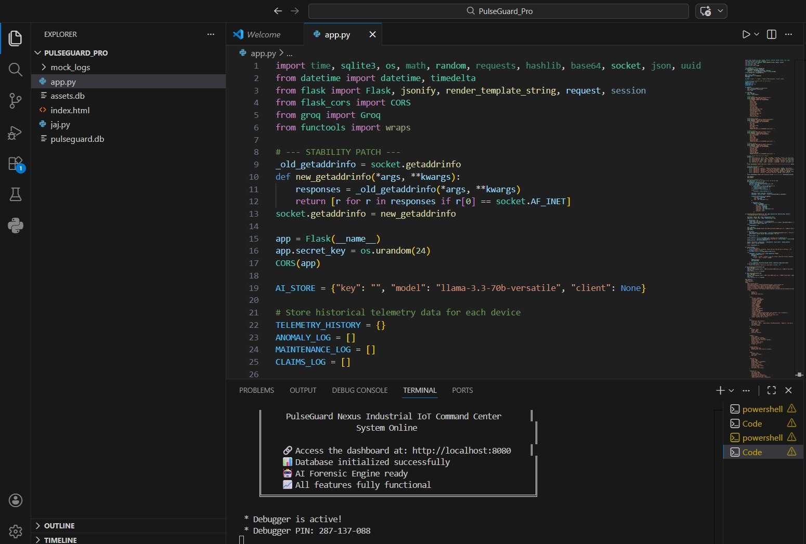
APPENDIX D

Slide 16
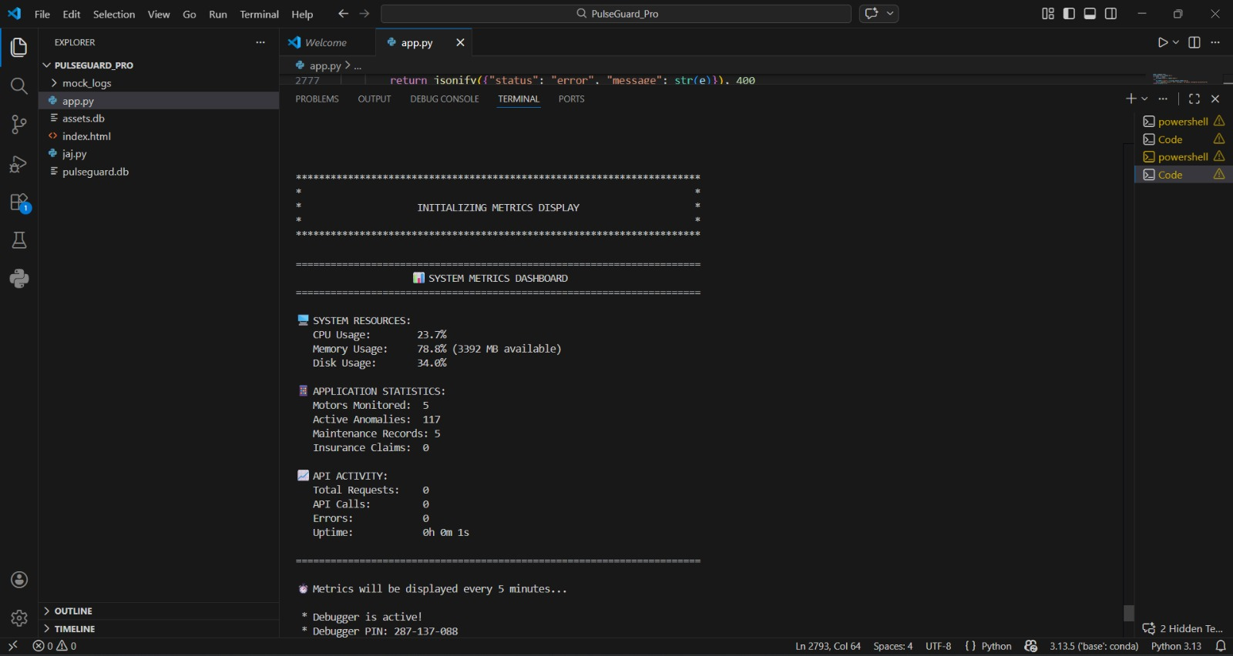
APPENDIX E

