Slide 1
KiranaAI Weekly Sales Analysis
2026-09-09 to 2026-09-15
Supermarket Operations Report

Slide 2
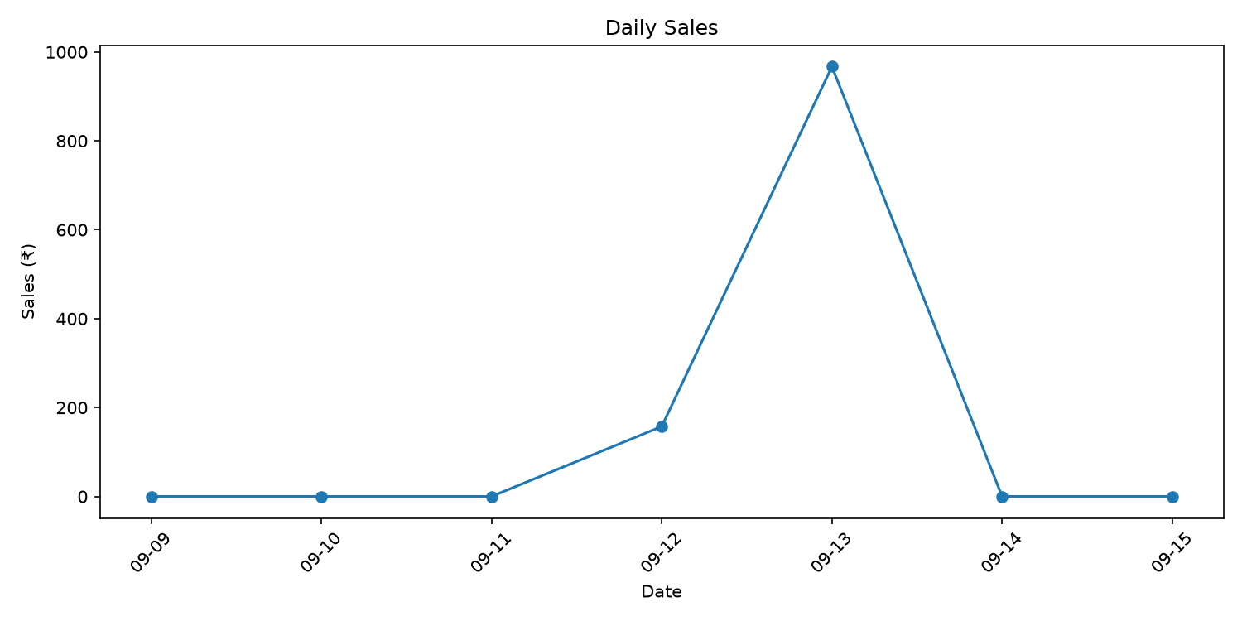
Sales Overview
Total Sales
₹1124.55
Bills
9
GST Collected
₹53.55
Products
8

Slide 3
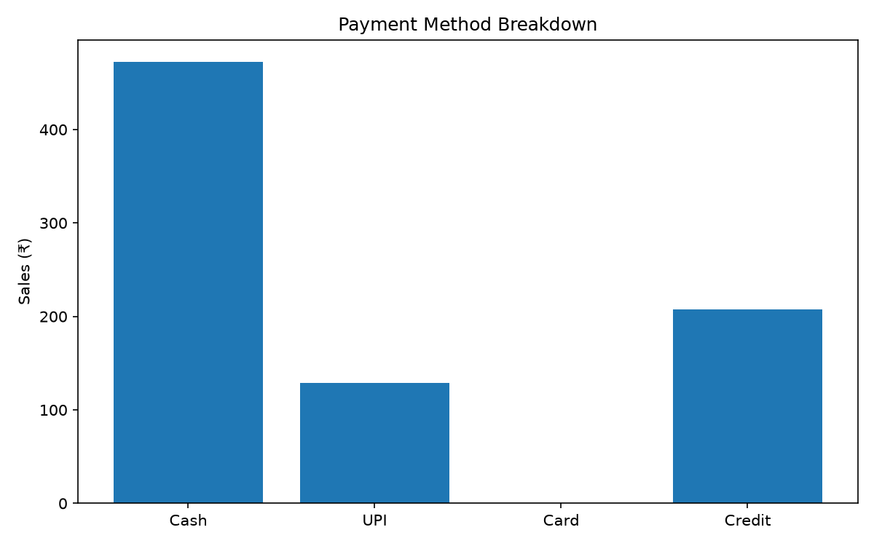
Payment Method Breakdown

Slide 4
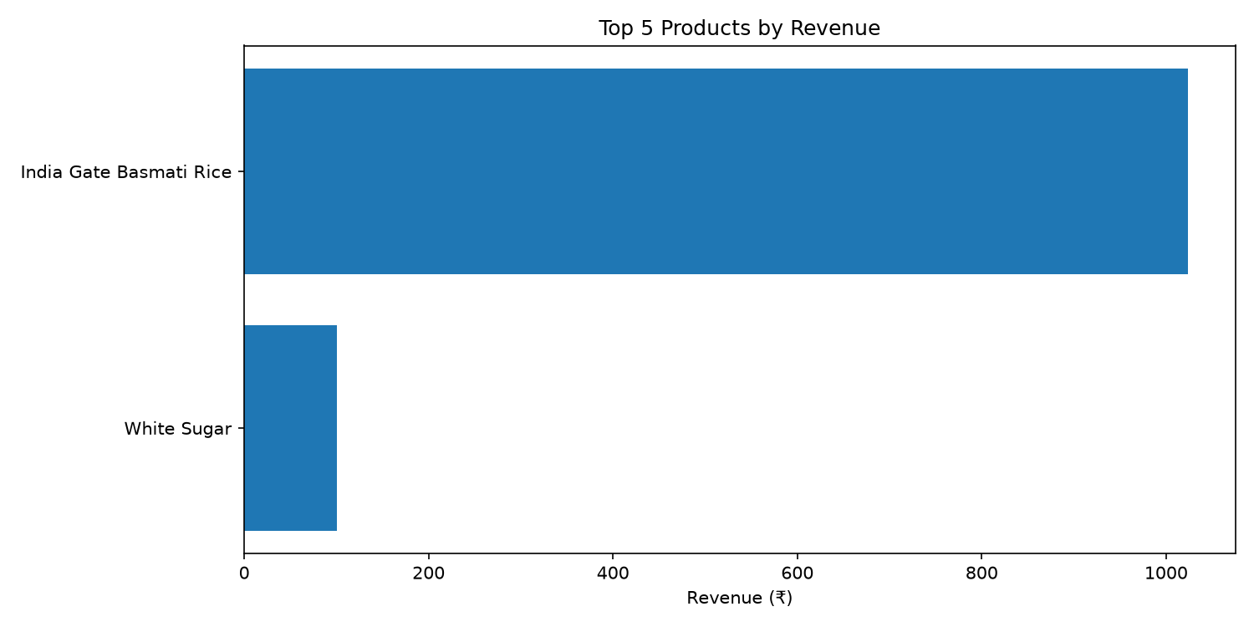
Top Selling Products

Slide 5
Inventory Health
Active Products
8
Low Stock Items
0
No products are currently below reorder level.

Slide 6
GST Collection
CGST
₹26.78
SGST
₹26.77
Total GST
₹53.55

Slide 7
Key Business Insights
• Cash was the largest payment mode with sales of ₹472.50.
• India Gate Basmati Rice generated the highest sales revenue at ₹1023.75.
• No products are currently at or below their reorder level.
• Total GST collected during the period was ₹53.55.

