Slide 1
Digital Portfolio
STUDENT NAME:Rithik Raja R
REGISTER NO AND NMID: 2426j1550/asbruaz2426j1550
DEPARTMENT: B.Sc information technology
COLLEGE: COLLEGE/ UNIVERSITY:KPR college of arts science and research /Bharathiyar University

Slide 2
PROJECT TITLE
PROJECT TITLE: Skill Showcase Dashboard

Slide 3


AGENDA
Problem Statement
Project Overview
End Users
Tools and Technologies
Portfolio design and Layout
Features and Functionality
Results and Screenshots
Conclusion
Github Link
3/21/2024 Annual Review

Slide 4

PROBLEM STATEMENT
Standard resumes and simple portfolios often fail to convey the true depth and proficiency of a developer's skills. Recruiters have to sift through numerous applications, and a static list of skills doesn't stand out. There is a need for a more organized, visually engaging, and professional way to present technical abilities that immediately demonstrates competence.

Slide 5

PROJECT OVERVIEW
This project is a modern, single-page web application that presents a professional portfolio in a dashboard-style format. It provides a clear and interactive overview of various technical skills, each with its own progress tracker. The dashboard allows for a deep dive into each skill by linking to relevant certifications, badges, and detailed project examples, creating a comprehensive and impressive digital resume.

Slide 6

WHO ARE THE END USERS?
Recruiters and Hiring Managers: To quickly assess a candidate's technical skills and experience.
Technical Leads and Team Managers: To evaluate a candidate's suitability for specific project requirements.
The Student (Yourself): As a dynamic and professional tool for personal branding and job applications.

Slide 7

TOOLS AND TECHNIQUES
HTML5: For the fundamental structure of the web page.
CSS3 & Tailwind CSS: For creating a responsive, modern, and professional design with a utility-first approach.
JavaScript: To power the interactivity, including the modal pop-ups, theme switching, and dynamic rendering of skill data.

Slide 8
PORTFOLIO DESIGN AND LAYOUT
The portfolio is designed as a clean, responsive grid-based dashboard.
Layout: A card-based layout where each card is dedicated to a specific skill.
Design: It features a modern and professional aesthetic with a consistent color scheme and typography.
User Experience: Includes a light/dark mode toggle for user comfort and a fully responsive design that adapts seamlessly to desktops, tablets, and mobile devices.
‹#›

Slide 9
FEATURES AND FUNCTIONALITY
Interactive Skill Trackers: Each skill is represented by an animated circular progress bar showing the level of proficiency.
Detailed Project Models: Clicking on a skill card opens a pop-up window (modal) that displays related projects, each with a description and a link.
Certifications and Badges: Each skill card has space to link to relevant certifications and badges to validate abilities.
Light/Dark Mode: A theme switcher allows users to toggle between a light and dark theme for optimal viewing.

Slide 10
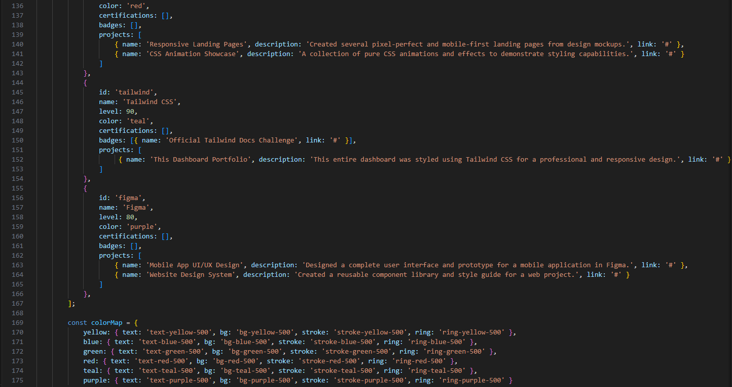
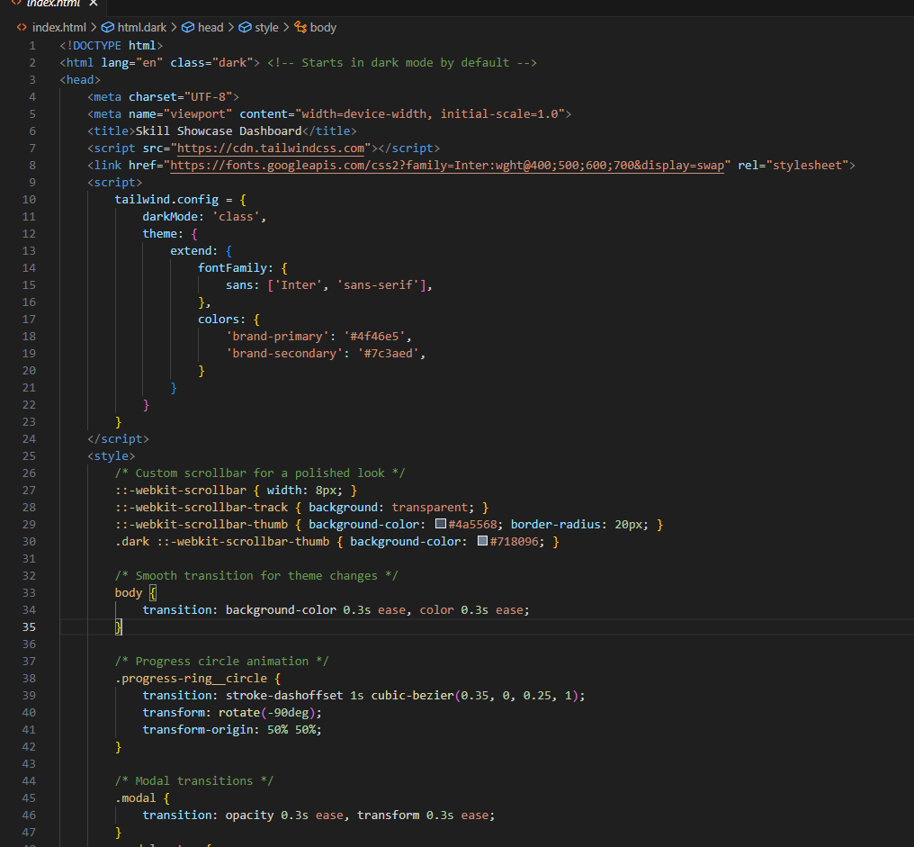
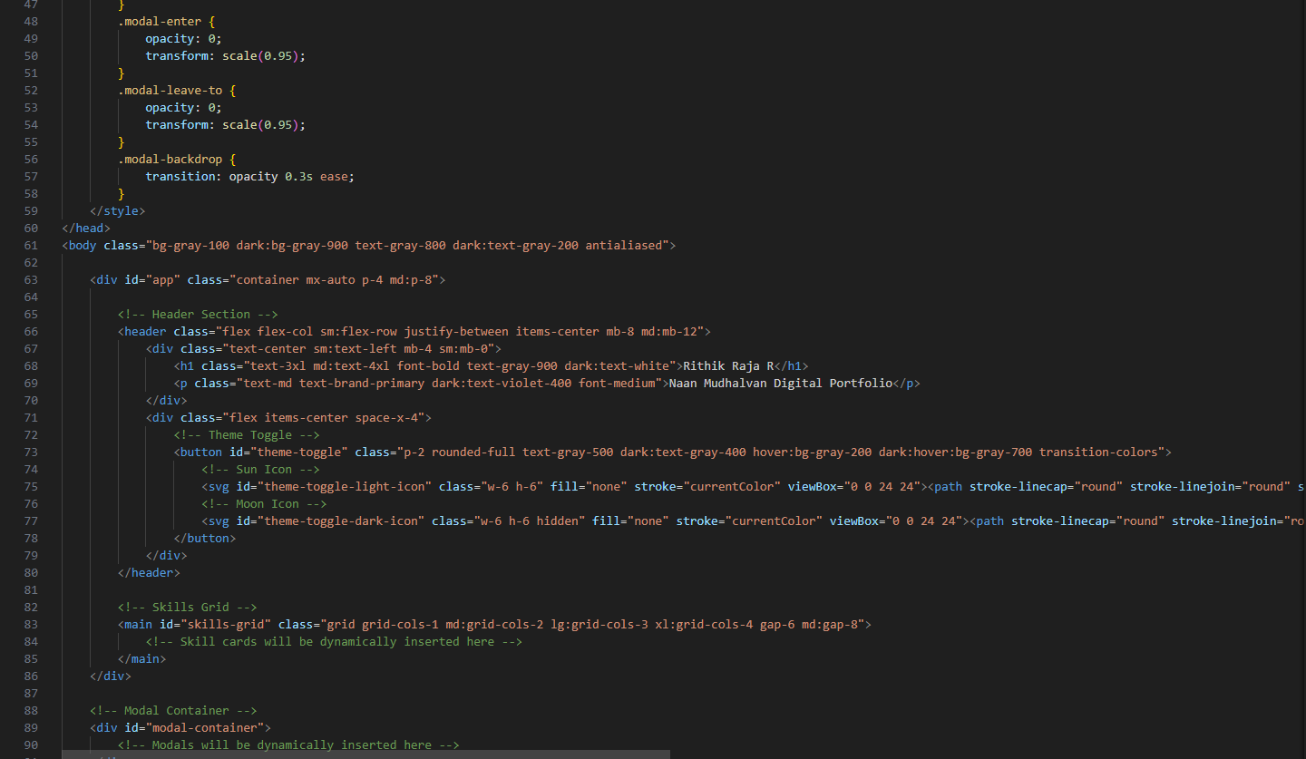
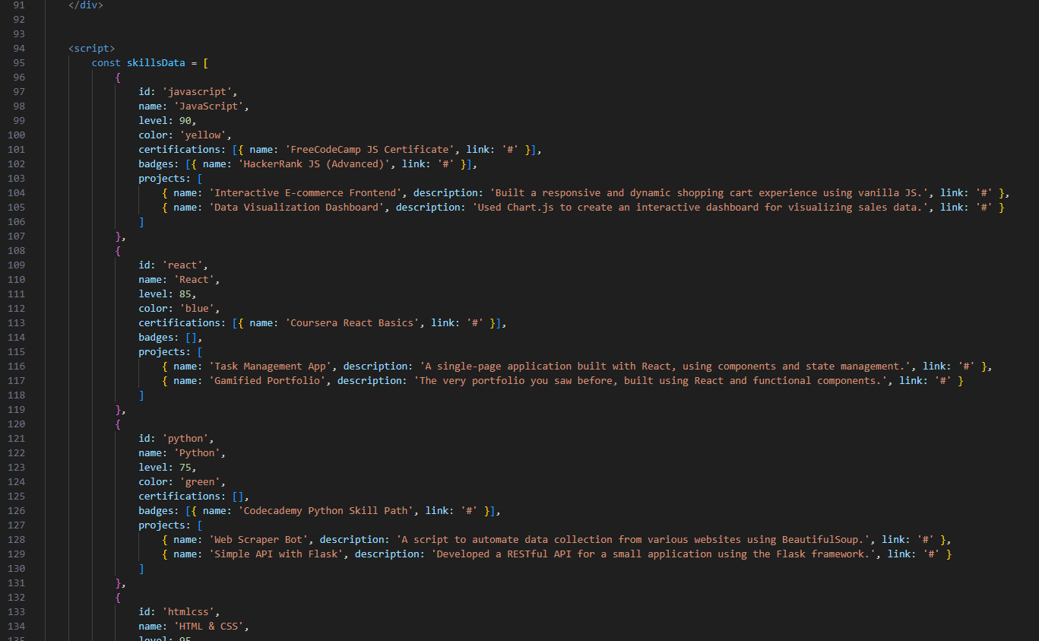
RESULTS AND SCREENSHOTS
3/21/2024 Annual Review
‹#›

Slide 11
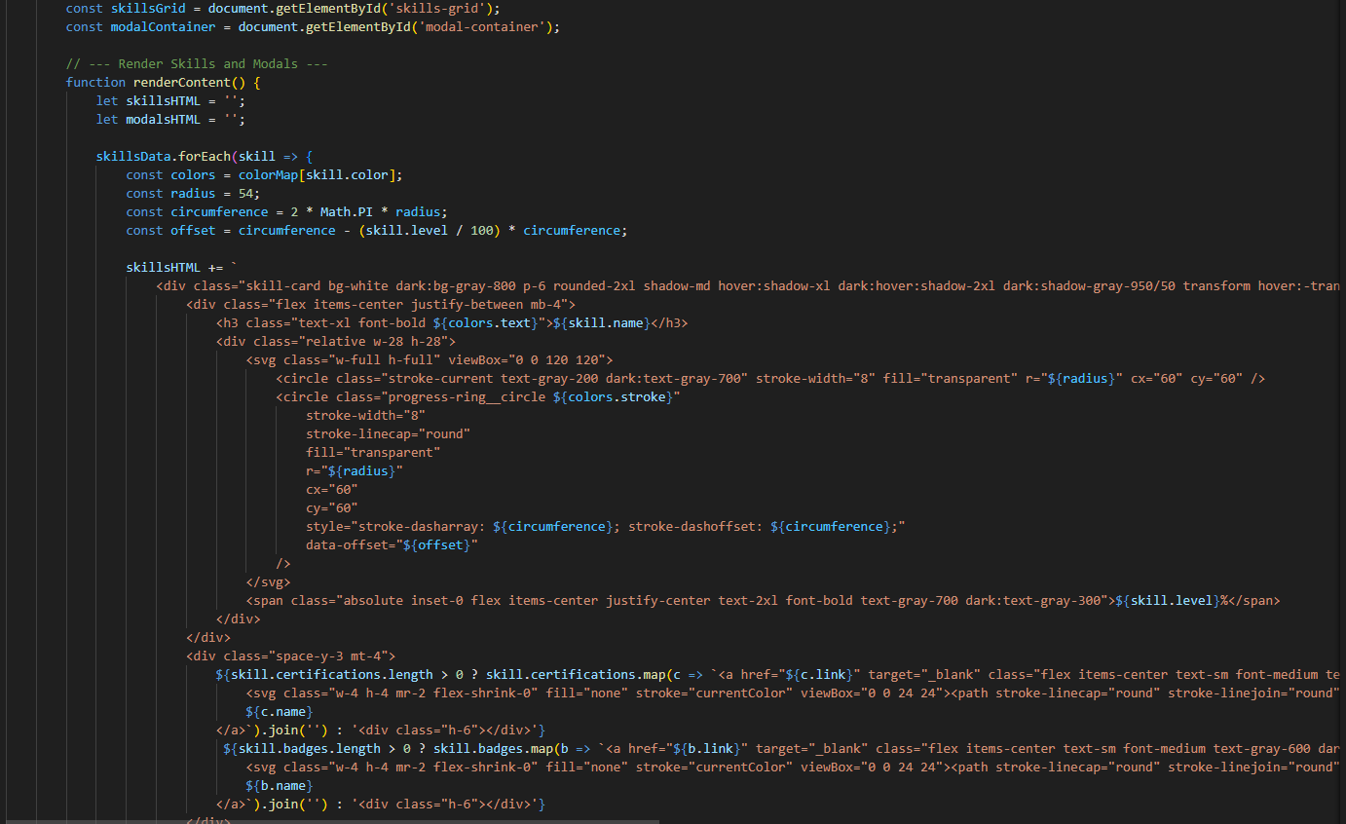
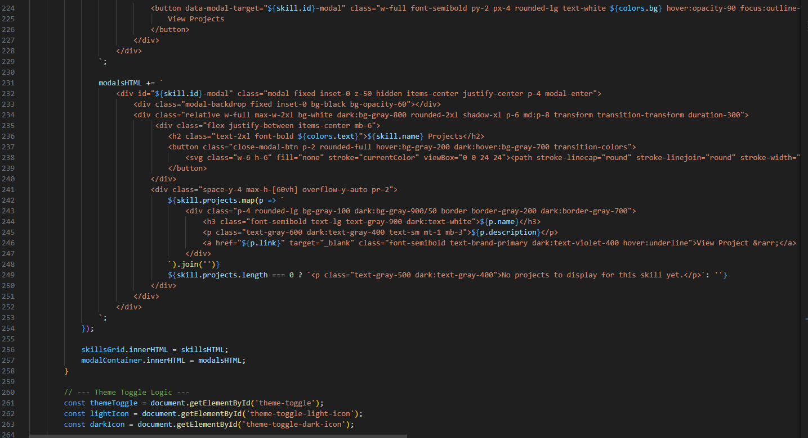
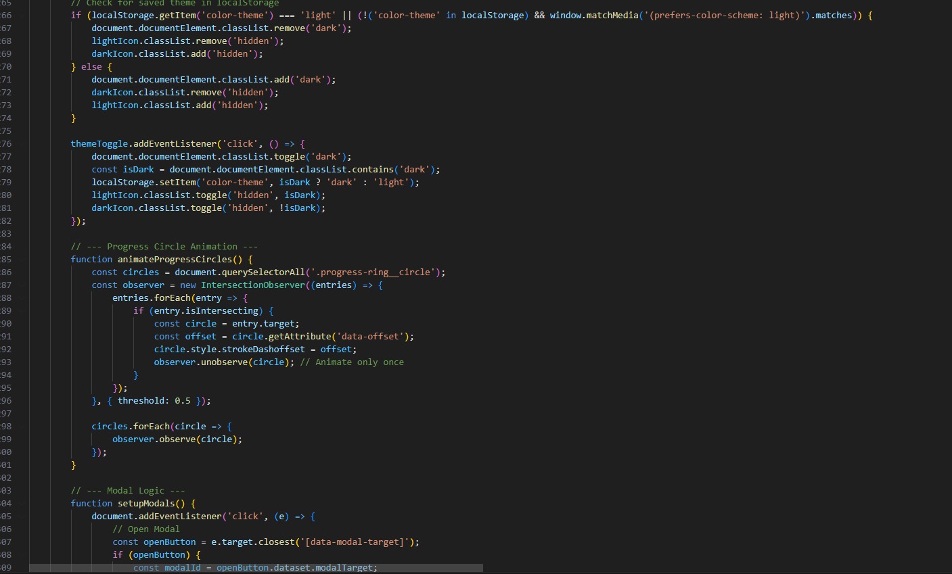
RESULTS AND SCREENSHOTS

Slide 12
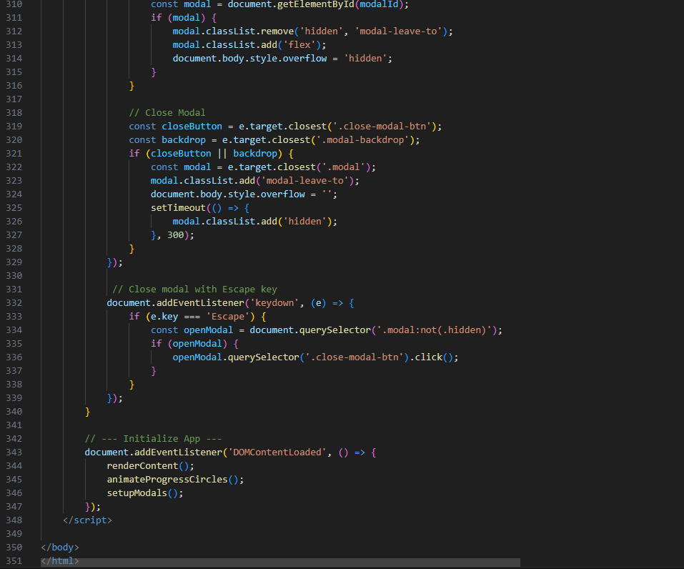
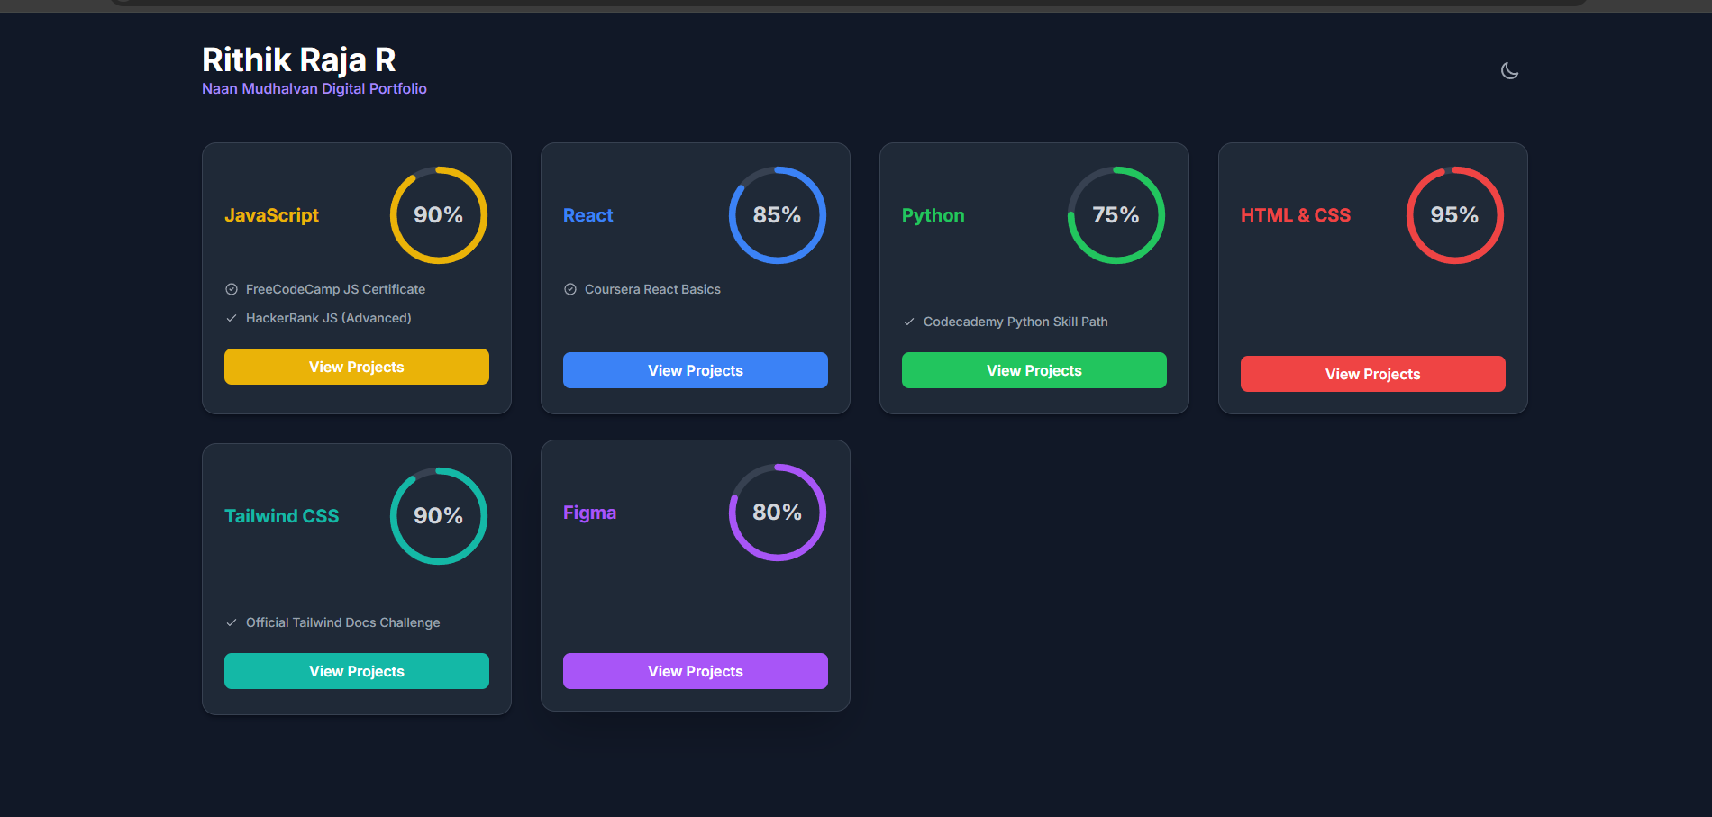
RESULTS AND SCREENSHOTS

Slide 13
CONCLUSION
The Skill Showcase Dashboard is a highly effective and modern alternative to traditional portfolios. By providing a clear, interactive, and visually appealing summary of technical abilities, it serves as a powerful tool for personal branding and helps make a strong impression on potential employers in the competitive tech industry.
‹#›

Slide 14
Github Link
https://rithikraja61-ctrl.github.io/index.html/

