Slide 1
Hochschule Rhein-Waal
University of Applied Sciences
Ambient Intelligent Systems
MQTT
Message Queuing Telemetry Transport
Group members
Rafay Ahmed, 32077
Rithik Kumar, 31522
Notes:
1

Slide 2
Agenda
Introduction to MQTT
History and Background
MQTT Specification
Features of MQTT
Core Elements
PubSub pattern
Role of components
Pros&Cons of PubSub
Client Broker Setup
Connect flow
Quality of Services
Topics
Sessions
Queued messages
Publish/Subscribe/Unsub
MQTT security
Class Activity
Message format
Protocol and communication
Packages and Libraries
Internet of Things
Class Activity
Client& Broker in IoT
Setup mosquito
MQTT Use Cases
Applications
Benefits of MQTT
Challenges
Conclusion
References

Slide 3
Introduction to MQTT
MQTT is a publish – subscribe protocol designed for connecting M2M devices.
It is now widely used in IoT (internet of things) applications.
It is a lightweight network protocol that transport messages between devices.
MQTT works in an event- driven manner allowing messages to be pushed to clients.
There is an architectural approach facilities highly scalable solution by separating data producers from data consumers, thereby removing dependencies between them.

Slide 4
History and Background
It was developed in 1999, Andy Stanford (IBM) and Arlen Nipper (Arcom) created MQTT for minimal battery loss and bandwidth usage in satellite connected oil pipelines.
However, the primary focus of the protocol is changed from propierty embedded systems to open IoT use cases.
IBM used it internally for initial 10 years then released MQTT 3.1 royalt-free in 2010.
IBM contributed in Eclipse Paho project by implementing MQTT client , enhancing community support.
From 2012-13 HiveMQ , developed and released the MQTT based software.
In 2014, it became an OASIS standard , by making it open and vendor neutral.
MQTT 5 was introduced in 2019 by OASIS which featured improved scalibilty and reliability in IoT applications.
Notes:
IBM : international business machines

Slide 5
MQTT Specifications
MQTT has evolved with the passage of time and now we have version MQTT 5.
This updated version introduces range of improvements, especially in IoT world.
Earlier we had MQTT 3.1.1, but this upgraded version has much to offer in terms of,
Better error handling
Integration
Acknwledgements
An much more

Slide 6
Features of MQTT
Lightweight message queuing and transport protocol
Asynchronous communication model with messages(events)
Low overhead (2 bytes header) for low network bandwidth applications
Publish/Subscribe model also called PubSub
Runs on TCP, connection oriented transport
Decoupling of data producer (publisher) and data consumer(subscriber) through topics (message queues)

Slide 7
Features of MQTT
Binary , extremely important because binary base protocols are best suitable for machines.
Bi-directional, from cloud to device and visa versa after connection is established
Data-agnostic, no bounding of file format. Whatever file you sent is acceptable.
Scaleable,
Built for push communication, as soon as data is sent to cloud , data is forwarded to the user
Suitable for constraint devices, Storage problem is encountered through libraries

Slide 8
Core Elements
Publish – Subscribe
Client and Server
Topic
Quality of Service QoS
Session

Slide 9
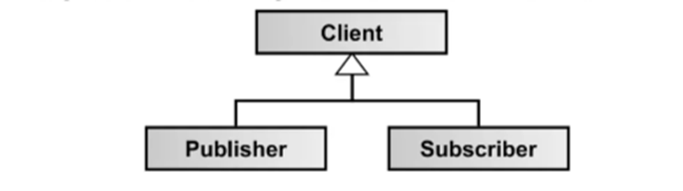
Publish/Subscribe pattern
PubSub is a fundamental pattern MQTT uses to implement protocol.
There are atleast three components;
MQTT Clients (publisher)
MQTT Broker
MQTT Clients (subscriber)
Broker is the heart of the pattern, as it is responsible for all the data handling.
Publishers can also be subscriber and visa versa, (Bi-directional)
Pro & cons of PubSub pattern is discussed later.

Slide 10
Roles of Components (1/2)
Broker : It is responsible for receiving messages, filtering messages, determining the subscribers and then pushing the messages to appropriate subscriber.
Client : Client can either act as a publisher or a subscriber and can be both.
Publisher : It has to connect to MQTT broker using a unique client identifier, send messages to the broker on specific topics, set QoS level.
Subscriber : Establish connection with broker using specific identifier, Subscribe to topic, receive messages, set QoS level.
Thus publisher and subscriber are special roles of a client.
Topics : Technically, topics are messages queues. Topics support the PubSub pattern for clients. Logically, topics allow clients to exchange information with defined semantics for eg, temperature sensor data of a room.

Slide 11
Roles of Components (2/2)
Session : A session identifies an attachment of a client to a server (temporary or permanent).
All communication between client and server takes place as part of a session.
Subscription : Unlike sessions, a subscription logically attaches a client to a topic. When Subscribed to a topic, client can exchange messages with a topic.
Messages : They are the units of data exchange between topic clients.

Slide 12
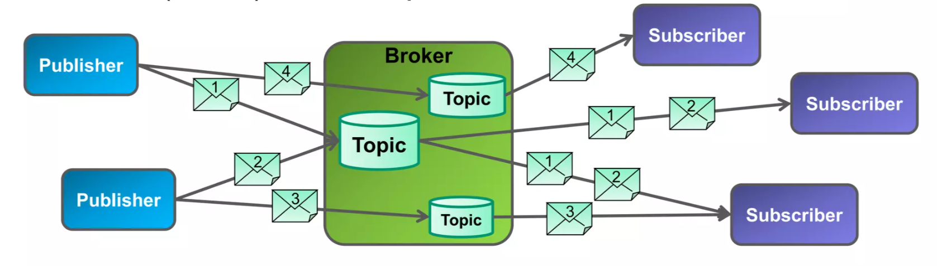
How PubSub works

Slide 13
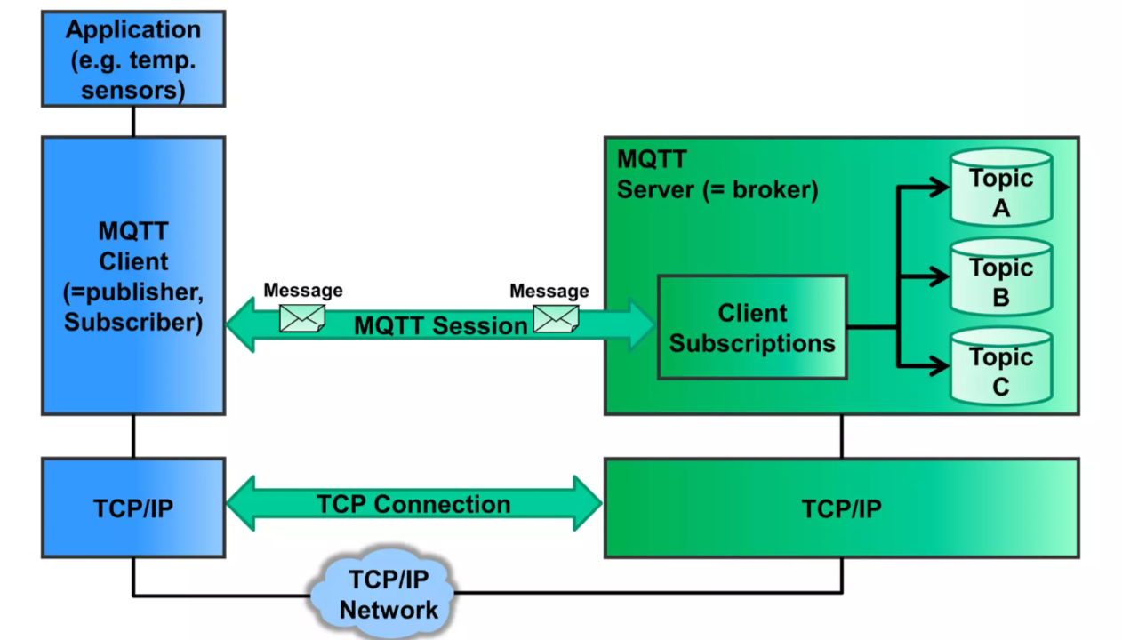
Model

Slide 14
Pros & Cons of PubSub approach
Scalability : PubSub scales better than the traditional client/server approach.
Event-Driven Architecture : Components react to events or messages as thy occur.
Security : broker can implement access control for publishing
Single point of failure : failure of broker may result in failure of architecture. In this case, Broker cluster could be more effective.
Overhead broker : managing large number of subscribers, can impose overhead on the broker.

Slide 15





Client Broker Setup
MQTT application or client, it can be implemented by using client libraries, for eg ; EclipsePaho, Java, python and so on.
For MQTT broker, there are open ecosystem, for eg; Mosquitto, HiveMQ community version.

Slide 16
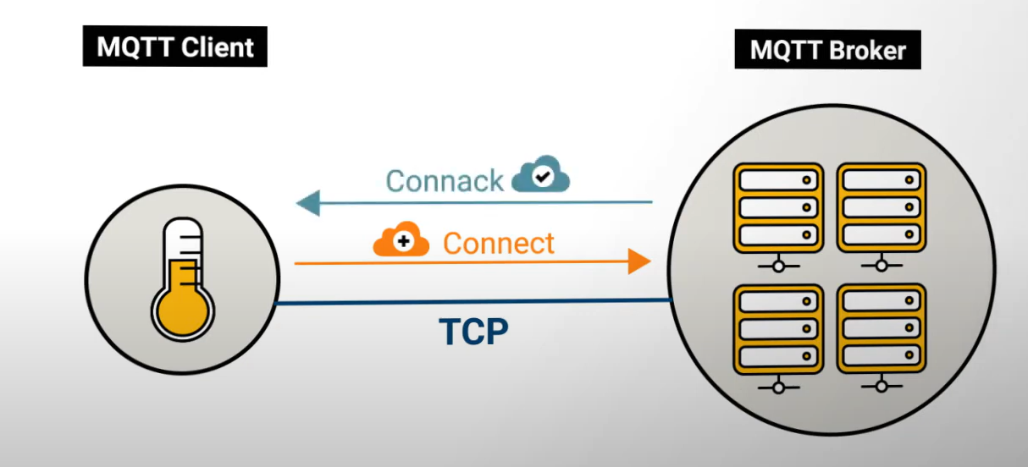
Connect Flow
Client bulits TCP connection with broker, TLS can also be used if security is enabled.
Then MQTT connect flow starts , MQTT client will send the Connect packet to the broker.
Client receives ConnAck packet after broker authenticates the client.

Slide 17
Properties of Connect flow
Connect packet Properties : It consist of ClientID(unique), username, password, lastwilltopic, lastwillQoS, lastwillmessage, lastwillretain, keepalive, cleanSession (forgetting celient).
All other properties are optional broker does not need it to establish connection
ConnAck packet Properties : It contains returnCode, sessionPresent.
ConnAck packet basically tells user that is it allowed to connect or not. ReturnCode tells the reason in case something went wrong.

Slide 18
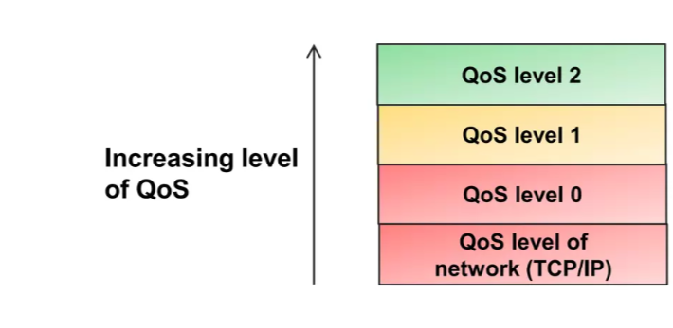
Quality of Service QoS
MQTT provides the typical delivery QoS levels of message oriented middleware.
Eventhough TCP/IP provides guaranteed data delivery, data loss can still occur if a TCP connection breaks down and messages in transit are lost.
Therefore, MQTT adds three more QoS levels on top of TCP.

Slide 19
Quality of Service Level 0
At most once delivery, minimal guarantee. Fire and forget concept
Messages are delivered according to the delivery guarantees of the underlying network.
Sender does not store message for redelivery
Also has the least overhead in comparison
It is recommened when messaage queuing is not required
When message loss is acceptable

Slide 20
QoS level 1
A least once delivery
Messages are guaranteed to arrive, but there may be duplicates
Sender stores the message until it gets PUBACK
PUBLISH and PUBACK associated by packetId.
Used usually as a default
Example : A door senses the door state. It is important that door state changes (closed >> open , open >> closed) are publishes losslessly to subscribers. Applications simply discard duplicate messages by evaluating the message ID field.

Slide 21
QoS level 2
Exactly once delivery
QoS-2 is the highest level that also incurs most overhead in terms of control messages and the need for locally storing the meassages.
Exactly once is a combination of at least once and at most once delivery guarantee.
Client sends Publish QoS-2, receives PUBREC, sends PUBREL, and gets PUBCOMP.
Example : Applications where duplicate events could lead to incorrect actions; e.g. sounding an alarm as a reaction to an event received by a message.

Slide 22
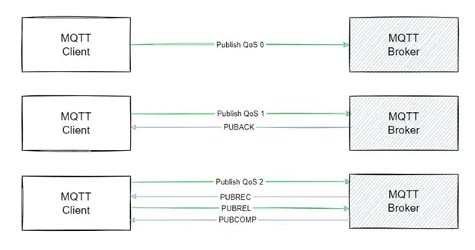
QoS levels

Slide 23
MQTT QoS levels
QoS levels are defined when creating a connection by the client.
QoS downgrade is possible in the case if subscribing client has lower QoS then publishing client.
With the increasing level of quality, bandwidth decreases do QoS 0 has the premium bandwidth while QoS 2 has the lowest.
And so the performance decreases

Slide 24
Topics in MQTT
The broker uses topics to filter messages for each subscriber
It consists of one or more levels
Each topic is separated by forward slash for eg;
building/floor1/sensors/temperature .
Myhome/groundfloor/livingroom
Topics are hierarchial
Wildcards play vital role here. nextslide

Slide 25
Topic Wildcards
As MQTT is a PubSub approach, so subcribers can often be interested in more than one topic.
So the solution for the point above is wildcard characters, ‘+’ and ‘#’
‘+’ is a single level means matches only one topic, example : building/floor1/+ .
‘#’ is a multi level wildcard, matches multiple levels, example : building/floor1/# .

Slide 26
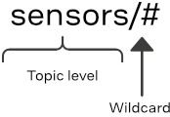
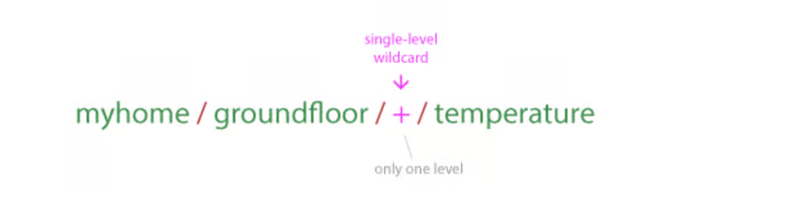
Topic WildCards
Subscribers can subscribe to multiple topics simultaneously using topic wildcards.

Slide 27
Examples of Wildcards
As ‘+’ wildcard matches exactly one topic level, so which topic matches this ‘Home/+/temperature’.
Home/livingroom/temperature
Home/kitchen/temperature
Home/garage/humidty
Home/bedroom/temperature
As ‘#’ matches any number of level including zero, which topic matches this ‘Home/+/temperature/#’.
Home/livingroom/temperature
Home/livingroom/temperature/current
Home/kitchen/temperature
Home/kitchen/temperature/current
Home/bedroom/humidity

Slide 28
Sessions
MQTT follows persistent session & clean sessions.
In persistent sessions, stores all relevant information of a client, this results in resubscription on reconnection.
Messages are retained by broker even if the client is offline.
This is set when connecting to broker. In clean session flag to false.
In clean Session, client information is no longer available to broker as soon as client disconnects.
Session data includes ; ClientID, Subscription, Unacknowledge QoS messages.

Slide 29
Queued Messages
Messages are queuing per client.
Broker queues all QoS 1-2 messages when a persistent session client is offline
In this case, client receives data later when gets online.
QoS 0 does not guarantee queued messaging.
Retained Messages : used at the publishing end, to send when a new subscriber has subscribed.
Usually, used when to send a start value to new subscriber.
Only one retained message is stored per topic.

Slide 30
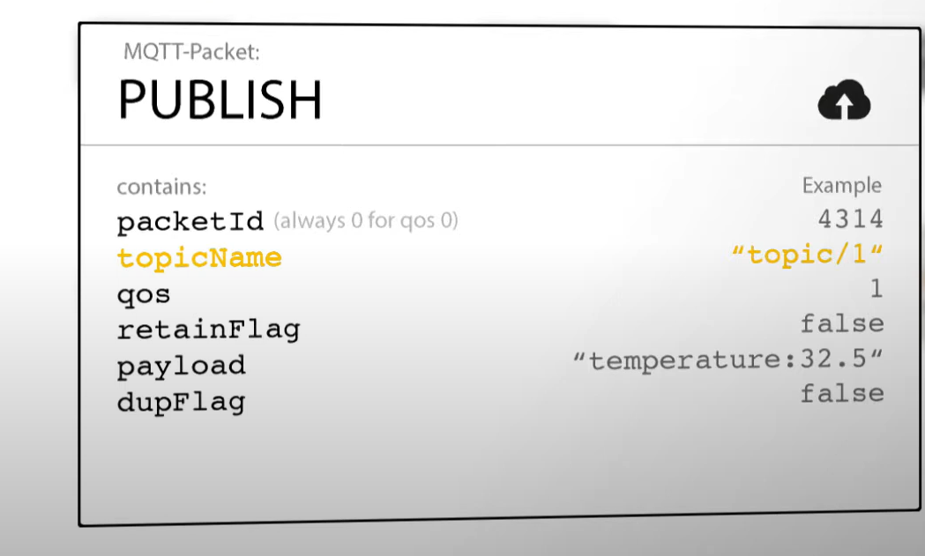
Publish/ Subscribe/ Unsubscribe
The most key operation MQTT has to offer.
As soon as the client has established it’s connection with broker, it can start sending packets. Subscribing client sends publish packet, this has essential information that broker needs for eg ;
The important is payload here as it
contain main file.
This packet will then forward to subs.

Slide 31
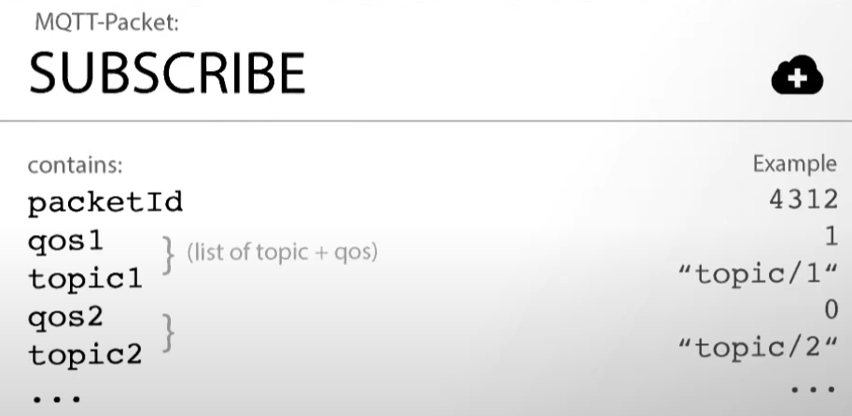
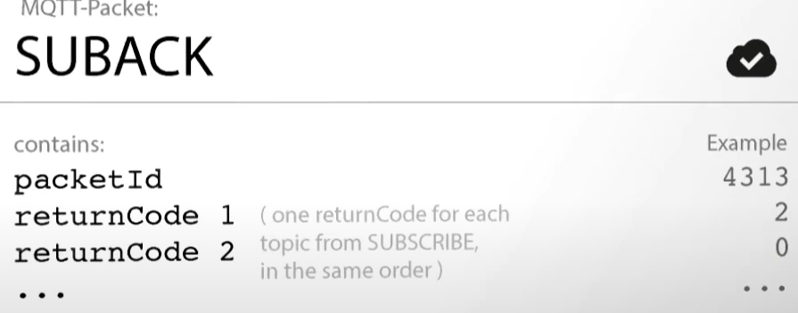
Publish/ Subscribe/ Unsubscribe
When client wants to receive a data, it sends Subscribe packet to the broker. And server sends Suback packet when subscription is granted.
This message can contain multiple subscription in single packet.

Slide 32
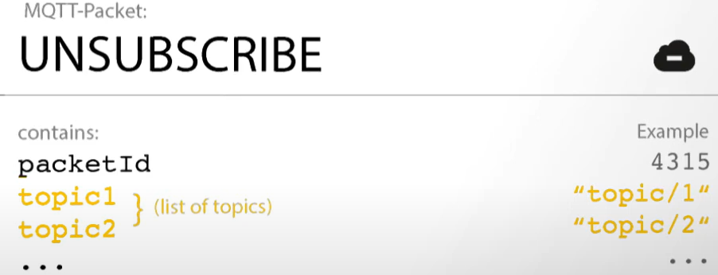
Publish/ Subscribe/ Unsubscribe
Lastly, unsubscribe packet, is used when client do not want to receive message from broker anymore. And then broker acknowledges it with UnsubAck.
Topics can be chosen which needs to be unsubscribed.

Slide 33
MQTT Security
Authentication : It supports client authentication, crucial for the identity of the client connecting to broker. It is done by username and password.
Authorization : MQTT allows for the authorization oof the clients, to specify what resources client can access and what can it perform.
TLS : Transport layer Security, is used at transport layer. Ensure the encryption of data between client and broker, Safeguardding.
Payload Encryption : Apart from TLS, MQTT payload messages can also be encrypted, providing an additional layer of security.

Slide 34
Class Activity
Which of the following statements about MQTT topics is true?a) MQTT topics are case-insensitive.
b) MQTT topics have a maximum length of 1024 bytes.
c) MQTT topics are hierarchical and case-sensitive.
d) MQTT topics cannot include slashes (/).
What does a clean session in MQTT indicate?a) The client will retain all messages after disconnecting.
b) The broker will store the client's state after disconnection.
c) The client does not save any state information after disconnection.
d) The broker will retain the client's subscription even after disconnecting
Which QoS level ensures a message is delivered at least once?
a) QoS 0
b) QoS 1
c) QoS 2
d) QoS 3

Slide 35
Which message type is used to unsubscribe from a topic in MQTT?
a) PUBLISH
b) SUBSCRIBE
c) UNSUBSCRIBE
d) CONNECT
What is the main purpose of using username and password in MQTT?
a) To establish a topic hierarchy.
b) To authenticate clients.
c) To encrypt messages.
d) To manage QoS levels.
Which part of an MQTT message contains the actual data being transmitted?
a) Fixed Header
b) Variable Header
c) Payload
d) Control Packet

Slide 36
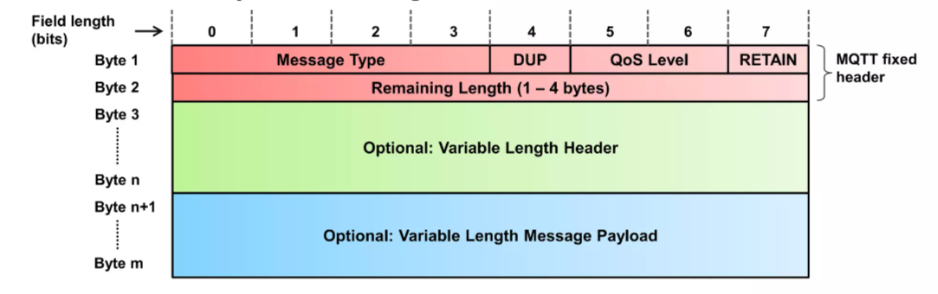
Message Format in MQTT
MQTT messages contain a mandatory fixed length header 2 bytes and an optional message specific variable length header and message payload.
Optional field usually complicate protocol processing to optimize bandwidth so optional fields are use for that.
MQTT uses network byte and bit ordering

Slide 37
Message format
For every message, there is different message format.
For CONNECT message format, it contains session related information as optional header fields.
CONNACK message format contains returncode, bytes , reserved
So in short, message format differs depending on the broker, client and information.

Slide 38
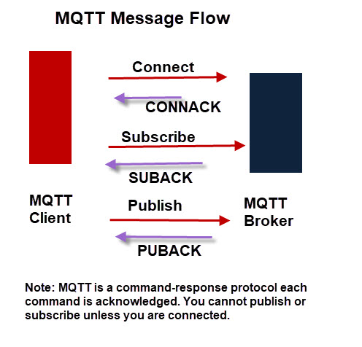
MQTT Protocol and Communication
CONNECT
CONNACK
PUBLISH
PUBACK, PUBREC, PUBREL, PUBCOMP
SUBSCRIBE
SUBACK
UNSUBSCRIBE
UNSUBACK
PINGREQ, PINGRESP
DISCONNECT

Slide 39
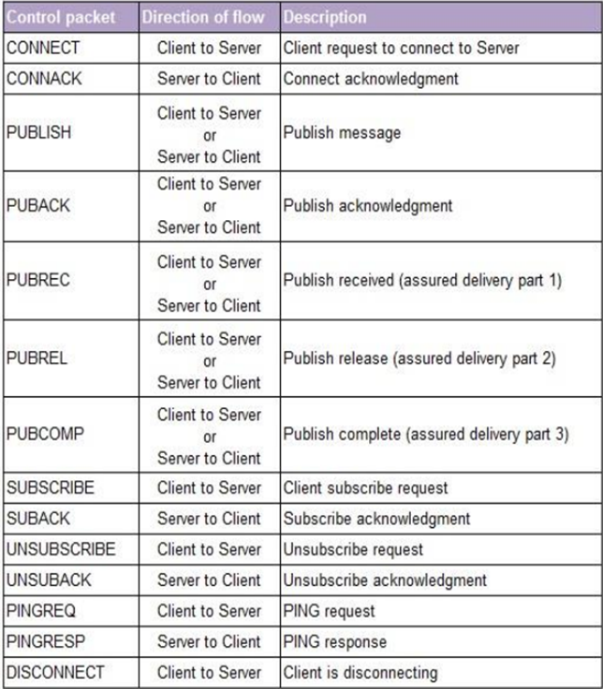
Exchange of Messages
These are the control packets exchange between server and client when connecting, subscribing etc.
Server always send
acknowledgment message back to client.

Slide 40
MQTT Packages in PL
As mentioned earlier, implementation can be done using java, python libraries mosquitto etc.
Programming languages use MQTT libraries in different environments here are some ;
Python :
Paho-MQTT, client library from Eclipse Paho project
“pip install paho-mqtt”
C# :
.net library for MQTT
“dotnet add package MQTTnet”
All repostitories link are available on GitHub for implementing MQTT libraries, packages

Slide 41
MQTT packages in PL
MQTT can also be implemented with electronic boards like Arduino, Rasberry Pi.
For both you need MQTT broker which could be mosquito, HiveMQ.
Implementing with Arduino requires Arduino board, Wifi library.
Rasberry Pi operating System

Slide 42
Internet of Things, IoT
A world where physical objects are seamlessly integrated into the information network and can become active participants in business process.
Services are available to interact with these Smart objects over the internet, query their state and any information associated with them.
MQTT is just very small but essential part of internet of things.
As MQTT is very lightweight broker based so it can be use in sensors, mobile, and IoT.

Slide 43
Class Activity:
Which part of an MQTT message contains control information essential for the message?
a) Payload
b) Fixed Header
c) Variable Header
d) Packet Identifier
In an MQTT PUBLISH message, what does the 'QoS' field in the fixed header signify?
a) Quality of Service level
b) Message Type
c) Topic Name
d) Connection Status
Which transport protocol is typically used by MQTT for communication?
a) HTTP
b) TCP
c) FTP
d) UDP

Slide 44
What is the primary function of the MQTT CONNECT message?
a) To publish a message to a topic
b) To establish a connection between the client and broker
c) To subscribe to a topic
d) To disconnect the client from the broker
Which of the following is a Java-based MQTT client library?
a) Paho
b) Mosquitto
c) HiveMQ
d) RabbitMQ
In the context of IoT, what role does MQTT play?a) It is a data storage system for IoT devices.
b) It is a communication protocol for lightweight, low-power devices.
c) It provides security services for IoT networks.
d) It is a hardware platform for IoT devices.

Slide 45
MQTT clients & Brokers in IoT
Eclipse Paho : Paho java client, it is a java-based MQTT client library, designed for applications on JVM , it also supports languages like C++, JavaScript.
Mosquitto Eclipse : Mosquitto is an open-source MQTT broker ánd is suitable for range of devices, available for linux, Mac, Windows & Rasberry Pi.
HiveMQ MQTT : commercial broker that enables client to client communication. It can be deployed on docker, kubernates, Azure, AWS.
RabbitMQ MQTT : Open source message broker that support many protocols including MQTT. But allows connectivity through plugins.

Slide 46
Easy Setup of Mosquitto
Install Mosquitto https://mosquitto.org/download/
Run it on your System and in services start it.
On cmd change directory to mosquito > netstat –a , default port of MQTT is 1883.
Now you can Publish and Subscribe messages on cmd,
Mosquitto_sub –t test_sensor_data –h localhost, (topic : test_sensor_data, and this will wait for the publisher to publisher to send message).
Mosquitto_pub –t test_sensor_data –h localhost –m “temp:35”, (topic : test_sensor_data, publisher has publish the message).

Slide 47
Use cases
MQTT is now being used in various fields including:
Automotive : BMW is using it for car sharing products for fleet operators.
Smart home : MQTT provides , good connectivity, scalabilty, Security in smart home projects.
Transportation : DB railway is also implementing IoT to enhance their operations and optimizimg it using M2M systems with IoT.
Energy : Celikler holding is a largest industrical companies from Turkey, they are bringing more innovations in energy sector with the help of MQTT .
And many other

Slide 48
Applications of MQTT
Remote Sensing : refers to the use of technology to gather sensors used to monitor remote settings.
Smart cities : Smart city apps like healthcare, buildings, smart homes all needs the use of standard telecommunication protocols.
Social media platforms : Allow apps to function on different internet connectivity around the globe. Chats are coupled with MQTT topic.
Home automation : MQTT app connects all the home devices, which saves energy, enables security, cost saving.

Slide 49
MQTT-S
MQTT-S is an extension of MQTT for WSNs (Wireless Sensor networks).
They do not have TCP/IP as transport layer, rather they have their own protocol stack.
It is aimed at constrained low end devices, usually running on batteries.
It is overall based on MQTT but some features are different, for example; Topic String, Predefined topic IDs, Offline keepalive supporting sleeping client.

Slide 50
Benefits of MQTT
Resource-Efficient and Leightweight : MQTT optimizes resource usage for clients and conserves network bandwidth.
Two-Way Communication : MQTT enables devices and servers to exchange data through publishing and subscribing, with the ability to broadcast messages to multiple devices.
Enhanced Security : MQTT includes TLS encryption for secure message transmission and authentication mechanis to verify clients.
Persistent connections : MQTT maintains persistent connections between devices and servers minimizing reconnections time in unstable network conditions.
Varied Quality of Service QoS levels : MQTT offers multiple Qos options to ensure dependable message transmission.

Slide 51
Challenges of MQTT
Limited support for large payloads
Scalability issues in high-throughput scenarios
Dependence on a central broker, it is generally a problem with PubSub approach.
Handling offline devices
Topic management

Slide 52
Conclusion
So, MQTT plays a key role in the modern communication, particularly in IoT and low-bandwidth environments.
It does not only addresses the challenges of diverse network conditions but also supports the efficient operation of constrained devices.
MQTT will continue to drive innivations, model smart facilitation and more responsive system that can work efficiently in different industries and applications.

Slide 53
References
http://www.steves-internet-guide.com/mqtt/
https://www.hivemq.com/blog/mqtt-essentials-part-1-introducing-mqtt/
https://www.slideshare.net/slideshow/introduction-mqtt-en/32794443#2
https://www.slideshare.net/slideshow/mq-telemetry-transport/25668863
https://chatgpt.com/share/20108524-a0e8-4df7-8e0c-a9d873eab2c3
https://www.emqx.com/en/blog/mqtt-5-introduction-to-publish-subscribe-model
https://www.hivemq.com/blog/mqtt-essentials-part-7-persistent-session-queuing-messages/#heading-what-are-persistent-sessions
https://iot.eclipse.org/community/resources/case-studies/pdf/Eclipse%20IoT%20Success%20Story%20-%20DB.pdf
https://www.cavliwireless.com/blog/nerdiest-of-things/what-is-the-mqtt-protocol.html
https://www.spiceworks.com/tech/iot/articles/what-is-mqtt/#_004
https://eclipse.dev/paho/index.php?page=downloads.ph (eclipse paho)

