Slide 1
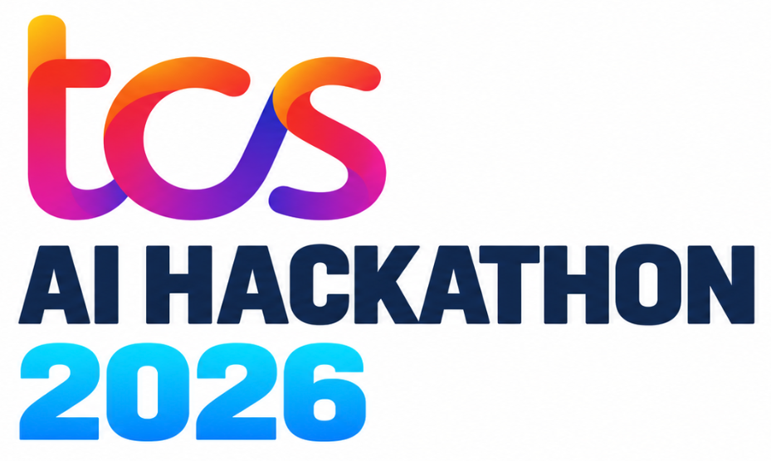


TCS AI HACKATHON 2026
Problem Statement ID – 10
Problem Statement Title – Ai Systems that reason across enterprise information and coordinate measurable business decisions
Theme – AI For Business
Domain – Retail / CPG
Team ID - Bannari_04
Team Name – TEAM NO SLEEP

Slide 2
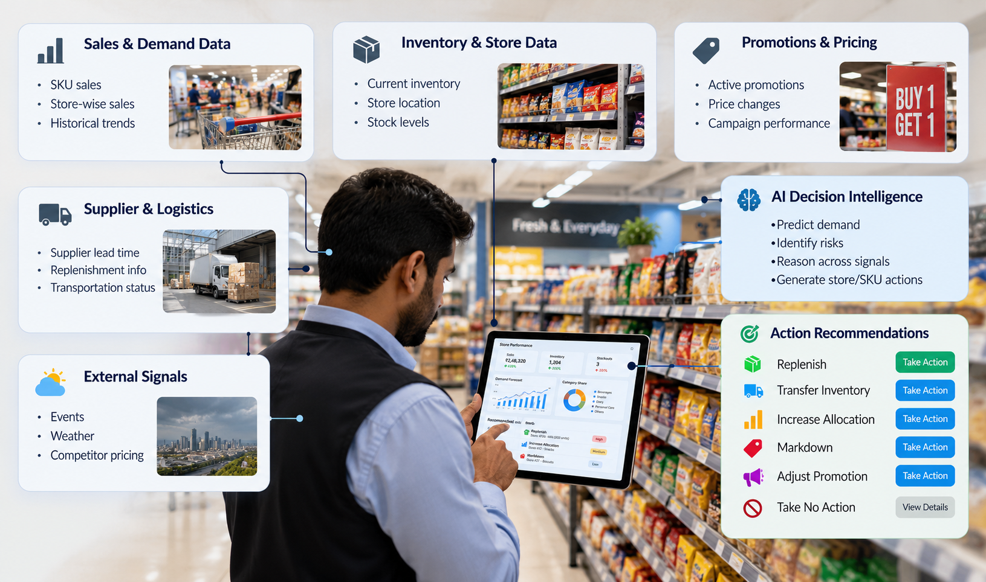
PROPOSED SOLUTION
OUR SOLUTION
PROTOTYPE
A centralized retail intelligence platform uses AI-powered forecasting, enterprise reasoning, and coordinated recommendations to optimize store-level business decisions across retail channels.
Enables intelligent demand forecasting across SKUs, stores, channels, markets, and daily operations.
Supports inventory optimization, promotion analysis, supplier insights, and risk detection for faster decisions.
Creates actionable recommendations for replenishment, transfers, markdowns, and allocation adjustments with measurable impact.
NOVELTY
AI-driven decision intelligence combines sales, inventory, pricing, promotions, and supplier signals for coordinated retail actions.
Predictive risk analysis identifies stockouts, excess inventory, demand shifts, and service-level issues early.
Agentic recommendations select replenishment, transfers, markdowns, or promotion changes based on expected operational outcomes and constraints.
EXPECTED BUSINESS IMPACTS
Reduce Stock Risks
Minimize Excess Inventory
Improve Product Availability
Increase Revenue Margins
Optimize Replenishments Stocks
Improve Decision Accuracy
Reduce Stock out Risks
Minimize Excess Inventory
Improve Product Availability
Increase Revenue Margins
Monitor Real Time Sales
Forecast Product Demand
Track Store Inventory
Identify Stock Risks
Optimize Stock Replenishments
Recommend Inventory Transfers
Adjust Pricing & Promotions
Analyze Supplier Performance
Generate Smart Recommendations
Measure Business Impacts

Slide 3
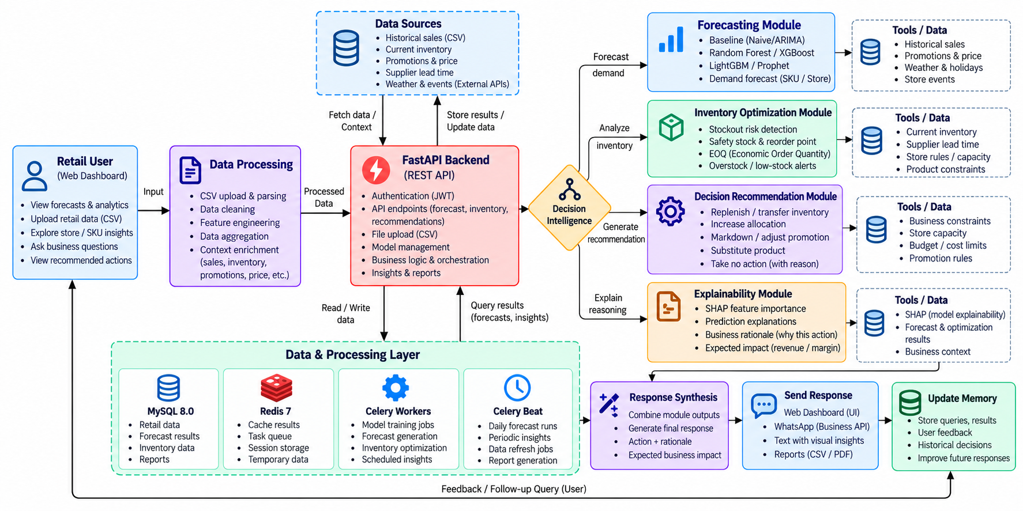




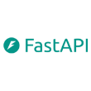


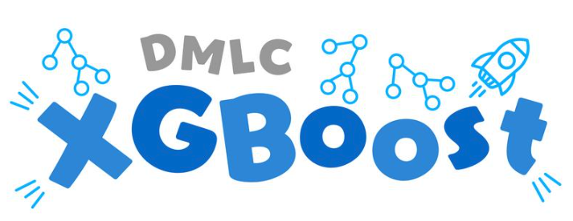



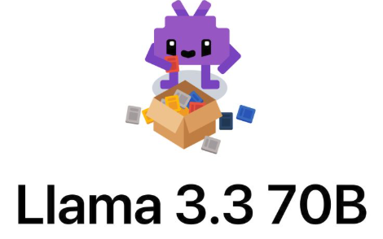

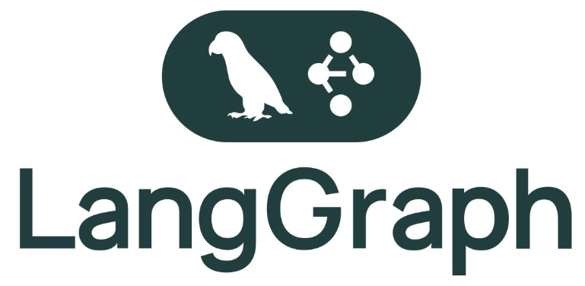

TECHNICAL APPROACH
1
PRODUCT WORKFLOW
TECH STACK
Frontend
py-plot
Lucide-react
tailwind
Backend
Machine Learning
Database
3rd Party Integrations
LLM
Libraries

Slide 4




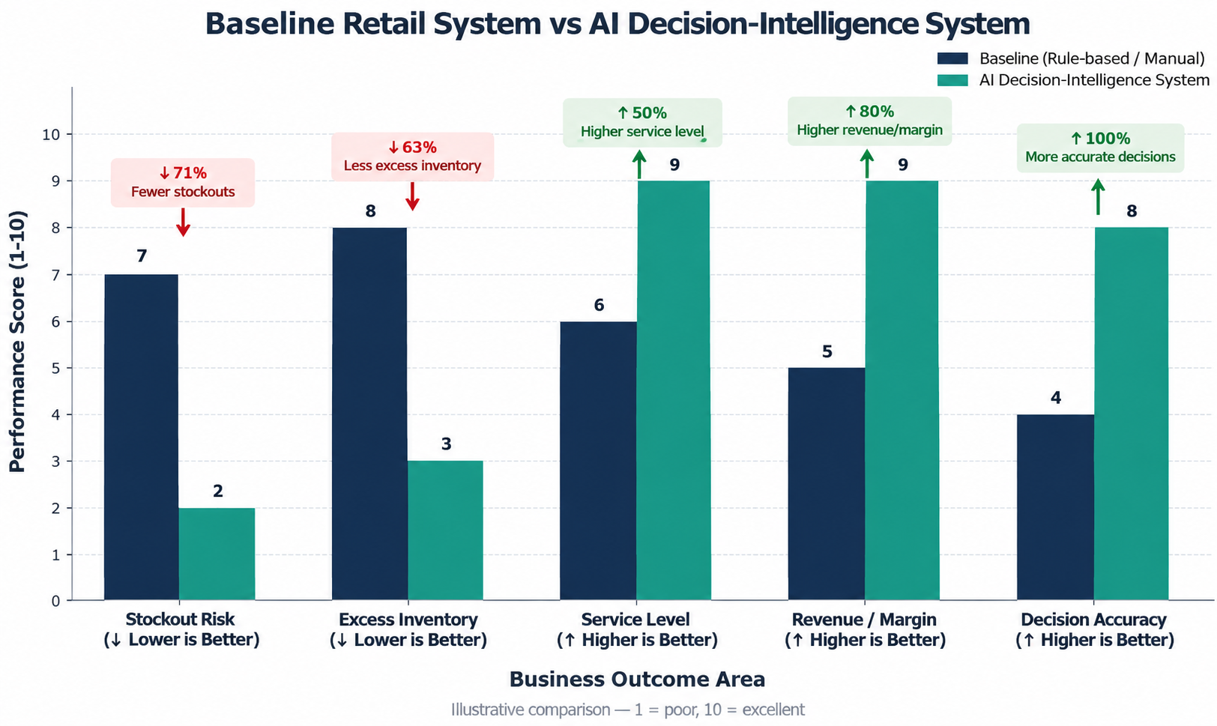

FEASIBILITY AND VIABILITY
Technical: Combines demand forecasting, inventory intelligence, promotion analysis, and Agentic AI to generate actionable store and SKU-level recommendations.
Legal Viability: Uses authorized business
data with appropriate data privacy, access control,
and secure enterprise data management.
Financial:
Reduces stock-out losses,
Economic Viability: Minimizes inventory holding costs, stock-out losses, and unnecessary replenishment while improving long-term profitability.
excess inventory, and operational costs while improving revenue, margins, and resource utilization.
Market & Operational: Supports retailers and supply chain teams with automated replenishment, inventory optimization, and intelligent pricing.
Operational: Designed for integration with existing ERP systems, POS platforms, inventory databases, and supply chain infrastructure.
MARKET ANALYSIS
CHALLENGE
Balancing demand, inventory, promotions, and profitability across multiple stores.
CHALLENGE
Turning retail data into actionable, profitable decisions.
STRATEGY
Demand Intelligence: Forecasts SKU demand using sales and market trends.
Inventory Optimization: Detects stockout risks and excess inventory.
STRATEGY
AI Knowledge Assistant: Recommends Optimal inventory & pricing actions
Multilingual & Interactive Access: Automates Store level decisions & tracks KPIs

Slide 5



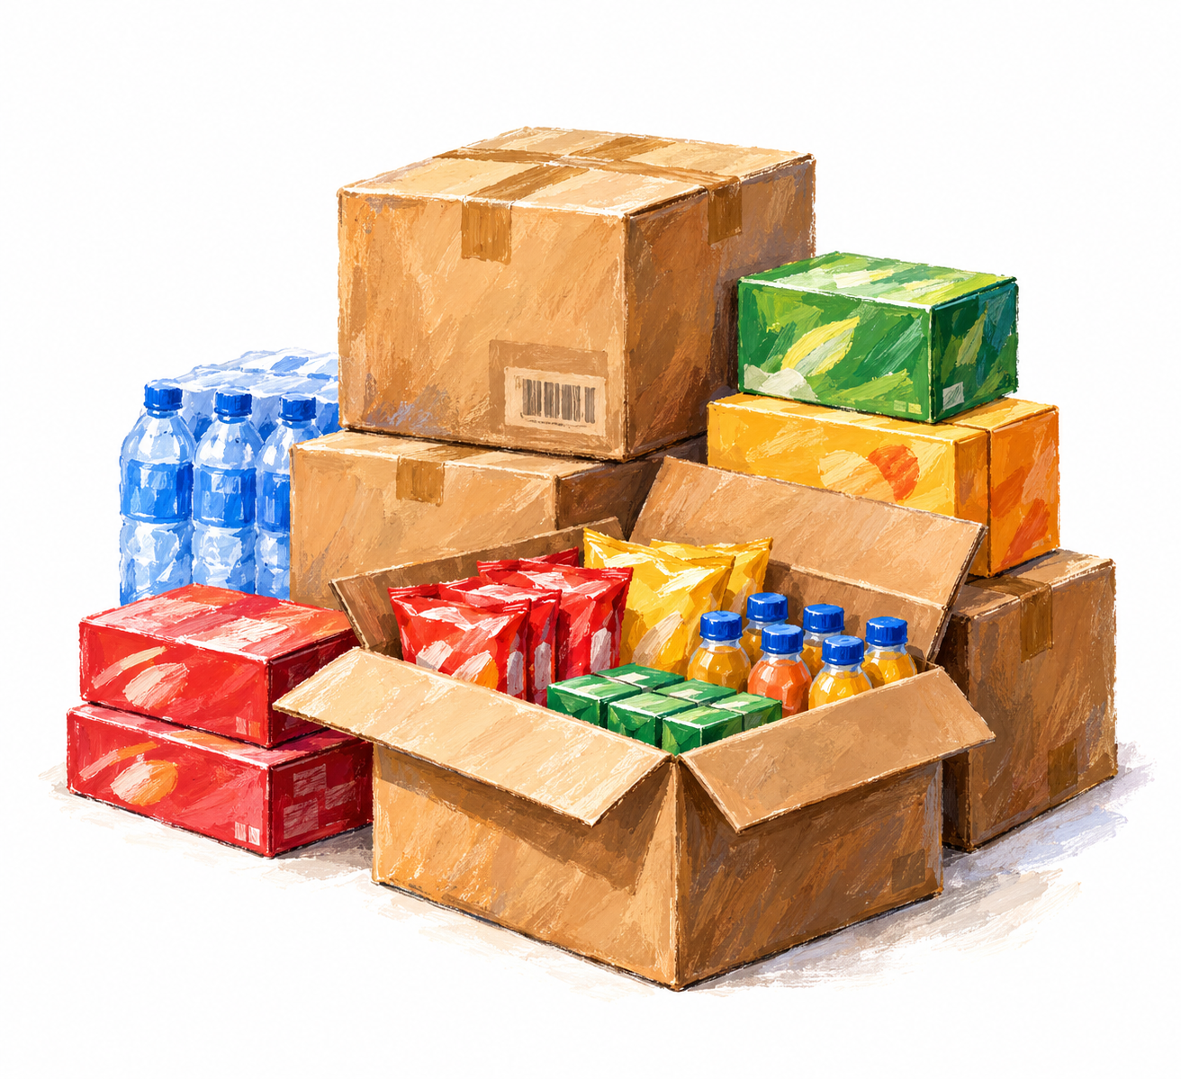
IMPACTS AND BENEFITS
Impacts
Benefits
Reduces Stock-out Risks
01
Accurate Demand Forecasting
Users Predicts SKU level demad using sales, promotions, weather and market trends.
Identifies potential stock shortages through AI-powered demand forecasting
From Retail Intelligence to Intelligent Decisions
01
Minimizes Excess Inventory
Intelligent Inventory Management
Identifies stock-out risks, excess inventory and replenishment needs.
Optimizes stock levels to reduce overstocking and holding costs
02
02
Improve Product Availability
Ensures the right products are available across store and sales channels
03
Automated Decision Recommendations
Suggests replenishments, transfers, markdowns and promotional adjustments.
03
Optimizes Retail Operations
Optimizes replenishment, inventory transfers and pricing decisions.
04
Improved Decision Accuracy
Provides explainable recommendations with expected business impacts
04
“Turing data into profitable retail actions”
Increases Business Profitability
Improves revenue and margin through data-driven retail decisions
Measurable Business Performance
Tracks stockouts, service levels, revenue, margins and inventory KPI’s
05
05

