Slide 1


Slide 2

Content
1. What is Firebase?
2. Traditional Database Vs Firebase
3. Project
4. Features
5. Drawbacks

Slide 3
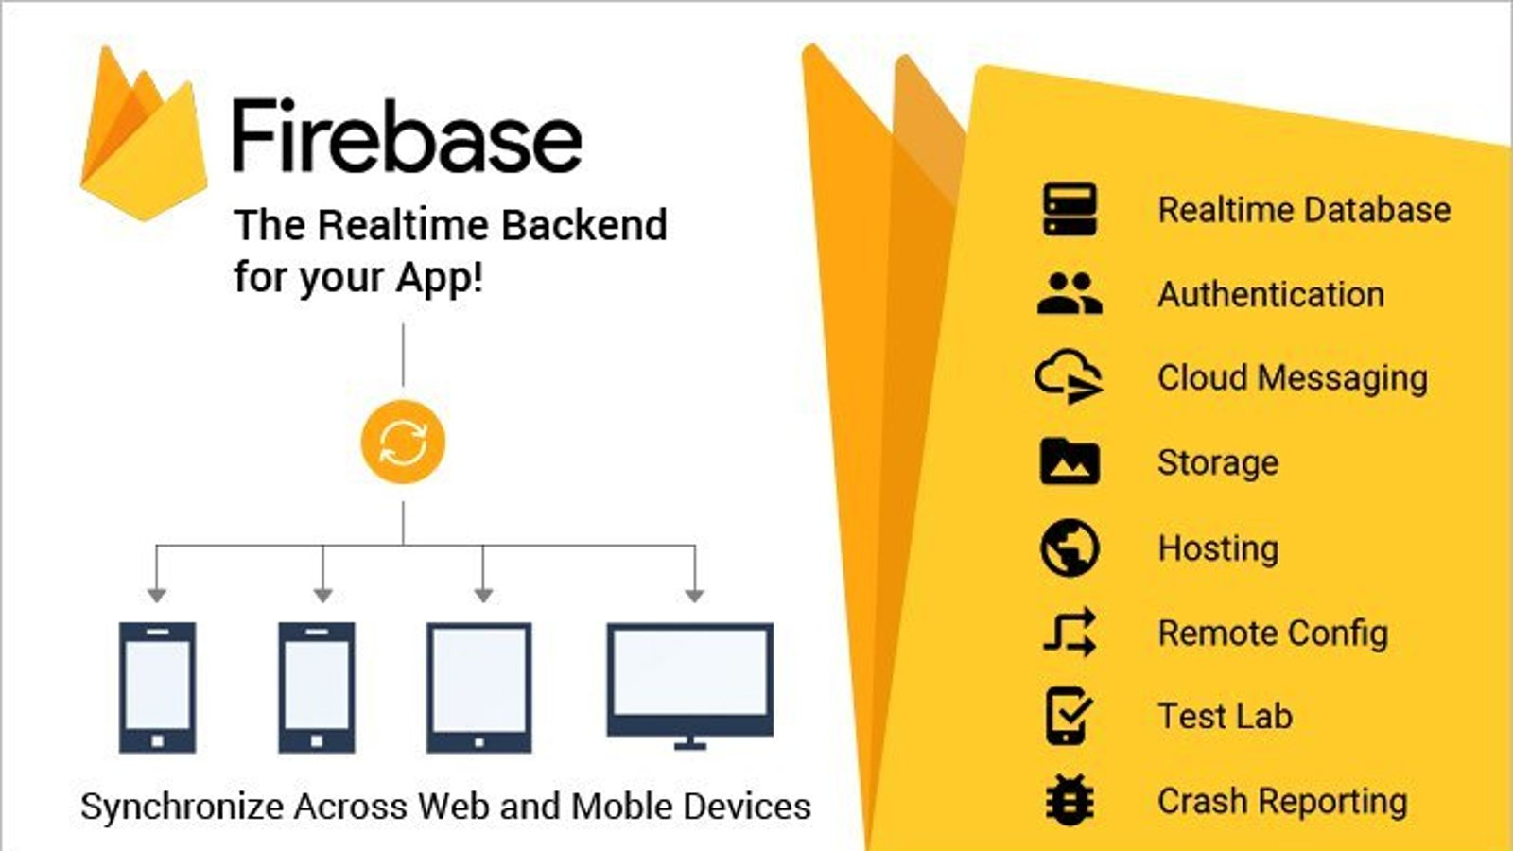

What is Firebase?
Developed By Google
Offers two types of two Non – SQL Databases:
Realtime Database
FireStore
Provides building tools to developers.

Slide 4
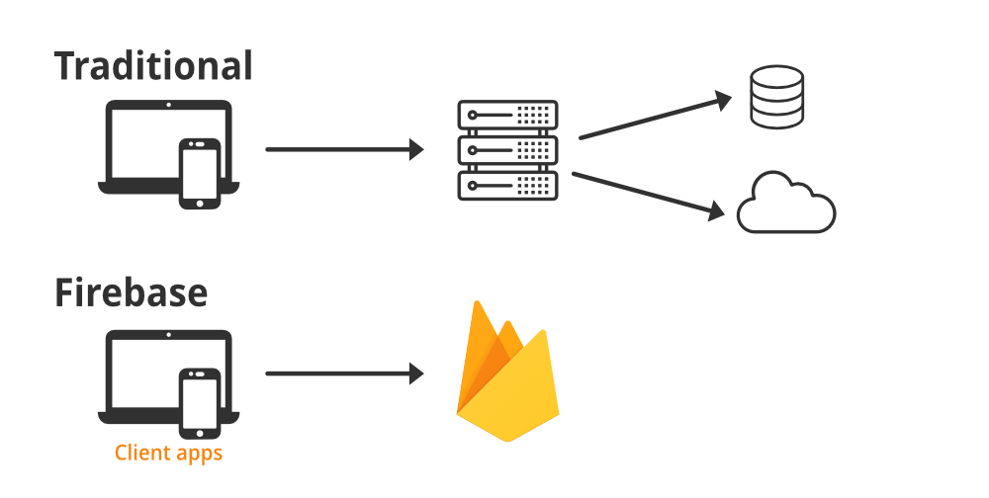
Traditional Database VS Firebase
A traditional backend involves custom server infrastructure.
It uses a combination of programming languages ,frameworks, and databases.
Firebase is a Backend-as-a-Service (BaaS) provided by Google that offers a suite of tools and services to build, improve, and grow apps.

Slide 5

Project
GitHub: Your Repositories (github.com)

Slide 6
Features
Simple
Authentication
Cloud Storage
Realtime Database
Remote Config

Slide 7
Limitations
No SQL
Limited Offline Support
Limited Query Capabilities

Slide 8
ThankYou

