Slide 1
26GE106-
PROBLEM SOLVING AND PYTHON PROGRAMMING
UNIT 1
INTRODUCTION TO ALGORITHMIC PROBLEM SOLVING

Slide 2
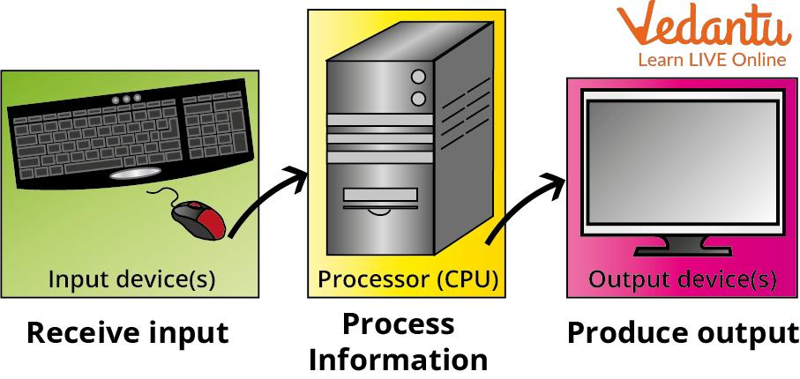
computer
A Computer Is An Electronic Device That:
1)Accepts Input
2)Processes The Input
3)Produces Output
4)Stores Information For Future Use
Basic Computer Model
Input → Processing → Output

Slide 3
Basic computer system
A Computer Generally Works Using Four Major Operations:
1.Input
Data Is Given To The Computer.
Examples:
Keyboard ,Mouse ,Scanner ,Microphone
2. Processing
The Computer Performs Operations On The Input.
The Cpu (Central Processing Unit) Performs Most Processing Operations.

Slide 4
Basic of computer system
3. Output
The Processed Information Is Presented To The User.
Examples:
Monitor ,Printer ,Speaker
4.Storage
Information Can Be Stored For Future Use.
Examples:
Hard Disk ,SSD ,Pen Drive ,Memory Card

Slide 5
Components of a computer system
Hardware:
i)Physical Parts (Keyboard, Monitor, CPU, Storage)
Software:
i)Instructions That Tell Hardware What To Do
ii)System Software (OS) & Application Software
Data: Raw Facts Processed To Produce Information

Slide 6
What is a program?
A Program Is A Set Of Instructions Written In A Programming Language To Perform A Specific Task.
Programming = Process Of Writing, Testing, And Maintaining Code
Programming Language: Formal Language (Syntax + Semantics) Used To Write Programs

Slide 7
INTRODUCTION TO COMPUTING AND PROBLEM SOLVING
Computing Is The Process Of Using Computers To Store, Process, And Communicate Information And Solve Problems.
Computing = Using A Computer To Solve Problems By Giving It Instructions.
Problem Solving Is The Systematic Approach To Define The Problem And Creating Number Of Solutions. The Problem Solving Process Starts With The Problem Specifications And Ends With A Correct Program.

Slide 8
PROBLEM SOLVING TECHNIQUES
Problem Solving Technique Is A Set Of Techniques That Helps In Providing Logic For Solving A Problem. Problem Solving Can Be Expressed In The Form Of
1. Algorithms.
2. Flowcharts.
3. Pseudo Codes.
4. Programs

Slide 9
Computational thinking
Computational Thinking Is A Way Of Thinking About A Problem So That It Can Be Solved Systematically, Often Using A Computer.
It Mainly Involves:
Decomposition
Breaking A Large Problem Into Smaller Problems.
Pattern Recognition
Finding Similarities Or Patterns In Problems.
Abstraction
Focusing Only On The Important Information And Ignoring Unnecessary Details.
Algorithm Design
Creating A Step-by-step Procedure To Solve The Problem.

Slide 10
steps in problem solving
Define/Analyze The Problem
Clearly Identify What The Problem Is
Understand Inputs, Outputs, And Constraints
Analyze The Problem
Break The Problem Into Smaller, Manageable Parts
Identify What Is Known And What Is Unknown
Understand The Relationships Between Variables
Generate Possible Solutions
Brainstorm Different Approaches To Solve The Problem
Consider Multiple Methods Before Choosing One
Select The Best Solution
Evaluate Each Possible Solution Based On Efficiency, Simplicity, And Feasibility
Choose The Most Suitable Approach

Slide 11
Steps in problem solving
Design An Algorithm
Convert The Chosen Solution Into A Step-by-step Logical Procedure
Represent It Using Pseudocode Or A Flowchart
Implement (Code) The Solution
Translate The Algorithm Into A Program Using A Programming Language (E.G., Python)
Write Actual Source Code Following Correct Syntax
Test And Debug
Run The Program With Different Test Cases (Including Edge Cases)
Identify And Fix Errors (Syntax Errors, Logical Errors, Runtime Errors)
Document And Maintain
Add Comments And Documentation Explaining The Code
Maintain/Update The Program For Future Changes Or Improvements

Slide 12
algorithm
An Algorithm Is A Finite, Ordered Sequence Of Clear And Unambiguous Steps Used To Solve A Problem Or Perform A Task.
In Simple Words:
Algorithm = Step-by-step Instructions To Solve A Problem.
It Takes Some Input, Processes It, And Produces An Output
An Algorithm Is A Well-defined Computational Procedure Consists Of A Set Of Instructions That Takes Some Values As An Input, Then Manipulate Them By Following Prescribed Texts In Order To Produce Some Values As Output.

Slide 13
algorithm
. Example 1 — Algorithm To Add Two Numbers
Step 1: Start
Step 2: Read Num1, Num2
Step 3: Sum = Num1 + Num2
Step 4: Print Sum
Step 5: Stop

Slide 14
algorithm
Example 2 — Algorithm To Find The Largest Of Two Numbers
Step 1: Start
Step 2: Read Num1, Num2
Step 3: If Num1 > Num2 Then
Print Num1 Is Greatest
Else
Print Num2 Is Greatest
Step 4: Stop

Slide 15
algorithm
Advantages
Easy To Understand And Debug
Provides A Clear Roadmap For Programmers
Independent Of Programming Language
Helps In Analyzing Time And Space Complexity
Limitations
Time-consuming To Write For Complex Problems
Difficult To Show Branching/Looping Visually (Flowcharts Are Better For That)
Not A Substitute For Actual Programming Logic

Slide 16
characteristics
Precision – The Steps Are Precisely Stated (Defined).
Uniqueness – Results Of Each Step Are Uniquely Defined And Only Depend On The Input And The Result Of The Preceding Steps.
Finiteness – The Algorithm Stops After A Finite Number Of Instructions Are Executed.
Effectiveness – Algorithm Should Be Most Effective Among Many Different Ways To Solve A Problem.
Input – The Algorithm Receives Input.
Output – The Algorithm Produces Output.
Generality – The Algorithm Applies To A Set Of Inputs.

Slide 17
Qualities of an Algorithm
The Following Factors Will Determine The Quality Of An Algorithm.
Accuracy Algorithm Should Provide Accurate Results.
Memory It Should Require Minimum Computer Memory.
Time The Time Taken To Execute Any Program Is Considered As A Main Quality.
Sequence The Procedure Of An Algorithm Must Be In A Sequential Form.

Slide 18
algorithm
Example
Write An Algorithm To Print
“Good Morning”
Step 1: Start
Step 2: Print “Good Morning”
Step 3: Stop

Slide 19
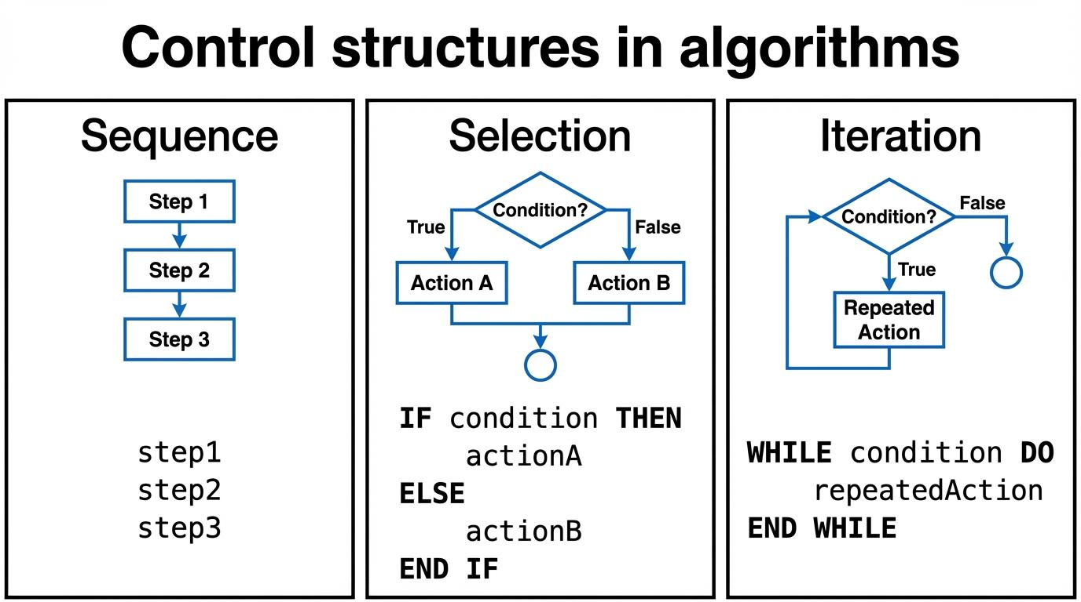
Building blocks of algorithm
The Building Blocks Of An Algorithm Are The Basic Control Structures Used To Construct The Logic Of A Solution.
There Are Three Fundamental Building Blocks:
Sequence
Selection
Iteration (Repetition/Looping)

Slide 20
statements
Statement Is A Single Action In A Computer.
In A Computer Statements Might Include Some Of The Following Actions
➢ Input Data-information Given To The Program
➢ Process Data-perform Operation On A Given Input
➢ Output Data-processed Result
A Sequence Of Statements Is Executed One After Another, In Order

Slide 21
State
State Refers To The Condition Or Status Of The System At A Particular Point In Time During Execution.
In Simple Words:
State = The Current Condition Of The Program.
Transition From One Process To Another Process Under Specified Condition With In A Time Is Called State.

Slide 22
Control flow
Control Flow Determines The Order In Which Statements Are Executed. It Decides The Path Of Execution Through The Algorithm.
. The Control Can Be Executed In Three Ways
1. Sequence
2. Selection
3. Iteration
In Simple Words:
Control Flow = The Path Taken By A Program While Executing Its Statements.

Slide 23
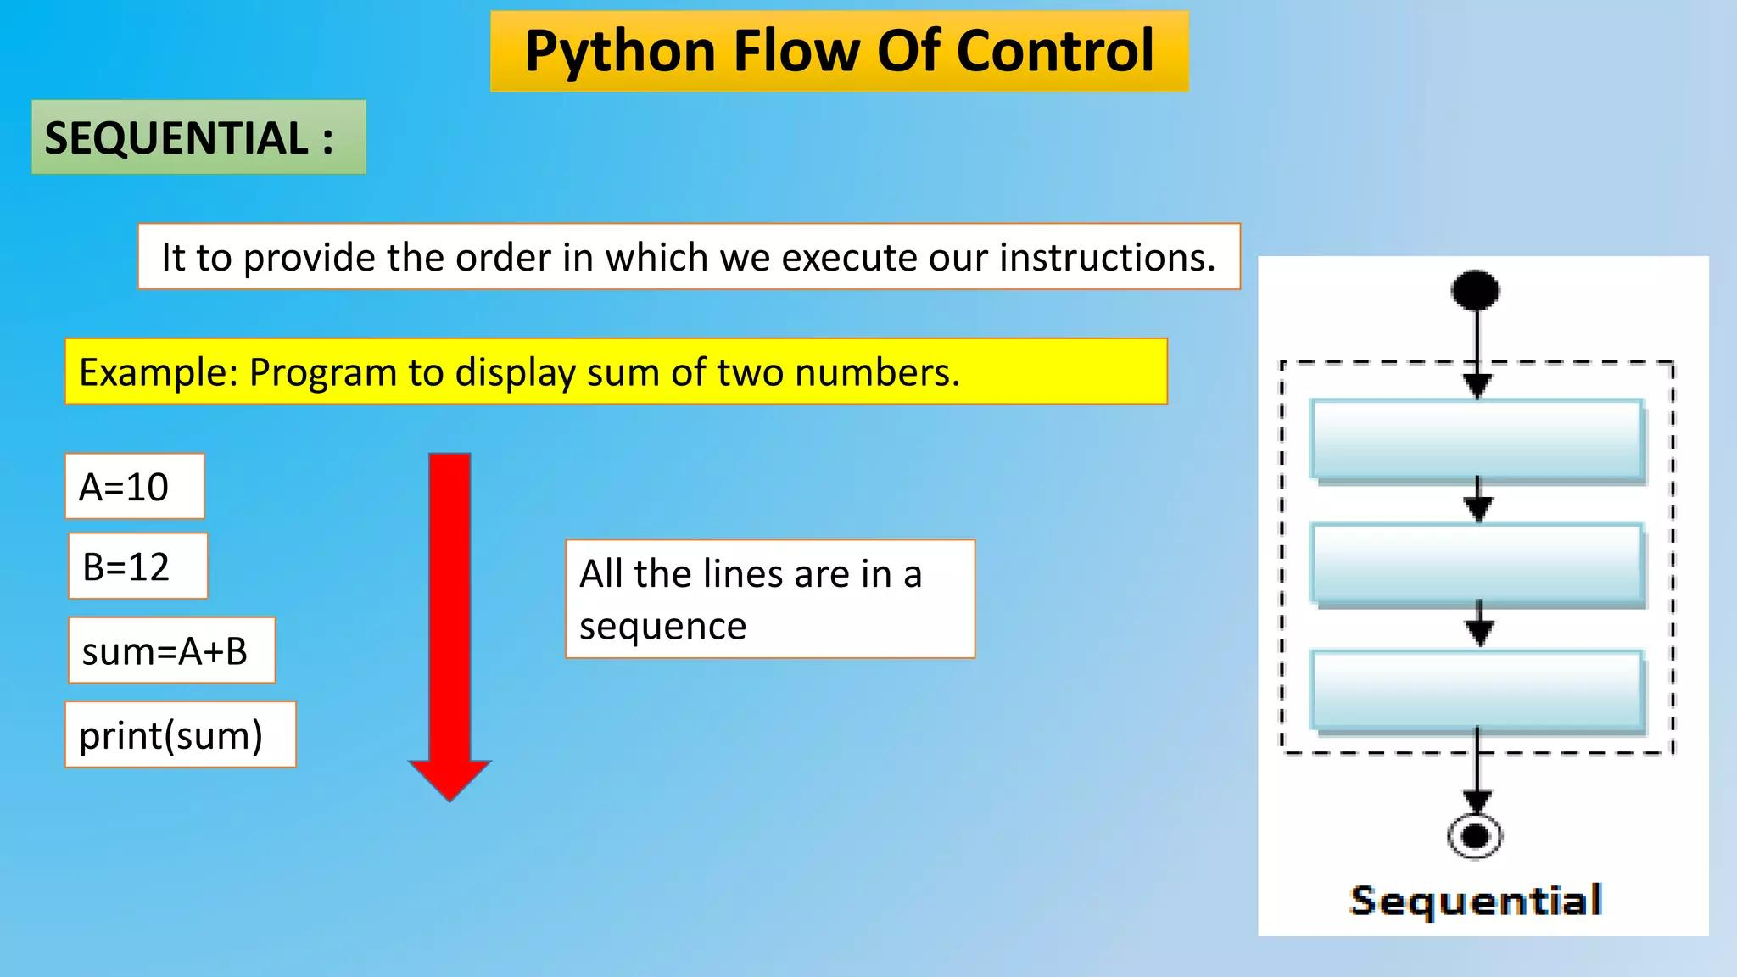
sequence
Statements Execute One After Another.
Execute A List Of Statements In Order.
The Statements Are Executed From Top To Bottom.
Remember:
Sequence = Execute In Order.

Slide 24
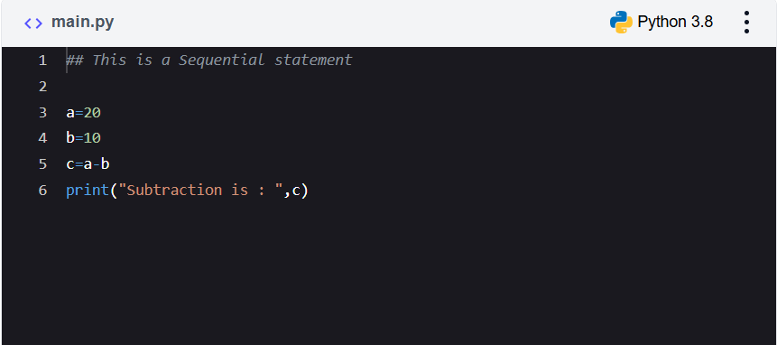
example
Add Two Numbers: Subtract Two Numbers:
Step 1: Start
Step 2: Get A,b
Step 3: Calculate C=a+b
Step 4: Display C
Step 5: Stop

Slide 25
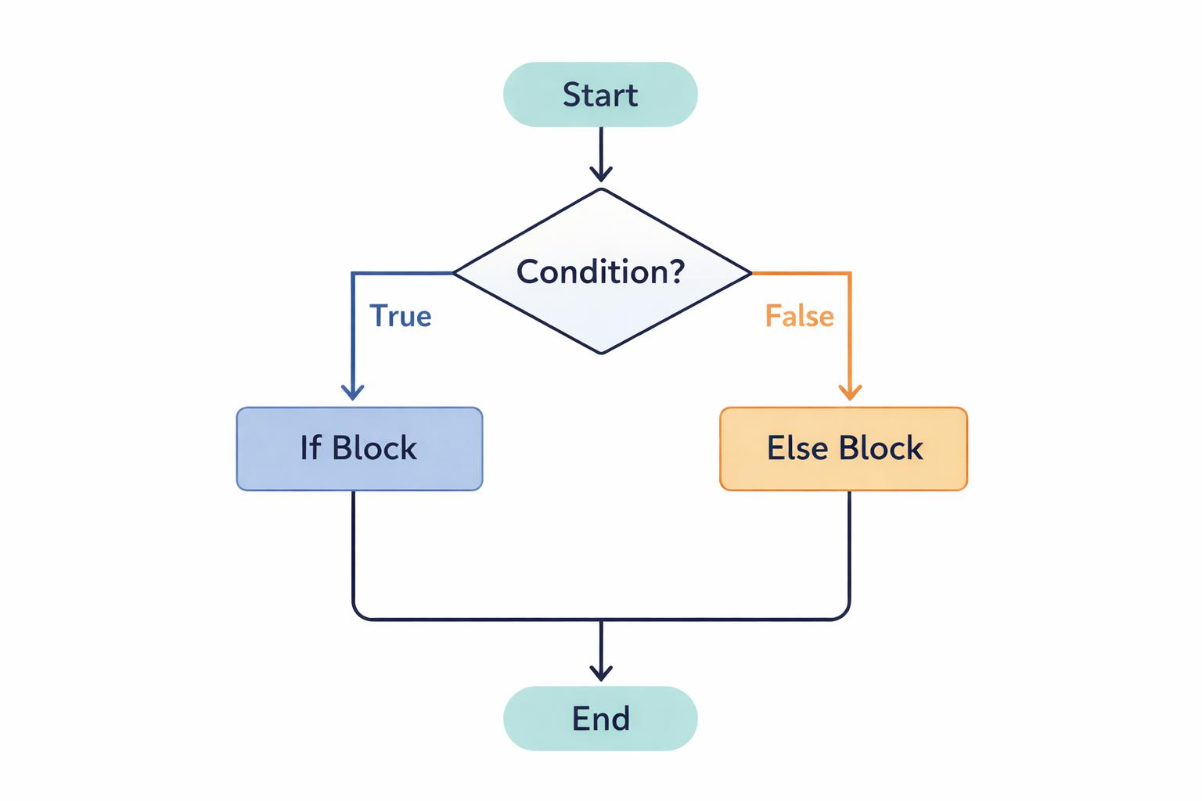
selection
In Selection, The Program Makes A Decision Based On A Condition.
The Program Can Follow Different Paths Depending On Whether The Condition Is True Or False.
Example
Check Whether A Student Has Passed.
Mark = 75 Execution
If Mark >= 40: Mark >= 40?
Print("pass") / \
Else: True False
Print("fail") ↓ ↓
PASS FAIL
Since 75 >= 40 Is True:
Remember:
Output: Pass Selection = Make A Decision.

Slide 26
example
Algorithm To Find Biggest Among 2 Numbers :
Step 1 : Start
Step 2: Get Two Numbers As Input And Store It In To A And B Step
Step 3: If A Is Greater Than B Then
Step 4: Print A Is Big
Step 5: Else
Step 6: Print B Is Big
Step 7: Stop

Slide 27
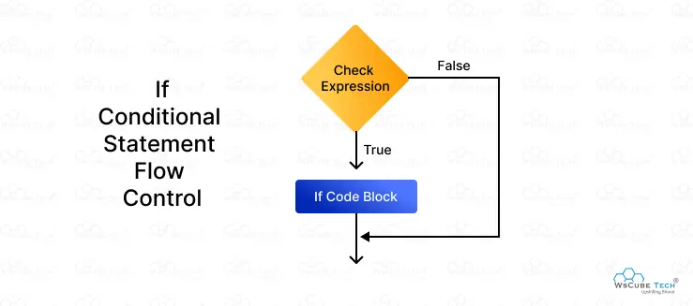
Simple if
The If Statement Executes A Block Of Code Only When The Condition Is True.
Syntax
If Condition:
Statement
Example
Problem: Check Whether A Person Is Eligible To Vote.
Age = 20
If Age >= 18:
Print("eligible To Vote")
Output:
Eligible To Vote

Slide 28
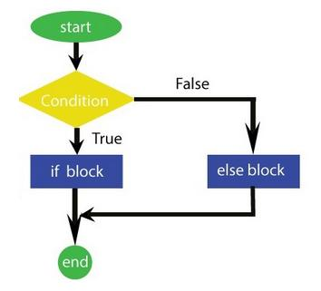
if-else
if-else provides two possible choices.
If the condition is True → execute if block.
If the condition is False → execute else block.
If Else statement is used to execute one block of code when the condition is True and another block when the condition is False
Syntax:
if condition:
#code block if condition is true
else:
#code block if condition is false

Slide 29
example
Problem: Check Whether A Number Is Even Or Odd.
Number = 7
If Number % 2 == 0:
Print("even")
Else:
Print("odd")
Output:
Odd

Slide 30
if-elif-else
Elif Statement Is Used To Check Multiple Conditions In A Program.
Once A True Condition Is Found, Its Block Runs, And The Rest Are Skipped.
Syntax:
If Condition1:
# Code Block
Elif Condition2:
# Code Block
Else:
# Code Block

Slide 31
example
Program:
Score = 70
If Score >= 90:
Print("grade: A") Output
Elif Score >= 60: Grade: B
Print("grade: B")
Else:
Print("grade: C")

Slide 32
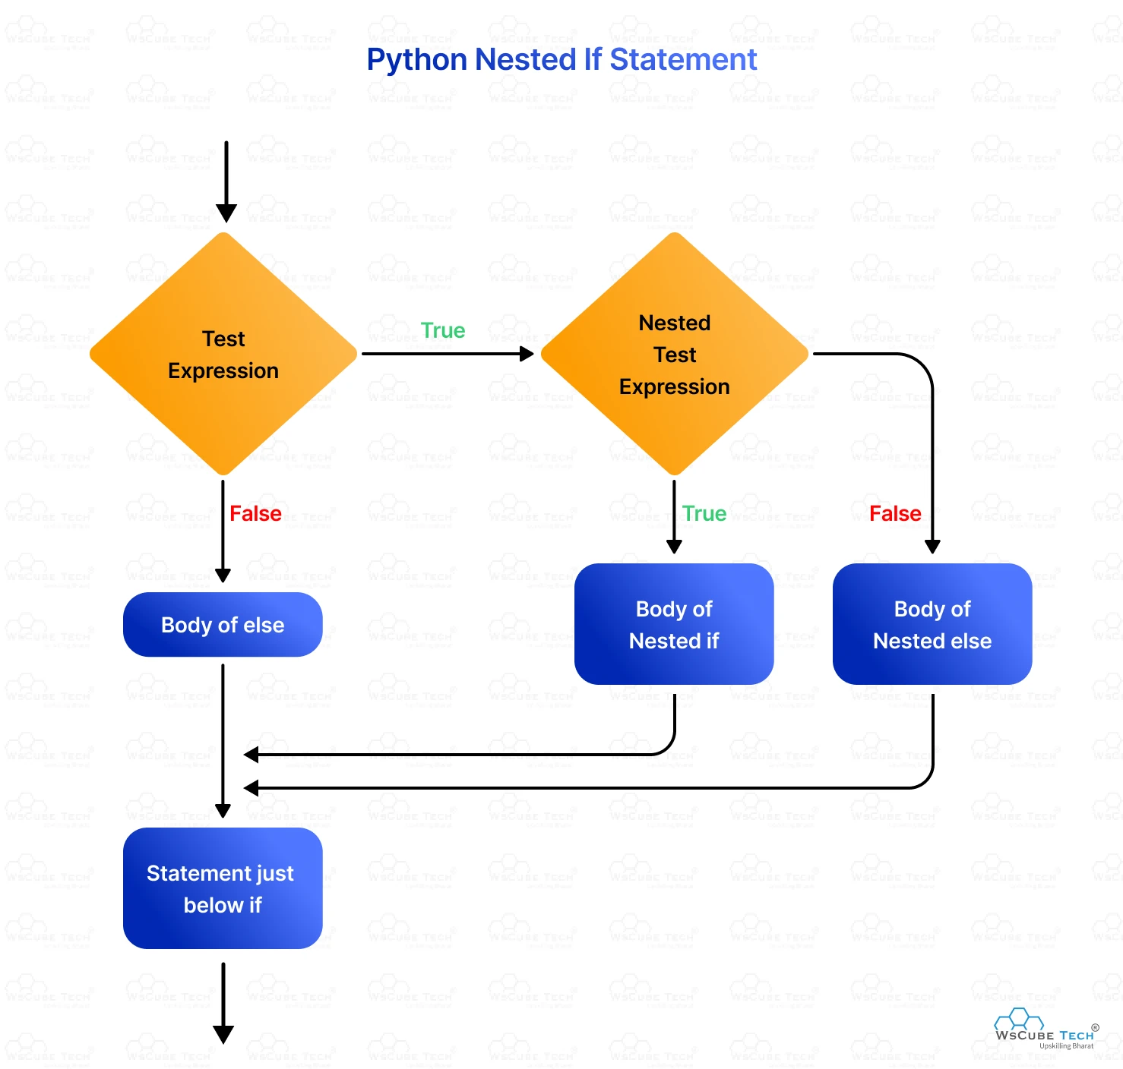
Nested if
Nested If Statements Allow Us To Place One If Statement Inside Another. This Helps When We Need To Check Multiple Conditions In A Structured Way.
Syntax:
If Condition1:
If Condition2:
# Code To Run

Slide 33
example
Program:
Language = "Python"
Experience = 3 Output:
If Language == "Python": You Are Using Python
Print("you Are Using Python") You Are An Experienced Python Developer
If Experience >= 2:
Print("you Are An Experienced Python Developer")
Else:
Print("please Choose Python To Continue")

Slide 34
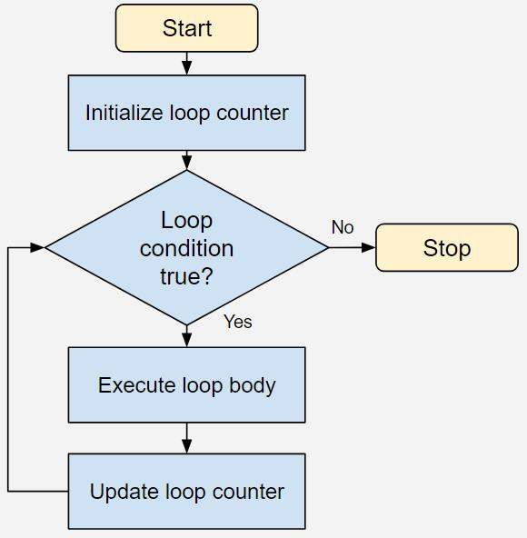
Iteration
Iteration Means Repeating A Group Of Statements Multiple Times.
It Is Also Called:
*Repetition * Looping
Iteration Is A Control Flow Structure That Repeatedly Executes A Set Of Statements Until A Specified Condition Is Satisfied.
In Simple Words:
Iteration = Repeating The Same Set Of
Instructions Again And Again.

Slide 35
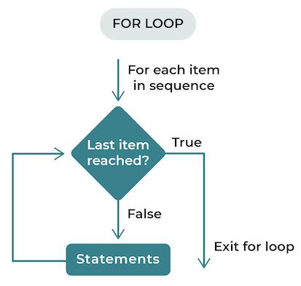
For loop
Used When You Know In Advance How Many Times To Repeat. It Has A Counter That Increases (Or Decreases) Each Time Until It Reaches A Limit.
Syntax
for variable in sequence:
#code block

Slide 36
example
Print numbers from 1 to 5
Program
For I In Range(1, 6): Output
Print(i) 1
2
3
4
5

Slide 37
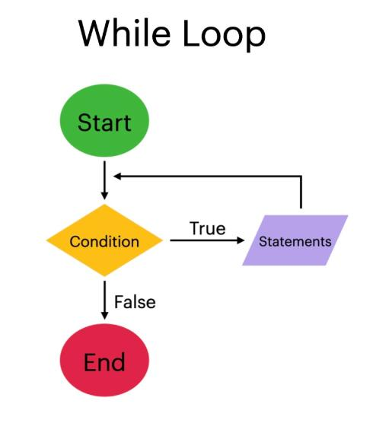
While loop
Repeats As Long As The Condition Is True. Condition Is Checked Before Execution.
It Is Typically Used When You Do Not Know The Exact Number Of Iterations Beforehand.
Syntax:
While Condition:
# Code Block To Execute

Slide 38
example
Program output
i = 1 1
while i <= 5: 2
print(i) 3
i = i + 1 4
5

Slide 39
functions
A Function Is A Named, Reusable Block Of Code That Performs A Specific Task.
It Can Accept Input (Parameters) And Optionally Return A Result (Output).
Used To Break A Large Program Into Smaller, Manageable Pieces.
Syntax of function
<function-name>(<parameter-list>)
(or)
def function_name(parameters):
# function body
return result

Slide 40
notations
A Series Or System Of Written Symbols Used To Represent Numbers, Amounts Or Elements In Programming Language Is Called As Notation.
The Basic Notations Used To Describe Algorithms Are
1)pseudocode
2)flowchart

Slide 41
pseudocode
Pseudocode(derived From Pseudo And Code)
Pseudocode Is An Informal Way Of Writing The Steps Of An Algorithm Using Simple English-like Statements.
It Is A Notation That Is Used To Develop The Solution Of A Problem.
Pseudocode Is An Artificial And Informal Language That Helps Programmers Develop Algorithms.
Pseudocode Is A "Text-based" Detail (Algorithmic) Design Tool..
The Rules Of Pseudocode Are Reasonably Straightforward.

Slide 42
Rules for writing pseudocode
Write One Statement Per Line
Capitalize Initial Keywords
Indent To Show Hierarchy
End Multiline Structure
Keep Statements Language Independent

Slide 43
example
Find the sum of two numbers
Start
Read A, B
Sum ← A + B
Display Sum
Stop
Important
Pseudocode Is Not Directly Executed By The Computer.
It Is Mainly Used To Plan The Logic Before Coding.

Slide 44
flowchart
A Flowchart Is A Graphical Representation Of An Algorithm Using Standard Symbols Connected By Arrows.
Flowcharts Are The Graphical Representation Of The Algorithms.
The Algorithms And Flowcharts Are The Final Steps In Organizing The Solutions.
Flowcharts Can Show Errors In The Logic And Set Of Data Can Be Easily Tested Using Flowcharts.

Slide 45
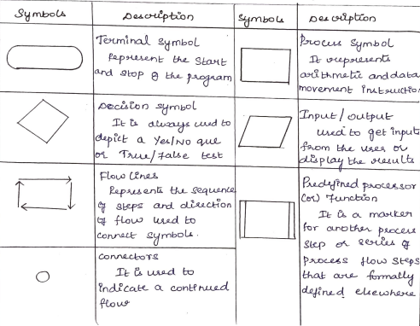

Slide 46
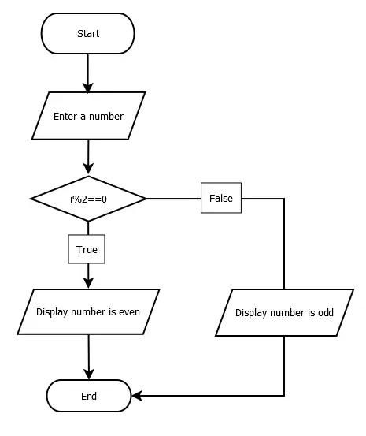

Slide 47
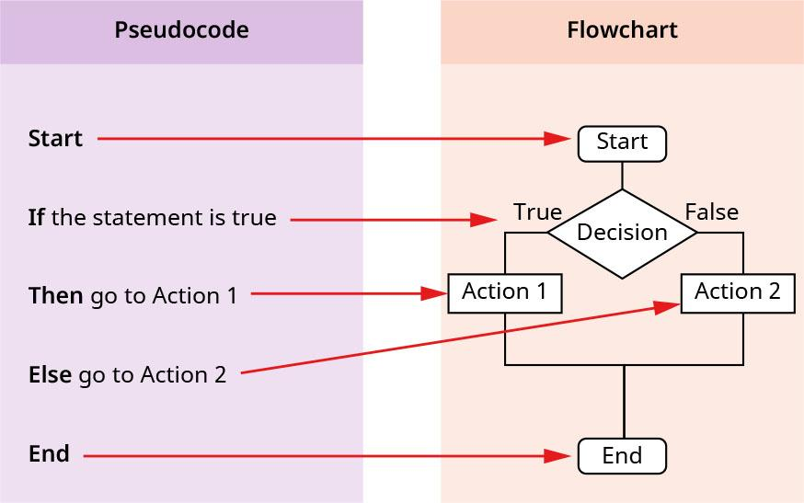

Slide 48
advantages
limitations
Complex Logic
Alterations And Modifications
Reproduction
To Understand Logic Clearly
Effective Analysis
Better Communication
Systematic Testing
Efficient Program Maintanence

Slide 49
Simple Strategies for Developing Algorithms
There Are Two Commonly Used Strategies Used In Developing An Algorithm
1. Iteration
2. Recursion
Basically Iteration And Recursion Perform The Same Kind Of Task.

Slide 50
Simple Strategies for Developing Algorithms
Step 1: Obtain A Description Of The Problem.
Step 2: Analyze The Problem.
Step 3: Develop A High-level Algorithm.
Step 4: Refine The Algorithm By Adding More Detail.
Step 5: Review The Algorithm.

Slide 51
iteration
Iteration Is A Strategy In Which A Set Of Instructions Is Repeatedly Executed Using Loops Until A Condition Is Satisfied.
In Simple Words:
Iteration = Solve A Problem By Repeating Steps Using Loops.

Slide 52
example
Def Factorial_iterative(n):
Result = 1
For I In Range(1, N + 1):
Result *= I
Return Result

Slide 53
recursion
Recursion Is A Method Of Solving Problems That Involves Breaking A Problem Down Into Smaller And Smaller Subproblems Until You Get To A Small Enough Problem That It Can Be Solved Trivially.
Properties Of Recursion:
There Are Three Important Laws Of Recursion:
1. A Recursive Algorithm Must Have A Base Case.
2. A Recursive Algorithm Must Change Its State And Move Toward The Base Case.
3. A Recursive Algorithm Must Call Itself, Recursively

Slide 54
example
program:
Def Factorial(n):
If N == 1:
Return 1 Output:
Else: 120
Return N * Factorial(n - 1)
Print(factorial(5))

Slide 55
Towers of hanoi
The Tower Of Hanoi Is A Classic Mathematical Puzzle Involving Three Rods (A, B, And C) And N Disks Of Different Sizes.
Initially, All Disks Are Stacked On Rod A In Decreasing Order Of Diameter - The Largest Disk At The Bottom And The Smallest At The Top.

Slide 56
Move Only One Disk At A Time.
At Each Step, You Can Take The Top Disk From Any Rod And Place It On Another Rod.
A Disk Can Only Be Moved If It Is The Topmost Disk Of A Rod.
No Larger Disk May Be Placed On Top Of A Smaller Disk.

Slide 57
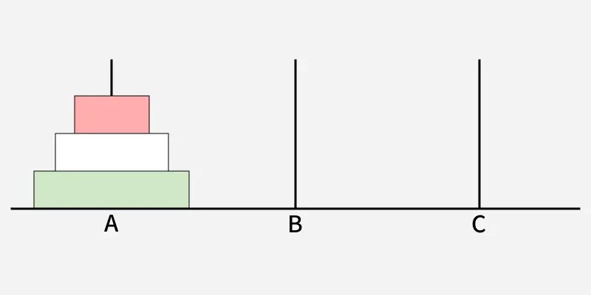

Slide 58
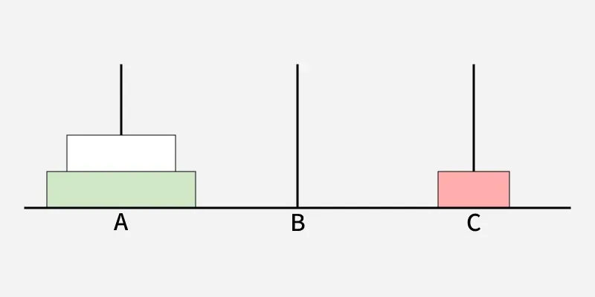

Slide 59
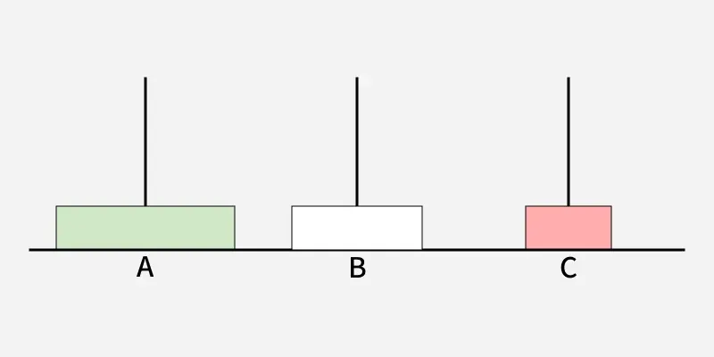

Slide 60
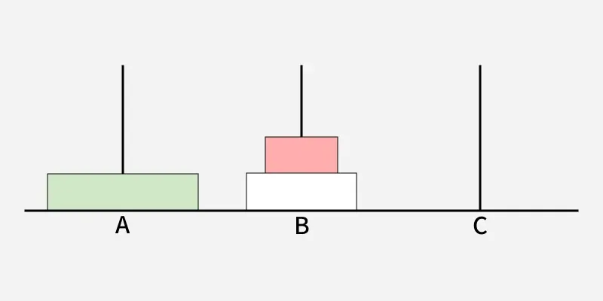

Slide 61
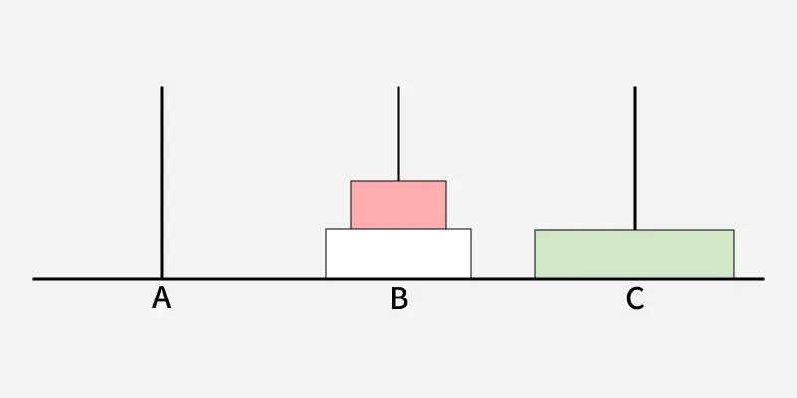

Slide 62
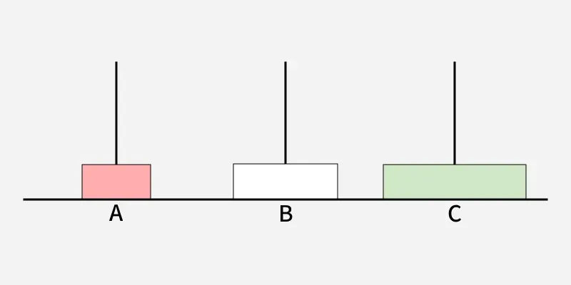

Slide 63
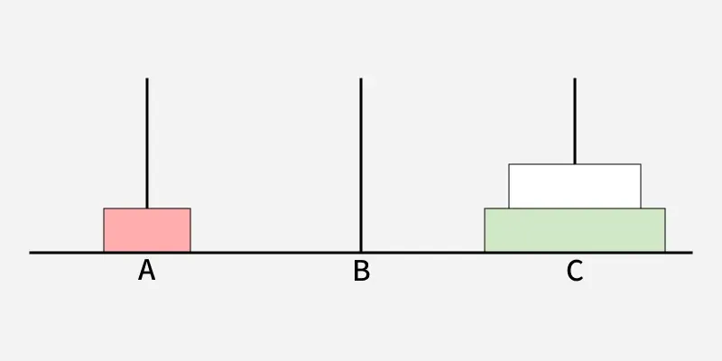

Slide 64
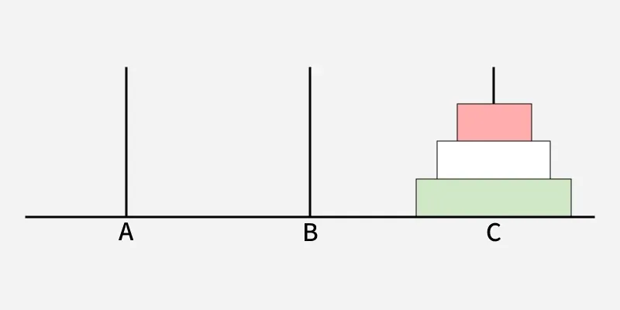

Slide 65


