Slide 1
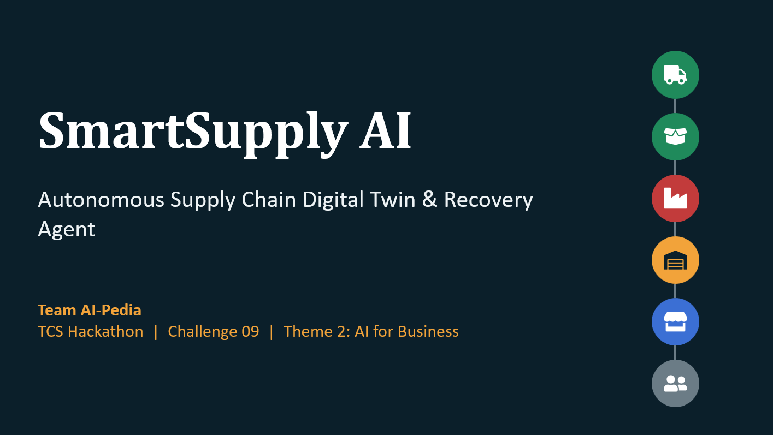

Slide 2




Problem Statement
SmartSupply AI | One supplier goes down and the effect spreads through the whole chain
Purchase orders & inventory
Material shortfalls ripple into stock-outs
32
nodes in the modelled digital twin
Production schedules
Factories idle or re-sequence around missing inputs
10
customer orders with SLA penalty clauses
Transport & distribution
Lanes, DC buffers and store replenishment all shift
$220k+
unmitigated damage in the demo scenario
Contracts & customers
SLA penalties and churn on Tier 1 accounts
A local fix can just move the disruption elsewhere. The full dependency chain has to be understood.
Notes:
Challenge context: a disruption touches POs, inventory, production, transport, contracts and customer priorities at once. The stats come from the repo README demo scenario (32-node twin, 10 customer orders, $220k+ unmitigated damage).

Slide 3
Proposed Solution
A closed-loop, multi-agent digital twin that turns a disruption into a verified plan
1
Monitor
Watches every entity across all 6 tiers in real time
What sets it apart
2
Detect
Supplier failures, deficits, capacity drops, freezes, spikes
Whole-chain reasoning, so a local fix cannot quietly shift the problem
Plans are verified before they are approved
Human approval, then in-flight adaptation
Several plans per disruption, never one answer
3
Reason
Computes the blast radius on a directed twin graph
4
Generate & simulate
5 distinct recovery plans scored on 6 criteria
5
Verify
Checks the plan creates no secondary shortage elsewhere
6
Adapt
Re-plans when a second disruption hits mid-recovery
7
Stay transparent
Every input tagged [KNOWN] or [ASSUMED]
Notes:
Walk the seven steps top to bottom. The right-hand card is the pitch: we reason about the whole chain, verify before executing, keep a human in the loop, and adapt if conditions change.

Slide 4
System Architecture
Five layers from the dashboard down to the twin engine and data services
Experience
Digital-twin canvas
Disruption Center
Recovery Planner
What-If Simulator
ROI view
API & orchestration
Node.js server (server.ts)
Recovery Decision Agent
Human approval gate
Agent layer
Monitoring
Impact prediction
Dependency reasoning
Simulation & optimisation
Recovery decision
Twin engine
Topology graph (32 nodes)
Blast-radius traversal
8-action optimiser
Verification engine
Plan diffing
Data & AI services
Firebase / Firestore*
LLM (Gemini)*
Env config (.env)*
Unit tests (tsx)
* Inferred from repository files (firebase-*.json, firestore.rules, .env.example). Confirm before presenting.
Notes:
Read the stack top to bottom. UI components and engine components come from the README. Items marked with an asterisk are inferred from file names in the repo (Firebase config, firestore rules, .env.example from the AI Studio template), so confirm them with the team before presenting.

Slide 5







Technologies Used
A TypeScript web stack with a graph-based reasoning and simulation engine
FRONTEND
BACKEND
REASONING
OPTIMISATION
React + Vite + TypeScript*
Node.js server (server.ts)
Directed graph traversal
SimPy-style simulation
Interactive twin canvas, planner and what-if views
API and agent orchestration; Bun lockfile in repo
NetworkX-equivalent blast-radius logic
Discrete-event sim + multi-objective optimiser
DATA
AI
TESTING
How to read this
Items marked * are inferred from repo files and the AI Studio template. Everything else is stated in the README.
Firebase / Firestore*
Gemini via AI Studio*
Node test runner + tsx
Rules and blueprint files in the repo
Generated from the AI Studio repository template
Unit tests on topology, blast radius, plans, adaptation
Notes:
Be upfront that React, Firebase and Gemini are inferred from file names (index.html, vite.config.ts, firebase-applet-config.json, .env.example, AI Studio template). SimPy and NetworkX are named in the README; the engine itself is TypeScript, so describe them as SimPy-style and NetworkX-equivalent.

Slide 6
Recovery Plans Compared
Five diverse plans across cost, time, SLA, risk and carbon; Plan E is recommended
Plan | Key levers | Cost | Recovery | SLA | Risk | CO2e
A | Cheapest | Economy off-peak volume, standard rail / road, buffer non-contractual Tier 3 | $18.5k | 5.5 days | 78% | 42 | 3,100 kg
B | Fastest | Chartered air freight, instant BOM substitute MAT-02, 24/7 overtime | $70.7k | 1.8 days | 96% | 35 | 7,200 kg
C | SLA Protection | Ring-fence warehouse stock, express inter-hub transfers, zero penalty days | $42.5k | 2.5 days | 100% | 22 | 3,800 kg
D | Green | 100% bio-circular resin MAT-02, electrified rail freight, hydro-powered lines | $46.9k | 3.8 days | 88% | 28 | 950 kg
E | Balanced | Split allocation SUP-02 + SUP-03, cross-docking, staggered weekend shift | $36.4k | 2.2 days | 94% | 18 | 2,450 kg
Simulated outputs from the repo's recovery engine. Lower is better except SLA. Risk is scored 1-100.
Recommended: Plan E, the Pareto-optimal trade-off with the lowest operational risk (18)
Notes:
Numbers are from the README plan table. Every single-objective plan wins one metric and loses others; Plan E has no weak spot. Together the five plans use all six recovery levers in the brief.

Slide 7
Requirement Satisfaction
Mapped to the challenge's success measures and guardrail
Requirement | How SmartSupply AI addresses it | Status
Disruption detection | Monitoring Agent flags supplier, stock, capacity and logistics anomalies | Met
Dependency reasoning | Directed twin graph traces SUP > MAT > FAC > DC > STR > orders | Met
Impact: materials to SLA | Blast radius plus exposure: revenue at risk and SLA penalties | Met
Recovery-plan diversity | 5 distinct strategies that together use all 6 recovery levers | Met
Optimisation quality | Constrained multi-objective optimiser; verified, Pareto-optimal pick | Met
Compare on 6 criteria | Cost, time, SLA, risk, CO2e shown; customer impact via SLA % | Partial
Adaptability | Second disruption triggers reassessment and a plan diff | Met
Known vs assumed | Audited [KNOWN] / [ASSUMED] tags on data | Met
Business impact | Side-by-side ROI against $220k+ unmitigated damage | Met
Notes:
Be candid about the one partial: the README lists cost, time, SLA, risk and carbon per plan. Customer impact is represented through SLA adherence and Tier 1 protection. If the app shows a dedicated customer-impact score, upgrade this row to Met.

Slide 8
Current vs Proposed System
From reactive, siloed firefighting to connected, verified recovery
Dimension | Current (typical practice) | Proposed: SmartSupply AI
Detection | Alerts after the fact; siloed ERP and email signals | Continuous monitoring across 6 tiers
Impact analysis | Manual spreadsheet tracing | Automated blast radius on the twin graph
Options considered | One or two ad-hoc fixes | 5 diverse plans, 8 action types
Evaluation | Cost-first, judged function by function | 6 criteria: cost, time, SLA, risk, CO2e
Side effects | A fix may shift the shortage elsewhere | Verified for secondary shortages
Change mid-recovery | Restart the analysis by hand | Automatic re-plan with plan diff
Transparency | Assumptions left unstated | [KNOWN] vs [ASSUMED] tagging
Notes:
The 'current' column is a general description of typical manual practice, not a measured baseline of a specific company. The 'proposed' column maps to features in the repo.

