Slide 1

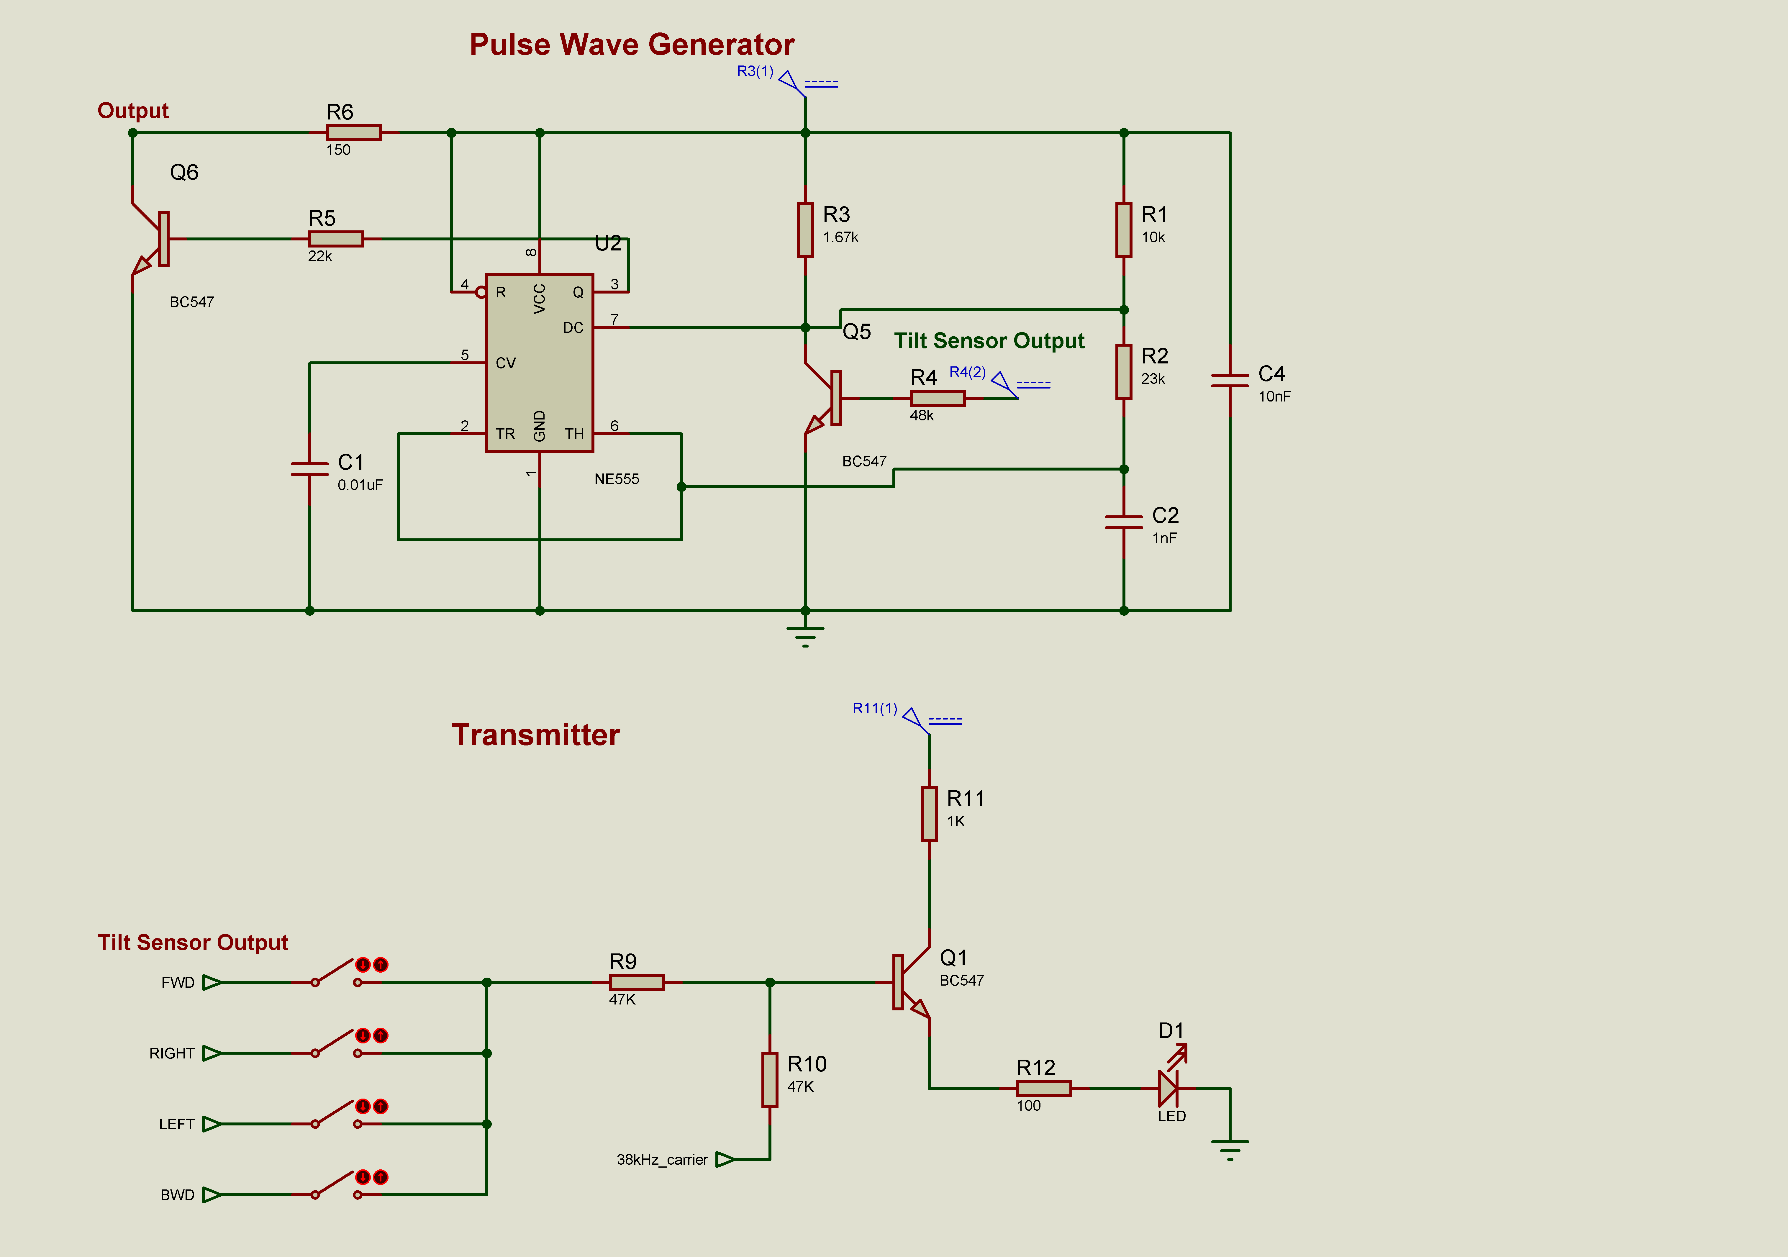
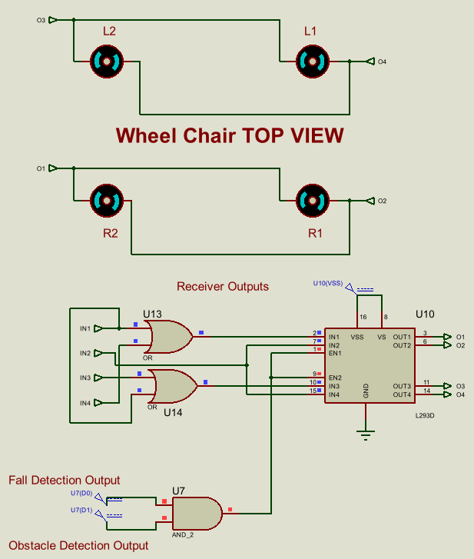
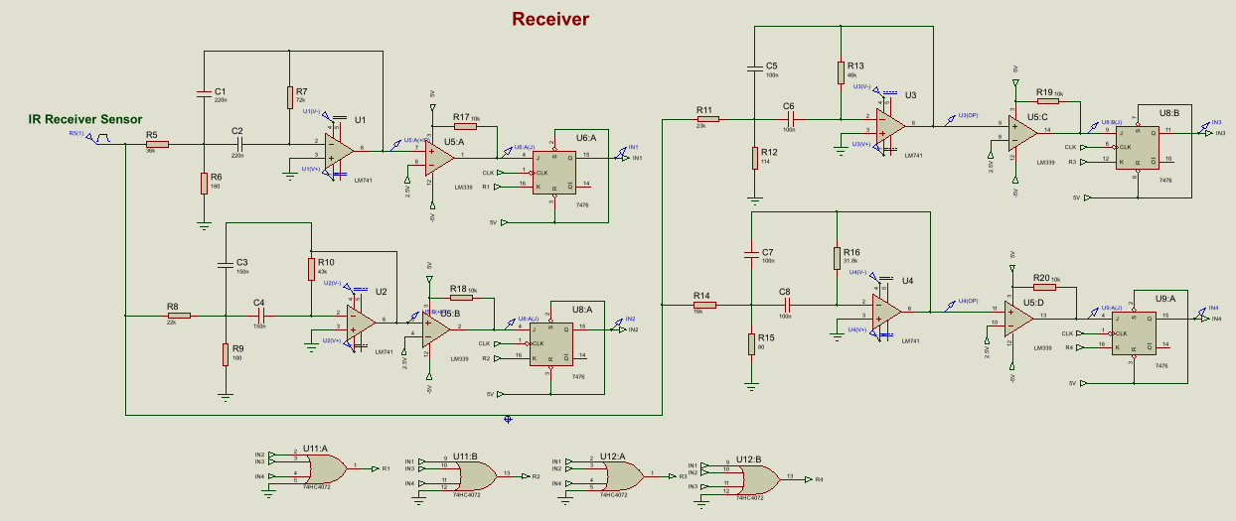
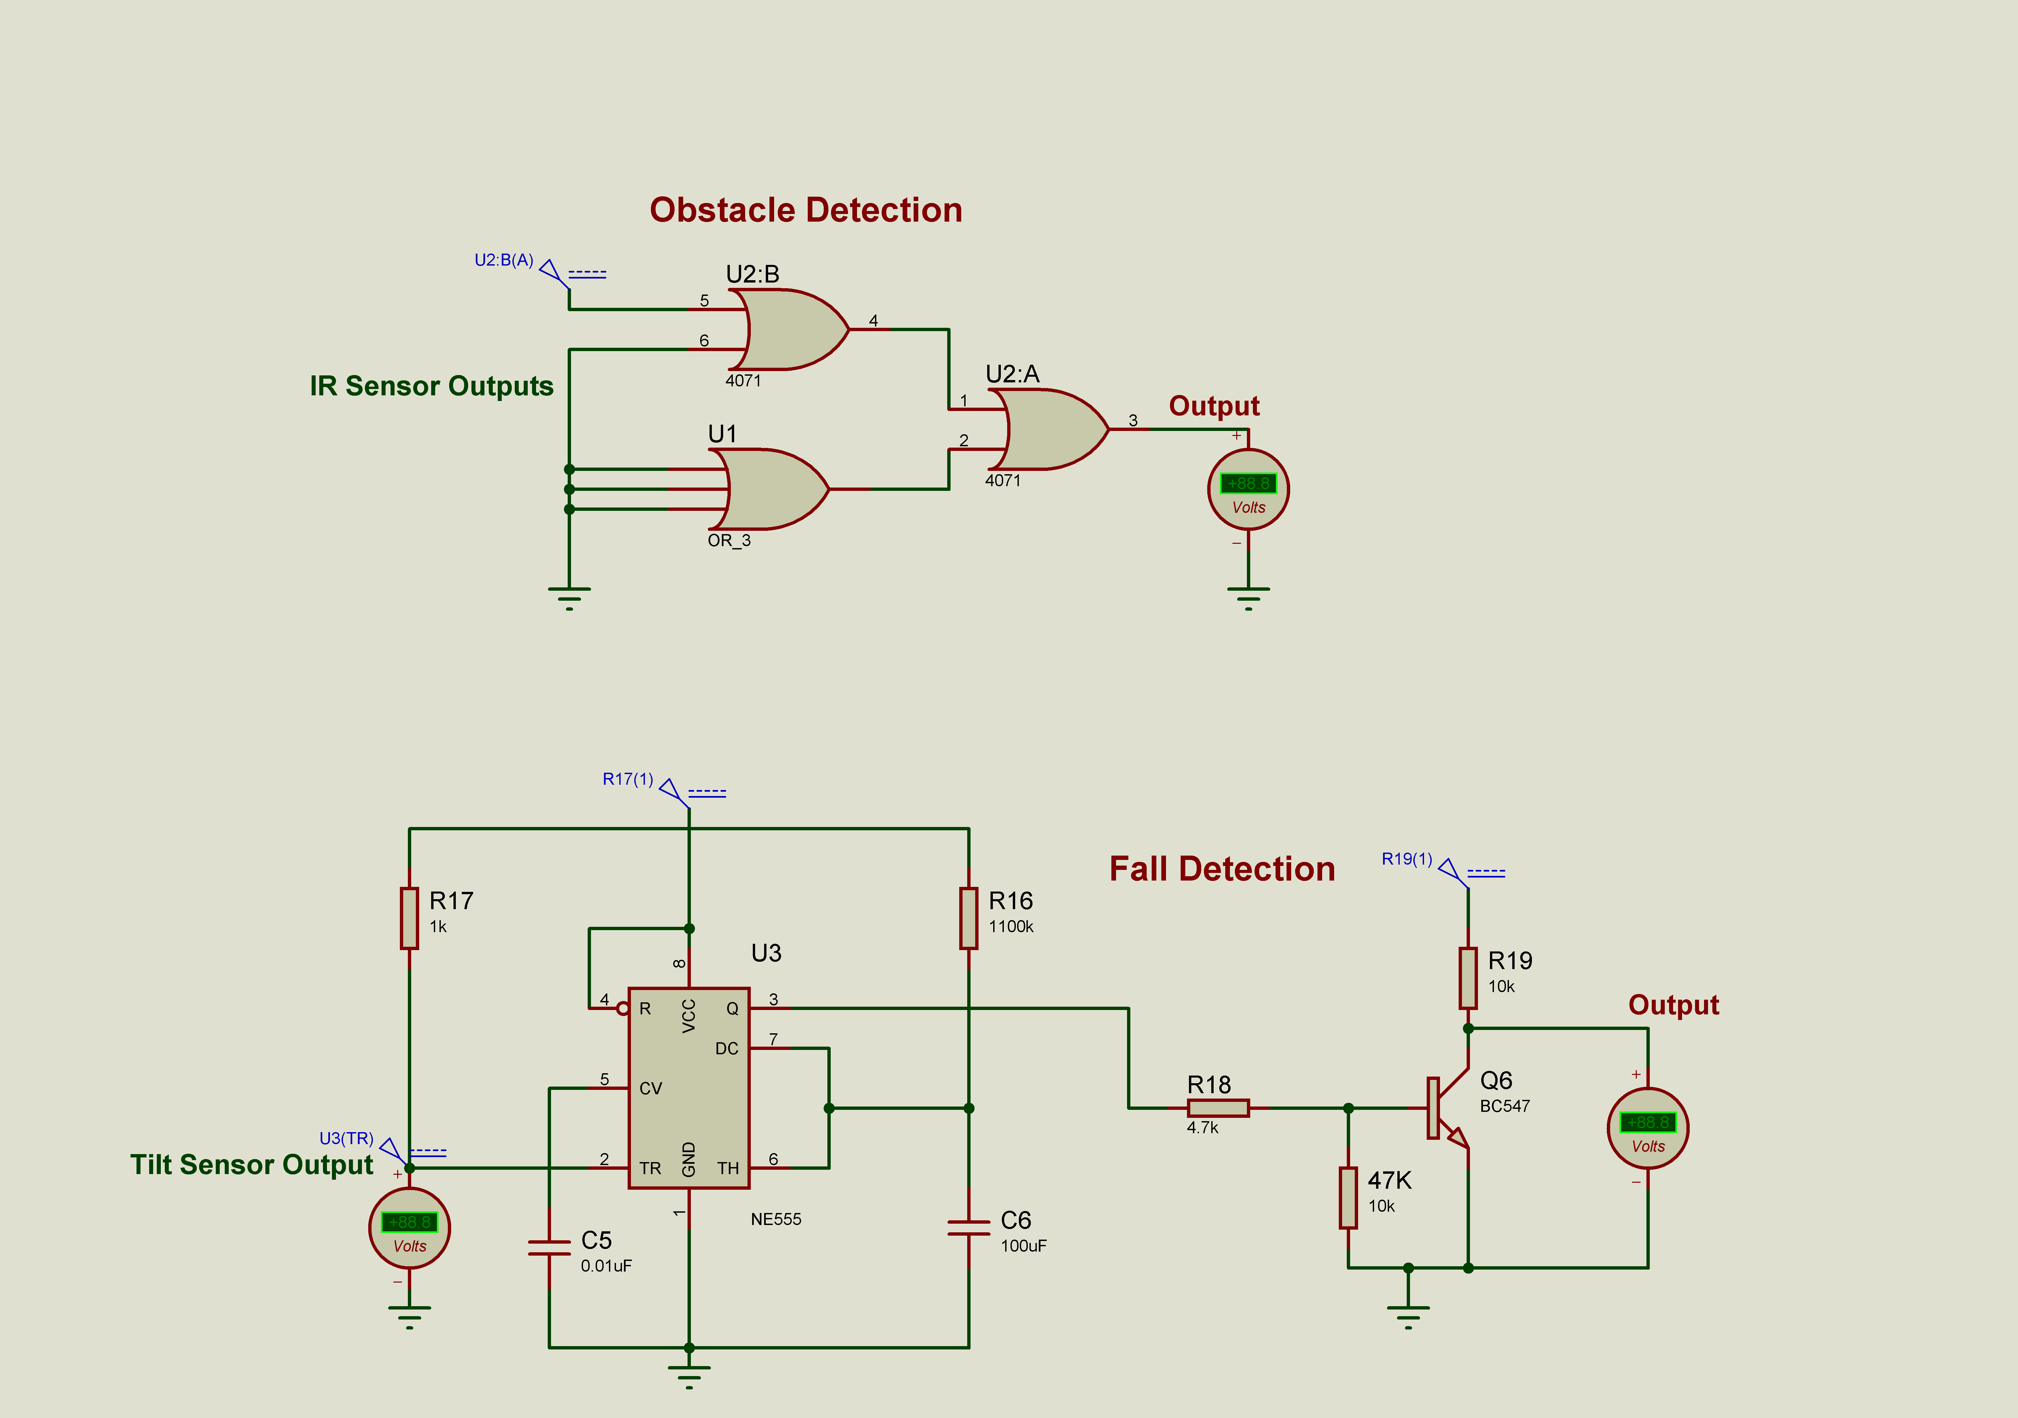
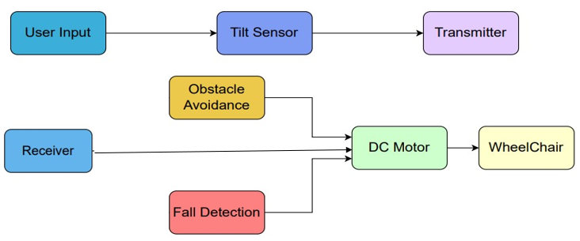
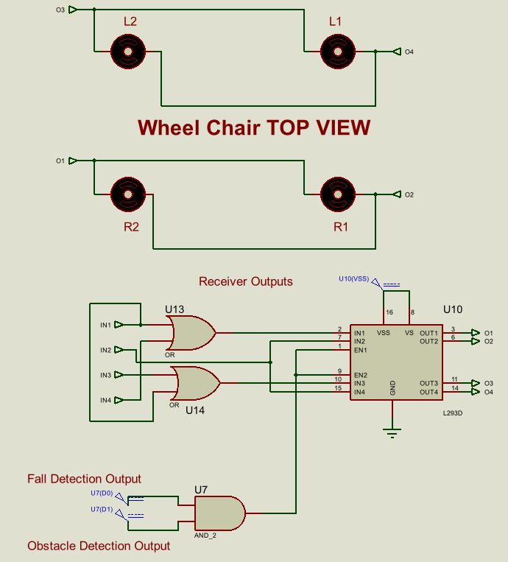
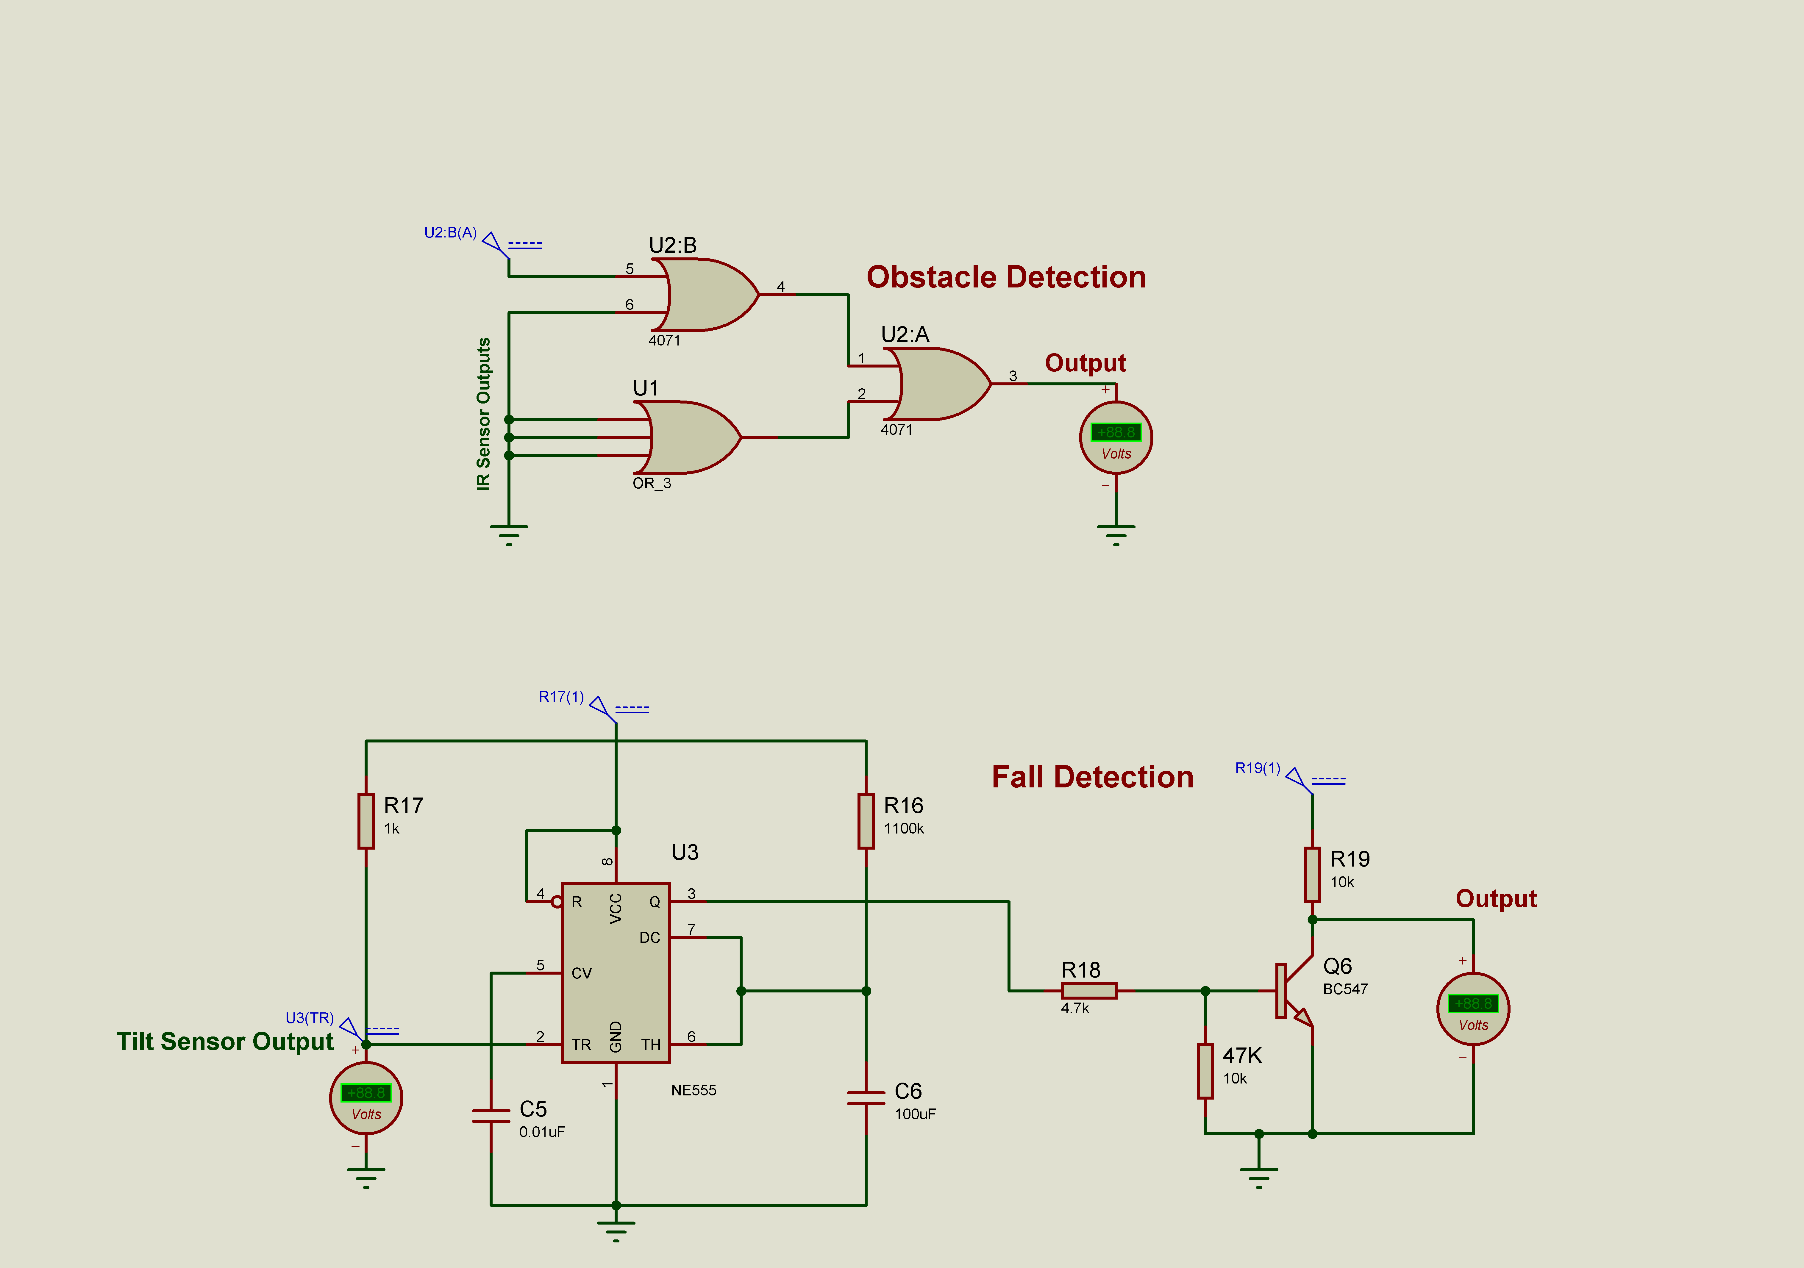
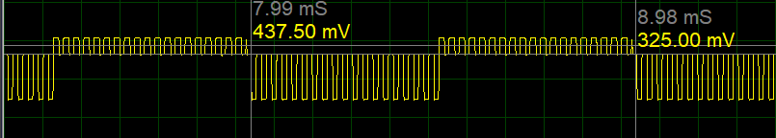

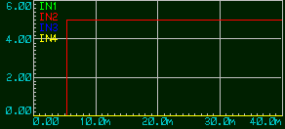

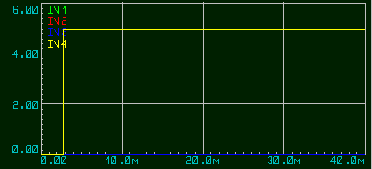
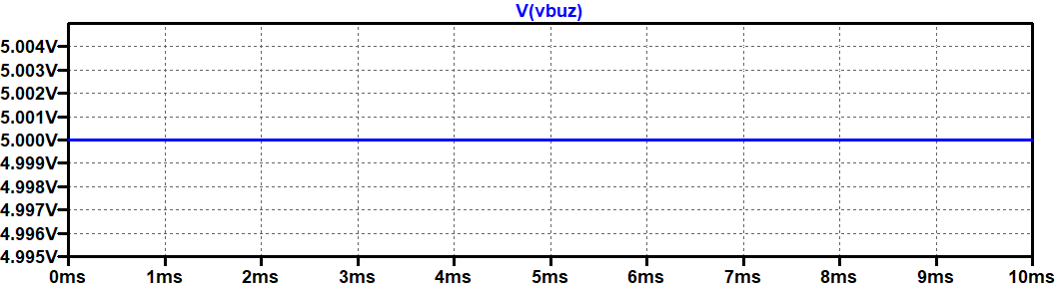
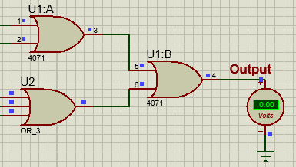
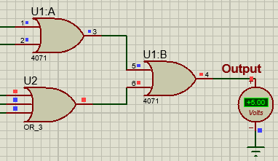
Department of Electronics and Communication Engineering
Amrita School of Engineering, Coimbatore - 641112
Batch ID : 23ECE381B08
B.Tech – ECE
23ECE381 Open Laboratory – I
Exhibition Date:11/ 10/ 25
A Wireless Hand Gesture-Controlled Wheelchair
CB.EN.U4ECE23121 – I Sahithi
CB.EN.U4ECE23132 – Rithigaa Shree T
CB.EN.U4ECE23143 – Sruthi Sakthivel
PROBLEM STATEMENT
CIRCUIT DIAGRAM
Motor Output:
Individuals with physical disabilities such as paralysis often face challenges in operating traditional wheelchairs, which require manual effort. For those with limited arm movement or finger dexterity, these methods can be difficult or impractical, increasing their dependence. Current wheelchair control systems lack adaptability, ease of use, and affordability for diverse user needs.
This project proposes a wireless hand gesture–based control mechanism that leverages sensor technology to translate intuitive hand movements into precise mobility commands, enhancing autonomy, comfort, and safety for users.
APPROACH / DESIGN/ METHODOLOGY
Block Diagram:
RESULTS
The tilt sensors generated stable 5V signals that triggered distinct modulation tones (200, 500, 700, 1000 Hz) for each gesture.
These tones successfully modulated the 38 kHz IR carrier and were transmitted reliably through the IR LED driver.
At the receiver, the TSOP1738 demodulated the carrier and recovered the original modulation frequencies.
Band-pass filters, comparators, and flip-flops accurately decoded and latched each command, producing clean direction outputs for the wheelchair.
Obstacle detection using IR sensors produced a digital low output when objects were within knee-height, disabling motor operation for safety.
Fall detection triggered the alarm circuit and motor cutoff within approximately 100ms, based on tilt sensor activation and rapid response timer circuitry.
The wheelchair motors, driven by the L293D IC, executed clockwise and anti-clockwise movement based on gesture inputs with reliable logic switching.
Safety circuits controlled the motor enable pins, preventing operation during obstacle or fall events, ensuring user protection throughout system testing.
Methodology:
Stage 1: Transmitter – The User
1. Sensor Input: 4 tilt sensors are attached to user’s hand detect hand gestures by acting as switches that change state based on hand movement.
2. Transmission of gestures: Each tilt sensor output goes into a separate oscillator section (using op-amp/comparator or 555 in astable mode). Forward → 200 Hz, Backward → 500 Hz, Left → 700 Hz, Right → 1000 Hz.
This allows FDM (Frequency-Division Multiplexing) → each gesture is encoded as a different modulation frequency.
A separate 38 kHz generator passed through a transistor driver stage, boosting current for the IR LED. The IR LED continuously sends the high-frequency 38 kHz carrier modulated at one of the four specific gesture frequencies.
Stage 2: Receiver – The Wheelchair
1. Reception: The TSOP1738 receives the 38 kHz IR signal and outputs only the low-frequency modulation (200/500/700/1000 Hz). This signal is passed through four band-pass filters, each tuned to one specific frequency for direction decoding. Each filtered tone is converted into a clean digital pulse using comparator stages. Finally, JK-flip-flops latch these pulses to give stable Forward/Backward/Left/Right outputs for motor control.
Safety Measures:
1. Obstacle Detection: IR sensors detect obstacles upto knee-length, and logic gates prevent motor operation to avoid collisions.
2. Fall Detection: Tilt sensor attached to the wheelchair detect falls, triggering alarms and disabling motors via a 555 timer.
2. Motor Driver: L293D IC controls wheelchair motors to move in clockwise/anti-clockwise direction based on the received signals. The obstacle and fall detector circuits control the enable pin of the motor.
SIMULATION RESULTS
Input from tilt sensors : 5V DC from each
Transmitter - Modulated Output:
When modulating wave = 1k Hz
Demodulated Outputs of Flip-Flops:
REFERENCES
M. R. Huda, "Developing a real-time hand-gesture recognition technique for smart wheelchair control system," PLoS ONE, vol. 20, no. 4, Apr. 2025.M. S. Sadi, "Finger-Gesture Controlled Wheelchair with Enabling IoT," IEEE Access, vol. 10, pp. 12345–12355, Nov. 2022.
Satish Kumar, Dheeraj, Neeraj, and Sandeep Kumar, “Design and Development of Head Motion Controlled Wheelchair,” International Journal of Advances in Engineering & Technology (IJAET), vol. 8, no. 5, pp. 816–822, Oct. 2015. ISSN: 2231-1963.
doi: 10.13140/RG.2.2.29123.71209.
DewanMohammed Abdul Ahad, Dewan Mohammed Rashid, Md. Sajid Hossain." Low Cost Obstacle Avoidance Robot with Logic Gates and Gate Delay Calculations". Vol.6,No.1,2018,pp.1-7.doi: 10.11648/j.acis.20180601.11
“CircuitDigest,”Circuitdigest.com, Nov. 13, 2015.https://circuitdigest.com/electronic-circuits/ir-transmitter-and-receiver-circuit? (accessed Sep. 01, 2025).
admin, “Vibration Alarm Circuit using Timer IC 555,” theoryCIRCUIT - Do It Yourself Electronics Projects, May 22, 2017. https://theorycircuit.com/ic-555-ic-741/vibration-alarm-circuit-using-timer-ic-555/? (accessed Sep. 01, 2025).
Fall Detector Output:
Obstacle Detector Outputs:

