Slide 1
23ECE381 - Open Lab Review 1
A Wireless Hand Gesture-Controlled Wheelchair For Differently Abled
Group Members
Sahithi I - CB.EN.U4ECE23121
Rithigaa Shree T - CB.EN.U4ECE23132
Sruthi Sakthivel - CB.EN.U4ECE23143

Slide 2
OBJECTIVES
To develop a low-cost wheelchair control system using tilt switches for hand gesture input, enabling users with limited mobility to navigate easily.
To design a wireless transmission system using NE555 timer ICs, transistors, and LC circuits, avoiding microcontrollers entirely.
To process gesture inputs through diode logic circuits and transmit them wirelessly to the receiver unit.
To implement obstacle avoidance using IR sensors and process signals with logic gates to control motor response automatically.
To include a fall detection unit using tilt/vibration sensors and logic-based interruption to halt motor operation during instability.

Slide 3
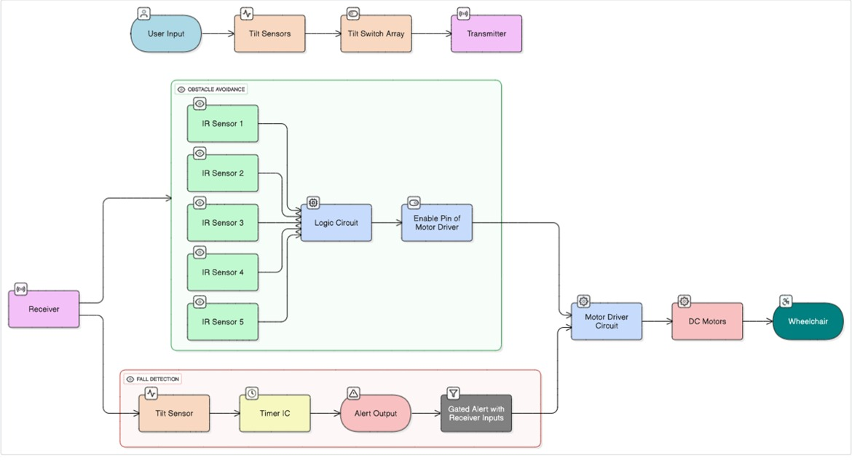
Methodology – Block Diagram

Slide 4
NAME OF THE PAPER | SOURCE |  | INFERENCE
 | PUBLISHED BY | YEAR PUBLISHED
Design and Development of Head Motion Controlled Wheelchair | International Journal of Advances in Engineering & Technology (IJAET) | 2015 | Tilt sensors detect head movement by changing internal contact states, giving 0 V when tilted and 5 V when idle via a voltage divider. Diode logic processes these outputs to produce direction-specific control signals.

Slide 5
NAME OF THE PAPER | SOURCE |  | INFERENCE
 | PUBLISHED BY | YEAR PUBLISHED
Simple Design of Transmitter Circuit and Optimization Design of Receiver Circuit for Wireless Power Transfer | IOP Publishing | 2018 | LC tank circuit transmits this frequency wirelessly via magnetic induction. Receiver LC tank picks up the transmitted frequency. The signal is rectified, filtered, and decoded to identify the gesture.

Slide 6
NAME OF THE PAPER | SOURCE |  | INFERENCE
 | PUBLISHED BY | YEAR PUBLISHED
Low Cost Obstacle Avoidance Robot with Logic Gates and Gate Delay Calculations | Automation, Control and Intelligent Systems, Science Publishing Group | 2018 | IR sensors detect obstacles and send binary signals (1 = detected, 0 = clear). Signals are processed using AND, OR, and NOT gates to form logic equations. Logic outputs control the motor driver IC. Motor driver enables the robot to move left, right, forward, or stop based on obstacle positions.

Slide 7
References:
Satish Kumar, Dheeraj, Neeraj, and Sandeep Kumar, “Design and Development of Head Motion Controlled Wheelchair,” International Journal of Advances in Engineering & Technology (IJAET), vol. 8, no. 5, pp. 816–822, Oct. 2015. ISSN: 2231-1963. doi: 10.13140/RG.2.2.29123.71209
I. Sukma, S. W. Hidayat, A. R. Hidayat and I. Supono, "Simple Design of Transmitter Circuit and Optimization Design of Receiver Circuit for Wireless Power Transfer," IOP Conf. Ser.: Earth Environ. Sci., vol. 166, p. 012033, 2018. doi: 10.1088/1755-1315/166/1/012033
Dewan Mohammed Abdul Ahad, Dewan Mohammed Rashid, Md. Sajid Hossain." Low Cost Obstacle Avoidance Robot with Logic Gates and Gate Delay Calculations".
Vol. 6, No. 1, 2018, pp. 1-7. doi: 10.11648/j.acis.20180601.11

Slide 8
THANK YOU

