Slide 1
A Wireless Hand Gesture-Controlled Wheelchair For Differently Abled
23ECE381 - Open Lab Review 2
Team Members:
Sahithi I - CB.EN.U4ECE23121
Rithigaa Shree T- CB.EN.U4ECE23132
Sruthi Sakthivel- CB.EN.U4ECE23143

Slide 2
Objectives
To develop a low-cost wheelchair control system using tilt switches for hand gesture input, enabling users with limited mobility to navigate easily.
To design a wireless transmission system using NE555 timer ICs, transistors, and LC circuits, avoiding microcontrollers entirely.
To process gesture inputs through diode logic circuits and transmit them wirelessly to the receiver unit.
To implement obstacle avoidance using IR sensors and process signals with logic gates to control motor response automatically.
To include a fall detection unit using tilt/vibration sensors and logic-based interruption to halt motor operation during instability.

Slide 3
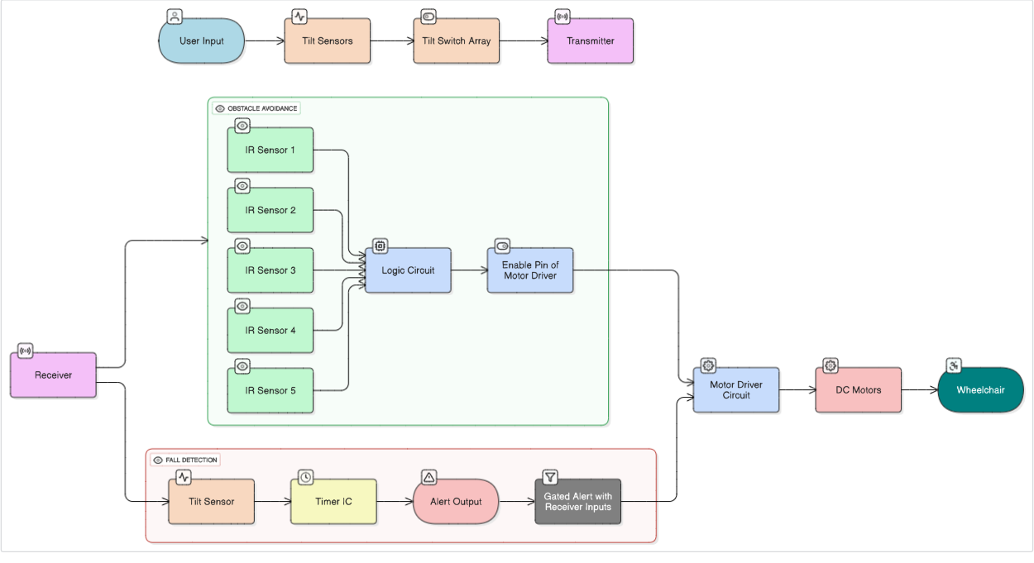
We will talk about this first.
Block Diagram
Add a brief introduction of your section here: Let’s dive in and get to know some interesting facts about animals!

Slide 4
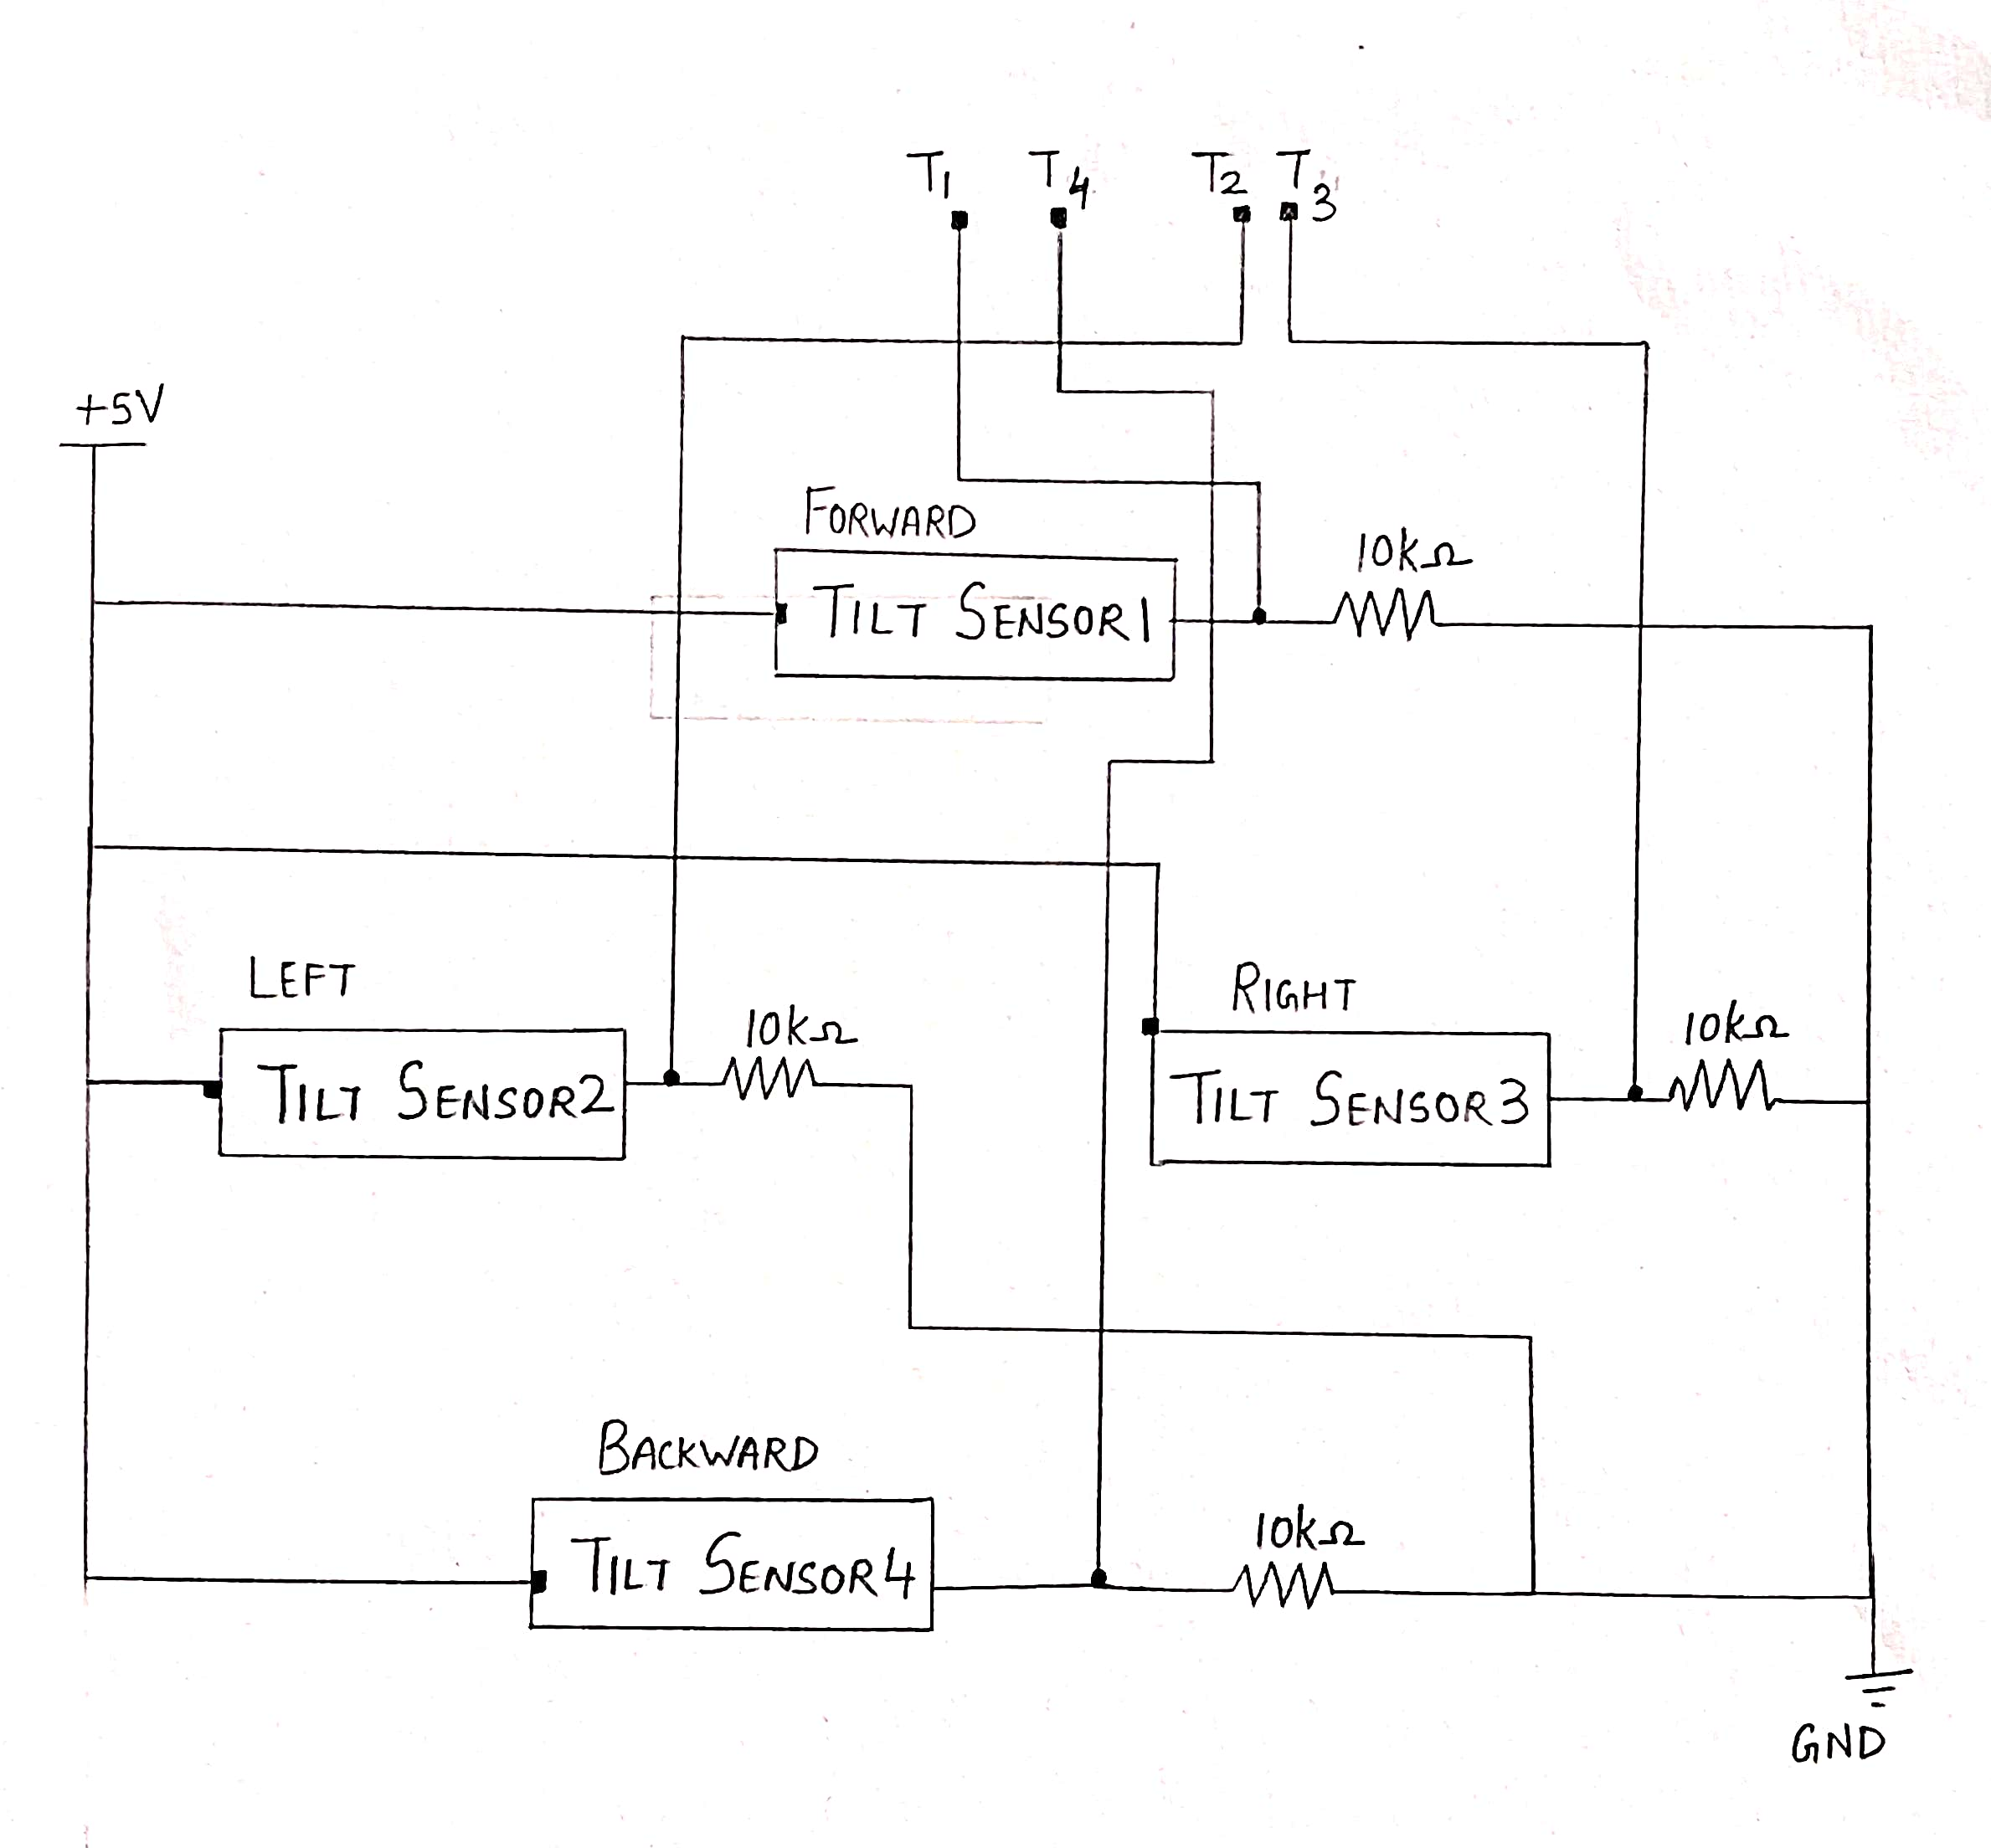
1. Sensor input
1. Sensor Input
Tilt sensors are used to detect the direction of head tilt by means of a free mass rolling ball inside that either closes or opens a contact between its pins. ​
Each tilt sensor is just a switch that closes when idle and opens when tilted. One end of each sensor goes to +5 V. The other end of the sensor goes to a 10 kΩ resistor to GND. The node between sensor and resistor is the output signal.​

Slide 5
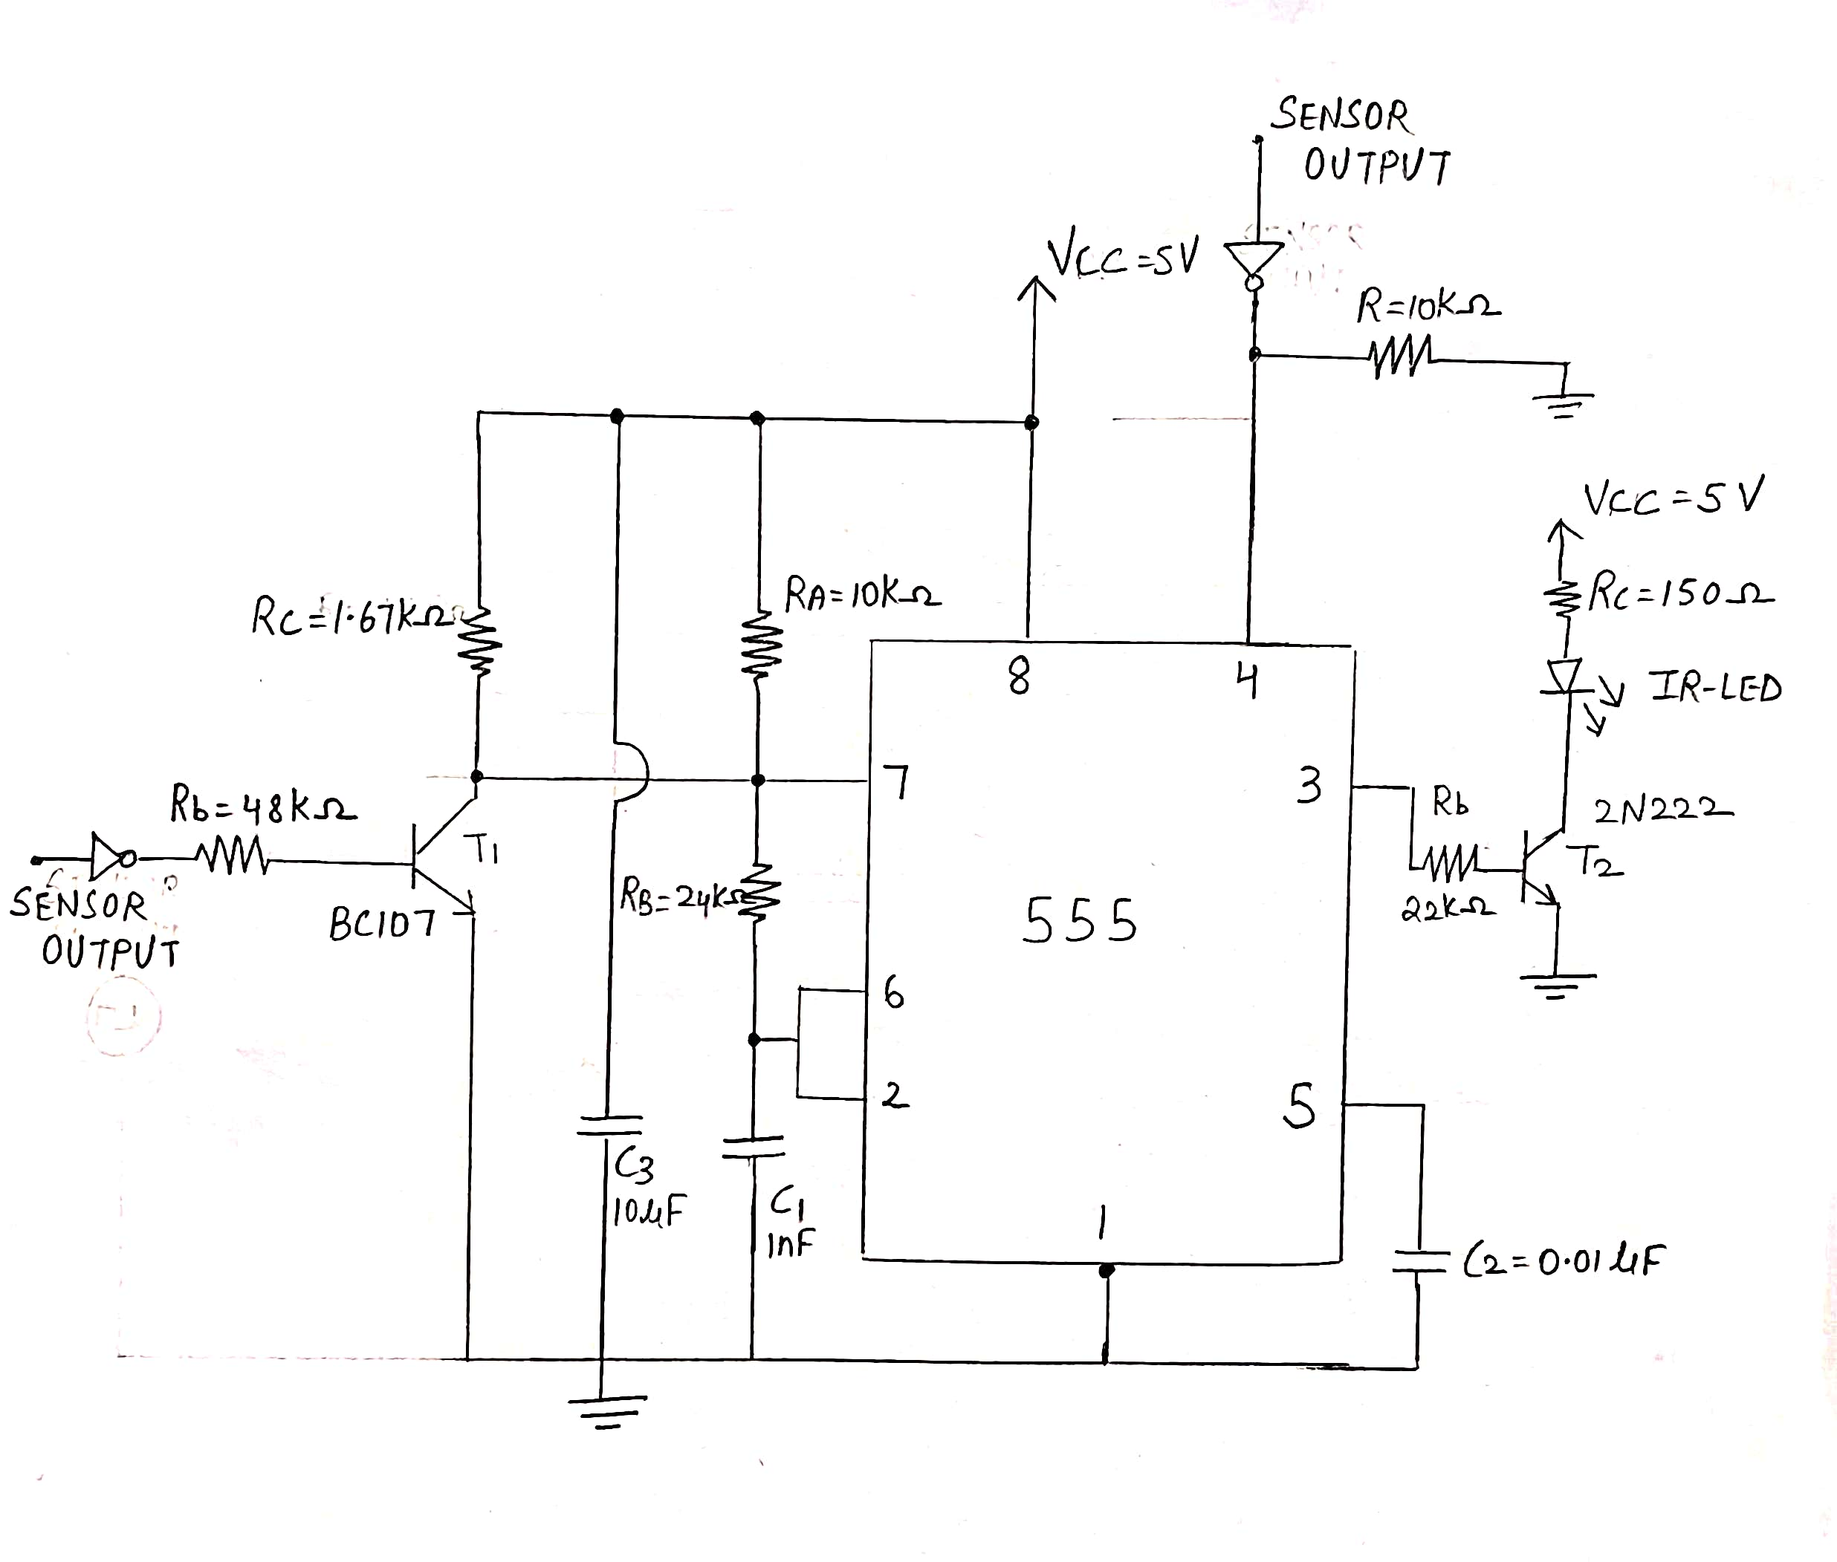
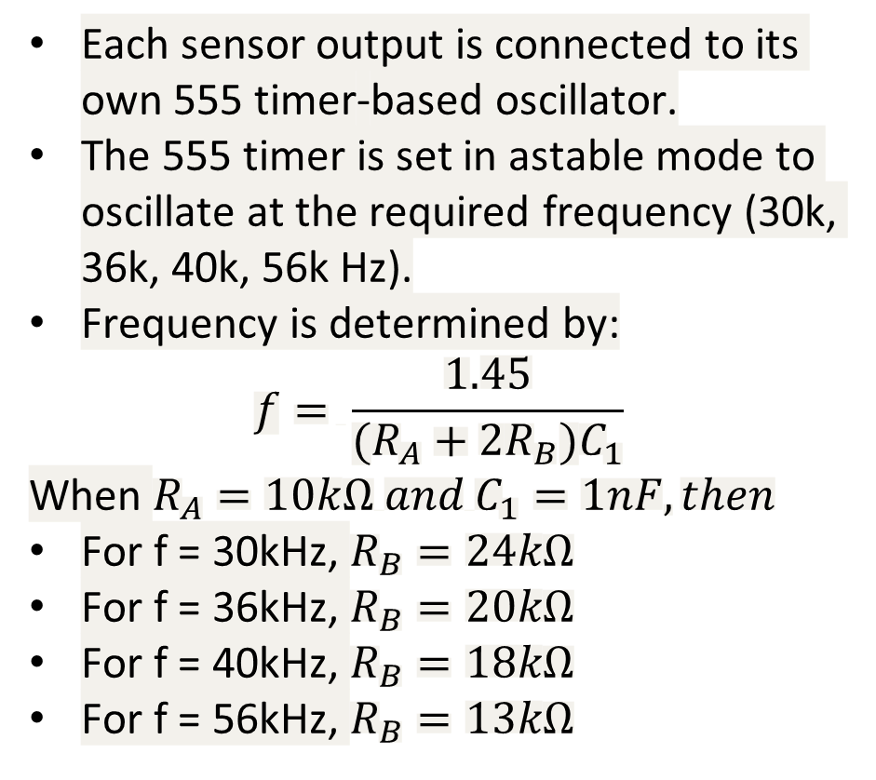
2. Transmitter
2.Transmitter
Each sensor output is connected to its own 555 timer-based oscillator.
The 555 timer is set in astable mode to oscillate at the required frequency (30k, 36k, 40k, 56k Hz).
Frequency is determined by:
$$f= \frac{1.45}{(R_{A}+2R_{B})C_{1}}$$
When $R_{A}=10kΩ and{ C}_{1}=1nF, then$
For f = 30kHz, $R_{B}=24kΩ$
For f = 36kHz, $R_{B}=20kΩ$
For f = 40kHz, $R_{B}=18kΩ$
For f = 56kHz, $R_{B}=13kΩ$

Slide 6
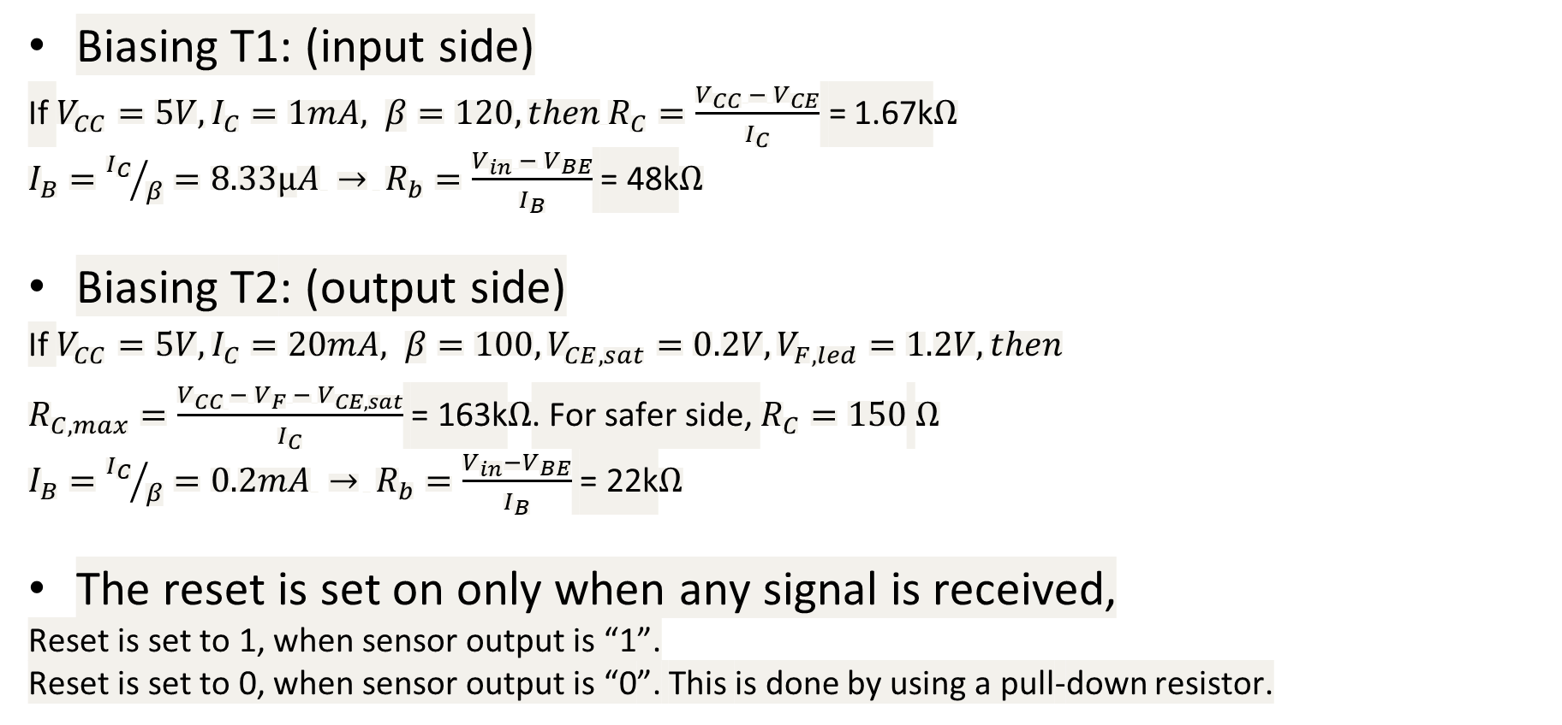
Calculations:
Biasing T1: (input side)
If $V_{CC}=5V, I_{C}=1mA, β=120, then R_{C}=\frac{V_{CC} − V_{CE}}{I_{C}}$ = 1.67k$Ω$
$I_{B}={I_{C}}/β=8.33μA → R_{b}=\frac{V_{in} −{ V}_{BE}}{I_{B}}$ = 48k$Ω$
Biasing T2: (output side)
If $V_{CC}=5V, I_{C}=20mA, β=100,V_{CE,sat}=0.2V,V_{F,led}=1.2V, then$
$R_{C,max}=\frac{V_{CC }− V_{F} − V_{CE,sat}}{I_{C}}$ = 163k$Ω$. For safer side, $R_{C}=150$ $Ω$
$I_{B}={I_{C}}/β=0.2mA → R_{b}=\frac{V_{in}−V_{BE}}{I_{B}}$ = 22k$Ω$
The reset is set on only when any signal is received,
Reset is set to 1, when sensor output is “1”.
Reset is set to 0, when sensor output is “0”. This is done by using a pull-down resistor.

Slide 7
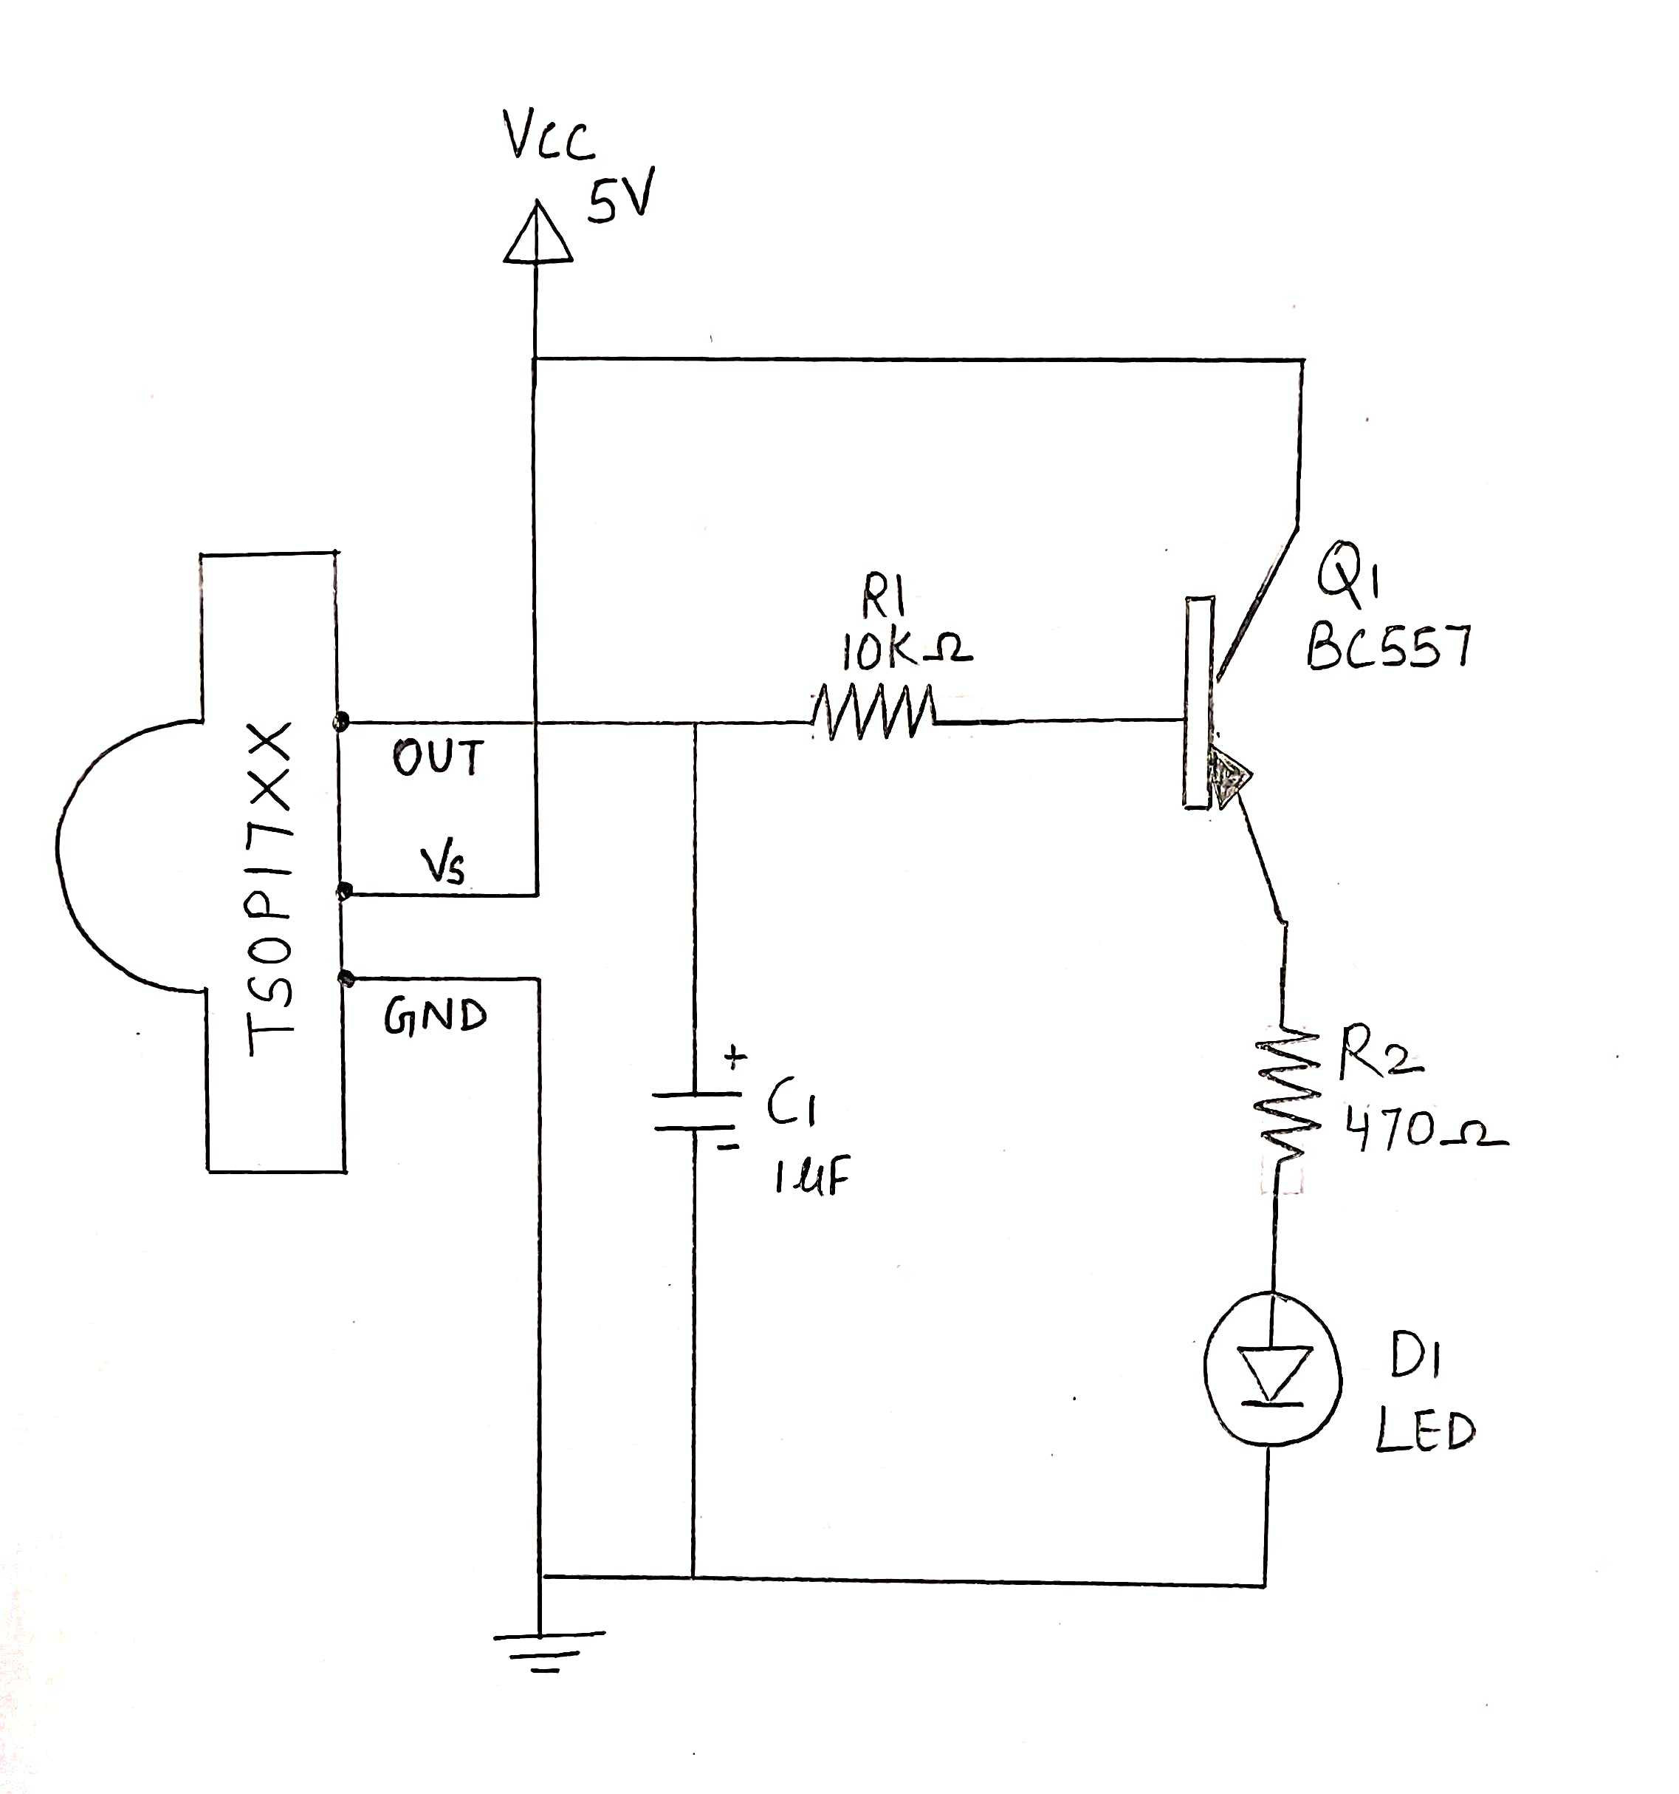
1. Sensor input
3. Receiver
The receiver stage is: TSOP output → RC smoothing → PNP high-side switch → LED.
TSOP’s output is active low, so normally TSOP output remains HIGH and Transistor behaves as open switch and LED will be OFF. As soon as TSOP detects Infrared, its output becomes low and transistor behaves as closed switch and LED will be ON.
Why TSOP receiver? TSOP operates on particular frequency so that other IRs in the environment can’t interfere, except the modulated IR of particular frequency.
Use the TSOP version matching the respective channel transmit frequency (1730/1736/1740/1756).

Slide 8
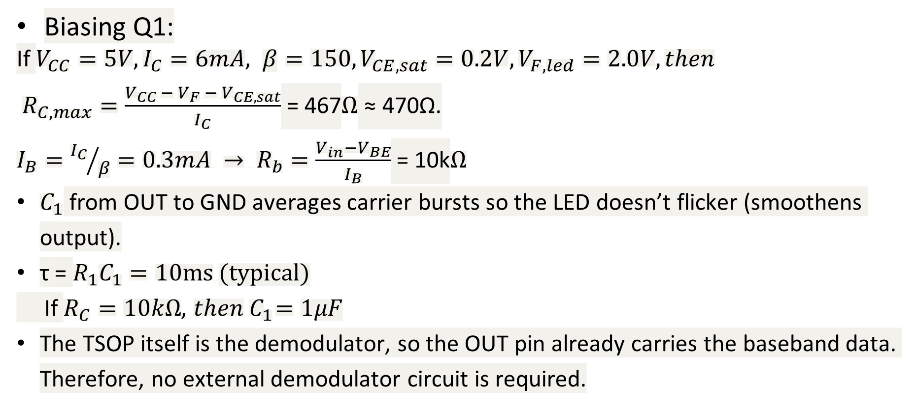
Calculations:
Biasing Q1:
If $V_{CC}=5V, I_{C}=6mA, β=150,V_{CE,sat}=0.2V,V_{F,led}=2.0V, then$
$R_{C,max}=\frac{V_{CC }− V_{F} − V_{CE,sat}}{I_{C}}$ = 467$Ω$ ≈ 470Ω.
$I_{B}={I_{C}}/β=0.3mA → R_{b}=\frac{V_{in}−V_{BE}}{I_{B}}$ = 10k$Ω$
$C_{1}$ from OUT to GND averages carrier bursts so the LED doesn’t flicker (smoothens output).
τ = $R_{1}C_{1}=10ms (typical)$
If $R_{C}=10kΩ, { then C}_{1}=1μF$
The TSOP itself is the demodulator, so the OUT pin already carries the baseband data. Therefore, no external demodulator circuit is required.

Slide 9
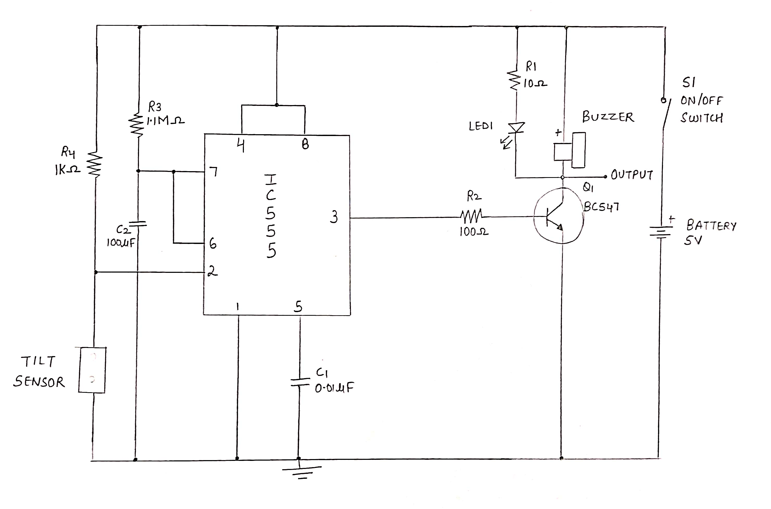
1. Sensor input
4. Fall Detection
When the fall detected by the tilt sensor, it will produce trigger signal and it triggers the timer IC 555 which produces monostable timing pulse up to 120 sec.
T = 1.1 x R x C
120 = 1.1 x R x 100µ
R = 1.1 MΩ
The output pulse taken from pin 3 is applied to the NPN transistor BC547, here the Q1 reacts as switching device and makes contact between buzzer, LED to ground supply and lasts up to mono pulse end. This is also given to the motor driver circuit as enable.
If fall detected, the enable of the motor driver circuit should be low and hence stop the wheels from moving.

Slide 10
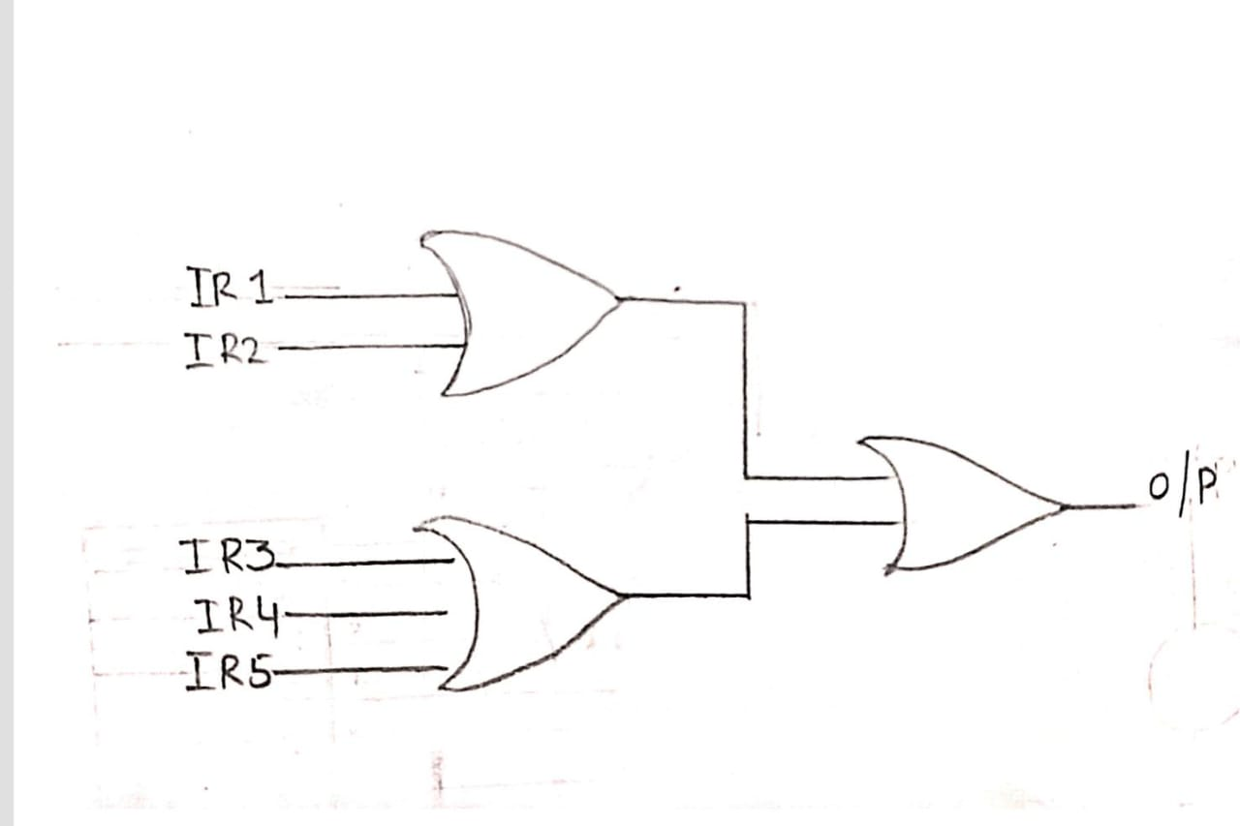
1. Sensor input
5. Obstacle Avoidance
Two IR sensors are placed in the front(5cm above the ground level), two sensors at knee level, and one at the back.
Each IR sensor detects obstacles up to knee length in front of the wheelchair.
When an obstacle is detected:
IR sensor output becomes HIGH (logic 1).
If the path is clear, the output remains LOW
If any one IR sensor detects an obstacle, the enable circuit sends a stop signal to the motor, ensuring user safety.

Slide 11
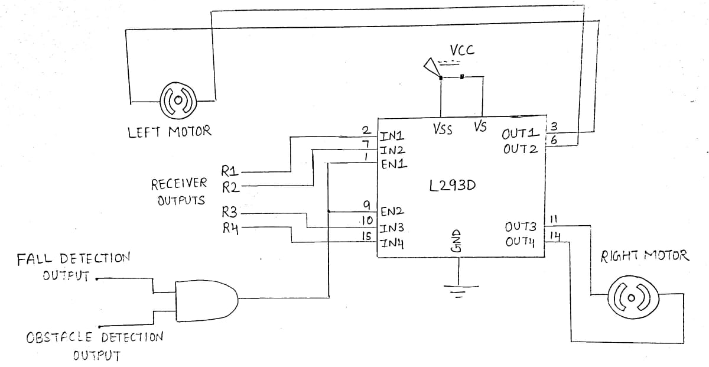
1. Sensor input
6. Motor Driver Circuit

Slide 12
1. Sensor input
6. Motor Driver Circuit - Analysis
L293D is a quadruple half-H driver IC that can drive two DC motors in both directions.
The IR receiver outputs are usually active-low. When control signals are applied at PNP transistor bases, they switch the corresponding L293D input lines. They provide current amplification and allow external signals to directly operate the motor inputs.
Diodes are used to protect the transistors and IC from back-EMF generated when the motors stop or change direction suddenly. They clamp negative voltage spikes to safe levels.
in1 | in2 | in3 | in4 | Out1 | Out2 | Out3 | Out4 | Direction
1 | 0 | 0 | 1 | +ve | -ve | -ve | +ve | FWD
1 | 0 | 1 | 0 | +ve | -ve | +ve | -ve | RGT
0 | 1 | 0 | 1 | -ve | +ve | -ve | +ve | LFT
0 | 1 | 1 | 0 | -ve | +ve | +ve | -ve | BWD
0 | 0 | 0 | 0 | NIL | NIL | NIL | NIL | STOP

Slide 13
1. Sensor input
6. Analysis of each stage
The Output of the tilt sensors are passed to the wheelchair(receiver) wirelessly through 4 channels through different modulating frequencies of carrier.
The modulator used is FSK and it is transmitted using IR LED to transmit each bit. (4 bits in parallel)
The modulated signal is received by the wheelchair using an IR receiver sensor. This sensor has inbuilt demodulator which recovers the message signal.
The received signal is fed to the motor which control the movement of the wheels through a motor driver circuit consisting of L293D IC.
The L293D IC controls the direction of the wheel, by using a H-bridge configuration to control 2 DC motors – Left motor and right motor.
The received signal is gated with the output of the fall detection circuit to operate the motors. The fall detection circuit detects the fall and this makes the motors to turn off and ring a buzzer as a call for help.
Obstacle avoidance circuit is made using logic circuit from output from 5 IR sensors and all the possible combinations are considered and expressions of each motor is constructed. This output is given as the enable of the motor driver IC, which only enables the motor to be ON only if no obstacle is found.

Slide 14
8. References
Satish Kumar, Dheeraj, Neeraj, and Sandeep Kumar, “Design and Development of Head Motion Controlled Wheelchair,” International Journal of Advances in Engineering & Technology (IJAET), vol. 8, no. 5, pp. 816–822, Oct. 2015. ISSN: 2231-1963. doi: 10.13140/RG.2.2.29123.71209 ​​
Dewan Mohammed Abdul Ahad, Dewan Mohammed Rashid, Md. Sajid Hossain." Low Cost Obstacle Avoidance Robot with Logic Gates and Gate Delay Calculations". ​
Vol. 6, No. 1, 2018, pp. 1-7. doi: 10.11648/j.acis.20180601.11​
“CircuitDigest,” Circuitdigest.com, Nov. 13, 2015. https://circuitdigest.com/electronic-circuits/ir-transmitter-and-receiver-circuit? (accessed Sep. 01, 2025).
admin, “Vibration Alarm Circuit using Timer IC 555,” theoryCIRCUIT - Do It Yourself Electronics Projects, May 22, 2017. https://theorycircuit.com/ic-555-ic-741/vibration-alarm-circuit-using-timer-ic-555/? (accessed Sep. 01, 2025).
“Learn & Make your own Cheap L293D motor Driver(A complete guide for l293D),” Just4electronics, Aug. 28, 2015. https://just4electronics.wordpress.com/2015/08/28/learn-make-your-own-cheap-l293d-motor-drivera-complete-guide-for-l293d/ (accessed Sep. 01, 2025).

