Slide 1
Python
Introduction
Installation Python
Installation of VS Code

Slide 2
Introduction
Python Support Functional & Object Orient Paradigm
Can be developed webapps, Data analysis & ML with python

Slide 3
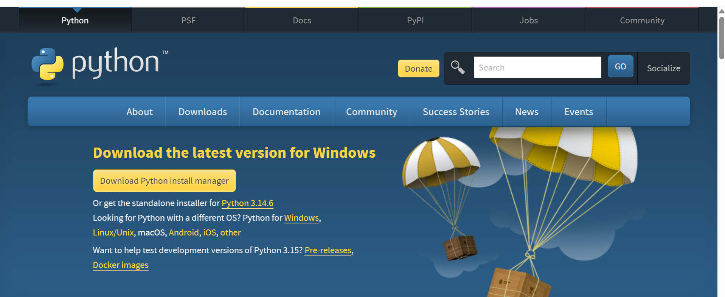
Installing Python

Slide 4
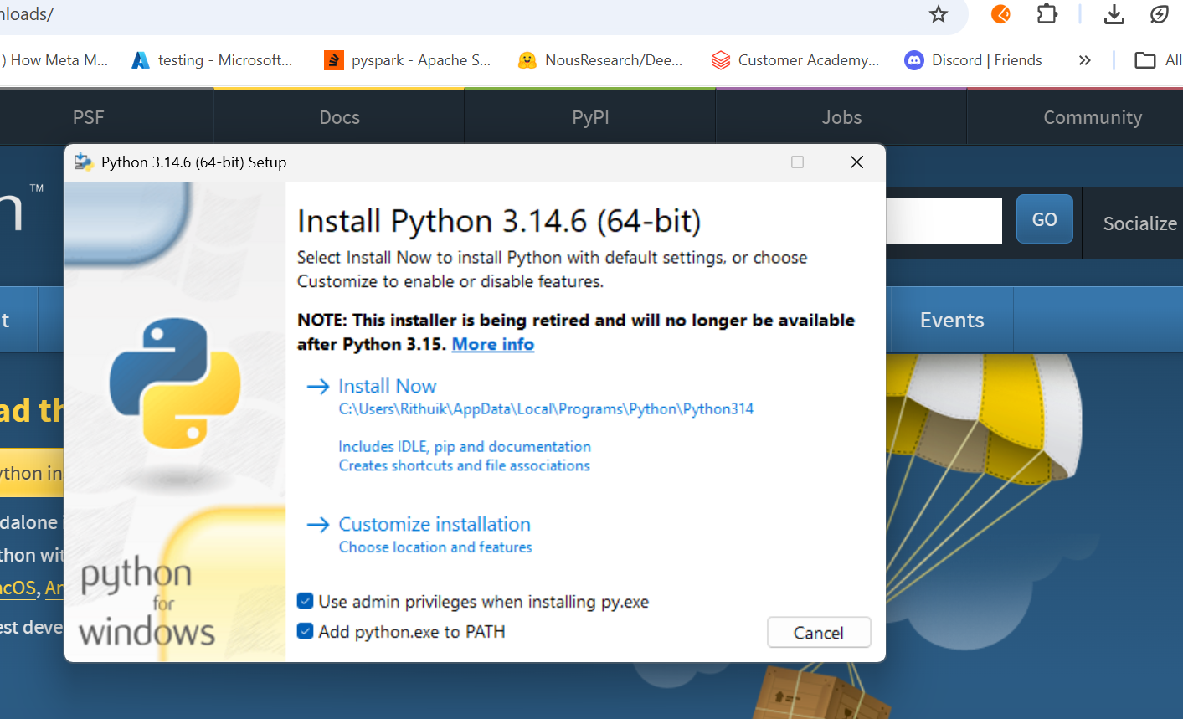

Slide 5
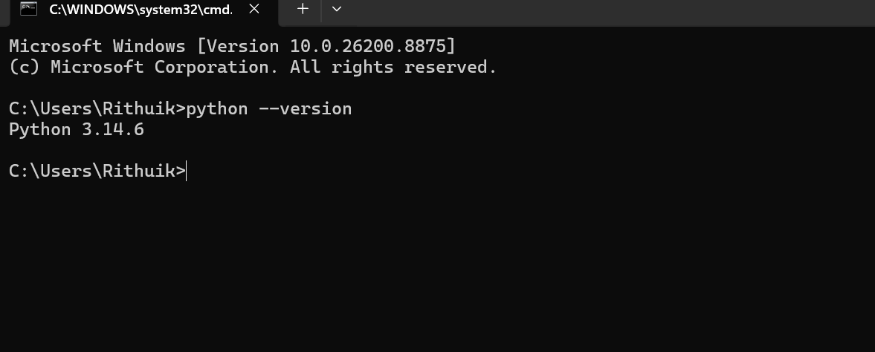
Installation Verification

Slide 6
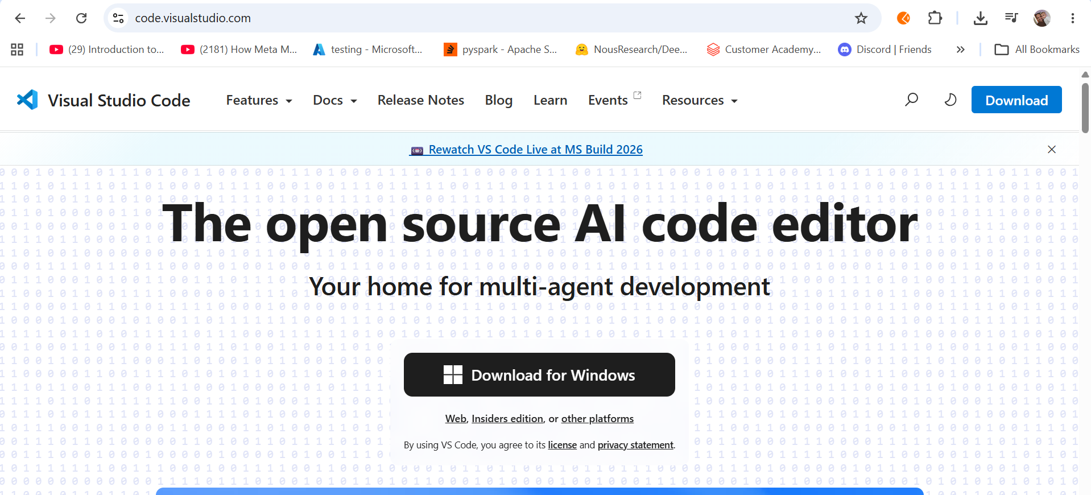
VS CODE INSTALLATION

Slide 7
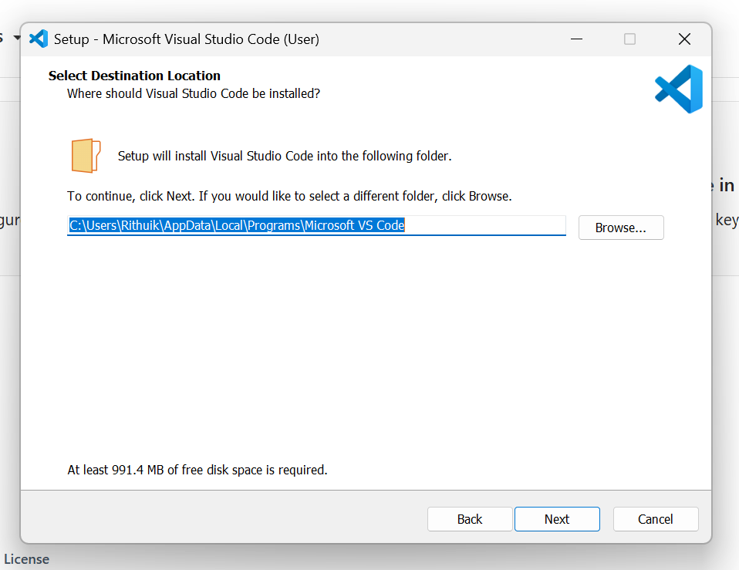

Slide 8
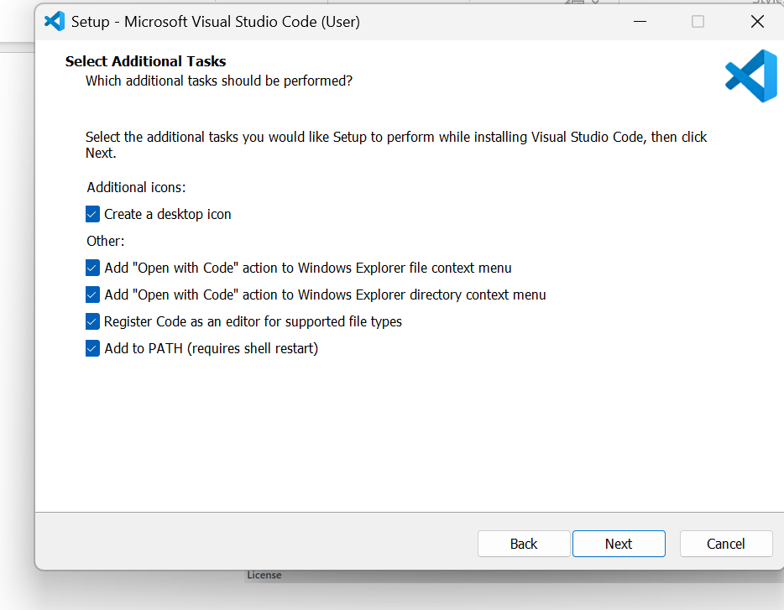

Slide 9
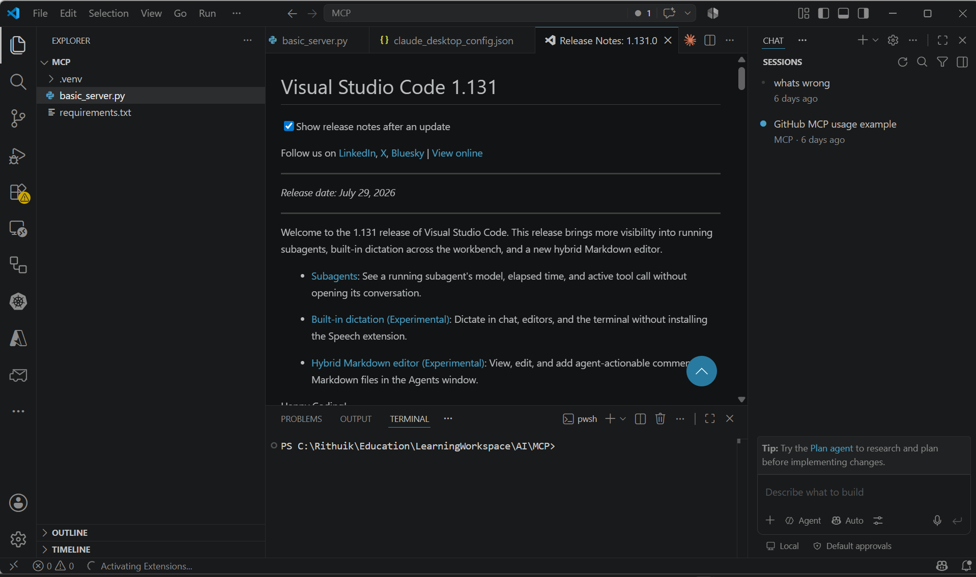

Slide 10
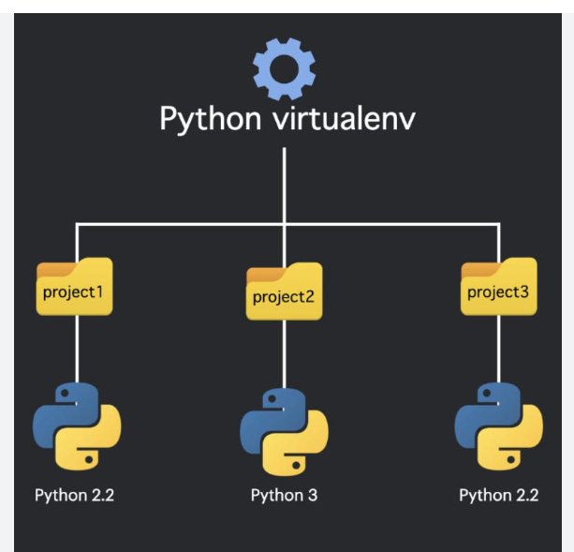
Python Virtual Environment

Slide 11
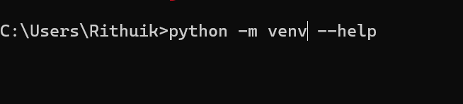
Creating Python Venv
Python –m venv

