Slide 1
Training Models. Linear classifiers and Decision Trees
What is learning? Minimizing training loss
Linear models
How to train linear models with gradient descent
All modern learning is optimization with gradient descent
Quick intro to Regularization in linear regression: Ridge Regression and Lasso
Part 2: How to train Decision Trees

Slide 2
Training Linear models
Linear regression
Training a linear regression with gradient descent
Learning is optimization.
Essence of all of deep learning training

Slide 3
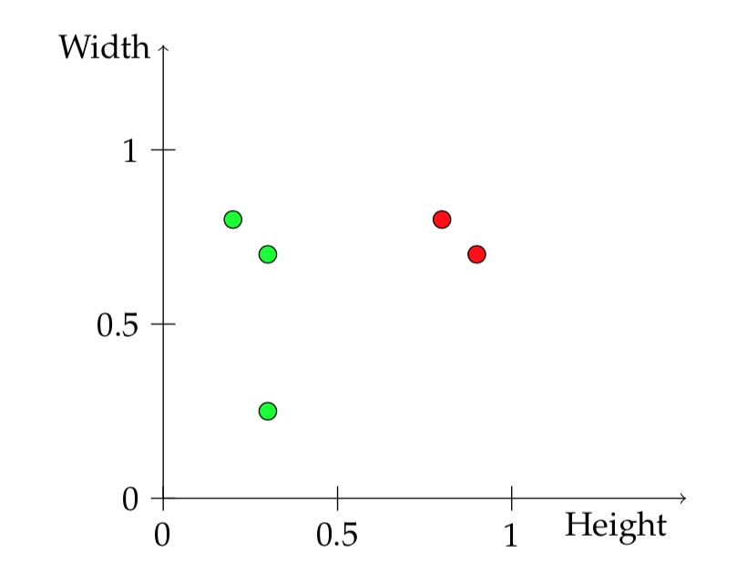
Binary classification with a linear classifier
 | Acidity(A) | Sweetness (S) | y=‘Great taste’? | Model 3 predicts
Bev1 | 0.8 | 0.8 | 1 | ?
Bev2 | 0.3 | 0.25 | 0 | ?
Bev3 | 0.2 | 0.8 | 0 | ?
Bev4 | 0.3 | 0.7 | 0 | ?
Bev5 | 0.9 | 0.7 | 1 | ?
features (A,S)
Model Parameters:
β₀ , β₁ ,β₂
Model 3:
f(A,S) = 1 if A+S -1 ≥ 0
0 otherwise
Sweetness
predictions
f(A,S)
Compute the predictions of this model.
Draw the decision boundary
Acidity

Slide 4
Binary classification with a linear classifier
 | Acidity(A) | Sweetness (S) | y=‘Great taste’? | Model 3 predicts
Bev1 | 0.8 | 0.8 | 1 | ?
Bev2 | 0.3 | 0.25 | 0 | ?
Bev3 | 0.2 | 0.8 | 0 | ?
Bev4 | 0.3 | 0.7 | 0 | ?
Bev5 | 0.9 | 0.7 | 1 | ?
features (A,S)
Model Parameters:
β₀ , β₁ ,β₂
Model 3:
f(A,S) = 1 if A+S -1 ≥ 0
0 otherwise
Sweetness
predictions
f(A,S)
Compute the predictions of this model.
Draw the decision boundary
Acidity

Slide 5
Binary classification with a linear classifier
 | Acidity(A) | Sweetness (S) | y=‘Great taste’? | Model 3 predicts
Bev1 | 0.8 | 0.8 | 1 | ?
Bev2 | 0.3 | 0.25 | 0 | ?
Bev3 | 0.2 | 0.8 | 0 | ?
Bev4 | 0.3 | 0.7 | 0 | ?
Bev5 | 0.9 | 0.7 | 1 | ?
features (A,S)
Model Parameters:
β₀ , β₁ ,β₂
predictions
f(A,S)

Slide 6
Linear regression
 | Acidity(A) | Sweetness (S) | y=Sales | Model 4 predicts
Bev1 | 0.8 | 0.8 | 80 | ?
Bev2 | 0.3 | 0.25 | 20 | ?
Bev3 | 0.2 | 0.8 | 30 | ?
Bev4 | 0.3 | 0.7 | 10 | ?
Bev5 | 0.9 | 0.7 | 70 | ?
features (A,S)
Model Parameters:
β₀ , β₁ ,β₂
For linear regression y is continuous
Model predicts a linear combination of features:
f(A,S) =β₀ + β₁ A+ β₂ S
Example model 4: β₀ =10 , β₁ =100 , β₂ = 0
Run the predictions of this model.
predictions
f(A,S)
Learning means update parameters to make predictions agree with training data.

Slide 7
Linear regression
 | Acidity(A) | Sweetness (S) | y=Sales | Model 4 predicts
Bev1 | 0.8 | 0.8 | 80 | 90
Bev2 | 0.3 | 0.25 | 20 | 40
Bev3 | 0.2 | 0.8 | 30 | 30
Bev4 | 0.3 | 0.7 | 10 | 40
Bev5 | 0.9 | 0.7 | 70 | 100
For linear regression y is continuous
Model predicts a linear combination of features:
f(A,S) =β₀ + β₁ A+ β₂ S
Example model 4: β₀ =10 , β₁ =100 , β₂ = 0
Run the predictions of this model.
Q: Is this a good model? How do we measure error for regression ?

Slide 8
Linear regression
 | Acidity(A) | Sweetness (S) | y=Sales | Model 4 predicts
Bev1 | 0.8 | 0.8 | 80 | 90
Bev2 | 0.3 | 0.25 | 20 | 40
Bev3 | 0.2 | 0.8 | 30 | 30
Bev4 | 0.3 | 0.7 | 10 | 40
Bev5 | 0.9 | 0.7 | 70 | 100
For linear regression y is continuous
Model predicts a linear combination of features:
f(A,S) =β₀ + β₁ A+ β₂ S
Example model 4: β₀ =10 , β₁ =100 , β₂ = 0
Run the predictions of this model.
Q: Is this a good model? How do we measure error for regression ?
A: Standard loss function: mean squared error: MSE=
f(A,S) =β₀ + β₁ A+ β₂ S
Example model 4: β₀ =10 , β₁ =10 , β₂ = 0
Compute the MSE loss of this model on the training set:

Slide 9
Linear regression
 | Acidity(A) | Sweetness (S) | y=Sales | Model 4 predicts
Bev1 | 0.8 | 0.8 | 80 | 90
Bev2 | 0.3 | 0.25 | 20 | 40
Bev3 | 0.2 | 0.8 | 30 | 30
Bev4 | 0.3 | 0.7 | 10 | 40
Bev5 | 0.9 | 0.7 | 70 | 100
For linear regression y is continuous
Model predicts a linear combination of features:
f(A,S) =β₀ + β₁ A+ β₂ S
Example model 4: β₀ =10 , β₁ =100 , β₂ = 0
Run the predictions of this model.
Q: Is this a good model? How do we measure error for regression ?
A: Standard loss function: mean squared error: MSE=
f(A,S) =β₀ + β₁ A+ β₂ S
Example model 4: β₀ =10 , β₁ =10 , β₂ = 0
Compute the MSE loss of this model on the training set:
n=5
1/5 ( (80-90)² +
(20-40) ² +
(30-30) ² +
(10-40) ² +
(70-100) ² )

Slide 10
Linear regression
 | Acidity(A) | Sweetness (S) | y=Sales | Model 4 predicts
Bev1 | 0.8 | 0.8 | 80 | 90
Bev2 | 0.3 | 0.25 | 20 | 40
Bev3 | 0.2 | 0.8 | 30 | 30
Bev4 | 0.3 | 0.7 | 10 | 40
Bev5 | 0.9 | 0.7 | 70 | 100
For linear regression y is continuous
Model predicts a linear combination of features:
f(A,S) =β₀ + β₁ A+ β₂ S
Example model 4: β₀ =10 , β₁ =100 , β₂ = 0
Run the predictions of this model.
Q: Is this a good model? How do we measure error for regression ?
A: Standard loss function: mean squared error: MSE=
f(A,S) =β₀ + β₁ A+ β₂ S
Example model 4: β₀ =10 , β₁ =10 , β₂ = 0
Compute the MSE loss of this model on the training set:
n=5
1/5 ( 100+
400 +
0 +
900 +
900)
So MSE loss of model 4 = 460.
Can you find a better model ?

Slide 11
Learning or Fitting a model
 | Acidity(A) | Sweetness (S) | y=Sales | Model 4 predicts
Bev1 | 0.8 | 0.8 | 80 | 90
Bev2 | 0.3 | 0.25 | 20 | 40
Bev3 | 0.2 | 0.8 | 30 | 30
Bev4 | 0.3 | 0.7 | 10 | 40
Bev5 | 0.9 | 0.7 | 70 | 100
f(A,S) =β₀ + β₁ A+ β₂ S
I would like to find the model parameters β₀ , β₁ , β₂
To minimize the MSE loss.
How to do that?
Ok start with some initial guess:
β₀ =10 , β₁ =10 , β₂ = 0
For each weight, see which modification decreases the loss the most.
Learning is optimizing a function
Finding the parameters that minimize the training loss.

Slide 12
Learning or Fitting a model
 | Acidity(A) | Sweetness (S) | y=Sales | Model predicts
Bev1 | 0.8 | 0.8 | 80 | ?
Bev2 | 0.3 | 0.25 | 20 | ?
Lets start with very simple models: f(A,S) =y_{i}hat = β_{0.}
Ie we force β₁ =0, β₂ =0.
Lets use the loss L(β₀)=
Activity: 1. Write down the loss function L(β₀), as a function of the model weight β₀
2. Plot the loss function
3. What choice β₀ minimizes the loss ?

Slide 13
Learning or Fitting a model
 | Acidity(A) | Sweetness (S) | y=Sales | Model predicts
Bev1 | 0.8 | 0.8 | 80 | ?
Bev2 | 0.3 | 0.25 | 20 | ?
Lets start with very simple models: f(A,S) =β₀
Ie we force β₁ =0, β₂ =0.
What choice β₀ minimizes the loss ?
Loss =

Slide 14
Learning or Fitting a model
 | Acidity(A) | Sweetness (S) | y=Sales | Model predicts
Bev1 | 0.8 | 0.8 | 80 | ?
Bev2 | 0.3 | 0.25 | 20 | ?
Lets start with very simple models: f(A,S) =β₀
Ie we force β₁ =0, β₂ =0.
What choice β₀ minimizes the loss ?
Loss = 1/2 ( (80- β₀)²+ (20- β₀)² )

Slide 15
Learning or Fitting a model
 | Acidity(A) | Sweetness (S) | y=Sales | Model predicts
Bev1 | 0.8 | 0.8 | 80 | ?
Bev2 | 0.3 | 0.25 | 20 | ?
Lets start with very simple models: f(A,S) =β₀
Ie we force β₁ =0, β₂ =0.
What choice β₀ minimizes the loss ?
Loss = 1/2 ( (80- β₀)²+ (20- β₀)² )
loss
(20- β₀)²
β₀ =20
β₀

Slide 16
Learning or Fitting a model
 | Acidity(A) | Sweetness (S) | y=Sales | Model predicts
Bev1 | 0.8 | 0.8 | 80 | ?
Bev2 | 0.3 | 0.25 | 20 | ?
Lets start with very simple models: f(A,S) =β₀
Ie we force β₁ =0, β₂ =0.
What choice β₀ minimizes the loss ?
Loss = 1/2 ( (80- β₀)²+ (20- β₀)² )
loss
(20- β₀)²
(80- β₀)²
β₀ =20
β₀ =80
β₀

Slide 17
Learning or Fitting a model
 | Acidity(A) | Sweetness (S) | y=Sales | Model predicts
Bev1 | 0.8 | 0.8 | 80 | ?
Bev2 | 0.3 | 0.25 | 20 | ?
Lets start with very simple models: f(A,S) =β₀
Ie we force β₁ =0, β₂ =0.
What choice β₀ minimizes the loss ?
Loss = 1/2 ( (80- β₀)²+ (20- β₀)² )
(20- β₀)² +(80- β₀)²
Loss
loss
(20- β₀)²
(80- β₀)²
β₀ =20
β₀ =80
β₀

Slide 18
Learning or Fitting a model
 | Acidity(A) | Sweetness (S) | y=Sales | Model predicts
Bev1 | 0.8 | 0.8 | 80 | ?
Bev2 | 0.3 | 0.25 | 20 | ?
Lets start with very simple models: f(A,S) =β₀
Ie we force β₁ =0, β₂ =0.
What choice β₀ minimizes the loss ?
Loss = 1/2 ( (80- β₀)²+ (20- β₀)² )
We will show two ways to solve linear regression:
1.Set derivative equal to zero and solve for optimum β*₀
2.Start with some random initialization β₀ and iteratively improve the loss by doing gradient descent.
(20- β₀)² +(80- β₀)²
Loss
loss
20
50
80
β₀

Slide 19
Linear regression
 | Acidity(A) | Sweetness (S) | y=Sales | Model 4 predicts
Bev1 | 0.8 | 0.8 | 80 | 90
Bev2 | 0.3 | 0.25 | 20 | 40
Bev3 | 0.2 | 0.8 | 30 | 30
Bev4 | 0.3 | 0.7 | 10 | 40
Bev5 | 0.9 | 0.7 | 70 | 100
For linear regression y is continuous
Model predicts a linear combination of features:
f(A,S) =β₀ + β₁ A+ β₂ S
Example model 4: β₀ =10 , β₁ =10 , β₂ = 0
Run the predictions of this model.
Q: Is this a good model? How do we measure error for regression ?
A: Standard loss function: mean squared error: MSE=
f(A,S) =β₀ + β₁ A+ β₂ S
Example model 4: β₀ =10 , β₁ =10 , β₂ = 0
Compute the MSE loss of this model on the training set:
n=5
1/5 ( 100+
400 +
0 +
900 +
900)
So MSE loss of model 4 = 460.
Can you find a better model ?
Notes:
%f(A_i,S_i) = \beta_0
%\min \frac{1}{n} \sum_{i=1}^n ( f(A_i,S_i)- y_i)^2
%\min \frac{1}{n} \sum_{i=1}^n ( \beta_0 - y_i)^2
%\frac{d}{d\beta_0} \left(\frac{1}{n} \sum_{i=1}^n ( \beta_0 - y_i)^2 \right)
%\frac{2}{n} \sum_i (\beta^*_0- y_i) =0
n \beta^*_0 - \sum_i y_i=0 \Rightarrow \beta^*_0= \frac{1}{n} \sum_i y_i

Slide 20
Linear regression
 | Acidity(A) | Sweetness (S) | y=Sales | Model 4 predicts
Bev1 | 0.8 | 0.8 | 80 | 90
Bev2 | 0.3 | 0.25 | 20 | 40
Bev3 | 0.2 | 0.8 | 30 | 30
Bev4 | 0.3 | 0.7 | 10 | 40
Bev5 | 0.9 | 0.7 | 70 | 100
For linear regression y is continuous
Model predicts a linear combination of features:
f(A,S) =β₀ + β₁ A+ β₂ S
Example model 4: β₀ =10 , β₁ =10 , β₂ = 0
Run the predictions of this model.
Q: Is this a good model? How do we measure error for regression ?
A: Standard loss function: mean squared error: MSE=
f(A,S) =β₀ + β₁ A+ β₂ S
Example model 4: β₀ =10 , β₁ =10 , β₂ = 0
Compute the MSE loss of this model on the training set:
n=5
1/5 ( 100+
400 +
0 +
900 +
900)
So MSE loss of model 4 = 460.
Can you find a better model ?
Notes:
%f(A_i,S_i) = \beta_0
%\min \frac{1}{n} \sum_{i=1}^n ( f(A_i,S_i)- y_i)^2
%\min \frac{1}{n} \sum_{i=1}^n ( \beta_0 - y_i)^2
%\frac{d}{d\beta_0} \left(\frac{1}{n} \sum_{i=1}^n ( \beta_0 - y_i)^2 \right)
%\frac{2}{n} \sum_i (\beta^*_0- y_i) =0
n \beta^*_0 - \sum_i y_i=0 \Rightarrow \beta^*_0= \frac{1}{n} \sum_i y_i

Slide 21
Linear regression
 | Acidity(A) | Sweetness (S) | y=Sales | Model 4 predicts
Bev1 | 0.8 | 0.8 | 80 | 90
Bev2 | 0.3 | 0.25 | 20 | 40
Bev3 | 0.2 | 0.8 | 30 | 30
Bev4 | 0.3 | 0.7 | 10 | 40
Bev5 | 0.9 | 0.7 | 70 | 100
For linear regression y is continuous
Model predicts a linear combination of features:
f(A,S) =β₀ + β₁ A+ β₂ S
Example model 4: β₀ =10 , β₁ =10 , β₂ = 0
Run the predictions of this model.
Q: Is this a good model? How do we measure error for regression ?
A: Standard loss function: mean squared error: MSE=
f(A,S) =β₀ + β₁ A+ β₂ S
Example model 4: β₀ =10 , β₁ =10 , β₂ = 0
Compute the MSE loss of this model on the training set:
n=5
1/5 ( 100+
400 +
0 +
900 +
900)
So MSE loss of model 4 = 460.
Can you find a better model ?
Notes:
%f(A_i,S_i) = \beta_0
%\min \frac{1}{n} \sum_{i=1}^n ( f(A_i,S_i)- y_i)^2
%\min \frac{1}{n} \sum_{i=1}^n ( \beta_0 - y_i)^2
%\frac{d}{d\beta_0} \left(\frac{1}{n} \sum_{i=1}^n ( \beta_0 - y_i)^2 \right)
%\frac{2}{n} \sum_i (\beta^*_0- y_i) =0
n \beta^*_0 - \sum_i y_i=0 \Rightarrow \beta^*_0= \frac{1}{n} \sum_i y_i

Slide 22
Linear regression
 | Acidity(A) | Sweetness (S) | y=Sales | Model 4 predicts
Bev1 | 0.8 | 0.8 | 80 | 90
Bev2 | 0.3 | 0.25 | 20 | 40
Bev3 | 0.2 | 0.8 | 30 | 30
Bev4 | 0.3 | 0.7 | 10 | 40
Bev5 | 0.9 | 0.7 | 70 | 100
=
For linear regression y is continuous
Model predicts a linear combination of features:
f(A,S) =β₀ + β₁ A+ β₂ S
Example model 4: β₀ =10 , β₁ =10 , β₂ = 0
Run the predictions of this model.
Q: Is this a good model? How do we measure error for regression ?
A: Standard loss function: mean squared error: MSE=
f(A,S) =β₀ + β₁ A+ β₂ S
Example model 4: β₀ =10 , β₁ =10 , β₂ = 0
Compute the MSE loss of this model on the training set:
n=5
1/5 ( 100+
400 +
0 +
900 +
900)
So MSE loss of model 4 = 460.
Can you find a better model ?
Notes:
%f(A_i,S_i) = \beta_0
%\min \frac{1}{n} \sum_{i=1}^n ( f(A_i,S_i)- y_i)^2
%\min \frac{1}{n} \sum_{i=1}^n ( \beta_0 - y_i)^2
%\frac{d}{d\beta_0} \left(\frac{1}{n} \sum_{i=1}^n ( \beta_0 - y_i)^2 \right)
%\frac{2}{n} \sum_i (\beta^*_0- y_i) =0
n \beta^*_0 - \sum_i y_i=0 \Rightarrow \beta^*_0= \frac{1}{n} \sum_i y_i

Slide 23
Linear regression
 | Acidity(A) | Sweetness (S) | y=Sales | Model 4 predicts
Bev1 | 0.8 | 0.8 | 80 | 90
Bev2 | 0.3 | 0.25 | 20 | 40
Bev3 | 0.2 | 0.8 | 30 | 30
Bev4 | 0.3 | 0.7 | 10 | 40
Bev5 | 0.9 | 0.7 | 70 | 100
=
=
For linear regression y is continuous
Model predicts a linear combination of features:
f(A,S) =β₀ + β₁ A+ β₂ S
Example model 4: β₀ =10 , β₁ =10 , β₂ = 0
Run the predictions of this model.
Q: Is this a good model? How do we measure error for regression ?
A: Standard loss function: mean squared error: MSE=
f(A,S) =β₀ + β₁ A+ β₂ S
Example model 4: β₀ =10 , β₁ =10 , β₂ = 0
Compute the MSE loss of this model on the training set:
n=5
1/5 ( 100+
400 +
0 +
900 +
900)
So MSE loss of model 4 = 460.
Can you find a better model ?
Notes:
%f(A_i,S_i) = \beta_0
%\min \frac{1}{n} \sum_{i=1}^n ( f(A_i,S_i)- y_i)^2
%\min \frac{1}{n} \sum_{i=1}^n ( \beta_0 - y_i)^2
%\frac{d}{d\beta_0} \left(\frac{1}{n} \sum_{i=1}^n ( \beta_0 - y_i)^2 \right)
%\frac{2}{n} \sum_i (\beta^*_0- y_i) =0
n \beta^*_0 - \sum_i y_i=0 \Rightarrow \beta^*_0= \frac{1}{n} \sum_i y_i

Slide 24
Linear regression
 | Acidity(A) | Sweetness (S) | y=Sales | Model 4 predicts
Bev1 | 0.8 | 0.8 | 80 | 90
Bev2 | 0.3 | 0.25 | 20 | 40
Bev3 | 0.2 | 0.8 | 30 | 30
Bev4 | 0.3 | 0.7 | 10 | 40
Bev5 | 0.9 | 0.7 | 70 | 100
=
=
For linear regression y is continuous
Model predicts a linear combination of features:
f(A,S) =β₀ + β₁ A+ β₂ S
Example model 4: β₀ =10 , β₁ =10 , β₂ = 0
Run the predictions of this model.
Q: Is this a good model? How do we measure error for regression ?
A: Standard loss function: mean squared error: MSE=
f(A,S) =β₀ + β₁ A+ β₂ S
Example model 4: β₀ =10 , β₁ =10 , β₂ = 0
Compute the MSE loss of this model on the training set:
n=5
1/5 ( 100+
400 +
0 +
900 +
900)
So MSE loss of model 4 = 460.
Can you find a better model ?
=>
Notes:
%f(A_i,S_i) = \beta_0
%\min \frac{1}{n} \sum_{i=1}^n ( f(A_i,S_i)- y_i)^2
%\min \frac{1}{n} \sum_{i=1}^n ( \beta_0 - y_i)^2
%\frac{d}{d\beta_0} \left(\frac{1}{n} \sum_{i=1}^n ( \beta_0 - y_i)^2 \right)
%\frac{2}{n} \sum_i (\beta^*_0- y_i) =0
n \beta^*_0 - \sum_i y_i=0 \Rightarrow \beta^*_0= \frac{1}{n} \sum_i y_i

Slide 25
Linear regression
 | Acidity(A) | Sweetness (S) | y=Sales | Model 4 predicts
Bev1 | 0.8 | 0.8 | 80 | 90
Bev2 | 0.3 | 0.25 | 20 | 40
Bev3 | 0.2 | 0.8 | 30 | 30
Bev4 | 0.3 | 0.7 | 10 | 40
Bev5 | 0.9 | 0.7 | 70 | 100
=
=
For linear regression y is continuous
Model predicts a linear combination of features:
f(A,S) =β₀ + β₁ A+ β₂ S
Example model 4: β₀ =10 , β₁ =10 , β₂ = 0
Run the predictions of this model.
Q: Is this a good model? How do we measure error for regression ?
A: Standard loss function: mean squared error: MSE=
f(A,S) =β₀ + β₁ A+ β₂ S
Example model 4: β₀ =10 , β₁ =10 , β₂ = 0
Compute the MSE loss of this model on the training set:
n=5
1/5 ( 100+
400 +
0 +
900 +
900)
So MSE loss of model 4 = 460.
Can you find a better model ?
=>
This is how we found the optimal regression coefficient by setting the gradient equal to zero. End of solution 1.
Notes:
%f(A_i,S_i) = \beta_0
%\min \frac{1}{n} \sum_{i=1}^n ( f(A_i,S_i)- y_i)^2
%\min \frac{1}{n} \sum_{i=1}^n ( \beta_0 - y_i)^2
%\frac{d}{d\beta_0} \left(\frac{1}{n} \sum_{i=1}^n ( \beta_0 - y_i)^2 \right)
%\frac{2}{n} \sum_i (\beta^*_0- y_i) =0
n \beta^*_0 - \sum_i y_i=0 \Rightarrow \beta^*_0= \frac{1}{n} \sum_i y_i

Slide 26
Solution no 2: Optimizing a function
loss function f (β)= β²
I start at some initial point β=1.
I want the function to increase, should I move left or right? β=1.1 or β=0.9 ?
If I start at β=-2, and I want the function to increase, should I move the left or right?
loss
β =-2
β
80
β
0
β =1

Slide 27
Solution no 2: Optimizing a function
loss function f (β)= β²
I start at some initial point β=1.
I want the function to increase, should I move left or right? β=1.1 or β=0.9 ?
If I start at β=-2, and I want the function to increase, should I move the left or right?
loss
β =-2
β
80
β
0
β =1

Slide 28
Solution no 2: Optimizing a function
loss function f (β)= β²
I start at some initial point β=1.
I want the function to increase, should I move left or right? β=1.1 or β=0.9 ?
If I start at β=-2, and I want the function to increase, should I move the left or right?
loss
β =-2
β
80
β
0
β =1
If the derivative is negative, to go up, you must move to the left.
Sign of derivative tells you which direction to move, to increase function.
Magnitude of derivative tells you how much you move up, infinitesimally.

Slide 29
Solution no 2: Optimizing a function
loss function f (β)= β²
f’(β)= 2 β
f’(1)= 2
f’(-2)= -4
loss
β =-2
β
80
β
0
β =1
If the derivative is negative, to go up, you must move to the left.
Sign of derivative tells you which direction to move, to increase function.
Magnitude of derivative tells you how much you move up, infinitesimally.

Slide 30
Solution no 2: Optimizing a function
(20- β)² +(80- β)²
Loss
loss
20
β
50
80
β
If the derivative is negative, to go up, you must move to the left.
Sign of derivative tells you which direction to move, to go up.
Magnitude of derivative tells you how much you move up, infinitesimally.

Slide 31
Learning or Fitting a model
 | Acidity(A) | Sweetness (S) | y=Sales | Model predicts
Bev1 | 0.8 | 0.8 | 80 | ?
Bev2 | 0.3 | 0.25 | 20 | ?
Lets start with very simple models: f(A,S) =β₀
What choice β₀ minimizes the loss ?
Training =
Min Loss(β)= 1/2 ( (80- β)²+ (20- β)² )
2. Solve with gradient descent:
Start with some initial guess β=30.
Loss(β=30) = 1/2 ( (80-30) ²+(20-30) ² )
I want to update β to β’ to reduce loss.
derivative of loss dL/dβ =2/2 ( (80- β)+ (20- β)) (-1)
=2/2 (2β-100).
At the point β=30, the derivative is ?
Should you move to bigger or smaller β ?
(20- β)² +(80- β)²
Loss
loss
20
β
50
80
β

Slide 32
Learning or Fitting a model
 | Acidity(A) | Sweetness (S) | y=Sales | Model predicts
Bev1 | 0.8 | 0.8 | 80 | ?
Bev2 | 0.3 | 0.25 | 20 | ?
Lets start with very simple models: f(A,S) =β₀
What choice β₀ minimizes the loss ?
Training =
Min Loss(β)= 1/2 ( (80- β)²+ (20- β)² )
2. Solve with gradient descent:
Start with some initial guess β=30.
Loss(β=30) = 1/2 ( (80-30) ²+(20-30) ² )
I want to update β to β’ to reduce loss.
derivative of loss dL/dβ =2/2 ( (80- β)+ (20- β)) (-1)
=2/2 (2β-100).
At the point β=30, the derivative=-40
That means go up, you must move to the right.
(20- β)² +(80- β)²
Loss
loss
20
β
50
80
β

Slide 33
Learning or Fitting a model
 | Acidity(A) | Sweetness (S) | y=Sales | Model predicts
Bev1 | 0.8 | 0.8 | 80 | ?
Bev2 | 0.3 | 0.25 | 20 | ?
(20- β)² +(80- β)²
Loss
f(x)= (1-x)^{2.} f’(x)= 2x-2.
start at x=2 ,
f’(2)= 2. I want to go up , find x’ that has bigger value that f(x’) >= f(x)
I have to go right, x’ >= x.
--
start at x=0. find x’ that f(x’) >=f(x)
f’(x=0) = -2 so to go up I have to go left.
in general to go up, I have to go in the direction of the derivative.
If you want to go down, you go in the opposite direction than the derivative.
x’ = x – α f’(x) , α is the learning rate aka step size
loss
20
β
50
80
β

Slide 34
Optimizing a function
(20- β)² +(80- β)²
Loss
loss
20
β
50
80
β
At the point β=30, the derivative=-40. That means go up, you must move to the left.
Sign of derivative tells you which direction to move, to go up.
Magnitude of derivative tells you how much you move up, infinitesimally.

Slide 35
Optimizing a function
(20- β)² +(80- β)²
Loss
loss
Key thing to know from optimization.
Gradient points in the direction of maximum ascent.
If you want to minimize a function, start from any point β and run iterative updates:
β’ = β – α Gradient(Loss(β))
α is called learning rate.
At local minima Gradient(Loss(β)) =0 so you stay there. (fixed point).
20
β
50
80
β
At the point β=30, the derivative=-40. That means go up, you must move to the left.
Sign of derivative tells you which direction to move, to go up.
Magnitude of derivative tells you how much you move up, infinitesimally.

Slide 36
Lets run gradient descent
β=30. Loss(30)= 1300
β’ = β – α Gradient(Loss(β))
Gradient(Loss(β=30))=-40
α=0.1
So doing one gradient step we find
β’ = β – α Gradient(Loss(β))= 30-0.1*(-40)
β’=34
Loss (34) =1156
Loss went down.
(20- β)² +(80- β)²
Loss
loss
Learning Curve.
loss
1300
20
β
50
80
β
1156
At the point β=30, the derivative=-40. That means go up, you must move to the right.
Lets use learning rate α=0.1
0 1 2 3 ….
iteration

Slide 37
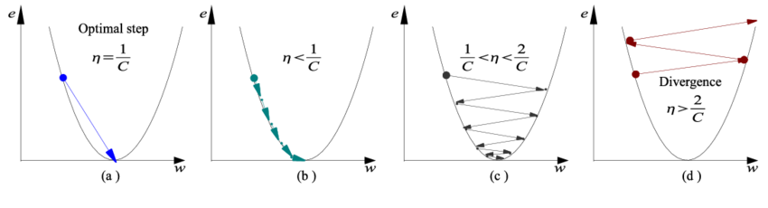
Optimizing a function
Effect of step size / learning rate.

Slide 38
Optimizing a function of two variables
f(b1,b2) = loss of the model with b1,b2 parameters.

Slide 39
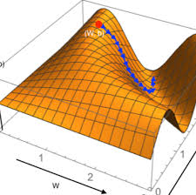
Learning with gradient descent.
In our example we have 2 features (Acidity, Sweetness) , so our model and loss are functions of three parameters: f(A,S) =β₀ + β₁ A+ β₂ S
We start with some initial guess of parameters
β₀ =10, β₁ =10, β₂ =0
and we want to update all three to reduce loss
L(β_{0,} β₁ β₂). This is now a function from 3 numbers to 1 number.
Gradient L is now a vector, with 3 coordinates:
The partial derivatives Grad(L) = [ dL/ β_{0,} dL/ β_{1,} dL/ β₂ ]
Gradient Still points in direction of maximum ascent.
So to minimize loss we run Gradient descent:

Slide 40
Linear regression
 | Acidity(A) | y=Sales | Model 4 predicts
Bev1 | 0.8 | 90 | 18
Bev2 | 0.3 | 20 | 13
f(A,S) =β₀ + β₁ A
Starting guess: [β₀ =10 , β₁ =10 ], Loss is 2616.5
L(β₀ ,β₁ ) = ½ [ ( 90- β₀ -0.8 β₁)² + ( 20- β₀ -0.3 β₁)²)
Gradient computation:
dL/d β₀ = ½ [ 2( 90- β₀ -0.8 β₁)(-1) +2 ( 20- β₀ -0.3 β₁) (-1) ]= -[ 110- 2β₀ -1.1 β₁ ]
Similarly we can compute the second coordinate of the gradient:
dL/d β₁ = ½ [ 2( 90- β₀ -0.8 β₁) (-0.8) +2 ( 20- β₀ -0.3 β₁) (-0.3) ]= -[ 78 -1.1 β₀ -0.73 β₁ ]
So at the initial point [β₀ =10 , β₁ =10 ], gradient is [-79, -59.7]
So after one gradient descent step the parameters become: [10,10] – 0.1 [-79,-59.7] = [17.9, 15.97].
Updated model predicts [30.6 , 22.7] and has loss: 1767

Slide 41
Linear regression
 | Acidity(A) | y=Sales | Model 4 predicts
Bev1 | 0.8 | 90 | 18
Bev2 | 0.3 | 20 | 13
f(A,S) =β₀ + β₁ A
Starting guess: [β₀ =10 , β₁ =10 ], Loss is 2616.5
L(β₀ ,β₁ ) = ½ [ ( 90- β₀ -0.8 β₁)² + ( 20- β₀ -0.3 β₁)²)
Gradient computation:
dL/d β₀ = ½ [ 2( 90- β₀ -0.8 β₁)(-1) +2 ( 20- β₀ -0.3 β₁) (-1) ]= -[ 110- 2β₀ -1.1 β₁ ]
Similarly we can compute the second coordinate of the gradient:
dL/d β₁ = ½ [ 2( 90- β₀ -0.8 β₁) (-0.8) +2 ( 20- β₀ -0.3 β₁) (-0.3) ]= -[ 78 -1.1 β₀ -0.73 β₁ ]
So at the initial point [β₀ =10 , β₁ =10 ], gradient is [-79, -59.7]
So after one gradient descent step the parameters become: [10,10] – 0.1 [-79,-59.7] = [17.9, 15.97].
Updated model predicts [30.6 , 22.7] and has loss: 1767

Slide 42
Linear regression
 | Acidity(A) | y=Sales | Model 4 predicts
Bev1 | 0.8 | 90 | 18
Bev2 | 0.3 | 20 | 13
To compute the gradient we used the chain rule of calculus. For bigger models, these computations become very complex. An algorithm called backpropagation can efficiently symbolically compute gradients.
This is is the main reason people use TensorFlow and Pytorch for deep learning
f(A,S) =β₀ + β₁ A
Starting guess: [β₀ =10 , β₁ =10 ], Loss is 2616.5
L(β₀ ,β₁ ) = ½ [ ( 90- β₀ -0.8 β₁)² + ( 20- β₀ -0.3 β₁)²)
Gradient computation:
dL/d β₀ = ½ [ 2( 90- β₀ -0.8 β₁)(-1) +2 ( 20- β₀ -0.3 β₁) (-1) ]= -[ 110- 2β₀ -1.1 β₁ ]
Similarly we can compute the second coordinate of the gradient:
dL/d β₁ = ½ [ 2( 90- β₀ -0.8 β₁) (-0.8) +2 ( 20- β₀ -0.3 β₁) (-0.3) ]= -[ 78 -1.1 β₀ -0.73 β₁ ]
So at the initial point [β₀ =10 , β₁ =10 ], gradient is [-79, -59.7]
So after one gradient descent step the parameters become: [10,10] – 0.1 [-79,-59.7] = [17.9, 15.97].
Updated model predicts [30.6 , 22.7] and has loss: 1767

Slide 43
Linear regression
 | Acidity(A) | y=Sales | Model 4 predicts
Bev1 | 0.8 | 90 | 18
Bev2 | 0.3 | 20 | 13
The statistician asks:
Hold on a minute. I learned linear regression in freshman year.
There is a formula for the optimal coefficients β*
Why are running an iterative algorithm when we have a closed-form expression derived by Gauss in 19th century?
A1: This is faster than matrix inversion.
A2: More importantly: This generalizes to any differentiable model f(x) beyond linear regression.
To compute the gradient we used the chain rule of calculus. For bigger models, these computations become very complex. An algorithm called backpropagation can efficiently symbolically compute gradients.
This is is the main reason people use TensorFlow and Pytorch for deep learning
f(A,S) =β₀ + β₁ A
Starting guess: [β₀ =10 , β₁ =10 ], Loss is 2616.5
L(β₀ ,β₁ ) = ½ [ ( 90- β₀ -0.8 β₁)² + ( 20- β₀ -0.3 β₁)²)
Gradient computation:
dL/d β₀ = ½ [ 2( 90- β₀ -0.8 β₁)(-1) +2 ( 20- β₀ -0.3 β₁) (-1) ]= -[ 110- 2β₀ -1.1 β₁ ]
Similarly we can compute the second coordinate of the gradient:
dL/d β₁ = ½ [ 2( 90- β₀ -0.8 β₁) (-0.8) +2 ( 20- β₀ -0.3 β₁) (-0.3) ]= -[ 78 -1.1 β₀ -0.73 β₁ ]
So at the initial point [β₀ =10 , β₁ =10 ], gradient is [-79, -59.7]
So after one gradient descent step the parameters become: [10,10] – 0.1 [-79,-59.7] = [17.9, 15.97].
Updated model predicts [30.6 , 22.7] and has loss: 1767

Slide 44
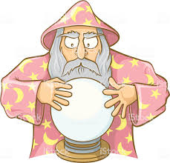
All of modern deep learning:
Features x
prediction
f_{β}(x)
Model f_{β}(x)
Model parameters β
Learning = finding the parameters β that minimize loss of the model f. e.g. Loss(β)= mean squared error of predictions - true labels y_{i}. = Average (f_{β}(x_{i})- y_{i} )² How to find the best β?
Start with some random β₀ initialization.
Update with gradient descent
β_{t}= β_{t-1} – α 𝛁loss( β_{t-1})

Slide 45
Variations of Gradient descent
 | Acidity(A) | y=Sales | Model 4 predicts
Bev1 | 0.8 | 90 | 18
Bev2 | 0.3 | 20 | 13
Model: f(A,S) =β₀ + β₁ A
MSE loss: L(β₀ ,β₁ ) = ½ [ ( 90- β₀ -0.8 β₁)² + ( 20- β₀ -0.3 β₁)²)
If you have n training samples, the loss will be sum over all of them.
If instead you select randomly a 1 sample at a time, and update β using only that stochastic gradient: Stochastic Gradient Descent.
If you select a batch of B samples, compute the gradient on this loss and update:
MiniBatch SGD.
If you modify gradient descent to maintain its trajectory or adapt its step size:
SGD with momentum
AdaGrad
ADAM
RMSProp and various other optimizer algorithms used widely.
All variations of SGD and gradient descent.

Slide 46
Quick note on regularization
Key idea:
Don’t only find a model that predicts well on the training set
but find a model that is BOTH simple AND predicts well the training set.
Minimize: Training Loss + λ Complexity Measure
λ is a hyperparameter that controls this tradeoff
complexity measures:
For Linear Regression
Number of nonzero coefficients
Magnitude of coefficients.
Can be controlled with regularization. Either l1 norm or l2 norm.
L2 norms makes all coefficients smaller
Called Ridge Regression
L1 norm promotes sparsity in the coefficients
Called Lasso or L1 regularization.

Slide 47
Regularizing linear regression to control complexity
Recall: Loss in regression is mean Squared Loss (MSE).
sum (yi – f_{β}( x ) )²
Instead we can ask to find coefficients β that minimize
MSE + λ ||β||₁
or
MSE + λ ||β||₂
Lasso regression is regularizing using the l1 norm of the coefficients
key fact: Lasso regression produces sparse coefficients i.e. beta coordinates=0
Ridge regression is regularizing using the l2 norm of the coefficients
l₀ norm is the number of nonzero entries in a vector.
x=[1,2,3,0] , ||x||₀= 3

Slide 48
Regularizing linear regression to control complexity
Norms of a vector.
l2 norm: Euclidean length of the vector squared.
||β||₂= sum of squared entries. = sum β_{i}²
l1 norm: Sum of absolute values of entries:
||β||₁= sum of squared entries. = sum |β_{i}|
Examples: If β =[β₀ =10 , β₁ =10 ]
||β||₂ = 10²+10² = 200
||β||₁ = |10|+|10| = 20

Slide 49
Regularizing linear regression to control complexity
Norms of a vector.
l2 norm: Euclidean length of the vector squared.
||β||₂= sum of squared entries. = sum β_{i}²
l1 norm: Sum of absolute values of entries:
||β||₁= sum of squared entries. = sum |β_{i}|
Example 2 : If β =[1 , 0, -2, 2,3 ]
||β||₂ =?
||β||₁ = ?
||β||₀=?

Slide 50
Regularizing linear regression to control complexity
Norms of a vector.
l2 norm: Euclidean length of the vector squared.
||β||₂= sum of squared entries. = sum β_{i}²
l1 norm: Sum of absolute values of entries:
||β||₁= sum of squared entries. = sum |β_{i}|
Example 2 : If β =[1 , 0, -2, 2,3 ]
||β||₂ = 1²+0²+2²+(-2)²+3² = 18
||β||₁ = |1|+|0|+ |-2|+|2|+|3| = 8
||β||₀=4

Slide 51
Training decision trees

Slide 52
How to train a decision tree
 | Acidity(A) | Sweetness (S) | y=‘Great taste’?
Bev1 | 0.8 | 0.8 | 1
Bev2 | 0.3 | 0.25 | 0
Bev3 | 0.2 | 0.8 | 0
Bev4 | 0.3 | 0.7 | 0
Bev5 | 0.9 | 0.7 | 1
Sweetness
Acidity
On which feature to split First?
What threshold to select?
o/w
S>= 0.75
Predict f(x)=0
Predict f(x)=1

Slide 53
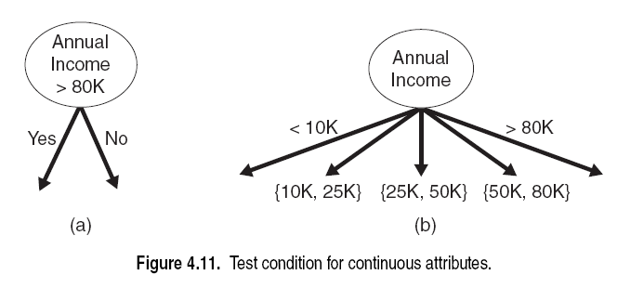
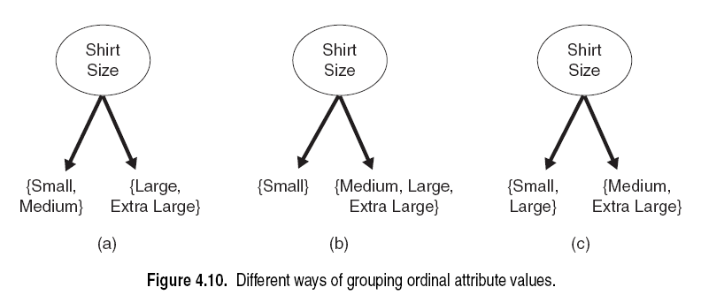
Attribute Split Conditions
Continuous Attributes
(a) Threshold Value
(b) Binning
Nominal Attributes
Ordinal Attributes
(a) Multiway Split
(a) Multiway Split
{Small}
{Medium}
{Large}
{Extra Large}
(b) Binary split {by grouping attribute values}
(b) Binary split {by grouping attribute values}
Bad! Does not preserve order among ordinal attributes!

Slide 54
Decision Tree Algorithm
Decision tree is grown recursively by partitioning data into successively purer regions
Step 1: If all the data in region belong to the same class, keep as leaf node
Step 2: Else, a feature test condition is selected to partition into smaller subsets. A child node is created for each partition of the data and the algorithm is recursively applied to each child node.

Slide 55
Decision Tree Algorithm
Decision tree is grown recursively by partitioning data into successively purer regions
Step 1: If all the data in region belong to the same class, keep as leaf node
Step 2: Else, a feature test condition is selected to partition into smaller subsets. A child node is created for each partition of the data and the algorithm is recursively applied to each child node.
Sweetness
Acidity

Slide 56
Decision Tree Algorithm
Decision tree is grown recursively by partitioning data into successively purer regions
Step 1: If all the data in region belong to the same class, keep as leaf node
Step 2: Else, a feature test condition is selected to partition into smaller subsets. A child node is created for each partition of the data and the algorithm is recursively applied to each child node.
Sweetness
Acidity

Slide 57
Decision Tree Algorithm
Decision tree is grown recursively by partitioning data into successively purer regions
Step 1: If all the data in region belong to the same class, keep as leaf node
Step 2: Else, a feature test condition is selected to partition into smaller subsets. A child node is created for each partition of the data and the algorithm is recursively applied to each child node.
Sweetness
Acidity

Slide 58
Decision Tree Algorithm
Decision tree is grown recursively by partitioning data into successively purer regions
Step 1: If all the data in region belong to the same class, keep as leaf node
Step 2: Else, a feature test condition is selected to partition into smaller subsets. A child node is created for each partition of the data and the algorithm is recursively applied to each child node.
Sweetness
Acidity

Slide 59
Decision Tree Algorithm
Decision tree is grown recursively by partitioning data into successively purer regions
Step 1: If all the data in region belong to the same class, keep as leaf node
Step 2: Else, a feature test condition is selected to partition into smaller subsets. A child node is created for each partition of the data and the algorithm is recursively applied to each child node.
Sweetness
Acidity

Slide 60
Decision Tree Algorithm
Decision tree is grown recursively by partitioning data into successively purer regions
Step 1: If all the data in region belong to the same class, keep as leaf node
Step 2: Else, a feature test condition is selected to partition into smaller subsets. A child node is created for each partition of the data and the algorithm is recursively applied to each child node.
Sweetness
Acidity

Slide 61
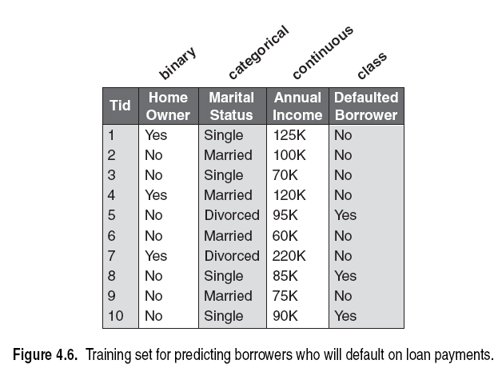
Example

Slide 62
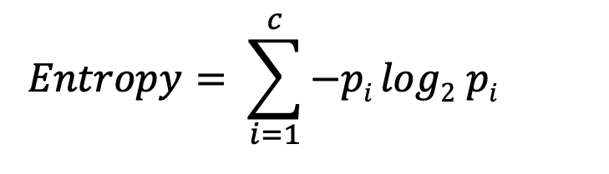
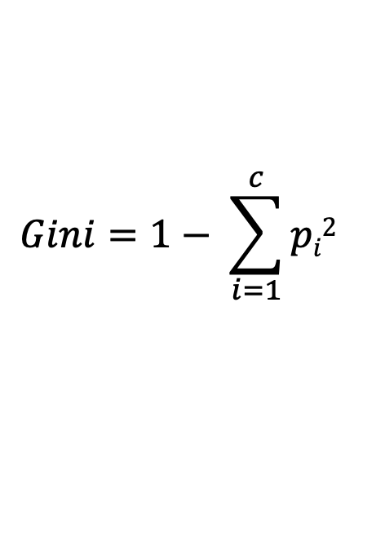
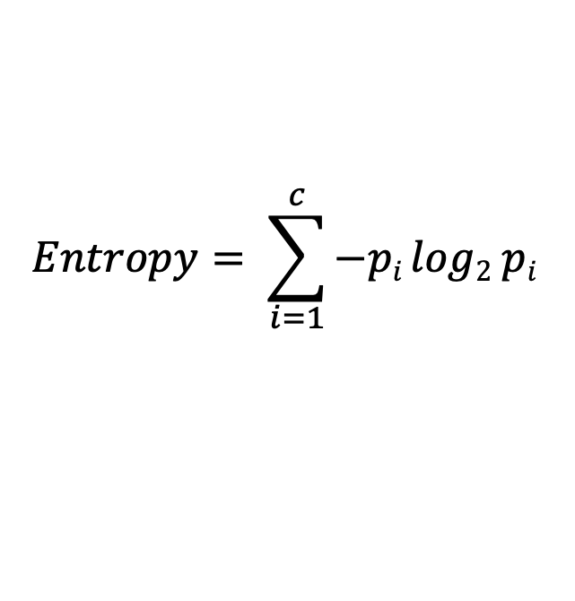
Selecting the Best Split
Measures for selecting the best split are often based on the degree of impurity of the child nodes
Example impurity measures:
$$Entropy= \sum_{i=1}^{c}{−pi log2 pi }$$
Where c is the number of classes;
p_{i} is the fraction of records belonging to class i;
and 0 log₂ 0 = 0 in entropy calculations
$$Gini=1− \sum_{i=1}^{c}{pi2}$$

Slide 63
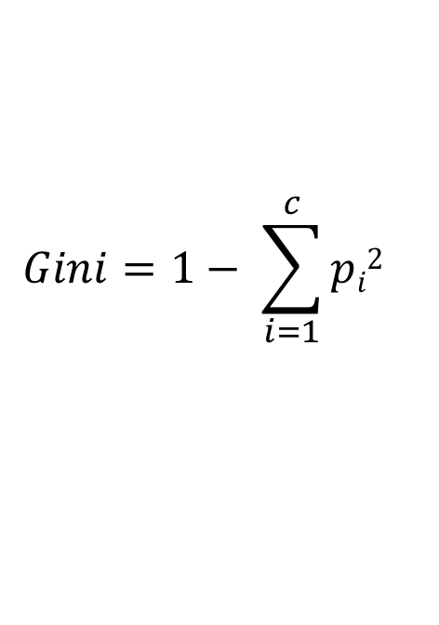
Gini impurity of a bucket of stuff
p_{i} is the fraction of records belonging to class i;
p_{blue} = 4/4 . Gini impurity = 1- (4/4)² =0
$$Gini=1− \sum_{i=1}^{c}{pi2}$$

Slide 64
Gini impurity of a bucket of stuff
p_{i} is the fraction of records belonging to class i;
p_{blue} = 3/4 , p_{red} = 1/4
Gini impurity = 1- (3/4)² - (1/4)² =0.375
$$Gini=1− \sum_{i=1}^{c}{pi2}$$

Slide 65
Gini impurity of a bucket of stuff
p_{i} is the fraction of records belonging to class i;
Probabilities?
Gini impurity ?
$$Gini=1− \sum_{i=1}^{c}{pi2}$$

Slide 66
Gini impurity of a bucket of stuff
p_{i} is the fraction of records belonging to class i;
p_{blue} = 2/4 , p_{red} = 2/4
Gini impurity = 1- (2/4)² - (2/4)² =0.5
(This is maximum Gini impurity)
$$Gini=1− \sum_{i=1}^{c}{pi2}$$

Slide 67
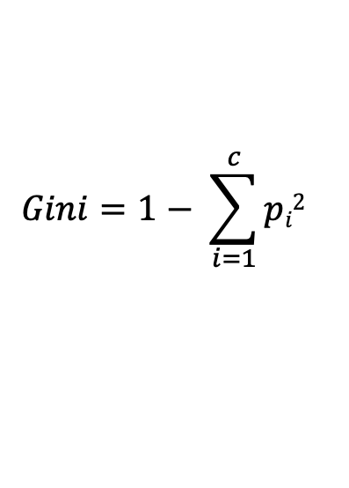
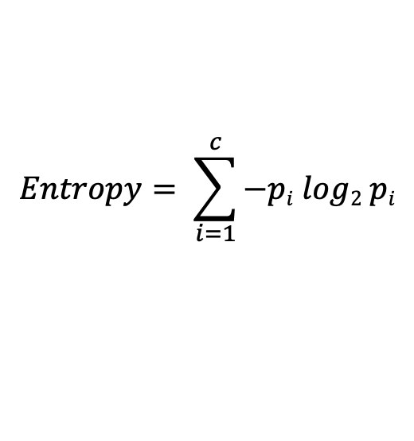
Examples of Impurity Measures
$$Entropy= \sum_{i=1}^{c}{−pi log2 pi}$$
$$Gini=1− \sum_{i=1}^{c}{pi2}$$
 | Count
Default=YES | 0
Default=NO | 6
Entropy = – (0/6) log2(0/6) – (6/6) log2(6/6) = 0
Gini = 1 – (0/6) – (6/6) = 0
2
2
 | Count
Default=YES | 1
Default=NO | 5
Entropy = – (1/6) log2(1/6) – (5/6) log2 (5/6) = 0.650
Gini = 1 – (1/6) – (5/6) = 0.278
2
2
 | Count
Default=YES | 3
Default=NO | 3
Entropy = – (3/6) log2(3/6) – (3/6) log2 (3/6) = 1
Gini = 1 – (3/6) – (3/6) = 0.5
2
2

Slide 69
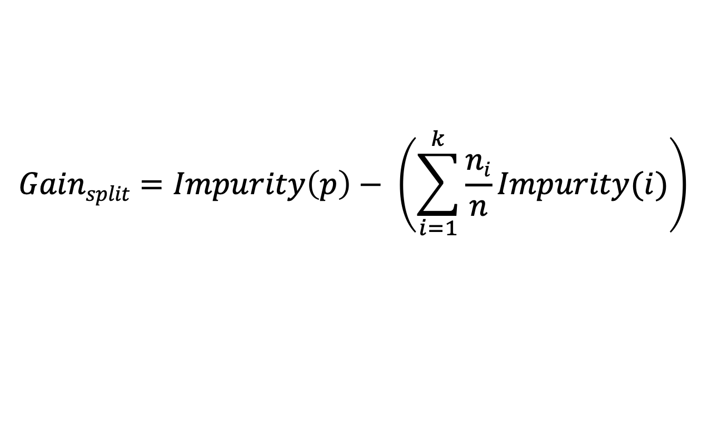
Gain
To determine the performance of a split condition, compare the impurity of the parent node (before the split) to the weighted impurity of the child nodes (after the split). The larger the gain, the better the split.
$$Gainsplit=Impurity\left(p\right)− \left(\sum_{i=1}^{k}{\frac{ni}{n}Impurity(i)}\right)$$
Where parent node p is split into k partitions;
n_{i} is the number of records in partition i;
and Impurity(node) is the result of the chosen impurity measure (entropy, Gini, etc.)

Slide 70

Consider examples flowing down the tree
 | Acidity(A) | Sweetness (S) | y=‘Great taste’? | Model 1 predicts
Bev1 | 0.8 | 0.8 | 1 | 1
Bev2 | 0.3 | 0.25 | 0 | 0
Bev3 | 0.2 | 0.8 | 0 | 1
Bev4 | 0.3 | 0.7 | 0 | 0
Bev5 | 0.9 | 0.7 | 1 | 0
Root: All beverages start here
o/w
S>= 0.75
Bev1, …?

Slide 71
Consider examples flowing down the tree
 | Acidity(A) | Sweetness (S) | y=‘Great taste’? | Model 1 predicts
Bev1 | 0.8 | 0.8 | 1 | 1
Bev2 | 0.3 | 0.25 | 0 | 0
Bev3 | 0.2 | 0.8 | 0 | 1
Bev4 | 0.3 | 0.7 | 0 | 0
Bev5 | 0.9 | 0.7 | 1 | 0
Root: All beverages start here
o/w
S>= 0.75
Bev2
Bev1, Bev3, Bev4,Bev5

Slide 72
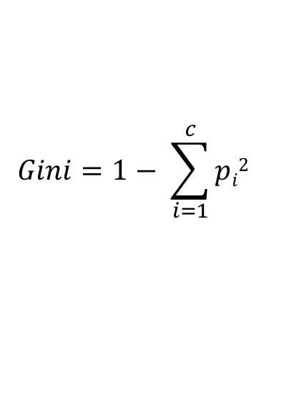
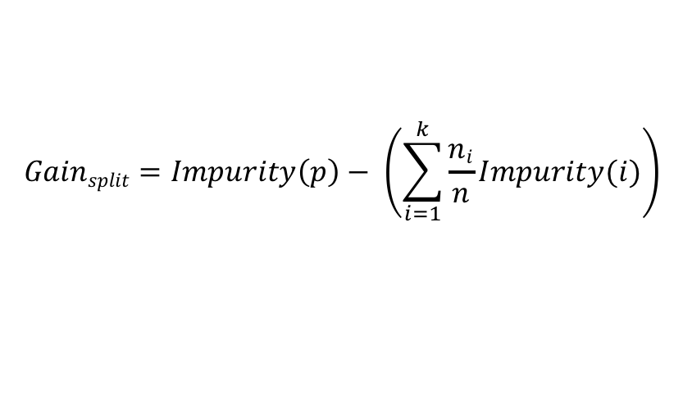
Consider examples flowing down the tree
$$Gainsplit=Impurity\left(p\right)− \left(\sum_{i=1}^{k}{\frac{ni}{n}Impurity(i)}\right)$$
$$Gini=1− \sum_{i=1}^{c}{pi2}$$
 | Acidity(A) | Sweetness (S) | y=‘Great taste’? | Model 1 predicts
Bev1 | 0.8 | 0.8 | 1 | 1
Bev2 | 0.3 | 0.25 | 0 | 0
Bev3 | 0.2 | 0.8 | 0 | 1
Bev4 | 0.3 | 0.7 | 0 | 0
Bev5 | 0.9 | 0.7 | 1 | 0
What is the Gini impurity of the root: 2 Ones, 3 Zeros. p0= 2/5, p1=3/5
Gini Impurity: 1- p0²-p1²
1-(2/5)²-(3/5)²= 0.48
Impurity of left leaf: (Bev2 only) 1 Zero. Impurity of right node (2 ones, 2 zeros)
1-(2/4)²-(2/4)²= 0.5
Root: All beverages start here
o/w
S>= 0.75
Bev2
Bev1, Bev3, Bev4,Bev5

Slide 73
Consider examples flowing down the tree
$$Gainsplit=Impurity\left(p\right)− \left(\sum_{i=1}^{k}{\frac{ni}{n}Impurity(i)}\right)$$
What is gain of the split?
Gini Impurity before split 0.48
Average Impurity after split =
1/5*0 + 4/5*0.5 = 0.4
So gain is 0.48-0.4= 0.08.
$$Gini=1− \sum_{i=1}^{c}{pi2}$$
 | Acidity(A) | Sweetness (S) | y=‘Great taste’? | Model 1 predicts
Bev1 | 0.8 | 0.8 | 1 | 1
Bev2 | 0.3 | 0.25 | 0 | 0
Bev3 | 0.2 | 0.8 | 0 | 1
Bev4 | 0.3 | 0.7 | 0 | 0
Bev5 | 0.9 | 0.7 | 1 | 0
What is the Gini impurity of the root: 2 Ones, 3 Zeros. p0= 2/5, p1=3/5
Gini Impurity: 1- p0²-p1²
1-(2/5)²-(3/5)²= 0.48
Impurity of left leaf: (Bev2 only) 1 Zero. Impurity of right node (2 ones, 2 zeros)
1-(2/4)²-(3/4)²= 0.5
Root: All beverages start here
o/w
S>= 0.75
Bev2
Bev1, Bev3, Bev4,Bev5

Slide 74
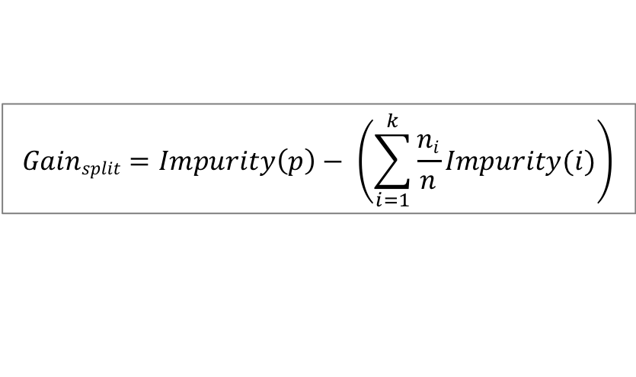
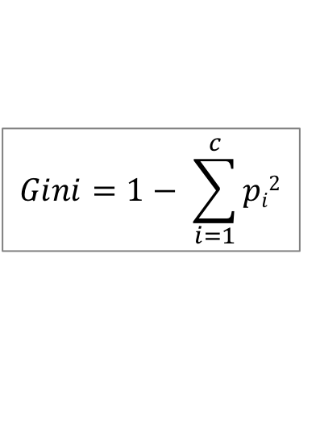
Example
$$Gainsplit=Impurity\left(p\right)− \left(\sum_{i=1}^{k}{\frac{ni}{n}Impurity(i)}\right)$$
$$Gini=1− \sum_{i=1}^{c}{pi2}$$
Calculate the gain of splitting on home ownership

Slide 75
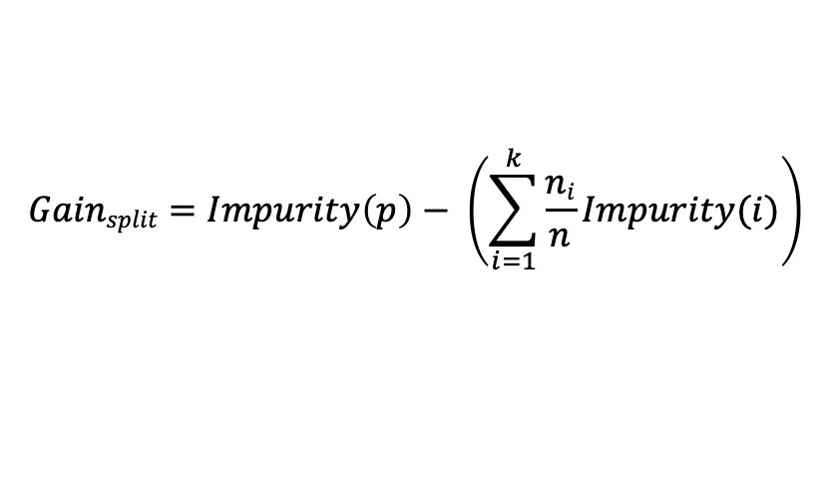
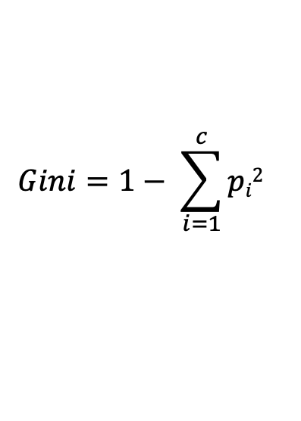
Example
$$Gainsplit=Impurity\left(p\right)− \left(\sum_{i=1}^{k}{\frac{ni}{n}Impurity(i)}\right)$$
$$Gini=1− \sum_{i=1}^{c}{pi2}$$
Calculate the gain of splitting on home ownership.
Impurity always calculated on y
Initial impurity of root (3 yes, 7 no)
= 1- (3/10)² – (7/10)² = 0.42..
After split, (yes home) leaf will have (No,No,No) so impurity
=1- (3/3) ² =0.
(no home) leaf will be (N,N,Y,N,Y,N,Y) impurity:
= 1- (3/7)² – (4/7)² = 0.489..
So average impurity after split is
3/10 * 0 + 7/10 * 0.489 = 0.342..
So Gain of splitting on home ownership is:
initial impurity- avg. impurity after split
= 0.42 – 0.342= 0.078..

Slide 76
Example
$$Gainsplit=Impurity\left(p\right)− \left(\sum_{i=1}^{k}{\frac{ni}{n}Impurity(i)}\right)$$
$$Gini=1− \sum_{i=1}^{c}{pi2}$$
Calculate the gain of splitting on Marital Status (3 way split)
Impurity always calculated on y
Initial impurity of root (3 yes, 7 no)
= 1- (3/10)² – (7/10)² = 0.42..
After split, (Married) leaf: 4 No,
=1- (4/4) ² =0.
(Single) leaf has: N,N,Y,Y
= 1- (2/4)² – (2/4)² = 0.5..
(Divorced) has: Y, N
Impurity 1- (1/2)²=0.5
So avg. impurity after split is
4/10* 0 + 4/10* 0.5 + 2/10*0.5
= 0.42 – 0.3= 0.12
So prefer to split on Marital status.

Slide 77
Example
$$Gainsplit=Impurity\left(p\right)− \left(\sum_{i=1}^{k}{\frac{ni}{n}Impurity(i)}\right)$$
$$Gini=1− \sum_{i=1}^{c}{pi2}$$
Calculate the gain of splitting on home ownership
Calculate the gain of splitting on marital status

Slide 78
Example
$$Gainsplit=Impurity\left(p\right)− \left(\sum_{i=1}^{k}{\frac{ni}{n}Impurity(i)}\right)$$
$$Gini=1− \sum_{i=1}^{c}{pi2}$$
Calculate the gain of splitting on home ownership
Calculate the gain of splitting on marital status
Calculate the gain of splitting on annual income

Slide 79
Example
Selecting a threshold value for continuous attribute
Annual Income

Slide 80
Example
Selecting a threshold value for continuous attribute
Annual Income

Slide 81
Example
Searching for the optimal threshold value, by
sorting and trying all.

Slide 82
Annual Income <= 97K

Slide 83
Recap: Training Decision Trees
Training time for decision trees is fast.
Inference time is is extremely fast. (Time to classify new data).
Decision trees are robust to the presence of noise and can handle outliers very well.
Presence of redundant/irrelevant attributes does not affect accuracy.
If the number of samples in each leaf is too small, this is an indication of overfitting.
We will discuss this more when we talk about overfitting vs underfitting.

Slide 84
Recap: Training Decision Trees
Punchline of underfitting vs overfitting:
Training decision trees is fast.
Inference time is is extremely fast. (Time to classify new data).
Decision trees are robust to the presence of noise and can handle outliers very well.
Presence of redundant/irrelevant attributes does not affect accuracy.
If the number of samples in each leaf is too small, this is an indication of overfitting.
We will discuss this more when we talk about overfitting vs underfitting.
Sweetness
Sweetness
Acidity
Acidity
Underfitting:
Model is too simple compared to data structure.
Overfitting:
Model is too complex compared to data structure. Memorizes.

